Slide 1
Lecture 3, April 10
What is “e”?
Exponential growth rate and graphing
Exponential growth rate looks linear when you take the log of the numbers
Log axes can handle a wide range of numbers (i.e. 10^1, 10^2, 10^3)
Exponential growth can’t go on forever

Slide 2
Review growth equation
N_{t+1} = N₀ * e ^{r*t}
What is “e”?

Slide 3
e = Naperian constant = 2.71828
How we get to e
Start with 1
Over 1 unit of time
growth rate of 1
Compounding interest
Calculate at 1 time 1 + 1*1 = 2
Calculate at 2 times (.5 is the expected increase over half the time interval)
1 + 1*.5 + 1.5 * .5 = 2.25
Calculate at many times (rate/intervals)
Go to Excel to illustrate

Slide 4
Why e is or friend
Want to calculate population at any time with any starting point
Have a function that starts with 1 and has a growth rate * t =1
Multiply it time the starting N
Take e to the power of the r *t
Stretches out the curve
Go to the board to draw

Slide 5
3-1. plot this
a. Draw N vs t for r = 0, N₀ = 500, for t = 0, 10, 20
b. Draw N vs t for r = 1, N₀ = 500, for t=0, 2, 5, 10
(put above 2 on the same graph)
c. Draw dN/dt on the Y axis versus N on the X axis. (What equation would you use?)
d. What would the slope be?

Slide 6
Calculations and graphing

Slide 7
3-1. a, b:
N vs t for r = 0 & 1, N₀ = 500, for t=0, 2, 5, 10 yr

Slide 8
3-1. c & d: dN/dt vs N for N₀=500, r = 0, 0.5, 1
d. dN/dt = rN; slope = r

Slide 9
The doubling time (t_{d}) of a population is the number of years it will take the population to double in size.
ln(2) is a constant ≈ 0.693. (~0.7)
The larger r, the less time it takes for the population to double.
Initial population size does not matter here

Slide 10
3-2. Doubling time problems, Solve for t_{d} using t_{d} = ln(2)/r :
A continuously growing population of bears has a population size of 300 and its intrinsic rate of increase is 0.07 per year. Assuming that this rate of increase remains the same, about how long should it take for the population to reach 600? A. 5 years B. 10 years C. 14 years D. 20 years E. 28 years
In 2012 the human population hit 7 bil and growth rate is 0.0118. What is the doubling time for the human population? In what year do we expect our population to hit 14 billion?
Notes:
Note: added to HW as ran out of time.
0.69 / 0.0118 ≈ 58.7 years; in 2071.

Slide 11
3-2. Doubling time problems, using t_{d} = ln(2)/r :
A continuously growing population of bears has a population size of 300 (N₀) and its intrinsic rate of increase is 0.07 per year (r). Assuming that this rate of increase remains the same, about how long should it take for the population to reach 600 (= 2x N₀)? Ln (2)/r ~= 0.7/0.07 per yr = 10 yr
In Oct 2011 the human population hit 7 bil and growth rate, r, is 0.0118. What is the doubling time for the human population? In what year do we expect our population to hit 14 billion if this rate keeps constant? ln (2)/r = .69/0.118 = 58.47 yr 2011.83+58.47 yr = 2070 (8 billion in 2024!)
Notes:
Note: added to HW as ran out of time.
0.69 / 0.0118 ≈ 58.7 years; in 2071.

Slide 12
9. Optional challenge: derive doubling time equation
Derive from N_{t} = N₀e^{rt}
To start, what is N_{t} in terms of N₀ given that we’re doubling?
Notes:
N_{t}=2*N₀; so: 2*N₀=N_{0*}e^{rt} ; divide by N₀: 2 = e^{rt}
take the ln of both sides: ln(2) = rt; t=ln(2)/r

Slide 13
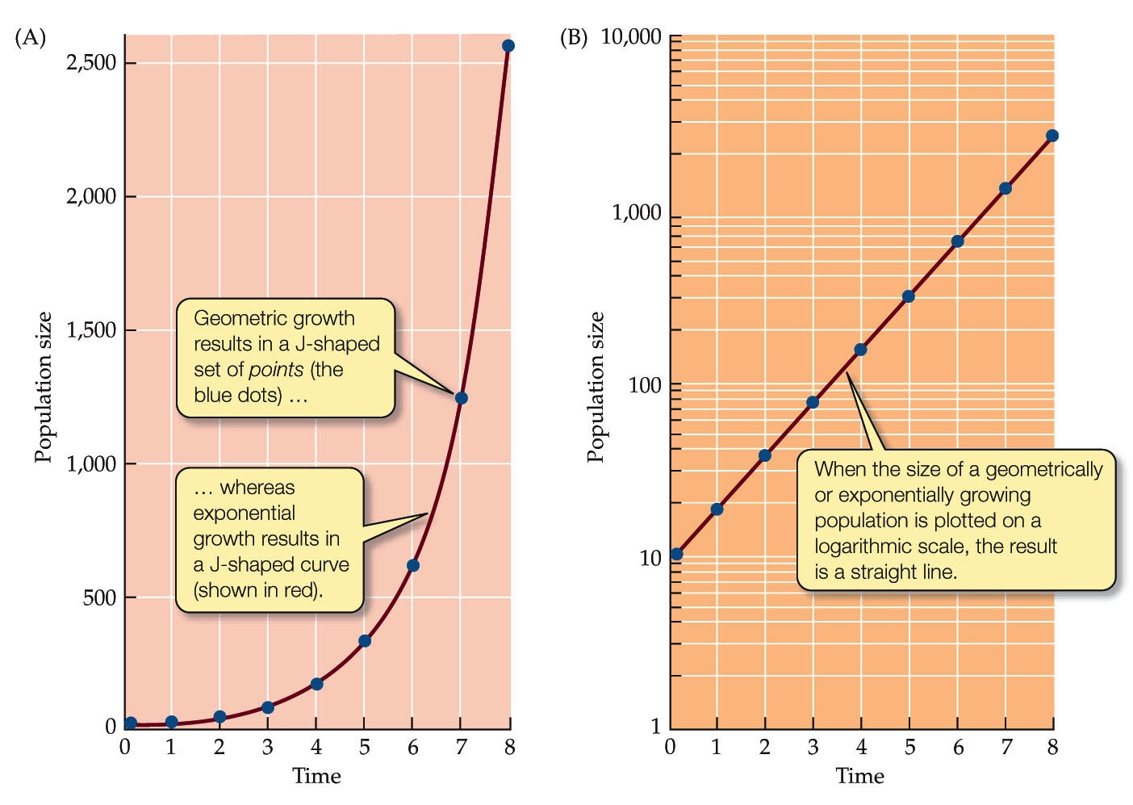
Exponential relationships between y and x appear linear when graphed on semi-log paper. Why use a log scale for the y axis?

Slide 14
Growth rate slows down
Can’t have exponential growth for ever

Slide 15
Sometimes find Exponential growth, (J-curve) but other times find S-shaped curves. Why?
Campbell 2010, Biology, 9th ed. Fig 53.8, Benjamin Cummings
Cain et al. 2011 Ecology Fig 9.17 Sinauer
Exponential growth in populations is not sustainable. What limits r?

Slide 16
What limits r?
Food/nutrient supply
Competition
Climate change
Hurricane
Density dependent factor: a factor that changes b &/or d to a varying degree based upon population density
Density independent factor: a factor that changes b &/or d but whose effect does not vary with population density

Slide 17
What limits r? Name three other density dependent and three other density independent factors.
Food/nutrient supply
Competition
Climate change
Hurricane
Density dependent factor: a factor that changes b &/or d to a varying degree based upon population density
Density independent factor: a factor that changes b &/or d but whose effect does not vary with population density

Slide 18
What limits r?
Food/nutrient supply
Competition
Predation
Waste production
Disease
Climate change
Hurricane
Drought
Fire
A cold winter
Density dependent factor: a factor that changes b &/or d to a varying degree based upon population density
Density independent factor: a factor that changes b &/or d but whose effect does not vary with population density

Slide 19
Population dynamics
Population distributions
Be able to define these terms:
Population size
Population density
Population distribution
Clumped
Uniform
Random
Sex Ratio
Age Structure
Why do these matter to population growth & stability?

Slide 20
Logistic growth: growth with limits
Because growth is typically slowed relative to exponential by density-dependent factors, the logistic model better mimics most pop’n growth
Calculate population change with logistic growth using: dN/dt = rN_{t}(1-(N/K))
K: the carrying capacity of the local environment
Growth is diminished due to competition, which is more apparent as N approaches K
Notes:
For continuous: N_{t} = K/ (1+[(K-N₀)/N₀]e^{-rt})

Slide 21
In lab, Paramecium show logistic growth

Slide 22
Let’s try using the logistic growth equation
3-3. For r = 0.667, N = 300, K = 400. By how much will the population change in a time step (= what is the population-level growth rate)?

Slide 23
Q1. Let’s try using the logistic growth equation
For r = .667, N = 300, K = 400. By how much will the population change in a time step (= what is the population-level growth rate)?
dN/dt = 0.667 * 300 * (1-(300/400))
= 200*(1-(3/4))
= 200 * ¼
= 50 = dN/dt
So, the population is expected to grow by 50 individuals in the next time step when population size is 300 (so will be 350).

Slide 24
3-4. How does population growth change across population size? At what point will you have greatest population-level growth? Why?
Calculate & plot values for r = 0.2, K = 100,000 and: N = 10, N = 100, N = K/2, N = 75,000, N = K, N = 150,000.
Why is the population growth low at low N? Why is low (or negative) at high N?
Population-level growth rate, dN/dt
0 K/2 K 3K/2
Population size, N
Notes:
Multiply out: dN/dt = rN – rN2/K
Take derivative, respect to N and set = 0: 0 = r - 2rN/K
Factor: 0 = r * (1-2N/K)
If r = 0, no growth at max; so 1-2N/K = 0 must be the max,
solve for N: 1 = 2N/K; K/2 = N = max

Slide 25
3-4. How population growth changes across N? At what point will you have greatest population-level growth? Why?
r = 0.2, K = 100,000;
N = 10, 100, K/2, 75,000, K, 150,000
Why is the population growth low at low N? Why is low (or negative) at high N?
N | dN/dt
10 | 2
100 | 20
50000 | 5000
75000 | 3750
100000 | 0
150000 | -15000
K/2 K 3K/2
Notes:
Multiply out: dN/dt = rN – rN^2/K
Take derivative, respect to N and set = 0: 0 = r - 2rN/K
Factor: 0 = r * (1-2N/K)
If r = 0, no growth at max; so 1-2N/K = 0 must be the max,
solve for N: 1 = 2N/K; K/2 = N = max

