Slide 1
ESM 221 Applied Environmental Studies Monday May 1, 2017
Module 2: Biodiversity and Habitat
Today
Importance of Biodiversity
Measures of biodiversity
Impacts and Models for processes
Estimating areas

Slide 2
Module 2
The Story Arc:
Why biodiversity?
How do we measure it?
Skills = diversity indices
What processes influence species richness?
Skills = island biogeography

Slide 3
Module 2
The Story Arc:
What processes determine habitat amount?
Skills = connectivity
Skills = metapopulations
Case Study

Slide 4
Global declines in Biodiversity
Birds
133 extinct, 21% now threatened, 1/3 in decline (US)
Mammals
79 extinct, 25% threatened, 32% threatened or near
Amphibians
39% extinct, 49% threatened or near
Use your book to learn these terms: extinct, threatened, near-threatened, least concern, data-deficient
Notes:
Definition based upon existence and abundance before/after the year 1500.

Slide 5
What do we mean by biodiversity and why is it important

Slide 6
Why Does Biodiversity Matter?
Having a diversity of species increases ecosystem function (Bradshaw 1984, Tilman 1999, Hooper et al. 2005, Schmid et al. 2009, …).

Slide 7
Why Does Biodiversity Matter?
Communities with higher diversity are:
Better able to withstand and recover from environmental stresses
E.g., Plots with 8 and 16 grass spp were 70% more stable than single grass plots
More productive and recover better from environmental stress.

Slide 8
Species, Biodiversity, and Function
Hooper et alia’s review of biodiversity (2005):
Species' functional characteristics strongly influence ecosystem properties.
Some ecosystem properties are initially insensitive to species loss because:
ecosystems may have multiple species that carry out similar functional roles,
some species may contribute relatively little to ecosystem properties, or
some systems are primarily controlled by abiotic environmental conditions.

Slide 9
Species, Biodiversity, and Function
More lessons from Hooper et al’s 2005 review:
More species are needed to insure a stable supply of ecosystem goods and services as spatial and temporal variability increases;
Certain combinations of species are complementary in their patterns of resource use and can increase average rates of productivity and nutrient retention.

Slide 10
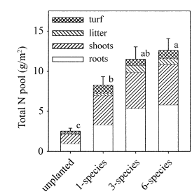
Species, Biodiversity, and Function
Calloway et al. 2003. FIG. 8. Mean N accumulation in 2000 (11 SE) by species-richness treatment. Bars are divided to indicate the amount contributed by roots, shoots, litter, and turf.
Notes:
Plants were chosen from a pool of the eight most common marsh plain species in southern California.
established 5 blocks along the tidal channel (A–E, west to east; Fig. 1) and planted five replicates of each of the 8 species alone (1 replicate/ block), and 15 unique combinations of randomly chosen 3- and 6-species assemblages (3 replicates/ block; Table 1). In addition, we established 15 plots with no plants (3 replicates/block). One plot each of the most common naturally occurring 3- and 6-species assemblages was also planted (total 5 87 plots), but only the 85 randomly selected treatment plots are included as a test of diversity effects.

Slide 11
Species diversity of a community is the variety of organisms that make up the community
Diversity has two components: species richness and relative abundance
Species richness is the total number of different species in the community
Relative abundance is the proportion each species represents of the total individuals in the community

Slide 12
Why Does Biodiversity Matter?
Philosophy
Utilitarianism vs. Biocentrism
We need the function that biodiversity provides. (see Ecosystem Services)
Biocentrism = species have the right to exist. We preserve biodiversity because we are morally obligated to do so, even if there is no inherent function.

Slide 13
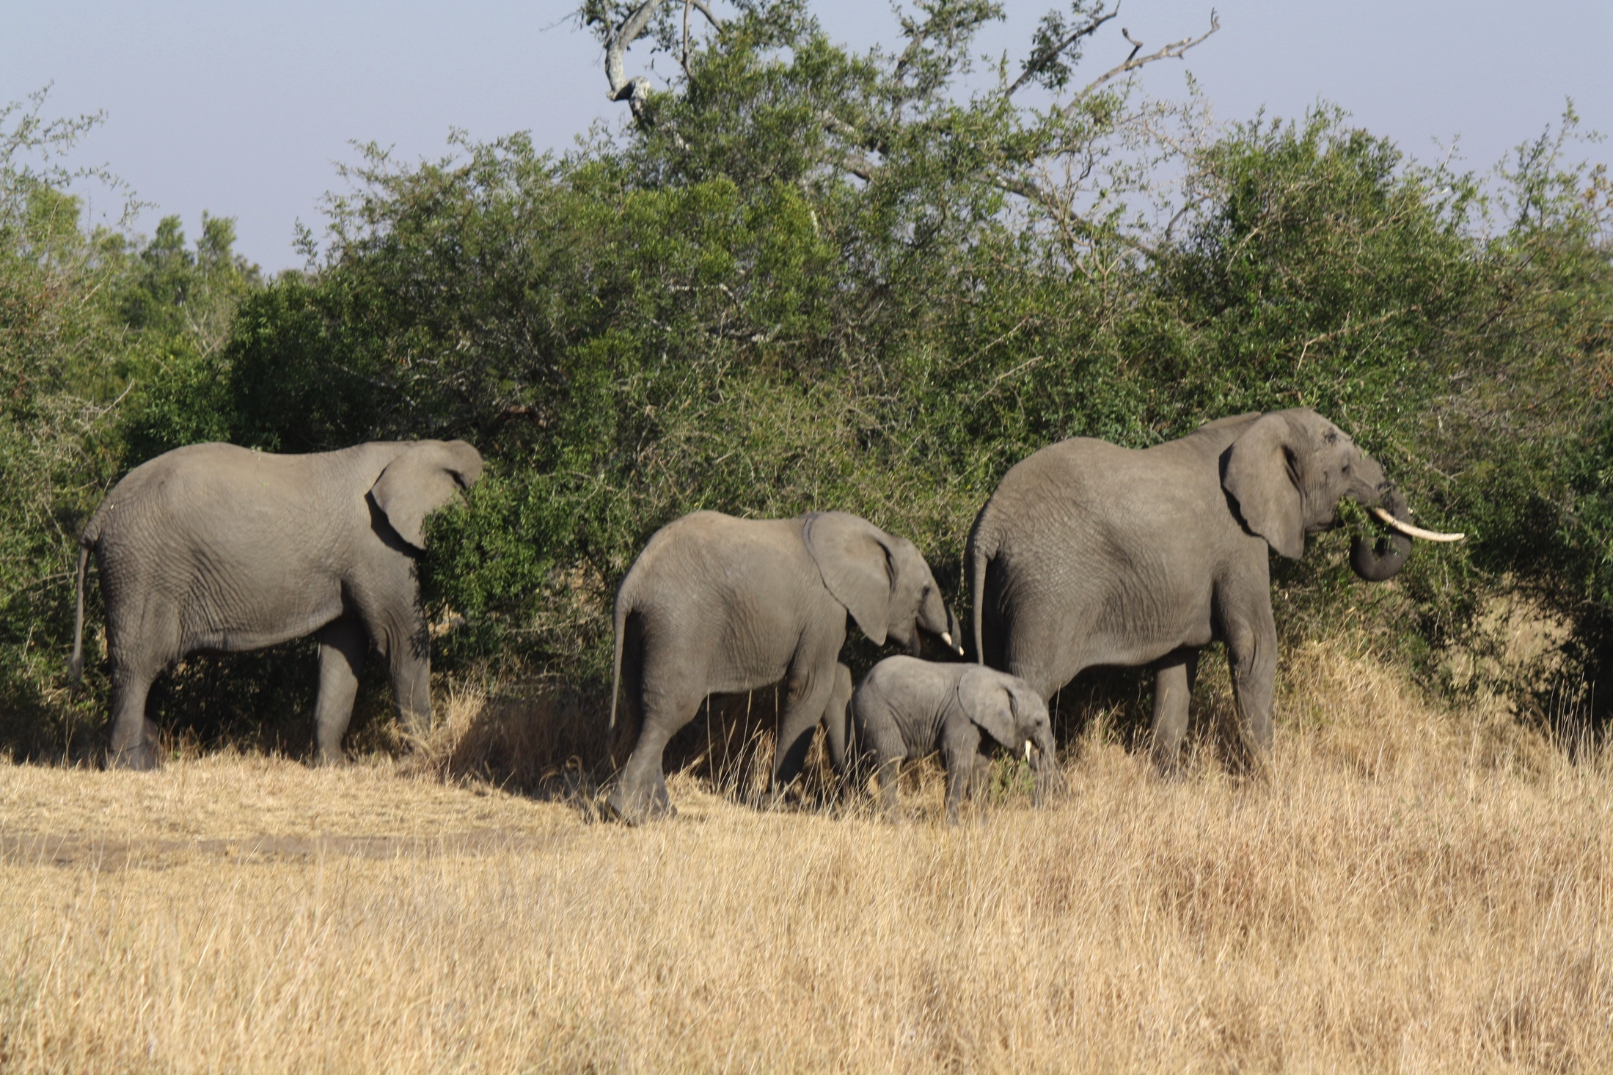

Slide 14
What we want to know and what we can measure
Want to know
Function
Linkages and interactions
Resilience
Food web (images)
Trophic network resilience or analysis
What we can measure
Number of different types of species
Spatial distribution
Sometimes we have to settle for indicators
http://web.pdx.edu/~rueterj/courses/objects/accounts-metrics-indicators.html

Slide 15
How Do We Measure Biodiversity?
Species richness (# of species)
Taxonomic richness (# of higher order taxa, e.g. # families)
Species composition (which species are there)
Species evenness (relative abundance)
Combination of richness and evenness
Comparison of diversity with other communities
Functional Diversity

Slide 16
Calculating diversity: Richness
Species richness = the number of species in a community.
It’s easy
But, often one or two species are dominant; the remaining species probably don’t have much of an effect on ecosystem function.
Should every species be counted equally in its contribution to biodiversity?
Hunt et al. 1986. Relative abundances of seabirds on Coburg Is., Canada
Glaucous-winged gull: 0.0004
Black-legged kittiwake: 0.1577
Thick-billed murre 0.8413
Black guillemot 0.0005
Richness = 4 species

Slide 17
Calculating diversity: Richness and Evenness
Shannon Index (or Shannon-Wiener)
Based on information theory
How equal are the abundances?
Simpson Index
The probability that two randomly selected individuals belong to different species
How equal are the abundances?

Slide 18
Calculating diversity: Shannon diversity
H’=[N * log N – Σ(n_{i}*log n_{i})]/N
n_{i} = #individuals per species
N = #individuals in total
Σ = sum of (add them up after the multiplication)
1+: high diversity, 0.001:low
Hunt et al. 1986
Glaucous-winged gull: 4
Black-legged kittiwake: 1,577
Thick-billed murre: 8,413
Black guillemot 5
Total, N= 9,999
Shannon index:
[9999*log(9999) – {(4*log(4))+ (1577*log(1577)+8413* log(8413) + 5*log(5)]/
9999
= [39,995.6-(2.41+5,043+ 33,020+3.5)]/9999
= [39,995.6-38,069.5]/9999
=0.1926=H’
Notes:
(14.5+ sum…)/13= (14.5-8.4)/13= 0.466=H’

Slide 19
Calculating diversity: Shannon diversity
Q1. Shannon index:
H’=[N * log N – Σ(n_{i}*log n_{i})]/N
1+: high diversity, 0.001:low
Bush tit: 8
Flicker: 2
Scrubjay: 1
Varied thrush: 2
Notes:
(14.5+ sum…)/13= (14.5-8.4)/13= 0.466=H’

Slide 20
Calculating diversity: Shannon diversity
Q1. Shannon index:
= [13*log(13) –
{(8*log(8)) + (2*log(2) + 1 * log(1) + 2*log(2)] / 13
= [33 - (4.2 + 1.4 + 0 + 1.4)] / 13
= [33 – 6.9] / 13
= 2.0 = H’
H’=[N * log N – Σ(n_{i}*log n_{i})]/N
1+: high diversity, 0.001:low
Bush tit: 8
Flicker: 2
Scrubjay: 1
Varied thrush: 2
Notes:
(14.5+ sum…)/13= (14.5-8.4)/13= 0.466=H’

Slide 21
Calculating diversity: Simpson’s diversity index
D_{s} = 1 – [(Σn_{i*}(n_{i}-1)) / (N*(N-1))]
n_{i} = #individuals per species
N = #individuals in total
Σ = sum of (add them up after the multiplication)
1 = high diversity, 0.001 = low
Hunt et al. 1986
Glaucous-winged gull: 4
Black-legged kittiwake: 1,577
Thick-billed murre: 8,413
Black guillemot 5
Total, N= 9,999
Simpson’s index:
1-[(4*3)+(1,577*1576)+ (8,413*8,412)+(5*4))/
(9999*9998)]
= 1-[(12+2,485,352+
70,770,156+ 20)/99,970,002]
= 1-[73,255,540/99,970,002]
= 1-0.7328 = 0.2672=D_{s}
Notes:
Which is more diverse? =1-(60/156) = 1-0.385= 0.615 so much higher diversity but same richness. Which to use? BOTH!

Slide 22
Calculating diversity: Simpson’s diversity index
D_{s} = 1 – [(Σn_{i*}(n_{i}-1)) / (N*(N-1))]
n_{i} = #individuals per species
N = #individuals in total
Σ = sum of (add them up after the multiplication)
1 = high diversity, 0.001 = low
Bush tit: 8
Flicker: 2
Scrubjay 1
Varied thrush: 2
Q2. Simpson’s index:
Notes:
Which is more diverse? =1-(60/156) = 1-0.385= 0.615 so much higher diversity but same richness. Which to use? BOTH!

Slide 23
Calculating diversity: Simpson’s diversity index
D_{s} = 1 – [(Σn_{i*}(n_{i}-1)) / (N*(N-1))]
n_{i} = #individuals per species
N = #individuals in total
Σ = sum of (add them up after the multiplication)
1 = high diversity, 0.001 = low
Bush tit: 8
Flicker: 2
Scrubjay 1
Varied thrush: 2
Simpson’s index:
= 1 - [(8*7) + (2*1) + (1*0) + (2*1)) /
(13*12)]
= 1- [(56 + 2 + 0 + 2) / 156]
= 1 - [60 / 156]
= 1 - 0.38 = 0.61 = D_{s}
Notes:
Which is more diverse? =1-(60/156) = 1-0.385= 0.615 so much higher diversity but same richness. Which to use? BOTH!

Slide 24
Where we are going
Want to preserve biodiversity
Have indicies that help us track progress
Need to understand processes that increase/decrease biodiversity (i.e. the drivers)
Habitat loss and fragmentation
“islands” of habitat

Slide 25
Lengths and area – units and conversions
Metric | “English”
Meter | Feet and yard | Yard and meter about the same
Km | mile | 10 km = 6.2 miles
Hectare 100 meters on a side | Acre 200 feet on a side | 1 hectare = 2.5 acre
Km^2 1 Km^2 = 100 hectares) | Mi^2 1 sq mile = 640 acres | 1 sq mile = 2.5 sq m

