Slide 1
Lecture 7: quiz review
Monday April 24, 2017
Review major concepts – provide context
Why we focus on math models
Coherence of description, math, graphs
Models we have
Quiz format and example questions

Slide 2
Major concepts
From reading
From lecture notes

Slide 3
Math models
Models simplify the real world
Need assumptions
Make predictions that can be tested

Slide 4
Example model
Population has exponential growth
  Currently 100 individuals
  Net growth rate is .2 per month per individual
Assumptions
  No major immigration or emigration
Predict that in 6 months it will be
  N₆ = N₀*e^^{(6*.2}) = 332

Slide 5
Coherence/multiple descriptions
Description
  Population is increasing at a constant rate per capita at first but then levels off and reaches a max population at around 500 individuals
  The initial doubling time is 2 weeks
Math model
  Logistic equation: K = 500 convert t_{d} to r
  0.69/t_{d} = r
Graph
  Sigmoidal – N goes from 0 to 500 and time is in weeks

Slide 6
We have 5 models
Linear growth
Exponential growth
Logistic growth
MSY
Allee effect

Slide 7
Linear growth model
Draw dN/dt vs. N

Slide 8
Exponential growth
Draw N vs time

Slide 9
Logistic growth
N vs time
dN/dt vs N

Slide 10
Logistic growth variations
Overshoot
  For N>K , dN/dt is <0, more deaths than birthss
Fluctuations
  Delay in population response, i.e. time lag
  Fluctuations can be damped or extreme

Slide 11
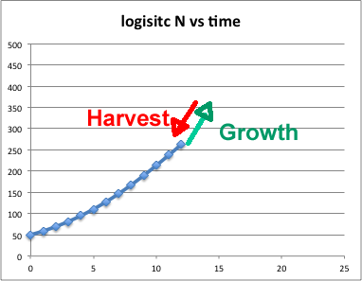
MSY
Based on truncating the logistic curve at maximum dN/dt
Maxiumum dN/dt at 250

Slide 12
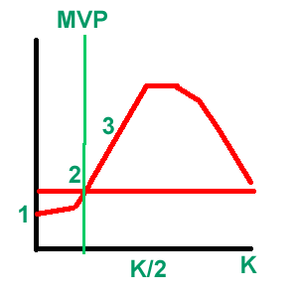
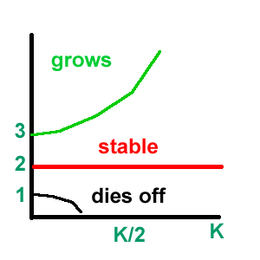
Allee effect and minimum viable population
dN/dt vs population
Pop vs time with different starting populations

Slide 13
Exam format
Timed to take an hour – 25 points
Vocabulary and concepts (about 10 questions)
Mechanics of calculating and graphing (10 points)
  Like we just went through and the problem sets
Application (5 points)
  Low overall points but it’s a combination of concepts and calculations

