Slide 1
ESM221 Spring 2017 Lecture 6: population management
Actual population numbers are messy and complex – fluctuations and predation
MSY – maximum sustainable yield
Processes that can lead to extinction
MVP – minimum viable population

Slide 2
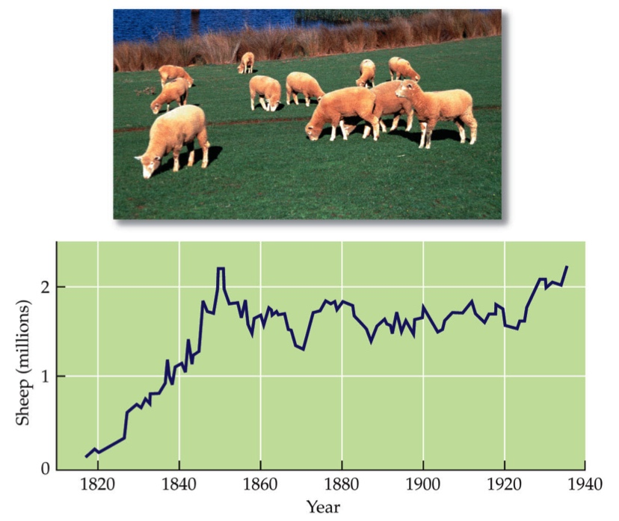
Usually growth of natural populations is messier than model curves (though usually still generally fits w/ logistic model)
Populations fluctuate
Overshoot & Die offs (predicted by the logistic model)
Variation around K due to Temp
Fig 10.4, Cain et al. 2011, Ecology, Sinauer

Slide 3
Population fluctuations can also be caused by predator–prey dynamics. E.g., Lynx and Hares

Slide 4
E.g. Wolves & Moose

Slide 5
6-1
Draw a stylized predator-prey fluctuation

Slide 6
Maximum Sustainable Yield (MSY)
Maximum sustainable yield: greatest harvest of a renewable resource that does not compromise the future availability of that resource. (pp 264-5)
Why is this concept useful?
How do you determine the level at which to harvest?
Notes:
obtain the most of a resource; manage wildlife to avoid overpopulation,

Slide 7
Maximum Sustainable Yield (MSY)
Assumption: population growth is fastest at K/2
Theory: Use the logistic growth curve as the basis for a harvesting plan. To keep the population sustainable, try to maintain it at K/2.

Slide 8
Per capita growth rate
Draw on board – difference between
Growth rate (dN/dt)
Per capita growth rate -

Slide 9
Load and power
http://web.pdx.edu/~rueterj/courses/objects/power-and-loading.html

Slide 10
Maximum Sustainable Yield
H = rate of harvest
The system is at equilibrium when the number of individuals removed is same as growth rate.
For almost all harvest rates, there can be two pop sizes yielding the same growth rates, far from vs. close to carrying capacity
Notes:
a. not many individuals are there to reproduce; b. intense competition for resources

Slide 11
Maximum Sustainable Yield Problems
Predicting the carrying capacity and the maximum growth rate in natural populations is difficult. These vary across time due to natural fluctuations.
If calculated wrong, harvest often happens at the H3 level (see previous slide) rather than the H2 level.
Harvest usually occurs at all size and age ranges – but each of these can drastically affect current and future populations

Slide 12
6-2
Draw logistic growth curve
Growth rate as a function of population
Per capita growth rate as a function of population
Identify where the MSY is

Slide 13
Avoiding extinctions
Sustainability
Pass on assets and choices to future generations
“Weak sustainability” – maximum assets
“Strong Sustainability” requires that we pass on functioning biodiversity, natural capital

Slide 14
Factors that drive populations to extinction
Deterministic (predictable) changes (e.g., overshoots of K, predator-prey;...)
Fluctuations in population growth rate, due to variable environment or lags.
Chance events
Issues from Small population size (Allee effects, inbreeding…)
Notes:
Many factors can drive populations to extinction:
Predictable (deterministic) factors, as well as fluctuation in population growth rate, population size, and chance events.
Small populations are at greatest risk.

Slide 15
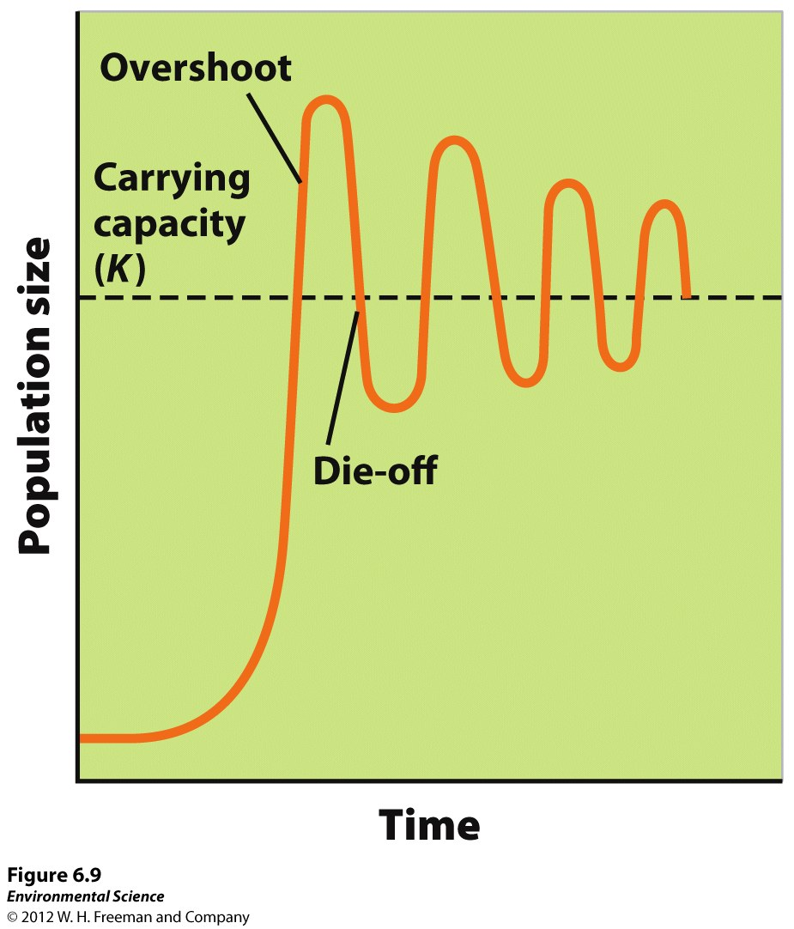
Overshoots of K can cause fluctuation, even extinction. Why do some populations have sizes above K?

Slide 16
Factors that drive populations to extinction
Deterministic (predictable) changes (e.g., overshoots of K, predator-prey;...)
Fluctuations in population growth rate, due to variable environment or lags.
Chance events
Issues from Small population size (Allee effects, inbreeding…)
Notes:
Many factors can drive populations to extinction:
Predictable (deterministic) factors, as well as fluctuation in population growth rate, population size, and chance events.
Small populations are at greatest risk.

Slide 17
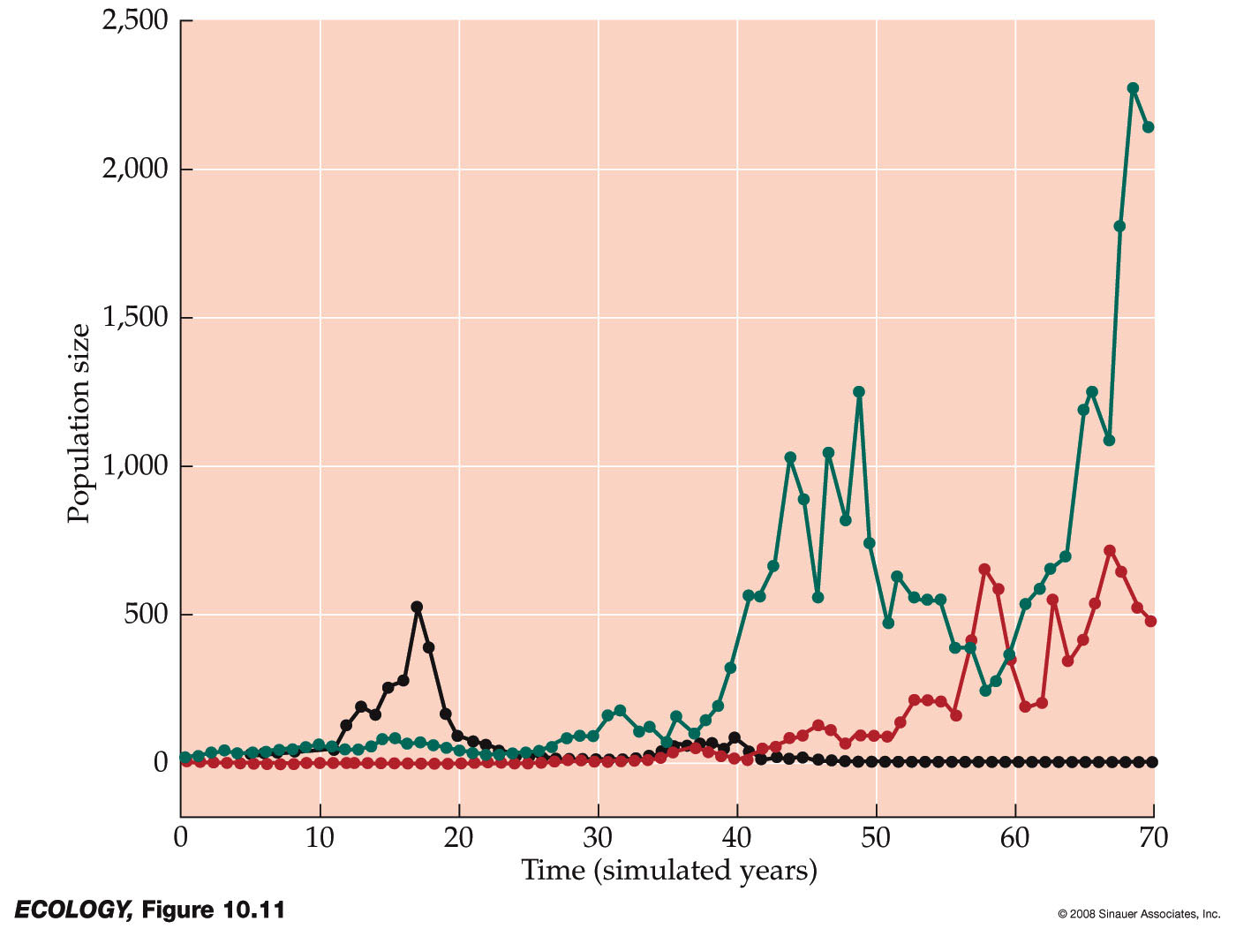
Fluctuations in growth rate can drive populations, especially small ones, to extinction, with greater risk accompanying greater fluctuation.
Q1. Why might growth rate fluctuate?
If N₀ = 10, r=0.2, growth rate std dev = 0.4, 17% of populations went extinct in 70 yrs.
If st. dev = 0.8, 53% went extinct.
[Std dev is a measure of variance.]
Notes:
Computer simulations of geometric growth for three populations allowed λ to fluctuate at random.
Two of the populations recovered from low numbers, but one went extinct.
Fluctuations increase the risk of extinction. Variation in λ in the simulations was determined by the standard deviation (σ) of the growth rate, which was set to 0.4.
In 10,000 simulations (initial population size = 10), when σ = 0.2, only 0.3% of the populations went extinct in 70 years.
When σ was increased to 0.4, 17% of the populations went extinct in 70 years.
When σ was increased 0.8, 53% of the populations went extinct.
When variable environmental conditions result in large fluctuations in a population’s growth rate, the risk of extinction of the population increases.
If the 10,000 simulations are repeated starting with population size = 100, and σ = 0.8, 29% of populations went extinct in 70 years.
If initial population size is increased to 1,000 or 10,000, populations going extinct drops to 14% and 6%, respectively.

Slide 18
Delayed density dependence can cause populations to fluctuate in size.
Density dependence: The size of the population (N) affects the population growth rate (dN/dt).
Delay: # births is influenced by population densities from several time periods back (e.g., because resources grow at a different rate; predator reproduces more slowly than prey; delay before young come into the population or breed).
Delayed density dependence: Delays in the effect that density has on population size; contributes to population fluctuations.

Slide 19
Delayed density dependence
The logistic equation can be modified to include time lags:
dN/dt = rN*(1-N_{(t-τ)}/K)
N_{(t-τ)} = population size at time t-τ in the past
Notes:
Population growth is based on population at a specific time step in the past (based on the lag time).
http://www.sinauer.com/ecology/problem10.htm

Slide 20
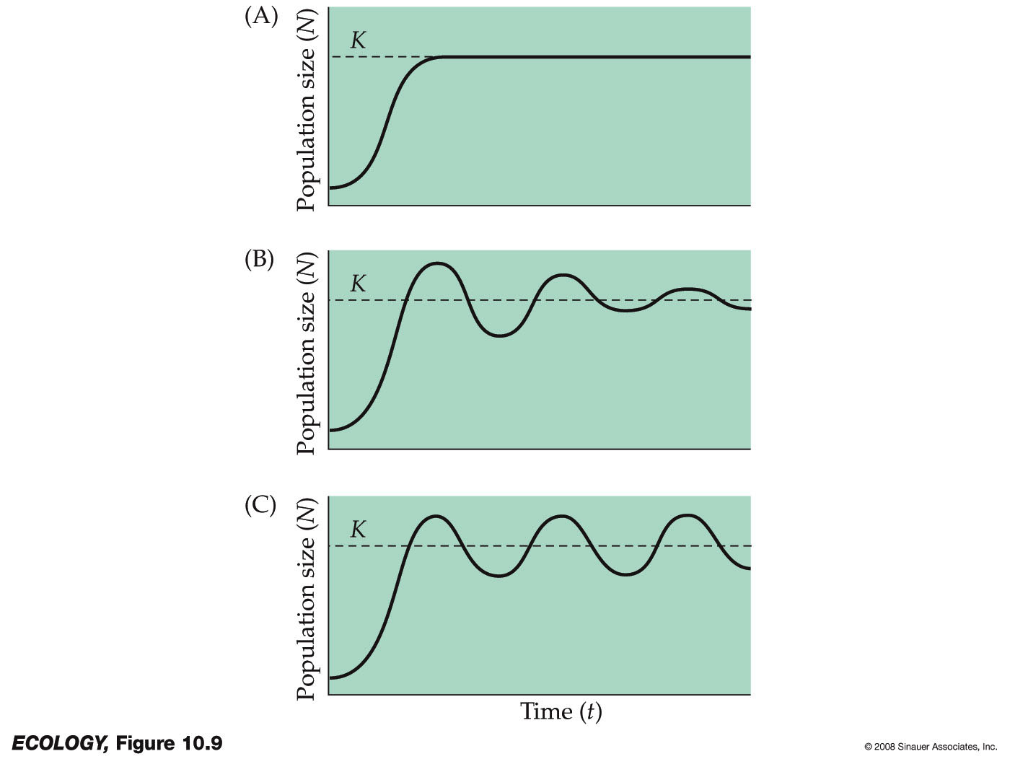
Logistic growth with delayed density dependence
May 1976:
If 0<r*t<0.368
Both higher r and higher t cause pops to overshoot K
If 0.368<r*t <1.57: dampened oscillations
If r*t >1.57: stable limit cycle
Notes:
The occurrence of fluctuations depends on the values of r and τ. Larger values of r make a population more likely to overshoot K. Larger time lags make a population more likely to overshoot.
Robert May (1976) found that when rτ is small (0 < rτ < 0.368), no fluctuation results.
At intermediate levels, (0.368 < rτ < 1.57), damped oscillations result.
When rτ is large (rτ > 1.57), the population fluctuates indefinitely about the carrying capacity.
This pattern is called a stable limit cycle.

Slide 21
Q1. Explore an overshoot
N = 200 butterflies; K = 500 (would be higher but the invasive grasses reduce the larval host plant)
Great conditions for growth (r_{max} ): Births = 900 (each of the females has 9 surviving offspring)! Deaths = 300 in the first year.
What is b? d? r?
Use dN/dt = rN(1-(N/K)) to calculate & plot 5 years of change & growth, given the same r_{max}

Slide 22
Q1. Explore an overshoot
Bring up excel file.

Slide 23
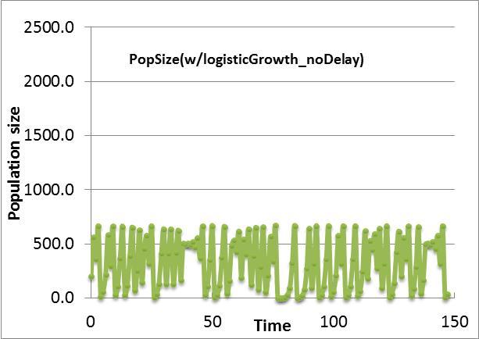
Q1. Explore an overshoot

Slide 24
Q2. Describe the effect of increasing r and time lag on population growth for three combinations of r and lag of 2 or 4 time steps (e.g. r = 1/2 & τ = 2/ 4)
EXCEL FILE ON THIS (& 2nd page of logistic file from lab)
Write down a description of what happens
Write down how this should affect management

Slide 25
Factors that drive populations to extinction
Deterministic (predictable) changes (e.g., overshoots of K, predator-prey;...)
Fluctuations in population growth rate, due to variable environment or lags.
Chance events
Small population size (Allee effects, inbreeding…)
Notes:
Many factors can drive populations to extinction:
Predictable (deterministic) factors, as well as fluctuation in population growth rate, population size, and chance events.
Small populations are at greatest risk.

Slide 26
The risk of extinction increases greatly for small populations
…because stochastic events cause population growth rates to fluctuate over time:
Genetic drift
Demographic stochasticity
Environmental stochasticity

Slide 27
Population Extinction: Small populations are vulnerable to the effects of genetic drift -
Chance events influence which alleles are passed on to the next generation
Loss of genetic variability reduces the ability of a population to respond to future environmental change.
2. Genetic drift can cause harmful alleles to occur at high frequencies.
Notes:
Genetic drift—chance events influence which alleles are passed on to the next generation.
This can cause allele frequencies to change at random from one generation to the next in small populations.
Drift reduces the genetic variation of small populations, but has little effect on large populations.

Slide 28
Population Extinction: Small populations are vulnerable to problems from Environmental stochasticity
Unpredictable changes in the environment.
Environmental variation that results in population fluctuation is more likely to cause extinction when the population size is small.
Examples?
Notes:
Ex in book: grizzlies – some yrs good, some bad, so av birth rates in the pop flux

Slide 29
Population Extinction: Small populations are vulnerable to problems from demographic stochasticity.
Chance events related to the survival and reproduction of individuals.
Example: A storm wipes out 6 individuals, which 6 may greatly affect # offspring next year.
Age class | N | Fertility
0 | 10 | 0
1 | 6 | 2
2 | 4 | 4
Notes:
When the population size is large, there is little risk of extinction from demographic stochasticity because of the laws of probability.
Stochasticity = randomness

Slide 30
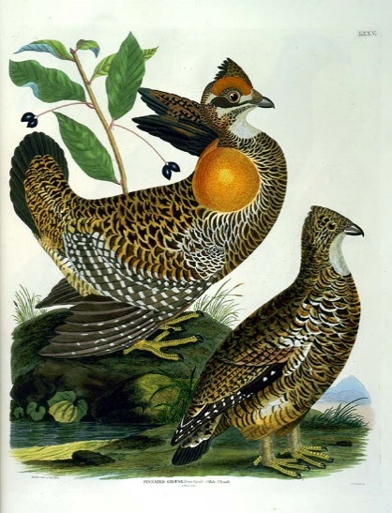
Chance events can strongly effect the size of small populations
Environmental stochasticity: Changes in the average birth or death rates occur from year to year because of random changes in environmental conditions, including natural catastrophes.
Demographic stochasticity: Population-level birth and death rates are constant within a year, but the fates of individuals differ.
Heath hens (wikipedia commons)
~2000 hens on Martha’s Vineyard in 1915; extinct in 1932
Notes:
Natural catastrophes, (floods, disease) can eliminate or reduce populations.
A species can be vulnerable to extinction when all are members of one population.
Heath hen (subsp of prairie chicken) populations were reduced by hunting and habitat loss to one population of 50 on Martha’s Vineyard, Massachusetts.
A reserve was established, and population size increased, but then a series of severe winters, big fire, diseases, inbreeding and predators (feral cats and goshawks) decreased the population to extinction in 1932 (once super common, NH maybe S to Florida; maybe was 1st Thanksgiving bird).
~70 in 1908 to ~2000 hens ~1915

Slide 31
Factors that drive populations to extinction
Deterministic (predictable) changes (e.g., overshoots of K, predator-prey;...)
Fluctuations in population growth rate, due to variable environment or lags.
Chance events
Small population size (Allee effects, inbreeding…)
Notes:
Many factors can drive populations to extinction:
Predictable (deterministic) factors, as well as fluctuation in population growth rate, population size, and chance events.
Small populations are at greatest risk.

Slide 32
Population Extinction: Small populations show a high frequency of Inbreeding
Mating between related individuals.
Inbreeding tends to increase the frequency of homozygotes, including those that have two copies of a harmful allele, which can lead to reduced reproductive success.
Notes:
In addition to direct loss of heterozygotes from genetic drift, small pops tend to have greater homozygosity due to inbreeding.

Slide 33
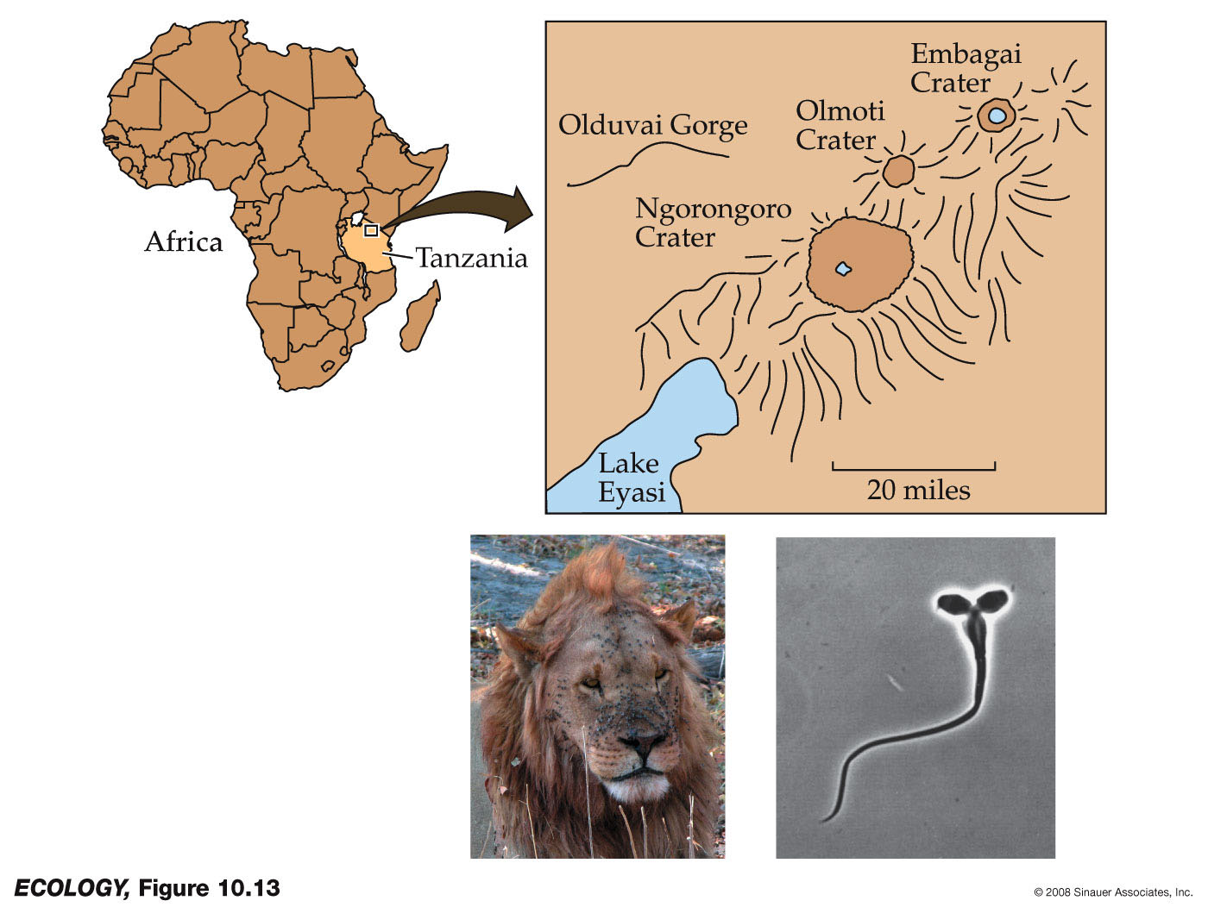
Genetic drift and inbreeding reduced the fertility of male lions in the Ngorongoro Crater
1962: biting flies reduced the population to 1 male, 9 females;
Current pop from 15 lions
Notes:
Genetic drift and inbreeding appear to have reduced the fertility of male lions in a crater in Tanzania.
In 1962 the population was reduced to a 1 male, 9 fems due to bites from an outbreak of biting flies. Population size has since increased (> original ##), but testing shows all individuals are descended from 15 lions.
The population has a high frequency of sperm abnormalities.

Slide 34
Population Extinction
Allee effect—per capita population growth decreases as population density decreases, which causes the population size to decrease even further.
Allee effects occur because small groups are not as good at detecting predators, facilitating mutualistic species, or finding suitable mates nearby.
Notes:
: Allee effects are a form of demographic stochasticity

Slide 35
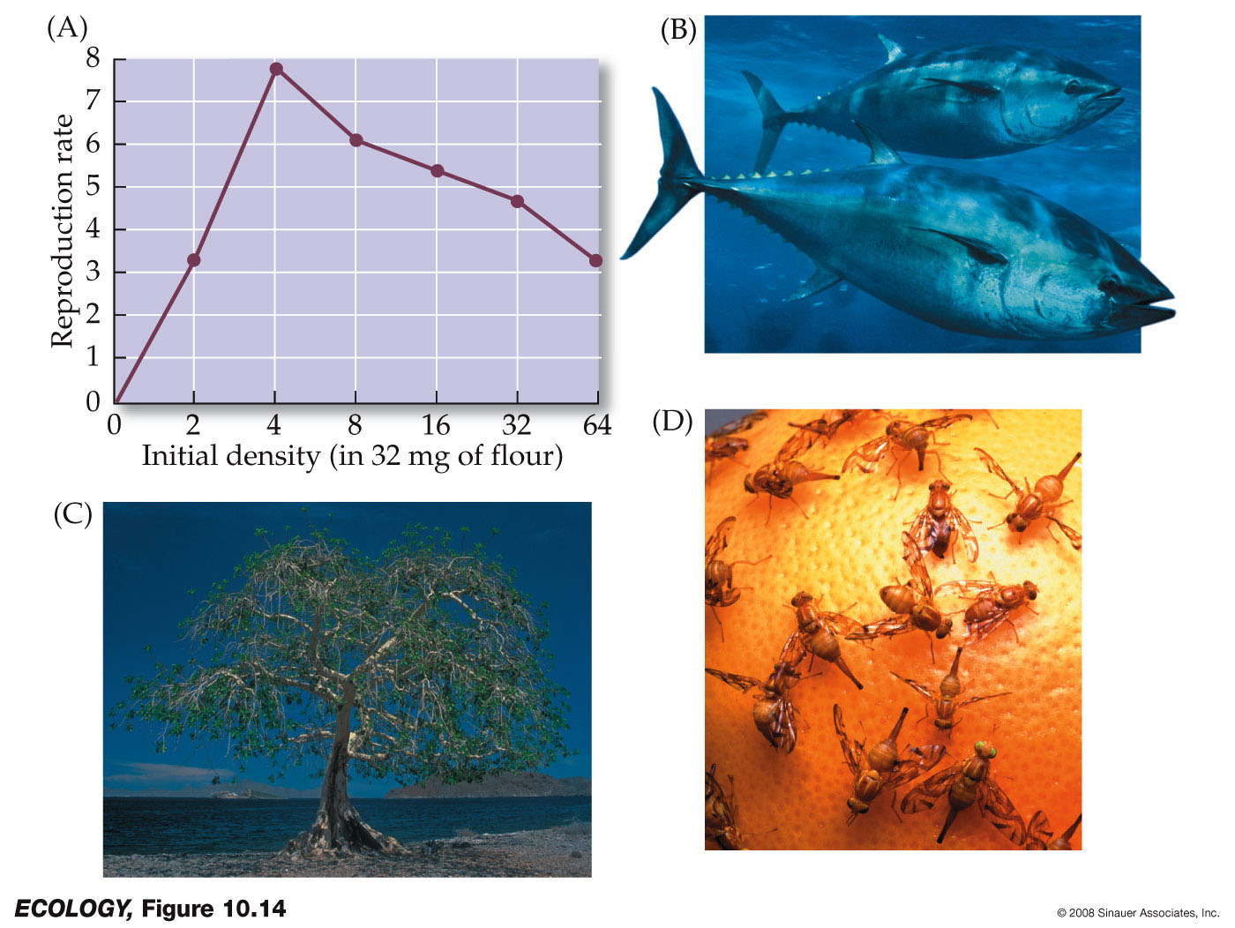
Figure 10.14 Allee Effects Can Threaten Small Populations
Notes:
Lab expt’s on tribolium b. bluefin tuna: form schools and smaller ones don’t do as well detecting preds early;
c. Fig trees – need enough nearby for a wasp to pollinate d. fruit flies – difficult to find mates at low densities
Also – forest example: too few trees means soils dry out and saplings can’t establish.

Slide 36
Allee effect: positive correlation between per capita growth rate and population size
Population growth rate, dN/dt
Population size, N
Population with exponential growth
Population with logistic growth
Population that suffers an Allee effect when small
Notes:
Also could occur for a population that otherwise would have exponential growth).

Slide 37
Allee effect: positive correlation between per capita growth rate and population size
Population growth rate, dN/dt
intraspecific competition decreases growth relative to exponential
Population size, N
Population with exponential growth
Population with logistic growth
Population that suffers an Allee effect when small
Notes:
Also could occur for a population that otherwise would have exponential growth).

Slide 38
Allee effect: positive correlation between per capita growth rate and population size
Population growth rate, dN/dt
intraspecific competition decreases growth relative to exponential
Allee effect: Decrease in growth rate due to problems in reproduction or defense based on small population size
Population size, N
Population with exponential growth
Population with logistic growth
Population that suffers an Allee effect when small
Notes:
Also could occur for a population that otherwise would have exponential growth).

Slide 39
Allee effect: positive correlation between per capita growth rate and population size (or density).
Per capita growth rate, dN/Ndt
Decrease in growth rate between exponential & logistic growth, due to intraspecific competition
r
Allee effect: Decrease in growth rate when pops are small due to lowered reproduction or defense, based on the small population size
Population size, N
K
Population with exponential growth
Population with logistic growth
Population that suffers the Allee Effect when small but otherwise grows according to logistic growth

