Slide 1
Lecture 2: Population growth rates
Arc of the course
Intro
  Biodiversity is important for ecosystem function
  Many causes for the loss of biodiversity
Module 1 – population growth
Module 2 – habitat loss and protection
Module 3 - climate

Slide 2
Declining Biodiversity
Declining global biodiversity can be explained by reference to the five HIPCO factors
H Habitat Loss & fragmentation
  I Invasive Species
  P Pollution
  C Climate Change
  O Overharvesting (direct killing)
(We’re not addressing invasive species or pollution.)

Slide 3
What do we need to know to manage populations and ecosystems and restore biodiversity and ecosystem function?
1. What do we know about populations?
2. How can we manage local biodiversity and ecosystem functions?
3. How can we manage global cycles?
Notes:
5 minutes

Slide 5
Population Growth
Notes:
First, what is a population? Morphologically, behaviorally, or biochemically distinct group of organisms

Slide 6
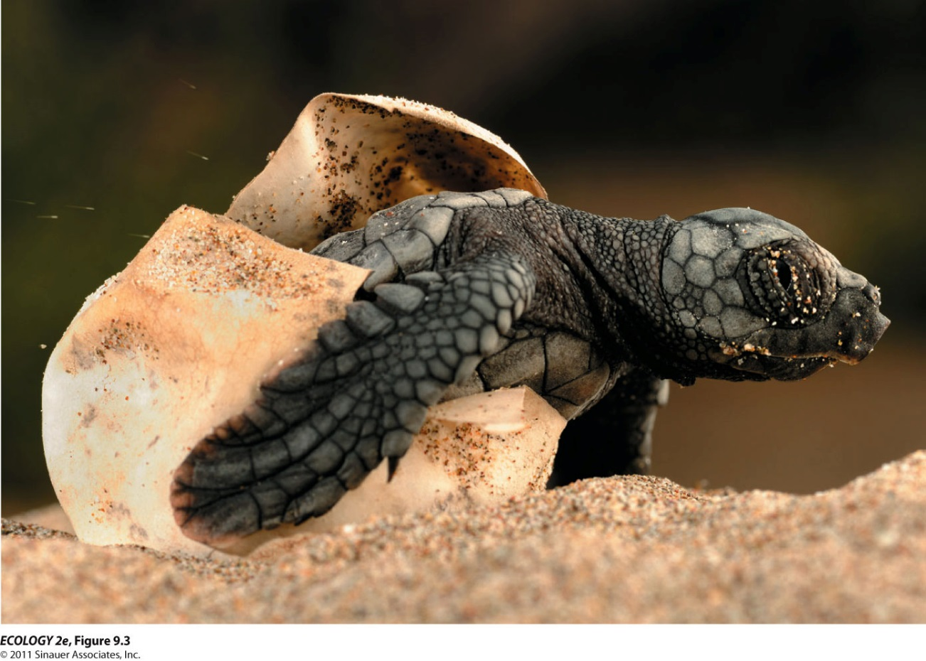
Information about births and deaths is essential to predict future population size and inform management.
How would you get this information?
Notes:
How get?
Follow a cohort over time for survival and # offspring (cohort life table).
Snapshot in time (static lifetable) of different ages. Better if v. long lived & can estimate ages (more assumptions)

Slide 7
Population dynamics: What primary factors affect population size?
N_{t+1}= N_{t} + B - D + I - E
N_{t} = initial population size at time t
B = number of individuals born during the time interval
D = number of individuals that die during t
I = number that immigrate during t
E = number that emigrate during t

Slide 8
Calculation 1. Complete the new population size for these two examples
N_{t+1}= N_{t} + B - D + I - E
Population of finches on an island over 1 yr
N_{t} = 463
B = 87
D = 93
I = 39
E = 14
N_{t+1} =
Population of Daphnia in a small pond over summer
(3 months)
N_{t} = 14, 207
B = 8,212
D = 4,945
N_{t+1} =

Slide 9
1. Completed population size examples
N_{t+1}= N_{t} + B-D + I-E
Population of Finches on an island during 1 year
N_{t} = 463 463
+ B = 87 87
- D = 93 + 39
+ I = 39 589
- E = 14 -107
N_{t+1}= 482
Population of Daphnia in a small pond over 3 summer months
N_{t}: 14, 207
+ B: 8,212
22,419
- D: 4,945
N_{t+1} = 17,474

Slide 10
Definitions
What does per capita mean?
What does rate mean?
Notes:
Rate: change over time

Slide 11
Developing a growth rate equation to predict population change (1)
For simple predictions, we assume no E or I. Why?
Formula becomes: N_{t+1}= N_{t} + B - D
To allow you to model population size across time periods, re-write N_{t+1}- N_{t} as: dN/dt = B-D
d is shorthand for ‘the change in’ (derivative of)
The change in N (pop size) with respect to changing t (time) is written: dN/dt = population growth rate
dN/dt is an operator (don’t divide N by t)

Slide 12
Developing a growth rate equation to predict population change (2)
Birth and death are combined into the term growth rate, number of births minus deaths in the time period: B – D
Growth rate is typically expressed per capita, (because population size affects the population-level growth rate): B/N – D/N = r; b-d=r.
b = per capita birth rate; d = per capita death rate
Rate of change in N can be written: dN/dt = rN_{t}
Exponential growth is described as dN/dt = rN_{t}

Slide 13
The intrinsic growth rate (r)
Definition: Under ideal conditions, with unlimited resources available, every population has a particular maximum growth potential for growth.
Notated as r or r_{max}
= b – d under ideal conditions

Slide 14
Calculation 2. Calculate growth rate
Population of Finches on a remote island during 1 yr
N_{t} = 463
B = 87
D = 93
What is the growth rate, r?
= b-d = B/N-D/N = (B-D)/N
= r

Slide 15
2. Calculate growth rates
Population of Finches on a remote island during
1 year
N_{t} = 463
B = 87
D = 93
B/N-D/N = (87-93)/463 = r = -0.013
Population of Daphnia in a small pond over 3 months
N_{t} = 14, 207
B = 8,212
D = 4,945
What is the growth rate, r?

Slide 16
2. Calculated growth rates for examples
Population of Finches on a remote island during 1 year N_{t} = 463
B = 87
D = 93
What is the growth rate? r= -0.013
Population of Daphnia in a small pond over 3 summer months
N_{t} = 14,207
B = 8,212
D = 4,945
What is the growth rate? B/N-D/N = (8,212-4,945)/14,207
= r = 0.23

Slide 17
3. Check in on r
  Write a group definition of r
  What information do you need to calculate r?
Notes:
Units: individuals / individual * time

Slide 19
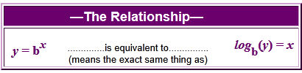
Quick Review of log and e:
Logarithms are the inverse of exponentials
100 = 10²; log₁₀(100)=2; log₁₀(10²)=2; log (100)=2
The base of the log can be 10 or e…
e, Euler’s constant ≈ 2.718, is the base of the natural logarithm,
log_{e}=ln(x)
In Excel, e^{x} is written as exp(x);
using your calculator…
1. What is the natural log of 2 = log_{e}(2)= ln(2) = ____? type 2, press ln
2. e^{3.73767} = ___ ? type 3.73767, then press e^{x} (2nd function)
3. log(10)= ____? ln(e) = ____ ? ln(e^{x})= _____
(Natural log = area under the curve of y=1/x)
Notes:
Type in ‘2’ and then push the LN button = 0.69.
Type in 3.73767 and then e^{x} (you may need to use the 2nd function button for this, I do). The answer is 42 (note that e = 2.718 so e¹ = 2.718)
=1 because e is the base of the natural logarithm. For log base 10, the log(10) = 1. ln (e^x) = x
Natural log = area under the curve of y=1/x as long as x is a real, + #. Given that integration (calculus) is all about the area under the curve, e appears often in models derived from calculus.

Slide 20
Quick Review of log and e:
Logarithms are the inverse of exponentials
100 = 10²; log₁₀(100)=2; log₁₀(10²)=2; log (100)=2
The base of the log can be 10 or e…
e, Euler’s constant ≈ 2.718, is the base of the natural logarithm,
log_{e}=ln(x)
In Excel, e^{x} is written as exp(x);
using your calculator…
1. What is the natural log of 2 = log_{e}(2)= ln(2) = _0.69___?
2. e^{3.73767} = _42__ ?
3. log(10)= _1___? ln(e) = _1___ ? ln(e^{x})= _x____
(Natural log = area under the curve of y=1/x)
Notes:
Type in ‘2’ and then push the LN button = 0.69.
Type in 3.73767 and then e^{x} (you may need to use the 2nd function button for this, I do). The answer is 42 (note that e = 2.718 so e¹ = 2.718)
=1 because e is the base of the natural logarithm. For log base 10, the log(10) = 1. ln (e^x) = x
Natural log = area under the curve of y=1/x as long as x is a real, + #. Given that integration (calculus) is all about the area under the curve, e appears often in models derived from calculus.

Slide 21
Definitions: Review
Population: individuals of a species that live in the same area at a given time
Species: a group of organisms that are morphologically, behaviorally, or biochemically distinct from other groups and that produce viable offspring with each other but can’t with others
Community: suite of species that co-occur in time and space
Biodiversity: variety of life forms
Ecosystem: interacting biotic & abiotic components of an area
Biome: region & its biological community shaped by regional temperatures, amount of precipitation, soil, & disturbance (land) or in salinity, depth, and flow (aquatic; less used)
Biosphere: the combination of all living organisms & our ecosystems; where life resides
r = per capita growth rate and often intrinsic growth rate, the per capita growth rate of a population in ideal conditions

Slide 22
Exponential Growth
In many species, the population can reproduce continuously, and generations can overlap.
When populations increase by a constant proportion of the population size (yet by ever more individuals each time period), there is exponential growth
(or if declining, exponential decay).
E.g., a population doubles in size every 10 yr
Notes:
example of doubling (2x is constant proportion...)

Slide 23
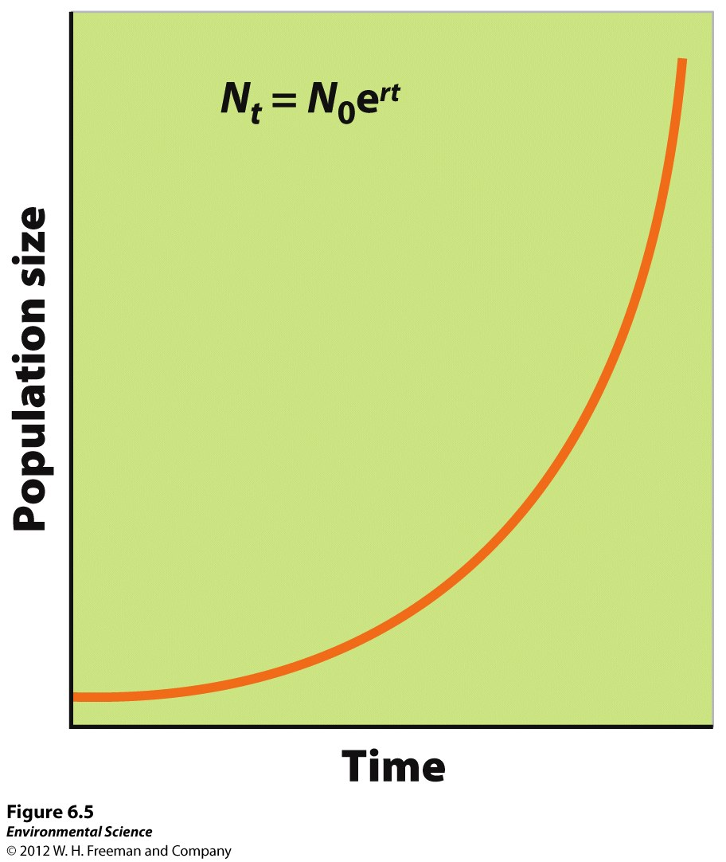
The exponential growth model describes a population with overlapping generations that grows continuously at a fixed rate.

Slide 24
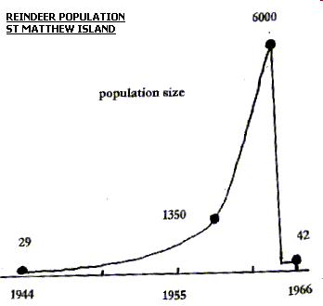
Example Population Growth

Slide 25
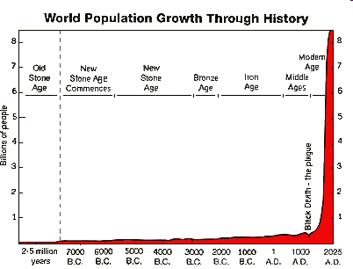
Human Population Growth

Slide 26
Exponential growth formula, the base model for population growth
N_{t}= N₀e^{rt}
Use this formula to predict for an exponentially ‘growing’ population one of: population size, intrinsic growth rate, or elapsed time
This formula assumes that conditions for survival and reproduction are ideal (= perfect)
This formula has many applications
(this equation is the integral of dN/dt = rN)

Slide 27
4. What do each of these variables mean?
N_{t} =
N₀ =
e =
r =
t =

Slide 28
5. Calculate population size after 1, 2, and 3 months of growth for this example:
  Fruit flies in a lab culture with ideal conditions,
  Initial population size (at time zero), N₀ = 147
  Time, t = 1 month
  Intrinsic growth rate, r = 0.1
  Formula: N_{t}= N₀e^{rt}
All together for the first time step
Solving for N_{t}

Slide 29
6. Calculated size over three months
  Fruit flies in a lab culture with ideal conditions,
  Initial population size (at time zero), N₀ = 147
  Time, t = 1 month
  Intrinsic growth rate, r = 0.1
  Formula: N_{t}= N₀e^{rt}
  1 mo: N_{t}= 147* e^{0.1*1mo} = 162
  2 mo:
  3 mo:

Slide 30
6. Calculated size over three months
  Fruit flies in a lab culture with ideal conditions,
  Initial population size (at time zero), N₀ = 147
  Time, t = 1 month
  Intrinsic growth rate, r = 0.1
  Formula: N_{t}= N₀e^{rt}
  1 mo: N_{t}= 147* e^{0.1*1 mo} = 162
  2 mo: N_{t}= 147* e^{0.1*2 mo} = 179
  3 mo: N_{t}= 147* e^{0.1*3 mo} = 198
  (note: the population grows by a greater amount each time step because more individuals are reproducing)

Slide 31
7. Challenge questions:
a. Draw N vs t for r = 0, N₀ = 500, for t = 0, 10, 20
b. Draw N vs t for r = 1, N₀ = 500, for t=0, 2, 5, 10
(put above 2 on the same graph)
c. Draw dN/dt on the Y axis versus N on the X axis. (What equation would you use?)
d. What would the slope be?

Slide 33
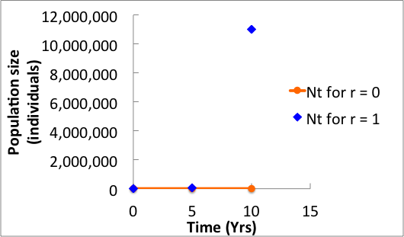
7. Challenge questions a, b:
N vs t for r = 0 & 1, N₀ = 500, for t=0, 2, 5, 10 yr

Slide 34
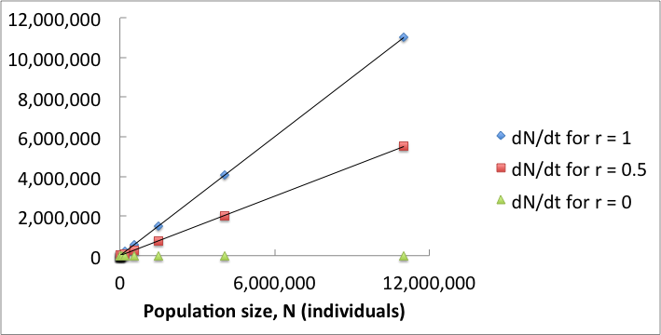
7. Challenge c & d: dN/dt vs N for N₀=500, r = 0, 0.5, 1
d. dN/dt = rN; slope = r

Slide 35
The doubling time (t_{d}) of a population is the number of years it will take the population to double in size.
ln(2) is a constant ≈ 0.693. (~0.7)
The larger r, the less time it takes for the
population to double.
Initial population size does not matter here

Slide 36
8. Doubling time problems,
Solve for t_{d} using t_{d} = ln(2)/r :
A continuously growing population of bears has a population size of 300 and its intrinsic rate of increase is 0.07 per year. Assuming that this rate of increase remains the same, about how long should it take for the population to reach 600?
A. 5 years B. 10 years C. 14 years D. 20 years E. 28 years
In 2012 the human population hit 7 bil and growth rate is 0.0118. What is the doubling time for the human population? In what year do we expect our population to hit 14 billion?
Notes:
Note: added to HW as ran out of time.
0.69 / 0.0118 ≈ 58.7 years; in 2071.

Slide 37
8. Doubling time problems, using t_{d} = ln(2)/r :
A continuously growing population of bears has a population size of 300 (N₀) and its intrinsic rate of increase is 0.07 per year (r). Assuming that this rate of increase remains the same, about how long should it take for the population to reach 600 (= 2x N₀)?
Ln (2)/r ~= 0.7/0.07 per yr = 10 yr
In Oct 2011 the human population hit 7 bil and growth rate, r, is 0.0118. What is the doubling time for the human population? In what year do we expect our population to hit 14 billion if this rate keeps constant?
ln (2)/r = .69/0.118 = 58.47 yr
2011.83+58.47 yr = 2070 (8 billion in 2024!)
Notes:
Note: added to HW as ran out of time.
0.69 / 0.0118 ≈ 58.7 years; in 2071.

Slide 38
9. Optional challenge: derive doubling time equation
Derive from N_{t} = N₀e^{rt}
To start, what is N_{t} in terms of N₀ given that we’re doubling?
Notes:
N_{t}=2*N₀; so: 2*N₀=N_{0*}e^{rt} ; divide by N₀: 2 = e^{rt}
take the ln of both sides: ln(2) = rt; t=ln(2)/r

Slide 39
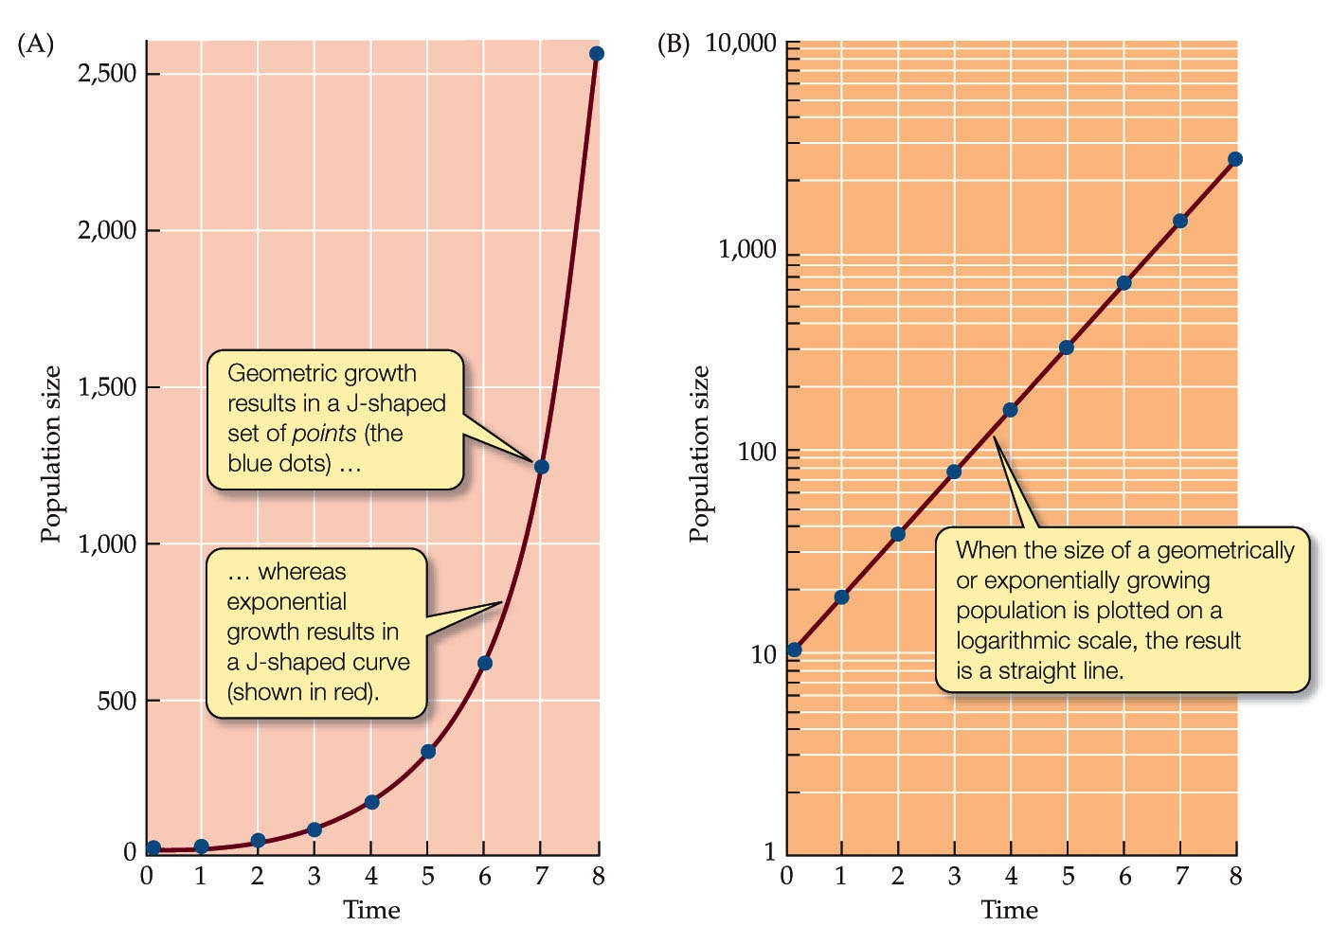
Exponential relationships between y and x appear linear when graphed on semi-log paper.
Why use a log scale for the y axis?

