Slide 1
Lecture 17 – June 5 Climate change: Mitigate, resist, adapt
Review expected impacts
Discuss choices:
Mitigate – prevent
Respond
Resist – use effort to counter change
Resilience – work within tolerance ranges
Adapt – forward looking plans
2 skills: feedback loops & game square

Slide 2
Lectures, readings, assignments
Date | Lecture | Reading | In-class | Assignments
Mon June 5 | 17 Mitigation or adaptation | Games | Feedback loops Game square
Wed June 7 | 18 review |  |  | PS 5 due
Wed June 14 | Final exam | 10:15 to 12:05

Slide 3
Ecological effects

Slide 4
Ecological Effects
Ocean acidity
Coral bleaching
Range shifts of plants in mountain areas
Changes in migration patterns of birds
Earlier spring greening of vegetation
Timing of plant growth and insect emergence
Timing of flowering and pollinator activity
Timing of bird hatching and insect emergence
Many more

Slide 5
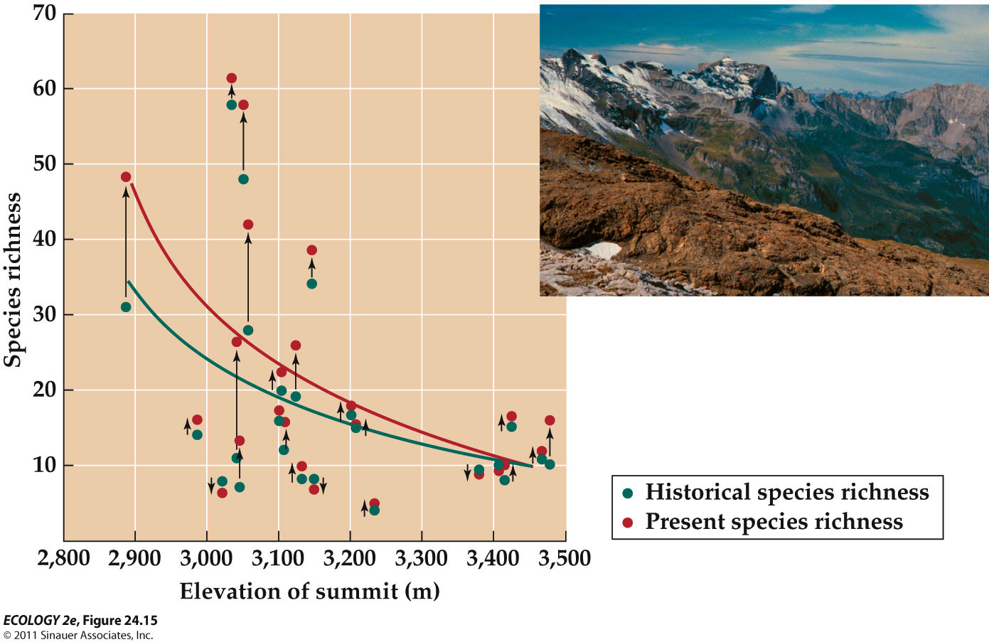
Plants Are Moving Up the Alps
Notes:
Ranges of plant species in the European Alps were compared with historical records (Grabherr et al. 1994).
A consistent trend of upward movement of species from lower elevations onto the summits was reported.
Parmesan and Yohe (2003) found that 63% of European butterfly species examined have shifted their ranges northward, while only 3% shifted their ranges southward.
Extinction of lizard populations in Mexico has been linked to warmer spring temperature which limits foraging time during the breeding season (Sinervo et al. 2010).
Using models of lizard physiology and projections for climate warming, they predict 39% of lizard populations will go extinct by 2050.
Changes in community composition and local extinctions may be indicators of climate change.
Warm water temperatures can kill the algal symbionts of corals, resulting in bleaching of coral reefs.
Several worldwide bleaching events have occurred in association with warmer-than-average sea surface temperatures.

Slide 6
Because climate change will be rapid, plants & animals are unlikely to demonstrate evolutionary responses
Dispersal may be the only way to avoid extinction.
Dispersal barriers and habitat fragmentation will be important constraints.
Plant dispersal rates are, on average, much slower than the predicted rate of climate change.
R-selected plants can disperse and establish quickly. K-selected shrubs and trees have much slower dispersal rates.

Slide 7
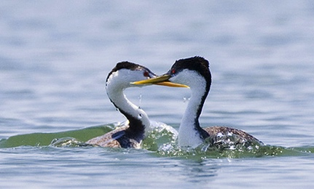
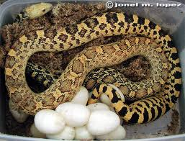
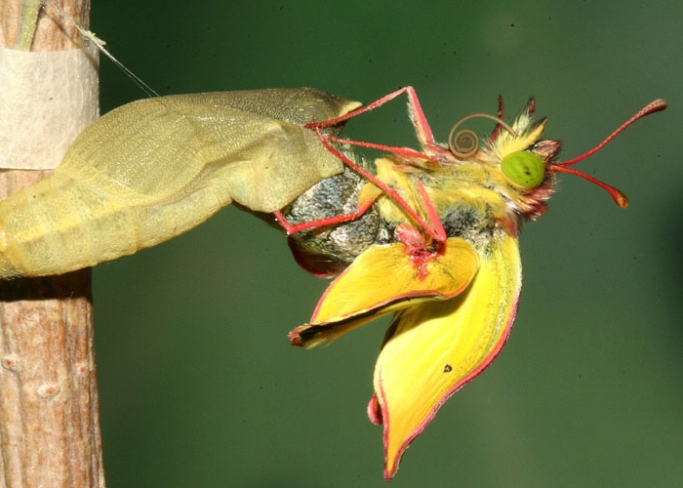
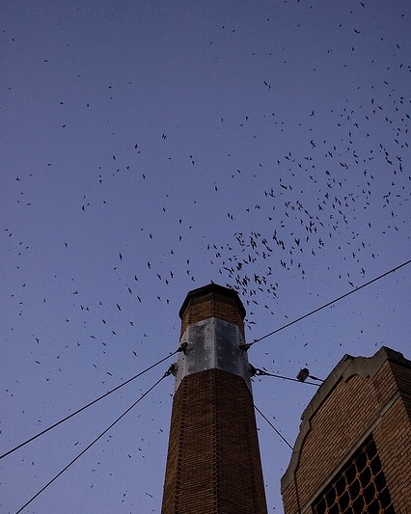
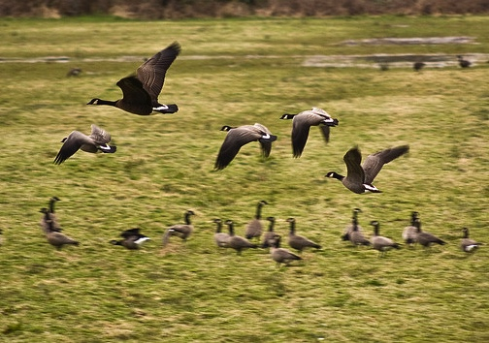
Phenology: The timing of life-cycle events and seasonal activities of organisms
Grebe pict from Care2; Colius moth pict from Ecotime;
Notes:
Phenological events in animals include mating, egg-laying, hatching, emergence/eclosing, migration

Slide 8
Phenology: The timing of life-cycle events and seasonal activities of organisms
Earliest: Farmers tracked plants / animals as indicators of when to plant, harvest, etc.
Chinese ~1000 BC: Written records
Later: Linneaeus, Thoreau, Leopold
(from Project Budburst)
Notes:
Phenological events in animals include mating, egg-laying, hatching, emergence/eclosing, migration

Slide 9
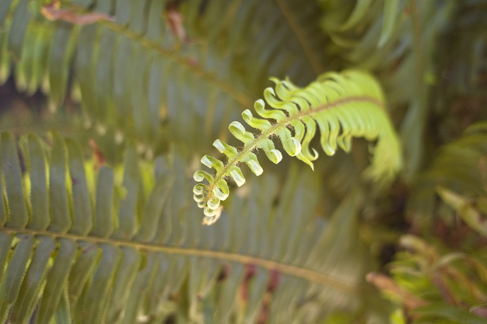
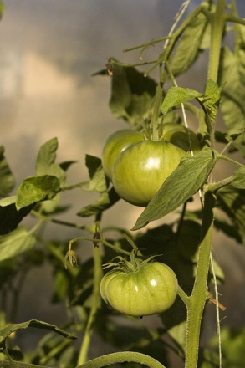
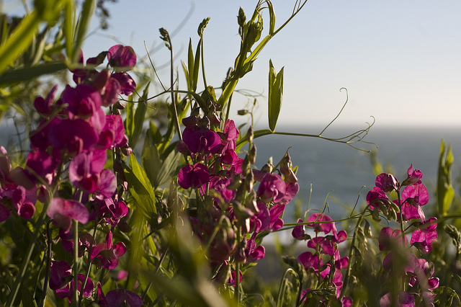
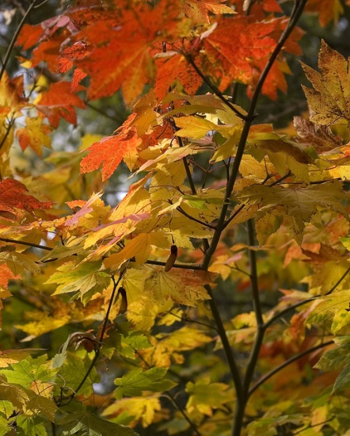
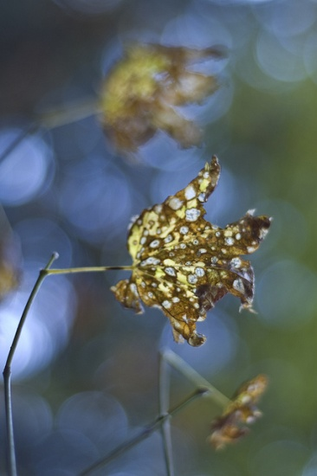
Phenophase: span of time in which a life history event occurs
Notes:
leaf bud burst, leaf unfolding, flowering, fruiting, leaf color change, senescence

Slide 10
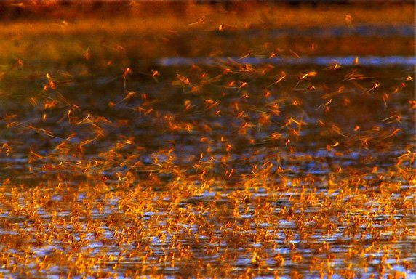
Phenology is one of the main quantifiable indicators of global climate change
Notes:
In mid-June (for 2 wks), emerging mayflies (Palingenia longicauda) on the Tisza River, Hungary, emerge These dense clouds of mayflies have been seen on radar images!
Shortly after mating, females lay eggs on the river's surface. The eggs drift to the bottom and after 45 days hatch into larvae, which dig tunnels forming dense colonies up to 400 per square foot. After three years larvae break for the surface where females molt once and males shed twice: first into a brief subadult stage then again minutes later into adulthood. After both sexes have fully matured, mayflies have roughly three hours before they die. Ephemeral ptera (flyers)

Slide 11
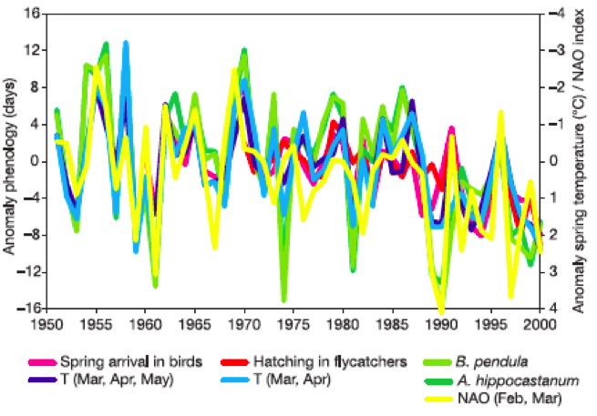
Anomaly: deviation from a long-term average
Fig. 2 Anomalies in different phenological phases correlate well with anomalies of mean spring air temp. (T) and Northern Atlantic Oscillation (NAO) index
Walther et al. 2002
Notes:
Temp affects phenology of birds: arrival and hatching; B. penduala is White Birch; A. hippocastanum is Horse Chestnut
(NAO = N. Atlantic oscillation)

Slide 12
Examples of Plant Phenology Changes
Earlier leaf unfolding; flowering advancing by 2.5 days (Europe) and 1.2-2.1 days per decade in the last 30-50 yrs. (Walther 2002, Menzel 2006, Cleland 2007)
78% of all phenological records advancing.
Plant phases advancing along with warming (Menzel 2006)
Average annual growing season lengthened by 10.8 days since 1960’s (Menzel 2000)
Notes:
“spring green up” = leaf unfolding
Advancing along w/ warming at a national scale

Slide 13
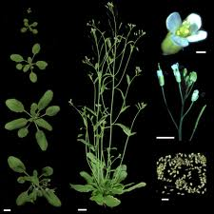
Plant Phenology Mechanisms
Photoperiodism – photoreceptor proteins sense changes in day and night length, affecting plant development
Chilling Requirement – flowering or breaking of dormancy promoted by prolonged cold
Arabidopsis: bioinformatics.unl.edu
Notes:
(phytocrome and cryptochrome)
After vernalization gene that represses flowering “FLC” turned off permitting flowering
Model system long-day, winter annual plant “Arabidopsis

Slide 14
The primary physiological cue for bird migration is the changes in the day length, while the primary cue for insect emergence and development is temperature
Snow geese – R. Nelson

Slide 15
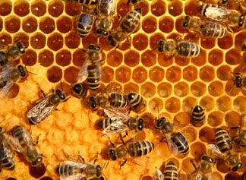
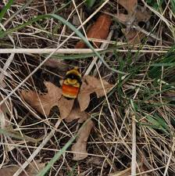
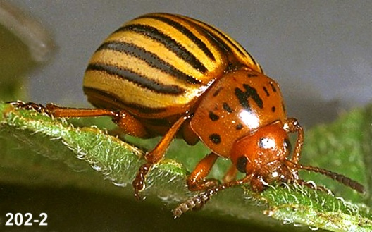
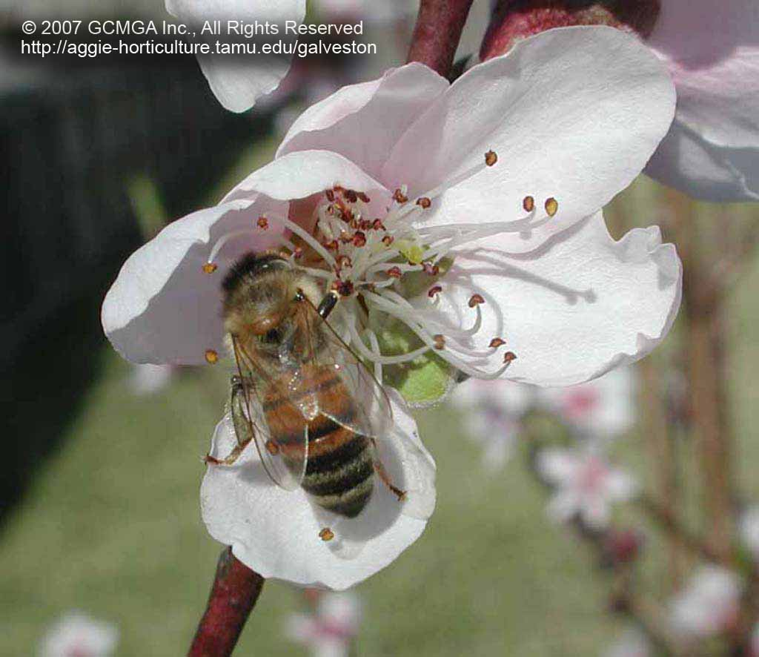
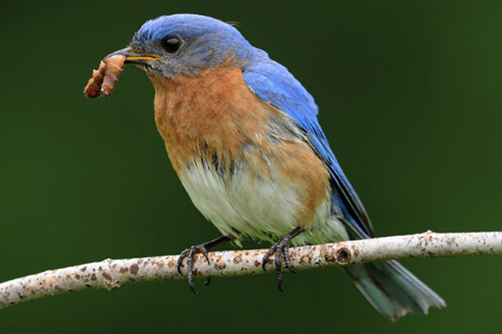
Temperature change can affect pest outbreaks, and pollinator and food web mismatches.
Most of Oregon’s >14,000+ arthropod species have temperature- dependent development
(Menzel 2000,Walther 2002;
picts: Ralph Berry OSU, Mike Onyon)
Notes:
Most of Oregon’s >14,000+ arthropod species have temperature-dependent development
Colorado Potato Beetle – potato pest (& tomato, eggplant...)
2012: Balmy temperatures have caused bees to emerge too early and go through their winter food stores before there is enough nectar and pollen out there to replenish their supply.”
pollinators:

Slide 16
A rise of 2°C (3.6°F) will hasten the annual, typically well defined, flight period in moths by >18 days (J. Miller, data from 2004-8)
Notes:
The seasonal timing of flight (a period of only 10–25 days for most species) is a critical time because this is the only chance females have to deposit eggs, an event followed by caterpillars feeding on suitable foliage.
Given photoperiod effects on bird migration, temp effects on insects, what would your expectations be for food available for nestling birds, most of whom eat insects?

Slide 17
Food security: Many plants require diurnal cycles of fluctuating temperatures
Temperature fluctuation affects germination, growth, flowering and fruiting
Climate change is decreasing differential
Notes:
…tomatoes grown at constant temp do poorly.
Exacerbated by Urban Heat Island Effect

Slide 18
Consequences to Humans
Loss of ecosystem services (pgs 77-81)
Many people will have to relocate due to coastal and island flooding.
Rates of diseases such as those carried by mosquitoes (malaria, yellow fever) could increase as temperature changes allow the vectors to expand in range.
Many economic consequences of shorter and warmer winters with longer and hotter summers

Slide 19
feedbacks
Some processes are self-limiting (negative feedback)
Other processes can “run away” for a time (positive feedback)
http://web.pdx.edu/~rueterj/courses/objects/global-warming-feedback.html

Slide 20
Planetary Atmosphere as The Commons
The Precautionary Principle
In the face of uncertainty we should behave cautiously
Humans should stabilize/reduce greenhouse gas emissions because humans have altered global climate
Mitigation = Reduce the Magnitude of the Problem

Slide 21
Decisions with uncertainty
 | Severe climate impacts | Turns out there was damage from climate
Spend money and effort to mitigate and adapt to changes | Lower damage Precautionary principle | “wasted” money on climate change preparation *Depends on what you spent money on
Don’t prepare, spend money growing economy and other societal needs | Unprepared for disasters and stress – worst case scenario | Economic growth or reduction of social problems Best case scenario
*Could be other benefits from reducing CO2 in air and switching off fossil fuels
Such as: discuss

Slide 22
How do we (environmental professionals) talk about climate stress?
Within discipline
To others – i.e. the “public”
Uncertainty
Research agenda
Impact is global
Driver
Ecosystem damage
Ecosystem services
Precautionary principle
Incentives and taxes
Motivation, blame
Multiple possible outcomes
Consensus has focused questions
Threat to you
Major processes
Loss of species, parks, etc.
Loss of “free” services
Better safe than sorry
---
---

Slide 23
What Solutions Available?
Reduce Emissions
Carbon Capture
Carbon Sequestration
Geo-engineering?

Slide 24
Solution: Reduce Emissions
How much do we have to reduce CO2 emissions?
We need to approach steady-state where atmosphere inputs = outputs (plants, ocean, soil)
If we are adding ~9 (bn tons) to the atmosphere and the planet absorbs ~5, what percent reduction do we need? (BOTE!)

Slide 25
Solution: Reduce Emissions
How much do we have to reduce CO2 emissions?
We need to approach steady-state where atmosphere inputs = outputs (plants, ocean, soil)
If we are adding ~9 (bn tons) to the atmosphere and the planet absorbs ~5, what percent reduction do we need?
Reduce by 4 bn tons or 4/9 = 45%.
When was the last time we emitted that little?
Why might this be difficult?

Slide 26
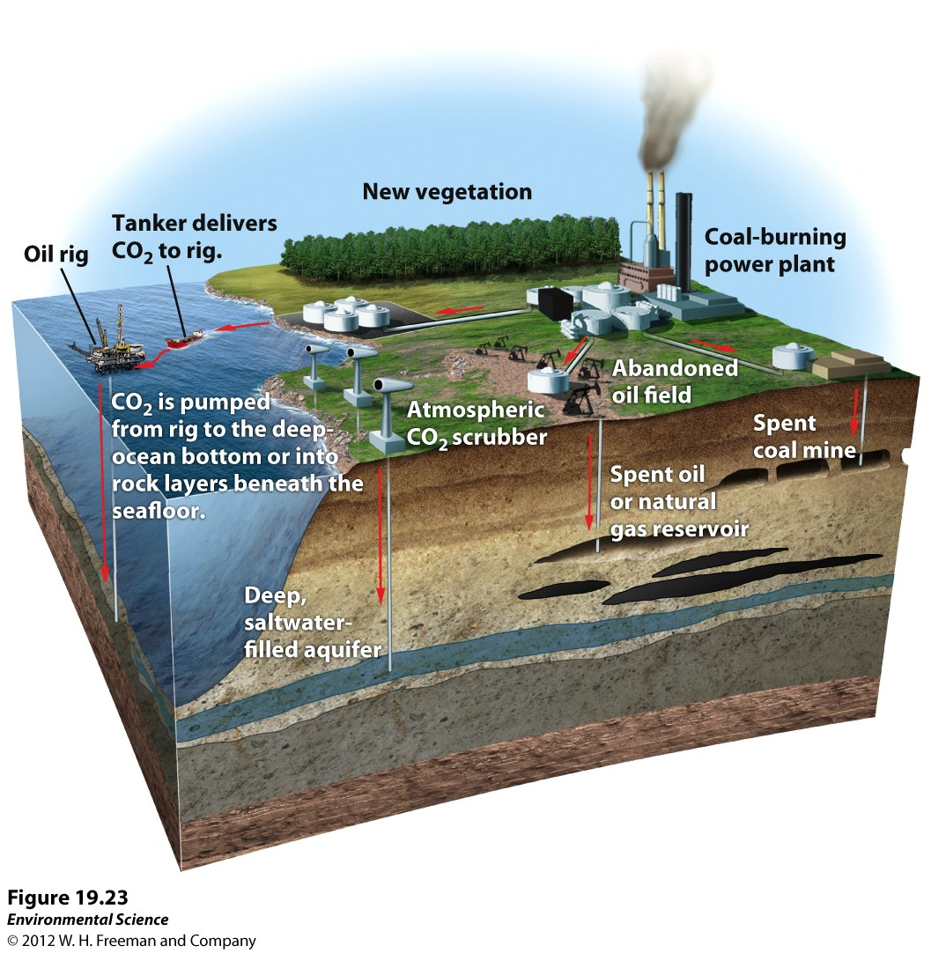
Solution: Carbon Capture
Capture CO₂ from air and emission sources (e.g., coal-burning power stations). This captured CO₂ would be compressed and pumped into abandoned oil wells or the deep ocean.

Slide 27
Solution: Carbon Sequestration
Take CO2 out of the atmosphere
Methods include:
storing carbon in agricultural soils
retiring agricultural land and allowing it to become pasture or forest
Forest restoration, forest health

Slide 28
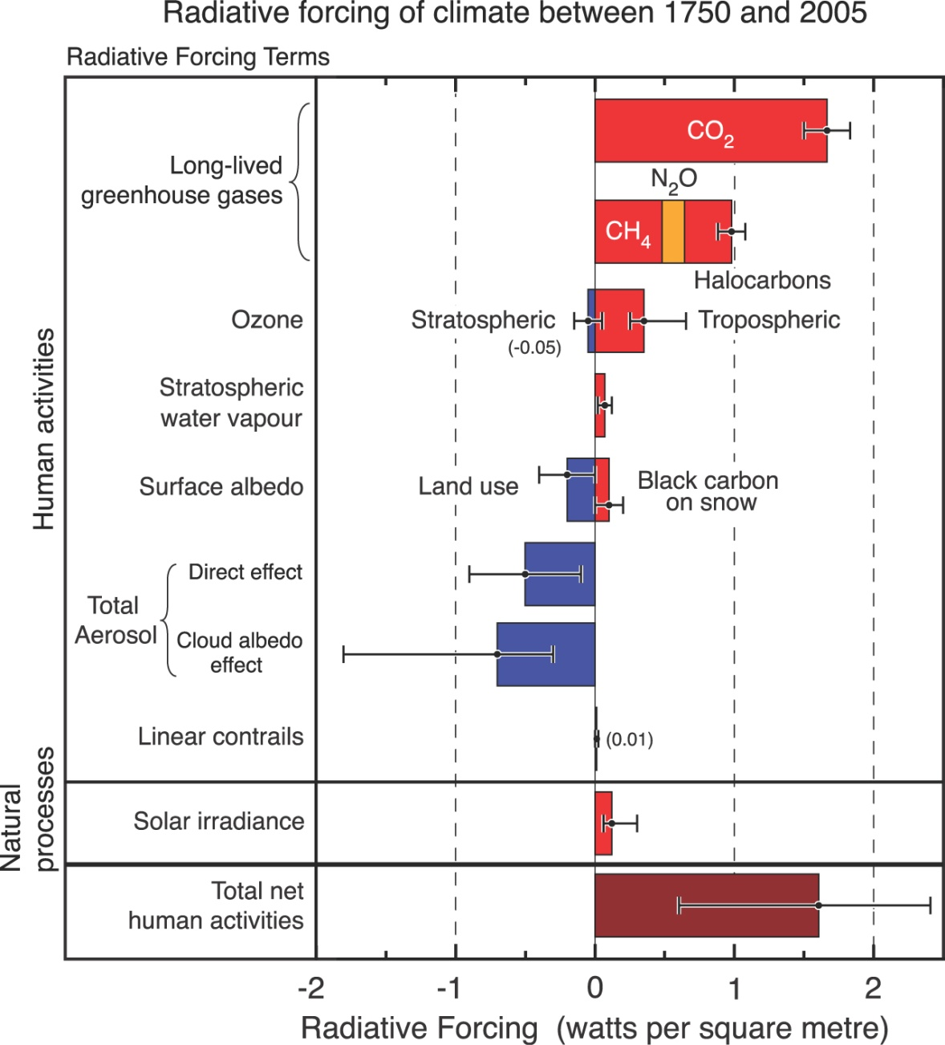
Geoengineering
How do we reduce greenhouse gas effects?

Slide 29
Managing for Change
These are broad concepts that apply to many situations, personal, professional, biodiversity.
Resistance
Resilience
Adaptation (aka Transformation)

Slide 30
Managing for Change
Note: Resistance and Adaptation are in conflict!
Resistance
Adaptation

Slide 31
Managing for Changing Biodiversity
Maintain Biodiversity
The Rambunctious Garden (Emma Marris):
Protect the Rights of Other Species
Protect Charismatic Megafauna/flora
Slow Extinction Rate
Protect Genetic Diversity

Slide 32
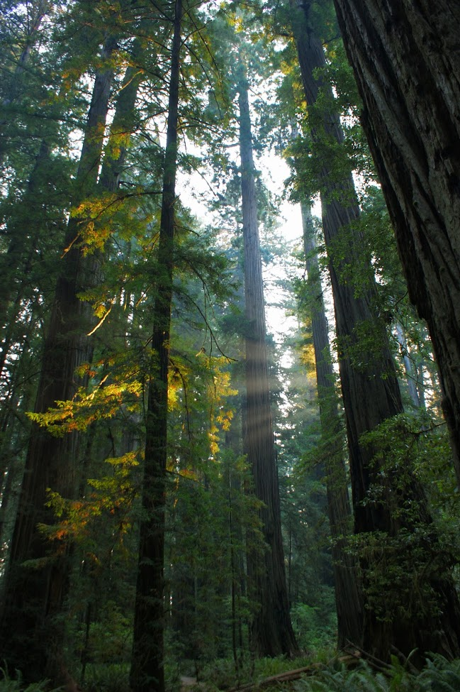
Managing for Changing Biodiversity: Resistance
Resistance: Maintaining a desired state in perpetuity
Approaches:
National Parks
Other reserves
Restoration
Wildfire suppression
Photo: USFS

Slide 33
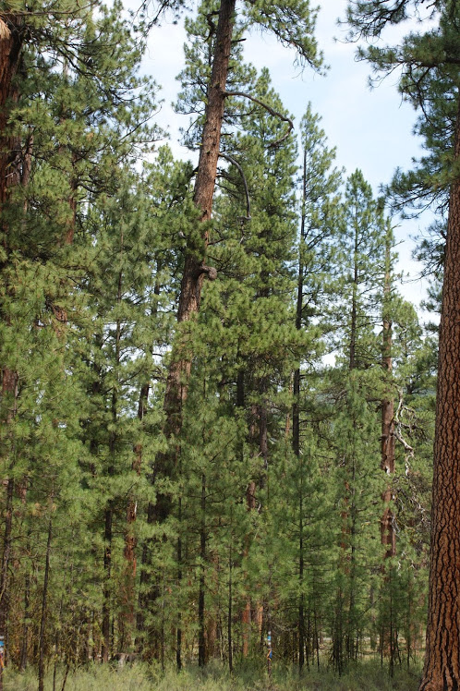
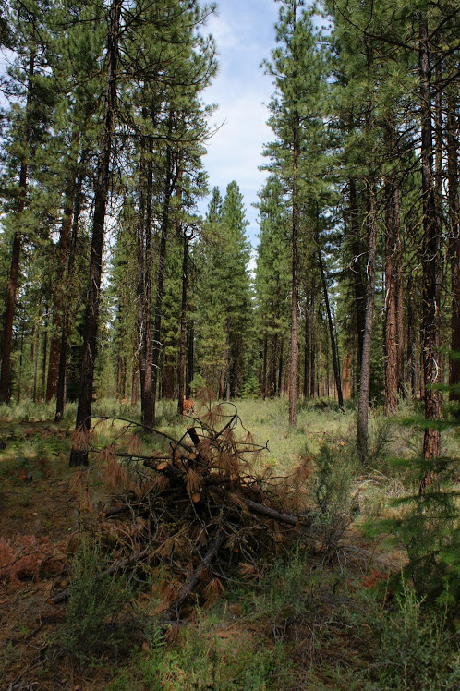
Managing for Changing Biodiversity: Resilience
Approaches:
Maintain high diversity, including age and genetic
Allow disturbance, prevent catastrophic disturbance
Western US Forests:
Fuel treatments
Prescribed fires
Before and After fuel treatment near
Metolius River, Oregon
Notes:
Ecosystem Services: water quality, soil stability, carbon storage, biological diversity, wood products, food, recreation, aesthetics, spiritual, cultural
Decline in ecosystem stability and resilience

Slide 34
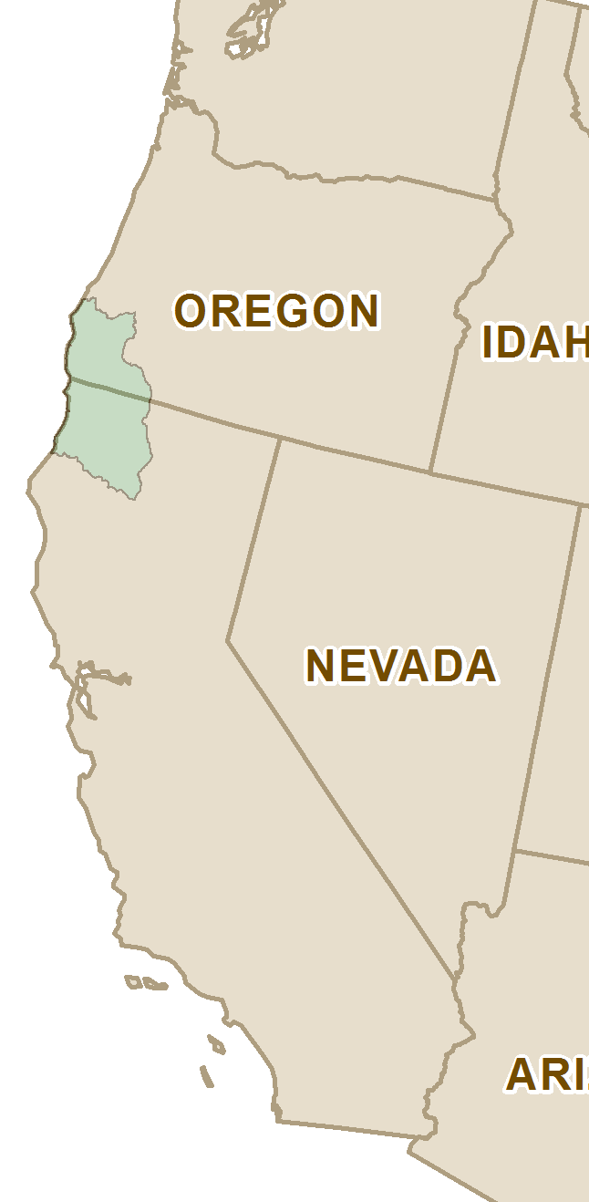
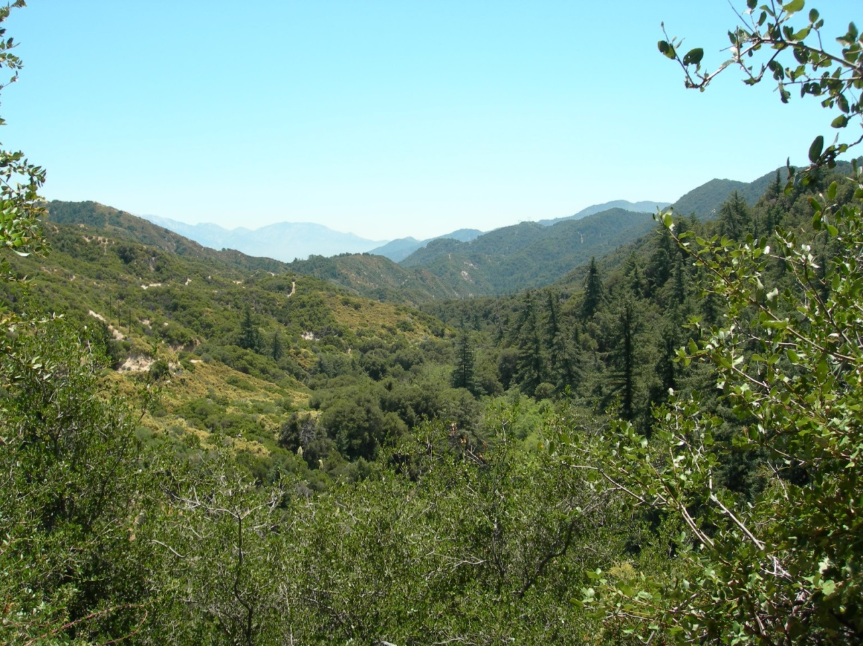
Managing for Changing Biodiversity: Resilience
Example: Risk of conversion from forest to chaparral in the Klamath region
Photo: Unknown
Notes:
Disturbance

Slide 35
Managing for Changing Biodiversity: Adaptation
Acceptance that the climate has changed, will continue to do so.

Slide 36
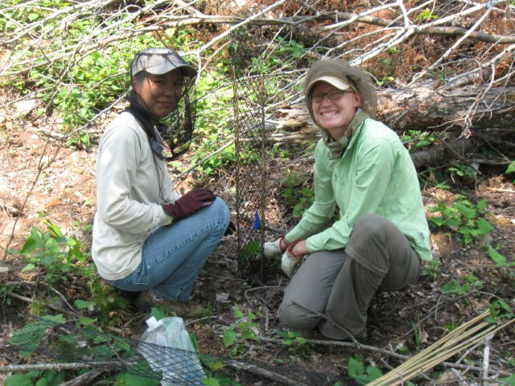
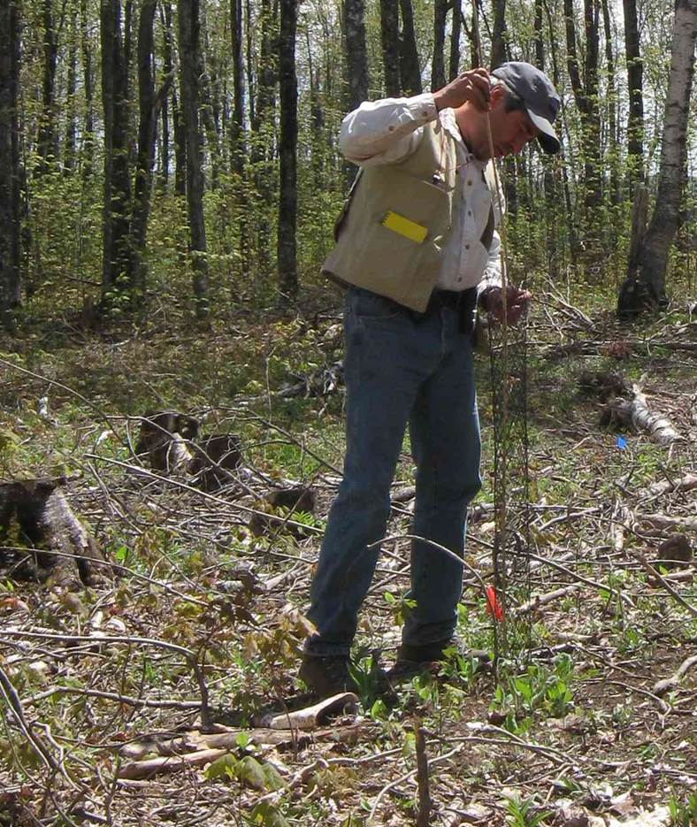
Managing for Changing Biodiversity: Adaptation
Approaches:
Increasing or introducing disturbances
Introducing new species: Facilitated migration
More species: Facilitated biodiversity
Example: TNC planting 250,000 climate resilient seedlings
Photos: Mark White

Slide 37
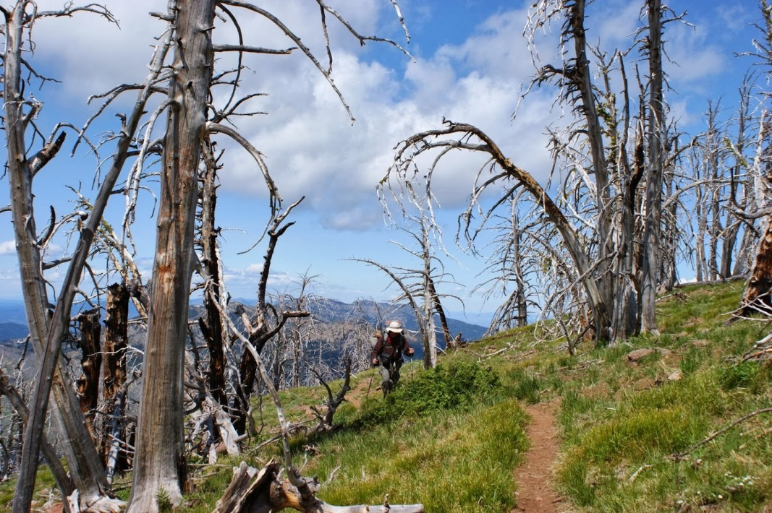
Managing for Changing Biodiversity: Adaptation
Consider Radical Innovations
Whole-sale ecosystem conversion
Abandonment
Facilitated Evolution
Other?
Whitebark pine following fire in 2004; re-burned 2015

Slide 38
Managing for Changing Biodiversity: Adaptation
Consider Radical Innovations
Emma Marris: All of the above!
Embrace biodiversity everywhere
Urban areas, agricultural areas
Wide-scale intentional introductions

Slide 39
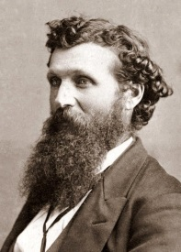
Managing for Biodiversity
Social attitudes towards managing biodiversity:
John
Muir
Resistance
Adaptation
Emma Marris

