Slide 1
Lecture 17 – Pep talk
President’s withdrawal from Paris Accord was bad news.

Slide 2
We are all working on it
Global movement that includes governments
People
Cities, states
Universities
NGOs
Corporations
Entrepreneurs

Slide 3
Other driving reasons to eliminate fossil fuels
Major source of pollution
CO₂ and Hg for example
Other energy sources are driving new jobs and economies in all the right places
Other energy sources are cheaper
Other energy sources are more reliable (than oil)
Renewable energy both sets limits and empowers us

Slide 4
Technology is creating opportunities
For example, batteries could be a game changer
EV
Home daily energy cycle

Slide 5
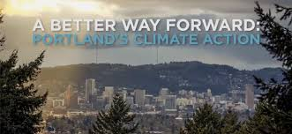
Climate Action Plans
NYC
wants to have the cleanest air of any city
Ex-mayor Bloomberg is doing a lot of pushing
Sierra Club
Blocked 100,000 megawatts of new powerplants based on pollution standards (not climate change)
Portland
Of course – we are leaders, first city to have a plan in 1993
Includes equity plan
https://www.portlandoregon.gov/bps/66993

Slide 6
We have important work to do
Characterize environmental impacts, quantify damage
Identify linkages – CHNS
Develop a portfolio of approaches and policies using new science and innovative institutions
Build the movement (Paul Hawken, Blessed Unrest) focusing on cooperation not competition

