Slide 1
Lecture 16 – May 31 Carbon cycle and ecological impacts
Carbon cycle plus anthropogenic impacts
Direct and indirect ecological effects
Quiz 2 - questions

Slide 2
Lectures, readings, assignments
Date | Lecture | Reading | In-class | Assignments
Wed May 31 | 16 C cycle and eco impacts | Pg 77 – 81 Chap 19 | Mass balance adiabatic
Mon June 5 | 17 Mitigation or adaptation | Games | Feedback loops Game square
Wed June 7 | 18 |  |  | PS 5 due
Wed June 14 | Final exam | 10:15 to 12:05

Slide 3
Carbon emissions as a driver of climate change

Slide 4
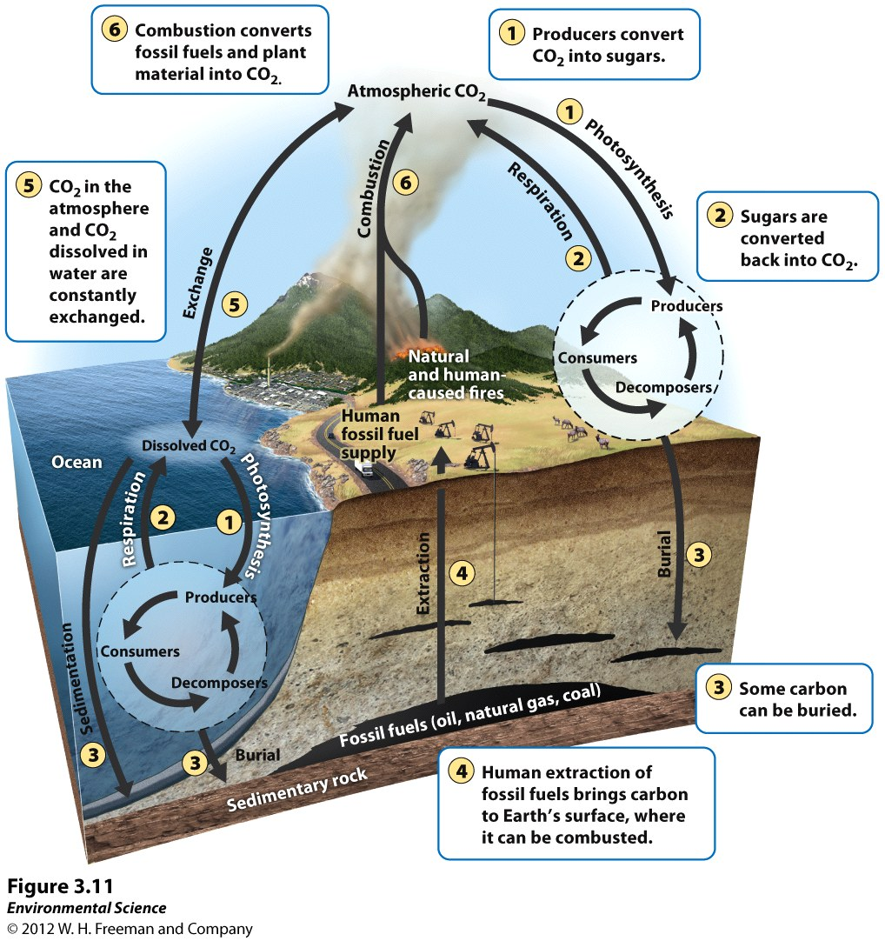
Carbon Cycle: Six key processes (CREEPS)
Six driving processes
Photosynthesis
Respiration
Exchange
Sedimentation and burial
Extraction
Combustion
Each process can be categorized as slow or fast
Slow: carbon held in rocks, soil, or as petroleum (can stay here millions of years)
Fast: carbon held in living organisms

Slide 5
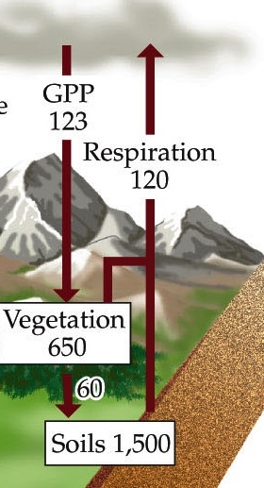
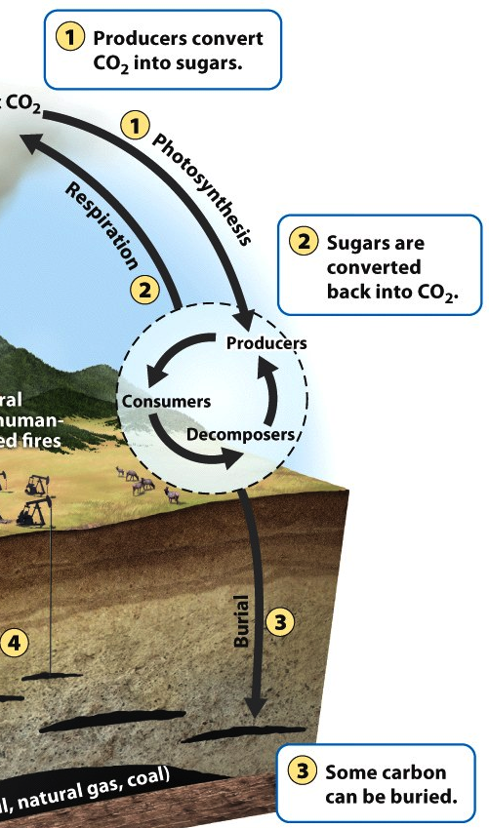
Carbon Cycle: Photosynthesis
The process that brings C to all living organisms & to burial.
Take in CO₂ and incorporate carbon.
Living organisms ~20%C of dry weight
Carbon moves from producers to consumers and decomposers.

Slide 6
Carbon Cycle: Respiration
Organisms take in CO₂ from photosynthesis, eating, or decomposing;
The byproduct of cellular energy production is CO₂
Organisms all release CO₂ through respiration
All cells (& organisms) respire; some cells respire and photosynthesize.

Slide 7
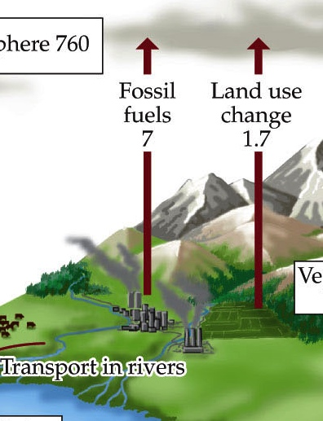
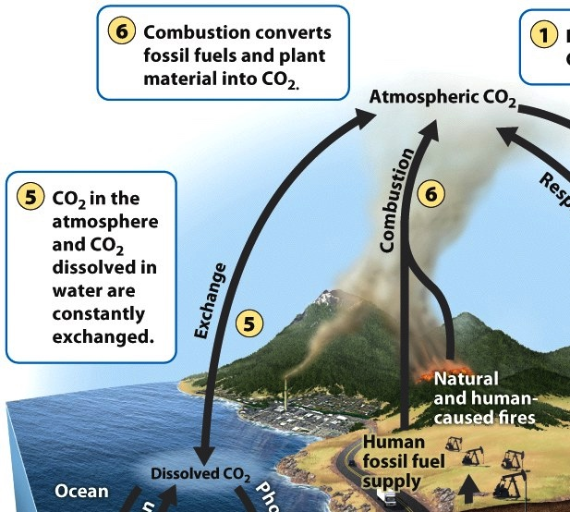
Carbon Cycle: Combustion
Burning of material with C; releases energy and CO₂
Involves burning fossil fuels, timber, other organic material (biomass)
Respiration, decomposition, and combustion all release CO₂ back to the atmosphere in gas form
All of these process also involve breaking molecules that contain carbon into single carbon molecules in order to gain energy

Slide 8
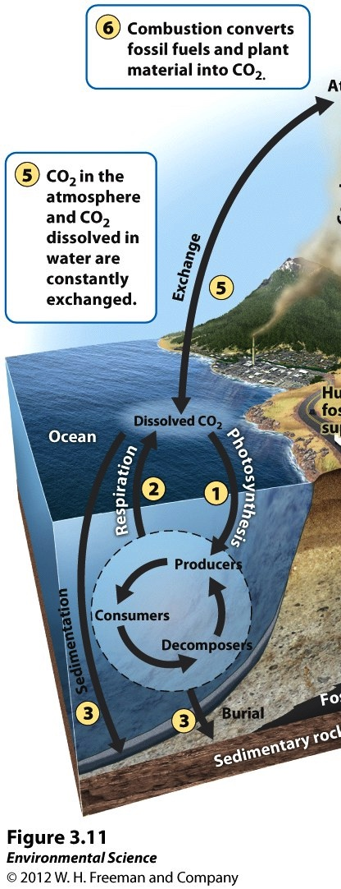
Carbon Cycle: Exchange
Large amounts of carbon are in oceans and fresh water
C enters water via diffusion (gas moves from higher to lower concentration)
CO₂ reacts w/ H₂O & is converted into bicarbonate (HCO₃⁺).
Because of the large amount of Ca²⁺ in sea water, some of the bicarbonate is converted into CaCO₃ (calcium carbonate).
C is transferred deeper as detritus and shells
Upwelling brings C-rich water to the surface, releasing CO₂ to the atmosphere

Slide 9
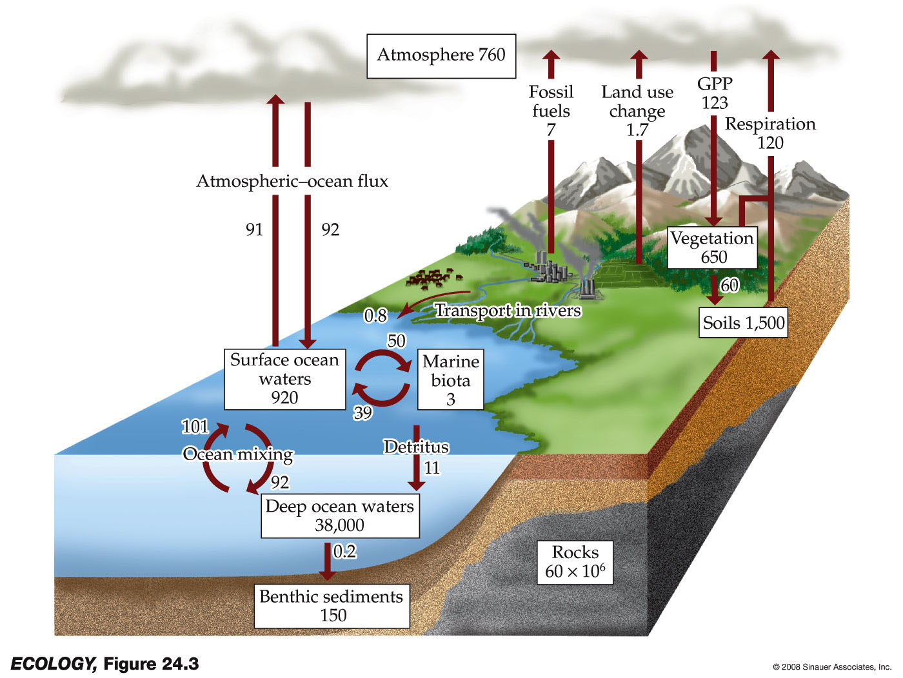
Carbon Cycle: Sedimentation and burial
Calcium Carbonate can form a solid (a precipitate) that settles to the bottom of the ocean.
Often leads to burial; then CaCO₃ transforms into limestone and dolomite.
C stays in this form for so long (and is constantly being formed) it is our largest pool of carbon
Some of the dead biomass becomes buried before fully decomposing & is converted into fossil fuels
Extraction: Removal of fossil fuels (coal, oil, natural gas) from burial

Slide 10
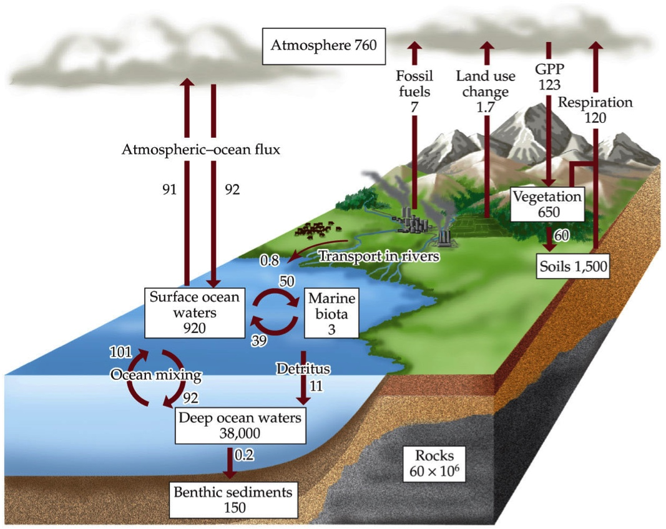
Carbon Cycle – Key facts
Before human disturbance, carbon cycling was in a steady state: released to atmosphere at ~ the same rate it entered the terrestrial & aquatic processes
Atmospheric C was stable for 10,000 years (before industrial revolution)
Biggest change in releases: from carbon fuels and soils and timber harvesting.
Fluxes Petagram/ha/yr
Imbalance in fluxes?
Effect of deforestation?

Slide 11
Carbon Cycle: Six key processes (CREEPS)
Six driving processes
Photosynthesis, Respiration, Exchange, Sedimentation and burial, Extraction, Combustion
16-1: Finish the mass-balance equation:
dC_{atmospheric}/dt = (put the basic components in place)

Slide 12
Carbon Cycle: Six key processes (CREEPS)
Six driving processes
Photosynthesis, Respiration, Exchange, Sedimentation and burial, Extraction, Combustion
Q2: Finish the equation:
dC_{atmospheric}/dt = R – P – Exchange – SB + C

Slide 13
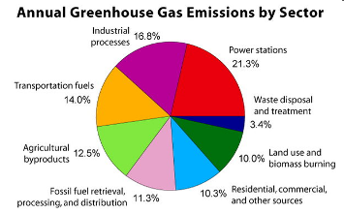
The Atmosphere as a Bathtub
Input: 9.1 billion tons
per year!
Currently: ~745 bn in the bathtub
Originally: ~570 bn
Out: 5 bn yr⁻¹
55% plants/soil
45% oceans
<1% sediments

Slide 14
What are ‘Greenhouse Gases’
Any gas that increases the ability of the atmosphere to absorb heat.
These are mostly Carbon gases: CO₂ and CH₄ (methane)

Slide 15
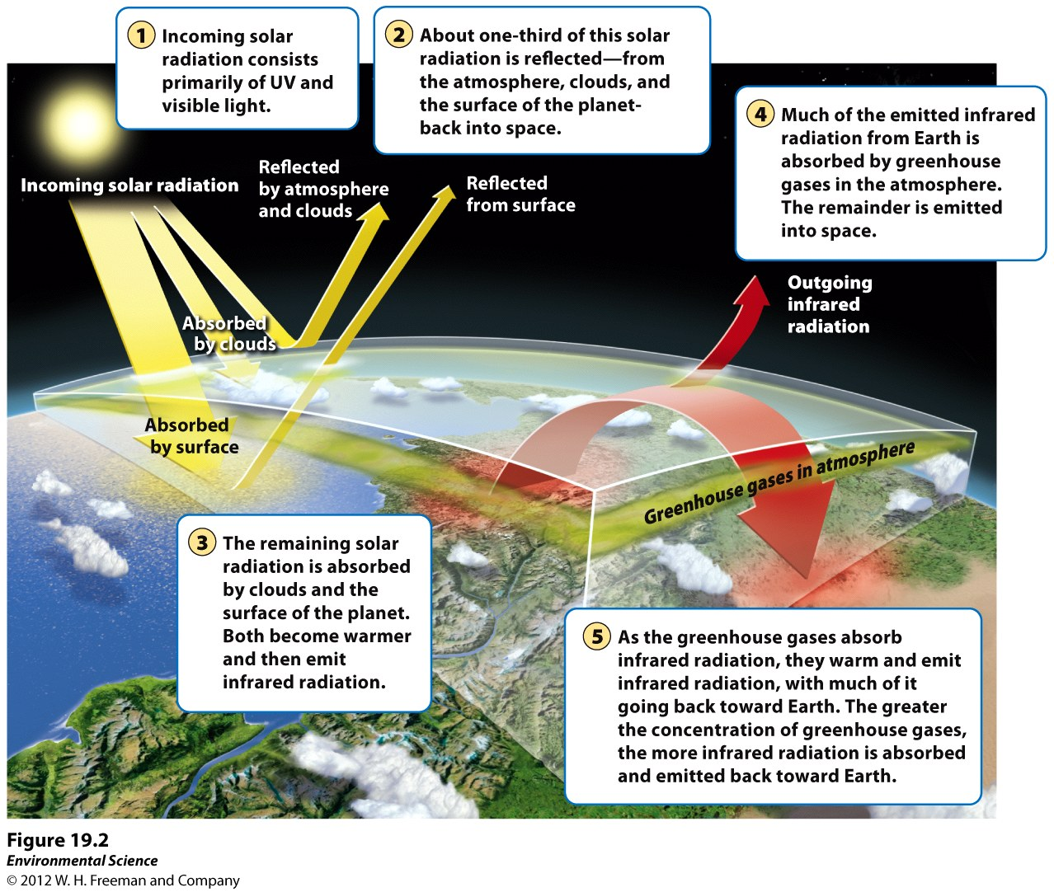

Slide 16
The Greenhouse Effect
Which greenhouse gases cause the most heat to be trapped?
A standard unit for measuring incoming solar energy is Watts per meter squared (W m⁻²)
It is commonly used to compare the strength of different forcing factors

Slide 17
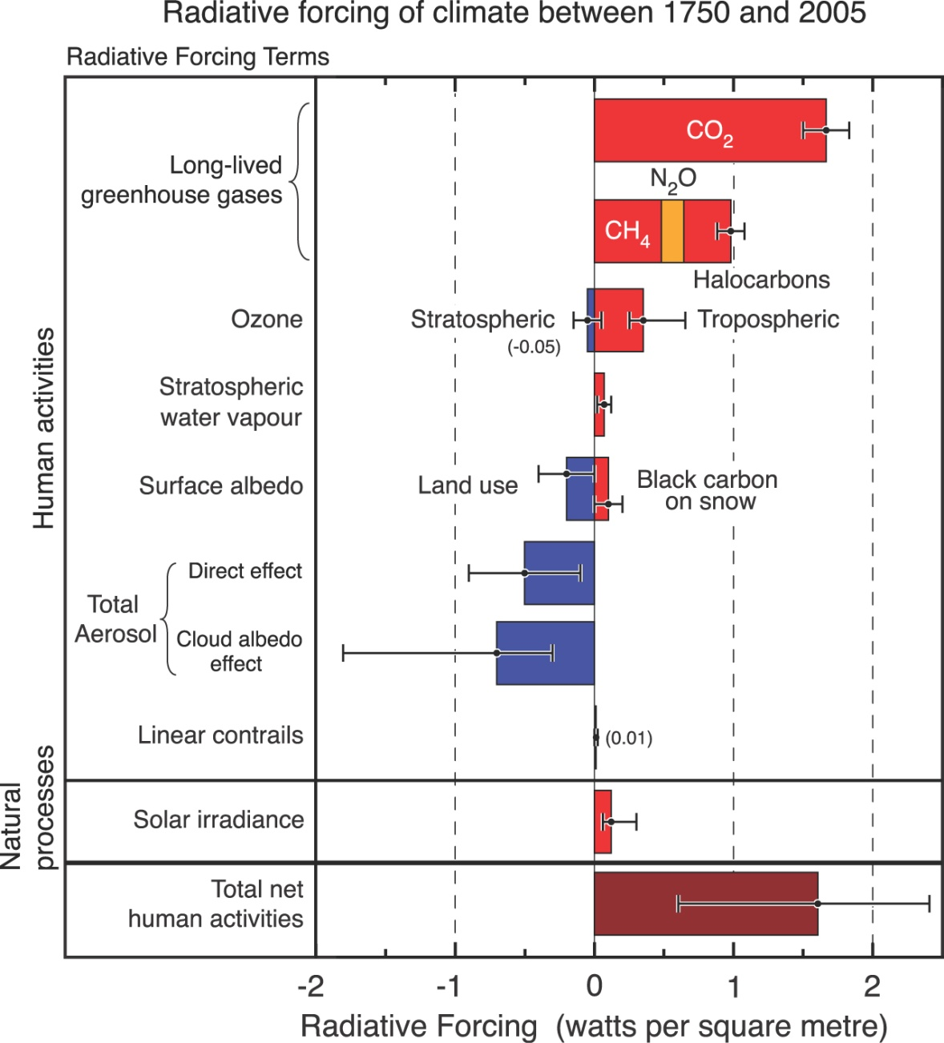
Climate Forcings
Watts per meter squared (Wm⁻²)

Slide 18
feedbacks
Some processes are self-limiting (negative feedback)
Other processes can “run away” for a time (positive feedback)
http://web.pdx.edu/~rueterj/courses/objects/global-warming-feedback.html

Slide 19
Ecological effects

Slide 20
Ecological Effects
Ocean acidity
Coral bleaching
Range shifts of plants in mountain areas
Changes in migration patterns of birds
Earlier spring greening of vegetation
Timing of plant growth and insect emergence
Timing of flowering and pollinator activity
Timing of bird hatching and insect emergence
Many more

Slide 21
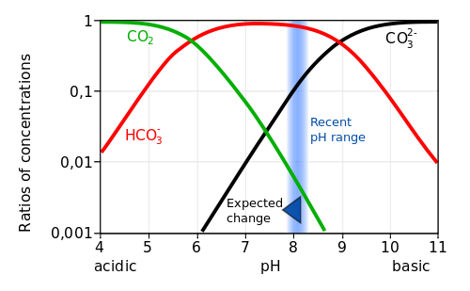
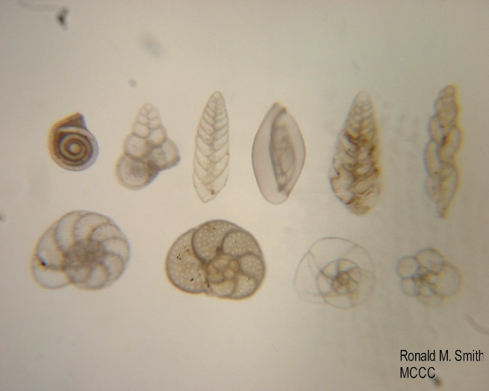
Ocean Acidity
Significant increases in ocean acidity forecast.
Many marine organisms form shells of calcium carbonate. Increasing acidity will decrease the ability to synthesize new shells.
Notes:
Other chemical reactions are also triggered which result in an actual net decrease in the amount of carbonate ions available, decreasing biogenic Calcium carbonate

Slide 22
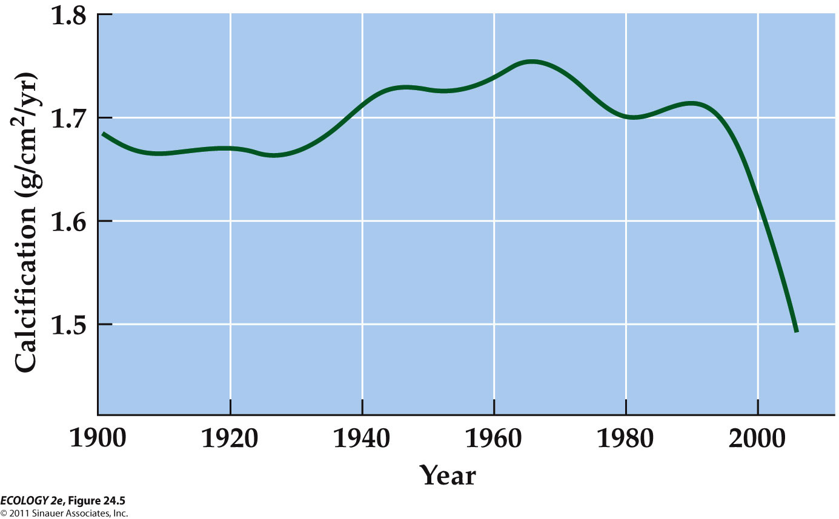
Rates of Calcification of Corals on Australia’s Great Barrier Reef, 1900-2005
2016 results showing acidification is the cause:
https://www.youtube.com/watch?v=TF60YAQxStA
http://www.scientificamerican.com/article/lowering-ocean-acidity-promotes-coral-growth-on-great-barrier-reef/

Slide 23
Adiabatic lapse rate
Dry: 1 C per 100 m
Moist: .5 C per 100 m
16-2 calculate change in temperature in F to go from here 50 ft above sea level to 1050 ft above sea level
Use the dry rate
1 ft = 30 cm
1 F = 5/9 * C

Slide 24
16-2
1000 ft * .3 m/ft * .01 degC/m * 9/5 degF/degC
= 5.4 deg F
300 meters = 3 deg C
3 deg C * 9/5 = 5.4 deg F

Slide 25
What does change in temperature mean for biological communities?
Compared with elevation on a mountain:
2.9°C would correspond to a 500 m shift in elevation (200–860 m).
In the Rocky Mountains = shift from subalpine forest (spruce and fir) to montane forest (Ponderosa pine).
Compared to latitudinal climatic shifts, optimal conditions for biological communities would move 500–1,000 km poleward.
Many factors determine species distributions. It is unlikely that the same assemblages of organisms will form the communities of the future.

Slide 26
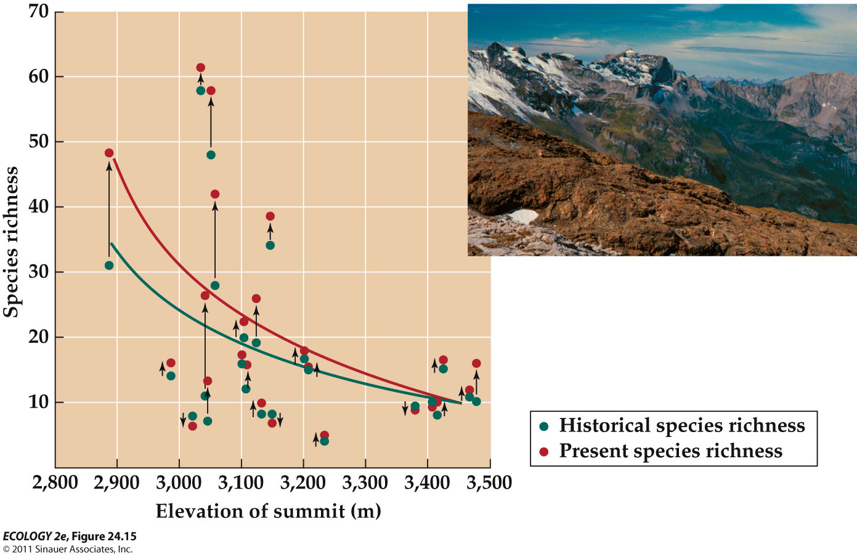
Plants Are Moving Up the Alps
Notes:
Ranges of plant species in the European Alps were compared with historical records (Grabherr et al. 1994).
A consistent trend of upward movement of species from lower elevations onto the summits was reported.
Parmesan and Yohe (2003) found that 63% of European butterfly species examined have shifted their ranges northward, while only 3% shifted their ranges southward.
Extinction of lizard populations in Mexico has been linked to warmer spring temperature which limits foraging time during the breeding season (Sinervo et al. 2010).
Using models of lizard physiology and projections for climate warming, they predict 39% of lizard populations will go extinct by 2050.
Changes in community composition and local extinctions may be indicators of climate change.
Warm water temperatures can kill the algal symbionts of corals, resulting in bleaching of coral reefs.
Several worldwide bleaching events have occurred in association with warmer-than-average sea surface temperatures.

Slide 27
Because climate change will be rapid, plants & animals are unlikely to demonstrate evolutionary responses
Dispersal may be the only way to avoid extinction.
Dispersal barriers and habitat fragmentation will be important constraints.
Plant dispersal rates are, on average, much slower than the predicted rate of climate change.
R-selected plants can disperse and establish quickly. K-selected shrubs and trees have much slower dispersal rates.

Slide 28
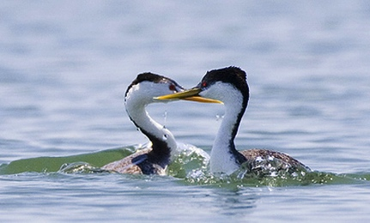
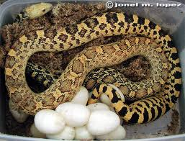
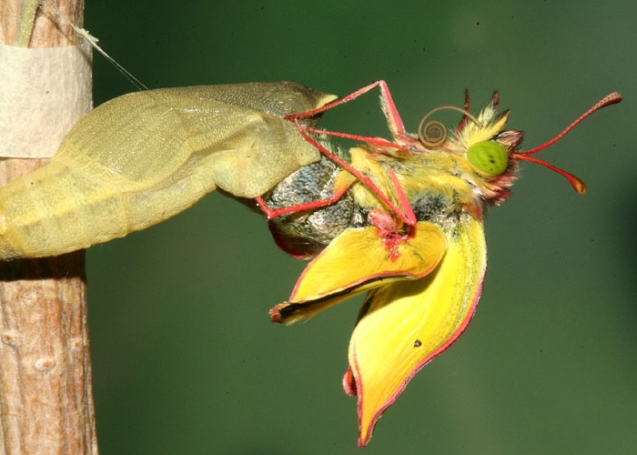
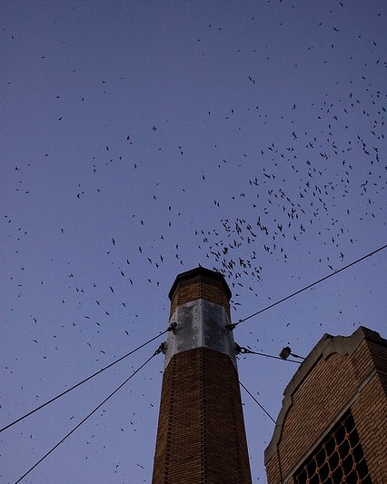
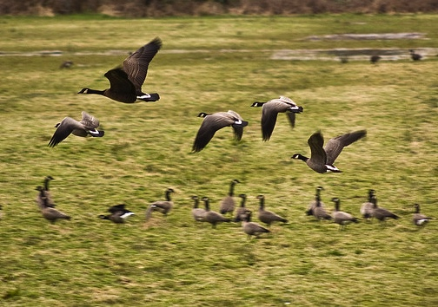
Phenology: The timing of life-cycle events and seasonal activities of organisms
Grebe pict from Care2; Colius moth pict from Ecotime;
Notes:
Phenological events in animals include mating, egg-laying, hatching, emergence/eclosing, migration

Slide 29
Phenology: The timing of life-cycle events and seasonal activities of organisms
Earliest: Farmers tracked plants / animals as indicators of when to plant, harvest, etc.
Chinese ~1000 BC: Written records
Later: Linneaeus, Thoreau, Leopold
(from Project Budburst)
Notes:
Phenological events in animals include mating, egg-laying, hatching, emergence/eclosing, migration

Slide 30
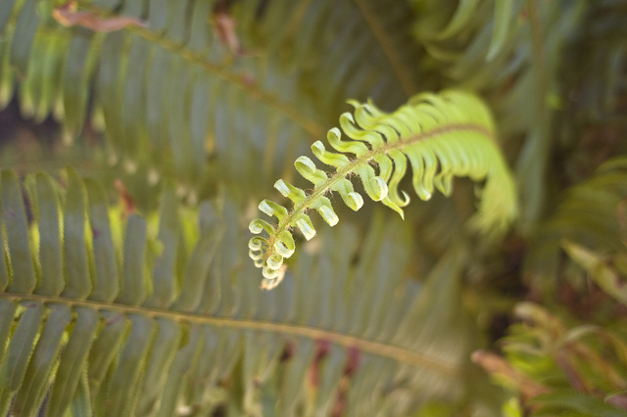
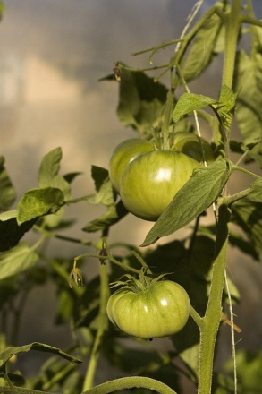
Phenophase: span of time in which a life history event occurs
Notes:
leaf bud burst, leaf unfolding, flowering, fruiting, leaf color change, senescence

Slide 31
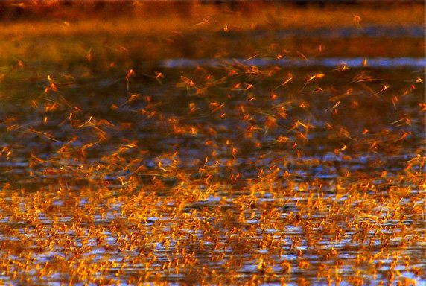
Phenology is one of the main quantifiable indicators of global climate change
Notes:
In mid-June (for 2 wks), emerging mayflies (Palingenia longicauda) on the Tisza River, Hungary, emerge These dense clouds of mayflies have been seen on radar images!
Shortly after mating, females lay eggs on the river's surface. The eggs drift to the bottom and after 45 days hatch into larvae, which dig tunnels forming dense colonies up to 400 per square foot. After three years larvae break for the surface where females molt once and males shed twice: first into a brief subadult stage then again minutes later into adulthood. After both sexes have fully matured, mayflies have roughly three hours before they die. Ephemeral ptera (flyers)

Slide 32
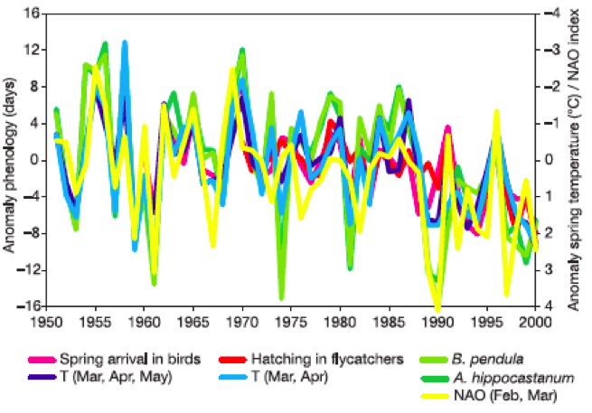
Anomaly: deviation from a long-term average
Fig. 2 Anomalies in different phenological phases correlate well with anomalies of mean spring air temp. (T) and Northern Atlantic Oscillation (NAO) index
Walther et al. 2002
Notes:
Temp affects phenology of birds: arrival and hatching; B. penduala is White Birch; A. hippocastanum is Horse Chestnut
(NAO = N. Atlantic oscillation)

Slide 33
Examples of Plant Phenology Changes
Earlier leaf unfolding; flowering advancing by 2.5 days (Europe) and 1.2-2.1 days per decade in the last 30-50 yrs. (Walther 2002, Menzel 2006, Cleland 2007)
78% of all phenological records advancing.
Plant phases advancing along with warming (Menzel 2006)
Average annual growing season lengthened by 10.8 days since 1960’s (Menzel 2000)
Notes:
“spring green up” = leaf unfolding
Advancing along w/ warming at a national scale

Slide 34
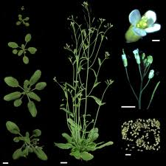
Plant Phenology Mechanisms
Photoperiodism – photoreceptor proteins sense changes in day and night length, affecting plant development
Chilling Requirement – flowering or breaking of dormancy promoted by prolonged cold
Arabidopsis: bioinformatics.unl.edu
Notes:
(phytocrome and cryptochrome)
After vernalization gene that represses flowering “FLC” turned off permitting flowering
Model system long-day, winter annual plant “Arabidopsis

Slide 35
The primary physiological cue for bird migration is the changes in the day length, while the primary cue for insect emergence and development is temperature
Snow geese – R. Nelson

Slide 36
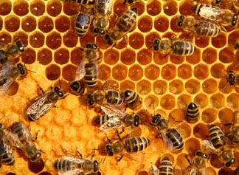
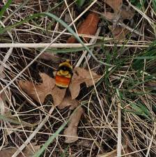
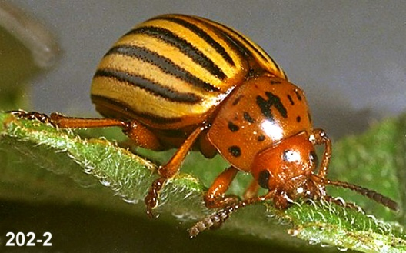
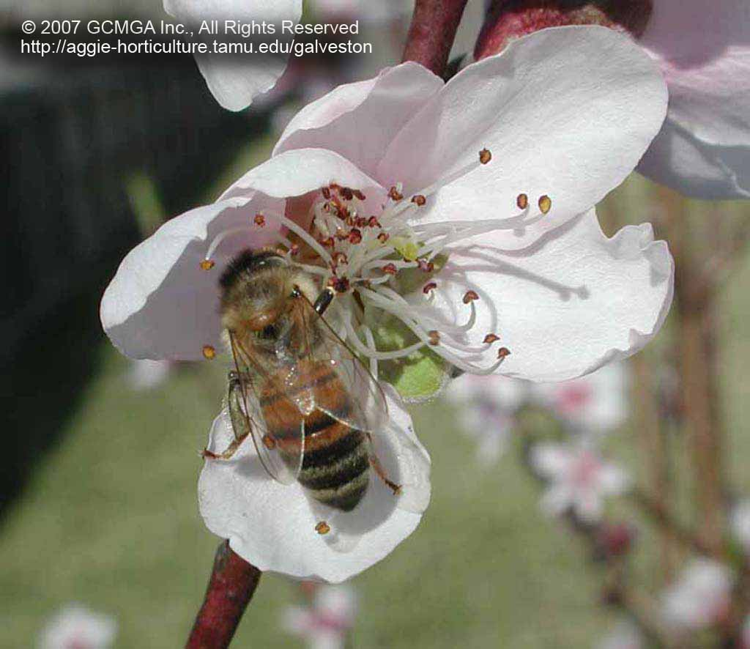
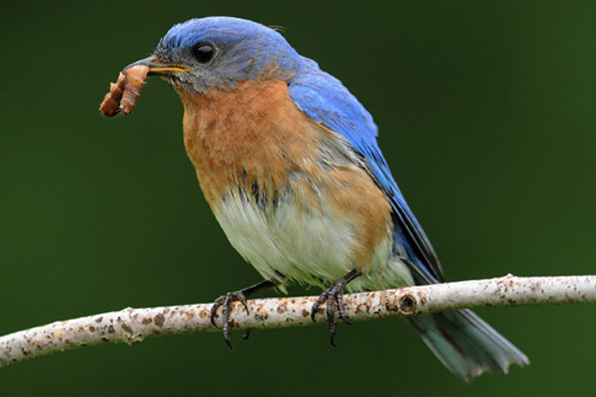
Temperature change can affect pest outbreaks, and pollinator and food web mismatches.
Most of Oregon’s >14,000+ arthropod species have temperature- dependent development
(Menzel 2000,Walther 2002;
picts: Ralph Berry OSU, Mike Onyon)
Notes:
Most of Oregon’s >14,000+ arthropod species have temperature-dependent development
Colorado Potato Beetle – potato pest (& tomato, eggplant...)
2012: Balmy temperatures have caused bees to emerge too early and go through their winter food stores before there is enough nectar and pollen out there to replenish their supply.”
pollinators:

Slide 37
A rise of 2°C (3.6°F) will hasten the annual, typically well defined, flight period in moths by >18 days (J. Miller, data from 2004-8)
Notes:
The seasonal timing of flight (a period of only 10–25 days for most species) is a critical time because this is the only chance females have to deposit eggs, an event followed by caterpillars feeding on suitable foliage.
Given photoperiod effects on bird migration, temp effects on insects, what would your expectations be for food available for nestling birds, most of whom eat insects?

Slide 38
Food security: Many plants require diurnal cycles of fluctuating temperatures
Temperature fluctuation affects germination, growth, flowering and fruiting
Climate change is decreasing differential
Notes:
…tomatoes grown at constant temp do poorly.
Exacerbated by Urban Heat Island Effect

Slide 39
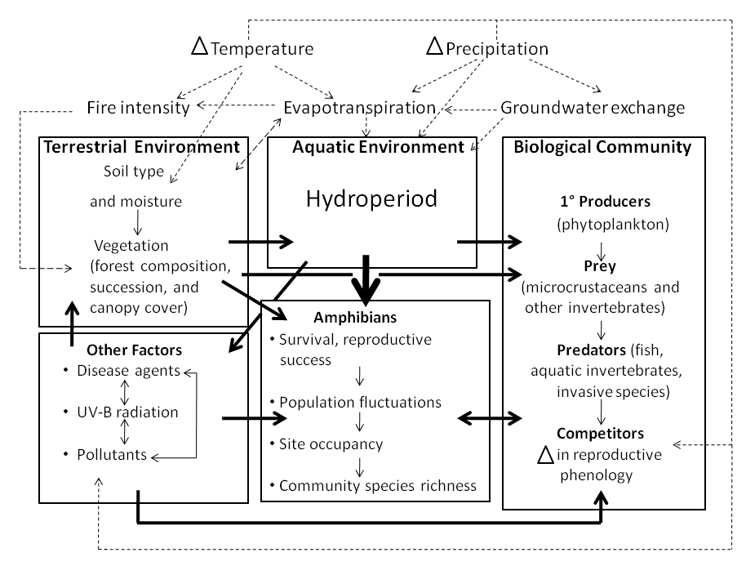
Blaustein et al. 2001; Environmental cues (temperature shifts, rain events) can trigger breeding in many amphibian species, and miscues can result in complete reproductive failure (Hartell, 2008).

Slide 40
Effects of asynchrony may be compounded by habitat fragmentation
Notes:
Can’t get to habitat patch w/ correct match.

Slide 41
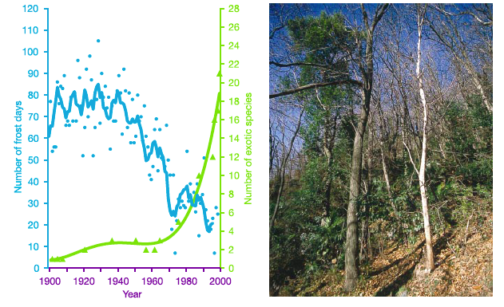
Fig 3. Vegetation shift from indigenous deciduous to exotic evergreen broad-leaved vegetation in S. Switzerland. Exotic shrubs appear to profit from milder winter conditions.
Walther et al. 2002

Slide 42
Hungry insects may halve forest carbon sink capacity (New Scientist, 2 March 2015)
Nearly 1/3 of all CO₂ from anthropogenic sources is currently absorbed by trees and other land-based plants
CO₂ stimulates tree growth, increasing the rate of photosynthesis ~50%, using more CO₂.
Bugs could lessen this capacity dramatically and “limit or compromise the capacity of forests to serve as carbon sinks," says Richard Lindroth.
With increased atmospheric CO₂, the protein concentration in leaves is lower," Lindroth says. The major plant protein RuBisCO, which aids the conversion of CO₂ into sugars, works more efficiently at higher CO₂ levels, so less of it is needed. Also, plants grown in high CO₂conditions tend to accumulate carbohydrates, diluting the protein concentration in the leaves, he says. "Insects compensate by eating more.“
Notes:
The fumigated plots maintained a carbon dioxide level of approximately 560 parts per million – an atmospheric concentration predicted for mid-century.

Slide 43
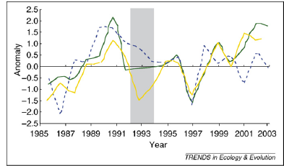
Cleland et al. 2007. Fig 2. Inter-annual variation in spring and total growing season carbon uptake
the years influenced by the Mount Pinatubo eruption in 1991
net spring uptake of CO₂ in June
anomalies in average growing season temperatures
net growing season uptake of CO₂, March to August
Since 1994, net uptake of CO₂ in the growing season has not risen in concert with rising temperatures, possibly indicating that warmer, drier summers are dampening the expected increase in net ecosystem productivity that would result from an earlier onset of spring.
Notes:
Take home: Temp is affecting growing season. The mean normalized anomalies in CO2 uptake by Northern Hemisphere (>208 latitude) vegetation were calculated for 1985–2003. Mount Pinatubo eruption in 1991 injected large amounts of aerosols into the stratosphere and decreased global temperatures. In the years before this volcanic event, temperatures and CO2 uptake showed an increasing trend over time, both during spring and across the growing season.

Slide 44
Consequences to Humans
Loss of ecosystem services (pgs 77-81)
Many people will have to relocate due to coastal and island flooding.
Rates of diseases such as those carried by mosquitoes (malaria, yellow fever) could increase as temperature changes allow the vectors to expand in range.
Many economic consequences of shorter and warmer winters with longer and hotter summers

Slide 45
Quiz 2 and PS 5

