Slide 1
Module 3: Climate Change Lecture 15 – Wed. May 24
Calendar
Intro to Module 3

Slide 2
Date | Lect | topic
May 24 | 15 | Climate change / carbon cycle processes
May 29 | -- | Memorial day holiday
May 31 | 16 | Ecological effects of climate change
June 5 | 17 | Mitigation to reduce effects
June 7 | 18 | Adaptation to and preparation for changes
June 14 |  | Final exam – Wed 10:15 to 12:05
Points
5 homeworks x 10 points each
Multiple in-class at 1 point each
2 Quizzes x 25 points each
Final
Lab counts for ¼ of the grade.

Slide 3
Module 3: Climate Change
Processes in the global carbon cycle are out of balance.
More CO₂ in the atmosphere leads to some direct (plant growth) and indirect effects (increased heat trapping) that impact ecosystems.
It would be wise to mitigate CO₂ increase by finding ways to slow the increase in the atmosphere.
We might have to make plans for adapting to climate change impacts.

Slide 4
Today
Understand the advantages of fossil/hydrocarbon fuels
Calculate carbon/energy ratios
Carbon cycle processes
Balance sheet for the carbon flow
Discuss how far we can go with evidence
Game theory in cases of uncertainty

Slide 6
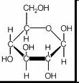
Organic carbon plays a major role in the energetics of life?
Photosynthesis
CO₂ + water + energy = sugar + oxygen
CO₂ + H₂O + energy = C₆H₁₂O₆ + O₂
Sugar = chemical energy

Slide 7
To release, unwind the reaction:
C₆H₁₂O₆ + O₂ = CO₂ + H₂O + energy
This is RESPIRATION

Slide 8
Why Our Carbon Economy?
What isn’t used by plants themselves is mostly eaten by animals, decayed by bacteria and fungi, or consumed by fire (and to the atmosphere).
Over time, a portion of this energy gets permanently buried before it has had a chance to decay or be eaten or burned.

Slide 9
Why Our Carbon Economy?
This chemical energy, buried over many millions of years, is the basis for fossil fuels.
Dead organic material gets buried, usually in a shallow lake or sea.
Eventually these deposits are further buried underneath sediment and the pressure (plus lots of time) compresses the original organic material until it is ~85% C and 14% H (by weight) and a little bit of other stuff.

Slide 10
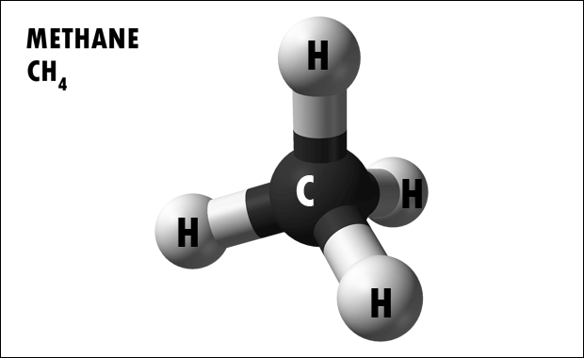
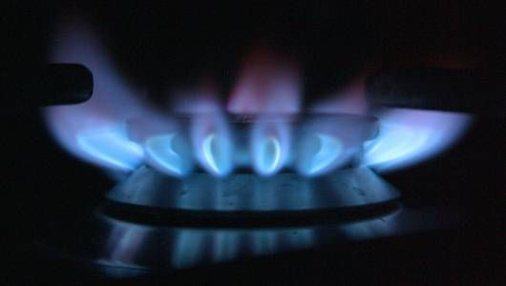
Why Our Carbon Economy?
For example, methane (or natural gas) starts as organic matter and gets squeezed into CH₄.
Methane can also be produced in human time scales by bacteria (such as in landfills), but most of it is a fossil fuel.

Slide 11
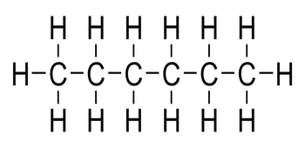
Why Our Carbon Economy?
Coal is derived from plant structural material – leaves, logs, twigs, etc.
Oil is derived from dead algae, NOT plants.
Both are long C chains with H hanging all over it (i.e, hydrocarbons, reduced molecules).

Slide 12
Why Our Carbon Economy?
COMBUSTION (very similar to RESPIRATION) also releases this chemical energy:
C_{X}H_{X} + O₂ = CO₂ + H₂O + energy

Slide 13
Why Our Carbon Economy?
So, the energy that drives >90% of our economy is ALL derived ultimately from sunlight and stored as chemical energy by plants and algae, sometimes over millions/billions of years ago.
We have other sources of energy: hydro and wind turbines and solar cells and nuclear power.
These other energy sources are not nearly as intensely concentrated and portable as fossil fuels.

Slide 14
Why Our Carbon Economy?
C_{X}H_{X} (e.g., gasoline) is great for energy storage and transport!
A pound of gasoline holds about 35X more energy than a pound of lead-acid batteries and about 6X more than lithium-ion batteries.
If you took a 1,500-watt space heater and left it on full blast for 24-hours, that roughly equivalent to how much energy is in a gallon of gas.
If it were possible for human beings to digest gasoline, a gallon would contain about 31,000 food calories -- equivalent to the energy in about 110 hamburgers!
3 gallons of gas is equivalent to 5 person days of hard labor.

Slide 15
Calculations
1 gallon of gas
Weighs 6.3 pounds (almost all carbon)
Produces 20 pounds of CO2 when burned
Contains 33.40 kWh of energy
At $0.12 kWh = $4 of electricity
Battery comparison
Lead-acid
Li-ion such ashttps://www.tesla.com/powerwall?redirect=no
Generator such as
http://powerequipment.honda.com/generators

Slide 16
Calculation 15-1

Slide 17
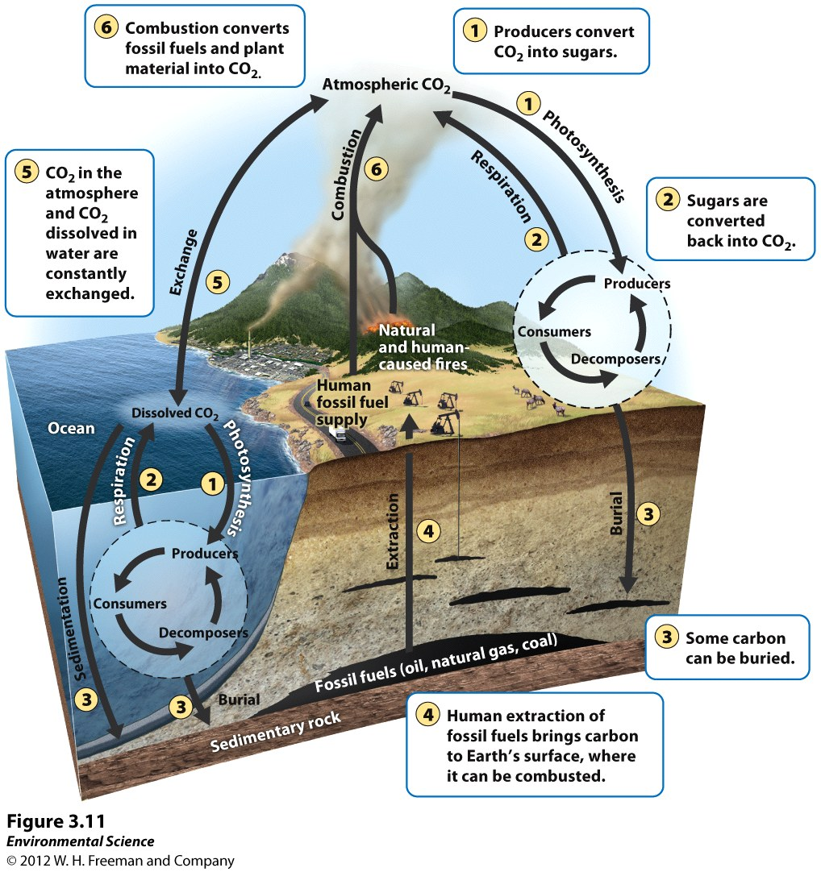
Carbon Cycle: Six key processes (CREEPS)
Six driving processes
Photosynthesis
Respiration
Exchange
Sedimentation and burial
Extraction
Combustion
Each process can be categorized as slow or fast
Slow: carbon held in rocks, soil, or as petroleum (can stay here millions of years)
Fast: carbon held in living organisms

Slide 19
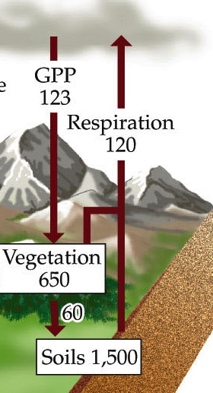
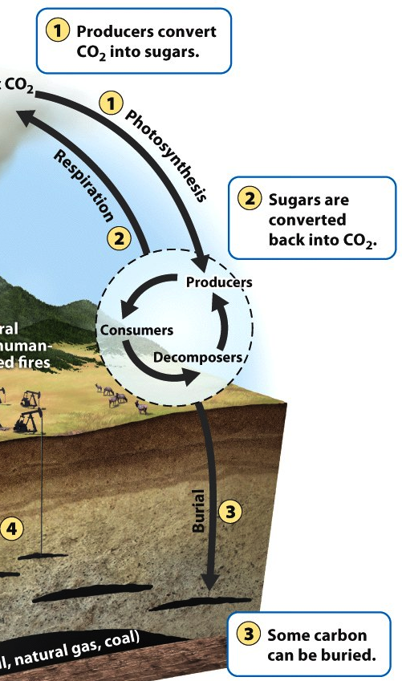
Carbon Cycle: Photosynthesis
The process that brings C to all living organisms & to burial.
Take in CO₂ and incorporate carbon.
Living organisms ~20%C (this is a lot since H₂O makes up ~75%)
Carbon moves from producers to consumers and decomposers.

Slide 20
Carbon Cycle: Respiration
Organisms take in CO₂ from photosynthesis, eating, or decomposing;
The byproduct of cellular energy production is CO₂
Organisms all release CO₂ through respiration
All cells (& organisms) respire; some cells respire and photosynthesize.

Slide 21
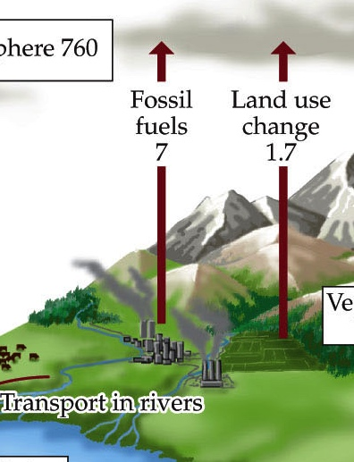
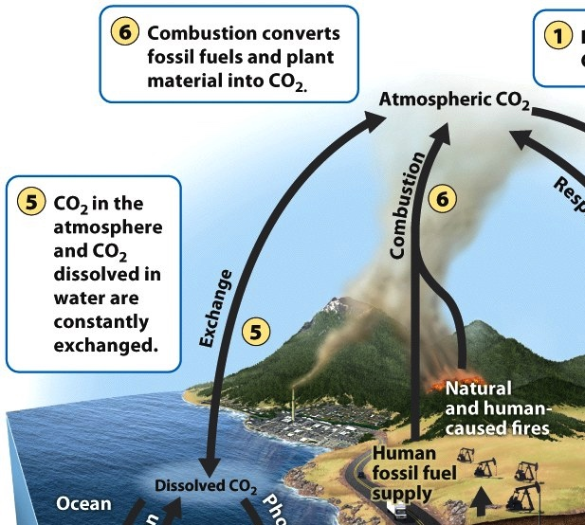
Carbon Cycle: Combustion
Burning of material with C; releases energy and CO₂
Involves burning fossil fuels, timber, other organic material (biomass)
Respiration, decomposition, and combustion all release CO₂ back to the atmosphere in gas form
All of these process also involve breaking molecules that contain carbon into single carbon molecules in order to gain energy

Slide 22
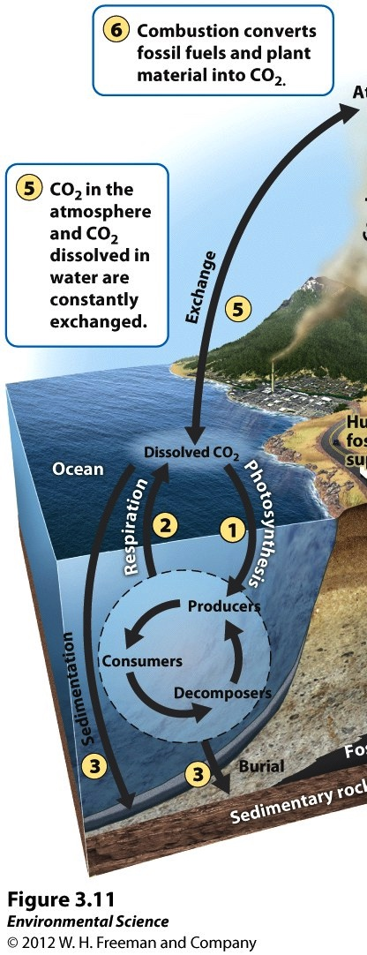
Carbon Cycle: Exchange
Large amounts of carbon are in oceans and fresh water
C enters water via diffusion (gas moves from higher to lower concentration)
CO₂ reacts w/ H₂O & is converted into bicarbonate (HCO₃⁺).
Because of the large amount of Ca²⁺ in sea water, some of the bicarbonate is converted into CaCO₃ (calcium carbonate).
C is transferred deeper as detritus and shells
Upwelling brings C-rich water to the surface, releasing CO₂ to the atmosphere

Slide 23
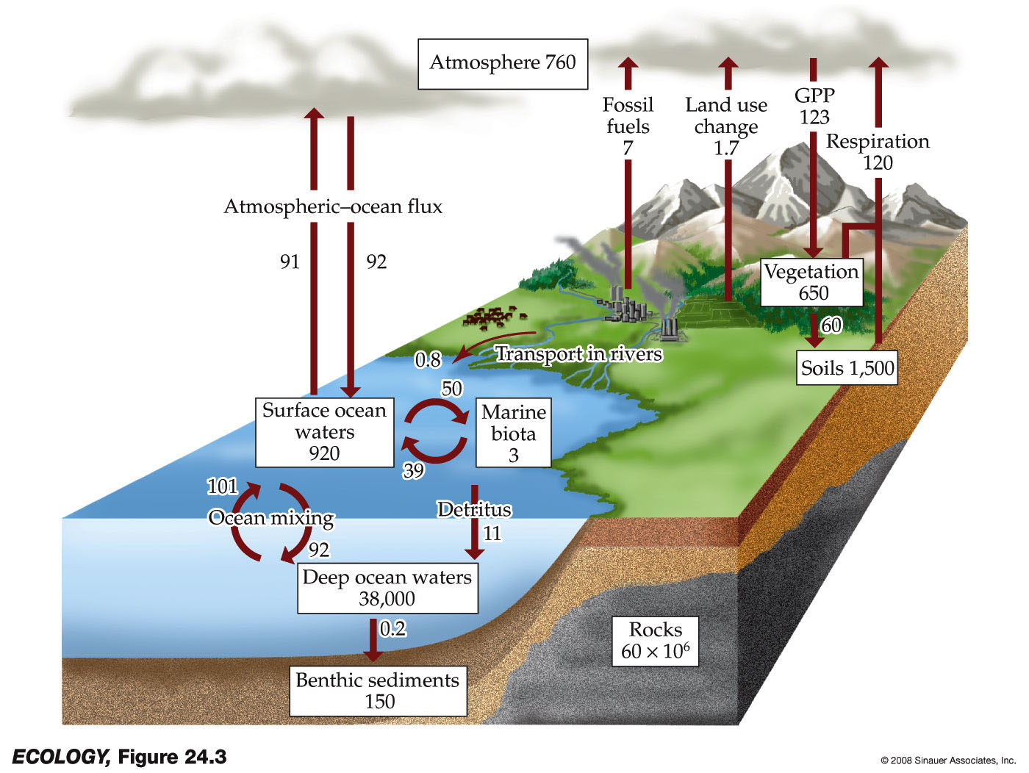
Carbon Cycle: Sedimentation and burial
Calcium Carbonate can form a solid (a precipitate) that settles to the bottom of the ocean.
Often leads to burial; then CaCO₃ transforms into limestone and dolomite.
C stays in this form for so long (and is constantly being formed) it is our largest pool of carbon
Some of the dead biomass becomes buried before fully decomposing & is converted into fossil fuels
Extraction: Removal of fossil fuels (coal, oil, natural gas) from burial

Slide 24
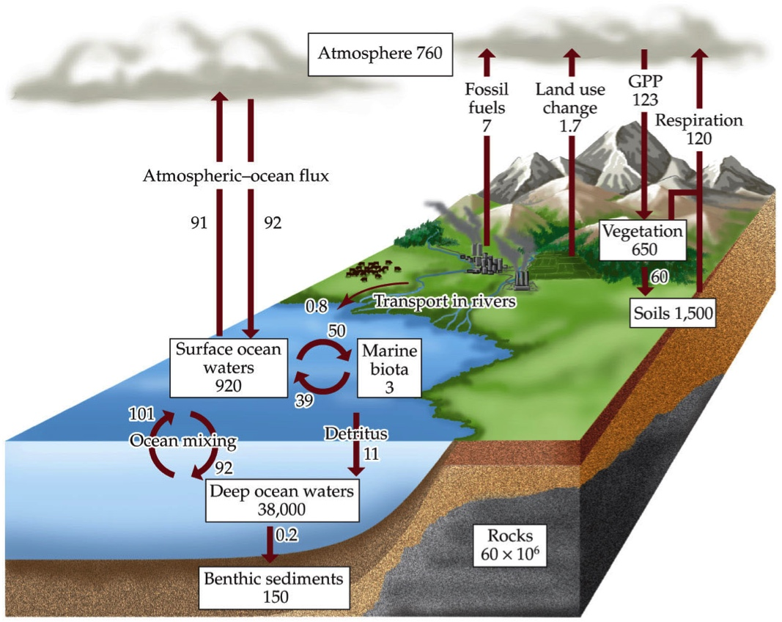
Carbon Cycle – Key facts
Before human disturbance, carbon cycling was in a steady state: released to atmosphere at ~ the same rate it entered the terrestrial & aquatic processes
Atmospheric C was stable for 10,000 years (before industrial revolution)
Biggest change in releases: from carbon fuels and soils and timber harvesting.
Fluxes Petagram/ha/yr
Imbalance in fluxes?
Effect of deforestation?

Slide 25
Carbon Cycle: Six key processes (CREEPS)
Six driving processes
Photosynthesis, Respiration, Exchange, Sedimentation and burial, Extraction, Combustion
15-2: Finish the mass-balance equation:
dC_{atmospheric}/dt = (put the basic components in place)

Slide 26
Carbon Cycle: Six key processes (CREEPS)
Six driving processes
Photosynthesis, Respiration, Exchange, Sedimentation and burial, Extraction, Combustion
Q2: Finish the equation:
dC_{atmospheric}/dt = R – P – Exchange – SB + C

Slide 28
Climate Change Basics
How is Global Climate Change different than Global Warming?
We can also expect:
shifts in precipitation
unstable climate patterns
more severe storms
loss of snow and glaciers
rising oceans

Slide 29
What are ‘Greenhouse Gases’
Any gas that increases the ability of the atmosphere to absorb heat.
These are mostly Carbon gases: CO₂ and CH₄ (methane)
First: How do they get into the atmosphere?

Slide 30
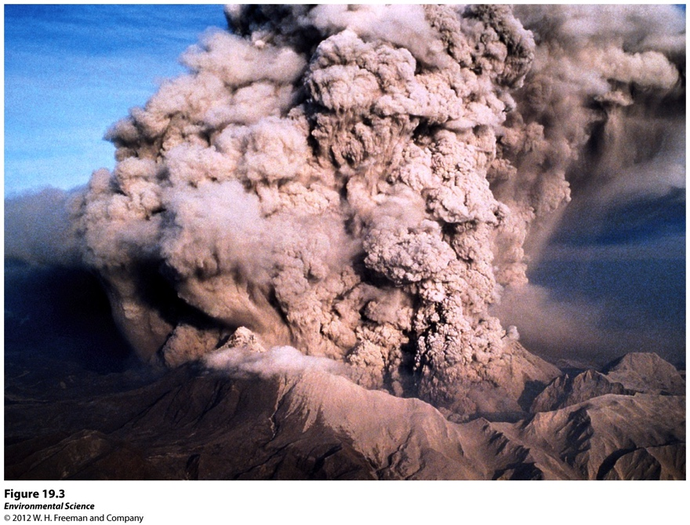
Sources of Greenhouse Gases
Natural sources
Volcanic eruptions: mainly carbon dioxide CO₂)
Decomposition (anoxic conditions): Methane (CH₄)
Denitrification in low O₂: Nitrous oxide (N₂O)
Evaporation/transpiration: H₂0
Notes:
Sources of greenhouse gases are both natural and anthropogenic: Volcanic eruptions: mainly carbon dioxide
Methane: from decomposition
Nitrous oxide: from denitrification
Water vapor

Slide 31
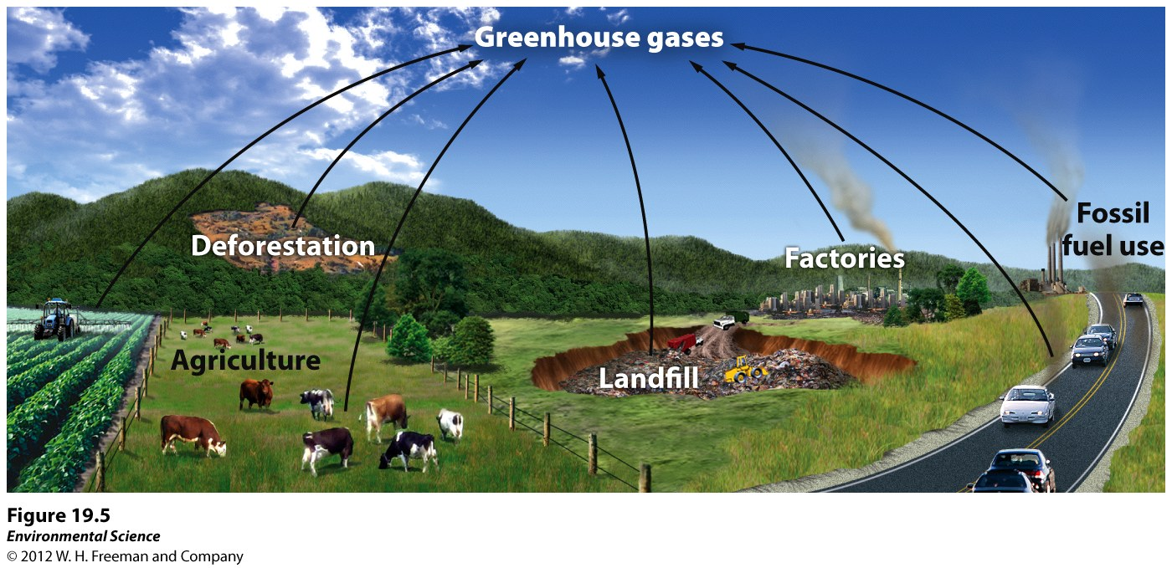
Anthropogenic sources of greenhouse gases

Slide 32
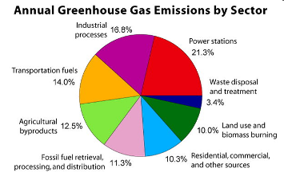
The Atmosphere as a Bathtub
Input: 9.1 billion tons
per year!
Currently: ~745 bn in the bathtub
Originally: ~570 bn
Out: 5 bn yr⁻¹
55% plants/soil
45% oceans
<1% sediments

Slide 33
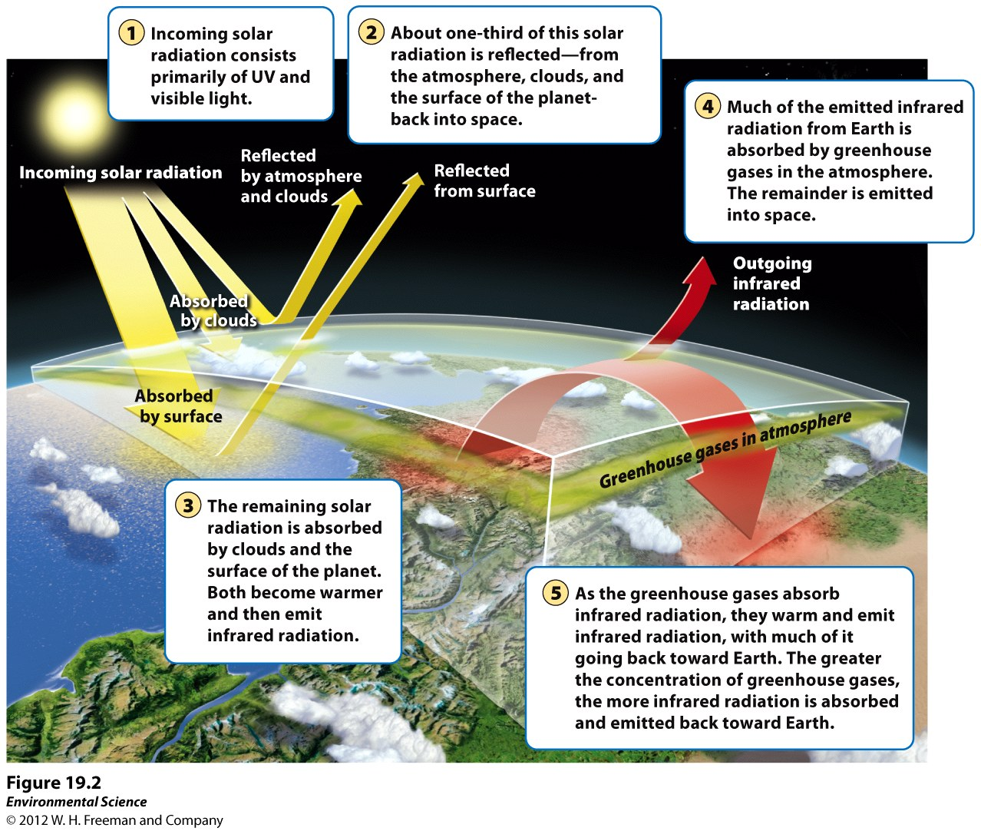

Slide 34
The Greenhouse Effect
Which greenhouse gases cause the most heat to be trapped?
A standard unit for measuring incoming solar energy is Watts per meter squared (W m⁻²)
It is commonly used to compare the strength of different forcing factors

Slide 35
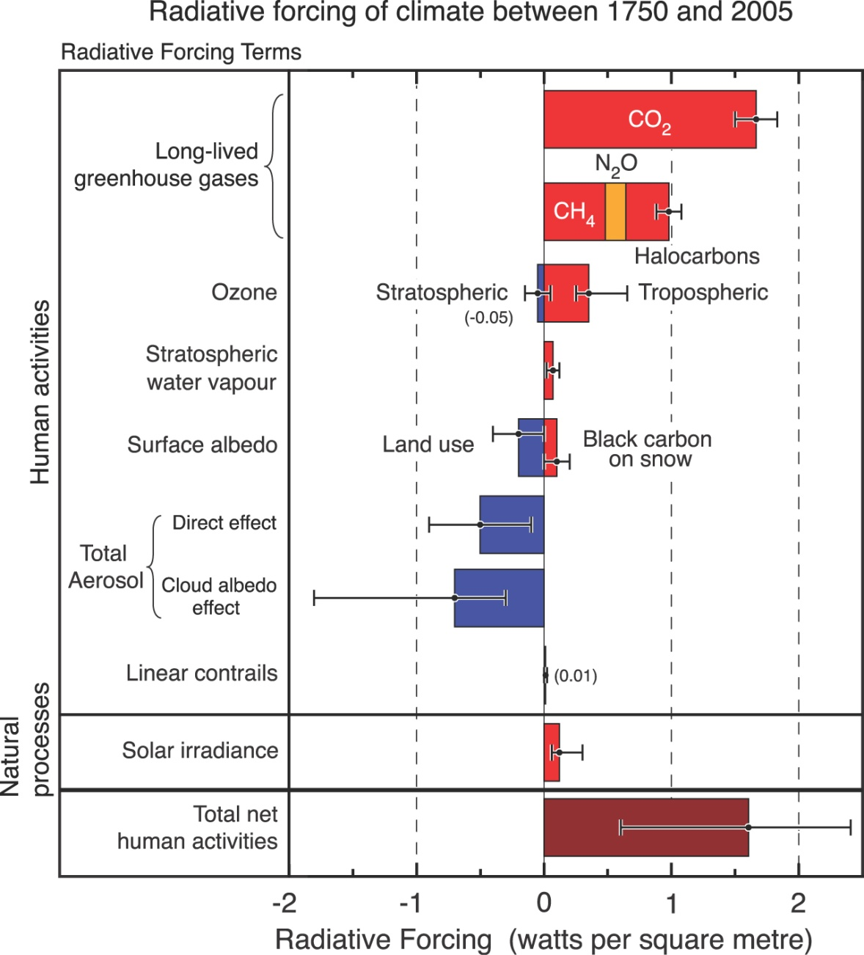
Climate Forcings
Watts per meter squared (Wm⁻²)

Slide 36
Preview of impact

Slide 37
CO₂ and Temperature
Last 160,000 years
700
CO₂ in 2100?
600
Double pre-industrial CO₂
500
Lowest possible CO₂
stabilisation level by 2100
400
CO₂ now
CO₂ concentration (ppmv)
300
10
Temperature
difference
from now °C
0
200
–10
100
160
120
80
40
Now
Time (thousands of years)

Slide 38
Past 10,000 years
S A Marcott et al. Science 2013;339:1198-1201

Slide 39
Recent Past

Slide 40
Observed Consequences of ~1°C

Slide 41
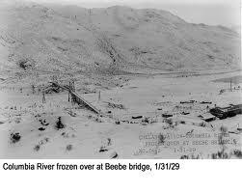
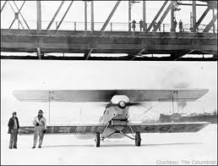
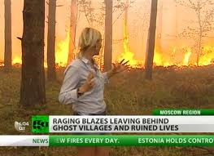
Changes in Temperatures: ~1°C
Widespread changes in extreme temperatures observed
Cold days, cold nights and frost are less frequent
Hot days, hot nights, and heat waves more frequent
Most warming is occurring in the WINTER at NIGHT
Russian Heat Wave 2010
Columbia River in winter 1920s

Slide 42
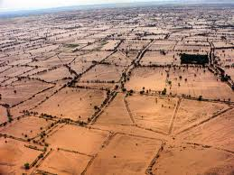
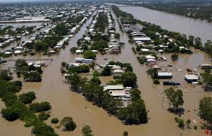
Changes in Extreme Events: ~1°C
The frequency of heavy precipitation events has increased - consistent with warming and increases of atmospheric water vapor.
More intense and longer droughts observed since the 1970s, particularly in the tropics and subtropics.
An increase of intense hurricane activity in the North Atlantic since 1970 – but NOT an increase in the number of hurricanes
Pakistan 2010
Australia 2011

Slide 43
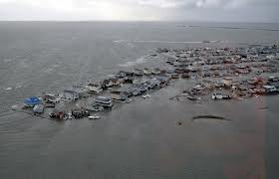
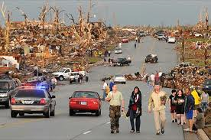
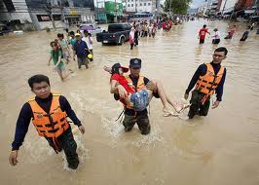
Changes in Extreme Events: ~1°C
Hurricane Sandy 2012
Joplin, MO 2011
Thailand 2011

Slide 44
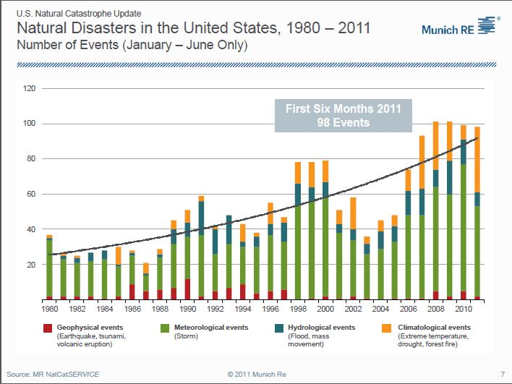
Costs of Extreme Events: ~1°C

