Slide 1
Wednesday May 17, 2017
Quiz 2 review
Short case study on how to plan land use to optimize both biodiversity and economic interest
Review major concepts
Go over home work #3 and #4
  Grid
  Key
Quiz is Monday May 22 starting at 10:15 going to 11:20

Slide 2
Optimization of land use
Assumptions
  Even in Oregon we need to use our land resources wisely
  Human impact on biodiversity is important
  Economic activity to support society is also important – but on another dimension

Slide 3
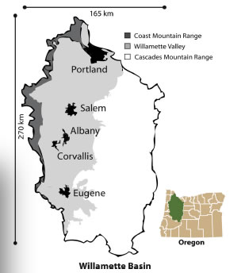
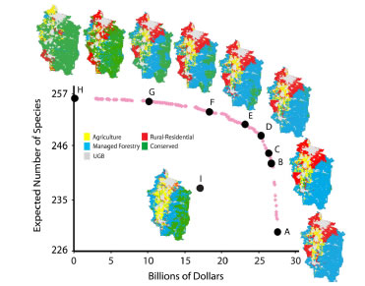
Where to put things
http://web.pdx.edu/~rueterj/courses/objects/where-to-put-things.html

Slide 4
Review content
Lecture 9 through today (Lect 14) inclusive

Slide 5
Skills – as evidenced by calculations and interpretations of graphs
Species richness (count)
Shannon index (calculate)
Simpson’s index (calculate)
Island Biodiversity Theory – processes and dynamic equilibrium using a graph
  Steady state for species number
  Meaning of points from different island
Species area curve
Relative loss of area vs loss of species
Metapopulation model
  Compared to island biodiversity theory

