Slide 1
Habitat connectivity and landscape mosaics
Monday 5/15
Species loss equations
Meta-populations on networks
Natural mosaics
Human-caused fragmentation and solutions

Slide 2
Plan for Wednesday
Short case study on how to plan land use to optimize both biodiversity and economic interest
Review major concepts
Go over 2 homeworks

Slide 3
Review
Succession
B-D+I-E = growth
S=cA^{z}

Slide 4
The Species Loss Equation
S_{ORIG} = cA_{ORIG}^{z}
Therefore,
S_{NOW} = cA_{NOW}^{z}

Slide 5
The Species Loss Equation
% Species remaining =
S_{NOW} / S_{ORIG} = (A_{NOW} / A_{ORIG} ) ^{z}
Q13-1. calculate
  What percentage of bird species will be lost in the Eagle Cap Wilderness if 28% of the forest burns, z = 0.263?

Slide 6
The Species Loss Equation
% Species remaining =
S_{NOW} / S_{ORIG} = (A_{NOW} / A_{ORIG} ) ^{z}
Q13-1.
What percentage of bird species will be lost in the Eagle Cap Wilderness if 28% of the forest burns, z = 0.263?
%remaining = (72% not burned or 0.72)^{z}
%remaining = 0.92 (or 92%)
%lost = 1 - %remaining = 8% lost

Slide 7
The Species Loss Equation
S_{NOW} / S_{ORIG} = (A_{NOW} / A_{ORIG} ) ^{z}
Critique?

Slide 8
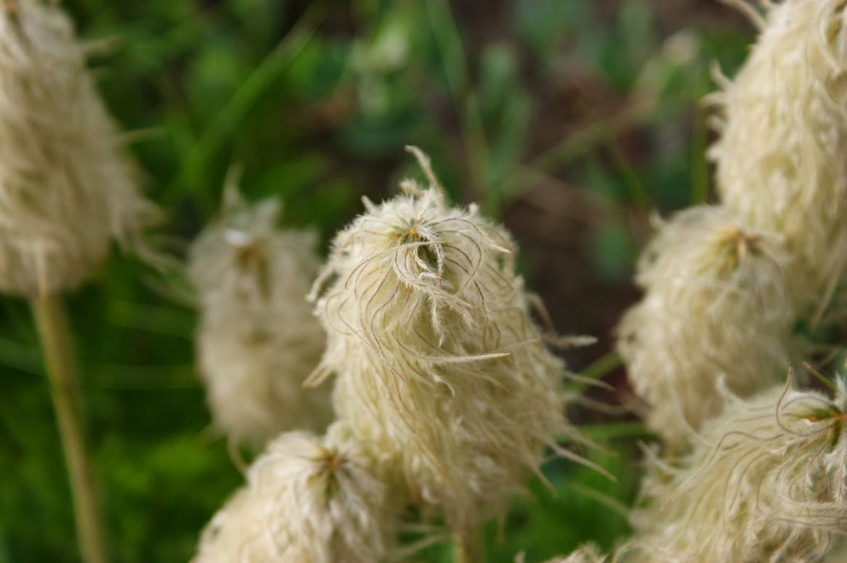

Slide 9
Metapopulations

Slide 10
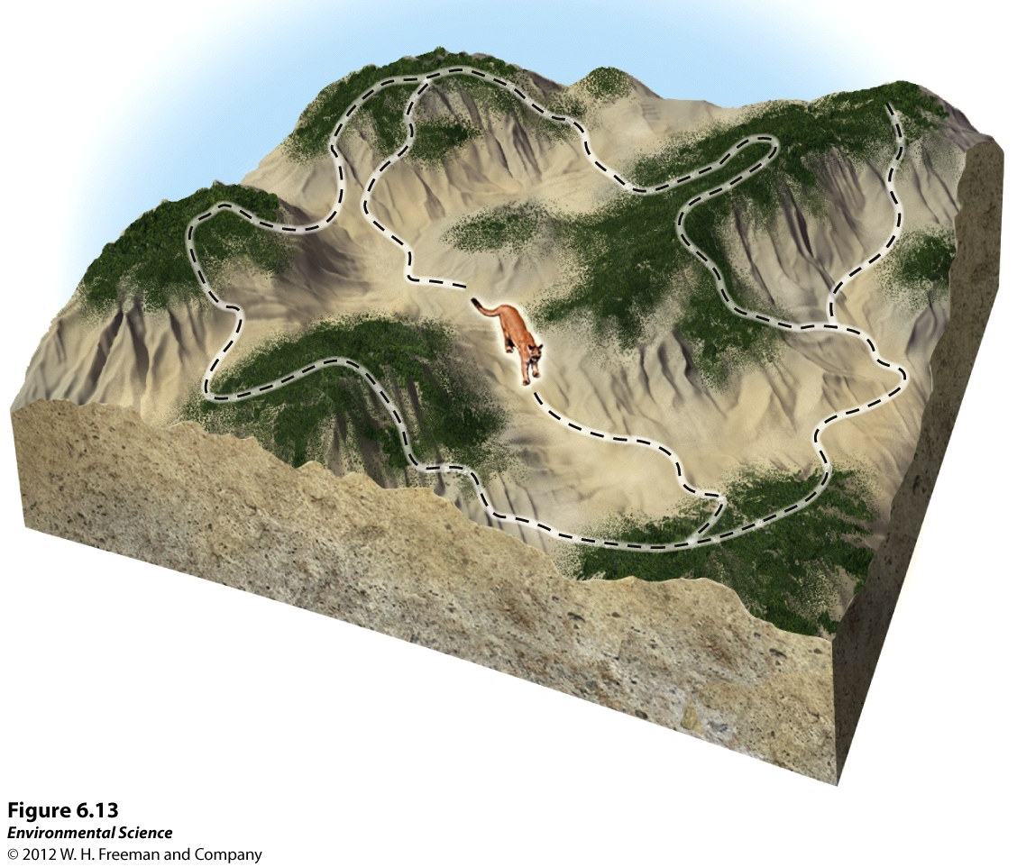
Metapopulations
Spatially isolated populations are linked by occasional dispersal, creating a metapopulation.
Metapopulations provide a rescue effect: Repeated colonization helps
safeguard against
extinction.
Notes:
Extinction and colonization of
patches can be described by:
dp/dt = cp(1-p)-ep
p = Proportion of habitat
patches occupied at time t
c = Patch colonization rate
e = Patch extinction rate
(note: you do not have to use this equation in this class)

Slide 11
Metapopulations
Metapopulations often created by habitat fragmentation.
If patches become more isolated, colonization
rate decreases.
If patches become smaller, extinction rate increases.
For a metapopulation to persist for a long time, the patch extinction rate < colonization rate.
Notes:
It led to research on key issues:
How to estimate factors that influence patch colonization and extinction.
Importance of the spatial arrangement of suitable patches.
Extent to which the landscape between habitat patches affects dispersal.
How to determine whether empty patches are suitable habitat or not.
If too much habitat is removed, e/c may shift to >1, and the metapopulation may go extinct, even if some suitable habitat remains.

Slide 12
Metapopulations
  Different species have different abilities to cross specific habitats.
  Example: Many forest interior species will not cross 25 m of open habitat (Laurance et al 2002).

Slide 13
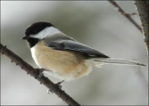
What are Metapopulations?
Local scale: Individuals interact
Metapopulation scale:
A set of local populations are linked by dispersal
Species’ geographic range:
Encompasses all local
populations and
metapopulations

Slide 14

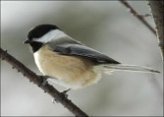
What are Metapopulations?
Individual movement among patches is the defining feature of a metapopulation.
Dispersal is a function of:
Distance between patches
Quality of Habitat
Mortality during dispersal
The type of Matrix

Slide 15
Generation of a natural mosaic

Slide 16
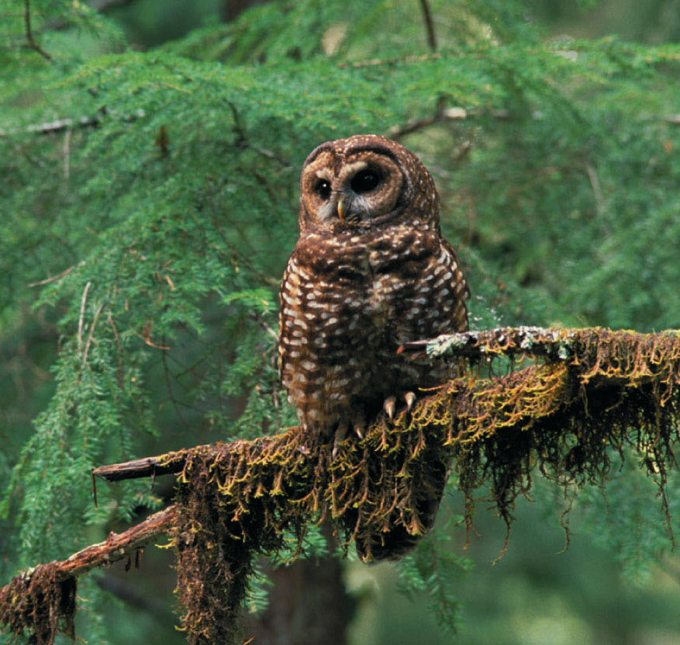
Example: Northern Spotted Owl
Lande (1988) estimated that the Northern Spotted Owl metapopulation would collapse if logging reduced suitable patches to < 20%.
Notes:
In studies of the northern spotted owl in old-growth forests in the Pacific Northwest, Lande (1988) estimated that the entire metapopulation would collapse if logging were to reduce the fraction of suitable patches to less than 20%.
Real metapopulations often violate the assumptions of the Levins model.
Patches may vary in population size and ease of colonization; extinction and colonization rates can vary greatly among patches.
These rates can also be influenced by nonrandom environmental factors.

Slide 17
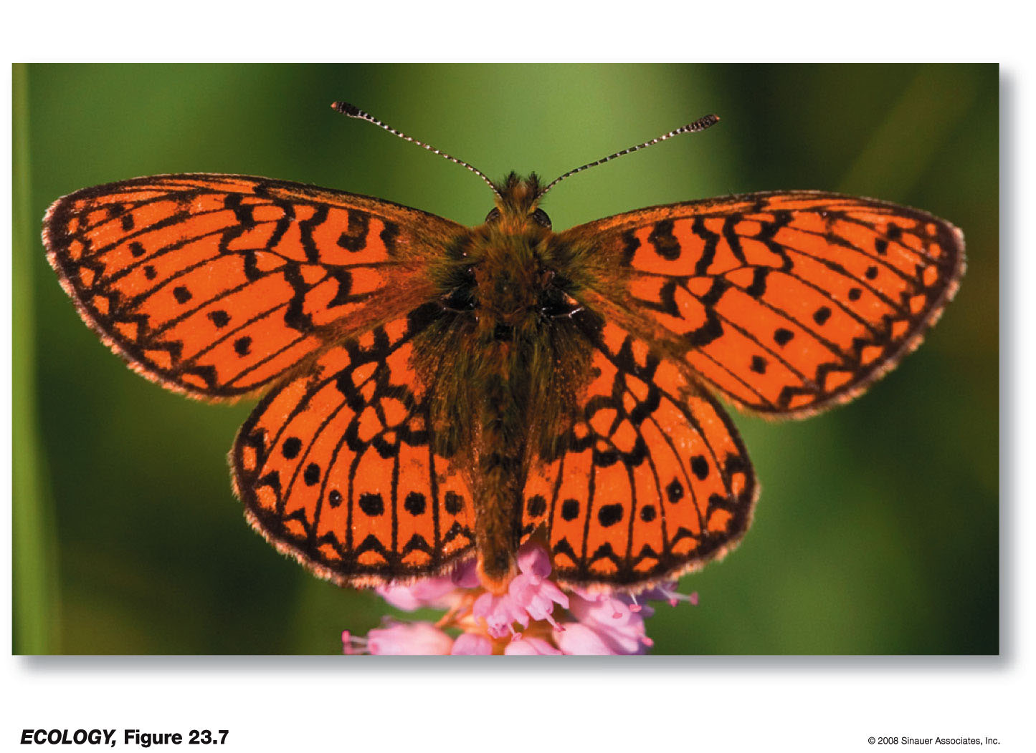
Example: Butterflies
Bog fritillary butterflies cross unsuitable matrix to nearby patches; but do so less when the distance between patches is larger.
Notes:
Landscape patches vary in terms of habitat quality and resource availability.
Patch boundaries, connections between patches, and the matrix between patches can affect population dynamics.
E.g. Bog fritillary butterflies cross unsuitable matrix to nearby patches; but not as much when the distance between patches is larger.

Slide 18
Metapopulation Terminology
Habitat patch: where a local population exists
Local extinction: disappearance of a population from a given patch
Re-colonization: re-establishment of a local population by new immigrants
Population turnover: how often the population is renewed
Population persistence time: how long a population may maintain itself

Slide 19


Factors Affecting Local Extinctions
Broad scale threats
Broad Scale Threats
Global Climate Change
Land-use change and fragmentation
Altered disturbance regimes
Invasive Species
Stochastic Causes

Slide 20
Factors Affecting Local Extinctions
Broad scale threats
Local Scale Threats:
Demographic stochasticity:
Random changes in population vital rates.
Genetic stochasticity:
Loss of fitness due to inbreeding in very small local populations
Environmental stochasticity:
Environmental changes, especially weather, that may result in fluctuations in resources.
Catastrophe:
Extreme stochastic events that affects the entire metapopulation.
Stochastic Causes

Slide 21
Factors Affecting Local Re-colonization
Factors influencing re-colonization reflect the interplay between life history traits and the connectivity to habitat.
Plants: seed size and viability, dispersal vector, seedbed requirements.
Animals: simple distance,
resistance of intervening habitats, dispersal behavior, mortality rates during dispersal.

Slide 22
Metapopulations
13-2 Draw a cartoon of metapopulation
List a few factors that are threats to metapopulations.

Slide 23
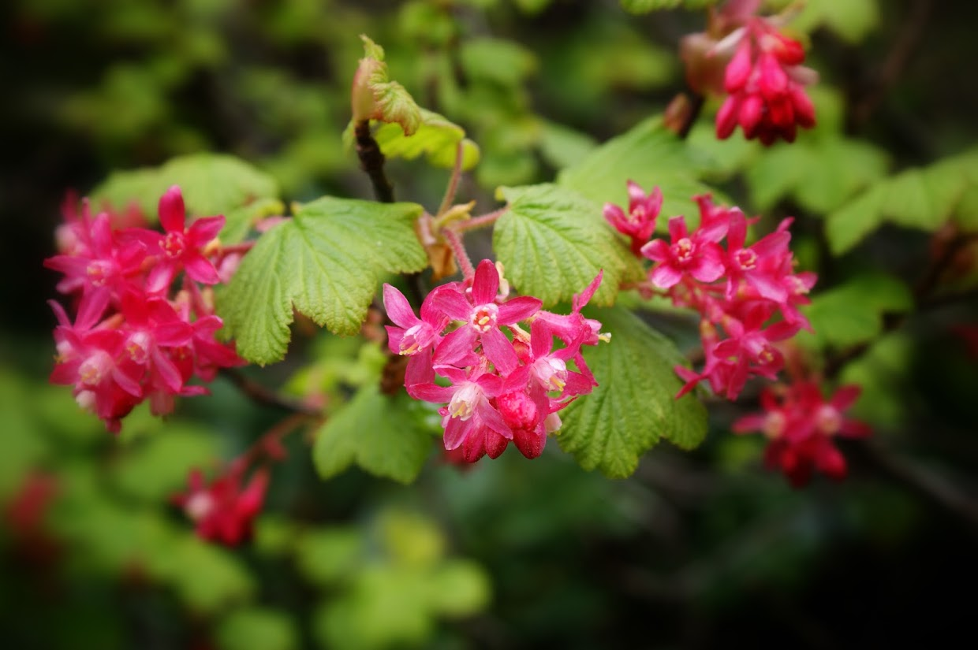

Slide 24
Island Biogeography vs. Metapopulation
Island Biogeography Model
Habitat Variables:
Island area
Distance from source (mainland)
Metapopulation model
Habitat Variables:
Patch area
Habitat abundance or variety
Distance between habitat patches
Habitat quality

Slide 25
Island Biogeography vs. Metapopulation
Island Biogeography Model
Species Variables include:
Ability to traverse distances
Robustness to genetic bottlenecks
Metapopulation model
Species variables include:
Demographic parameters for local population dynamics
Dispersal range and/or mobility, dispersal behavior
Habitat affinities, territory or home range size
Interactions with other species

Slide 26
Actions to save biodiversity
More natural reserves
Reserves with buffer areas
Many small or several big ones
Connectivity

Slide 27
Nature Reserves
We should design reserves with configurations that help:
maintain the largest possible populations.
provide habitat throughout the range of target species.
Connect to other reserves to maintain metapopulations.
Notes:
Biological reserves—smaller reserves with conservation of a single species or ecological community as the main objective.
Although small, they can be important, especially where human population density is high and large reserves are not feasible.

Slide 28
Nature Reserves with Buffer Zones
Augment core areas with buffer zones—areas with less stringent controls on land use, but that can still meet the requirements of many species
Buffer zones can also be managed for:
  sustainable harvest of resources
  agriculture,
  limited housing.
Notes:
Masoala National Park design includes 71,000 hectares of forest land designated for sustainable timber harvesting.
Buffer areas were determined by proximity to villages, how much wood was needed to sustain them, and how much land was needed to provide this.
Buffer zones can also become population sinks for some species, as animals that stray from core areas to buffer zones become vulnerable to hunting, roadkill, or other sources of mortality.

Slide 29
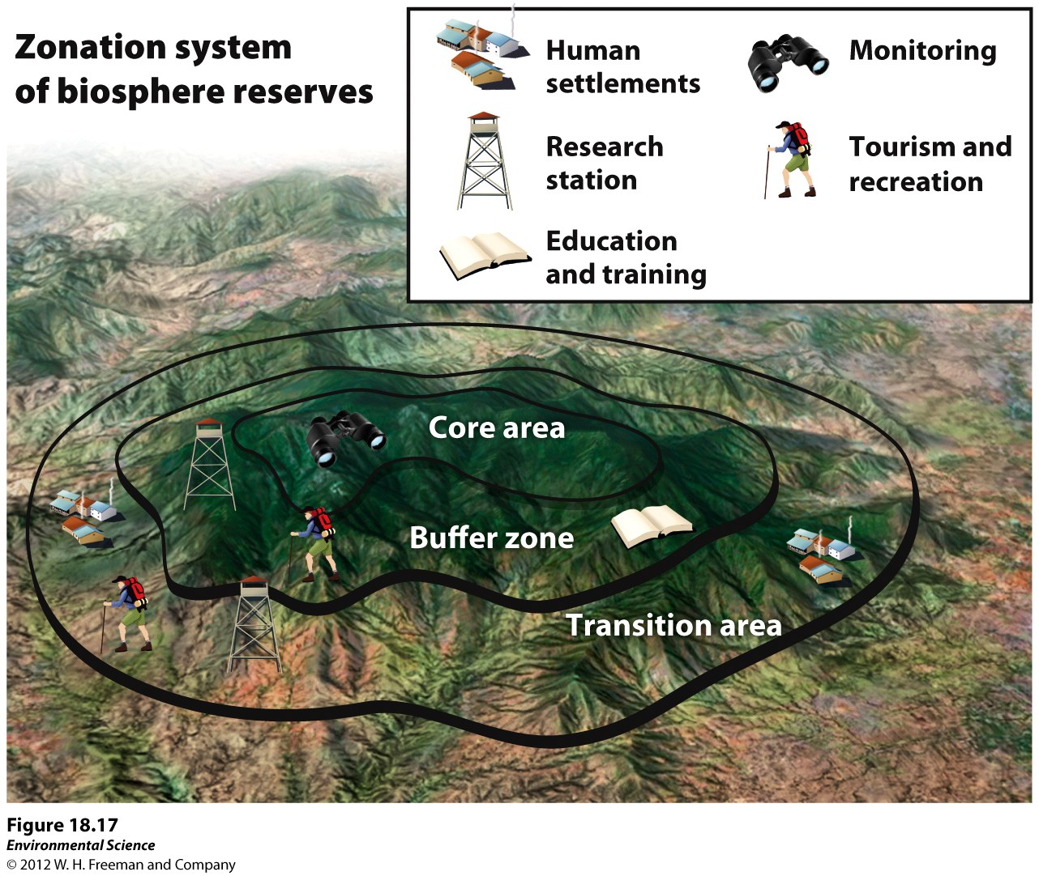
Biosphere reserves have zones that vary in permissible human impact (564 worldwide)

Slide 30
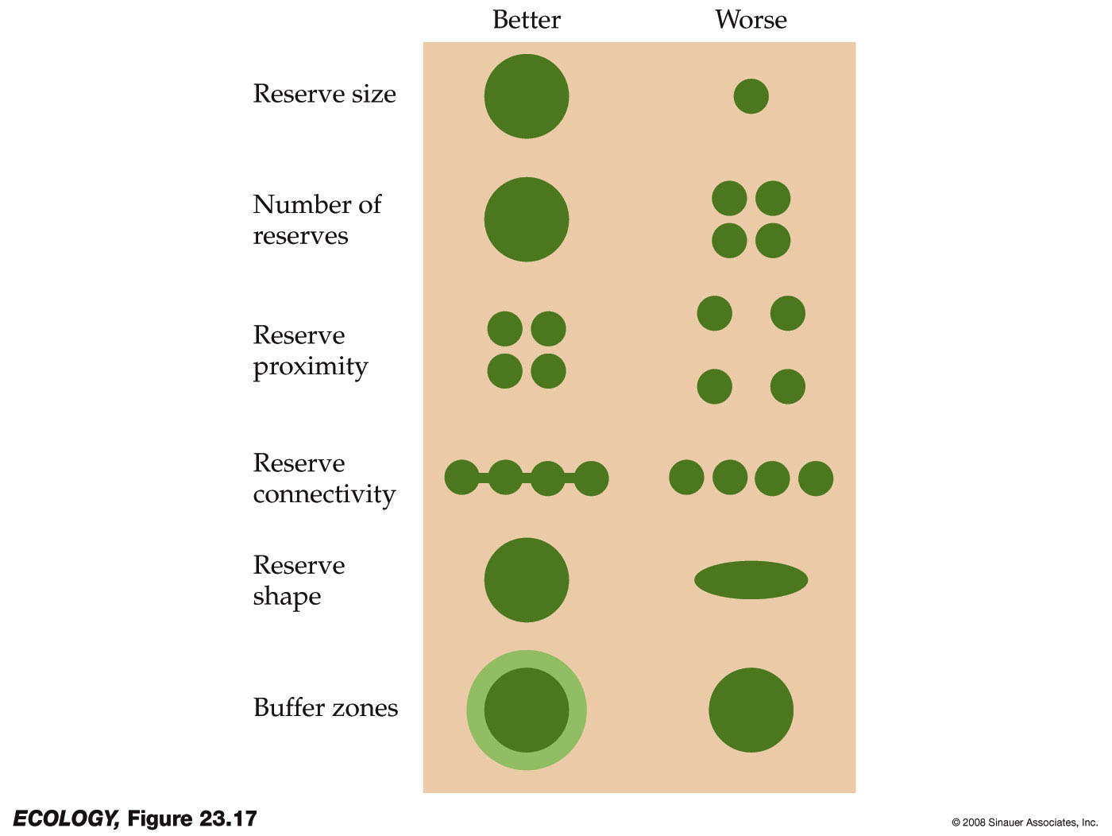
Designing Nature Reserves
Best spatial configurations for a core natural area?
There has been great debate over whether Single Large or Several Small reserves is better.
(The ‘SLOSS’ Debate)
Notes:
Some spatial designs are better than others for fostering biodiversity.
Large, compact, and connected reserves are ideal.
But smaller or disconnected reserves may sometimes be more desirable (e.g., diseases would spread less quickly).
Several is better than one, but maybe not if overall area is smaller or edge effects are pronounced. Depends on the spp!

Slide 31
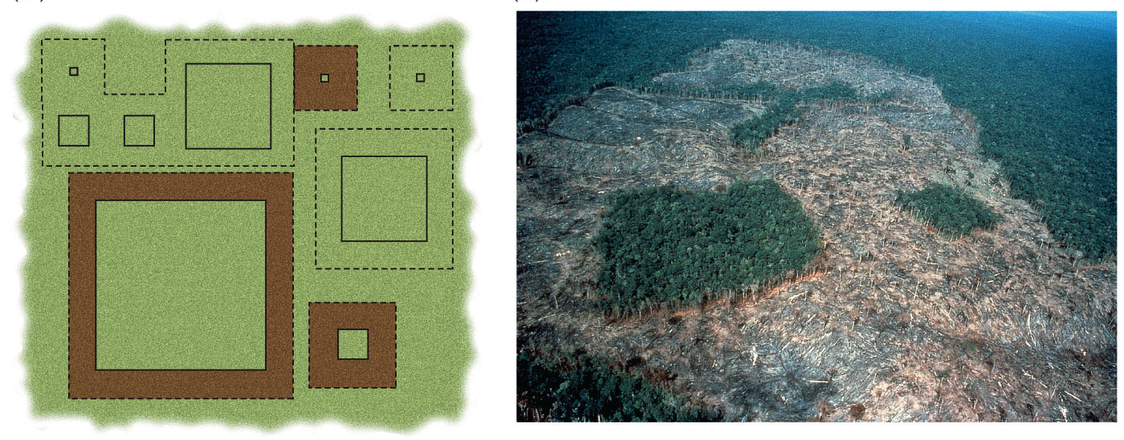
In 1979, Thomas Lovejoy set up 1, 10, 100, or 1,000 hectare plots surrounded by logged land: The Dynamics of Forest Fragments Project.
More species in 1 hectare of Amazonia than in all of Europe!
Found that most forest fragments are too small to maintain all their original species. E.g., 100 hectare plots lost ½ their bird species within 15 yrs (Ferraz et al. 2003)
From Cain et al. Ecology.
Notes:
In 50 years’ time, 15% of the rainforest has been converted to pastureland, towns, roads, and mines
The Amazon Basin is the largest watershed in the world. The number of fish species in the Amazon River exceeds the total number found in the entire Atlantic Ocean.
When these ecosystems are disturbed, there is devastating species loss.
Deforestation began with road building in the 1960s.
In 50 years’ time, 15% of the rainforest has been converted to pastureland, towns, roads, and mines.
While 15% seems modest, the sheer number of species impacted is staggering.
The pattern of deforestation has also resulted in extreme habitat fragmentation, making it more difficult to maintain species diversity.
In 1979, habitat fragmentation spurred Thomas Lovejoy to initiate the longest running ecological experiment ever conducted: The Dynamics of Forest Fragments Project (BDFFP).
He was guided by The Theory of Island Biogeography, an explanation for the observation that more species are found on large islands than on small islands. Four different sizes of forest plots were set up: 1, 10, 100, or 1,000 hectares.
Control plots were surrounded by forest. Fragments were surrounded by logged land.
The BDFFP started with the question, “What is the minimum area of rainforest needed to maintain species diversity?”

Slide 32
Designing Nature Reserves
Habitat corridors—linear patches that connect blocks of habitat.
Connectivity can reduce the effects of fragmentation by preventing isolation of populations.
Do corridors work?

Slide 33
Maintain Landscape Permeability
Matrix is less permeable when it is very different from the core habitat.
Few animals will travel far through any matrix habitat unless they can use stepping stones or corridors.
Stepping stones are relatively small patches of native vegetation scattered throughout the landscape. E.g., the rufous hummingbird stops in small mountain meadows during long-distance migration (Russell et al. 1994)

Slide 34
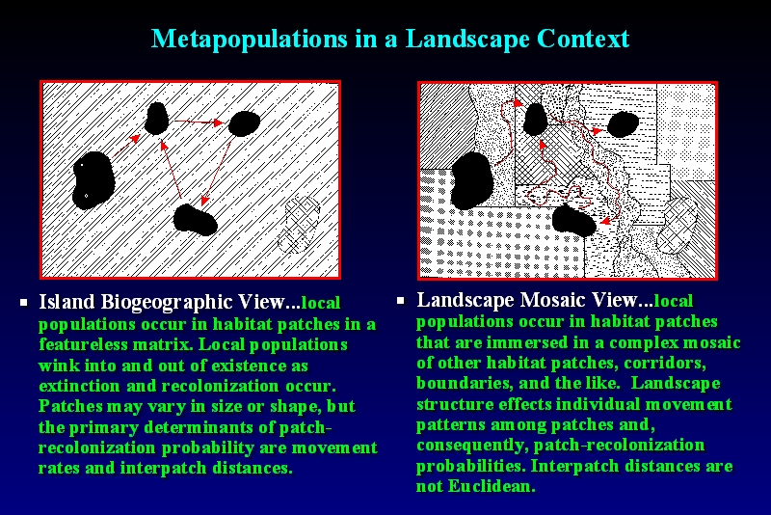
Island Biogeography vs. Landscape Mosaic
Island biogeographic view
Landscape mosaic view
Featureless matrix
Local populations “blink” in and out.
Recolonization based on movement rates and distance between patches.
Complex matrix
Matrix affects movement patterns between patterns and recolonization
Patch distances are not Euclidean

Slide 35
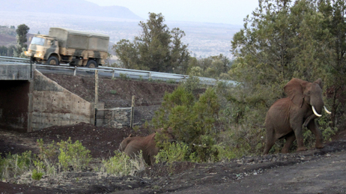
Metapopulation Solutions
“Elephant Underpass Connects Cousins in Kenya”
Source: NPR News 1/28/11
Jason Straziuso/AP

Slide 36
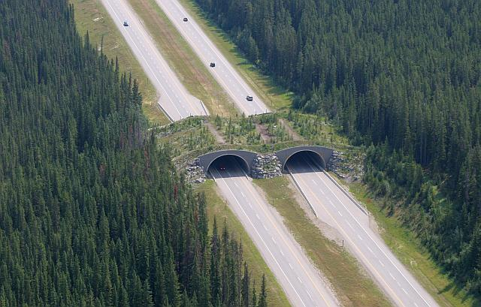
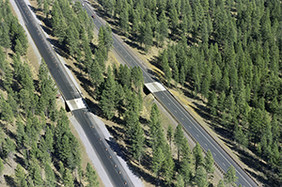
Metapopulation Solutions

Slide 37
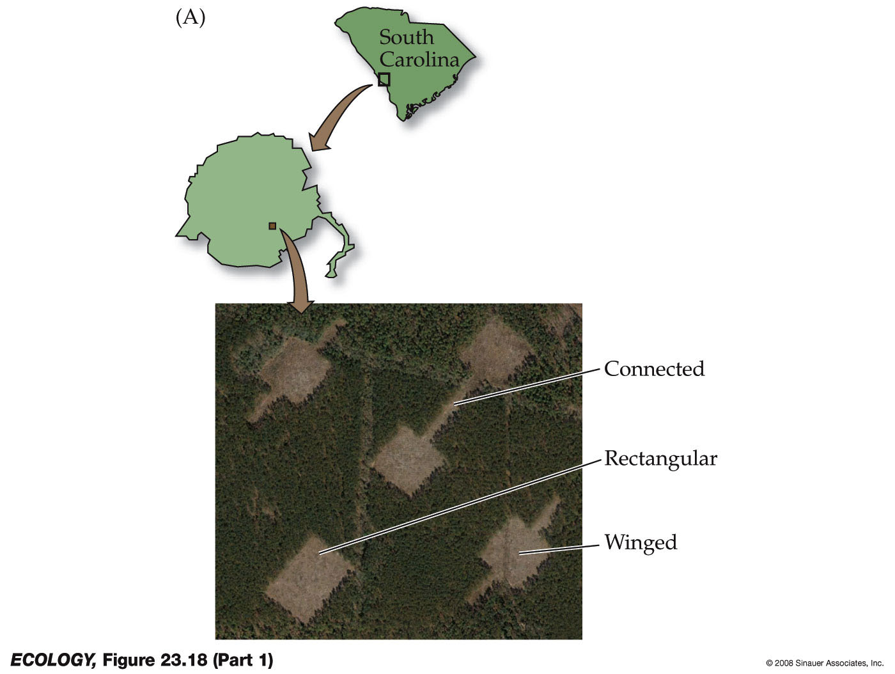
Corridor Effectiveness
How effective are habitat corridors? Savannah River Ecological Laboratory (Tewksbury et al. 2002)
Patches of early successional habitat were established in a matrix of pine forest, some connected by corridors.
Controls had same area but didn’t lead anywhere.
Notes:
A test of habitat corridors was made at the Savannah River Ecological Laboratory, SC.
Patches of early successional habitat were established in a matrix of pine forest, some connected by corridors.

Slide 38
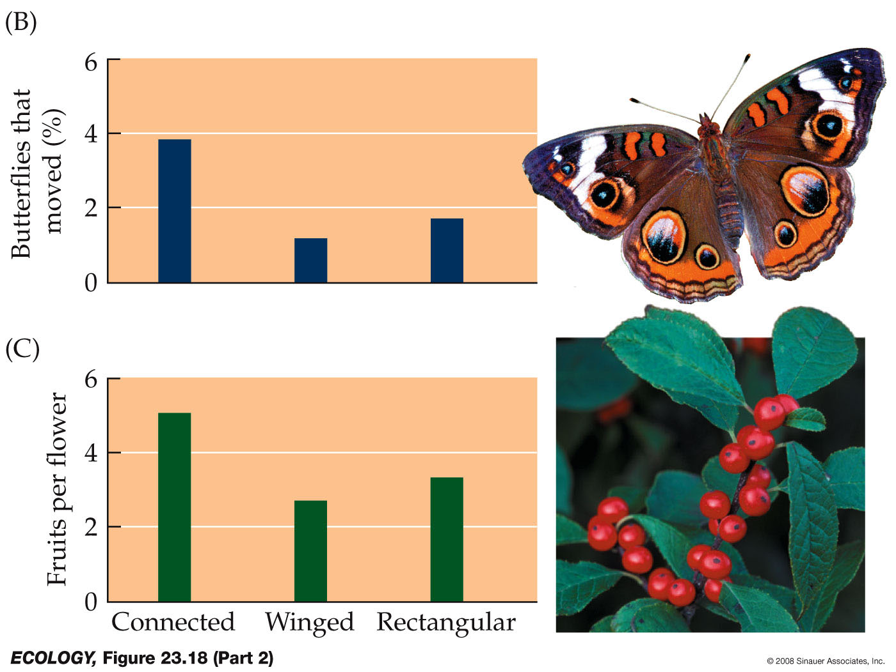
Corridor Effectiveness
Effective for butterfly movement, pollen, bird-dispersed fruits (Tewksbury et al. 2002).
Other studies of corridors have found negative effects, or no benefits.
Why not always effective?
Notes:
Corridors did facilitate movement of butterflies, pollen, and bird-dispersed fruits. But other studies of corridors have found negative effects, or no benefits.
At the Savannah River experiment, indigo bunting nest predation was higher in patches connected by corridors.
Corridors may also facilitate movement of pathogens and invasive species.

Slide 39
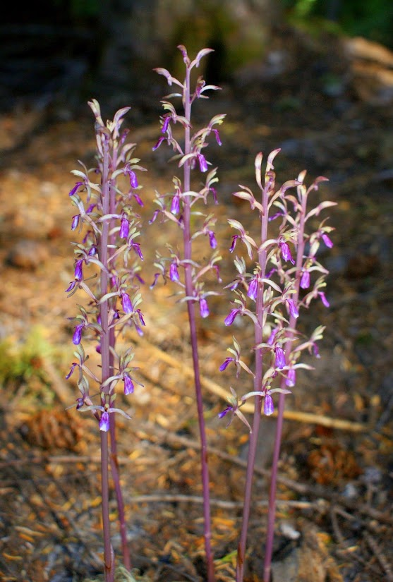

Slide 40
Plan for Wednesday
Short case study on how to plan land use to optimize both biodiversity and economic interest
Review major concepts
Go over 2 homeworks

