Slide 1
Lecture 12: Land use and conservation areas Wed May 10, 2017
Land use
Impact on habitat availability
Fragmentation and edge effects

Slide 2
Module 2 Story Arc
Why biodiversity?
How do we measure it?
Skills = diversity indices
What processes influence species richness?
Skills = species area curves
Skills = island biogeography
Challenges
Land use - today
Fragmentation thresholds
Metapopulations on a landscape mosaic
Solutions and case study

Slide 3
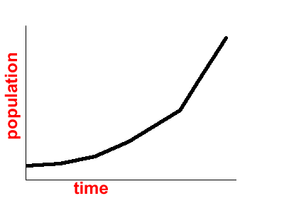
Comment on graphing
Sometimes we are following a continous process or function
Sometimes we are collection points from different observations and fitting them to a line
Population with time
Species with time on a new island

Slide 4
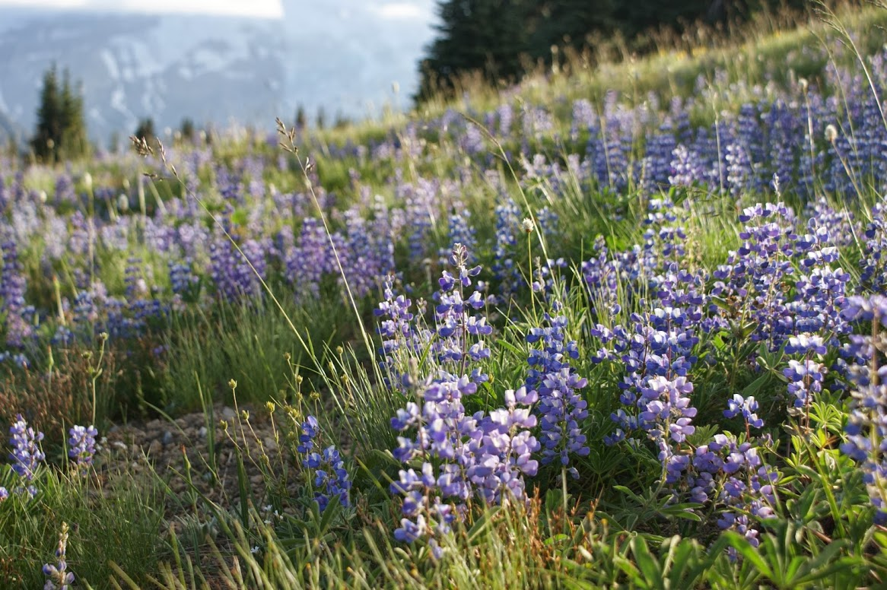

Slide 5
Is All the World Becoming Islands?
Area of habitat declining.
Isolation increasing.
Fewer species expected?

Slide 6
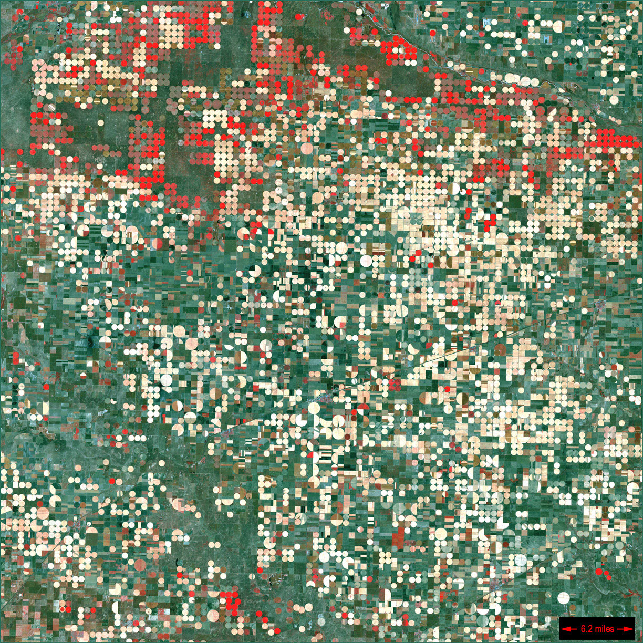
Garden City, Kansas Image taken 9/25/2000
Center pivot irrigation systems create red circles of healthy vegetation in this image of croplands near Garden City, Kansas.
Garden City can be found on Landsat 7 WRS Path 30 Row 34, center: 37.48, -100.51.
US Geological Survey/NASA http://astroboy.gsfc.nasa.gov/earthasart/index.html

Slide 7
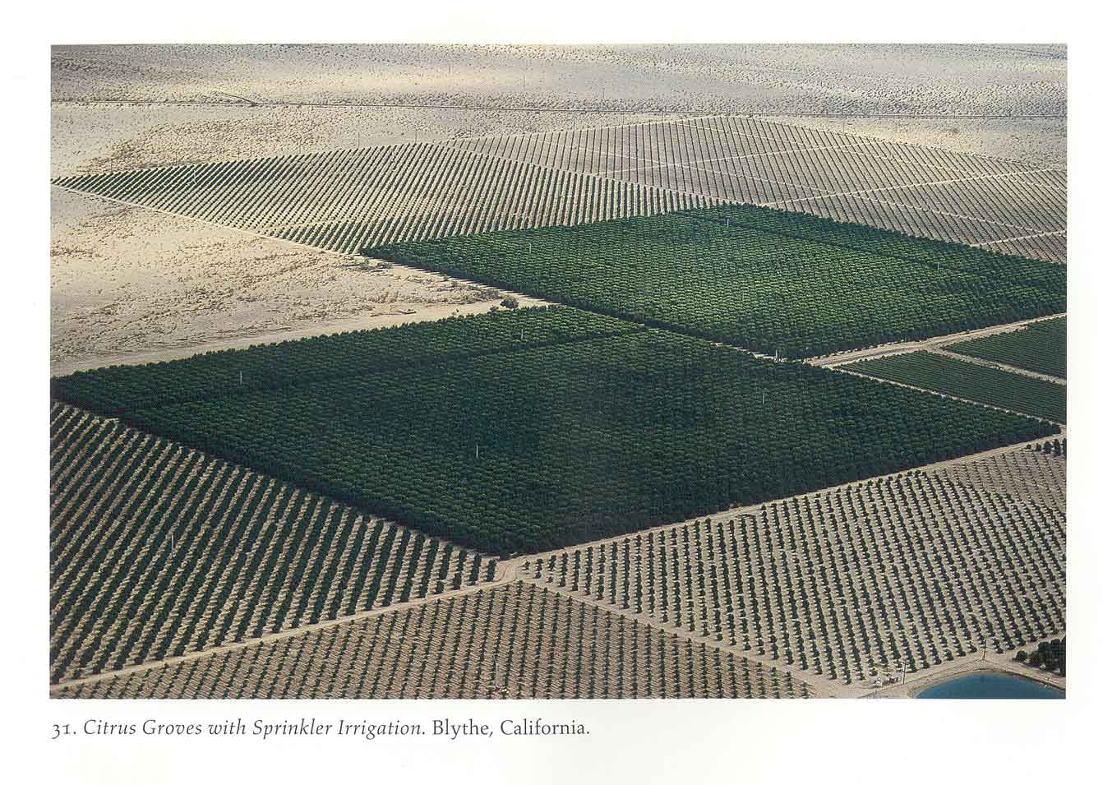
Introduction to Land Use Change
Human actions now major source of changes in the biosphere
From Corner and MacLean 1996; photograph by A. MacLean

Slide 8
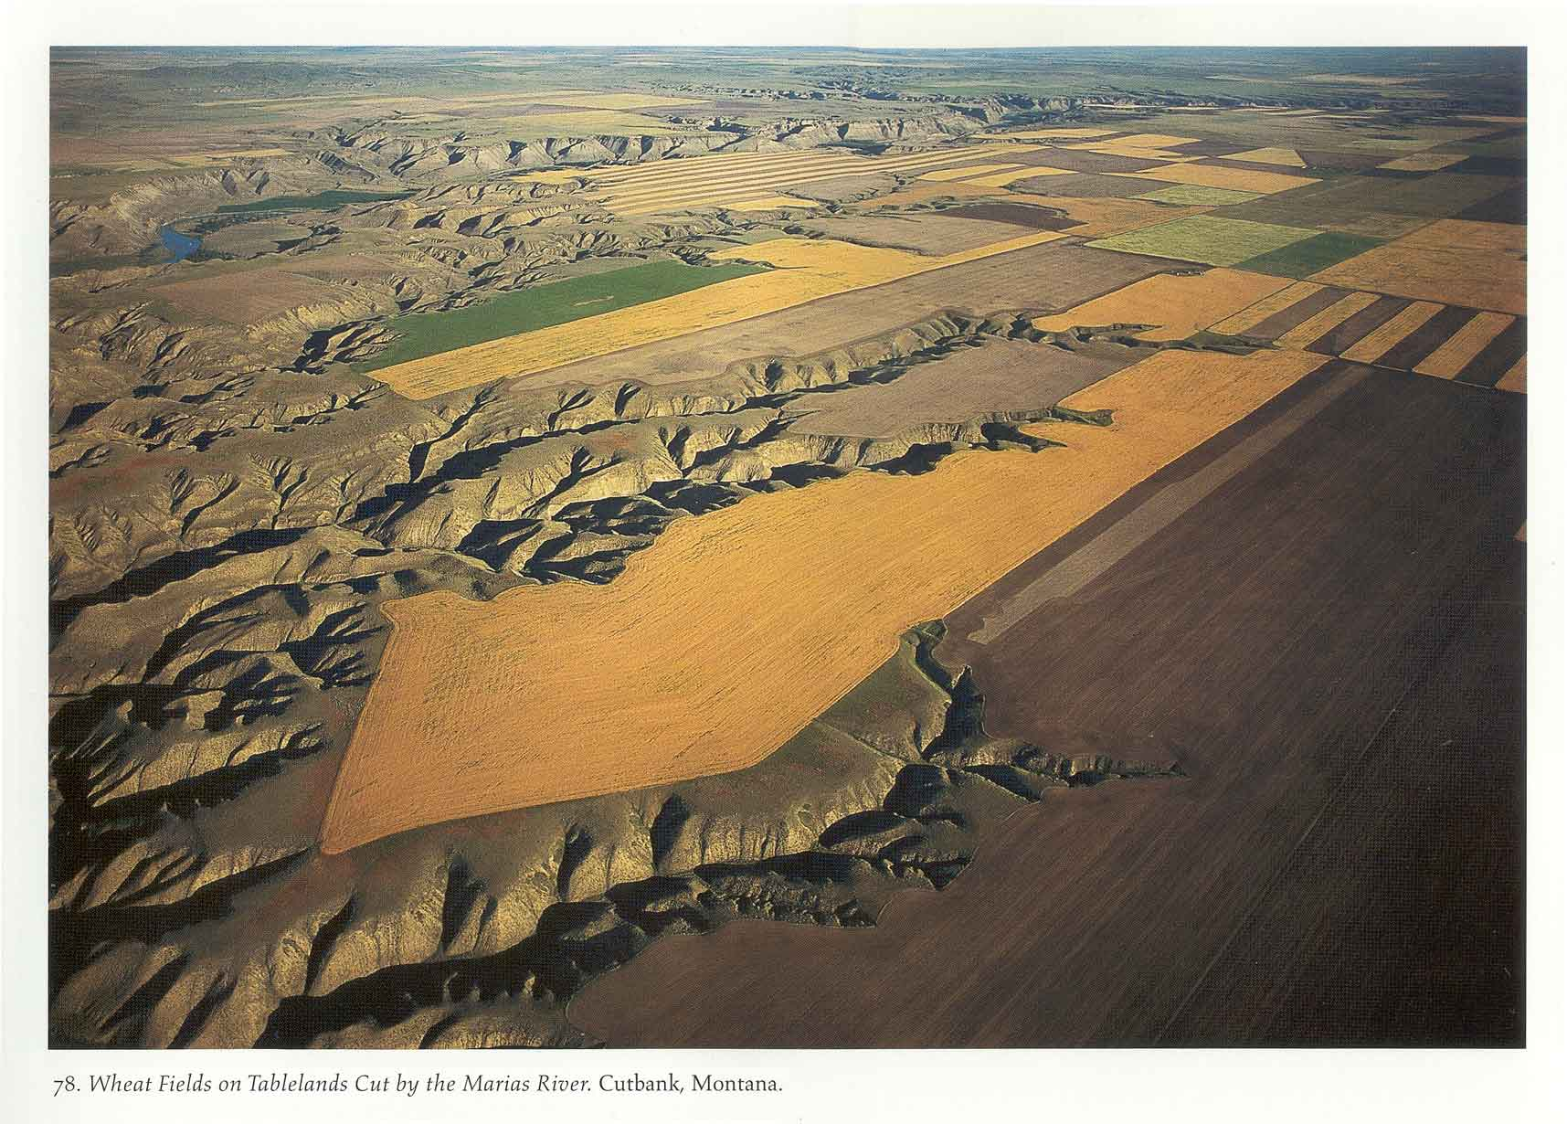
Introduction to Land Use Change
Land use change is the principle cause of landscape change across the globe.
From Corner and MacLean 1996; photograph by A. MacLean

Slide 9
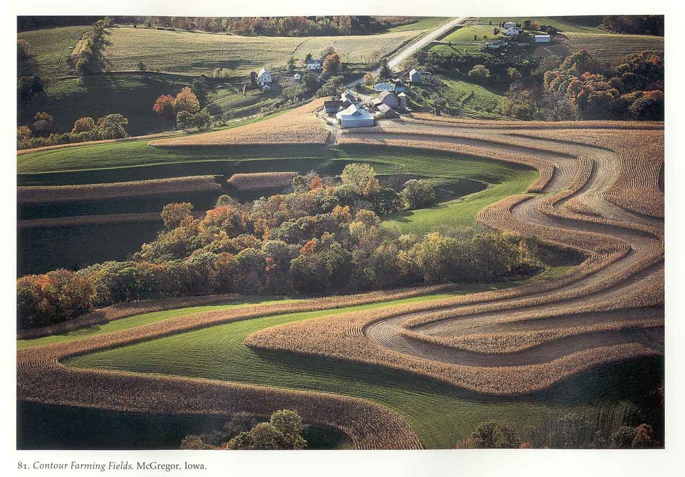
Introduction to Land Use Change
Land use change has very long-term consequences
From Corner and MacLean 1996; photograph by A. MacLean

Slide 10
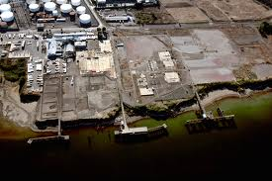
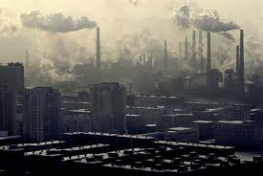
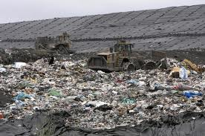
Causes of Land Use Change
Two proximate sources of global environmental change 1. Industrial processes 2. Land transformation (Agriculture)
Industrial processes
Energy, material flows, and pollution due to production and consumption.

Slide 11
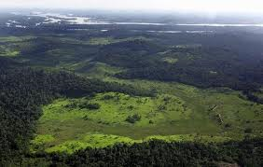
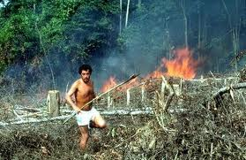
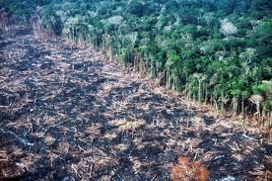
Causes of Land Use Change
Land transformation: Physical change, e.g., forest clearing, plowing grassland.

Slide 12
Introduction to Land Use Change
Ellis, EC. 2011. Philosophical Transactions of the Royal Society. 369:1010-1035.

Slide 13
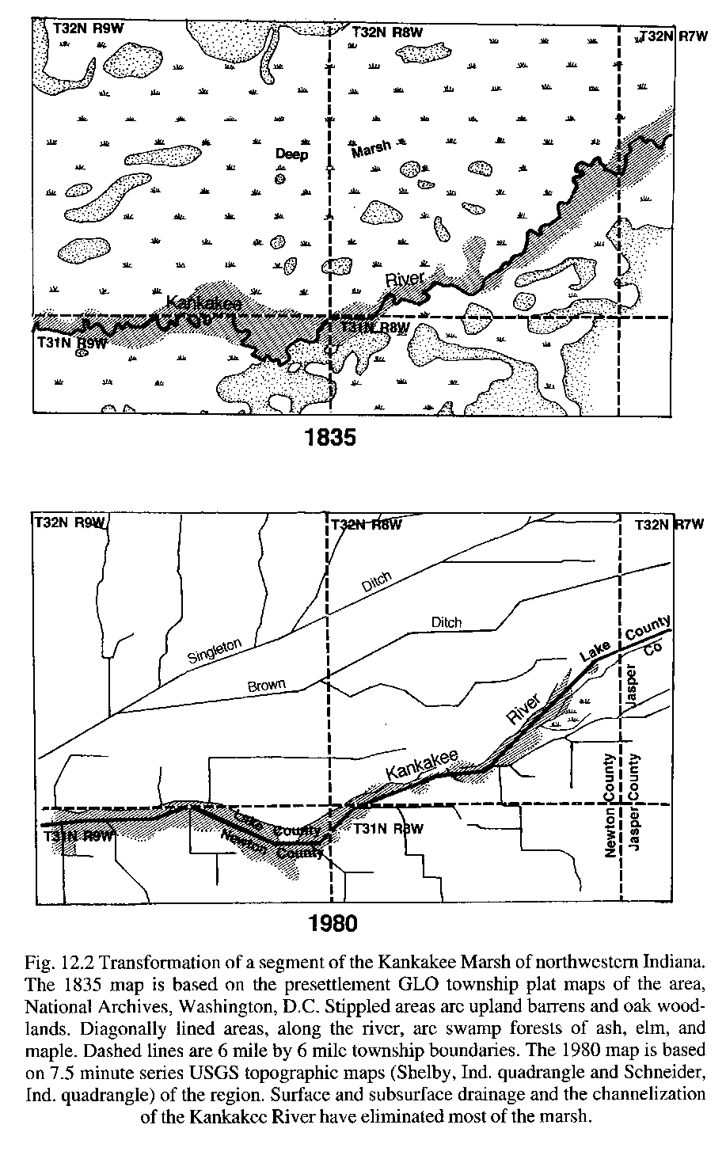
History of Land Use Change
During most of history of human land use history, modification was largely impacts on soils and biota due to agriculture.
Land transformation seen as good (“development”, “improvement”) until very recently.
From Whitney 1994

Slide 14
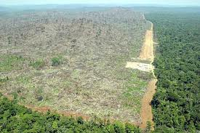
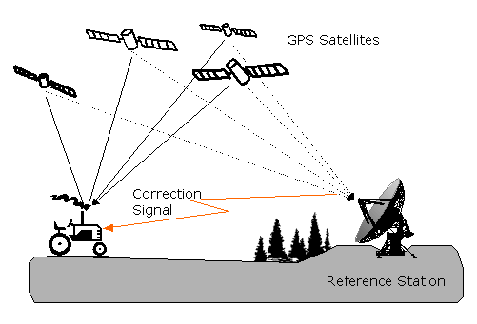
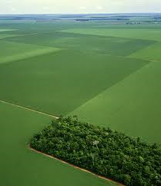
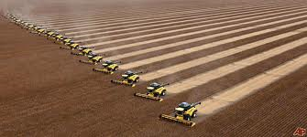
History of Land Use Change
Post-agricultural society has not reduced land transformation!
It has diversified and intensified due to population increase, economic globalization, technological capacity.

Slide 15
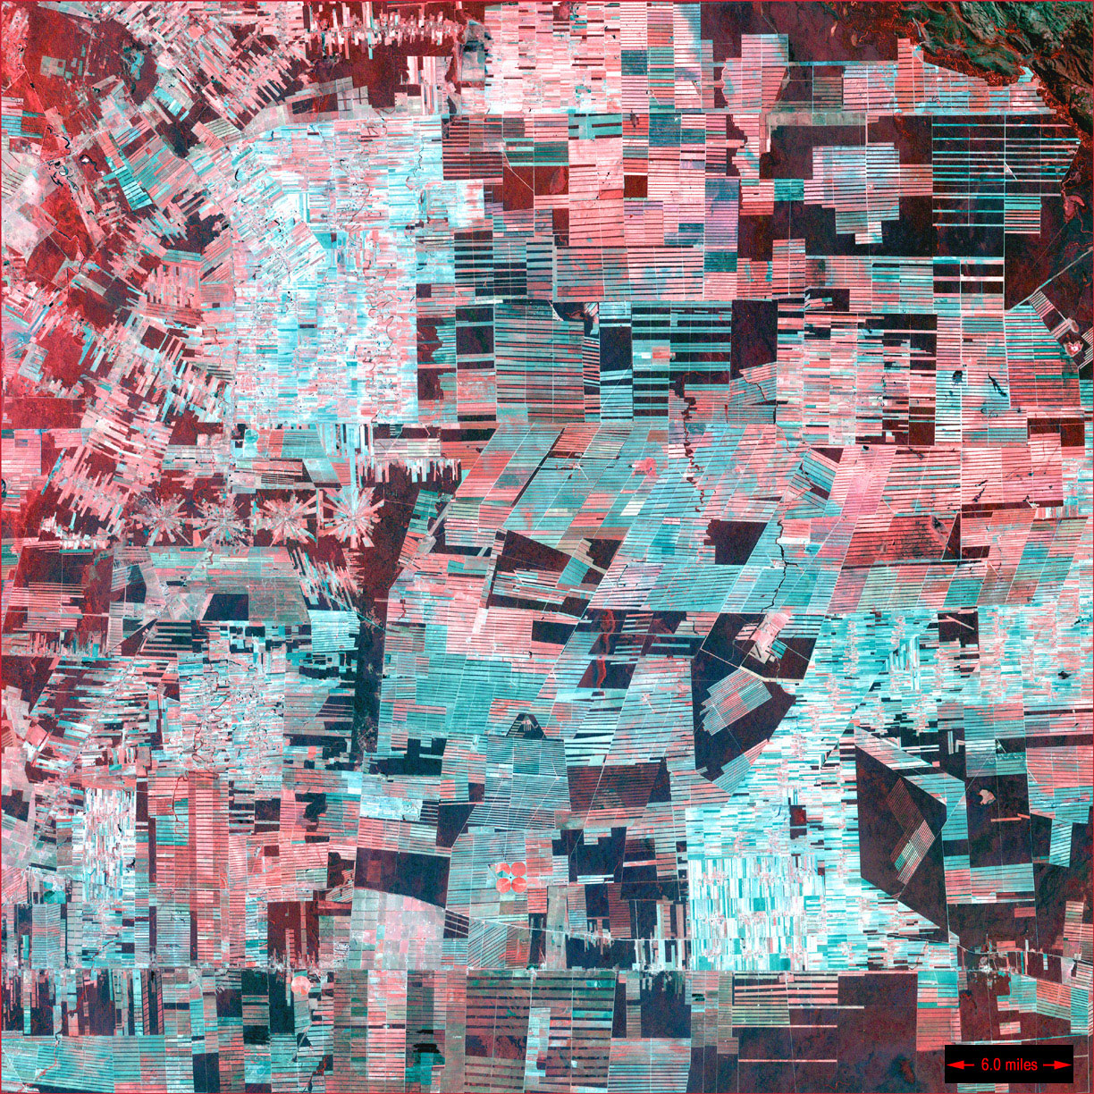
History of Land Use Change
In much of the tropics, there is huge pressure on remaining undeveloped forest land for agricultural use.
Bolivian Deforestation Image taken 8/1/2000
US Geological Survey/NASA http://astroboy.gsfc.nasa.gov/earthasart/index.html

Slide 16
You can view these effects yourself
Google maps
Cancun, Mexico
Rondonia, Brazil
Oakridge, OR

Slide 17
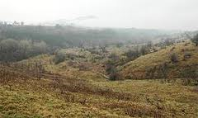
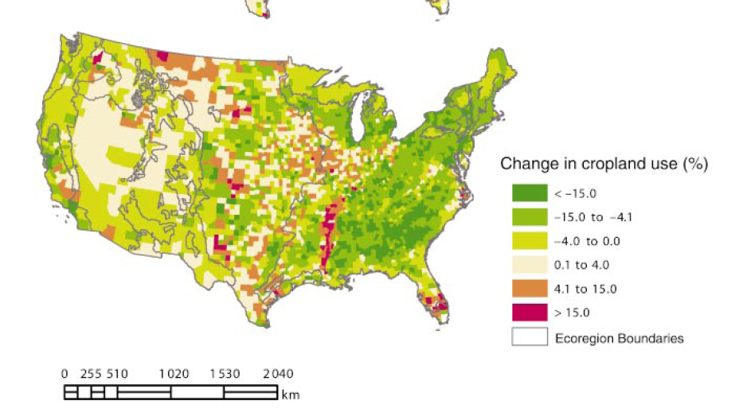
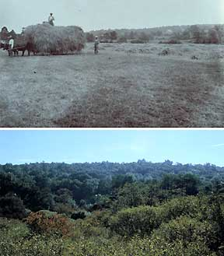
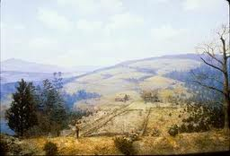
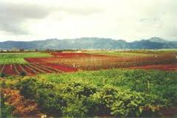
History of Land Use Change
Agricultural abandonment is becoming important – in developed and developing countries.
Particularly: US, Central America, Europe.
Why?
Before
After
Brown et al. 2005. Ecol. Apps.

Slide 18
The World’s Briefest History of Land Use Change in the US

Slide 19
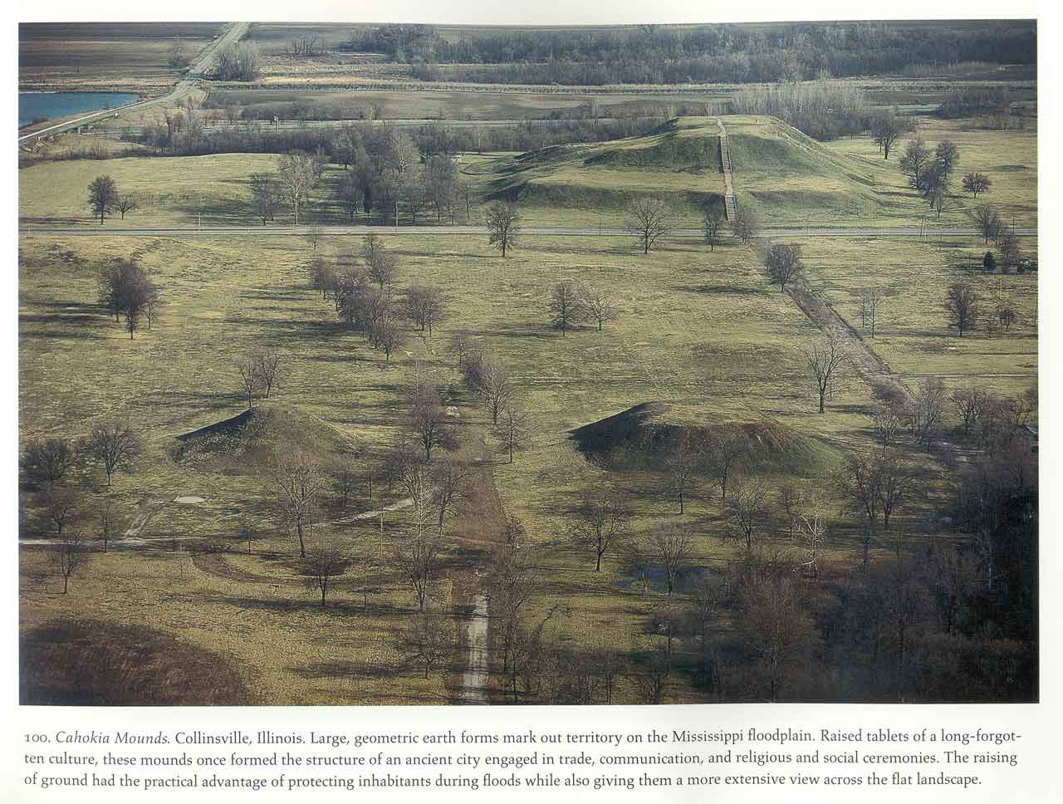
In North America, some areas had fairly high populations around agricultural development in Pre-European settlement times
From Corner and MacLean 1996; photograph by A. MacLean

Slide 20
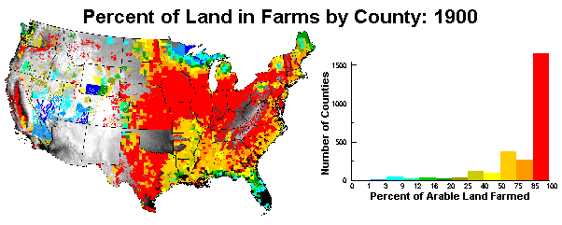
From Sisk 1998, Chap. 2

Slide 21
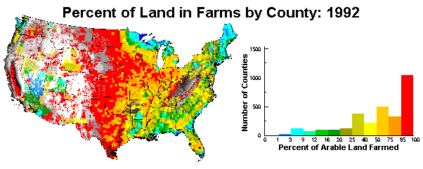
From Sisk 1998, Chap. 2

Slide 22
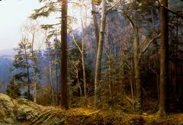
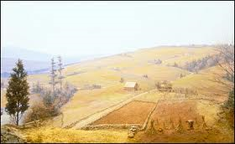
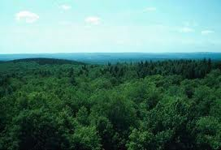
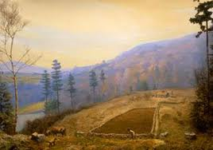
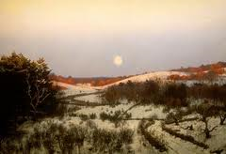

Slide 23
Habitat Loss and Biodiversity
Greatest cause of decline for most species
Most species can only thrive within a narrow range of abiotic and biotic conditions (specialized habitat)
Examples for habitat loss
Clearing/changing forests (US, South America, sub-Saharan Africa, Southeast Asia
Changing coral reefs
Habitat reduction: Florida Panther, Brown-headed cowbird

Slide 24
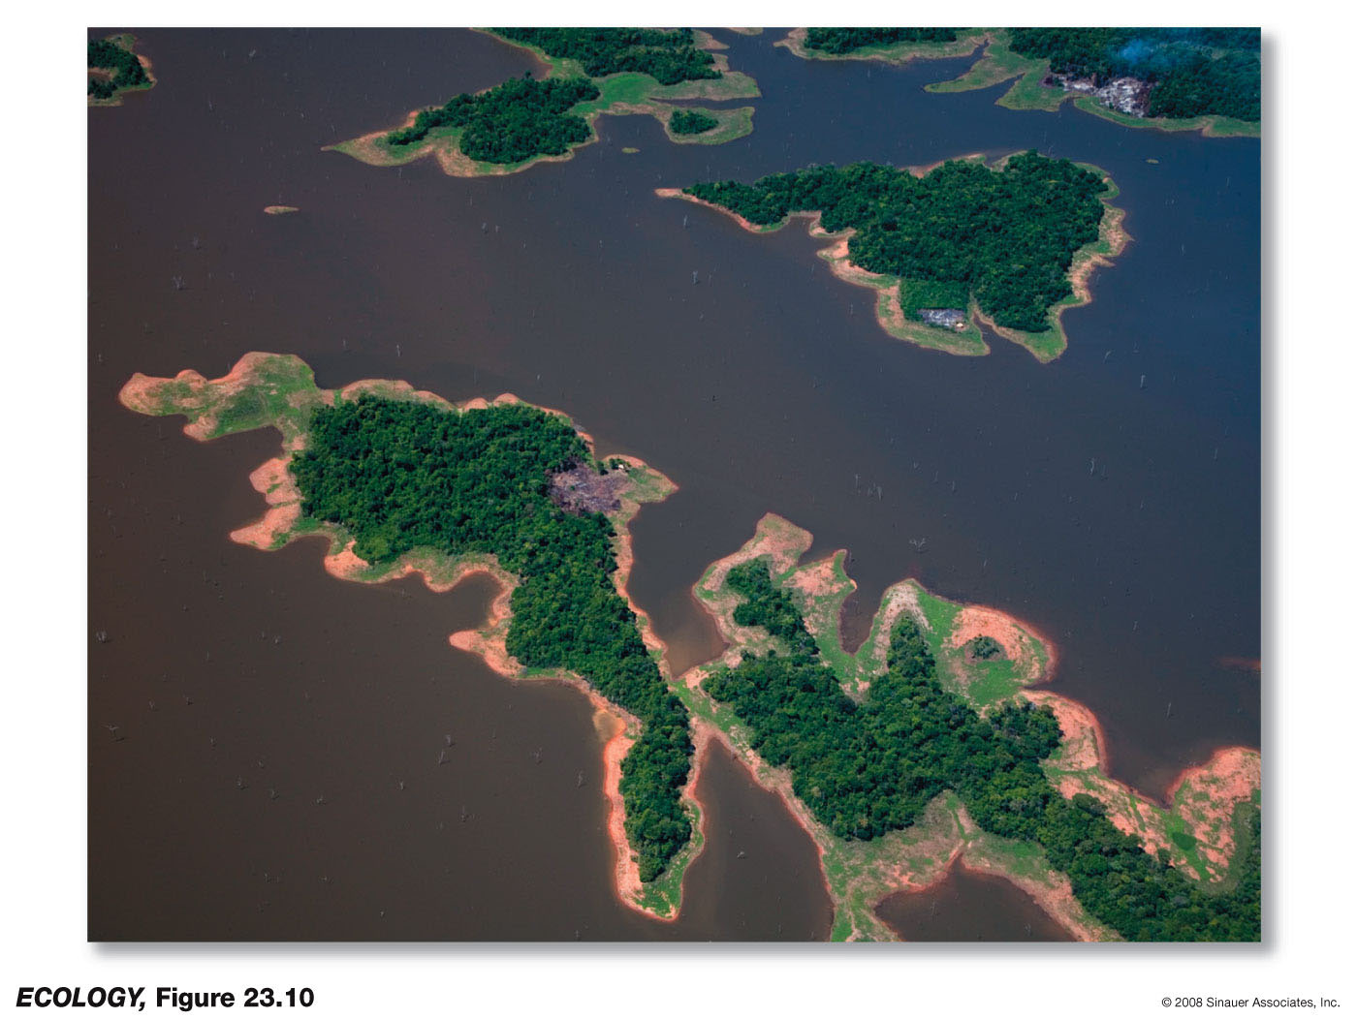
Habitat Loss
Habitat loss reduces habitat area.
Habitat fragmentation isolates populations and alters conditions at habitat edges.
The islands of Lago Guri after the 1986 flooding of forest by a Venezuelan hydroelectric project.
Notes:
In 1986, a massive hydroelectric project in the Caroni River valley of Venezuela created islands of tropical forest surrounded by water - Lago Guri - in what had been an intact forest.
Loss and fragmentation typically go hand in hand so it is difficult to separate out the effects of one from the other on ecological communities and ecosystem function.

Slide 25
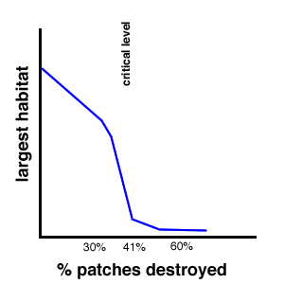
Habitat loss leads to fragmentation
Maximum patch area
Connected parcels
Decreases with % development/degradation
Threshold effect
http://web.pdx.edu/~rueterj/courses/objects/landscape-connectivity.html

Slide 26
Simulation of threshold
Fire.nlogo
Forest fires move through adjacent areas that are connected
% of forest that is connected leads to different forest fire patterns
Threshold effect
Good for habitat connectivity
Bad for forests (but we’ll see later that we want a mosaic – not just trees of same age)

Slide 27
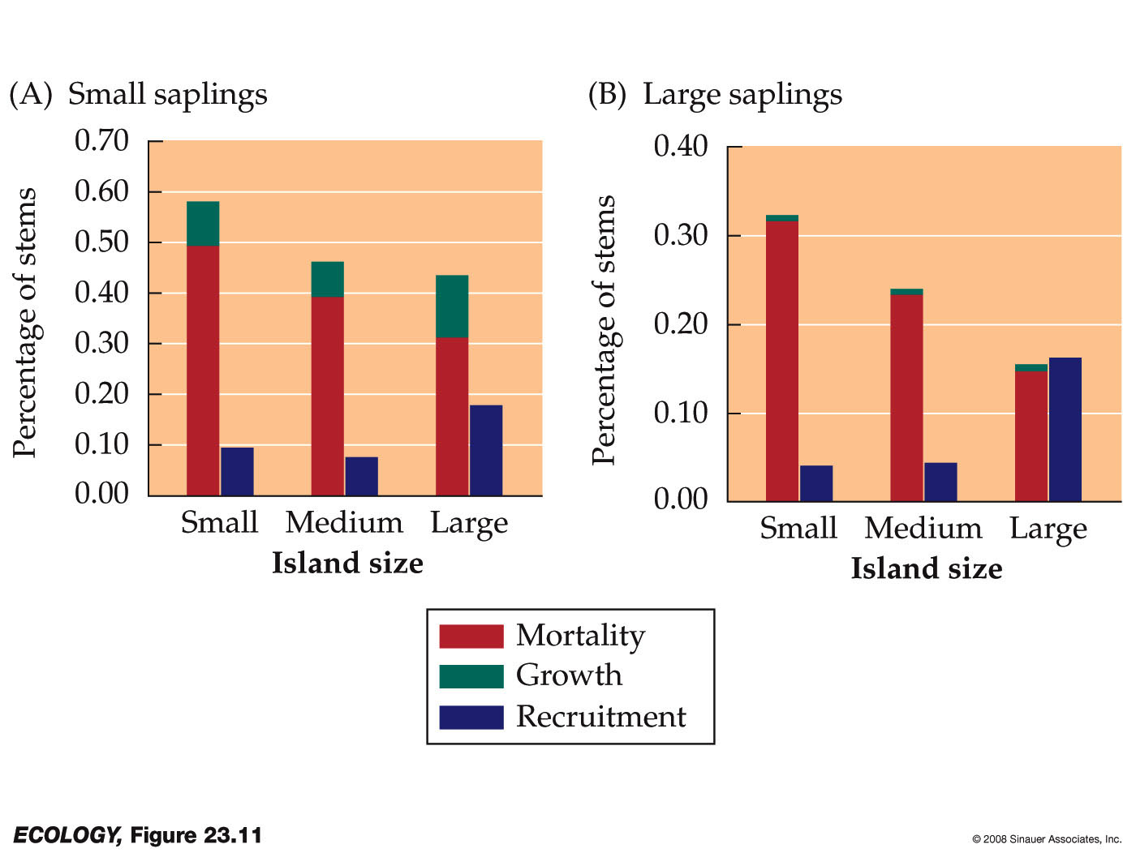
Habitat Loss
Effects of habitat fragmentation in Lago Guri (Terborgh et al. 2006).
Top predators were rare on the smaller islands, reducing top-down regulation; predators of plants, seeds, & inverts, were 10-100x more abundant on the islands than the mainland.
Notes:
This landscape change was studied by Terborgh et al. (2006).
Small and medium-sized islands were lacking the top predators found on the mainland—cats, raptors, large snakes.
Generalist herbivores, seed predators, and predators of invertebrates were 10 to 100 times more abundant on the islands.
This had a dramatic effect on the vegetation: Tree recruitment decreased and tree mortality increased due to high rates of herbivory, primarily by leaf-cutter ants.
This was seen as an example of top-down regulation.

Slide 28
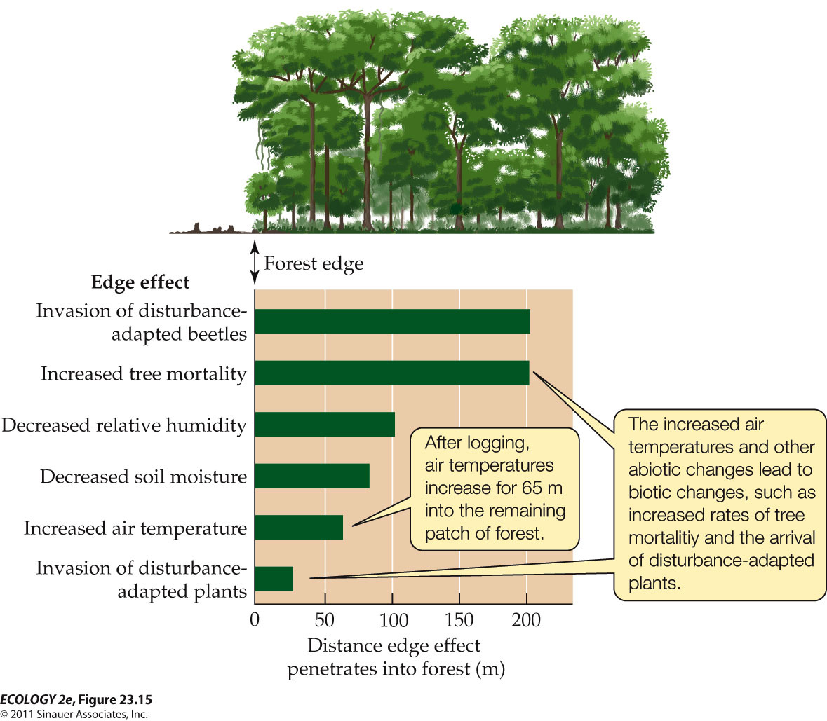
Fragmentation and Edge Effects
(Laurance et al. 2002)
Notes:
Ecology2e-Fig-23-15-0.jpg

Slide 29
End on Wed

