Slide 1
Lecture 11: island biogeography hypothesis May 8, 2017
Shannon calculation using Ln (log_{e})
Species area curve – observed relationship
Hypothesized mechanism, i.e. IBH
Preview of application

Slide 2
announcements
Reading
Chap 14 agriculture
Chap 11 pollution, that follows from ag
Homeworks
#3: stream biodiversity in context (due Wed)
#4: Island biodiversity (due Wed May 17)
Quiz 2 – Mon May 22
Species area curves
Mechanisms of island biodiversity

Slide 3
Comments on next quiz
In class | Homework | quiz
Simpson and Shannon | #3
Species area curve | #4
Island biodiversity equilibrium | #4
Applied to the questions of habitat area, connectivity and land use.
Impact of agriculture and pollution (from the reading).

Slide 4
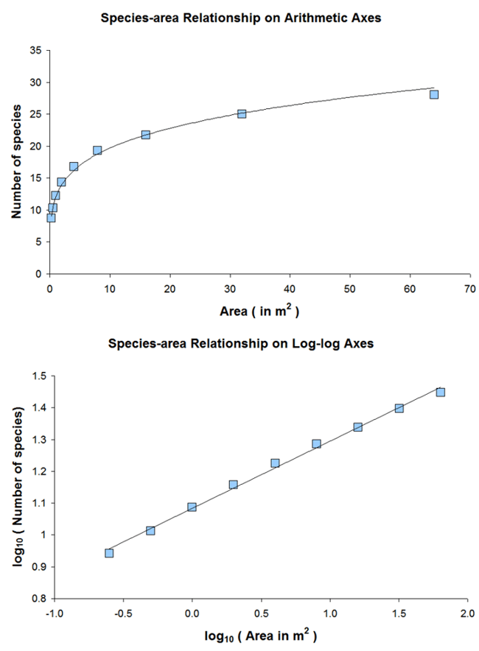
Species-Area Curves
Log area is common.
For example, as area gets 10 times bigger, increase in species by roughly 50% to 100% (doubles)
No matter where you start

Slide 5
Species-Area Curves
This idea has been generalized:
S = C * A^{Z}
S = species richness
C = a taxonomic specific constant (species/area)
A = Area
Z = similar for many islands, typically < 0.1

Slide 6
Species area curve
S = C*A^{z}
C = .2 species/km^2
z = .3
11-1 Plot from 10 km^2 to 1000km^2

Slide 7
Species area curve
S = C*A^{z}
Curve
C = .2 species/km^2
z = .3
Plot from 10 km^2 to 1000km^2
C 5
z 0.3
10 10.0
30 13.9
50 16.2
100 19.9
300 27.7
500 32.3
1000 39.7

Slide 8
Island Biogeography
EO Wilson’s studies on ants led to the theory of island biogeography.
Every 10x increase in island area led to a 2x increase in the number of ant species (ant S).
An equilibrium ant S on an each island: ant S depends on island size & distance from source
Teamed w/ MacArthur to make theory: 1963

Slide 9
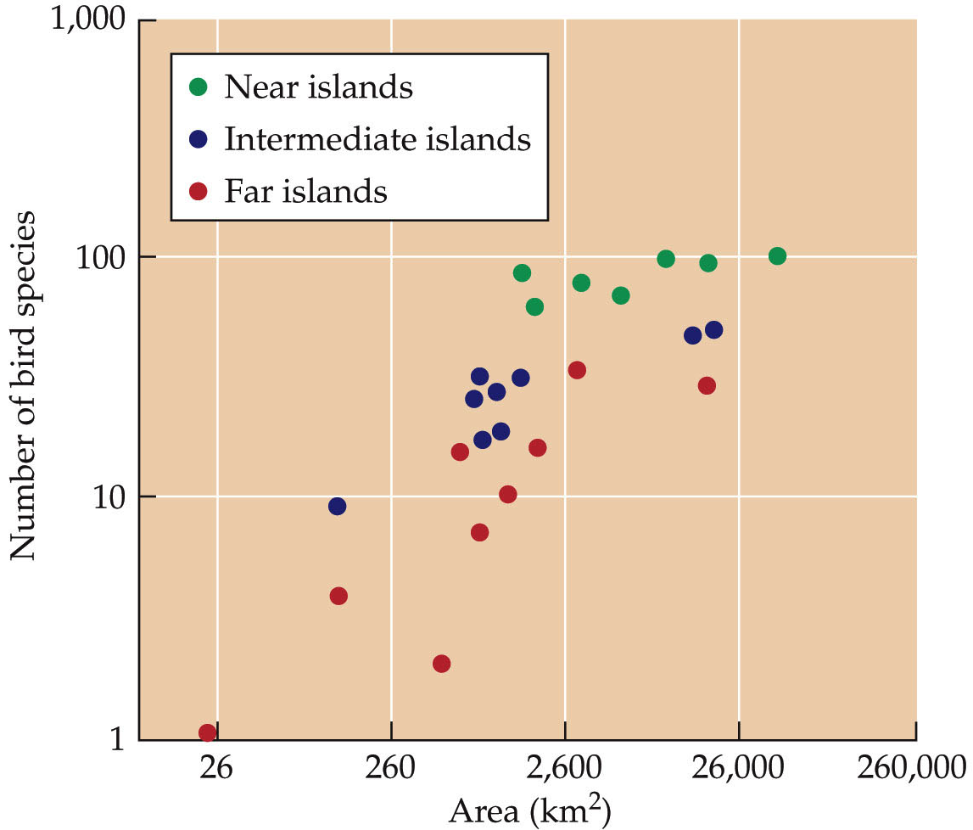
Island Biogeography – MacArthur & Wilson 1963
MacArthur & Wilson (1963) islands off New Guinea
From Cain et al. Ecology.

Slide 10
Island Biogeography Theory
S
Lowest
As distance increases,
S decreases.
As area increases,
S increases.
Mainland
S
Highest

Slide 11
Island Biogeography Theory
Examine equilibrium number of species
Area effect: Larger islands support higher S due to more complex habitat and lower extinction rates due to larger populations.
Isolation effect: Nearer islands
support higher S due to greater
immigration and recolonization
rates.

Slide 12
Island Biogeography Theory
MacArthur and Wilson 1967
Number of Species
Time
Why time? What does this represent?

Slide 13
Island Biogeography Theory
Near
Far
Rate of Immigration
Number of Species
MacArthur and Wilson 1967

Slide 14
Island Biogeography Theory
Small
Rate of Extinction
Large
Number of Species
MacArthur and Wilson 1967

Slide 15
Island Biogeography Theory
If we have species immigration rate and species extinction rate, we can calculate S.
S = Immigration – Extinction
Equilibrium S occurs when Immigration = Extinction
(Note the similarity to population growth = b – d + i – e)

Slide 16
Island Biogeography Theory
Near Mainland
Small Island
Far
Large
Rate of Immigration
Rate of Extinction
Equilibrium Number of Species (S)
MacArthur and Wilson 1967
What Does Equilibrium Mean?

Slide 17
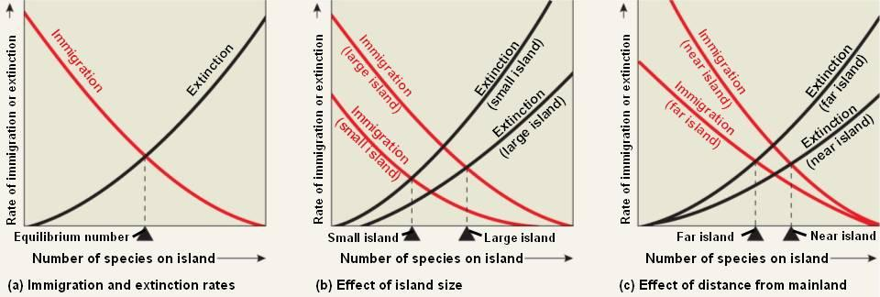
Island Biogeography Theory
MacArthur and Wilson 1967

Slide 18
Island Biogeography Theory
Small Island
Far from Mainland
Rate of Immigration
Rate of Extinction
Number of Species (S)
MacArthur and Wilson 1967

Slide 19
Island Biogeography Theory
Near Mainland
Large Island
Rate of Immigration
Rate of Extinction
Number of Species (S)
MacArthur and Wilson 1967

Slide 20
Island Biogeography Theory
Rate of Immigration
Rate of Extinction
Number of Species (S)
10-3. Fill in the graph for near the mainland, small island. Relatively how many species (high, medium-high, medium, medium-low, low)?

Slide 21
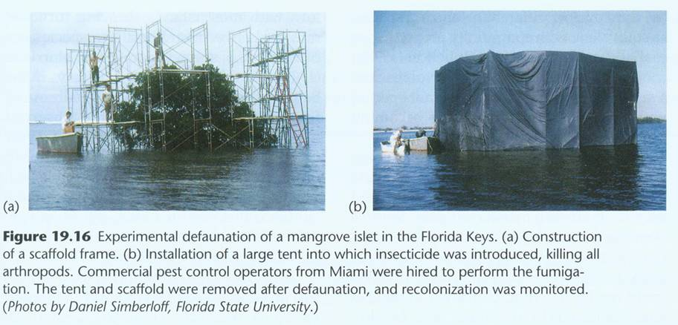
Simberloff: Experimental Test

Slide 22
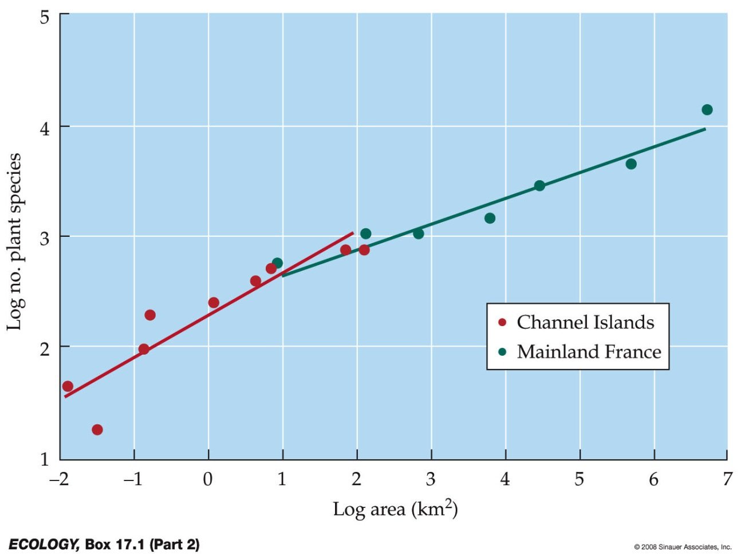
Island Biogeography
Does island biogeography apply to habitat ‘islands’ on continents?
Why do islands start with fewer-than predicted species at small areas compared with continents?
From Cain et al. Ecology.
Notes:
mainlands less isolation so rescue effect/colonization more frequent (hence small areas have more species)
Species–area curves were plotted for plants on the Channel Islands and the French mainland. Curves for islands tend to have steeper slopes than those for mainlands. Islands include all kinds of isolated areas surrounded by dissimilar habitat (matrix habitat).
Habitat fragments, such as in the Amazon forest, can be considered as islands.
All display the same basic pattern: Large islands have more species than small islands.

Slide 23
Island Biogeography
Can theory can be applied to habitat ‘islands’ on larger land masses?
Examples?
Notes:
mainlands less isolation so rescue effect/colonization more frequent (hence small areas have more species)
Species–area curves were plotted for plants on the Channel Islands and the French mainland. Curves for islands tend to have steeper slopes than those for mainlands. Islands include all kinds of isolated areas surrounded by dissimilar habitat (matrix habitat).
Habitat fragments, such as in the Amazon forest, can be considered as islands.
All display the same basic pattern: Large islands have more species than small islands.

Slide 24
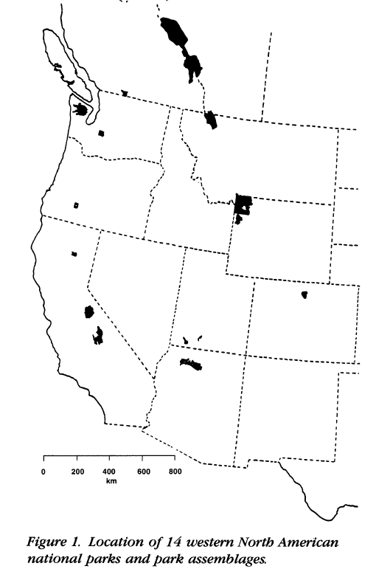
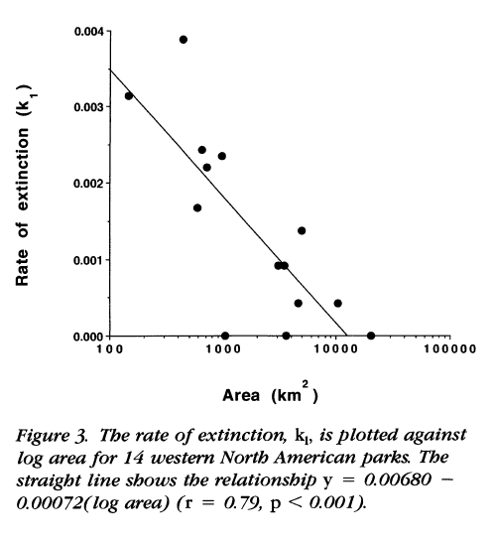
Species and Area
W.D.Newmark Conservation Biology 1995: Rate of mammal extinction in western parks.

