Slide 1
Lecture 10: Island Biogeography Wed May 3, 2017
Conditions for high biodiversity
Species vs. area curves
Island biogeography hypothesis

Slide 2
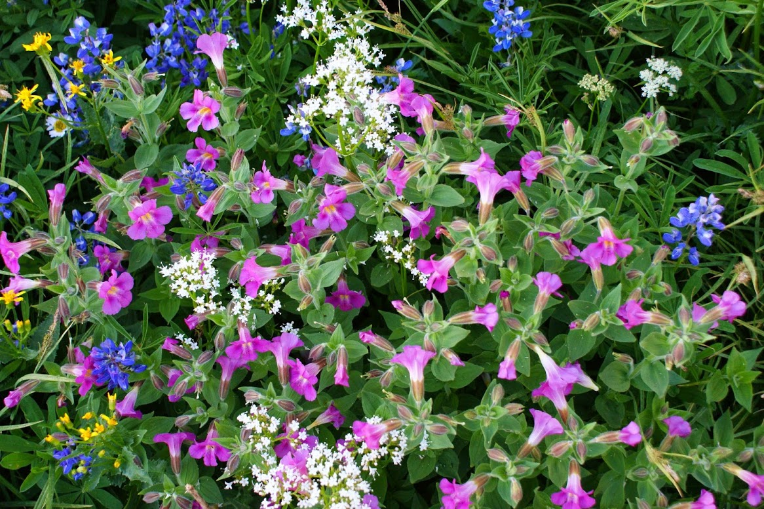
What factors are related to species richness?

Slide 3
Four factors that relate to biodiversity
From text – what are they

Slide 4
Four factors
Latitude
Time
Habitat size
Distance from other communities

Slide 5
Focus on size and distance

Slide 6
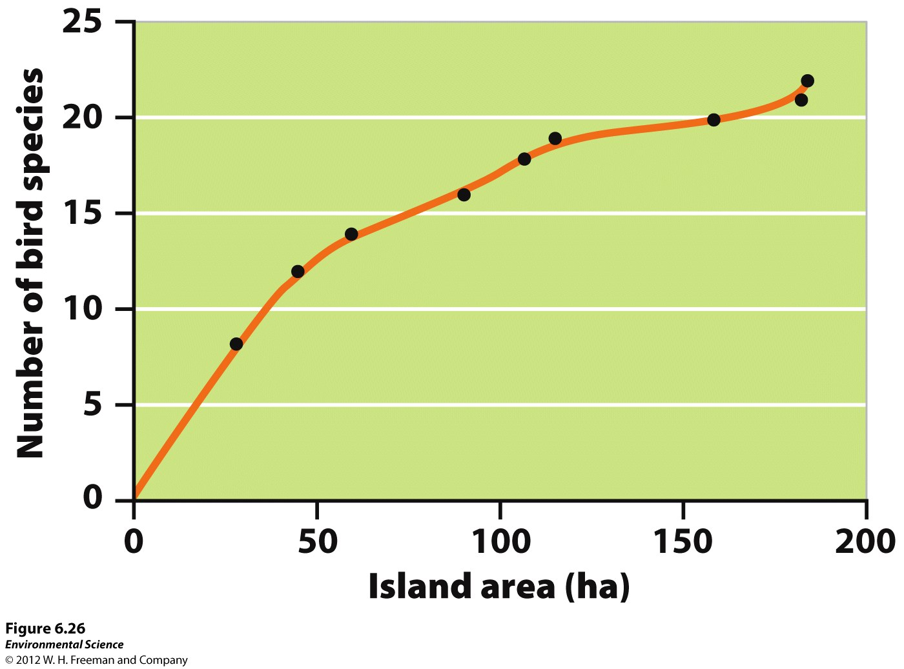
Island size affects species diversity.

Slide 7
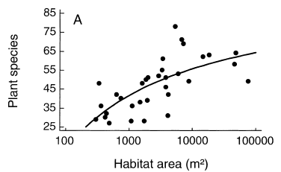
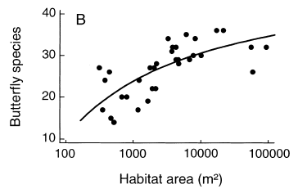
Species and Area
Steffan-Dewenter & Tscharntke 2000:
Notes:
The effect of area on likelihood of occupation by a species translates up to whole communities.

Slide 8
Species and Area
Reach# | SpeciesFoundInSample | #Individuals/sp
1 | Bluntnose minnow | 8
1 | Gizzard shad | 11
1 | Longnose gar | 4
2 | Bluntnose minnow | 9
2 | Common carp | 8
2 | Gizzard shad | 18
2 | Mimic shiner | 6
3 | Golden redhorse | 16
3 | Shorthead redhorse | 12
3 | Bluntnose minnow | 3
3 | Longnose gar | 3
4 | Gizzard shad | 21
4 | Golden redhorse | 14
4 | Longnose gar | 2
4 | Spotfin shiner | 9
5 | Gizzard shad | 14
5 | Quillback | 5
5 | Mimic shiner | 8
5 | Shorthead redhorse | 8
Example: Fish found in Kankakee River, Illinois (species from Kwak & Peterson 2007)
Notes:
The effect of area on likelihood of occupation by a species translates up to whole communities.

Slide 9
Species and Area
Reach# | SpeciesFoundInSample | #Individuals/sp
1 | Bluntnose minnow | 8
1 | Gizzard shad | 11
1 | Longnose gar | 4
2 | Bluntnose minnow | 9
2 | Common carp | 8
2 | Gizzard shad | 18
2 | Mimic shiner | 6
3 | Golden redhorse | 16
3 | Shorthead redhorse | 12
3 | Bluntnose minnow | 3
3 | Longnose gar | 3
4 | Gizzard shad | 21
4 | Golden redhorse | 14
4 | Longnose gar | 2
4 | Spotfin shiner | 9
5 | Gizzard shad | 14
5 | Quillback | 5
5 | Mimic shiner | 8
5 | Shorthead redhorse | 8
10-1. Graph the species-area curve.
Species Richness
1 2 3 4 5
Number of Reaches
Notes:
The effect of area on likelihood of occupation by a species translates up to whole communities.

Slide 10
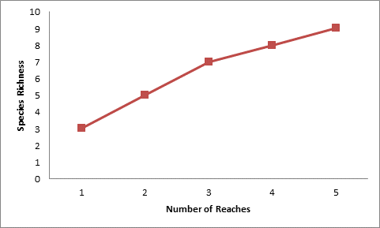
Species and Area
Reach# | SpeciesFoundInSample | #Individuals/sp
1 | Bluntnose minnow | 8
1 | Gizzard shad | 11
1 | Longnose gar | 4
2 | Bluntnose minnow | 9
2 | Common carp | 8
2 | Gizzard shad | 18
2 | Mimic shiner | 6
3 | Golden redhorse | 16
3 | Shorthead redhorse | 12
3 | Bluntnose minnow | 3
3 | Longnose gar | 3
4 | Gizzard shad | 21
4 | Golden redhorse | 14
4 | Longnose gar | 2
4 | Spotfin shiner | 9
5 | Gizzard shad | 14
5 | Quillback | 5
5 | Mimic shiner | 8
5 | Shorthead redhorse | 8
Q5. Graph the species-area curve.
Notes:
The effect of area on likelihood of occupation by a species translates up to whole communities.

Slide 11
Species and Area
Reach# | SpeciesFoundInSample | #Individuals/sp
1 | Bluntnose minnow | 8
1 | Gizzard shad | 11
1 | Longnose gar | 4
2 | Bluntnose minnow | 9
2 | Common carp | 8
2 | Gizzard shad | 18
2 | Mimic shiner | 6
3 | Golden redhorse | 16
3 | Shorthead redhorse | 12
3 | Bluntnose minnow | 3
3 | Longnose gar | 3
4 | Gizzard shad | 21
4 | Golden redhorse | 14
4 | Longnose gar | 2
4 | Spotfin shiner | 9
5 | Gizzard shad | 14
5 | Quillback | 5
5 | Mimic shiner | 8
5 | Shorthead redhorse | 8
10-2. Group:
How is this useful? For sampling? For conservation?
Notes:
The effect of area on likelihood of occupation by a species translates up to whole communities.

Slide 12
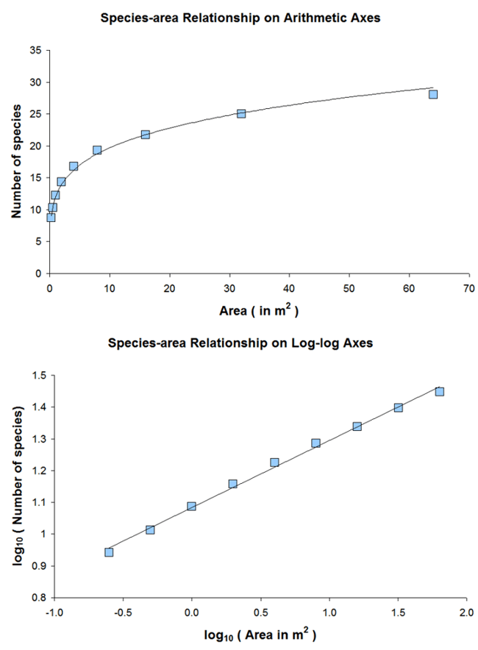
Species-Area Curves
Log area is common.
For example, as area gets 10 times bigger, increase in species by roughly 50%
No matter where you start

Slide 13
Species-Area Curves
This idea has been generalized:
S = C * A^{Z}
S = species richness
C = a taxonomic specific constant (species/area)
A = Area
Z = similar for many islands, typically < 0.1

Slide 14
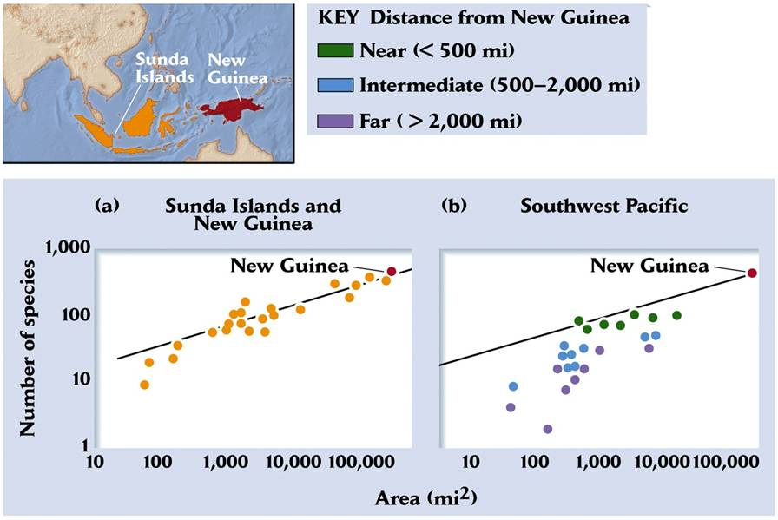
Species Richness as a f(area, distance)

Slide 15
Species Richness as a Function of Distance

Slide 16
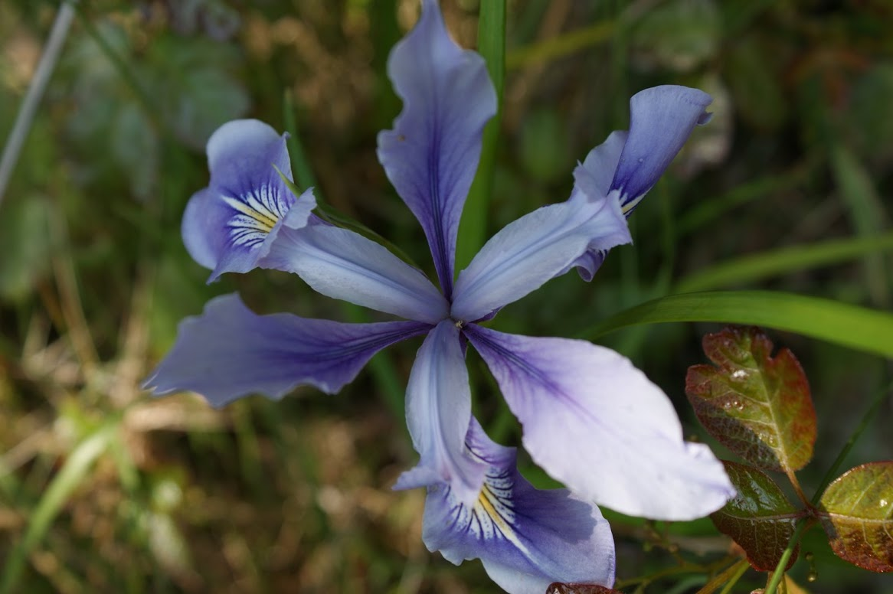

Slide 17
Island Biogeography
EO Wilson’s studies on ants led to the theory of island biogeography.
Every 10x increase in island area led to a 2x increase in the number of ant species (ant S).
An equilibrium ant S on an each island: ant S depends on island size & distance from source
Teamed w/ MacArthur to make theory: 1963

Slide 18
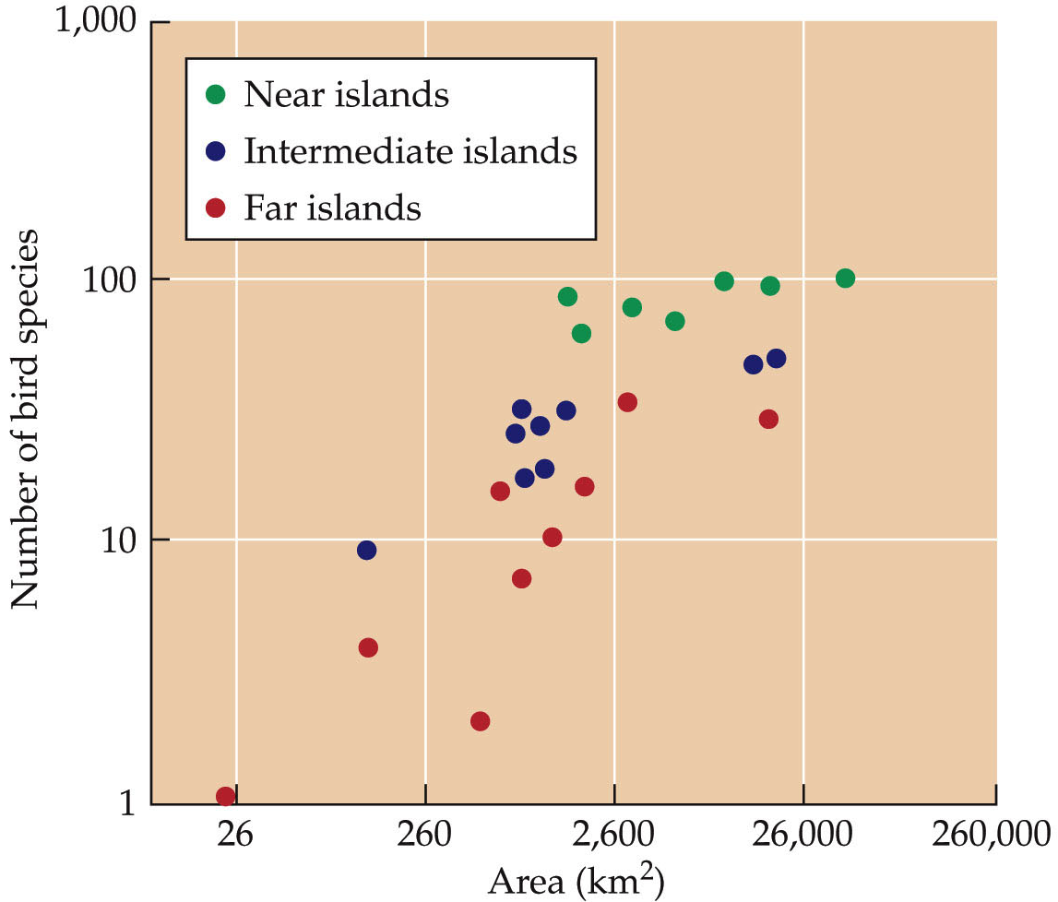
Island Biogeography – MacArthur & Wilson 1963
MacArthur & Wilson (1963) islands off New Guinea
From Cain et al. Ecology.

Slide 19
Island Biogeography Theory
S
Lowest
As distance increases,
S decreases.
As area increases,
S increases.
Mainland
S
Highest

Slide 20
Island Biogeography Theory
Examine equilibrium number of species
Area effect: Larger islands support higher S due to more complex habitat and lower extinction rates due to larger populations.
Isolation effect: Nearer islands
support higher S due to greater
immigration and recolonization
rates.

Slide 21
Island Biogeography Theory
MacArthur and Wilson 1967
Number of Species
Time
Why time? What does this represent?

Slide 22
Island Biogeography Theory
Near
Far
Rate of Immigration
Number of Species
MacArthur and Wilson 1967

Slide 23
Island Biogeography Theory
Small
Rate of Extinction
Large
Number of Species
MacArthur and Wilson 1967

Slide 24
Island Biogeography Theory
If we have species immigration rate and species extinction rate, we can calculate S.
S = Immigration – Extinction
Equilibrium S occurs when Immigration = Extinction
(Note the similarity to population growth = b – d + i – e)

Slide 25
Island Biogeography Theory
Near Mainland
Small Island
Far
Large
Rate of Immigration
Rate of Extinction
Equilibrium Number of Species (S)
MacArthur and Wilson 1967
What Does Equilibrium Mean?

Slide 26
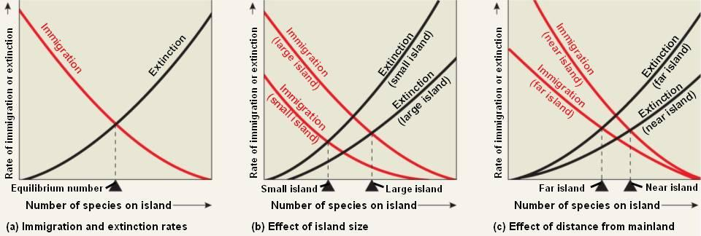
Island Biogeography Theory
MacArthur and Wilson 1967

Slide 27
Island Biogeography Theory
Small Island
Far from Mainland
Rate of Immigration
Rate of Extinction
Number of Species (S)
MacArthur and Wilson 1967

Slide 28
Island Biogeography Theory
Near Mainland
Large Island
Rate of Immigration
Rate of Extinction
Number of Species (S)
MacArthur and Wilson 1967

Slide 29
Island Biogeography Theory
Rate of Immigration
Rate of Extinction
Number of Species (S)
10-3. Fill in the graph for near the mainland, small island. Relatively how many species (high, medium-high, medium, medium-low, low)?

Slide 30
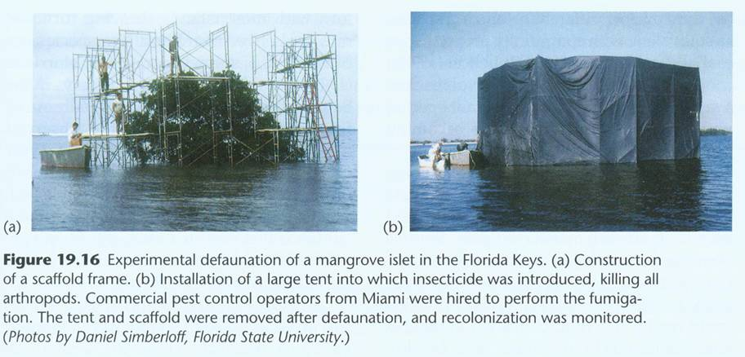
Simberloff: Experimental Test

Slide 31
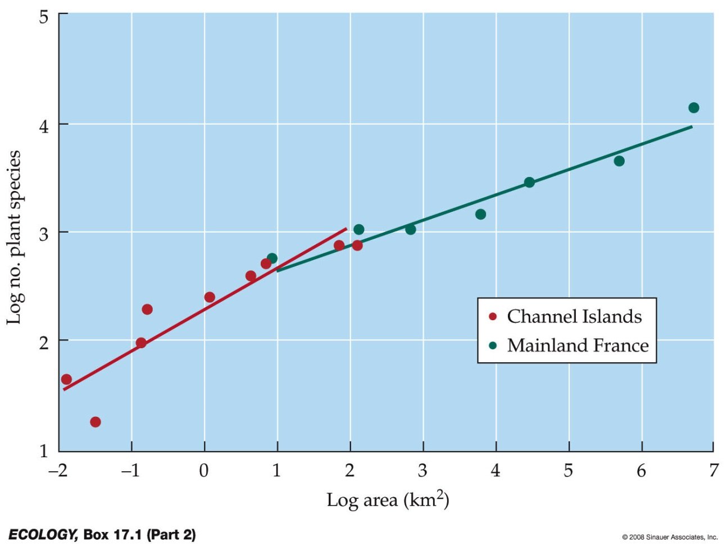
Island Biogeography
Does island biogeography apply to habitat ‘islands’ on continents?
Why do islands start with fewer-than predicted species at small areas compared with continents?
From Cain et al. Ecology.
Notes:
mainlands less isolation so rescue effect/colonization more frequent (hence small areas have more species)
Species–area curves were plotted for plants on the Channel Islands and the French mainland. Curves for islands tend to have steeper slopes than those for mainlands. Islands include all kinds of isolated areas surrounded by dissimilar habitat (matrix habitat).
Habitat fragments, such as in the Amazon forest, can be considered as islands.
All display the same basic pattern: Large islands have more species than small islands.

Slide 32
Island Biogeography
Can theory can be applied to habitat ‘islands’ on larger land masses?
Examples?
Notes:
mainlands less isolation so rescue effect/colonization more frequent (hence small areas have more species)
Species–area curves were plotted for plants on the Channel Islands and the French mainland. Curves for islands tend to have steeper slopes than those for mainlands. Islands include all kinds of isolated areas surrounded by dissimilar habitat (matrix habitat).
Habitat fragments, such as in the Amazon forest, can be considered as islands.
All display the same basic pattern: Large islands have more species than small islands.

Slide 33
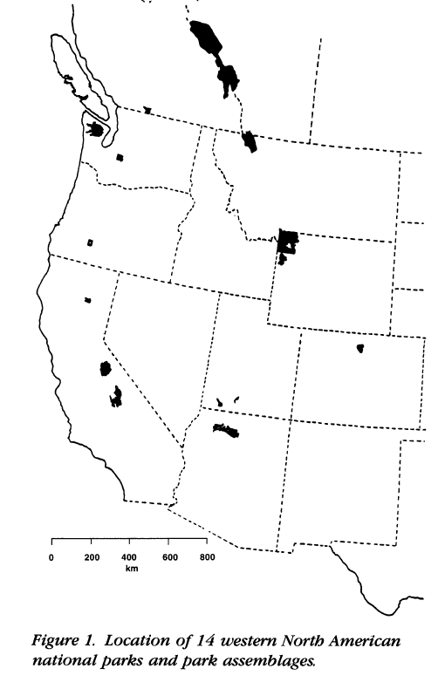
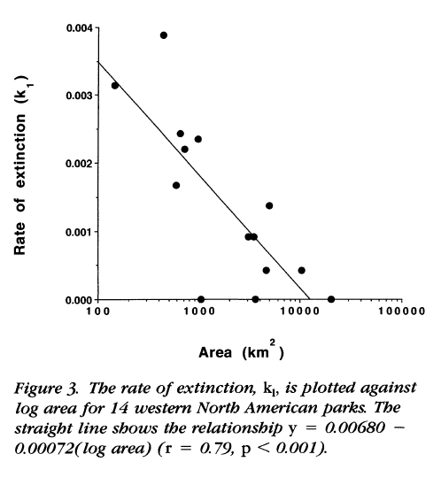
Species and Area
W.D.Newmark Conservation Biology 1995: Rate of mammal extinction in western parks.

