Slide 1
ESM 221 Applied Environmental Studies: Preparation for Problem Solving
Dr. John Rueter

Slide 2
Outline
Course organization & goals
Biodiversity & ecosystem function
Population growth introduction
factors affecting growth
exponential growth

Slide 3
Course Goals
This course is focused on solving environmental management problems.
We will explore concepts and tools that can be used to apply the principles of ecology for the protection of biodiversity and the restoration and maintenance of ecosystem functions.

Slide 4
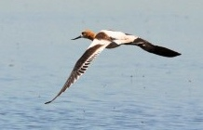
Carp in Malheur WR, a crucial stopover for migratory birds
Millions of non-native carp causing declines in plants & insects that birds need.
Used to be >500,000 birds stopped each day; now 50,000
Failed approaches: dynamite, poison, draining (for suffocation), screens… but carp always repopulated after 2-4 yrs
Question: What should we do?
Photos: http://www.oregonlive.com/
Notes:
100 yr
Common carp
http://www.oregonlive.com/environment/index.ssf/2015/12/post_46.html#incart_river_home

Slide 5
Introductions
Prof. John Rueter
Course syllabus
Assignment 1 due date, in-class dropbox
Book
How to Succeed in this course:
Attend class! Take notes!
Always bring: Paper AND laptop
In-class and weekly assignments are designed to help you ace the tests.
Labs: Provide valuable hands-on experience. Embrace and enjoy.
Notes:
15 minutes

Slide 6
Introductions
Interview two of your neighbors and for each:
Write down name, email (if shares); check lab section
Share one life experience that informed your decision to study environmental science or studies.
What you think is the #1 environmental issue you’d like to contribute towards solving.
Discuss the biggest challenges to implementing environmental management for your issues?
Share some of the issues & challenges w/ class. Do not turn in.
Notes:
15 minutes

Slide 7
Group work
You will do a lot of individual and group work in this class from identifying simple definitions to figuring out solutions to problems.
Each class day at the end of class, turn in your answers to the work.
Keep your returned responses for reference and studying.

Slide 9
Biodiversity & Ecosystem Function
Q1. Define these terms:
a. Population
b. Species
c. (Ecological) Community
d. Biodiversity
e. Ecosystem
f. Biome
g. Biosphere
Notes:
First, what is a population? Morphologically, behaviorally, or biochemically distinct group of organisms

Slide 10
Biodiversity is declining globally.
of birds on the Pacific island of Eua (Tonga)
Humans having been causing extinctions for centuries.
Notes:
Anthropogenic extinctions have been occurring for millennia (e.g., 8,000 island birds went extinct following Polynesian colonization)
Note the deceit of the x axis.

Slide 11
Extinction rates estimated from the fossil record are 2-3 orders of magnitude lower than now.
The extinction rate for mammals and birds: background: 1 species every 200 years current: 1 species per year,
Average species life span: background: 1-10 million years; current: 10,000 years.
Notes:
Rates of extinction are estimated using indirect measures.
Extinction rates determined from the fossil record are used as background rates against which to compare current rates.
Current extinction rate estimation relies on:
The species–area relationship.
Changes in the threat status of species (e.g., shift from endangered to critically endangered).
Rates of population decline or range contraction of common species.

Slide 12
Declining Biodiversity
Declining global biodiversity can be explained by reference to the five HIPCO factors H Habitat Loss & fragmentation
I Invasive Species
P Pollution
C Climate Change
O Overharvesting (direct killing)

Slide 13
What do we need to know to manage populations and ecosystems and restore biodiversity and ecosystem function?
1. What do we know about populations?
2. How can we manage local biodiversity and ecosystem functions?
3. How can we manage global cycles?
Notes:
5 minutes

Slide 14
Biodiversity and ecosystem function are related
Notes:
Atmospheric composition & deposition: nitrogen deposition
Ecosystem processes include productivity and nutrient cycling.
Regional processes include trace gas fluxes to the atmosphere and nutrient fluxes from terrestrial to aquatic systems.

Slide 15
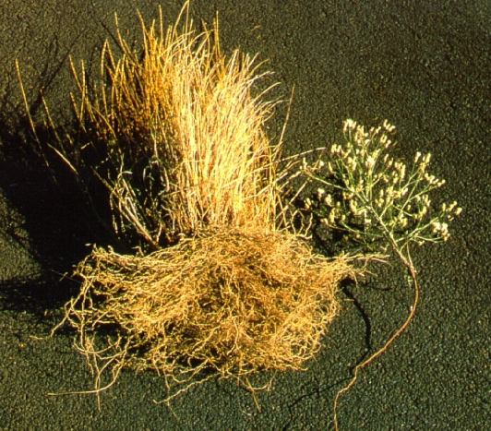
Species have unique roles. Their functional traits affect ecosystem process of erosion rate
Example: Fibrous root of native bunch grass vs. taproot of the non-native spotted knapweed

Slide 17
Population Growth
Notes:
First, what is a population? Morphologically, behaviorally, or biochemically distinct group of organisms

Slide 18
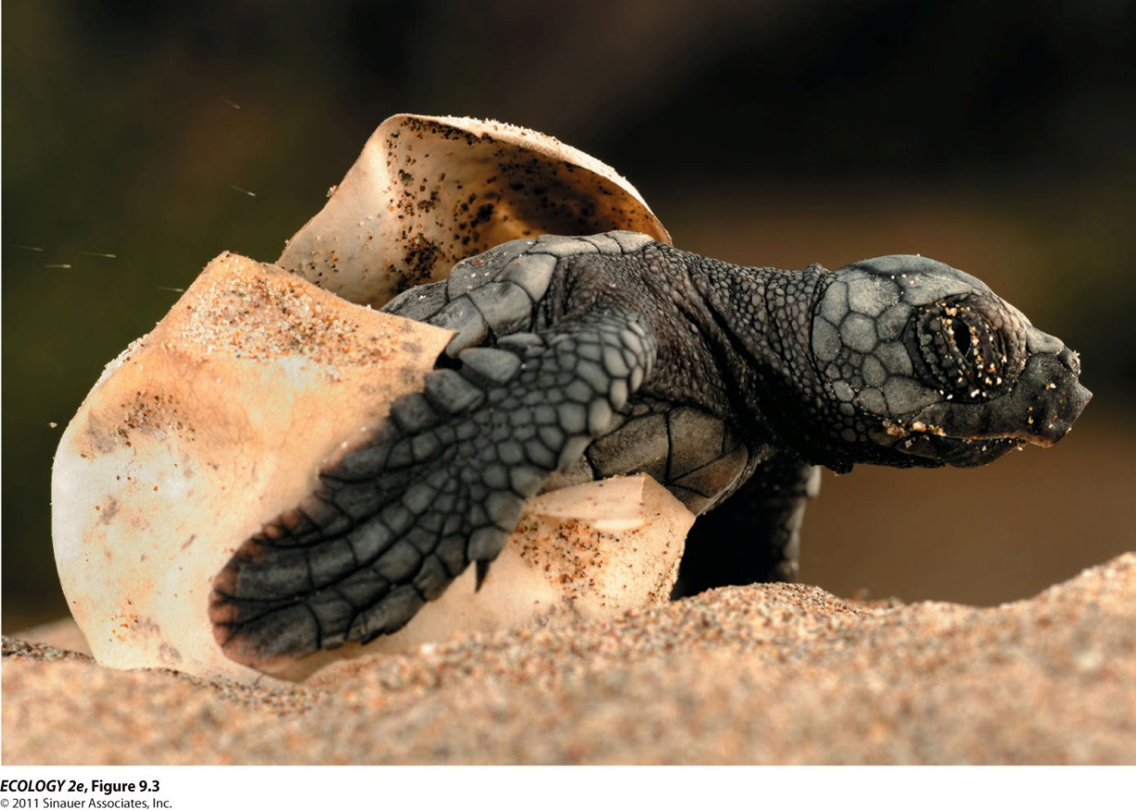
Information about births and deaths is essential to predict future population size and inform management.
How would you get this information?
Notes:
How get?
Follow a cohort over time for survival and # offspring (cohort life table).
Snapshot in time (static lifetable) of different ages. Better if v. long lived & can estimate ages (more assumptions)

Slide 19
Population dynamics: What primary factors affect population size?
N_{t+1}= N_{t} + B - D + I - E
N_{t} = initial population size at time t
B = number of individuals born during the time interval
D = number of individuals that die during t
I = number that immigrate during t
E = number that emigrate during t

Slide 20
2. Complete the new population size for these two examples
N_{t+1}= N_{t} + B - D + I - E
Population of finches on an island over 1 yr
N_{t} = 463
B = 87
D = 93
I = 39
E = 14
N_{t+1} =
Population of Daphnia in a small pond over summer (3 months)
N_{t} = 14, 207
B = 8,212
D = 4,945
N_{t+1} =

Slide 21
2. Completed population size examples
N_{t+1}= N_{t} + B-D + I-E
Population of Finches on an island during 1 year
N_{t} = 463 463
+ B = 87 87
- D = 93 + 39
+ I = 39 589
- E = 14 -107
N_{t+1}= 482
Population of Daphnia in a small pond over 3 summer months
N_{t}: 14, 207
+ B: 8,212
22,419
- D: 4,945
N_{t+1} = 17,474

Slide 22
Definitions
What does per capita mean?
What does rate mean?
Notes:
Rate: change over time

Slide 23
Developing a growth rate equation to predict population change (1)
For simple predictions, we assume no E or I. Why?
Formula becomes: N_{t+1}= N_{t} + B - D
To allow you to model population size across time periods, re-write N_{t+1}- N_{t} as: dN/dt = B-D d is shorthand for ‘the change in’ (derivative of)
The change in N (pop size) with respect to changing t (time) is written: dN/dt = population growth rate
dN/dt is an operator (don’t divide N by t)

Slide 24
Developing a growth rate equation to predict population change (2)
Birth and death are combined into the term growth rate, number of births minus deaths in the time period: B – D
Growth rate is typically expressed per capita, (because population size affects the population-level growth rate): B/N – D/N = r; b-d=r. b = per capita birth rate; d = per capita death rate
Rate of change in N can be written: dN/dt = rN_{t}
Exponential growth is described as dN/dt = rN_{t}

Slide 25
The intrinsic growth rate (r)
Definition: Under ideal conditions, with unlimited resources available, every population has a particular maximum growth potential for growth.
Notated as r or r_{max}
= b – d under ideal conditions

Slide 26
3. Calculate growth rate
Population of Finches on a remote island during 1 yr
N_{t} = 463
B = 87
D = 93
What is the growth rate, r?
= b-d = B/N-D/N = (B-D)/N = r

Slide 27
3. Calculate growth rates
Population of Finches on a remote island during 1 year
N_{t} = 463
B = 87
D = 93
B/N-D/N = (87-93)/463 = r = -0.013
Population of Daphnia in a small pond over 3 months
N_{t} = 14, 207
B = 8,212
D = 4,945
What is the growth rate, r?

Slide 28
3. Calculated growth rates for examples
Population of Finches on a remote island during 1 year N_{t} = 463
B = 87
D = 93
What is the growth rate? r= -0.013
Population of Daphnia in a small pond over 3 summer months
N_{t} = 14,207
B = 8,212
D = 4,945
What is the growth rate? B/N-D/N = (8,212-4,945)/14,207
= r = 0.23

Slide 29
4. Check in on r
Write a group definition of r
What information do you need to calculate r?
Notes:
Units: individuals / individual * time

Slide 31
Quick Review of log and e: Logarithms are the inverse of exponentials
100 = 10²; log₁₀(100)=2; log₁₀(10²)=2; log (100)=2
The base of the log can be 10 or e…
e, Euler’s constant ≈ 2.718, is the base of the natural logarithm,
log_{e}=ln(x)
In Excel, e^{x} is written as exp(x);
using your calculator…
1. What is the natural log of 2 = log_{e}(2)= ln(2) = ____? type 2, press ln
2. e^{3.73767} = ___ ? type 3.73767, then press e^{x} (2nd function)
3. log(10)= ____? ln(e) = ____ ? ln(e^{x})= _____
(Natural log = area under the curve of y=1/x)
Notes:
Type in ‘2’ and then push the LN button = 0.69.
Type in 3.73767 and then e^{x} (you may need to use the 2nd function button for this, I do). The answer is 42 (note that e = 2.718 so e¹ = 2.718)
=1 because e is the base of the natural logarithm. For log base 10, the log(10) = 1. ln (e^x) = x
Natural log = area under the curve of y=1/x as long as x is a real, + #. Given that integration (calculus) is all about the area under the curve, e appears often in models derived from calculus.

Slide 32
Quick Review of log and e: Logarithms are the inverse of exponentials
100 = 10²; log₁₀(100)=2; log₁₀(10²)=2; log (100)=2
The base of the log can be 10 or e…
e, Euler’s constant ≈ 2.718, is the base of the natural logarithm,
log_{e}=ln(x)
In Excel, e^{x} is written as exp(x);
using your calculator…
1. What is the natural log of 2 = log_{e}(2)= ln(2) = _0.69___? 2. e^{3.73767} = _42__ ?
3. log(10)= _1___? ln(e) = _1___ ? ln(e^{x})= _x____
(Natural log = area under the curve of y=1/x)
Notes:
Type in ‘2’ and then push the LN button = 0.69.
Type in 3.73767 and then e^{x} (you may need to use the 2nd function button for this, I do). The answer is 42 (note that e = 2.718 so e¹ = 2.718)
=1 because e is the base of the natural logarithm. For log base 10, the log(10) = 1. ln (e^x) = x
Natural log = area under the curve of y=1/x as long as x is a real, + #. Given that integration (calculus) is all about the area under the curve, e appears often in models derived from calculus.

Slide 33
Definitions: Review
Population: individuals of a species that live in the same area at a given time
Species: a group of organisms that are morphologically, behaviorally, or biochemically distinct from other groups and that produce viable offspring with each other but can’t with others
Community: suite of species that co-occur in time and space
Biodiversity: variety of life forms
Ecosystem: interacting biotic & abiotic components of an area
Biome: region & its biological community shaped by regional temperatures, amount of precipitation, soil, & disturbance (land) or in salinity, depth, and flow (aquatic; less used)
Biosphere: the combination of all living organisms & our ecosystems; where life resides
r = per capita growth rate and often intrinsic growth rate, the per capita growth rate of a population in ideal conditions

Slide 34
Exponential Growth
In many species, the population can reproduce continuously, and generations can overlap.
When populations increase by a constant proportion of the population size (yet by ever more individuals each time period), there is exponential growth (or if declining, exponential decay).
E.g., a population doubles in size every 10 yr
Notes:
example of doubling (2x is constant proportion...)

Slide 35
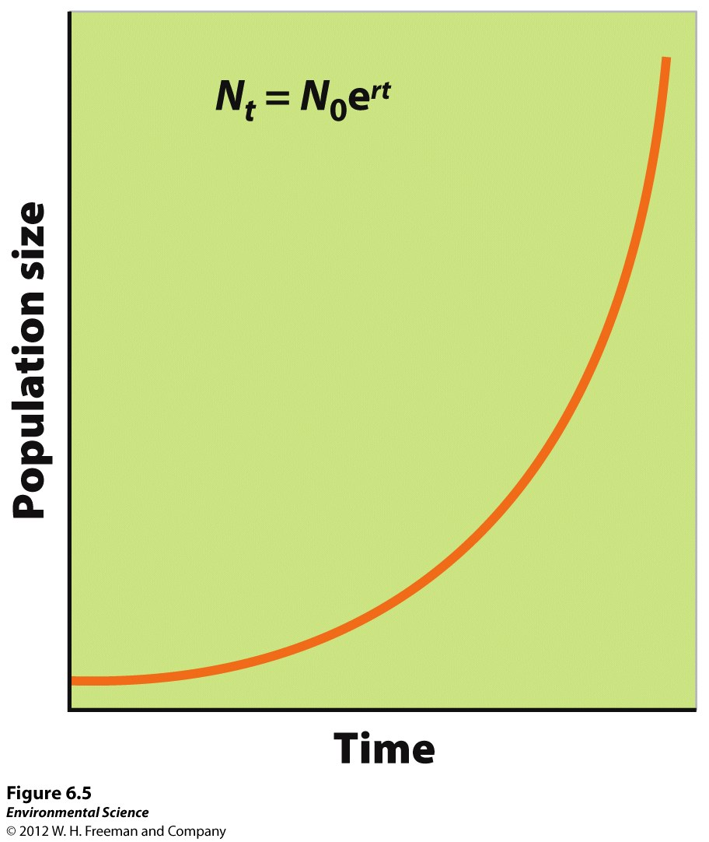
The exponential growth model describes a population with overlapping generations that grows continuously at a fixed rate.

Slide 36
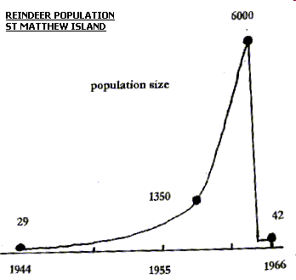
Example Population Growth

Slide 37
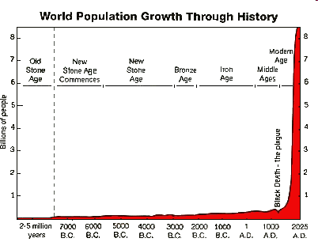
Human Population Growth

Slide 38
Exponential growth formula, the base model for population growth
N_{t}= N₀e^{rt}
Use this formula to predict for an exponentially ‘growing’ population one of: population size, intrinsic growth rate, or elapsed time
This formula assumes that conditions for survival and reproduction are ideal (= perfect)
This formula has many applications
(this equation is the integral of dN/dt = rN)

Slide 39
5. What do each of these variables mean?
N_{t} =
N₀ =
e =
r =
t =

Slide 40
6. Calculate population size after 1, 2, and 3 months of growth for this example:
Fruit flies in a lab culture with ideal conditions,
Initial population size (at time zero), N₀ = 147
Time, t = 1 month
Intrinsic growth rate, r = 0.1
Formula: N_{t}= N₀e^{rt}
All together for the first time step
Solving for N_{t}

Slide 41
6. Calculated size over three months
Fruit flies in a lab culture with ideal conditions,
Initial population size (at time zero), N₀ = 147
Time, t = 1 month
Intrinsic growth rate, r = 0.1
Formula: N_{t}= N₀e^{rt}
1 mo: N_{t}= 147* e^{0.1*1mo} = 162
2 mo:
3 mo:

Slide 42
6. Calculated size over three months
Fruit flies in a lab culture with ideal conditions,
Initial population size (at time zero), N₀ = 147
Time, t = 1 month
Intrinsic growth rate, r = 0.1
Formula: N_{t}= N₀e^{rt}
1 mo: N_{t}= 147* e^{0.1*1 mo} = 162
2 mo: N_{t}= 147* e^{0.1*2 mo} = 179
3 mo: N_{t}= 147* e^{0.1*3 mo} = 198
(note: the population grows by a greater amount each time step because more individuals are reproducing)

Slide 43
7. Challenge questions:
a. Draw N vs t for r = 0, N₀ = 500, for t = 0, 10, 20
b. Draw N vs t for r = 1, N₀ = 500, for t=0, 2, 5, 10
(put above 2 on the same graph)
c. Draw dN/dt on the Y axis versus N on the X axis. (What equation would you use?)
d. What would the slope be?

Slide 44
7. Challenge questions a, b:
N vs t for r = 0 & 1, N₀ = 500, for t=0, 2, 5, 10 yr

Slide 45
7. Challenge c & d: dN/dt vs N for N₀=500, r = 0, 0.5, 1
d. dN/dt = rN; slope = r

Slide 46
The doubling time (t_{d}) of a population is the number of years it will take the population to double in size.
ln(2) is a constant ≈ 0.693. (~0.7)
The larger r, the less time it takes for the population to double.
Initial population size does not matter here

Slide 47
8. Doubling time problems, Solve for t_{d} using t_{d} = ln(2)/r :
A continuously growing population of bears has a population size of 300 and its intrinsic rate of increase is 0.07 per year. Assuming that this rate of increase remains the same, about how long should it take for the population to reach 600? A. 5 years B. 10 years C. 14 years D. 20 years E. 28 years
In 2012 the human population hit 7 bil and growth rate is 0.0118. What is the doubling time for the human population? In what year do we expect our population to hit 14 billion?
Notes:
Note: added to HW as ran out of time.
0.69 / 0.0118 ≈ 58.7 years; in 2071.

Slide 48
8. Doubling time problems, using t_{d} = ln(2)/r :
A continuously growing population of bears has a population size of 300 (N₀) and its intrinsic rate of increase is 0.07 per year (r). Assuming that this rate of increase remains the same, about how long should it take for the population to reach 600 (= 2x N₀)? Ln (2)/r ~= 0.7/0.07 per yr = 10 yr
In Oct 2011 the human population hit 7 bil and growth rate, r, is 0.0118. What is the doubling time for the human population? In what year do we expect our population to hit 14 billion if this rate keeps constant? ln (2)/r = .69/0.118 = 58.47 yr 2011.83+58.47 yr = 2070 (8 billion in 2024!)
Notes:
Note: added to HW as ran out of time.
0.69 / 0.0118 ≈ 58.7 years; in 2071.

Slide 49
9. Optional challenge: derive doubling time equation
Derive from N_{t} = N₀e^{rt}
To start, what is N_{t} in terms of N₀ given that we’re doubling?
Notes:
N_{t}=2*N₀; so: 2*N₀=N_{0*}e^{rt} ; divide by N₀: 2 = e^{rt}
take the ln of both sides: ln(2) = rt; t=ln(2)/r

Slide 50
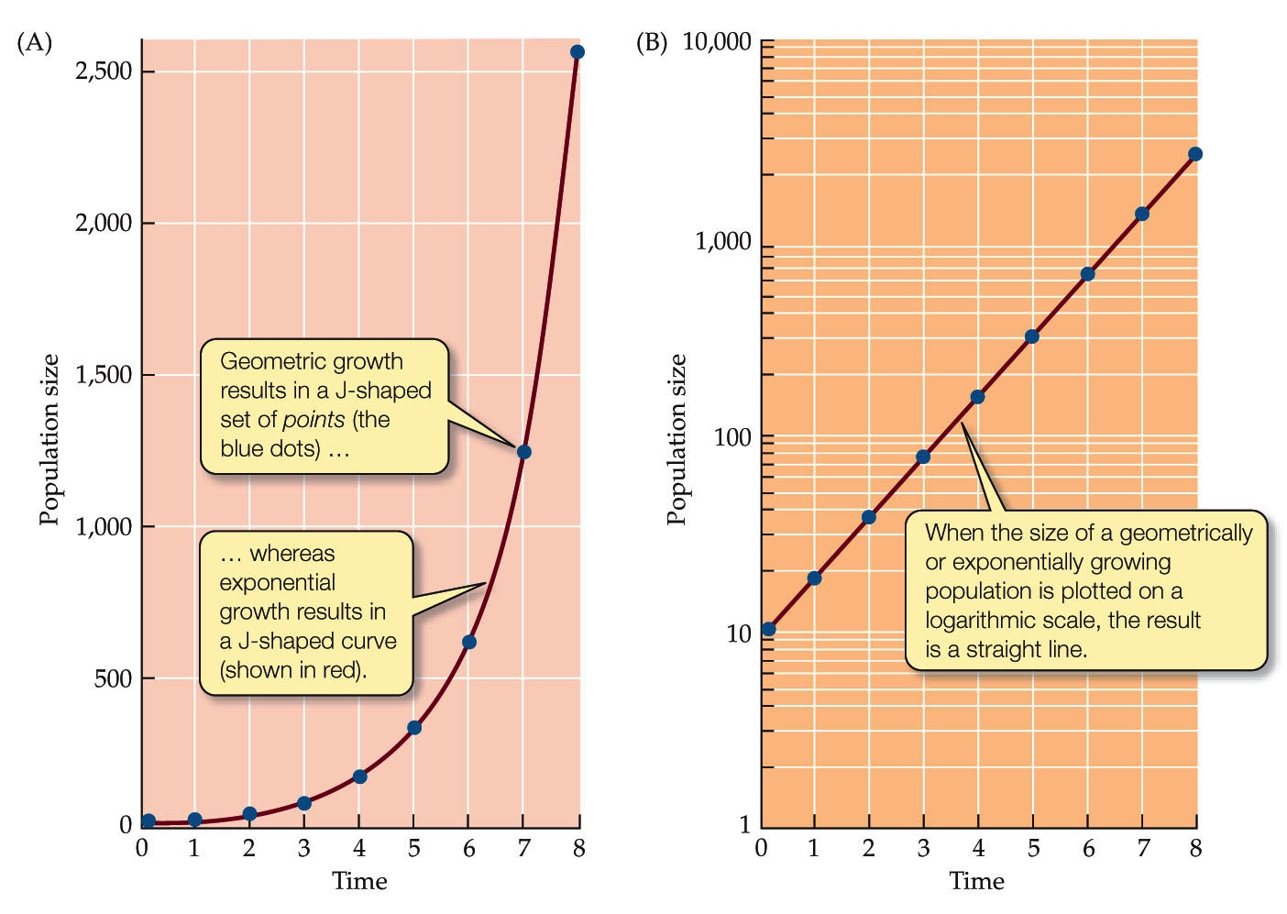
Exponential relationships between y and x appear linear when graphed on semi-log paper. Why use a log scale for the y axis?

