Slide 1
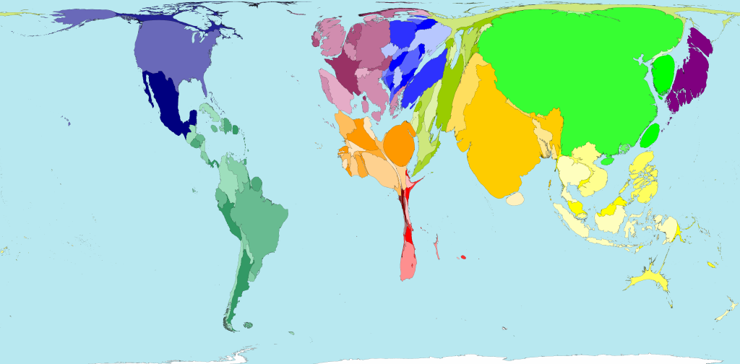
What does this illustrate?
Notes:
(Source: World Health Organization and United Nations Development Program Energy Access in Developing Countries: A Review Focusing on the Least Developed Countries and Sub-Saharan Africa (New York and Geneva: 2009)
Territory size is proportional to the percentage of world electricity production that occurs there. (source: worldmapper.org)
Some people guess income, or health, issues. So, when you say it is electricity, it makes the point that electricity goes hand in hand with other development indicators.
This map shows where people who have electricity supplied to their homes live. Electricity access includes that sourced from a publicly used grid and self-generated electricity (possibly from solar, wind or hydroelectric sources). This map shows access, not the quantities of electricity used. The percentage of people with access to electricity in their own homes is over 97% in Eastern Asia, Eastern Europe, North America, Western Europe and Japan. 7 of the 10 territories with the lowest access to electricity are in Southeastern Africa. Electricity in homes can be used to power lighting, heating, cooking, radios, televisions, computers, washing machines, and other appliances. "Have you ever thought about what you would have to give up or how much work and effort you would have to dedicate to daily activities if electricity did not help you?" Prazká Energetika, 2005 Territory size shows the proportion of all people with some electrical power in their homes living there.
1.5 billion w/o electricity, 2.6 billion use biomass (wood, dung, straw, charcoal)

Slide 2
Global & Local Picture on Energy and Water

Slide 4
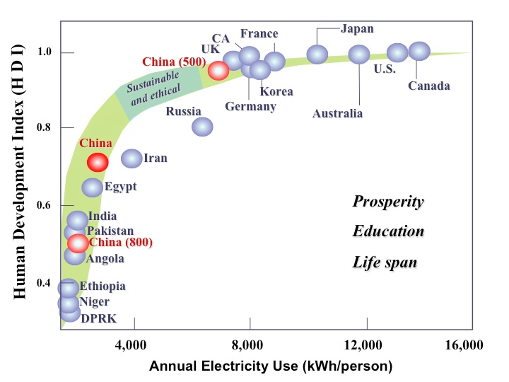
Energy and Development
Notes:
So, there is a clear correlation between HDI and energy use, but which way is the causality? Does energy use contribute to raising standards of living, or do wealthier people just use more energy.
Also point out that at a certain point, the curve levels off and there is no additional HDI benefit from additional energy use.
The United Nations Human Development Index (HDI) relates energy use to the quality of life to which most humans aspire. The middle class averages about 0.8 on the HDI and requires access to over 3,000 kWhrs per person per year. 80% of the world’s population of over 7 billion people is below 0.8 on the HDI. Source: Wright and Conca, 2007).
However, this 0.70 HDI is a composite of 500 million people above 0.8 HDI and 800 million still below 0.6 HDI. Almost all of China’s policies are geared to raising the remaining 800 million above 0.8 HDI and into the middle class. This should dispel any notion that China’s hunger for all energy sources will slow anytime soon.

Slide 5
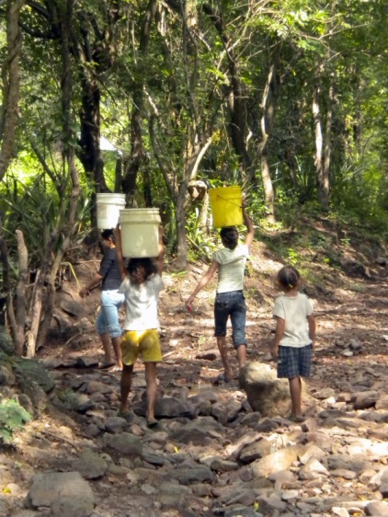
Energy Poverty
What requires energy in daily life?
Hauling wood, water
Cooking, lighting, transportation
Pumping or lifting water
Agricultural work, harvest processing
Cell phones, radio, television
Which of these tasks can benefit from electricity?
Who benefits most?

Slide 6
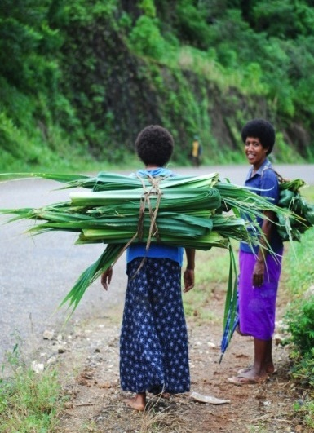
Energy Poverty & Gender
Worldwide, 70% of people living in poverty are women
Lack of access to energy affects women and girls disproportionately
Culturally, women are often not associated with energy interest or skill; or in decision-making
Notes:
Why are woman more likely to suffer from energy poverty?
There are many reasons why women, particularly in developing countries, are affected disproportionately. They comprise 70% of the 1.2 billion people worldwide living in poverty; women have less access and control over resources; women are vulnerable to changes outside of their control (e.g. drought) because of their lack resources. They expend the majority of metabolic energy with tasks related to wood/biomass collection and carrying.
This fact alone means women and girls are disproportionately affected by energy poverty in terms of their:
Health: carrying tens of kilos of fuel wood over long distances; in-door pollution
Education: Literacy: girls are kept from school
Fertility: illiteracy increases family size
Safety: household fires, personal attack
Future economic participation
Culturally, women are not perceived as having an interest or skills in the energy arena; they are not seen as pertinent to decisions about energy.

Slide 7
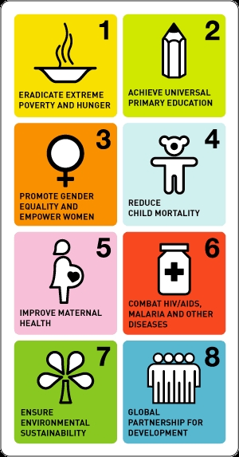
Energy & Millennium Development Goals
MDG: Universal Education
ENERGY: Light for studying. Computers. Communications.
MDG: Gender Equality
ENERGY: Burden of firewood & water collection
MDG: Child and Maternal Health
ENERGY: Electricity for health clinics
MDG: Reduce poverty and hunger
ENERGY: Small businesses. Food processing. Irrigation
Notes:
Animate? Ask for other ways energy is involved?

Slide 8
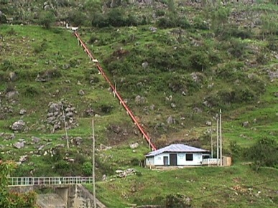
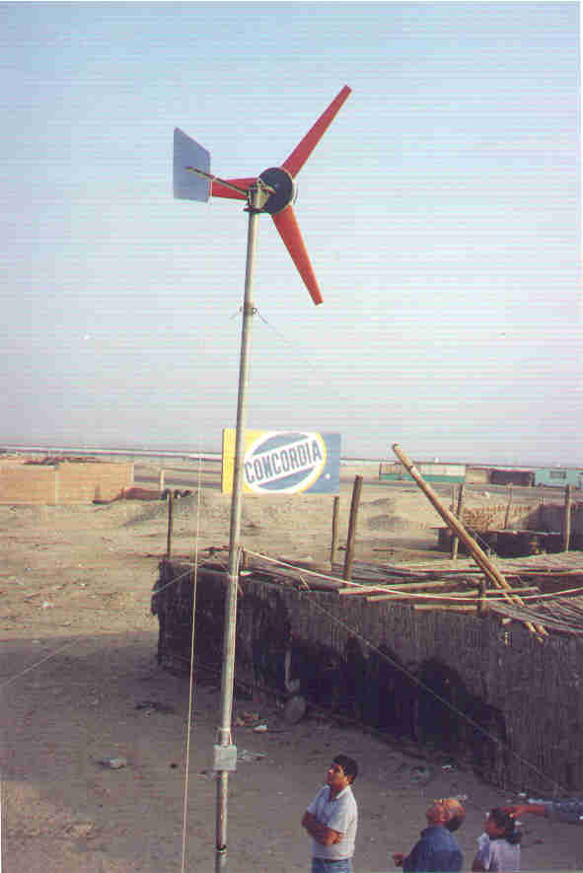
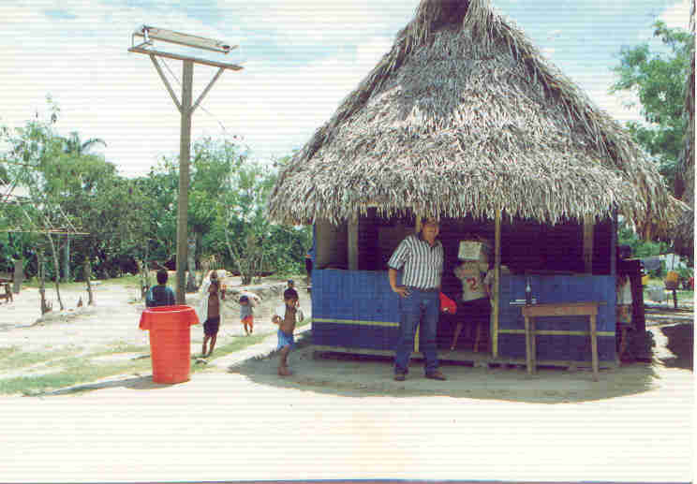
Wind Power
Hydro power
LPG
kerosene
candles
Energy options
Solar power
Biomass (wood, manure, bagasse)
Improved kitchens
Biodiesel
Biogas
Human power = labor
Electrical grid
Diesel generators
Notes:
Note overlap & link between energy & labor, particularly child & women labor,
And indoor pollution (kerosene, wood burning)

Slide 9
Climate Change
Around the world, rural communities are seeking access to modern conveniences of the industrialized world (electricity, water, better housing, roads, appliances) which will add to fossil fuel extraction and use, and higher emissions….
But, can we de-link improvements in human wellbeing from increases in CO2?
And take another route to ‘development’?

Slide 10
Why Renewable Energies?
Environmental: no green house gases or local pollution; reduced mining of finite resources; reduced footprint of distribution grid
Economical: ‘fuel’ is locally available - no importation; no future escalating fuel cost; reduced dependency on transport infrastructure; no need for large distribution grid
Social: small-scale decentralized creates local jobs, keep remote areas attractive; local control = empowerment
Political: no dependent on importing from volatile or shady governments; no security risk from concentration of dangerous or valuable material

Slide 11
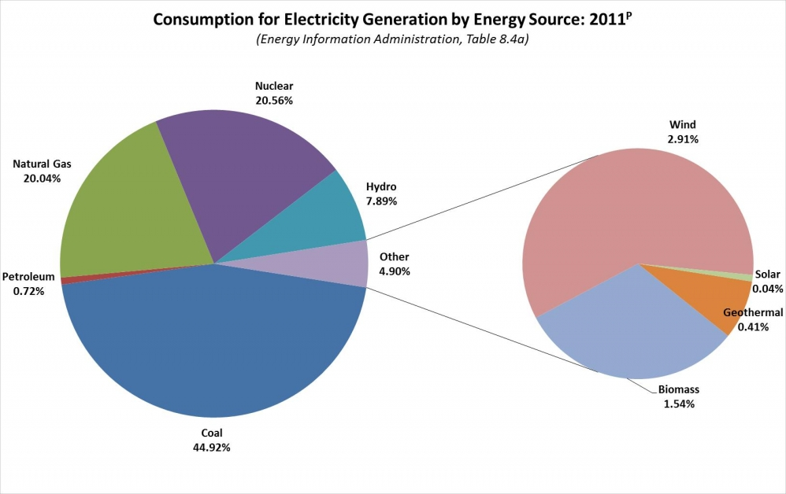
Renewable Energy in the World
Notes:
Electricity is only a small percentage of the overall energy use (planes, transportation fuel, etc)

Slide 12
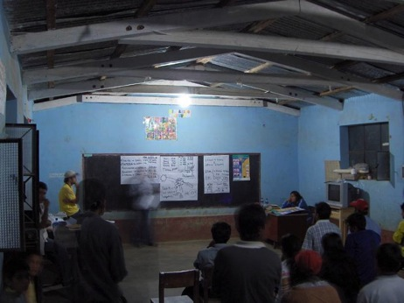
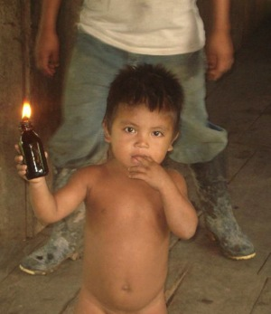
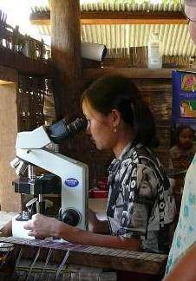
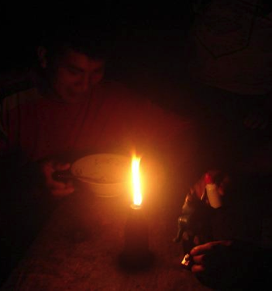
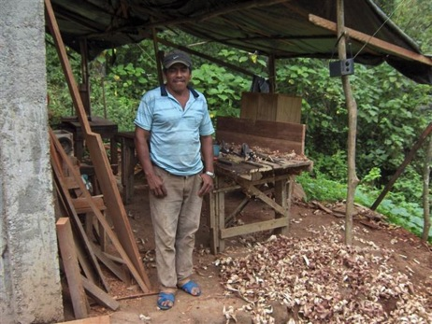
Electricity
Notes:
Fire and health hazards of kerosene lamp: pulmonary diseases, burns, accidents, etc.
Bad for the eyes - Electricity in various amounts allows homework, reading, night classes…
Directed lighting for surgery, refrigeration of vaccines, sterilization of equipment, Medical CD-ROM, Lab tests
Also cost and inconvenience of procuring the (imported) fuel
Goals – improved nutrition/health/income/education

Slide 13
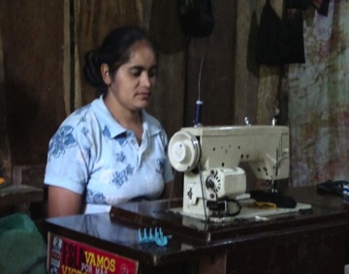
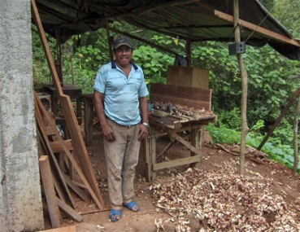
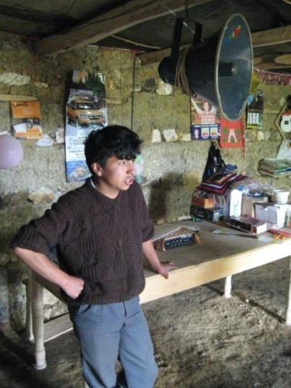
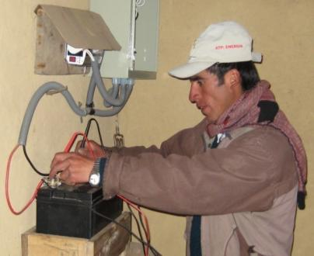
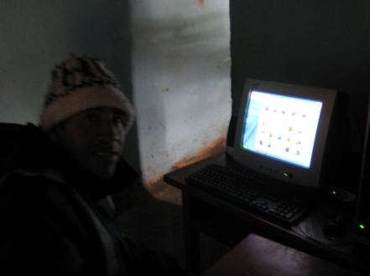
Electricity & Quality of Life

Slide 14
Video
Green Living Project -Nicaragua
solar pumping, micro-hydro, wind, biogas
GreenLivingProject-AsoFenix.mp4 (3:18)
http://www.youtube.com/watch?v=9xpH2rRstgU
Notes:
Embed?

Slide 15
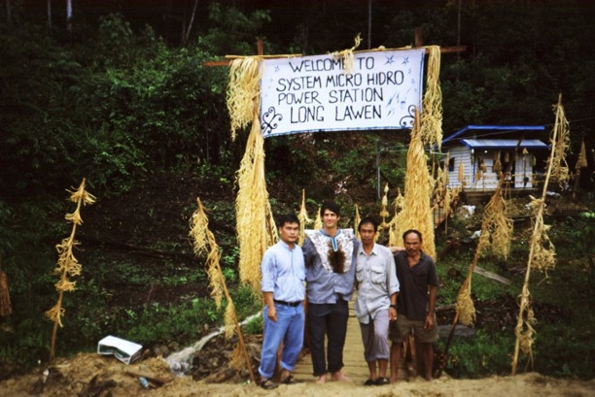
Strategies for rural electrification
Grid extension (powered by coal, oil, large hydro dams, or large wind)
Distributed / decentralized energy
Micro-grids at a village level (e.g. microhydro)
Distributed energy (e.g. solar home systems)
Notes:
Ask students to think about who is in charge of each of these strategies…

Slide 16
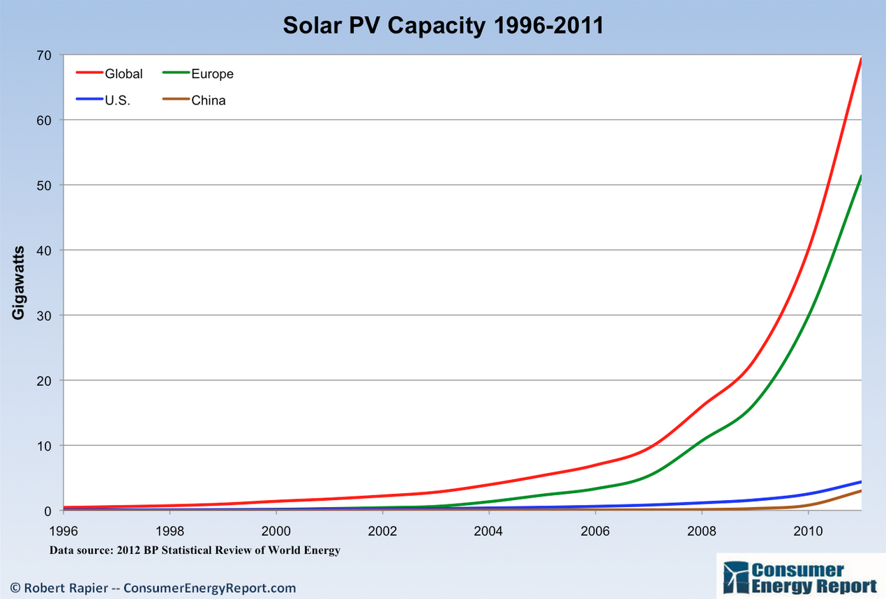
Growth of Wind and Solar
Notes:
Source: http://www.energytrendsinsider.com/wp-content/uploads/2012/07/Global-Solar.png?00cfb7

Slide 17
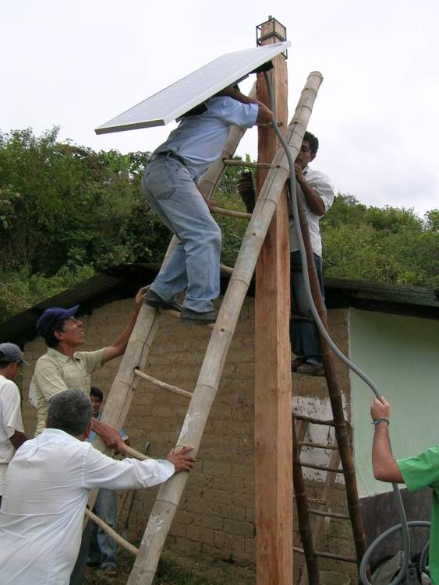
Solar Programs
2014 in the news: 24M solar pumps + drip irrigation for India?
Older news
Bangladesh: 500,000 solar home systems
Northwest China: 400,000 solar home systems
India: 500,000 solar home systems and 700,000 solar lanterns
Kenya: 300,000 solar home systems
Sri Lanka: 70,000 solar home
systems (Sarvodaya)
Notes:
These #s are a few years old. Update?
(Source “Renewables 2010: Global Status Report” Renewable Energy Policy Network for the 21st Century)

Slide 18
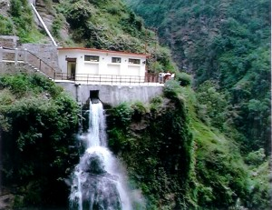
Small – Micro Hydro Programs
China: more than 42,000 units with generating capacity reaching 28 GW (units less than 50 MW)
(Source: Tong, Jiandong, “Mini Hydropower” 2004. Image source: hydropowerstation.com )
Notes:
Update #s?

Slide 19
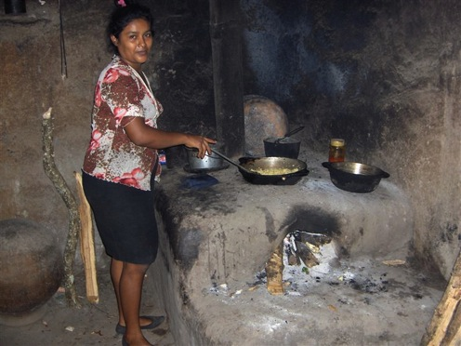
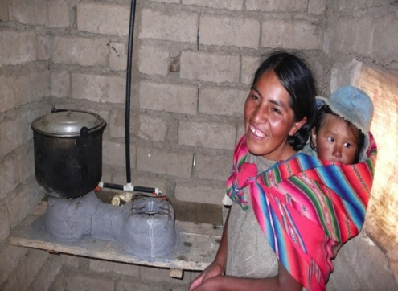
Cooking
1.6m deaths/year from toxic stove smoke
Respiratory infections are leading cause of death for children under 5
Cooking is largest energy need in rural areas
Currently large contributor to deforestation and erosion
Fetching wood keeps kids away from education
Sources: WHO; Energy Services for the Millennium Development Goals UNDP
Notes:
Wood smoke from damp wood = incomplete combustion = respiratory diseases
Responsible for low birth weight (like cigarettes), which is predictive of future health an developmental issues.
Cataracts and burns
Heavy loads -- 40lbs of wood /day = large time sink keeping kids away from school
Over 3 billion people use coal and biomass to cook their food and heat their homes
Concentrations of PM and CO 20-100 times higher than EPA standards for indoor air quality
Women and children face the greatest risks.
Source: http://www.who.int/indoorair/health_impacts/en/
Source: Practical Action 2010, “Poor Peoples Energy Outlook”
Image Source: Hedon: Household Energy Network (www.hedon.info)

Slide 20
Forests and Fuelwood
Notes:
Currently large contributor to deforestation and erosion!!!

Slide 21
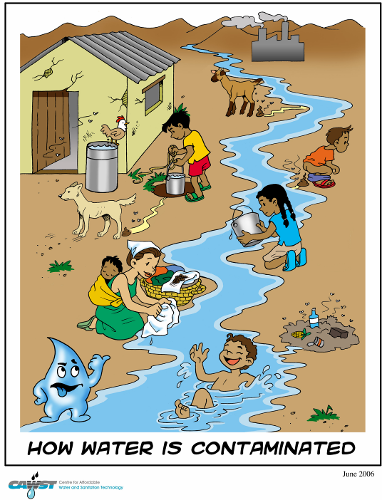
Clean Water
2.5 billion live w/o adequate sanitation
Due to pollution & scarcity ~ 1.1 billion lack access to clean drinking water
Diarrhea is the second leading cause of death of children under five ~ 1.5 million per year
88% of diarrhea cases attributed to limited access to water and inadequate sanitation/hygiene.
Sources: Pacific Institute & UNICEF
Notes:
This audience has probably seen these stats many times.

Slide 22
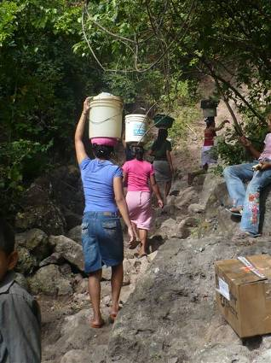
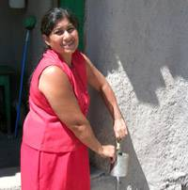
Water access
Goal = 5-10 gallons of water/day/person
Notes:
Health effects of water:
Open wells / streams / containers: easily contaminated by animals, dirt, etc.
Carrying heavy load (5gal = 40lbs): lots of calories / stunts growth – childbirth problems & deaths
Water projects = opportunity to test of Arsenic etc. & filter / treat if needed
Time spent = away from education and other pursuits
average per capita daily water use in the US 69.3 gallons (Water Works Association)
Dehydration
WHO = 10-12 gallons per person per day
UNICEF:
Women and children are primarily responsible for fetching water.
Everyday women around the world spend 200 million hours collecting water to meet their basic needs.
The millennium development goals set the goal of halving the number of people without access to safe drinking water by 2015.
These targets are on their way to being met in Middle East/North Africa, South Asia, East Asia/Paciﬁc and Latin America/Caribbean.
They are unlikely to be met in West/Central Africa, Eastern/Southern Africa and Central Eastern Europe/Commonwealth of Independent States
Over 50% of all water projects fail in the first few years.

Slide 23
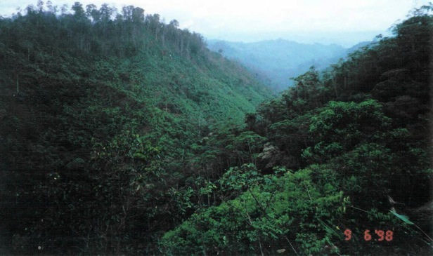
Forests, Energy, Water
Link between forests and Water supply + Micro-Hydro energy
Methods of forest conservation:
Local ordinances
Purchase Forest Reserves
Training courses in agroforestry and restoration
Watershed mapping – increased community oversight
Native tree nurseries

Slide 24
Energy poverty and gender issues

Slide 25
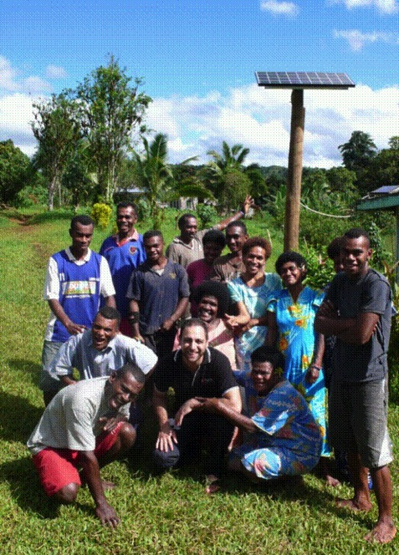
Success of Electricity Projects
Success of electricity projects requires:
Consideration of needs of all members of a community
Effective selection of technology that meets these needs
Trained workforce that can install and maintain technology in a sustained manner
Notes:
Achievement of success requires a broad lens

Slide 26
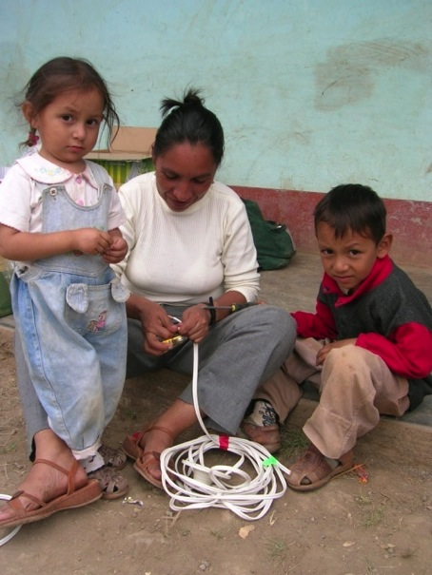
Women Exclusion
Women’s exclusion is due to:
Underrepresentation in decision-making bodies at the national and local levels
Limited training in technology fields
Perceptions that women are not interested in technology
Other factors in your community?
Notes:
Women have traditionally been excluded from needs, design, and workforce.
Women have been excluded for a number of reasons

Slide 27
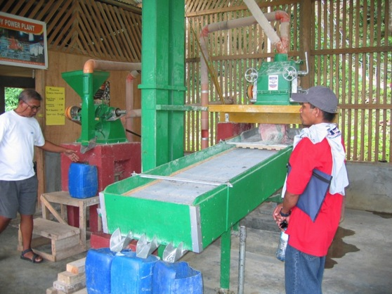
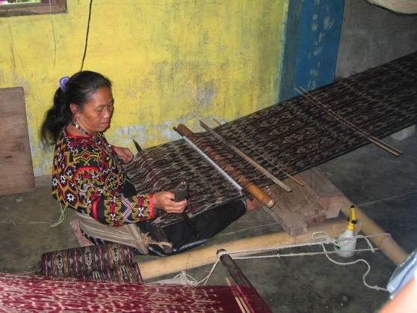
Case Study: Productivity in The Philippines
Tablo micro-hydro (MH) system
Women increased their income by weaving at night
Women no longer carry rice to be milled far away
Notes:
In the village of Tablo, Southern Philippines, Green Empowerment and its local partner YAMOG implemented a micro-hydro plant. Besides providing electricity for lights and televisions, the Farmers Cooperative obtained power to run agro processing equipment. Now women need not carry and walk a distant municipal center to have their rice milled. In addition, as a result of having light at night, the Women Weavers Cooperative increased their production of traditional woven cloth and arts products. They also found that the natural fibers they use are more flexible at night, making their work easier.

Slide 28
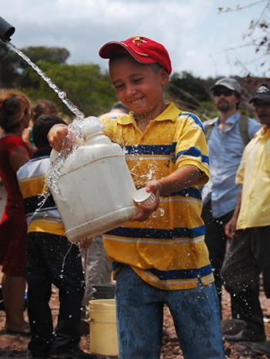
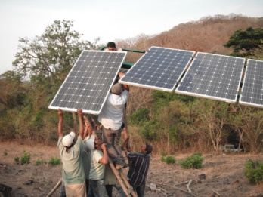
Case Study: Water Distribution in Nicaragua
Solar pumps for villages
Consideration of the needs of all members of the community has been shown to have positive impact
ater cooperatives are run by both women and men
Notes:
Here are three successful examples (case studies) of inclusion of women in energy transactions.
Several solar pumps were installed in Nicaragua by Green Empowerment and its local partner Asofenix. The population of the area are small-scale farmers who are severely affected by seasonal variations in water availability. A total of five PV-powered water pumps were installed, taking into consideration the local conditions. Most of the year, primarily women and children used to walk for hours to fetch water and carry it in buckets on their heads. The PV systems pump the water to a high reservoir from where it is distributed by gravity to the households. Not only have the pumps reduced the drudgery of the women, they have also contributed to increased economic activity, better health, and improved living conditions.

Slide 29
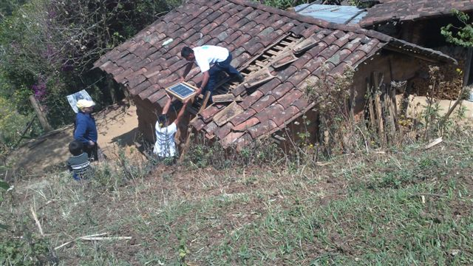
Case Study: Women Exclusion in Guatemala
Household solar panels in Guatemala
Battery failed quickly because trained men were not at home to maintain them.
Women can be trained and be available to maintain energy systems in communities

Slide 30
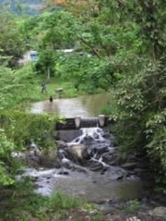
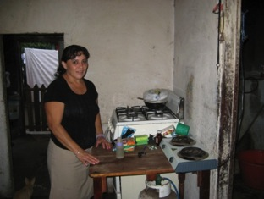
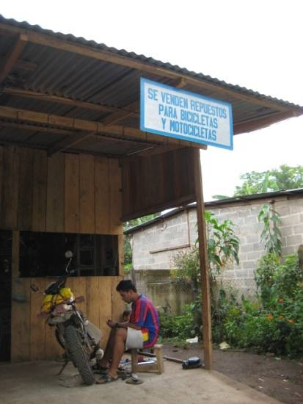
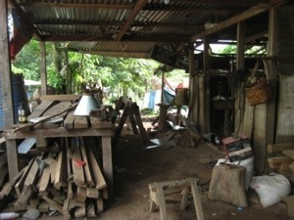
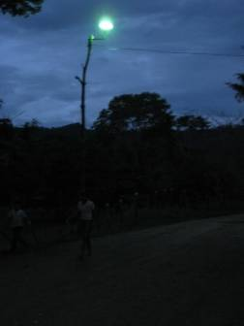
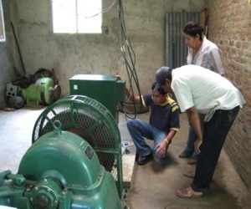
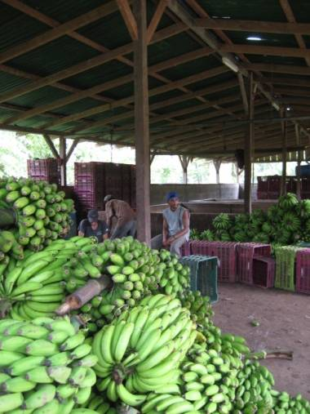
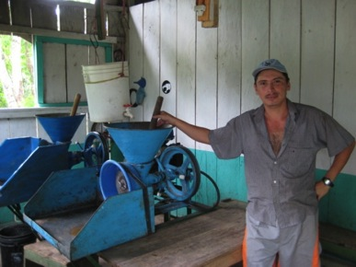
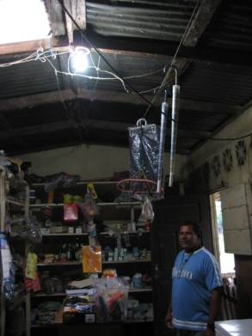
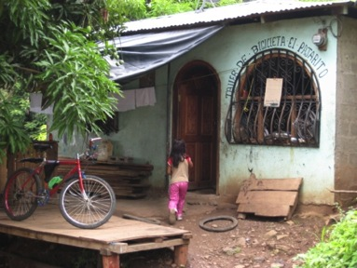
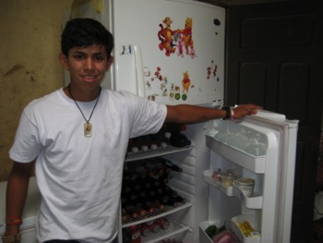
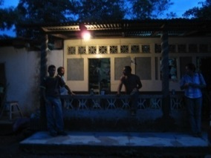
Notes:
La Pita, Nicaragua, micro-hydro
30

Slide 31
Budget Examples
Electricity for lighting & basic appliances for villages in San Pablo district, Peru :
37 families, using 100Wp solar each: $60k
64 families with a 21kW micro-hydro system: $82k
53 families, with 100W mini wind turbine each: $100k
Potable water distribution:
To 360 people in Negros Occidental, Philippines, w/ ram pump: $10k
To 250 people in El Jocote, Nicaragua, with a solar pump: $50k
Price of an SUV = bring water to a whole village

