Slide 1
Energy Units & Consumption
ESM 102

Slide 3
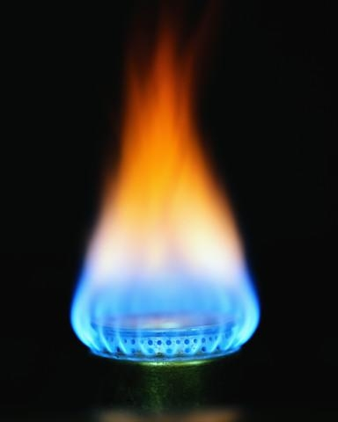
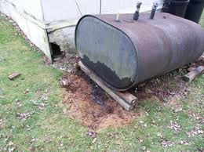
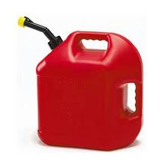
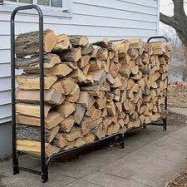
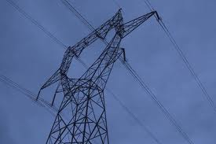
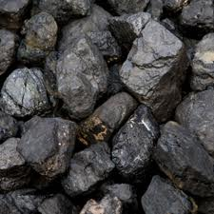
Sources of Energy

Slide 4
Natural Gas
Sold in units of THERMS
100 cubic feet
Hydrocarbon mixture (mostly methane)
Uses: generating electricity, heating houses, providing heat & power to industry and vehicles
Found deep in underground rock formations & above crude oil reservoirs
Cheaper than oil, easy to transport, burns hotter & cleaner than other fossil fuels
Leaks of natural gas into atmosphere

Slide 5
Electricity
Sold in units of kilowatt hours (kWh)
1000 watt hours
Sources of electricity:
Fossil fuel combustion
Wind power
Hydropower
Can’t be easily stored…must generate
as much as needed

Slide 6
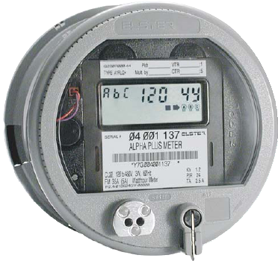
Kilowatt Hours

Slide 7
Heating Oil
Sold in units of gallons
Low viscosity, flammable liquid petroleum similar to diesel fuel
Stored in above or underground storage tanks
Fuel for furnaces or boilers

Slide 8
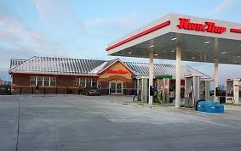
Gasoline
Sold in units of gallons
Petroleum derived liquid used for fuel in internal combustion engines
In US and many other countries, gasoline blended with up to 10% ethanol
US accounts for 44% of world wide usage

Slide 9
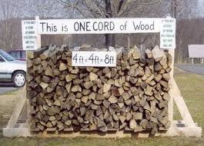
Wood
Sold in units of cords
= 4’ x 4’ x 8’ stack of wood
= 250 copies of Sunday NYT
1 forested acre produces 10-15 cords
Amount of energy depends on type of wood
Density
Water content

Slide 10
Energy in terms of BTUs
1 Calorie = 3.968 BTUs
Heating Oil: 1 gallon = 138,690 BTUs
Gasoline: 1 gallon = 124,238 BTUs
Natural Gas: 1 therm = 100,000 BTUs
Electricity: 1kWh = 3412 BTUs
Coal: 1 short ton = 19,858,000 BTUs
http://www.eia.gov/kids

