Slide 1
Week 2: Population growth
Using population growth models predict increase in impact
ESM 102L Winter 2015

Slide 2
I = P * A * T
Population is a major “multiplier” of the impact
More people require more resources

Slide 3
Models for human population growth
Optimistic (population will be in manageable levels)
Cautious (if we take precautions we can minimize negative impacts of too many people)
Decline (resource limitations will lead to decline in population)
Catastrophic (over-population will lead to disastrous situation)
Notes:
This course will deal with these different outcomes more in week 8 or 9 on worldviews

Slide 4
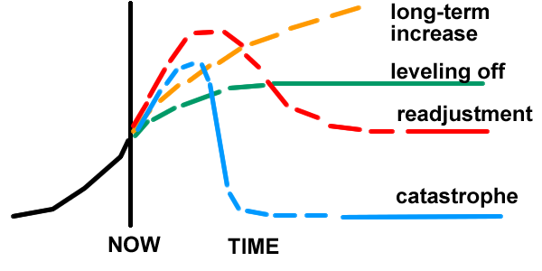
4 models
Notes:
Beyond the scope of this course to decide between these models

Slide 5
Science can explore assumptions
Large degree of uncertainty in these predictions
  Sources of uncertainty
    Changing conditions
    Human decisions
Population growth rate
Resource consumption
Regional differences
Susceptibility to disease or social-economic collapse
Notes:
Can’t provide answers to this question
Complex system –
Demographic transition – is this a valid model

Slide 6
I=PAT is a complex system
All factors are interacting and constantly changing
We can deal with the near term
  Current rate of increase by region
  Assume stability of countries
  Known resources and technologies

