Slide 1
Week 1: Human impact
Human impact on water and energy resources
ESM 102 Winter 2015

Slide 2
I = P A T
Impact
Population of consumers
Affluence or consumption
Technology is the tools and processes used

Slide 3
Consumption has two types of impact
Reduction in the available resource
Using water from a limited source
Burning fossil fuels
Side effects from consumption
Depleting stream flow that leads to injury to fish
Emission of pollution from fossil fuels
CO2
Hg, SO4, etc

Slide 4
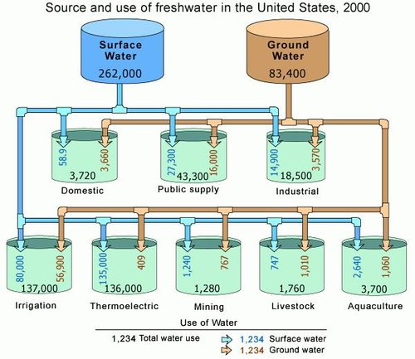
Water consumption in the USA
Ag = 40%
Elect = 40%
Pub = 12%
Ind = 6%
Dom = 1%
Image from http://www.eoearth.org/view/article/152861/
Notes:
Source is important – is it renewable or non-renewable
Irrigation for food is the most and domestic (home use) is only 1%

Slide 5
Energy consumption in the USA
Residential and commercial is only 10%
Energy sources
73% of total energy comes from fossil fuels
9% from nuclear
8% from renewables
Notes:
Internet serves consume 1 to 2 % of the USA’s electricity.

Slide 6
Other impacts
Water consumption
Stream flow depletion
Water pollution from use
Shifting ecosystems (by changing water delivery)
Others?
Energy consumption
Pollution
Indoor pollution
Social structure depends on energy
Others?
An important role of scientific studies is to determine what these side-effects are. Rigorous studies follow leads and explore unknown areas.
Notes:
This is a good slide for discussion

Slide 7
Some people don’t have enough water and/or energy
Almost 1 billion people in the world don’t have access to sufficient drinking waterhttp://www.unwater.org/water-cooperation-2013/water-cooperation/facts-and-figures/en/
Nearly 3 billion people cook over woodstoves
(http://www.cleancookstoves.org/our-work/the-issues/environment.html)
Notes:
Interactions between water and energy supply will be addressed more fully in lecture. For example, using electricity to pump deep wells represents a depletion of a water source at the expense of increasing amounts of energy use.

Slide 8
“Appropriate” technology can help
Innovations that help people
Provide clean renewable sources of water and energy
Minimize negative impacts
Useful for
Developing regions
Sustainable communities
Disaster preparedness or response
Notes:
Social and economic contexts will be dealt with in class
Roller water drums – allow people to haul water more from wells to their villages without hurting their backs.

