Slide 1
Week 2 esm 101 lab
Forming a testable hypothesis

Slide 2
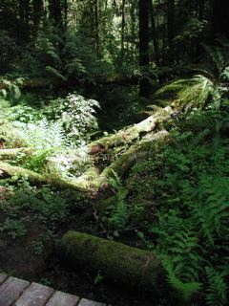
Field Trip #1
In a natural area, such as Marquam Nature Park
http://www.fmnp.org/gallery/fomnp01.jpg

Slide 3
What is a hypothesis?
A proposed answer to a scientific question
A tentative assumption made in order to draw out its logical or empirical consequences and test its consistency with facts that are known or may be determined
A proposition or set of propositions, set forth as an explanation for the occurrence of some specified group of phenomena
A mere assumption or guess

Slide 4
We Need Meaningful Hypotheses
Includes at least two proposed causes of a certain condition
Should be able to disprove at least one aspect with measurements and data collected in the field
Must have a meaningful understanding of the problem to formulate
The investigator must NOT currently know the outcome of a test or that it remains reasonably under continuing investigation
EXAMPLE: Plant biodiversity at Forest Park is more limited by dogs off leash than the presence of English Ivy.

Slide 5
MORE QUALITIES OF GOOD HYPOTHESES
Supplies a testable mechanism
Not unnecessarily complicated
Conforms with existing knowledge
Should be a way to show that the hypothesis is incorrect

Slide 6
Null Hypotheses
A hypothesis to be tested and accepted or rejected in favor of an alternative; specifically : the hypothesis that an observed difference (as between the means of two samples) is due to chance alone and not due to a systematic cause
Be careful not to use this in a trivial manner, i.e to disprove what is obviously false
that doesn’t move our understanding along

Slide 7
BAD QUALITIES…
Question is not scientifically good or useful
Question will never lead to or achieve a useful answer
Question can not be proven one way or another
The null hypothesis is trivial

Slide 8
GOOD or BAD?
Which of these could you improve with tighter language?
The use of native cover crops in a vineyard will increase the carbon to nitrogen ratio in the A-horizon of the soil more than the use of non-native cover crops.
Salmon do not return to their native stream to spawn.
Plant biodiversity at Forest Park is not limited by the presence of English Ivy.
Tomato plants exhibit a higher rate of growth when planted in compost rather than soil.

Slide 9
Term Project
Formulate a meaningful hypothesis for improving biodiversity in your green space.
Collect data in support of or against your hypothesis.
Provide recommendations based on the outcome of your field work.
Provide additional research on the recommendations that are formulated.
Detail the predicted consequences of your recommendations.

