Slide 1
Restoration efforts on Upper Klamath Lake: Can we describe what we want a healthy lake to look like?
John Rueter
ESM
Center for Lakes and Reservoirs
SoE
PSU

Slide 2
Suppose we are successful in restoring UKL, what will it look like?
Users point of view
Limnologist’s point of view

Slide 3
Explore this question
Background on UKL and restoration ideas
What do we mean by a healthy lake?
Are there shapes that are related to health?
Can we expand the existing aquatic plants beds?
What could we measure to show the relationship between structure and function?
Where does this leave us?

Slide 4
1. Background on UKL
Basin – UKL links to habitat
Eutrophic with crashes

Slide 5
Technical workshop
Klamath River Water Quality Workshop, Sept 10-13, 2012, Sacramento, CA
Teams were charged with presenting methods for lake restoration
Common parameters
Amount of land area
P and N removal
Costs
Technical feasibility
Proposed lake restoration methods
Dredging
Alum treatment
Filtration
Increase native wetlands
Off-channel treatment marshes
Distributed, smaller projects

Slide 6
Plans for restoration of the lake
KBRA
Basin wide restoration
Including removing dams to let the Klamath River run
Lake restoration
So when the salmon get there, it’s a friendly place
Considering 6 approaches
Dredging
Filtration
Alum or oxygenation
Increase reserves and natural wetlands
Create treatment wetlands
Distributed projects such as small wetlands and riparian improvements

Slide 7
2. Description of a healthy lake ecosystem
Homeostasis, absence of disease, diversity, resilience, scope for growth, balance between components (Costanza 1992)
Health Score Card
Self regulating
Absences of HABs
Habitat and Species Diversity
Resilience
Scope for growth
Balance of components

Slide 8
Scorecard for health of UKL
Health Score Card
Self regulating | How frequent and persistent are the crashes
Absences of noxious and toxic algal blooms | Blooms, noxious, toxic
Habitat and Species Diversity | Spatial and species
Resilience | Awkward for UKL, MSS in the “wrong state”
Healthy habitat for fish | Inventory of in-lake, rivers and streams
Balance of components | Visual mix and variety
Might want to consider other factors such as:
contribution to local economy
cultural and spiritual assets

Slide 9
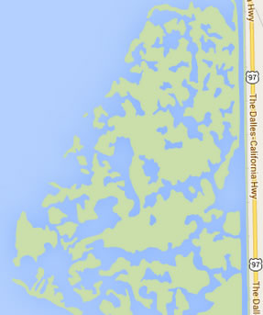
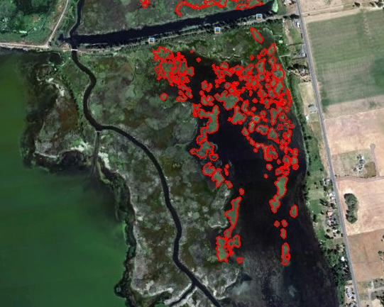
What are some notable physical changes that would be related to increased health?
Compare shape to other lakes
Expansion of in-lake Wocus
Marsh fringe – floating islands
Notes:
Odell Lake - AOL image used in FRAKOUT
Wood River Delta – google maps analyzed by Diana Spartis
Hanks Marsh on east side of UKL --- maps.google.com

Slide 10
3. Compare the shapes of lakes

Slide 11
Fractal Dimension of the Shoreline
Calculation by how many grid elements make up the shore line
High dimension = shoreline variability
Low dimension means that it is relatively simple

Slide 12
Fractal dimension and circleness compared to days listed for HABs
 |  | acres | miles | circleness | Fractal D
Lake name | county | area | perimeter
Agate | Jackson | 204.57 | 3.18 | 0.63 | 1.269
Agency | Klamath | 9380.1 | 60.72 | 0.22 | 1.210
Crescent | Klamath | 3822.82 | 11.47 | 0.76 | 1.253
Diamond | douglas | 3039.75 | 9.06 | 0.85 | 1.179
Emigrant | Jackson | 780.69 | 12.81 | 0.31 | 1.362
Fish Lake | Jackson | 383.49 | 5.99 | 0.46 | 1.268
Fish Lake | Douglas | 93.31 | 1.68 | 0.81 | 1.213
Gerber Res | Klamath | 3815.1 | 27.99 | 0.31 | 1.345
Lemolo | Douglas | 431.48 | 7.88 | 0.37 | 1.236
Lost Creek | Jackson | 3183.55 | 30.55 | 0.26 | 1.233
Miller | Klamath | 519.06 | 4.32 | 0.74 | 1.217
Odell | Klamath | 3415.01 | 12.48 | 0.66 | 1.244
Upper Klamath Lake | Klamath | 61543 | 148.4 | 0.23 | 1.280
Willow Lake | Jackson | 316.41 | 4.58 | 0.54 | 1.306

Slide 13
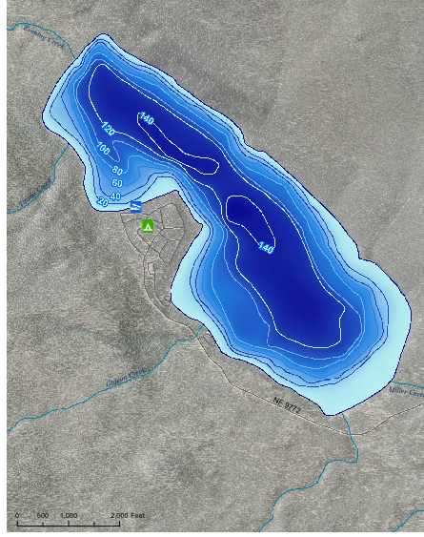
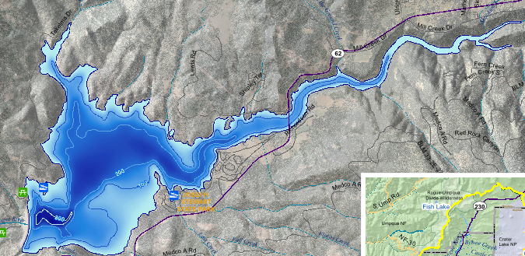
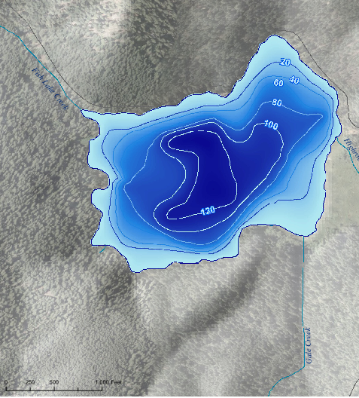
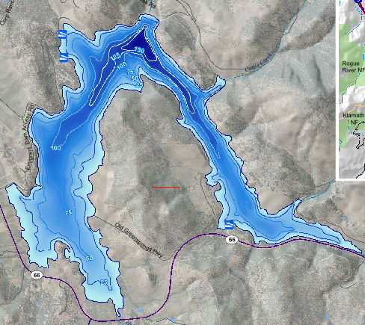
Low Fractal D: Miller
Low Circle-ness: Lost Creek/Jackson
Nearly a circle: Fish Lake/Douglas
High Fractal D: Emigrant

Slide 14
4. Expansion of current aquatic plants
Aquatic plants in the fringe marshes (Ray et al)
Wave exposure
Elevation relative to lake level fluctuation
Near shore topography from dredging
Wocus survey for areal extent
Wocus / Yellow Pond Lilly / Nuphar lutum

Slide 15
Wocus distribution
Maps with ground “experience”
Limited to certain areas now
Current area = 0.4 km^2 compared to a fringe area of 50 m wide = 17.4 km^2 (2.3%)

Slide 16
Expansion of peri-lake wetlands
Target areas
Technology is available – floating islands
Where to put stuff
Multiple criteria problem
Improve health
Increase diversity
Notes:
Image from Floating Islands West

Slide 17
5. What can we measure?
Mixing regime near islands
AFA is sensitive to mixing
Dominates in most conditions
Doesn’t do well in overnight stratification
Measure temperature profiles in transects
Notes:
Previous work from my lab

Slide 18
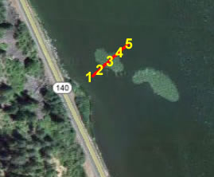
Transect across a wocus “island”
Notes:
Points at 30 meters 1 meter, middle, 1 m, 30 meter
Points shown from Aug 29 at noon to Sept 2 at midnight

Slide 19
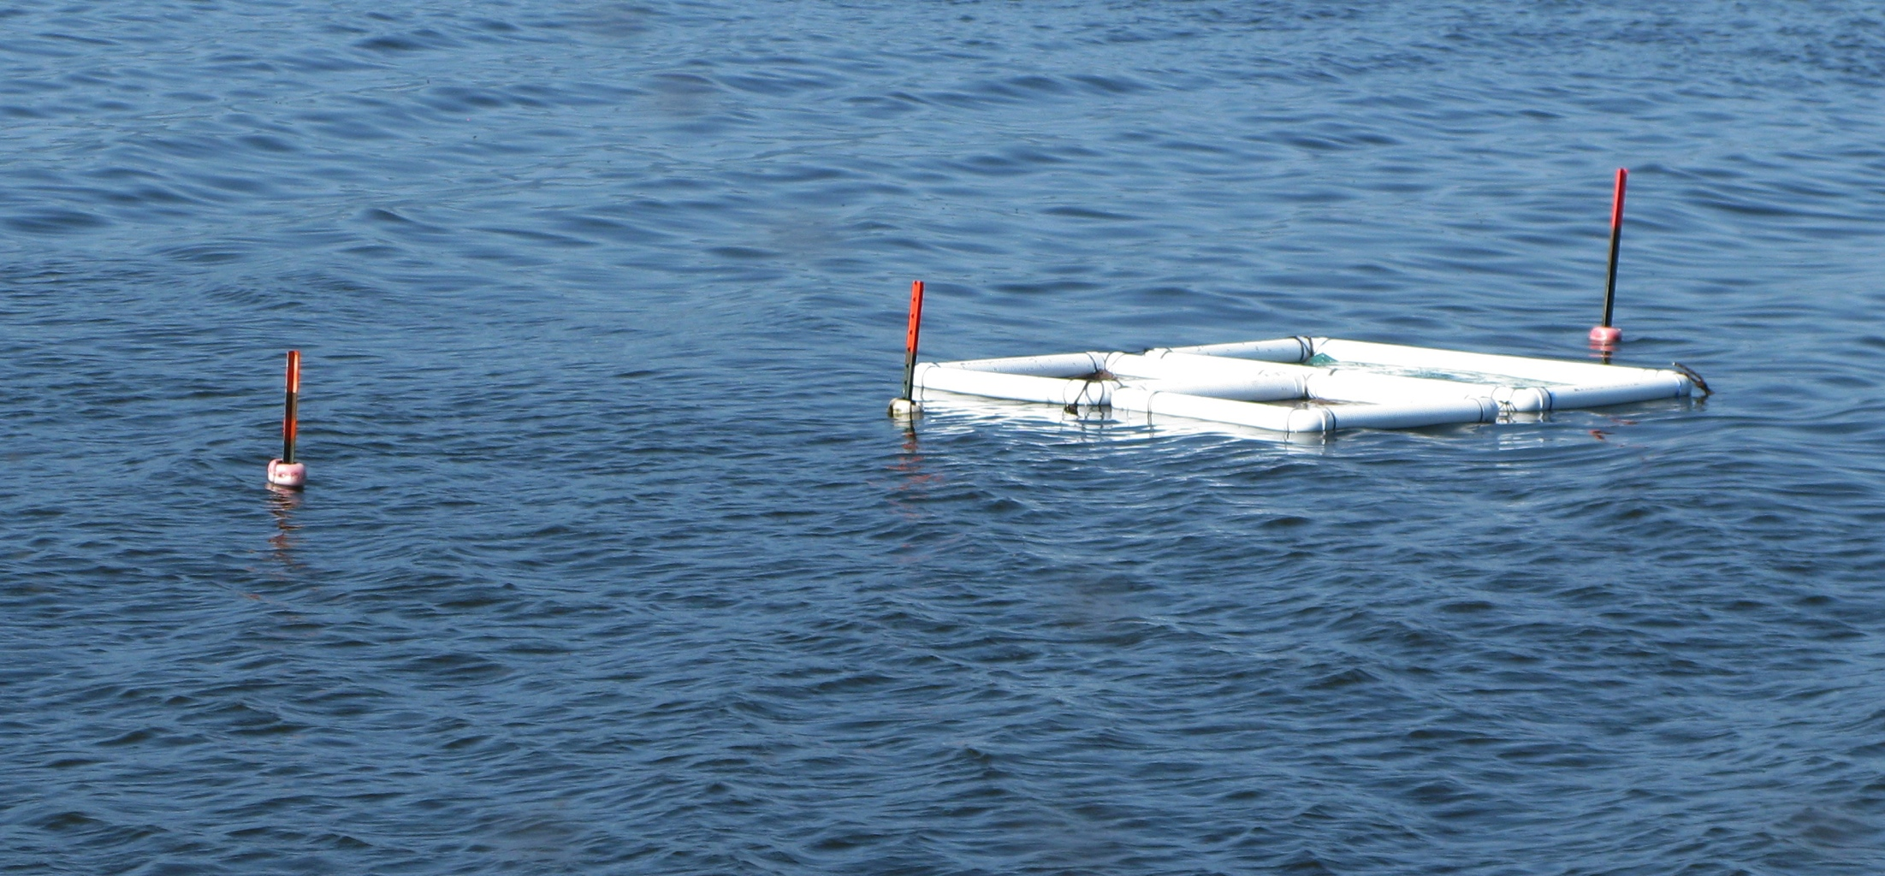
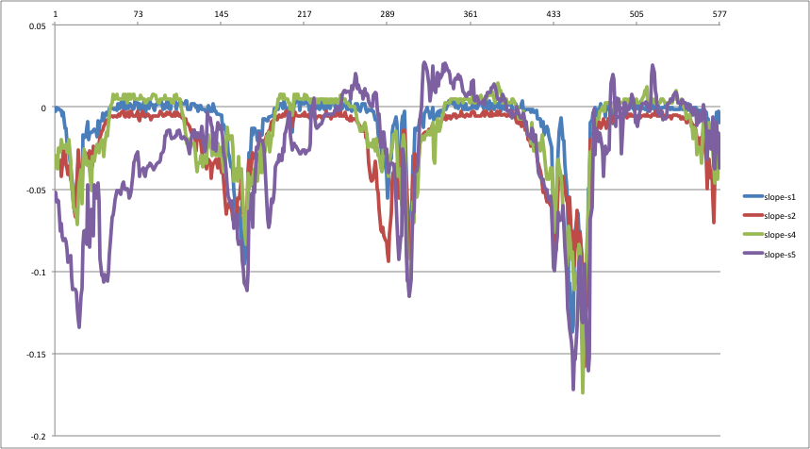
Transect near simple raft

Slide 20
6. Summary
Looking for relationship between observable physical features and health
Lake shape
Circle-ness
Fractal dimension of the shoreline
Extend existing wocus patches
Minor difference on whole lake scale
Could be in particular areas
Expand fringe marsh
Using placement of islands
Diversity of physical habitat
Need an objective set of measurements for effect of changes and improved health

Slide 21
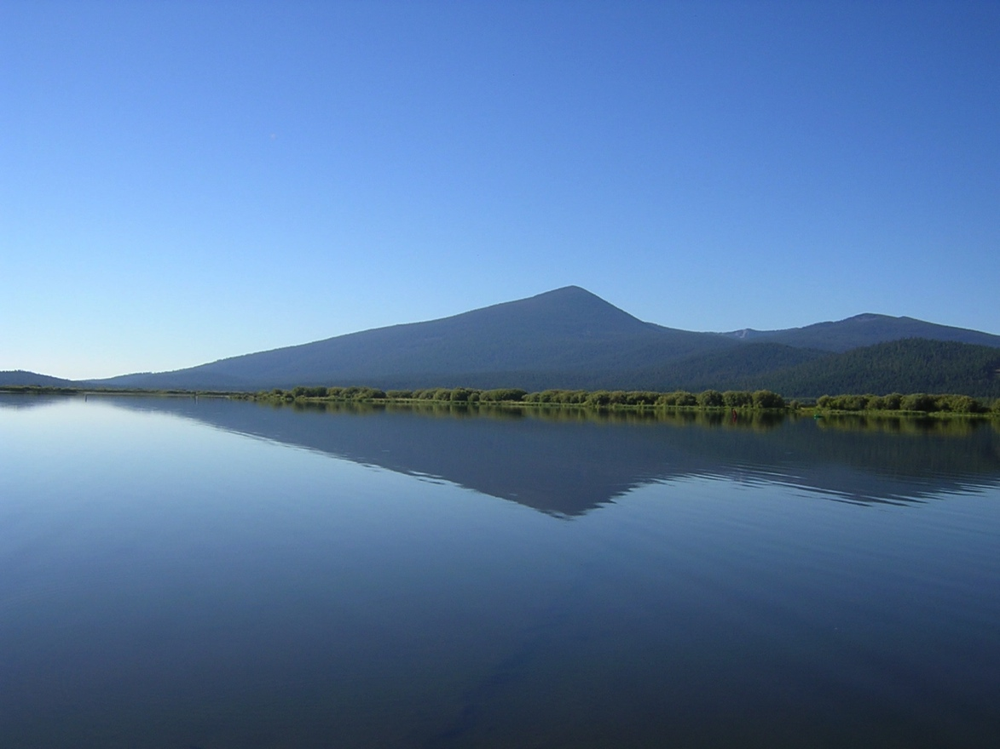
"Beauty is wholeness; it is health in the ecological sense of amplitude and balance. And ecology is long-term economics. ”
Wendell Berry 1972

Slide 22
References
Costanza 1992
Ray
TMDL ORDEQ
Wendell Berry (1972)
Wocus picture from http://explore.globalcreations.com/places/upper-klamath-national-wildlife-refuge/

