Slide 1
Understanding worldviews may help sort through technical assessment of restoration methods
“May you study interesting systems”
Paraphrased proverb
Focus on the Klamath Basin and Upper Klamath Lake
John Rueter
Environmental Sciences and Management Program
Center for Lakes and Reservoirs
School of the Environment
Portland State University
rueterj@pdx.edu

Slide 2
Overview
The Klamath Basin and Upper Klamath Lake has problems
Technical proposals for cleaning up Upper Klamath Lake
It is important to identify worldviews, even in technical sessions
We can use information about disparate values to choose approaches
Creating scenarios, based on these worldviews, is a start
Conclusions
Notes:
These problems are value statements

Slide 3
1. Overview of the Klamath Basin and the issues
From KRPRW Environmental Setting
USGS
Notes:
15,772 mi^2
About the size of Vermont
Larger than 9 states and DC
About 100 government groups, agencies, or other groups in the KBRA
11 hrs to drive from headwaters to coast
Historical data resource

Slide 4
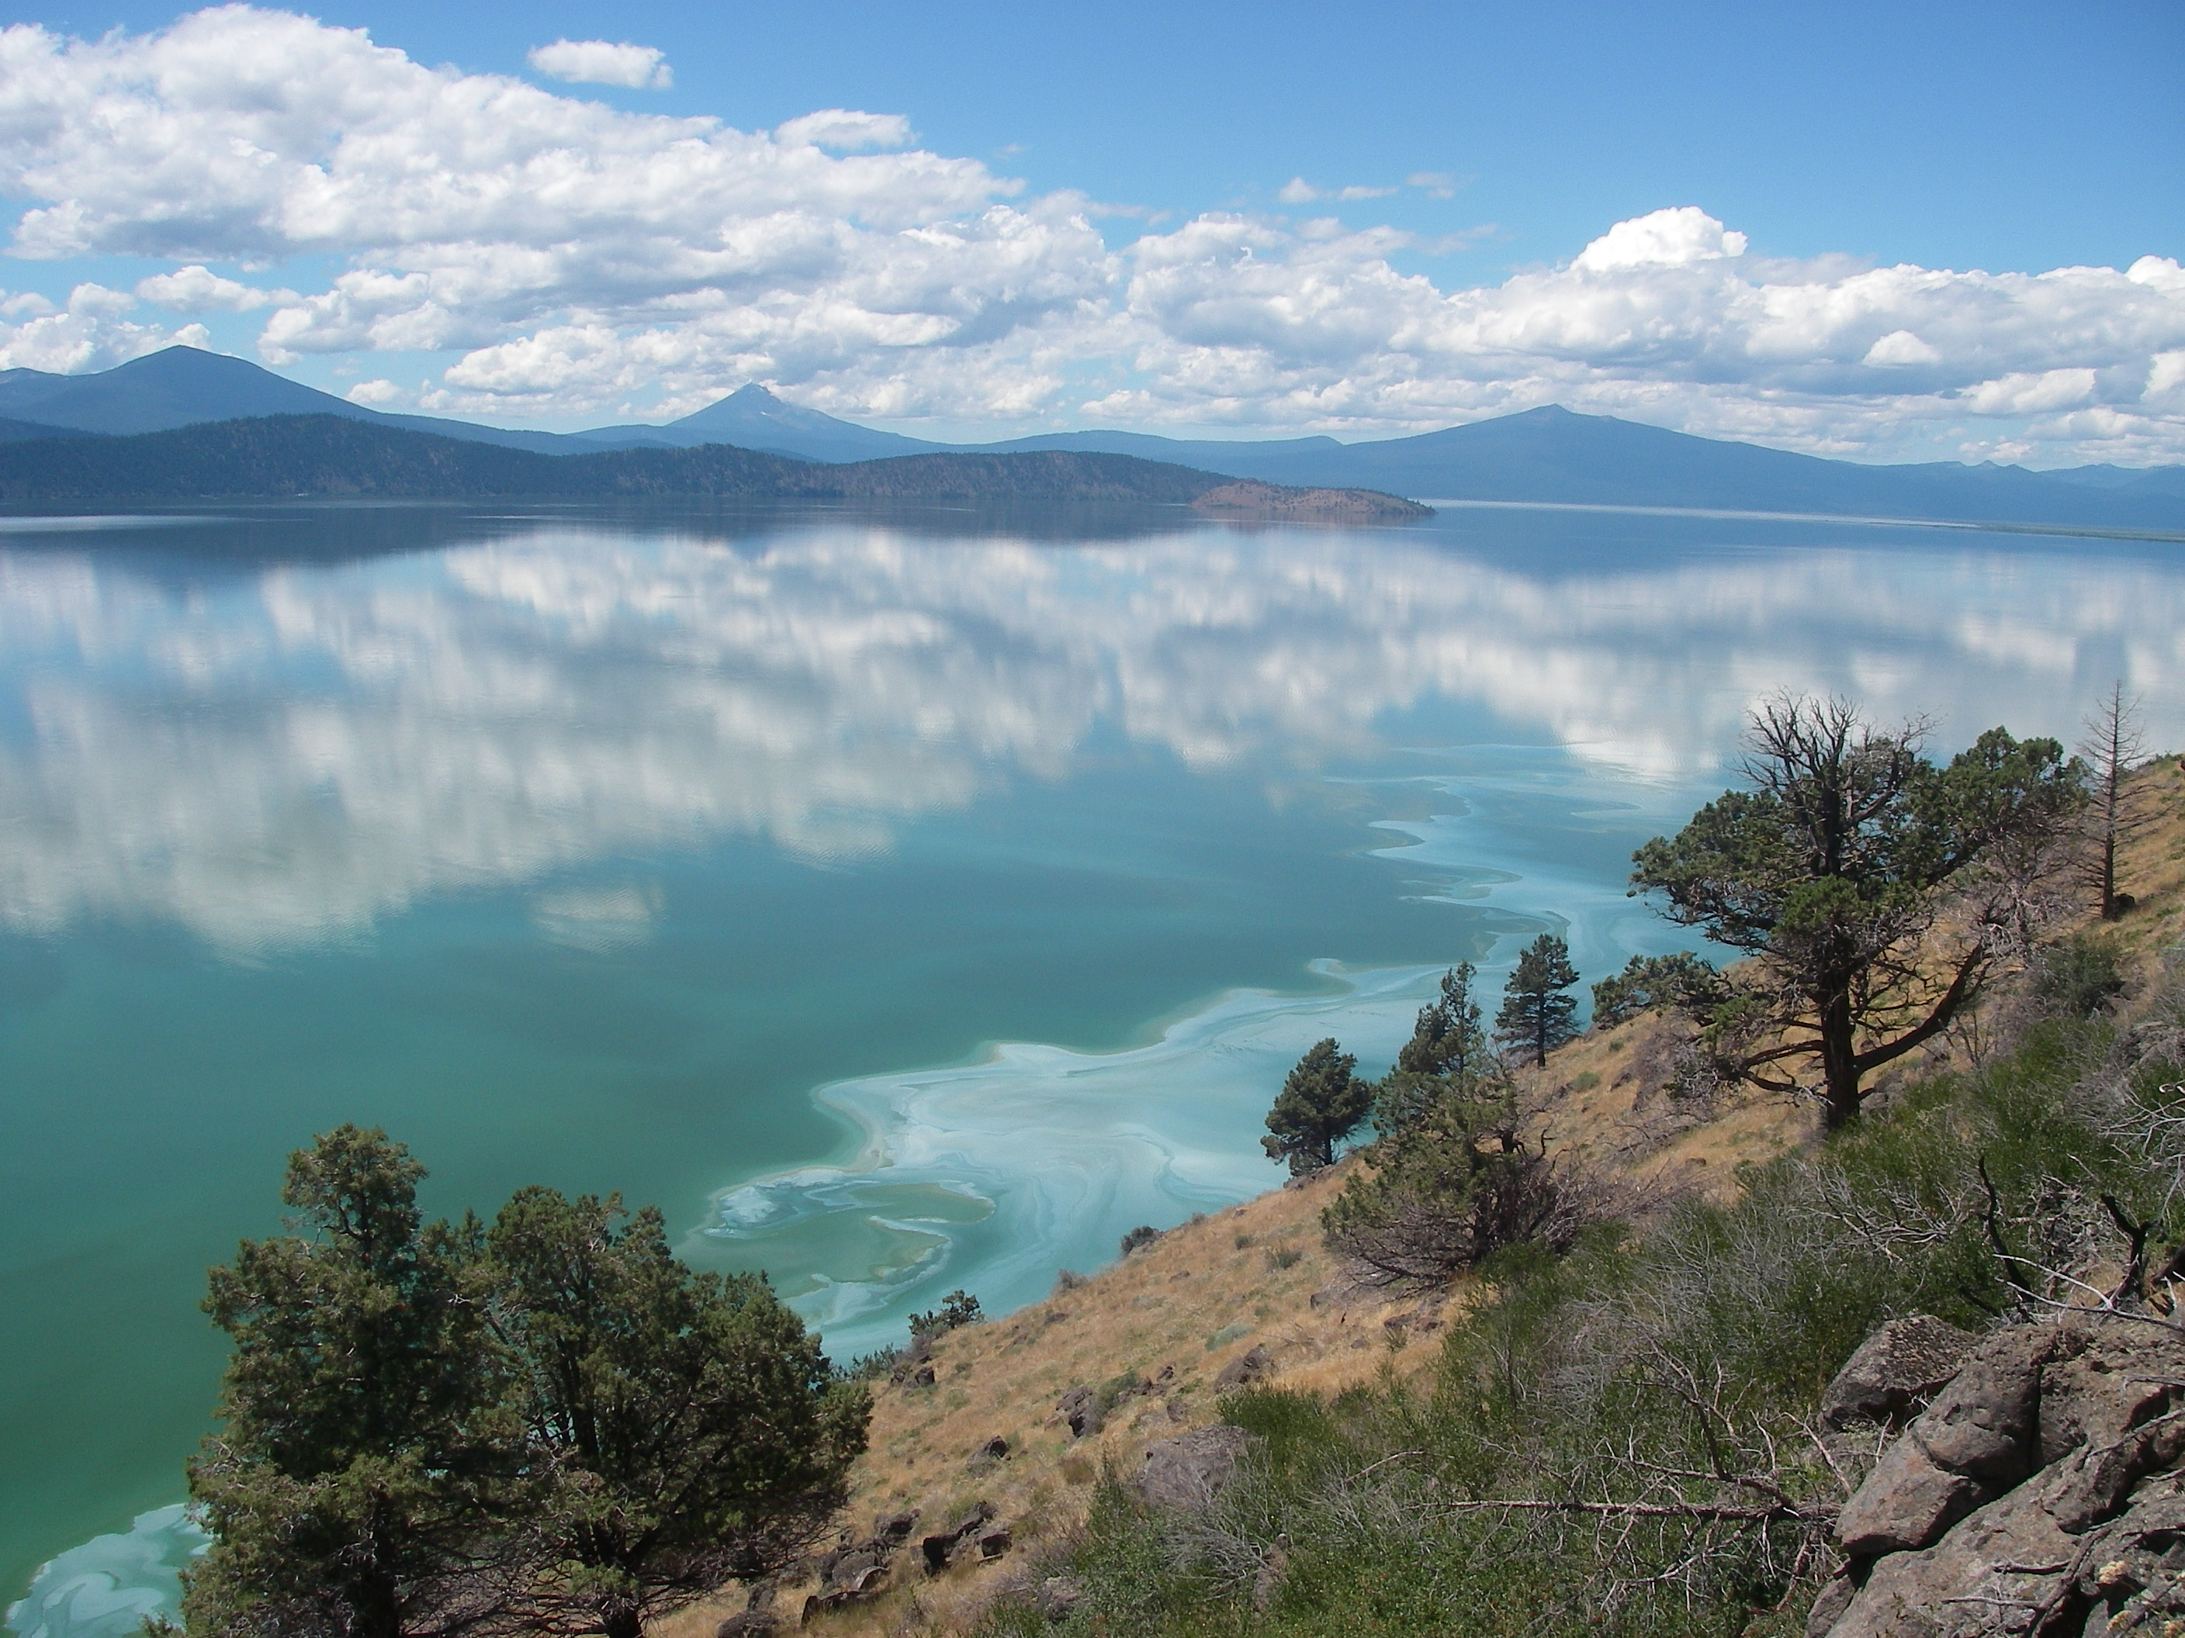
Issues and problems in the lake
Not enough water for all users
High phosphorus
High chlorophyll
Extreme algal blooms and crashes
Endangered fish populations

Slide 5
2. Technical workshop
Klamath River Water Quality Workshop, Sept 10-13, 2012, Sacramento, CA
Teams were charged with presenting methods for lake restoration
Common parameters
Amount of land area
P and N removal
Costs
Technical feasibility
Proposed lake restoration methods
Dredging
Alum treatment
Filtration
Increase native wetlands
Off-channel treatment marshes
Distributed, smaller projects

Slide 6
3. Important to identify worldviews
Based on holder’s assumptions about how the world works
Can use these assumptions to check against the other worldviews
Example – Hobbes/Rousseau
Can use these to generate scenarios (like in MEA)

Slide 7
Set of Worldviews
Individualist – free market
Hierarchist – establish rules and procedures
Egalitarian – use bottom up governance
Deep Ecology – respect the rights of other organisms
Fatalist – skeptical that this will make a difference
Notes:
These were evident in the presentations – even at this highly technical workshop
We can make objective statements about the impact of these worldviews and analyze them rigorously, i.e. scientific evaluation

Slide 8
Workshop & Worldviews
Worldview | Proponent | Salient words
Individualist/ cornucopian | USDA NRCS who works closely with farmers | Ranchers have always been able to solve them using innovation Individuals will do the right thing with their property
Hierachist/ Industrical ecology | Representative from USGS | We can identify the causes and scale our efforts to efficiently address these
Egalitarian/ Committed environmentalist | University professor | Precautionary principle invoked, don’t rely on large scale energy use
Deep Ecology | Representative from Resighini Rancheria | Return to pre-European conditions Self-regulating ecosystem
Fatalist/techno-skeptic | Not represented | Need to solve your current problems

Slide 9
Considering values mismatches in looking for approaches
Range of worldviews means that there will be values mismatches
Example: Individualists will favor population growth whereas Deep Ecologists will favor zero population growth
Not our job to solve these debates
Can include disparate values as a factor in choosing how to address environmental problems

Slide 10
4. Problem types and strategies
Problem typology
Management strategies
 | Value alignment | Value conflict
Information available | Simple (Regulations) | CPR (Institutions)
Information lacking | Information (Research) | Wicked (Entrepre-neurial)
 | High control | Low control
Sufficient knowledge | Optimal project management | Hedging/diversification
Uncertainty | Scientific Adaptive Managment | Scenarios
Notes:
Problem typology from
Management Strategies from DOI Handbook of Adaptive Management

Slide 11
Engaging with problems
Knowledge:Control:Value
K | C | V | Effective modes of engagement
L | L | L | Scenarios and expanded narratives
L | L | H
L | H | L | Environmental Entrepreneurism
L | H | H | Scientific Adaptive Manage
H | L | L | Multi-criteria
H | L | H | Hedging/Diversification
H | H | L | CPR - institutions
H | H | H | Optimal Project Management

Slide 12
Building scenarios: Assumptions
Lake restoration will involve the entire community
Building trust will take deliberate effort
What will the lake and the region look like?
Modernity
Post-modernity
Second modernity (Gross)
Retro-modernity
Went through an analysis of what conditions and values each of these worldviews think will be in their future
Notes:
Modernity - future will be different than the past
Post-modernity – there will be many versions of the truth and multiple conflicting “authorities”
Second modernity (Gross) - the future is uncertain and it will be different in ways we can’t even predict
Retro-modernity – only versions of the future that contain recognizable components of the present are feasible
Turnover time of physical assets
People are able to embrace the familiar

Slide 13
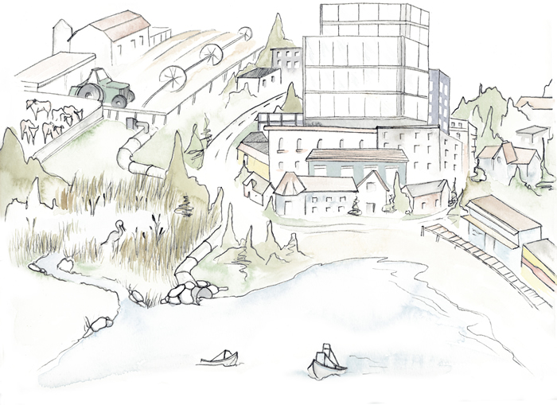
Individualist: Economic Renaissance

Slide 14
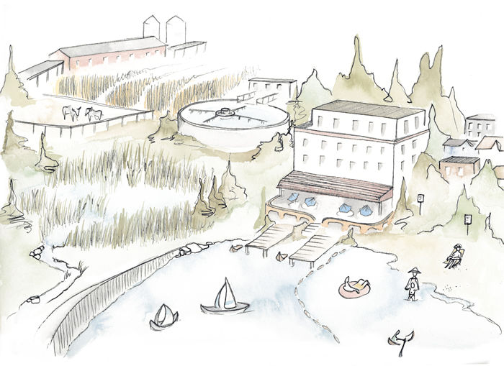
Hierarchist: Expert Lake Management

Slide 15
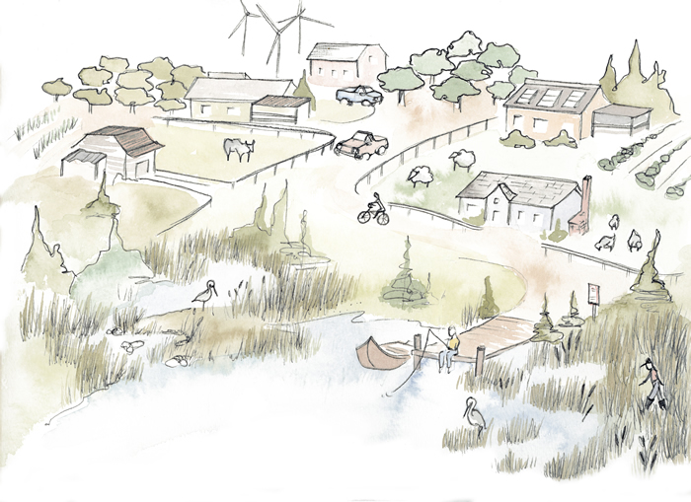
Egalitarian: Mosaic

Slide 16
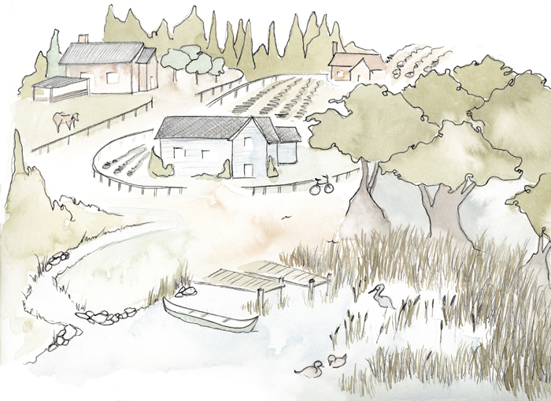
Deep Ecology: Return to Nature

Slide 17
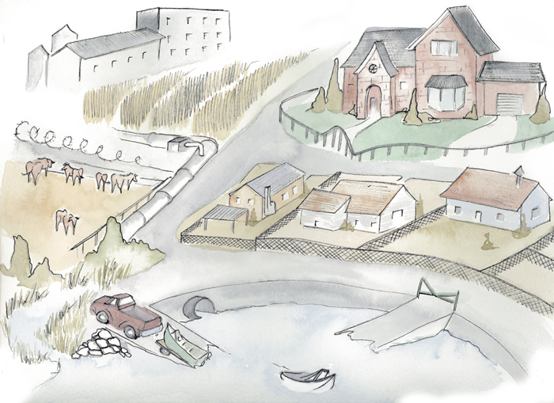
Fatalist: You’re all crazy!

Slide 18
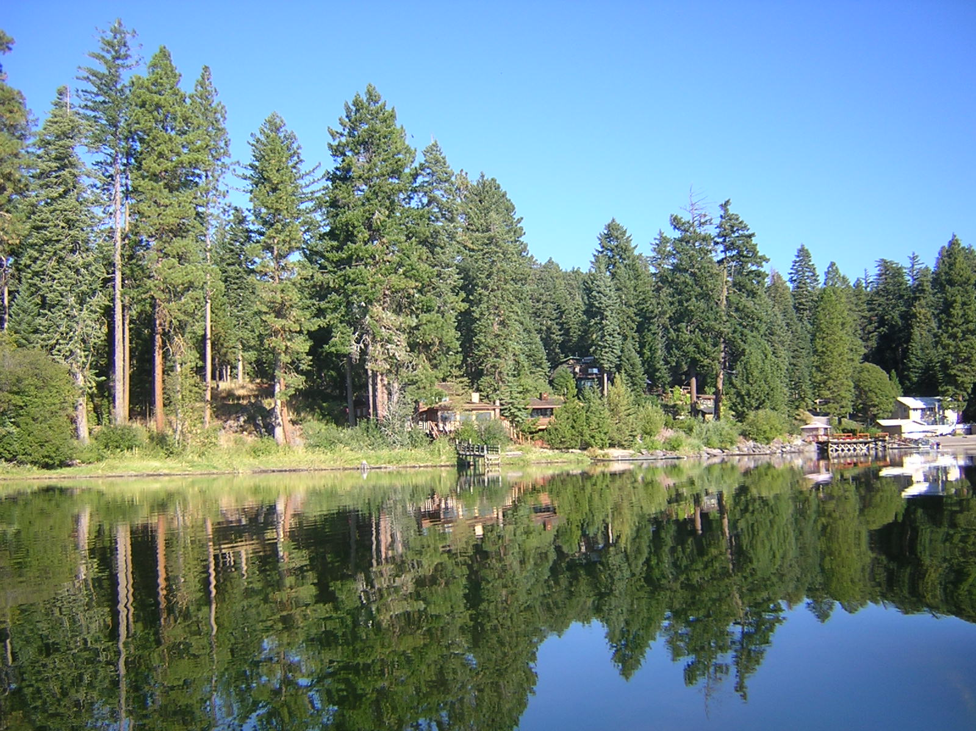
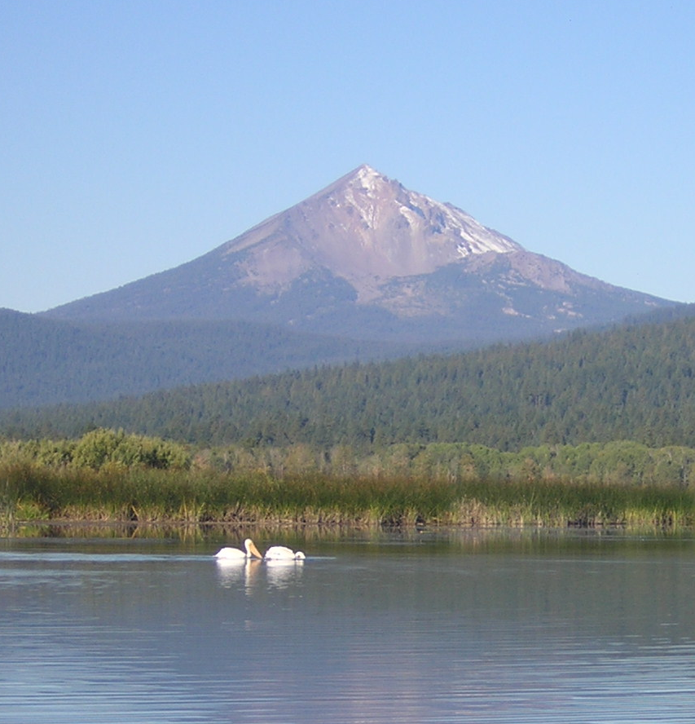
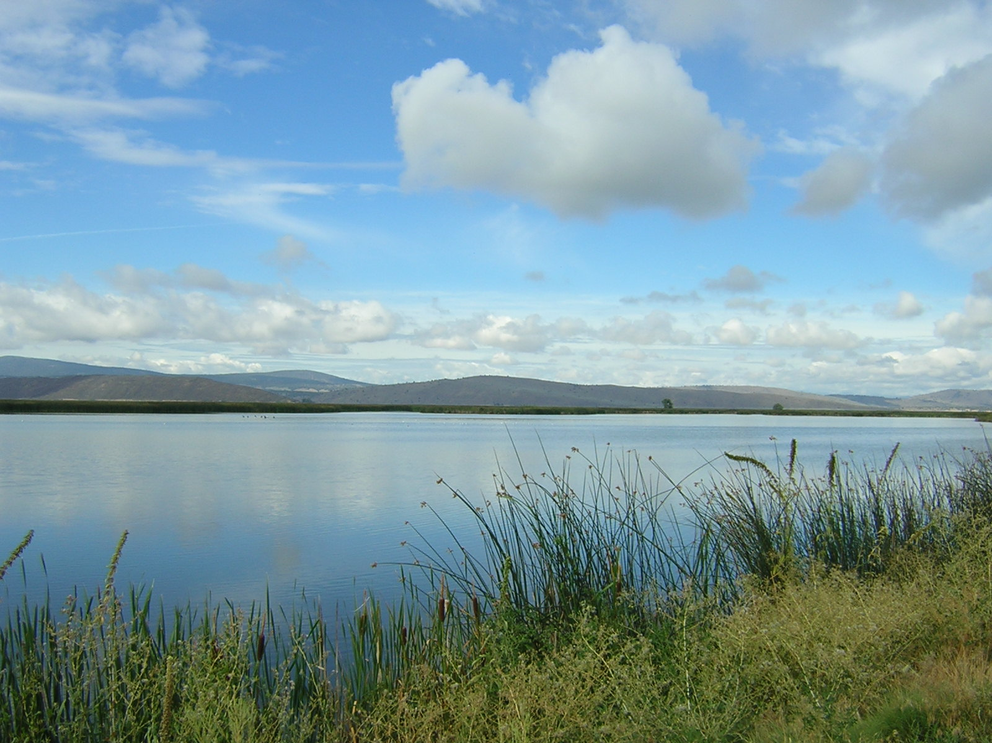
6. Conclusions
It’s not hopeless for us.
We can make objective statements about values.
Sorting out KCV can help us choose approaches
Under high uncertainty, scenarios that contain familiar elements can help us build trust and cooperation.
Notes:
Problems are relative to what we value about the lake

Slide 19
Thank You

Slide 20
Acknowledgements & Contact Information
Klamath Water Quality Workshop
Clayton Creager, North Coast Water Board, CA
Maia Singer, Stillwater Sciences
Lindsay Jordon– for the sketches
http://lindsayjordankretchun.com/
My contact info:
John Rueter
rueterj@pdx.edu
http://cyanolab.research.pdx.edu

Slide 21
Problem typology
Alignment of values with costs good poor
Simple | CPR
Inform-ation | Wicked
Low
High
Complexity of information
The problems we will address in this seminar contain different mixtures values, information demands, and our ability to control the situation enough to manage change

Slide 22
Dredging
Captial and O&M = $5-15/yd³
Total project costs $150-460 mil
$110-330 per Kg P
Estimates don’t include disposal costs

Slide 23
Phosphorus removal – alum or aeration
Compared to other lakes with similar characteristics
$90 to $180 mil for a treatment that would last from 8 to 15 years
Over 50 years
$260 per Kg P
Also considered aeration

Slide 24
Removing algae with filtration
Roaming filtering barges or stationary
Barge costs
Capital = $300k
O&M = $3.4 mill
$110 per Kg P filtered and removed to landfill

Slide 25
Filtration at Canal A

Slide 26
Restore existing marshes
Based on general size of the current projects for restoration
Capital = $15M to $28M
O&M = $16M - $128M
$30 - $480 per Kg P

Slide 27
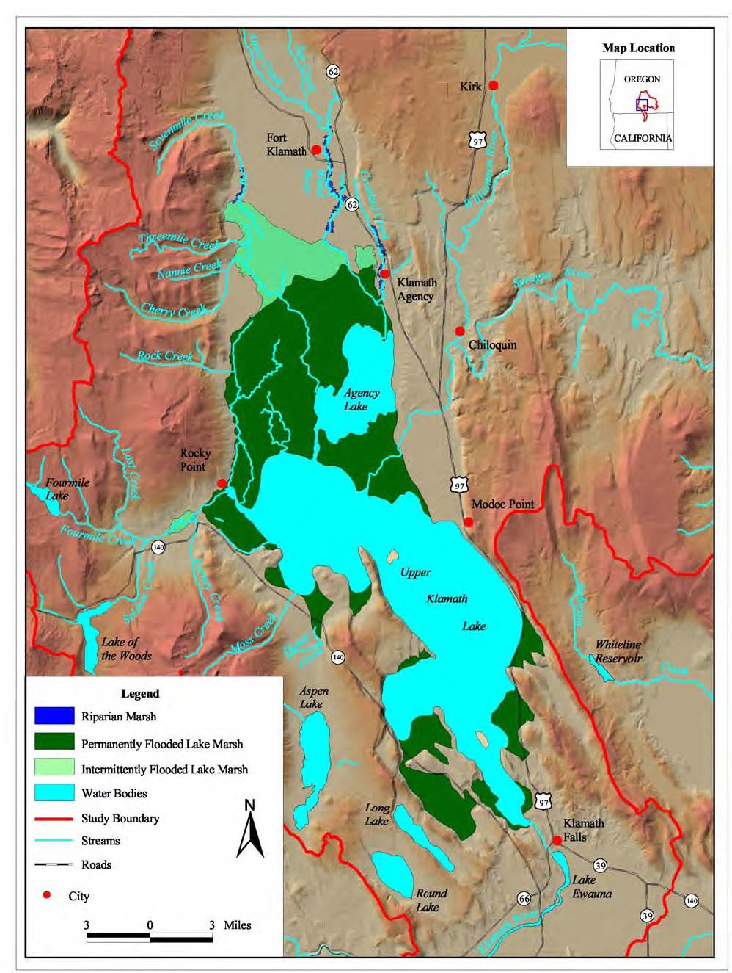
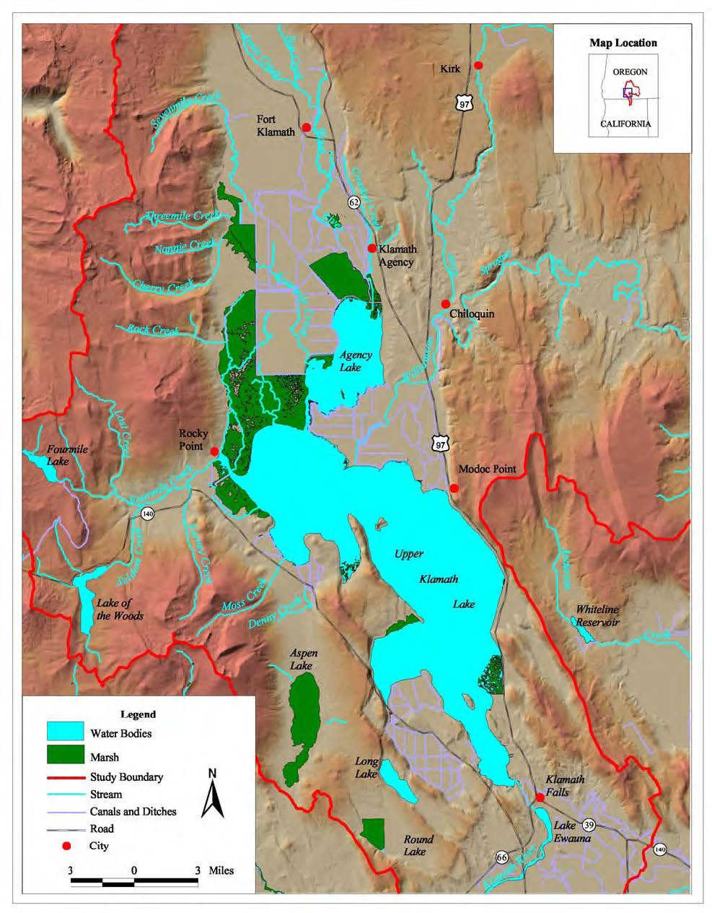
Wetlands Drained for Agriculture
Recently restored wetlands
Images: USBR (2005) Natural Flow of the Upper Klamath River

Slide 28
Build treatment marshes
For 1,000 to 2,000 acres for 50 years
Capital = $17M
O&M = $21M -$64M
$47 - $162 per Kg P

Slide 29
Floating Treatment Wetlands
Considered as a type of treatment wetlands

Slide 30
Distributed BMP on Ranches
100 acre parcel with 0.9 acre in-pasture wetland
50 years
Capital = $18k
O&M = $12k
$160-$320 per Kg P removed

Slide 31
Values and Conditions
Values of the Public
Ecosystem Function
Demographics
Energy and Global Climate Change
Institutions
Knowledge base
Notes:
Values of the public – will they change significantly?
Trust individuals vs. control with rules
Rights: property-animal-“nature” continuum
Economics: financial methods can capture all important values
Job preference: people will seek environmental jobs
People support the government’s projects
Ecosystem function
The system is currently resilient and will take great effort to change
There are thresholds vs. the system will respond incrementally
Rehabilitated or restored ecosystems (marshes) will provide benefits to the public beyond just the marsh
Demographics
The population will grow significantly
Employment opportunities in other segments (outside of ecosystem restoration or the lake) will increase employment rates overall
Energy and Global Warming
Strong global warming impact
Restricted/expensive energy costs
Institutions
Government is effective enough to lead change
Government has sufficient money
Government mission is stable over a long enough period to finish projects
NGOs and Trust are effective
Private enterprise, such as socially responsible corporations, can contribute to accomplishing goals
There is continued innovation in institutions to meet new needs
Knowledge base, provides the ability to successfully manage
technical projects are feasible at these scales
wetlands will provide desired water quality outcomes
direct innovation will help meet mission goals
Scientific adaptive management can be employed and supported to grow the knowledge base and reduce uncertainty

Slide 32
Values and Conditions
Values of the Public
Trust individuals vs. control with rules
Rights: property-animal-“nature” continuum
Economics: financial methods can capture all important values
Job preference: people will seek environmental jobs
People support the government’s projects
Ecosystem Function
Demographics
Energy and Global Climate Change
Institutions
Knowledge base
Notes:
Values of the public – will they change significantly?
Trust individuals vs. control with rules
Rights: property-animal-“nature” continuum
Economics: financial methods can capture all important values
Job preference: people will seek environmental jobs
People support the government’s projects
Ecosystem function
The system is currently resilient and will take great effort to change
There are thresholds vs. the system will respond incrementally
Rehabilitated or restored ecosystems (marshes) will provide benefits to the public beyond just the marsh
Demographics
The population will grow significantly
Employment opportunities in other segments (outside of ecosystem restoration or the lake) will increase employment rates overall
Energy and Global Warming
Strong global warming impact
Restricted/expensive energy costs
Institutions
Government is effective enough to lead change
Government has sufficient money
Government mission is stable over a long enough period to finish projects
NGOs and Trust are effective
Private enterprise, such as socially responsible corporations, can contribute to accomplishing goals
There is continued innovation in institutions to meet new needs
Knowledge base, provides the ability to successfully manage
technical projects are feasible at these scales
wetlands will provide desired water quality outcomes
direct innovation will help meet mission goals
Scientific adaptive management can be employed and supported to grow the knowledge base and reduce uncertainty

Slide 33
Values and Conditions
Values of the Public
Ecosystem Function
The system is currently resilient and will take great effort to change
There are thresholds vs. the system will respond incrementally
Rehabilitated or restored ecosystems (marshes) will provide benefits to the public beyond just the marsh
Demographics
Energy and Global Climate Change
Institutions
Knowledge base
Notes:
Values of the public – will they change significantly?
Trust individuals vs. control with rules
Rights: property-animal-“nature” continuum
Economics: financial methods can capture all important values
Job preference: people will seek environmental jobs
People support the government’s projects
Ecosystem function
The system is currently resilient and will take great effort to change
There are thresholds vs. the system will respond incrementally
Rehabilitated or restored ecosystems (marshes) will provide benefits to the public beyond just the marsh
Demographics
The population will grow significantly
Employment opportunities in other segments (outside of ecosystem restoration or the lake) will increase employment rates overall
Energy and Global Warming
Strong global warming impact
Restricted/expensive energy costs
Institutions
Government is effective enough to lead change
Government has sufficient money
Government mission is stable over a long enough period to finish projects
NGOs and Trust are effective
Private enterprise, such as socially responsible corporations, can contribute to accomplishing goals
There is continued innovation in institutions to meet new needs
Knowledge base, provides the ability to successfully manage
technical projects are feasible at these scales
wetlands will provide desired water quality outcomes
direct innovation will help meet mission goals
Scientific adaptive management can be employed and supported to grow the knowledge base and reduce uncertainty

Slide 34
Values and Conditions
Values of the Public
Ecosystem Function
Demographics
The population will grow significantly
Employment opportunities will increase overall
Energy and Global Climate Change
Institutions
Knowledge base
Notes:
Values of the public – will they change significantly?
Trust individuals vs. control with rules
Rights: property-animal-“nature” continuum
Economics: financial methods can capture all important values
Job preference: people will seek environmental jobs
People support the government’s projects
Ecosystem function
The system is currently resilient and will take great effort to change
There are thresholds vs. the system will respond incrementally
Rehabilitated or restored ecosystems (marshes) will provide benefits to the public beyond just the marsh
Demographics
The population will grow significantly
Employment opportunities in other segments (outside of ecosystem restoration or the lake) will increase employment rates overall
Energy and Global Warming
Strong global warming impact
Restricted/expensive energy costs
Institutions
Government is effective enough to lead change
Government has sufficient money
Government mission is stable over a long enough period to finish projects
NGOs and Trust are effective
Private enterprise, such as socially responsible corporations, can contribute to accomplishing goals
There is continued innovation in institutions to meet new needs
Knowledge base, provides the ability to successfully manage
technical projects are feasible at these scales
wetlands will provide desired water quality outcomes
direct innovation will help meet mission goals
Scientific adaptive management can be employed and supported to grow the knowledge base and reduce uncertainty

Slide 35
Values and Conditions
Values of the Public
Ecosystem Function
Demographics
Energy and Global Climate Change
Strong global warming impact
Restricted/expensive energy costs
Institutions
Knowledge base
Notes:
Values of the public – will they change significantly?
Trust individuals vs. control with rules
Rights: property-animal-“nature” continuum
Economics: financial methods can capture all important values
Job preference: people will seek environmental jobs
People support the government’s projects
Ecosystem function
The system is currently resilient and will take great effort to change
There are thresholds vs. the system will respond incrementally
Rehabilitated or restored ecosystems (marshes) will provide benefits to the public beyond just the marsh
Demographics
The population will grow significantly
Employment opportunities in other segments (outside of ecosystem restoration or the lake) will increase employment rates overall
Energy and Global Warming
Strong global warming impact
Restricted/expensive energy costs
Institutions
Government is effective enough to lead change
Government has sufficient money
Government mission is stable over a long enough period to finish projects
NGOs and Trust are effective
Private enterprise, such as socially responsible corporations, can contribute to accomplishing goals
There is continued innovation in institutions to meet new needs
Knowledge base, provides the ability to successfully manage
technical projects are feasible at these scales
wetlands will provide desired water quality outcomes
direct innovation will help meet mission goals
Scientific adaptive management can be employed and supported to grow the knowledge base and reduce uncertainty

Slide 36
Values and Conditions
Values of the Public
Ecosystem Function
Demographics
Energy and Global Climate Change
Institutions
Government is effective enough to lead change
Government has sufficient money
Government mission is stable over a long enough period to finish projects
NGOs and Trust are effective
Private enterprise, such as socially responsible corporations, can contribute to accomplishing goals
There is continued innovation in institutions to meet new needs
Knowledge base
Notes:
Values of the public – will they change significantly?
Trust individuals vs. control with rules
Rights: property-animal-“nature” continuum
Economics: financial methods can capture all important values
Job preference: people will seek environmental jobs
People support the government’s projects
Ecosystem function
The system is currently resilient and will take great effort to change
There are thresholds vs. the system will respond incrementally
Rehabilitated or restored ecosystems (marshes) will provide benefits to the public beyond just the marsh
Demographics
The population will grow significantly
Employment opportunities in other segments (outside of ecosystem restoration or the lake) will increase employment rates overall
Energy and Global Warming
Strong global warming impact
Restricted/expensive energy costs
Institutions
Government is effective enough to lead change
Government has sufficient money
Government mission is stable over a long enough period to finish projects
NGOs and Trust are effective
Private enterprise, such as socially responsible corporations, can contribute to accomplishing goals
There is continued innovation in institutions to meet new needs
Knowledge base, provides the ability to successfully manage
technical projects are feasible at these scales
wetlands will provide desired water quality outcomes
direct innovation will help meet mission goals
Scientific adaptive management can be employed and supported to grow the knowledge base and reduce uncertainty

Slide 37
Values and Conditions
Values of the Public
Ecosystem Function
Demographics
Energy and Global Climate Change
Institutions
Knowledge base
technical projects are feasible at these scales
wetlands will provide desired water quality outcomes
direct innovation will help meet mission goals
Scientific adaptive management can be employed
Notes:
Values of the public – will they change significantly?
Trust individuals vs. control with rules
Rights: property-animal-“nature” continuum
Economics: financial methods can capture all important values
Job preference: people will seek environmental jobs
People support the government’s projects
Ecosystem function
The system is currently resilient and will take great effort to change
There are thresholds vs. the system will respond incrementally
Rehabilitated or restored ecosystems (marshes) will provide benefits to the public beyond just the marsh
Demographics
The population will grow significantly
Employment opportunities in other segments (outside of ecosystem restoration or the lake) will increase employment rates overall
Energy and Global Warming
Strong global warming impact
Restricted/expensive energy costs
Institutions
Government is effective enough to lead change
Government has sufficient money
Government mission is stable over a long enough period to finish projects
NGOs and Trust are effective
Private enterprise, such as socially responsible corporations, can contribute to accomplishing goals
There is continued innovation in institutions to meet new needs
Knowledge base, provides the ability to successfully manage
technical projects are feasible at these scales
wetlands will provide desired water quality outcomes
direct innovation will help meet mission goals
Scientific adaptive management can be employed and supported to grow the knowledge base and reduce uncertainty

Slide 38
Redo --- Cross comparison of assumptions

Slide 39
Fatalist/Techno-Skeptic
Maybe interpreted as the need to take care of your current infrastructure
Water spraying out of the penstock that connects the Link River Dam to the powerhouse
Shooting 10 to 30 feet into the air

Slide 40
Knowledge, Control & Values
Knowledge
From well understood to substantial uncertainty
Control
From ability to manage projects to un-manageable
Values
From everybody agrees to mismatches between individuals and society or disparity in the benefits

