Slide 1
Organizing the Organizations that Provide Health Care
PA 574: Health Systems Organization
Session 6 – May 8, 2013

Slide 2
History and Context
Recent history (last three plus decades) of health care reform have really been about organization (re-)structuring of the health care system
Yes about insurance and thus access – but system organization determines what you get.
“Bending the Cost Curve” and hitting the Triple Aims really about changing how health care is delivered

Slide 3
History and Context
  Primary care medical homes are the micro-example of this
  This is about creating boundary spanning organization/system forms that can act like a “rational” system.
  Seeking Triple Aim capable system:
    ACOs, CCOs, HMOs, MCOs – all the same thing generally
    About the “right” mix of natural/rational/open
  All starts with managed care – Managed Care Organizations (MCO) or Health Maintenance Organizations (HMOs)

Slide 4
Managed Care
Been around since mid-20th century:
  Kaiser-Permanente
  Group Health Cooperative
  Health Insurance Plan of NY
  Couple others..
Despite 1973 law supporting HMOs with tax breaks and other legal support:
  In late 80’s, less than 20% population enrolled in HMOs/MCOs
  By early 90’s, more than 80% population enrolled in HMOs/MCOs
Why switch?
  Intense cost/value concerns
  State law changes and anti-trust suits removed many barriers

Slide 5
Managed Care
So what is “managed care”
  Single care providing organization paid a global budget (marriage of insurance and care provision
  Defined population (covered lives)
  Need to provide all services (access and coordination)
  Keeping people healthy could actually make money
  Voluntary enrollment (individual experience of care)
  Triple Aim potential!

Slide 6
Managed Care
What are types of MCO/HMOs
  Staff Model -Formal single organization where everyone is employee and everything owned by org – Group Health Cooperative
  Group Model – Limited entities act as single organization through tight, longer term contractual ties – Kaiser-Permanente
  Virtual Model – Several to many organizations represent as single organization through looser and more time limited contracts.
Kind of like private versions of Beveridge Classic, to Neo-Classic, to Bismarck(??)

Slide 7
Managed Care
Did it change anything?
  Cost yes – actually bent the cost curve!!
  Much more emphasis on prevention at all levels
  But system incentives against advertising you are good at treating ill (adverse selection)
  Some but limited evidence of quality improvement
  No evidence of quality loss – despite books entitled “How Managed Care Can Kill You”

Slide 8
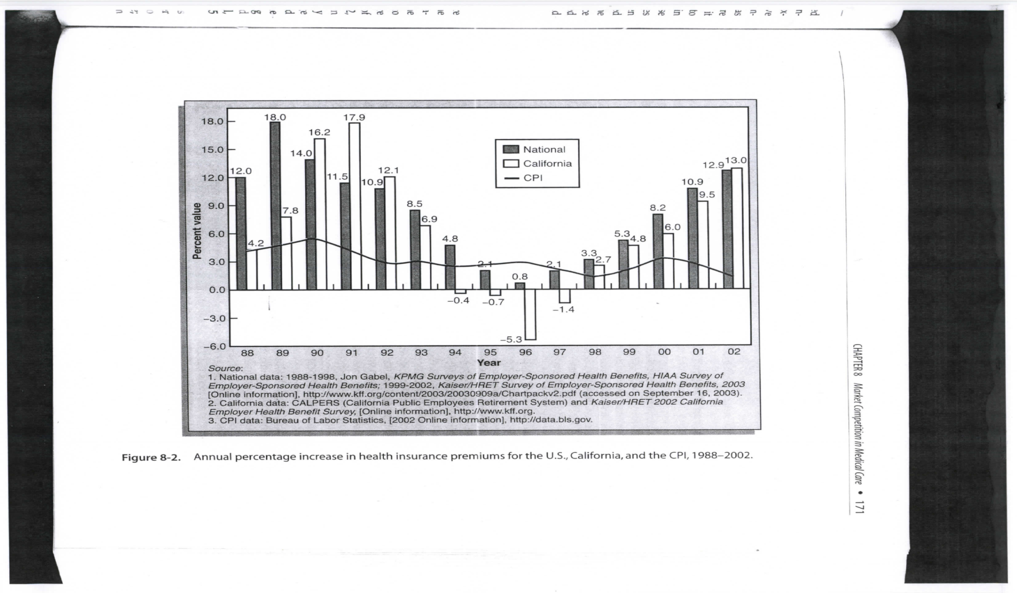
Managed Care

Slide 9
Managed Care
So what happened?
  Managed care “backlash” of late 90’s
  Perogatives and incomes of providers threatened
  Some bad MC processes – 1-800-BEGFORCARE
  Perception that MC was designed to skimp on care (note lack of formal quality constraints despite profit incentive)
  Consumers not used to “closed” systems and change not managed
  “Top down” system – “bureaucrats interfering with individual care”

Slide 10
Managed Care
Managed care goes “underground” – but not gone
Ten years or so and new boundary spanning org forms start to re-appear
Birth of ACOs, CCOs, etc.
All based on general MC principles
Avoiding “top-down” and encouraging “bottom-up” main difference

Slide 11
Accountable Care Organizations
First formally introduced through CMMS under Medicare (pilots) and then into PPACA
Affiliation of hospitals and ambulatory providers – spanning care process
Focus on reducing “downstream” intensive inpatient care

Slide 12
Accountable Care Organizations
“Natural” boundaries defined:
  Patients who use hospital(s)
  Providers who refer to hospital(s)
Paid bonuses for attaining population health goals (gain sharing)
MC “light” – “natural”, voluntary affiliations, no global budget, but explicit quality targets
“Sub”-system of care – limited scope

Slide 13
Super ACOs
Colorado’s Regional Coordinated Care Organizations (RCCOs)
  Developed for Medicaid population
  Integrates behavioral and physical care
  State divided into geographic care regions (defines “population”)
  RCCO orgs formed that provide regional oversight/representation/technical assistance/monitoring but no direct authority

Slide 14
Super ACOs
Primary Care Homes main underlying “technology”
State develops a data warehouse and tech assistance unit
Explicit quality targets defined
Bonuses paid to RCCOs (and distributed?) and PCHs for improved care
All other payment (FFS) and service arrangements generally the same

Slide 15
ACOs meet MCOs
Oregon’s Coordinated Care Organizations are “next step” up.
Medicaid (OHP) also – but with eye to private
Combine physical, behavioral, dental care responsibility in one org (and wanted to include LTC)
Regional orgs with global budgets and explicit quality targets

Slide 16
What Are CCOs
Coordinated Care OrganizationsReplace today’s MCO/MHO/DCO system
Local health entities that deliver health care and coverage for people eligible for Medicaid (the Oregon Health Plan).
16
✓Local control
✓One point of accountability
✓Global (single) budget –fixed rate of growth
✓Expected health outcomes
✓Health Equity
✓Integrate physical and behavioral health
✓Community health workers
✓Focus on prevention
✓Reduced administrative overhead
✓Electronic health records
✓Patient-Centered Primary Care Homes**CCOs required to include recognized clinics in their networks of care to the maximum extent feasible

Slide 17
What is Essence of All This
Value – improved quality at fixed cost
Health as main outcome – performance on population health rewarded
More “bottom-up”, “natural” design – attention to individual needs (consumers, providers, communities)
Voila – the Triple Aim….

