Slide 1
Ch. 28 Campylobacter and Helicobacter

Slide 2
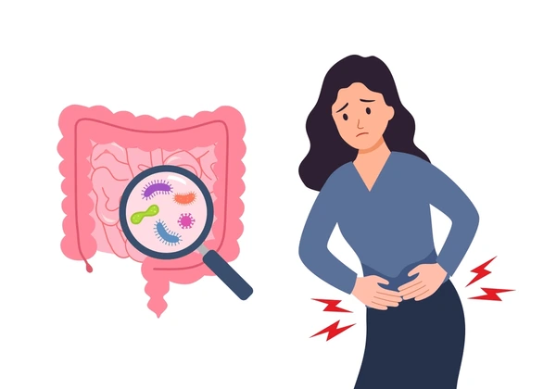
Overview
Discovered in 1886
Campylobacter infections are the most common cause bacterial diarrheal illness in the US
only four species are common human pathogens

Slide 3
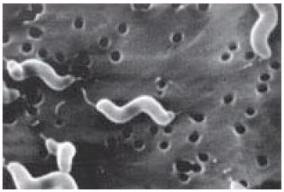
Physiology and Structure
Gram negative, non fermenting, non spore forming, motile, small size
Most are catalase positive and oxidase positive
Comma, spiral shaped, or curved rod, single polar flagella, capsule
Lipo-oligosaccharides LOS
Microaerophilic: require low oxygen (5% to 7%) and increased carbon dioxide (5% to 10%) for growth
scanning electron micrograph of the single polar flagellum and corkscrew shape of C. jejuni. These morphologic characteristics contribute to the characteristic darting motility of C. jejuni in the viscous mucous layer of the intestinal lumen. Sean F. Altekruse National Cancer Institute, Rockville.

Slide 4
Pathogenesis and Immunity
What the the textbook book says:
"Although adhesins, cytotoxic enzymes, and enterotoxins have been detected in C. jejuni, their specific role in disease remains poorly defined”
"strains lacking enterotoxin activity are still fully virulent”
If you are interested in learning about possible specific roles, this is a good paper to start at:
Lopes, Graciela Volz, et al. “Virulence Factors of Foodborne Pathogen Campylobacter Jejuni.” Microbial Pathogenesis, vol. 161, no. Part A, Dec. 2021, p. 105265, https://doi.org/10.1016/j.micpath.2021.105265.

Slide 5
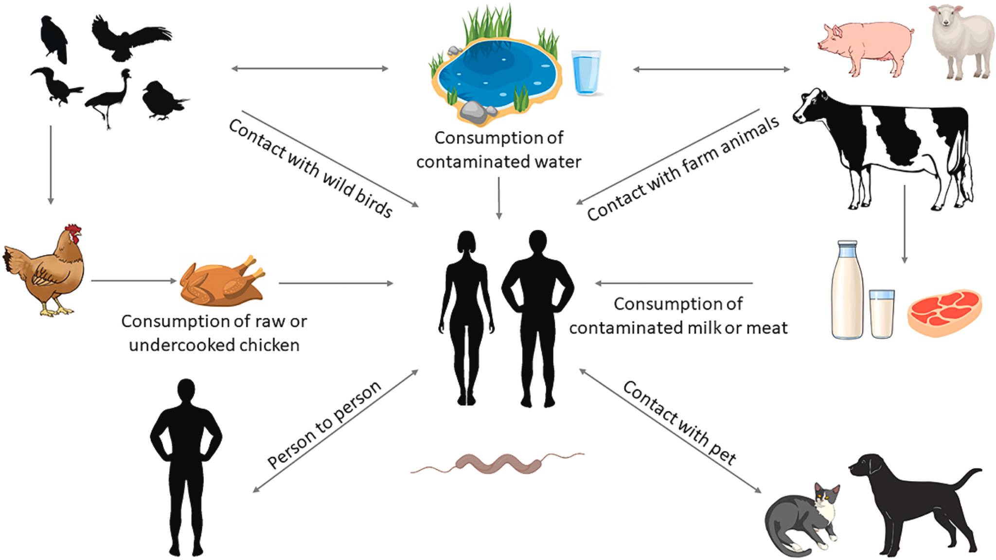
Epidemiology
Zoonotic
Uncommon for disease to be transmitted by food handlers
Disease most commonly observed in infants and young children, with a second peak of disease in 20- to 40-year-old adults.
Higher incidence in developing countries

Slide 6
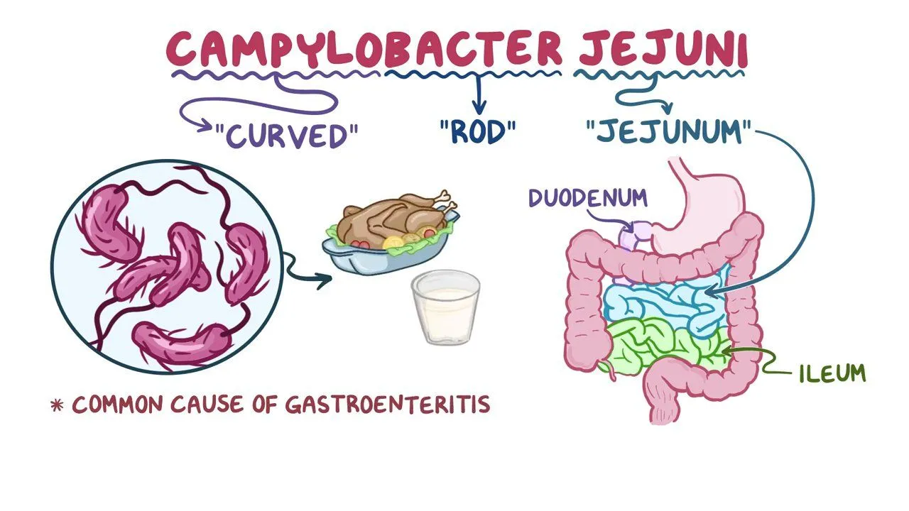
Clinical Disease
C. jejuni:
Common reservoirs: poultry, cattle, sheep
Causes: raw/undercooked meat, unpasteurized milk, contaminated water
Symptoms: incubation is 2-5 days, diarrhea (often bloody), severe abdominal pain, fever
Diseases: Gastroenteritis, extraintestinal infections
Complications:
on rare occasion lead to Guillain Barre syndrome a rare acute autoimmune disease that attacks the peripheral nervous system.
reactive arthritis

Slide 7

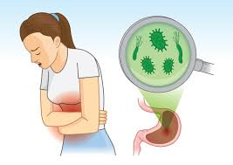
Clinical Disease
C. Coli
Common reservoirs: Pigs, poultry,sheep,birds
Causes: raw/undercooked poultry, unpasteurized milk, contaminated water
Symptoms: incubation period 2-5 days,diarrhea (often bloody), severe abdominal pain, fever
Diseases: Gastroenteritis,extraintestinal infections

Slide 8
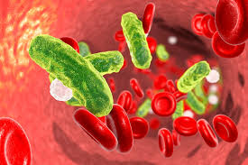
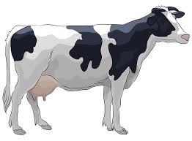
Clinical Disease
C. fetus
Uncommon, primarily infects immunocompromised or elderly people
Common reservoirs: cattle,sheep
Causes: raw/undercooked poultry, unpasteurized milk, contaminated water
Symptoms: prolonged fever, chills, muscle aches. Symptoms appear 2-5 days after incubation
Diseases: intravascular diseases (septicemia, endocarditis, septic thrombophlebitis) and extraintestinal diseases (meningoencephalitis, abscesses) infections.

Slide 9

Clinical Disease
C. upsaliensis
Common reservoirs: contact with domestic dogs, cats (with feces of either healthy carriers or pets with diarrheal disease)
Symptoms: prolonged fever, chills, muscle aches. Symptoms appear 2-5 days after incubation
Diseases: Gastroenteritis, extraintestinal infections, Guillain-Barré syndrome

Slide 10

Treatment, prevention, and control
Treatment C. jejuni, C. coli and C upsaliensis
Hydrate and replenish electrolytes
Antibiotic therapy for severe infections: Erythromycin or azithromycin are first choice for the treatment of enteritis, tetracycline or fluoroquinolones used as secondary antibiotics
Treatment for C. fetus
prompt antibiotic treatment
Prevention:
Proper food preparation
Avoid unpasteurized dairy products
implementation of safeguards to prevent contamination of water supplies

Slide 11
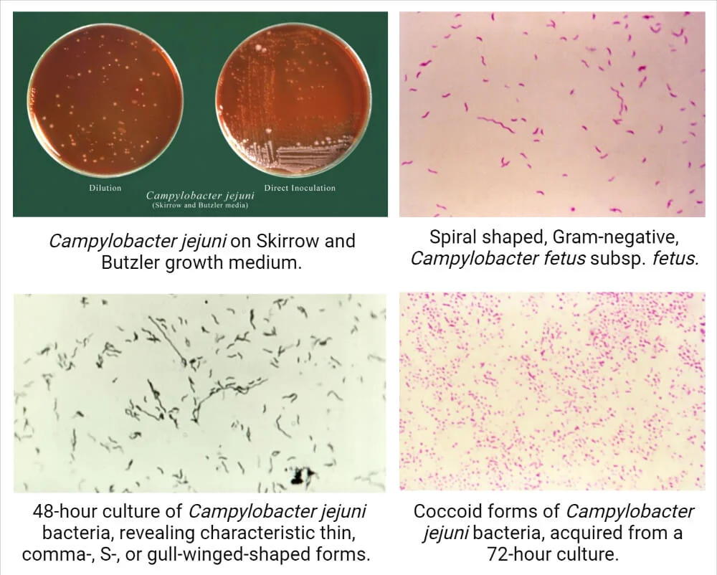
Lab Diagnosis
Microscopy
Antigen detection: immunoassays for C. jejuni and C. coli
Nucleic Acid amplification test: C. jejuni and C. coli
Culture isolation requires growth in a microaerophilic atmosphere with incubation temperature (42°C), and on selective agar media (blood or charcoal) to suppress non pathogenic enteric bacteria.

Slide 12
Helicobacter
In 1983, helicobacter were found in patients with gastritis type B
subdivided into:
(gastric helicobacters) species that primarily colonize the stomach
(enterohepatic helicobacters) that colonize the intestines

Slide 13
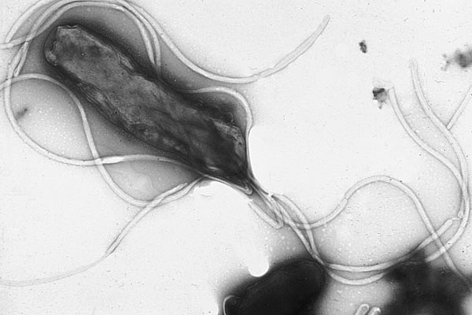
Physiology and Structure
spiral shape or curved rod, sheathed flagella,
highly motile (corkscrew motility), produce abundance of urease, non fermenting, catalase positive, oxidase positive
Yutaka Tsutsumi, M.D. Professor Department of Pathology Fujita Health University School of Medicine - Yutaka Tsutsumi, M.D. Professor Department of Pathology Fujita Health University School of Medicine

Slide 14
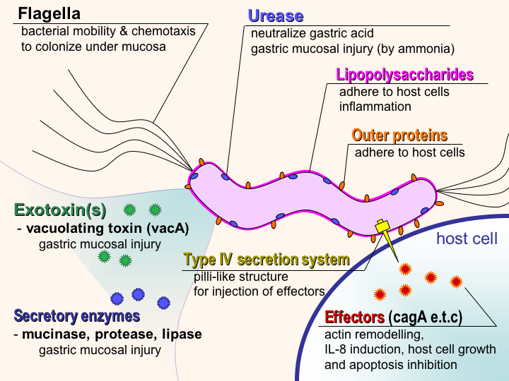
Pathogenesis and Immunity
Adherence:
Multiple surface adhesion proteins adhering to epithelial cells.
Immune Evasion:
Surface proteins can also bind host proteins and help the bacteria evade the immune system.
Pathogenicity:
Vacuolating cytotoxin A (VacA): damages epithelial cells by producing vacuoles.
(CagA) protein: interferes with the normal cytoskeletal structure of the epithelial cells
The cag phosphoribosylanthranilate isomerase (PAI) genes also induce interleukin (IL)-8 production,
CagA and Cag PAI injected by type VI secretion system
Mucinase, protease,phospholipases cause localized tissue damage
By user:Y_tambe - Y_tambe's file, CC BY-SA 3.0, https://commons.wikimedia.org/w/index.php?curid=1551272

Slide 15
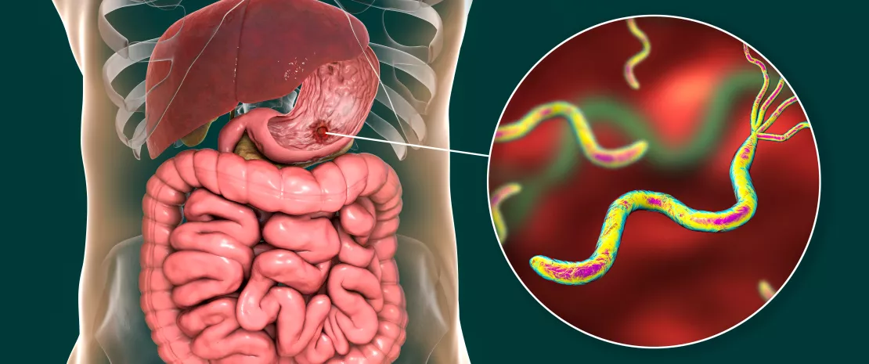
Epidemiology
Humans are the primary reservoir for H. pylori
colonization is believed to present for life, in majority of people unless specifically treated.
H. pylori appears to offer protection from gastroesophageal reflux disease and adenocarcinomas of the lower esophagus and gastric cardia.

Slide 16
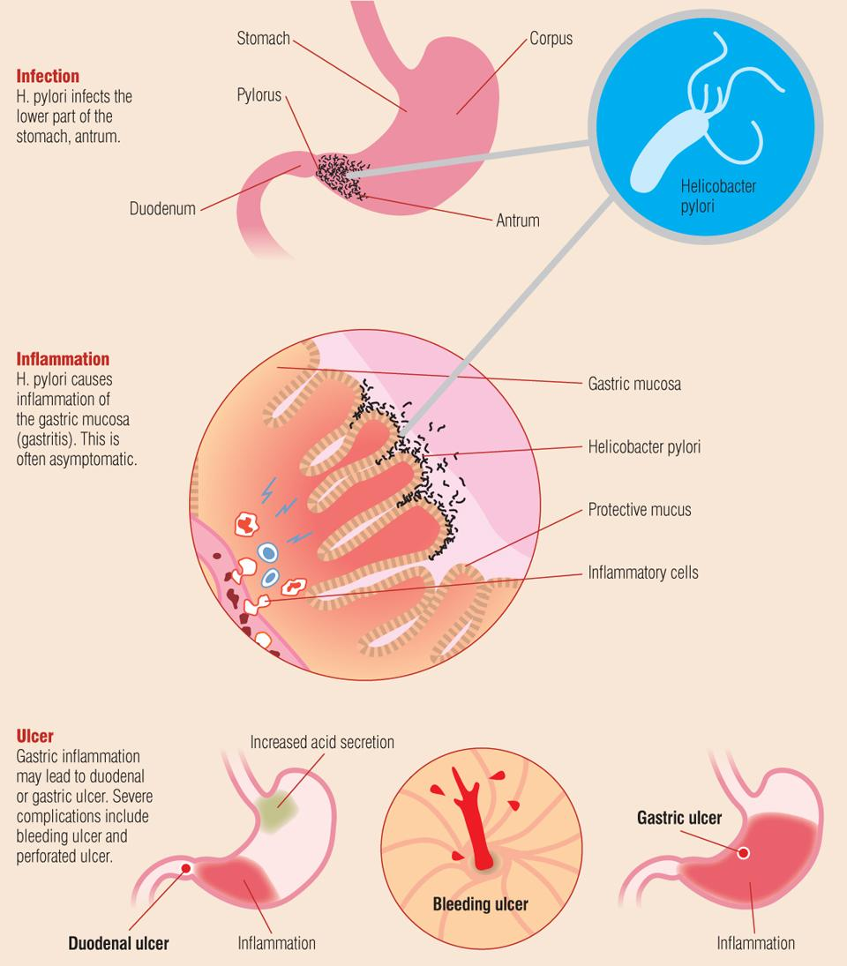
Clinical Disease
H. pylori
Common reservoir: Humans, primates, pigs
How is it spread?: oral or fecal route
Symptoms: feeling of fullness, nausea, vomiting, and
hypochlorhydria (decreased acid production in the stomach)
Disease: can be asymptomatic or can develop gastritis or gastroenteritis.
10%-15% of patients with chronic gastritis develop peptic ulcers (gastric ulcer or duodenal ulcer)
increases the patient’s risk for gastric cancer by almost 100-fold
In a small number of patients, a monoclonal population of B cells may develop and evolve into a MALT lymphoma.

Slide 17
Clinical disease
H. cinaedi
Common reservoir: Humans, hamster
Disease: Gastroenteritis, septicemia, proctocolitis
H. fennelliae
Common reservoir: Humans
Disease: Gastroenteritis, septicemia, proctocolitis

Slide 18
Lab diagnosis
*For H.pylori
Antigen detection: Biopsy specimens can also be tested for the presence of bacterial urease activity, but is invasive
Noninvasive (urea breath test) but is relatively expensive because of the cost of the detection instruments.
Antibody identification: serology test; IgA and IgG antibodies can persist for months to years. the test cannot be used to discriminate between past and current infection.

Slide 19

Treatment, Prevention, Control
Treatment:
combination of a proton pump inhibitor (omeprazole), a macrolide (clarithromycin), and a β-lactam (amoxicillin), with administration for 7 to 10 days initially
Prevention:
Handwashing, avoid sharing utensils

