Slide 1
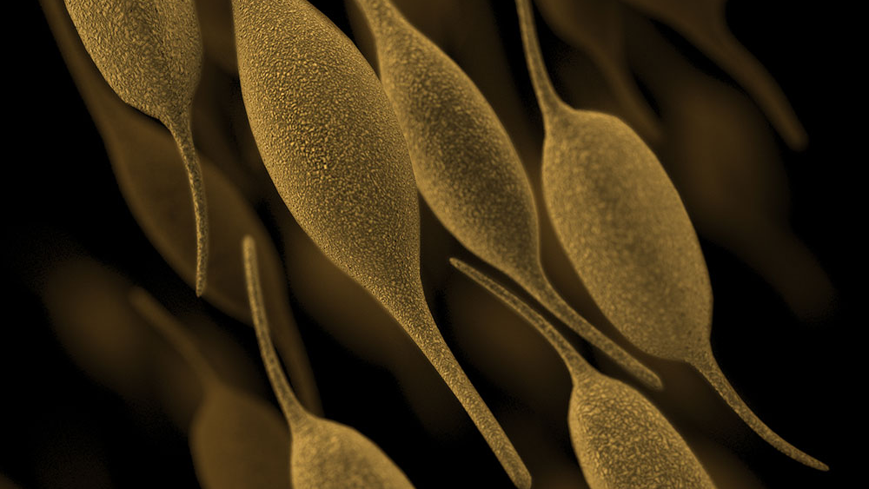
Mycoplasma
By Hank Munro

Slide 2
Terms to Know
Malaise: general fatigue, “feeling off”
Sterol: unsaturated fatty alcohols, typically waxy solids
Epithelial cells: cells that cover the “outside” of our bodies

Slide 3
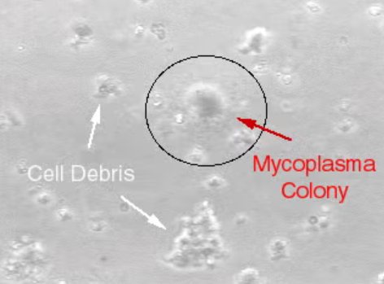
Overview
Genus of >100 species
Lacks a cell wall
  Other cell wall lacking species can grow one under certain conditions
Not part of the normal mucosal flora
Thought to be a virus initially
  Passes through 0.45 μm filter used to eliminate bacteria
Huge issue when making cell cultures
  Sneaky, leads to erroneous results
  Pain in the butt to get rid of

Slide 4
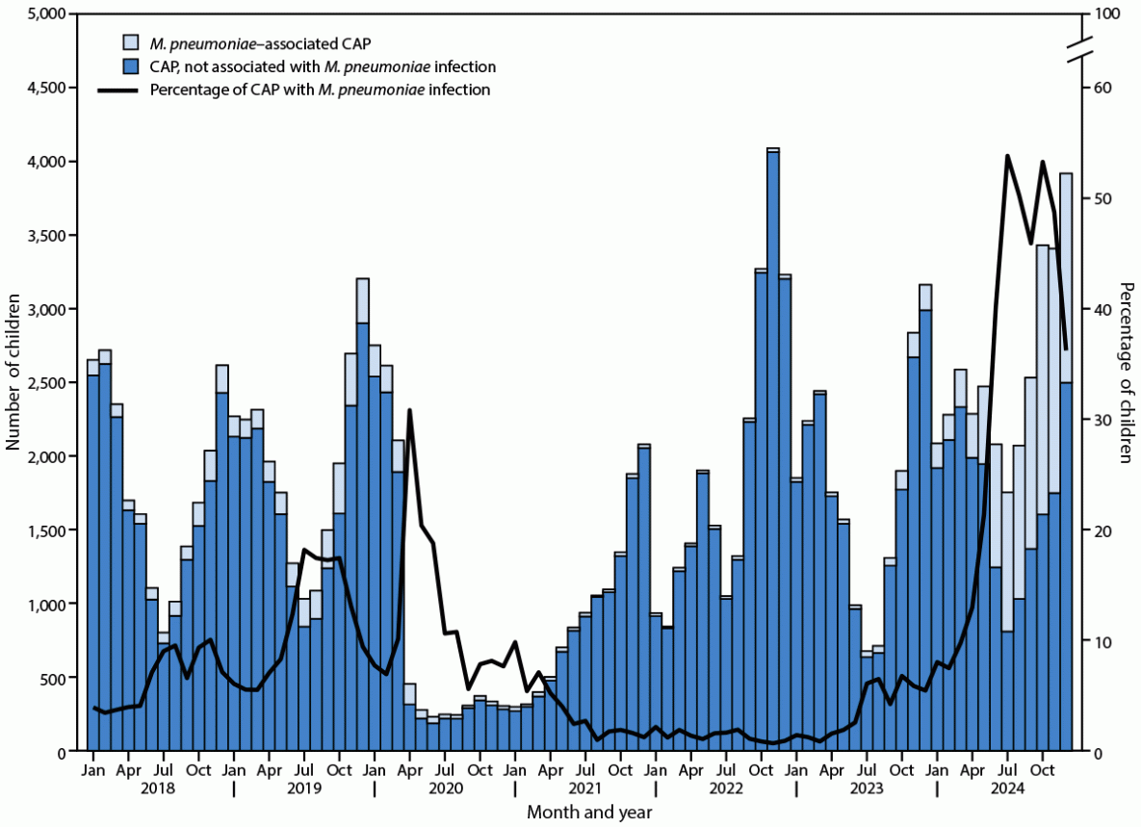
Epidemiology
Strict human pathogen
Colonizes respiratory system
  Throat, trachea, nose, lower tract
Not seasonal, epidemic every 4-8 years
Common in school-aged children (5-15 years)
  Previous exposure lowers chance of reacquiring
2 million cases of pneumonia from M. pneumoniae yearly in U.S.
Hard to test for
  not an exclusively reported disease

Slide 5
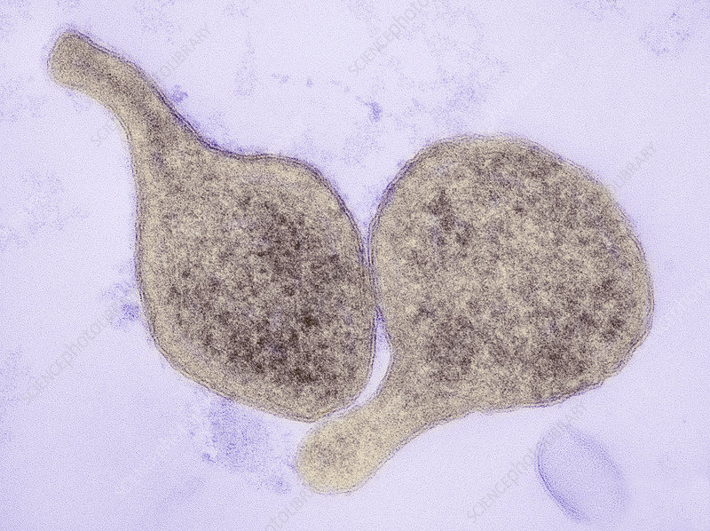
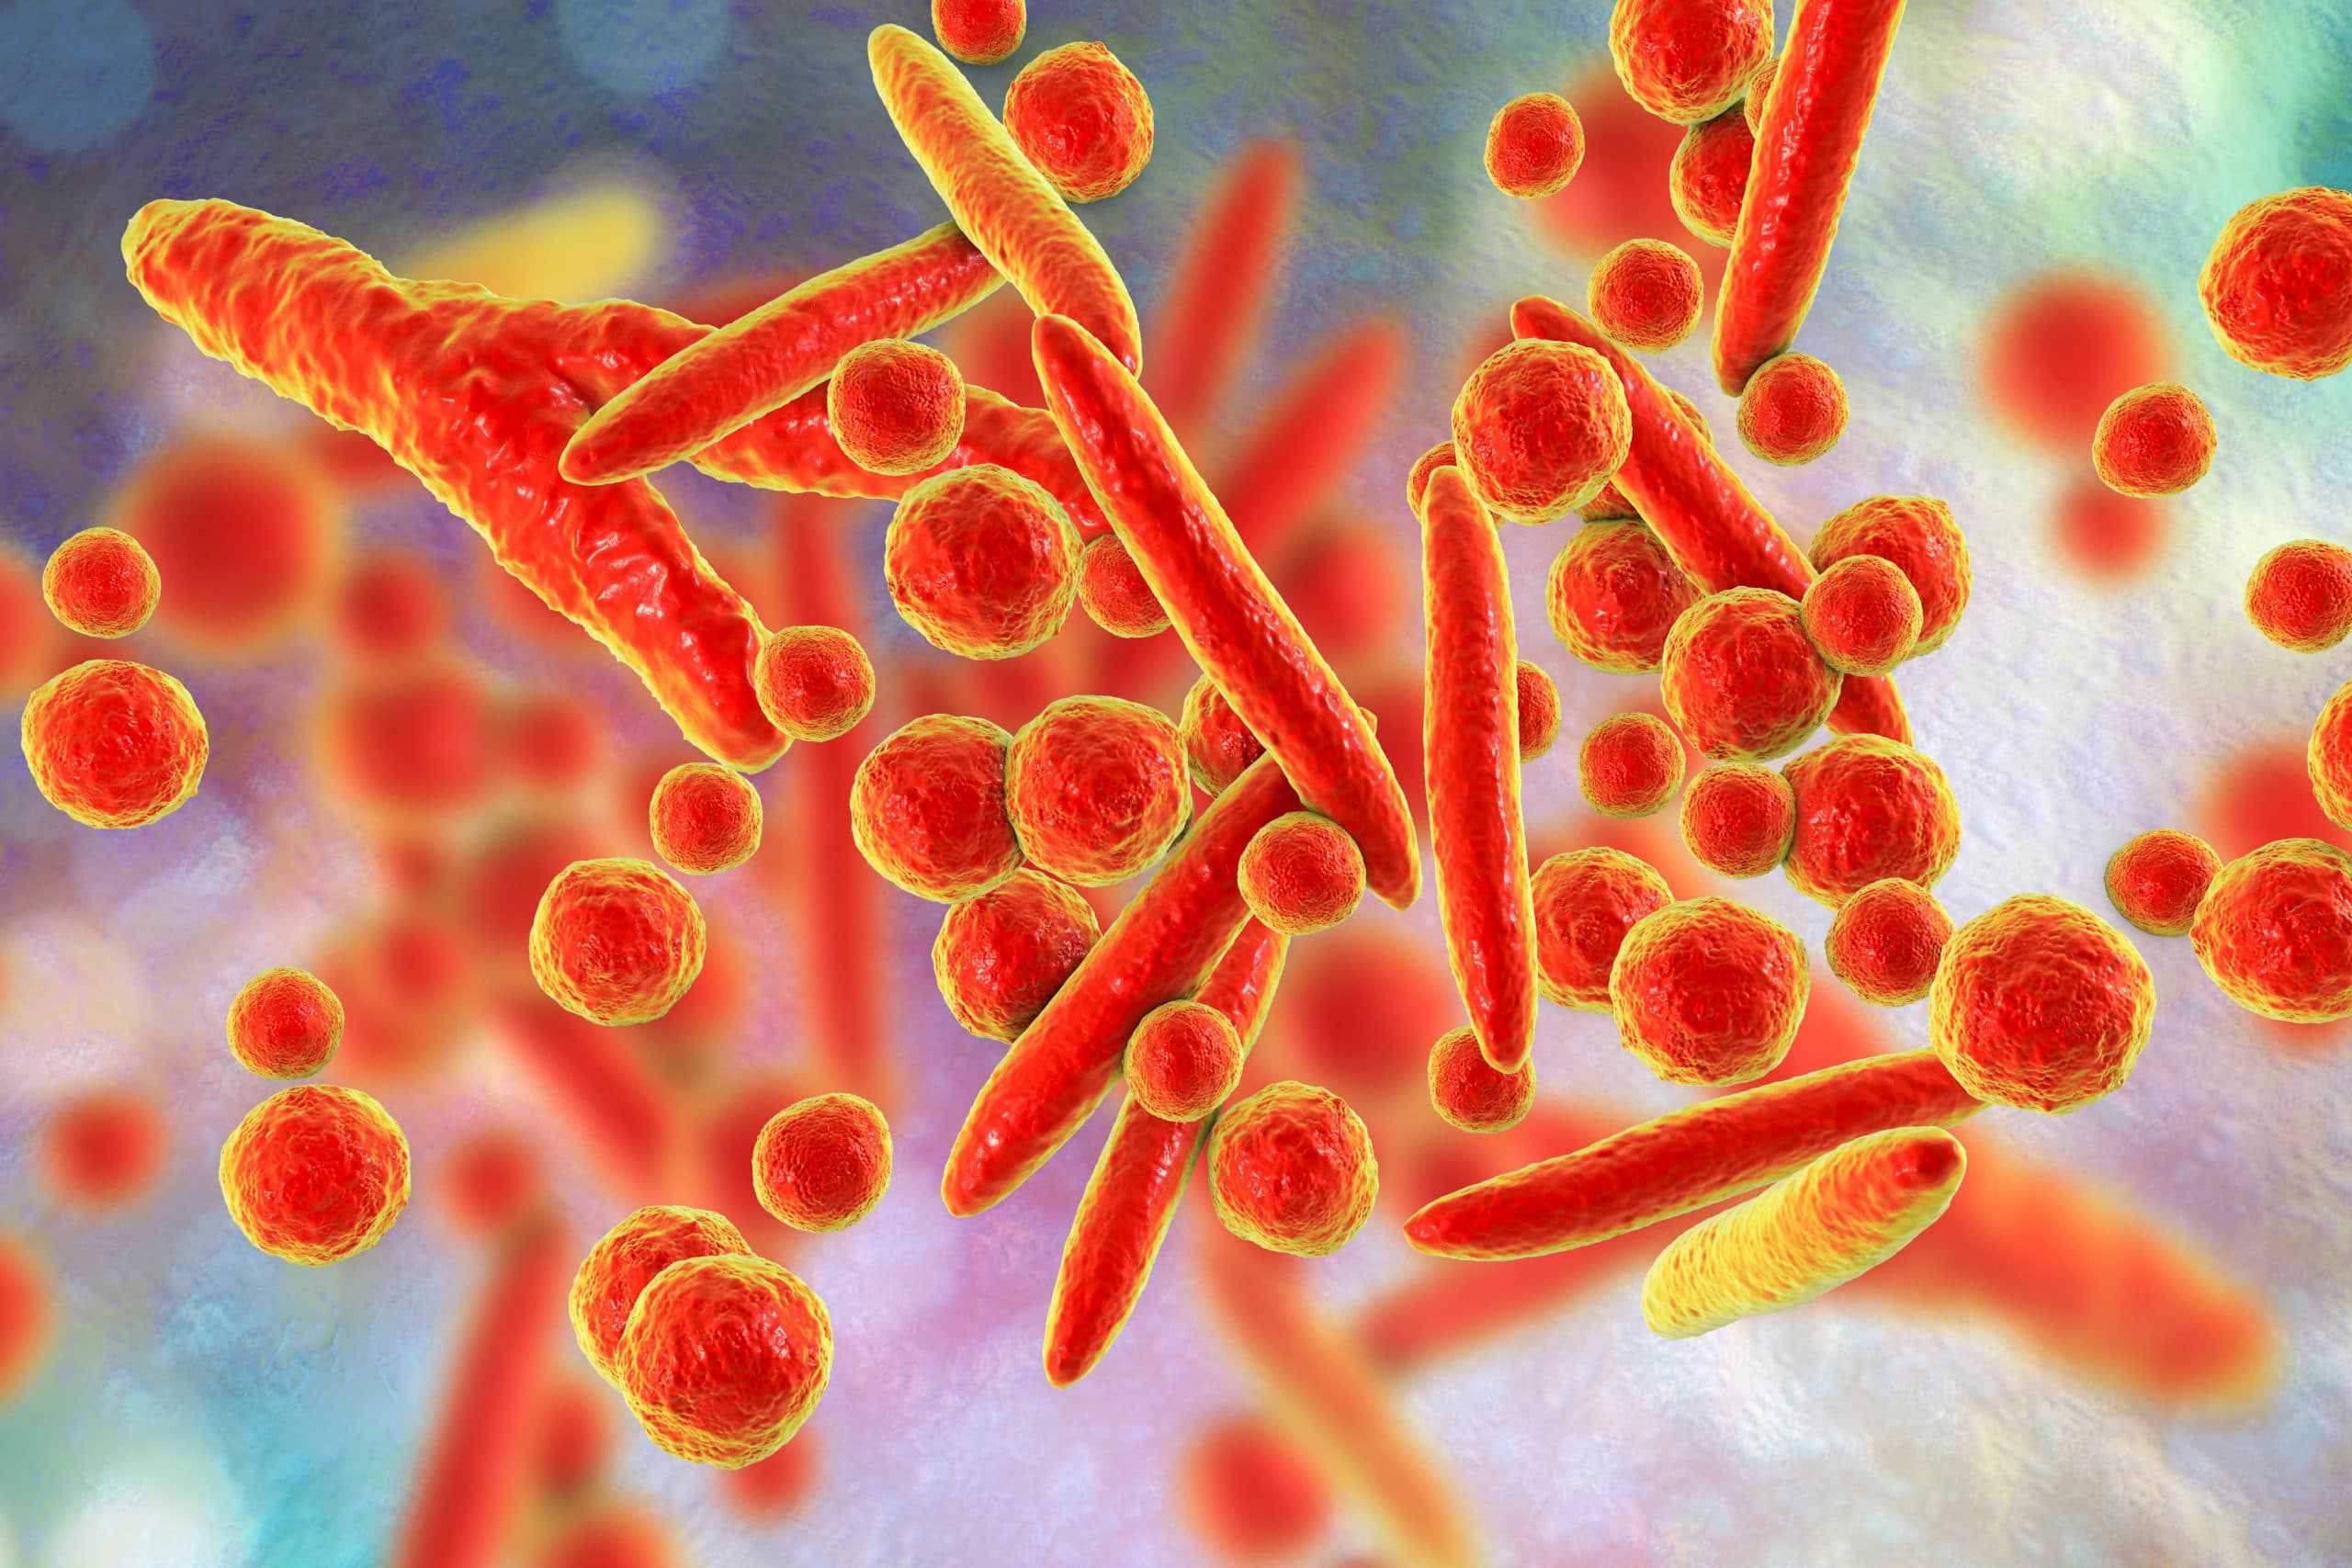
Physiology & Structure
Smallest free-living bacterium!
  Pleiomorphic
  Cocci 0.2-0.3 μm
  Bacilli 1-2 X 0.1-0.2 μm
Lacks cell wall
  Sterol-prominent structure
Slow growing
  Generation time between 1-16 hours, 6 on average
  E. coli: 20 minutes

Slide 6
Pathogenesis & Immunity
Nutritionally depletes host cells
Intracellular permeability(?)
Attaches to respiratory epithelium with adhesin complex (P1 adhesin)
  Membrane protrusion
  Leads to destruction of ciliated epithelial cells
  Invade lower tract
Acts as superantigen
  TNF alpha, IL1, and later IL6
Microtubule release of H2O2 & superoxide radicals
rCARDS toxin
  Induces inflammation
  ADP ribosylator
  pertussis-like symptoms
Some change expression rapidly
  Evades immune response
  Establishes chronic infection

Slide 7
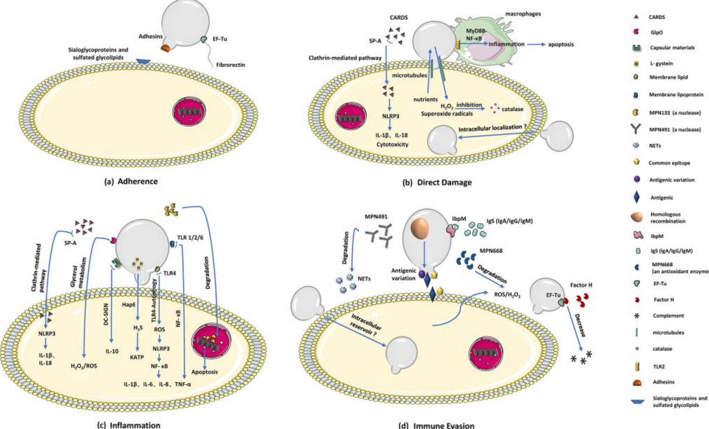

Slide 8
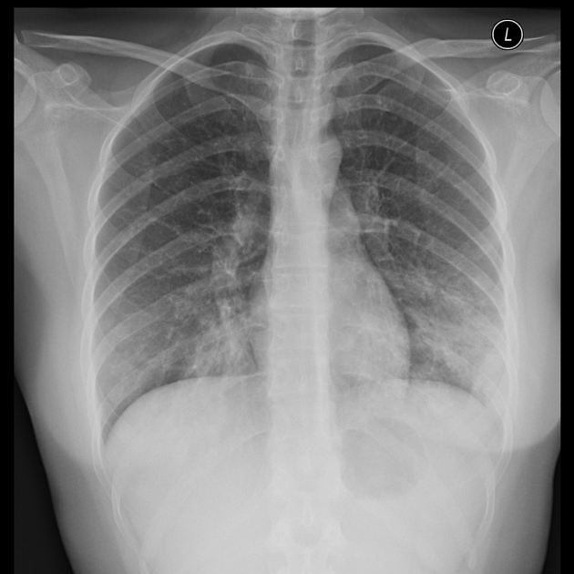
M. pneumoniae Clinical Disease
Mostly asymptomatic
Tracheobronchitis
  Low grade fever, malaise, headache, dry cough
  Onset 2-3 weeks post exposure
  Persists for 2 weeks
  Contagious for 10 days
Atypical pneumonia
  Diffuse on x rays
  No high fever
  Milder than typical pneumonia
Pharyngitis
  Swelling in back of throat

Slide 9
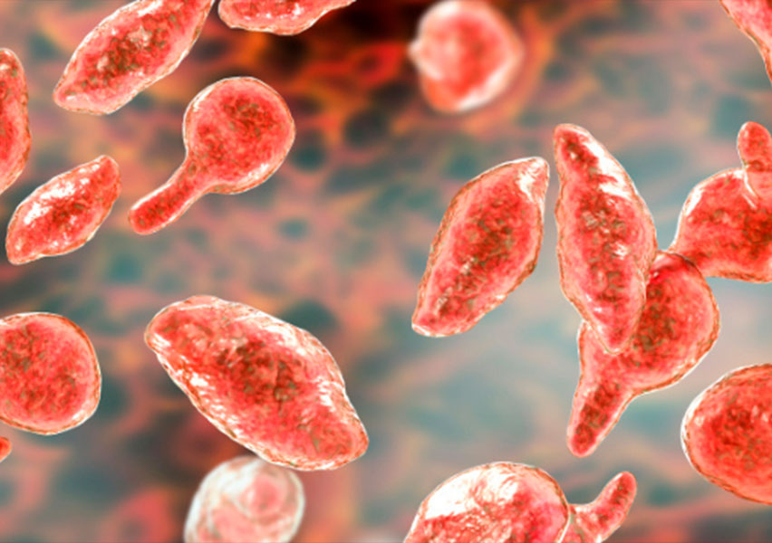
M. genitalium, homininis Clinical Disease
M. genitalium
  Non-gonococcal urethritis
    Burning when peeing
  Cervicitis
    Infection in cervix
  Pelvic inflammatory disease
    Infection in uterus if untreated
M. homininis
  Postpartum fevers
    Lowered antibody level?
  Pyelonephritis
    UTI that reaches kidney

Slide 10
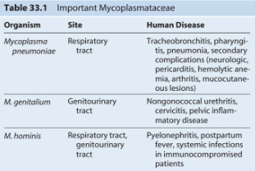
M. pneumoniae vs. other Mycoplasma sp.
M. pneumoniae: strict aerobe
M. genitalium, homininis: facultative anaerobes
  15% of sexually active people colonized

Slide 11
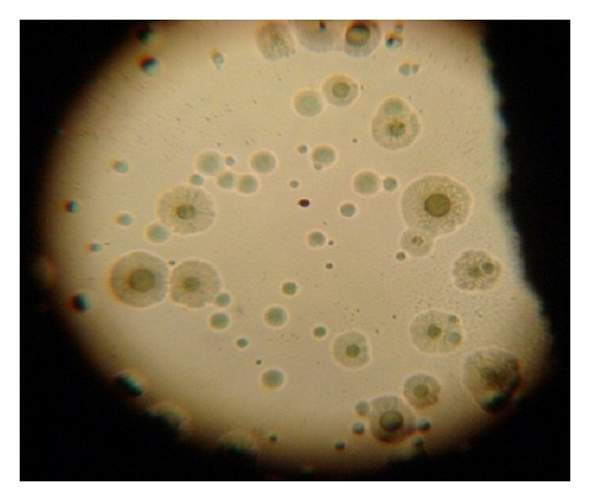
Diagnosis
Poor gram stain
Antigen tests lack specificity and sensitivity
Nucleic acid amplification tests do the trick
Do not cause turbidity in fluid
Isolated from throat, bronchial washings, sputum
Cultured on sterol-supplemented media
  Animal-derived sterols added to media, along with
    Glucose
    Yeast extract
    Penicillin
Serology tests take 3-4 weeks
“Fried egg” appearance of M. homininis

Slide 12
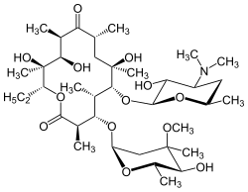
Treatment
Mild cases can resolve on their own
Treated with:
  Macrolides
    Protein synthesis
  Tetracyclines
    30S ribosomal subunit binder
  Fluoroquinolones
    DNA replication
Resistant to: Beta lactams
  Penicillin
  Cephalosporin
  Vancomycin
Erythromycin

Slide 13
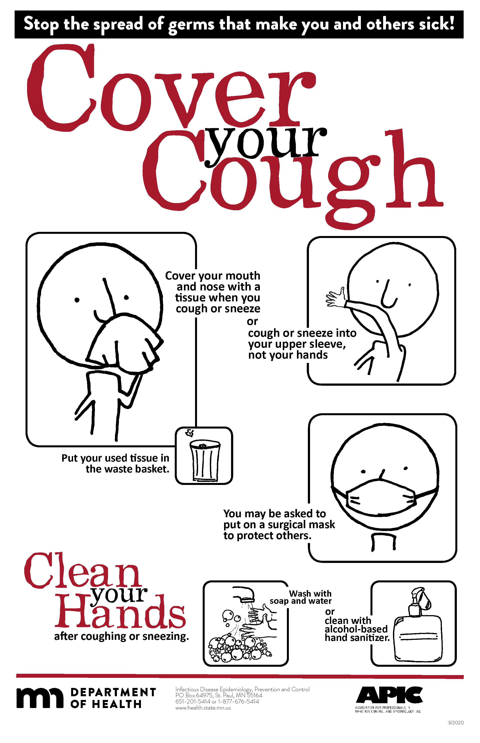
Prevention
Can survive on stainless steel and in air for up to 4 hours
Impractical to isolate, since it can persist for weeks
Cover your cough!
Wear a mask if you are feeling sick!
Wash your hands!

Slide 14
References
Hu J, Ye Y, Chen X, Xiong L, Xie W, Liu P. Insight into the Pathogenic Mechanism of Mycoplasma pneumoniae. Curr Microbiol. 2022 Dec 2;80(1):14. doi: 10.1007/s00284-022-03103-0. PMID: 36459213; PMCID: PMC9716528.
Lanao AE, Chakraborty RK, Cristovao D, et al. Mycoplasma Infections. [Updated 2023 Aug 7]. In: StatPearls [Internet]. Treasure Island (FL): StatPearls Publishing; 2025 Jan-. Available from: https://www.ncbi.nlm.nih.gov/books/NBK536927/
Mitoma T, Oba H, Mishima S, Ohira A, Kirino S, Tani K, Maki J, Eto E, Hayata K, Masuyama H. Postpartum pyomyoma due to Mycoplasma hominis: A case report. Case Rep Womens Health. 2022 Oct 13;36:e00456. doi: 10.1016/j.crwh.2022.e00456. PMID: 36281242; PMCID: PMC9587518.
Tuttle AR, Trahan ND, Son MS. Growth and Maintenance of Escherichia coli Laboratory Strains. Curr Protoc. 2021 Jan;1(1):e20. doi: 10.1002/cpz1.20. Erratum in: Curr Protoc. 2022 Aug;2(8):e552. doi: 10.1002/cpz1.552. Erratum in: Curr Protoc. 2022 Aug;2(8):e551. doi: 10.1002/cpz1.551. PMID: 33484484; PMCID: PMC8006063.
Nikfarjam L, Farzaneh P. Prevention and detection of Mycoplasma contamination in cell culture. Cell J. 2012 Winter;13(4):203-12. Epub 2011 Dec 22. PMID: 23508237; PMCID: PMC3584481.
https://my.clevelandclinic.org/health/diseases/23545-mycoplasma
https://unclineberger.org/tissueculture/contaminant/mycoplasmacontam/
https://www.cdc.gov/mmwr/volumes/74/wr/mm7423a1.htm
https://www.researchgate.net/figure/Appearance-of-colonies-of-Mycoplasma-pneumoniae-Colonies-of-M-pneumoniae-on-an-agar_fig2_299344460
https://www.canada.ca/en/public-health/services/laboratory-biosafety-biosecurity/pathogen-safety-data-sheets-risk-assessment/mycoplasma-pneumoniae.html
https://www.health.state.mn.us/people/cyc/index.html

