Slide 1
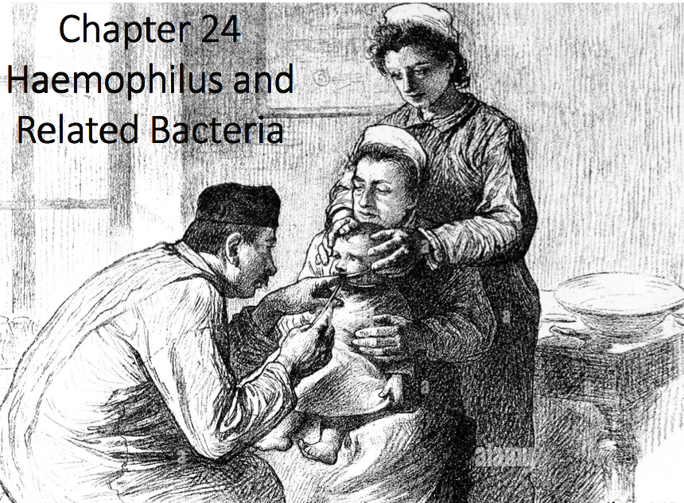
Chapter 24
HAEMOPHILUS AND RELATED BACTERIA

Slide 2
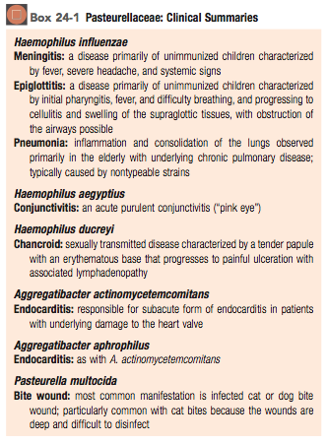
Overview
Species
• 3 most important genera in the family Pasteurellaceae are Haemophilus, Aggregatibacter, and Pasteurella
• They are responsible for a broad spectrum of diseases
• Members of this family are small (0.2 to 0.3 × 1.0 to 2.0 μm), facultative anaerobic, gram-negative rods
• Most have fastidious properties, requiring enriched media for isolation

Slide 3
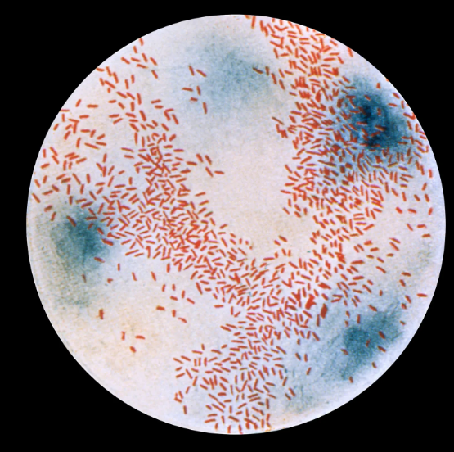
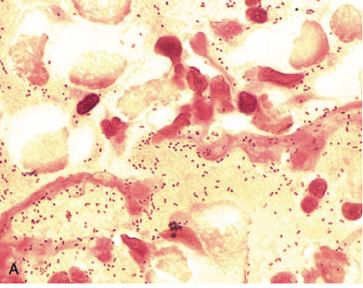
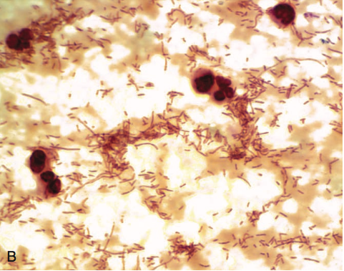
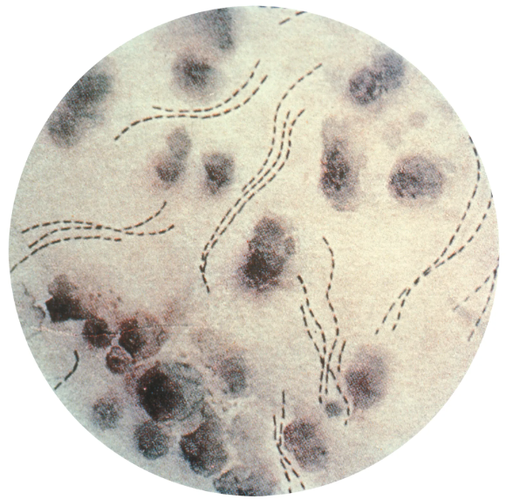
Overview
Haemophilae influenzae, aegyptius, ducreyi
• Haemophilae are small, sometimes pleomorphic, gram- negative rods present on the mucous membranes of humans
• H. influenzae and others are normal inhabitants of the upper respiratory tract in first 6 months of life
• H. influenzae is the species most commonly associated with disease, although introduction of the H. influenzae type b vaccine has dramatically reduced the disease incidence, particularly in the pediatric population
• H. aegyptius is an important cause of acute purulent conjunctivitis
• H. ducreyi is recognized as the etiologic agent of the sexually transmitted disease soft chancre or chancroid
H. influenzae
H. ducreyi
FIGURE 24-1 Gram stains of Haemophilus influenzae. A, Small coccobacilli forms seen in sputum from patient with pneumonia. B, in pleomorphic forms seen in a 1-year-old unvaccinated child in Africa with overwhelming meningitis

Slide 4
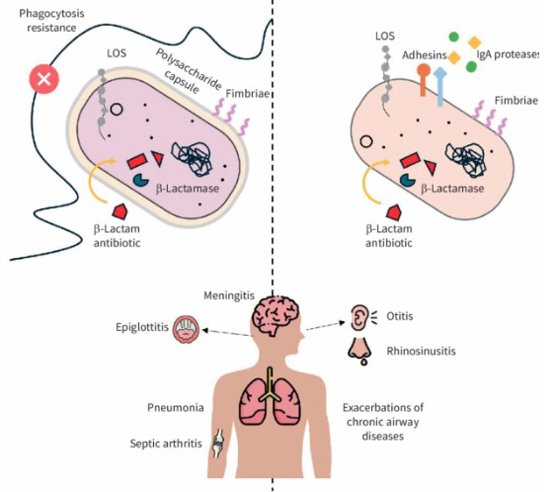
Overview
Haemophilae influenzae
• Two type Encapsulated and Nonencapsulated
• Encapsulated causes from invasive infections
• Nonencapsulated more localized infections
• For encapsulated strains (type B), antibodies directed against the capsule greatly stimulate phagocytosis and complement-mediated bactericidal activity
• People with antibodies from previous exposure, or babies who have them passed down from mom have lower risk of disease.
• The LPS lipid A component induces meningeal inflammation and may be responsible for meningitis and many of the more severe problems.
Comparative illustration of virulence factors and clinical manifestations of typeable and nontypeable Haemophilus influenzae.

Slide 5
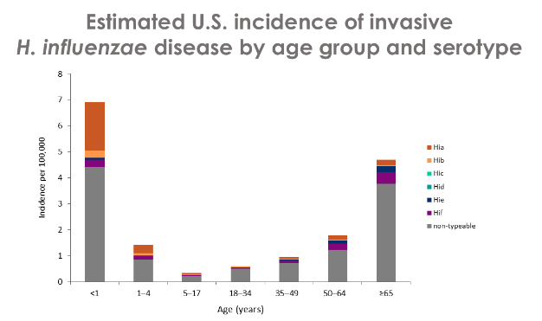
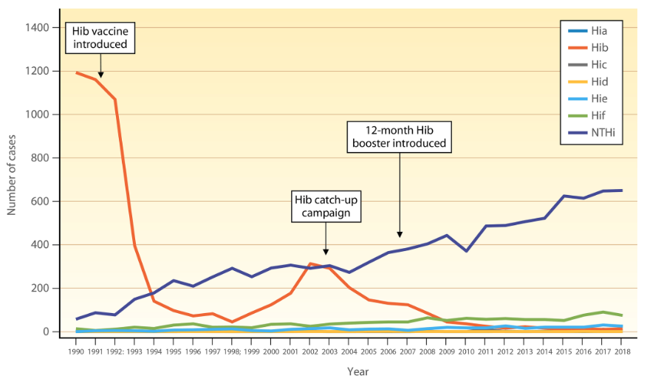
Epidemiology
Haemophilae influenzae, aegyptius, ducreyi
• Haemophilus spp. present in everyone, colonizing respiratory mucosal membranes
• H. parainfluenzae is the predominant Haemophilus in the mouth
• Prior to H. influenzae type b vaccine, 20,000 cases of invasive H. influenzae type b disease / year in US children >5 years
• Most H. influenzae type b infections now occur in nonimmune children (non-vax or a poor response) and the elderly
Still very serious in developing countries
Other Haemophilus spp. (mostly nonencapsulated) cause ear and sinus infections

Slide 6
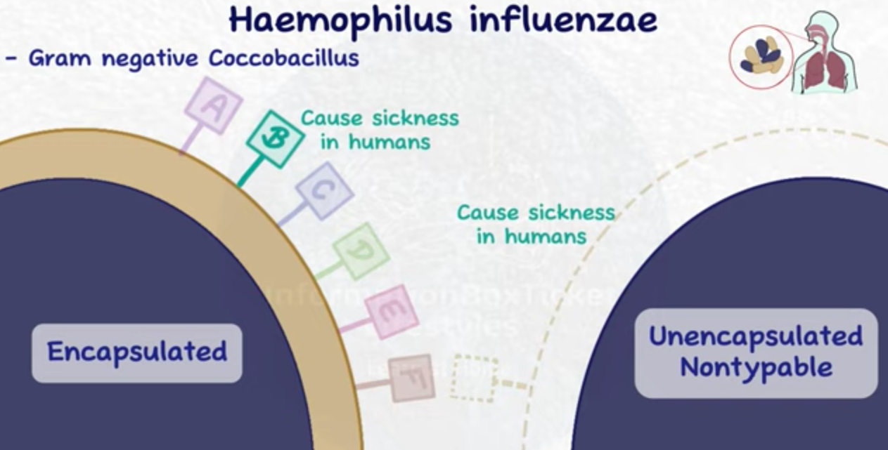
Physiology & Structure
Haemophilae influenzae
Typical Gram negative with LPS and endotoxicity
Nonmotile, facultative anaerobe, catalase positive, oxidase positive
H. influenzae encapsulated types have 6 antigenic serotypes (A - F)
further subdivided into 8 biotypes (I - VIII)
based on biochemical reactions
• Type B was responsible for >95% of Haemophilus influenzae infections (but we have a vaccine for that now)
  Vaccine is for type b only, doesn’t protect against other encapsulated or non-encapsulated types

Slide 7
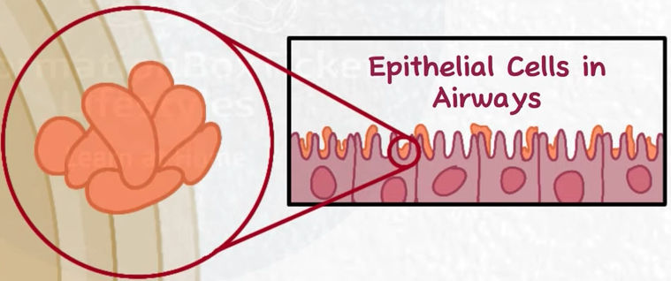
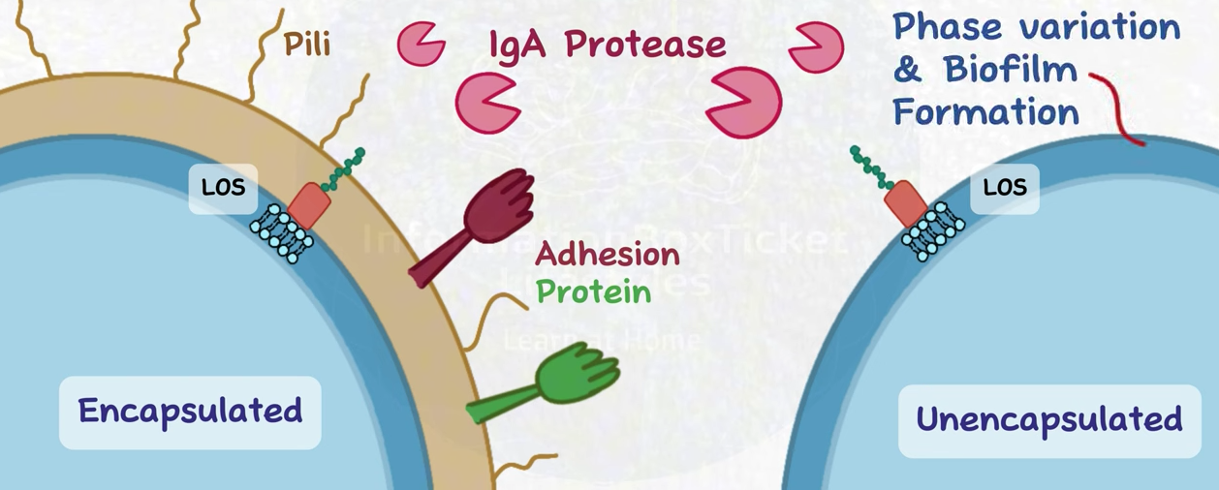
Pathogenesis & Immunity
Haemophilae influenzae
Encapsulated form B (more invasive)
Adhesion and immune invasion
Pili and nonpilus adhesins mediate colonization of the oropharynx
Polysaccharide capsule inhibits phagocytosis, contains ribose, ribitol, and phosphate (commonly referred to as polyribitol phosphate [PRP]). Capsule is critical for virulence.
IgA protease inactivated the IgA along the epithelium allowing it to avoid phagocytosis.
• Cell wall components of the bacteria (e.g., LPS and a low- molecular-weight glycopeptide) impair ciliary function, also helping to it establish colonies in epithelial cell lining.
Capsule

Slide 8
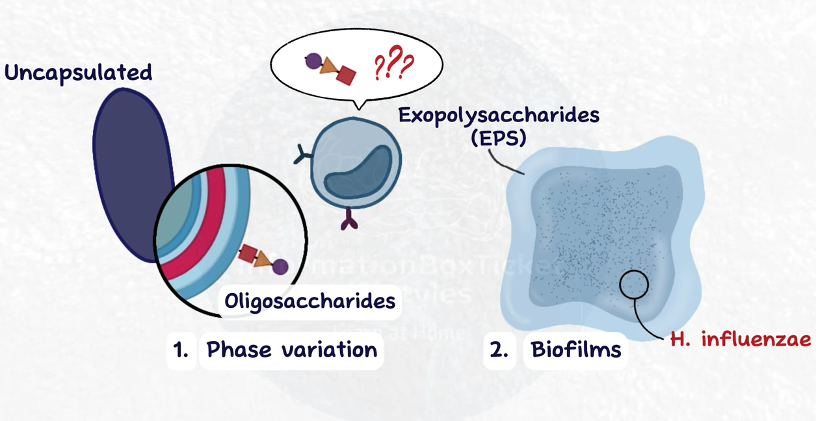
Pathogenesis & Immunity
Haemophilae influenzae
Unencapsulated untypable (less invasive)
Adhesion and immune invasion
IgA protease inactivated the IgA along the epithelium allowing it to avoid phagocytosis.
Phase variation of the surface epitopes helps avoid the immune system
These also form biofilms as a mechanism of immune evasion.
• Cell wall components of the bacteria (e.g., LPS and a low- molecular-weight glycopeptide) impair ciliary function, also helping to it establish colonies in epithelial cell lining.

Slide 9
Pathogenesis & Immunity
Haemophilae influenzae
Both Encapsulated and Unencapsulated
Toxins
• LPS and (Protein A component) functions as an endotoxin. Induces inflammation, complement. responsible for meningitis and severe symptoms associated with form B. As well as less severe localized symptoms on unencapsulated strains.

Slide 10
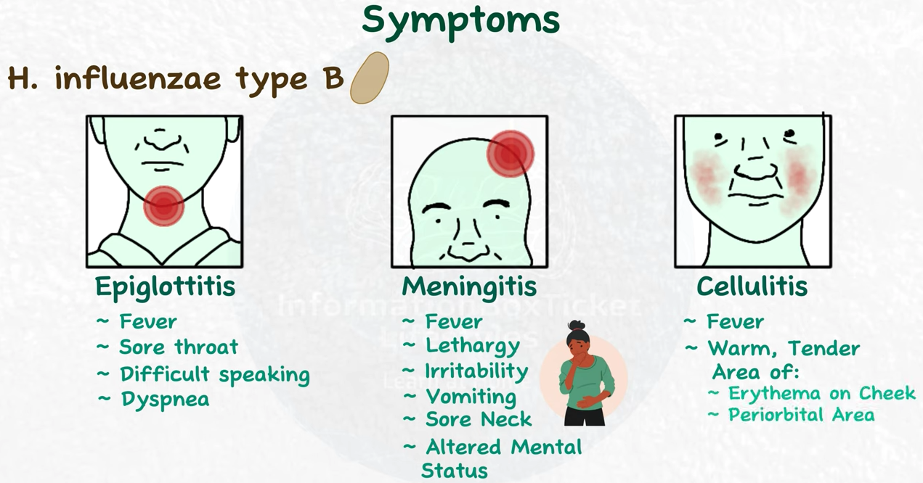
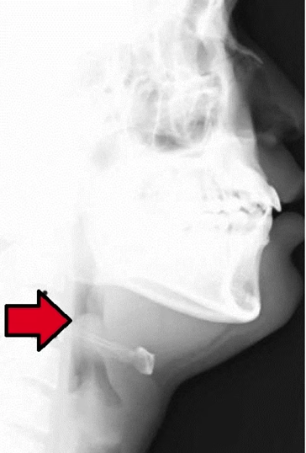
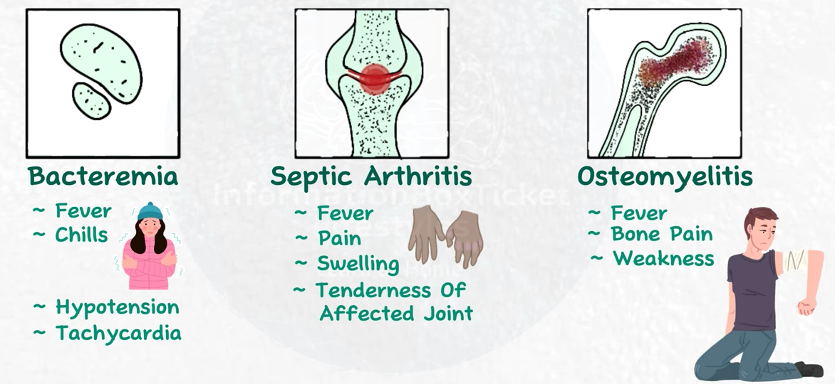
Clinical Disease
*All of these are less common now because of H influenzaae type b vaccine
Haemophilae influenzae
Encapsulated (More invasive)
Thumb print sign on lateral X-ray
• Disease in nonimmune patients results from bacteremic spread from nasopharynx.
• presents with 1–3 days of mild upper respiratory disease, before these more serious symptoms.
• Mortality is less than 10% in patients with prompt antibiotic treatment
• Active person-to-person spread in nonimmune populations
• cellulitis and swelling of supraglottic tissues.
• Can cause suffocation

Slide 11
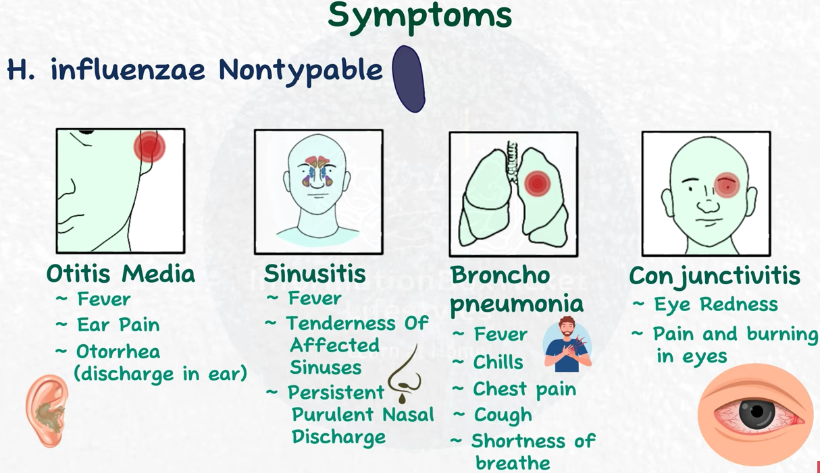
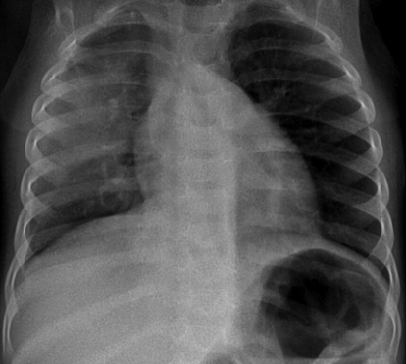
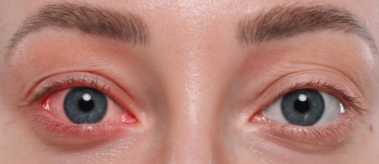
Clinical Disease
Haemophilae influenzae
Unencapsulated (Less invasive)
• Nonencapsulated strains are opportunistic pathogens that can cause more localized disease,
Otitis, Sinusitis, and Lower Respiratory Tract Disease
• vaccine does not protect against these
• H. influenzae and Streptococcus pneumoniae are the two most common causes of acute and chronic otitis and sinusitis
can be caused by
H. aegyptius,
also called the
Koch-Weeks bacillus
Posteroanterior chest radiograph of an 11-mo infant showing right-sided pneumonia caused by H. influenzae type b

Slide 12
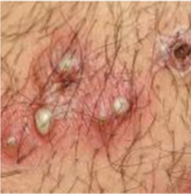
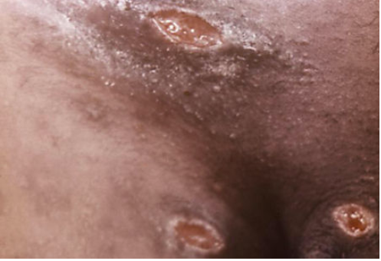
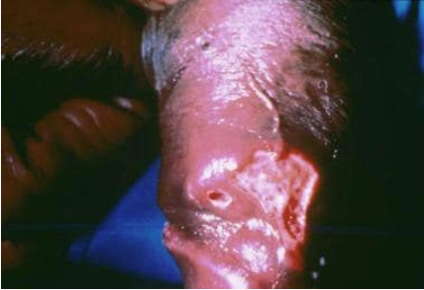
Pathogenesis & Immunity
Other Haemophilae aegyptius, ducreyi
Haemophilae aegyptius
Haemophilae ducreyi
• Chancroid
• Caused by H. ducreyi, an STI is most commonly diagnosed in men, (because may be asymptomatic or inapparent in women)
• 5-7 days after exposure, a tender papule with erythematous base develops on genitalia or perianal area
• Within 2 days, the lesion ulcerates, becomes painful, and inguinal lymphadenopathy is commonly present
• Other causes of genital ulcers, such as syphilis and herpes simplex disease, must be excluded to confirm the diagnosis of chancroid
• Conjunctivitis
• Caused by H. aegyptius, also called the Koch-Weeks bacillus

Slide 13
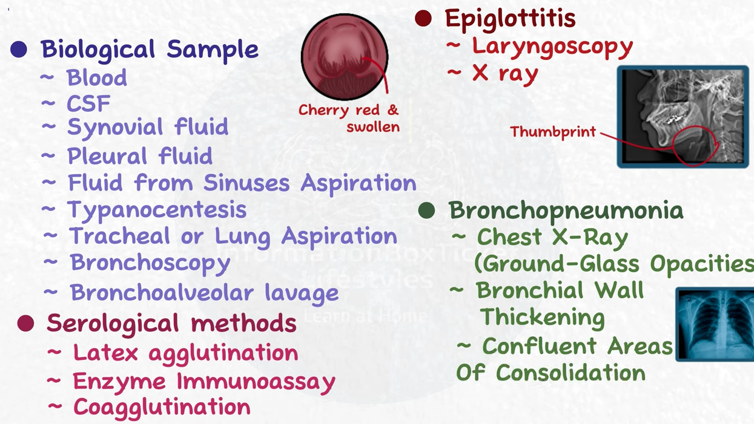
Laboratory Diagnosis
Haemophilae influenzae

Slide 14
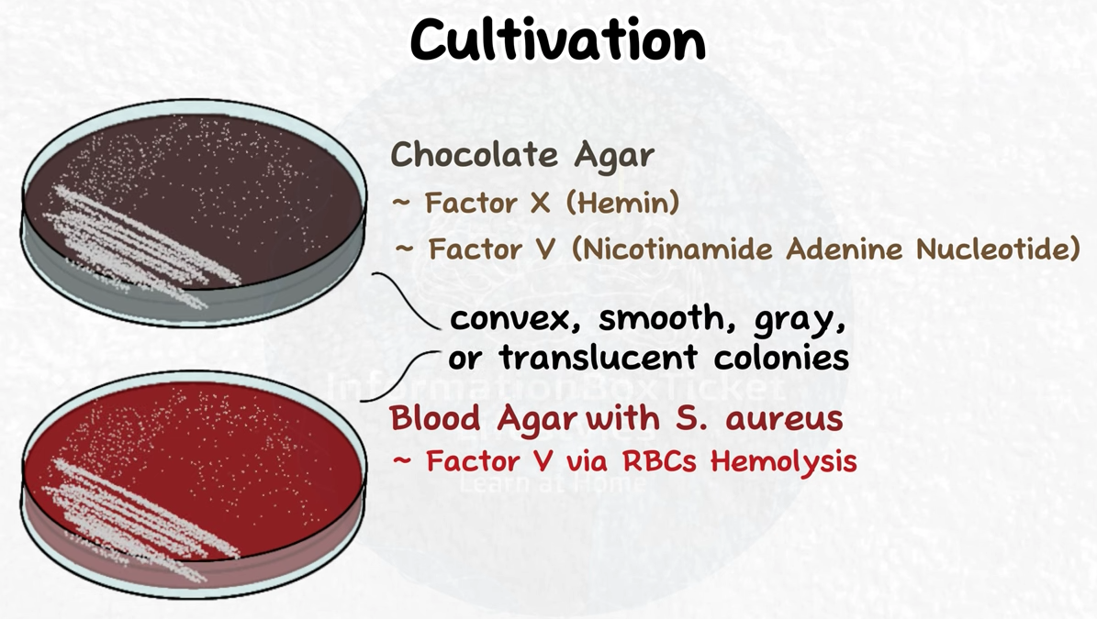
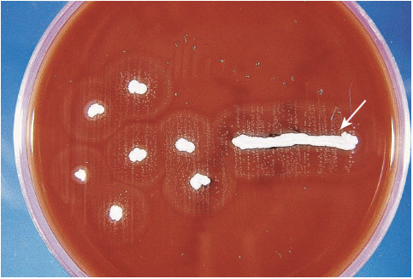
Laboratory Diagnosis
Haemophilae influenzae
blood and cerebrospinal fluid (CSF) should be collected from patients with a diagnosis of meningitis for culture or PCR
FIGURE 24-3 Satellite phenomenon. Staphylococcus aureus excretes nicotinamide adenine dinucleotide (NAD, or V factor) into the medium, providing a growth factor required for H. influenzae (small colonies surrounding S. aureus).

Slide 15

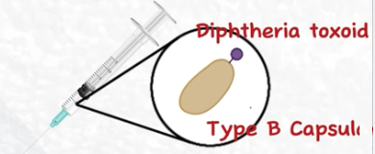
Treatment and Prevention
Haemophilae influenzae, aegyptius, ducreyi
Treatment
Prevention
• patients with systemic H. influenzae require prompt antimicrobial therapy using broad-spectrum cephalosporins
• untreated mortality rate with meningitis or epiglottitis ~100%.
• Less severe infections, (sinusitis and otitis), treated with amoxicillin, cephalosporin, doxycycline, or a fluoroquinolone
• H. ducreyi is susceptible to erythromycin, and the drug of choice.
• immunize between 2-18 months of age.
• works on type B only (the serious one).

Slide 16
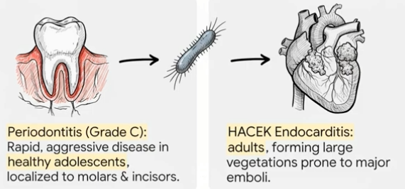
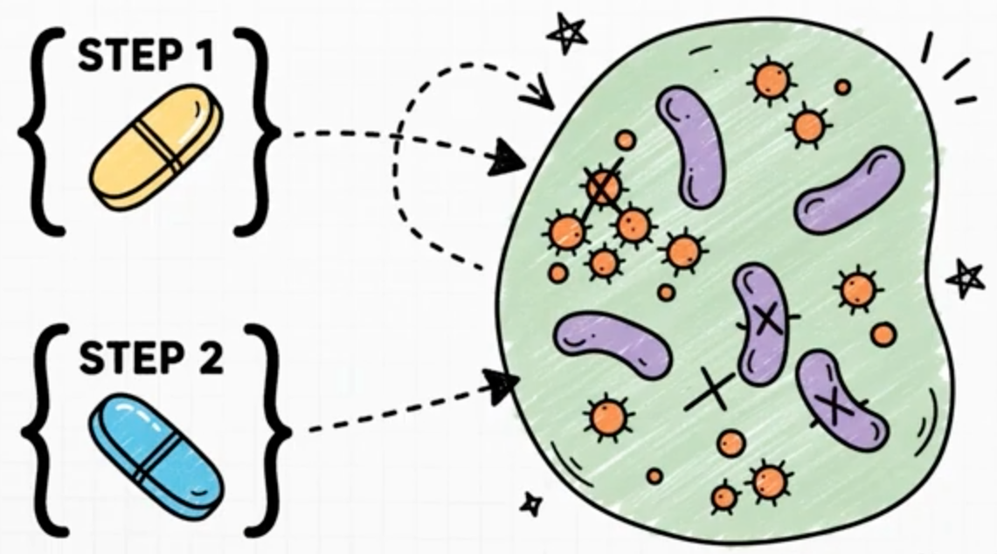
Overview
Aggregatibacter
• 2 members of this genus are important human pathogens:
A. actinomycetemcomitans
A. aphrophilus
• Likes to clump
• Forms complex multiorganism biolfilms
• Both species colonize the mouth and can spread to the blood and stick to damaged or artificial heart valves, causing endocarditis
Treat with
Amoxicillin (for Aggregatibacter)
Plus
Metrinidozole (for other bacteria in the biofilm)

Slide 17
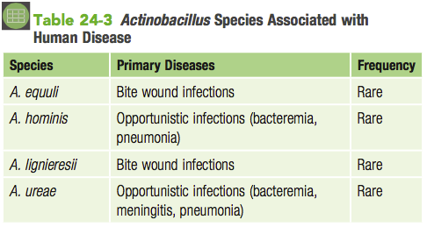
Overview
Actinobacillus
Actinobacillus colonize the oropharynx of humans and animals and are causes of periodontitis and rarely endocarditis, bite wound infections, and opportunistic infections.

Slide 18

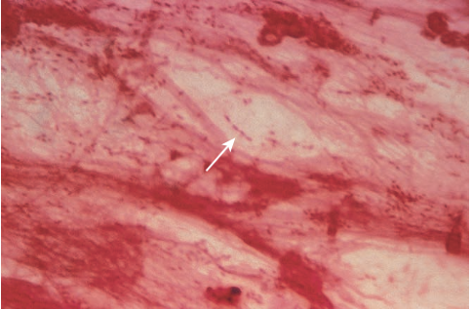
Overview
Pasteurella
• Common commensals in oropharynx of animals
• Most human infections result from animals via bites, scratches, or shared food
• P. multocida (most common) and P. canis human pathogens
3 general forms of disease are reported:
(1) *localized cellulitis and after a bite or scratch (can spread)
(2) exacerbation of existing chronic respiratory disease
(3) systemic infections in immunocompromised patients
FIGURE 24-4 Pasteurella multocida in respiratory specimen from patient with pneumonia (arrow).

