Slide 1
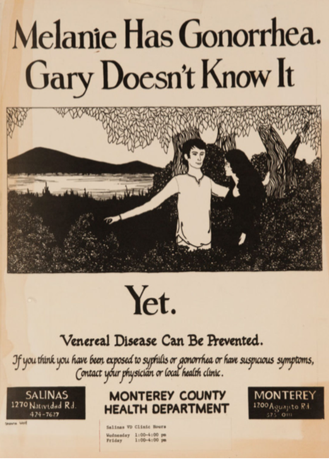
Chapter 23
NEISSERIA AND RELATED GENERA

Slide 2
Terms to Know
DIC – disseminated, intravesical clotting. abnormal clotting throughout the body
Petechiae - pinpoint, round spots that appear on the skin as a result of bleeding under the skin
• Commensal organisms – another way of saying that these are normally found on/in the human body
• VD - Until the 1990s, STIs were commonly known as venereal diseases, an antiquated euphemism derived from the Latin venereus, being the adjective form of Venus, the Roman goddess of love

Slide 3
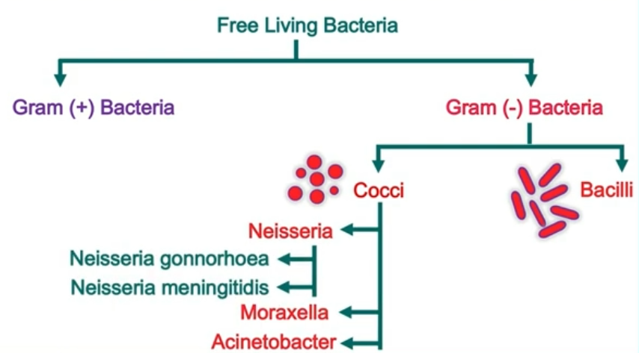
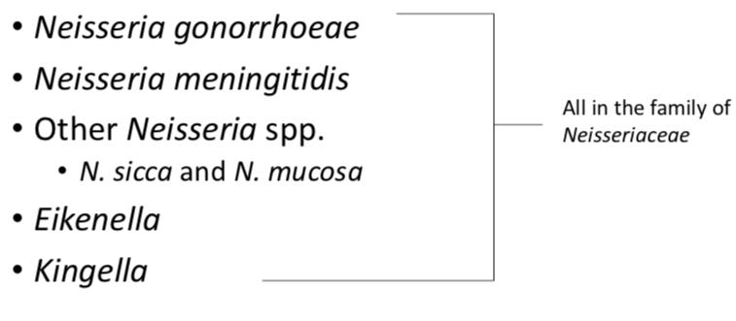
Overview
Neisseria family
• The genus Neisseria consists of 35 species and subspecies with two species, that are strictly human pathogens:
1 Neisseria gonorrhoeae = gonorrhea (STI)
2 Neisseria meningitidis = meningitis
• Eikenella corrodens and Kingella kingae colonize the human oropharynx and are opportunistic pathogens

Slide 4
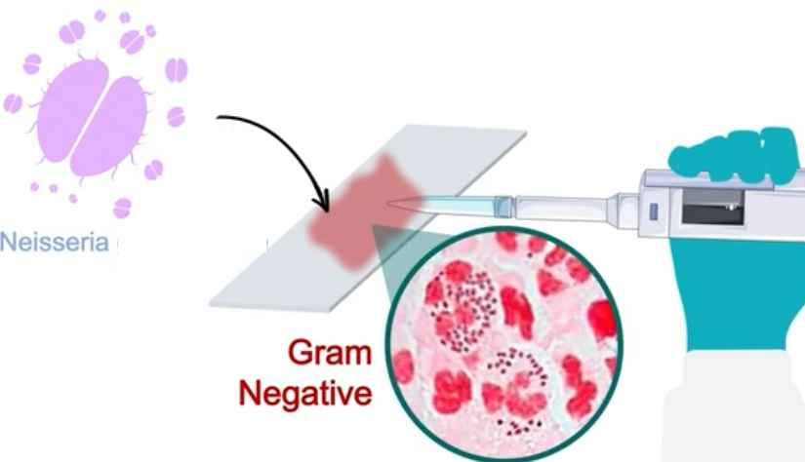
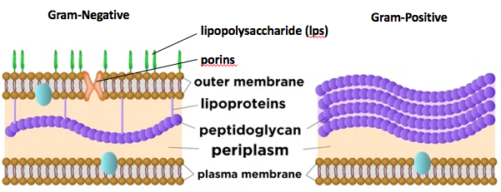
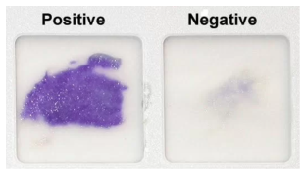
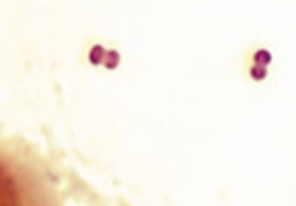
Physiology & Structure
Remember this?
Neisseria gonorrhoeae (and meningitidis)
• All species are fastidious, aerobic, Gram-negative bacteria
• Optimum growth at human body temp, 37ºC. Need humid atmosphere supplemented with 5% carbon dioxide.
• coccoid shaped (0.6 to 1.0 μm in diameter), and arranged in pairs (diplococci) with adjacent sides flattened together, resembling coffee beans.
• All species are oxidase positive and most are catalase positive, (together with the Gram stain and morphology) allows a rapid, presumptive ID in clinical isolates.
• Pathogenic and nonpathogenic strains of Neisseria have pili that extend from the cytoplasmic membrane through the outer membrane
Reagent: Uses tetramethyl-p-phenylenediamine dihydrochloride, which turns from colorless to dark blue/purple when oxidized by cytochrome c oxidase.

Slide 5
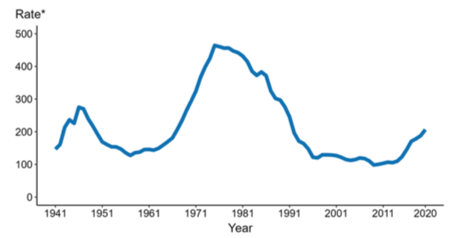
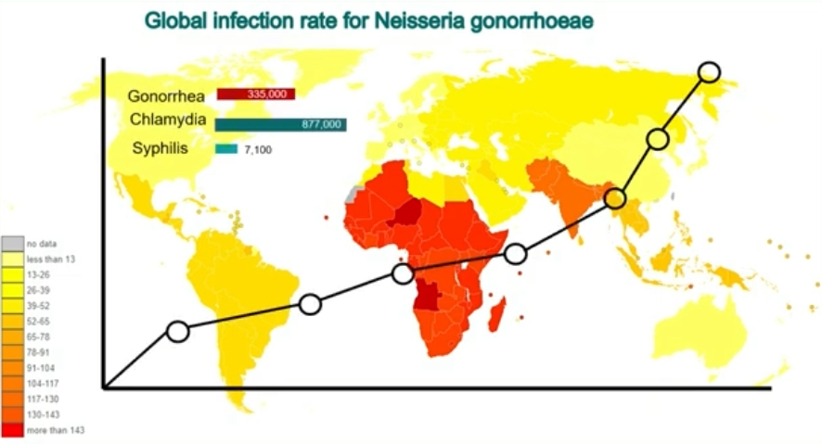
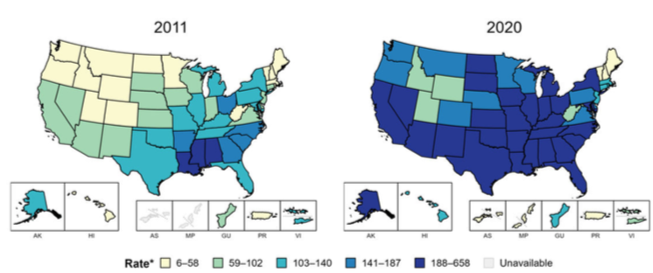
Epidemiology
Per 100,000
Reported Cases/year
Neisseria gonorrhoeae
Only humans can get gonorrhea
2nd most common STI (chlamydia is first)
It is on the rise
• Women have a 50% chance of infection from single exposure. Men have a 20% chance from a single exposure.
• Many people (women) will have no symptoms, so it is easy to spread.
• Common to acquire infection rectally or orally as well
Reported Cases/State
Per 100,000

Slide 6
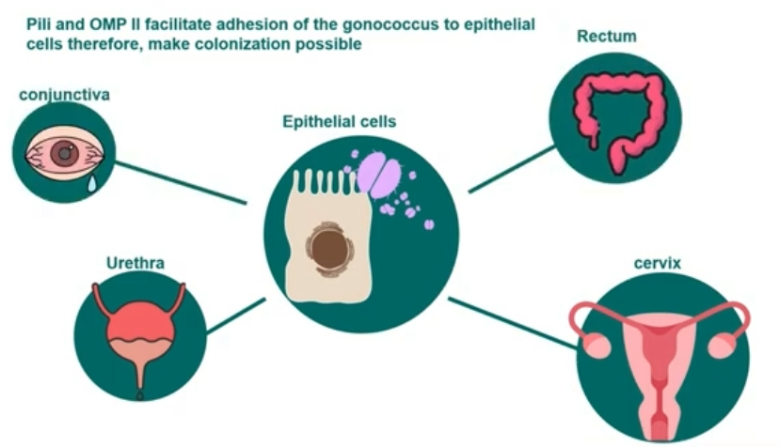
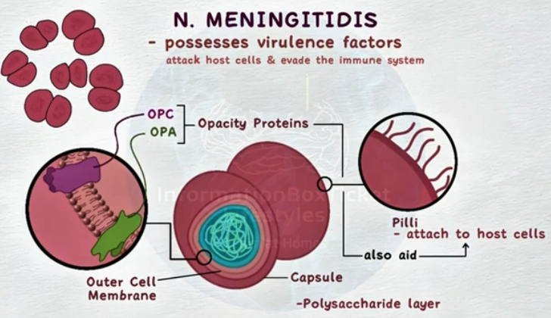
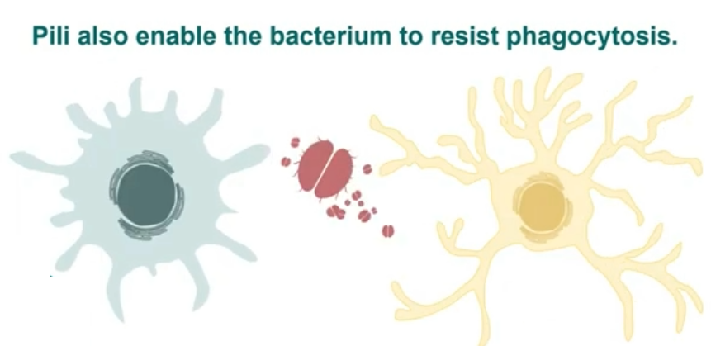
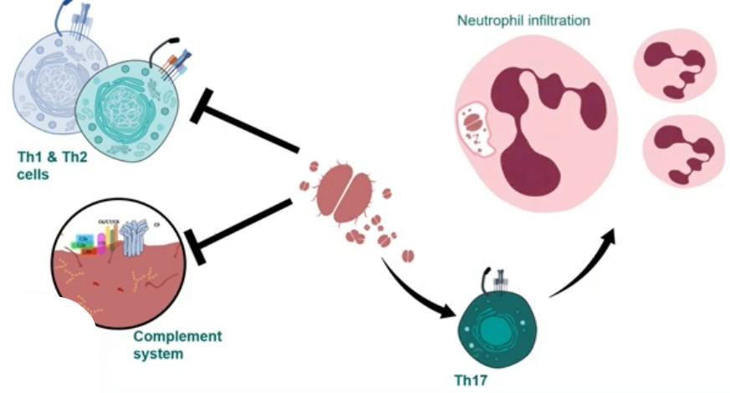
Pathogenesis & Immunity
N. gonorrhoeae
Neisseria gonorrhoeae
Adhesion and immune avoidance:
It can colonize the non-ciliated epithelial cells of the urethra. But also the rectum, cervix, mouth, and eyes are possible too.
Adhesion is facilitated by both Pilli and Opa proteins (opacity proteins are a family of membrane proteins that mediate binding to epithelial and phagocytic cells and are important for cell-to-cell signaling.
Pili also function in transfer of genetic material, motility, and block attachment/killing by neutrophils.
Pili also help evade immune system through antigenetic variation and phase variation.
PorB is important for the virulence of N. gonorrhoeae because these proteins can interfere with degranulation of neutrophils
Rmp proteins (reduction-modifiable proteins). Functionally blocks classical antibody-mediated complement activity against pathogenic Neisseriae. Interferes with antibodies against other antigens.
immunoglobulin (Ig)A1 protease, which cleaves/inactivates IgA1.
Opa II

Slide 7
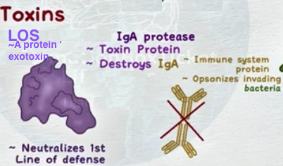
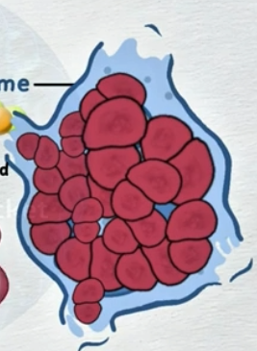
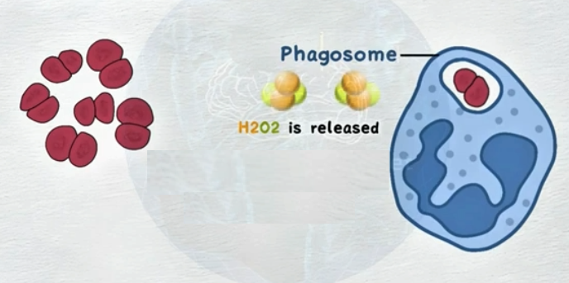
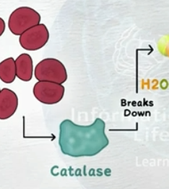
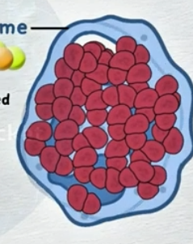
Pathogenesis & Immunity
Neisseria gonorrhoeae
Toxins:
Lipo-oligosaccharide (LOS) is like LPS but lacks the O-antigen polysaccharide and, similarly, has endotoxin activity. The bacteria release outer membrane blebs to protect themselves from the host (decoys that contain endotoxin). This stimulates tumor necrosis factor (TNF)-α, which causes most of the symptoms associated with gonococcal disease .
immunoglobulin (Ig)A1 protease, which cleaves/inactivates IgA1.
Replication:
Catalase break down oxidative burst allowing survival.
Once inside, PorB blocks phagolysosome fusion

Slide 8
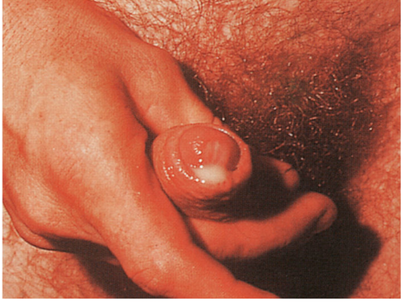
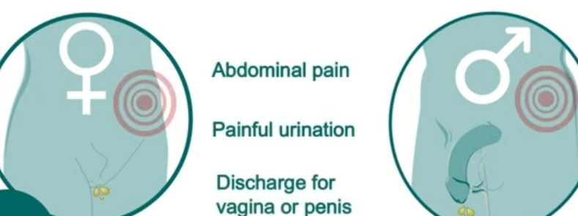
Clinical Disease
Neisseria gonorrhoeae
• Also called “the clap”
• 2–5 day incubation period
• In men, restricted to the urethra (urethritis) with a purulent, thick, discharge. Almost always acutely symptomatic.
• In women, the primary infection site is the cervix where bacteria infect endocervical columnar epithelial cells. Symptomatic patients experience vaginal discharge, dysuria, and abdominal pain. If untreated, ascending genital infections, including salpingitis (inflammation of the fallopian tubes, tubo-ovarian abscesses (serious, encapsulated pus involving the fallopian tubes and ovaries, and pelvic inflammatory disease (PID), are observed in 10% to 20% of women. Many women have no symptoms initially

Slide 9
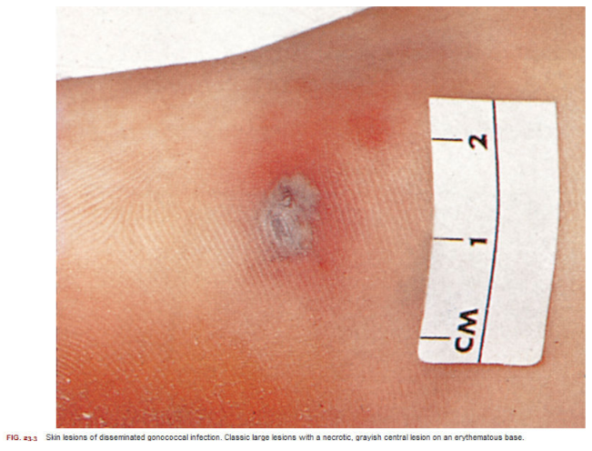
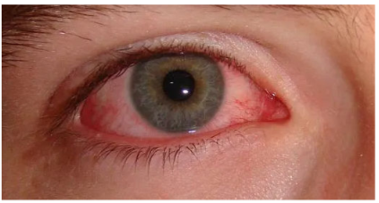
Clinical Disease
Neisseria gonorrhoeae
• Disseminated infections with septicemia and infection of skin and joints occur in 1% to 3% of infected women and in a much lower percentage of infected men
• The clinical manifestations of disseminated disease include fever; migratory arthralgias; suppurative arthritis in the wrists, knees, and ankles; and a pustular rash on an erythematous base over the extremities but not on the head and trunk .
• Not uncommon to see infections in the eyes, purulent conjunctivitis
• Can result in sterility.

Slide 10
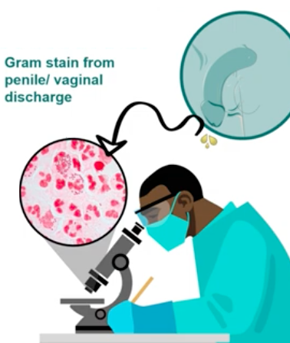
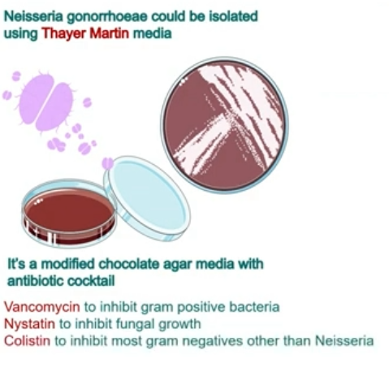
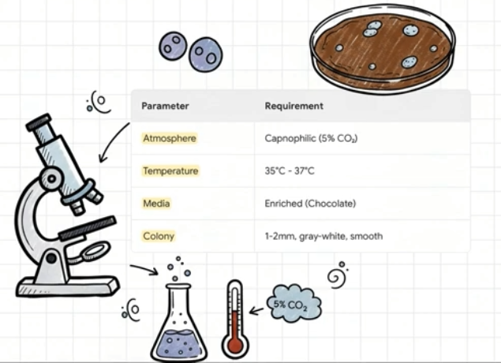
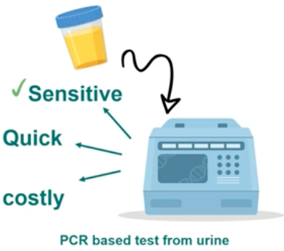
Laboratory Diagnosis
• Gram stain works great for detection in the discharge
• Now, we mostly test urine or vaginal swabs using PCR. Can also test join fluid, CSF, etc.
Neisseria gonorrhoeae
Opaque colonies are recovered most commonly in patients with localized disease (i.e., endocervicitis, urethritis, pharyngitis, proctitis), whereas transparent colonies are more commonly associated with pelvic inflammatory disease and disseminated infections.

Slide 11
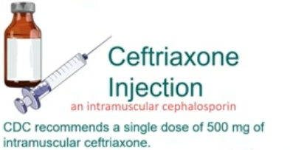
Treatment and prevention
Neisseria gonorrhoeae
Creating a vaccine remains challenging
Treatment
Natural Infection Does Not Induce Protective Immunity
Antigenic Variation: rapidly change its surface proteins (antigens), PorB and pilus proteins, have silent copies in chromosome, highly competent for transformation.
Phase variation: turn on and off expression of surface proteins.
RmpM generates “Blocking" Antibodies that inhibit the effects of protective antibodies
Trails have targeted the PorB Omp Pilus…
Cefrtriaxone 3rd generation Cephalosporin
Cephalosporin is a 3rd generation Penecillin
Some studies suggest vaccine against N. meningitidis provides some protection via cross reactivity

Slide 12
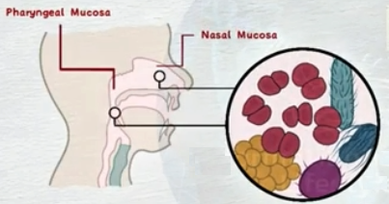
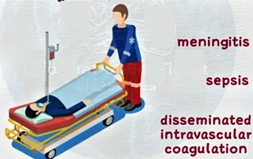
Overview
Neisseria meningitidis
A lot of the info for N. meningitidis is the same as that of N. gonorrhoeae with respect to physiology and structure, pathogenic mechanisms and toxins.
But the clinical disease differs, by a lot.
Colonizes nasal pharyngeal mucosa, often harmlessly.
But can switch to become pathogenic, leads to meningitis, and then sepsis and disseminated intravascular coagulation (DIC).
Only bacteria known to cause meningitis epidemically.
Notable for how rapidly one goes from healthy to dead.
often outbreaks show up in
people living in close quarters. communities with common water source

Slide 13
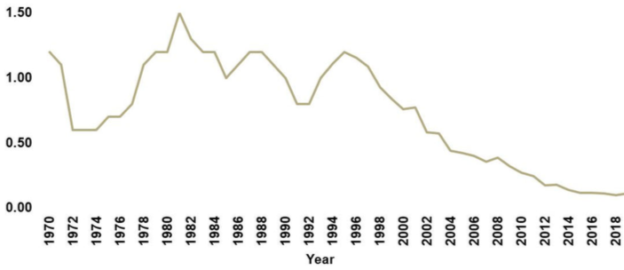
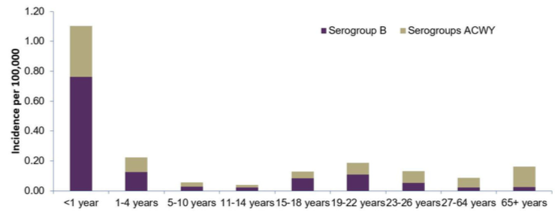
Epidemiology
Cases/year
Neisseria meningitidis
Per 100,000
Epidemics pop up, especially in developing countries
Epidemic spread results when new virulent strain introduced into an immunologically naive population • Of 13 serogroups. Almost all infections are caused by A, B, C, W135, X, and Y (B most common in US)
Cases/year by age and serogroup

Slide 14
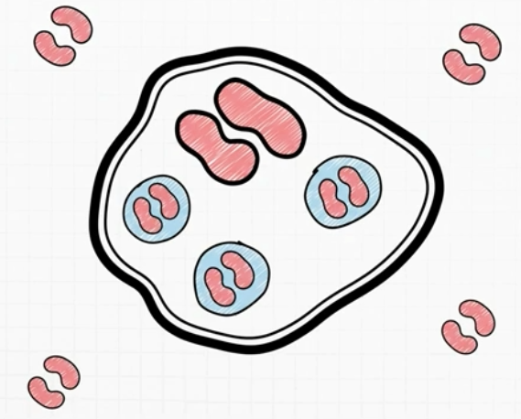
Physiology & Structure
Neisseria meningitidis
Structure, cell physiology:
similar to Neisseria gonorrhoeae

Slide 15
Pathogenesis & Immunity
Neisseria meningitidis
.
Attachment, immune evasion, toxins:
similar to Neisseria gonorrhoeae

Slide 16
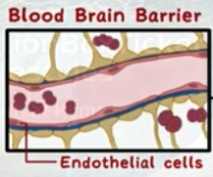
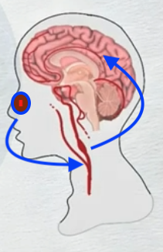
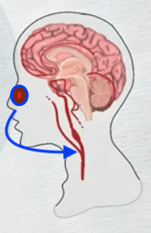
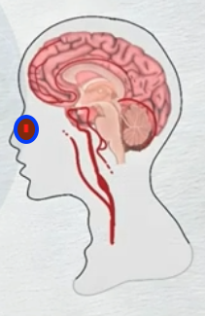
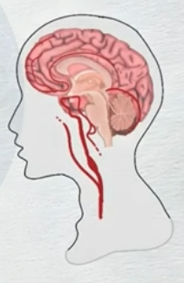
Pathogenesis & Immunity
Neisseria meningitidis
But where it lives and replicates differs from Neisseria gonorrhoeae.
It goes from nose/pharynx
invading/replicating through the endothelial cells
to the blood
circulating
to the brain
invading/replicating through the endothelial cells
to the cerebrospinal fluid.
.

Slide 17
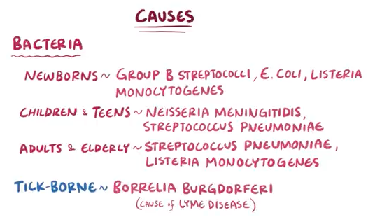
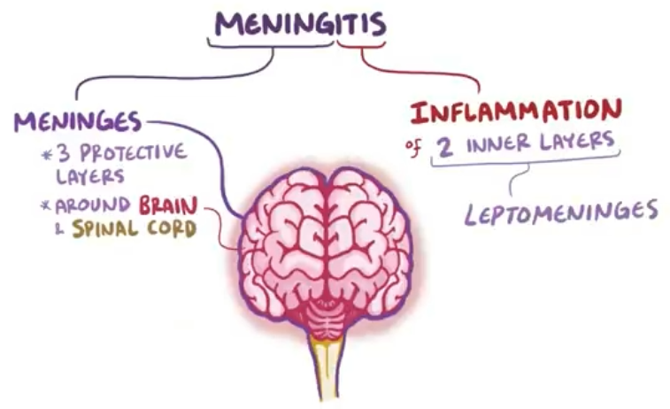
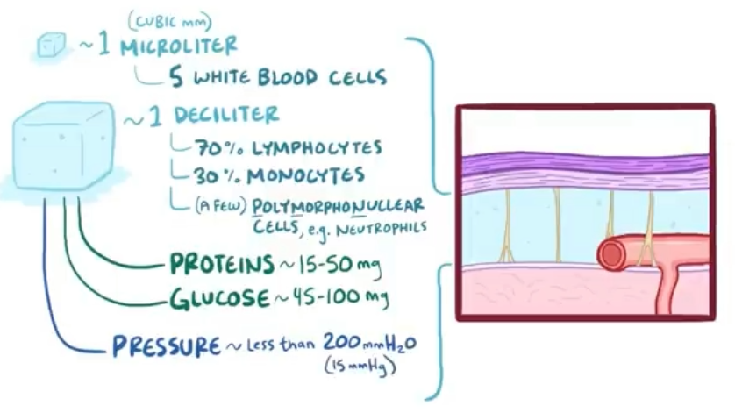
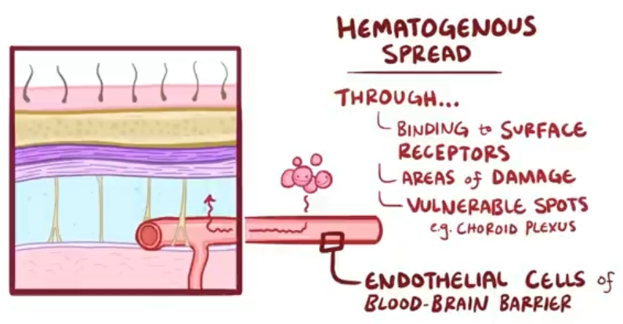
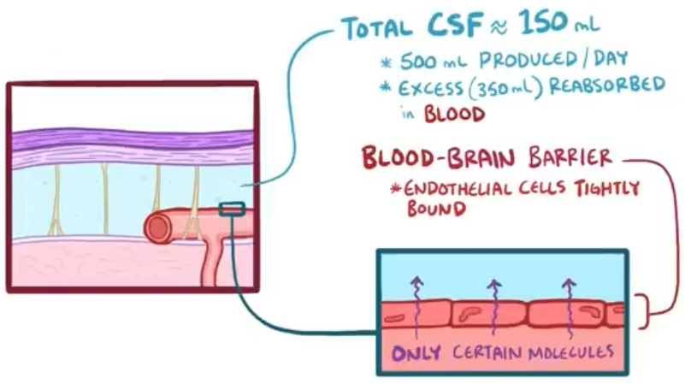
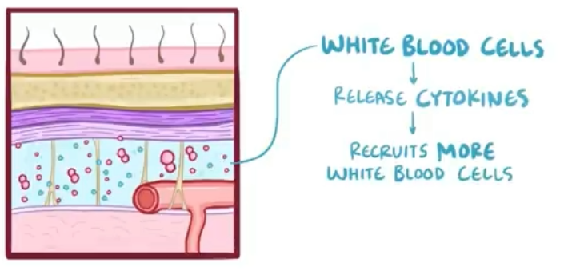
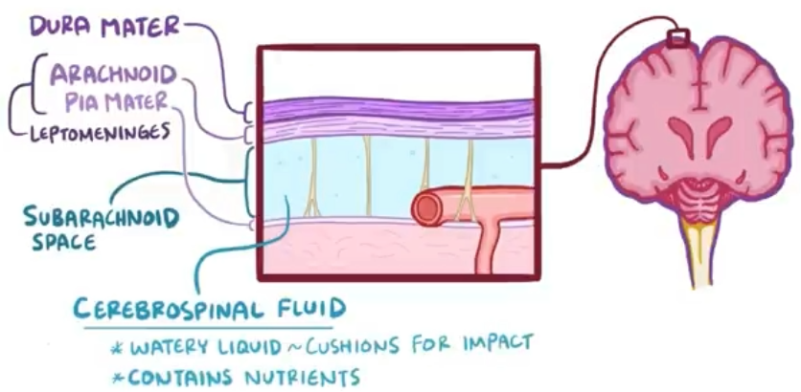
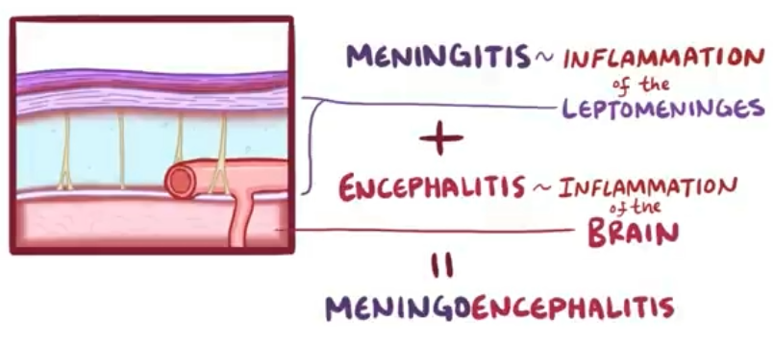

Pathogenesis & Immunity
Neisseria meningitidis
what is meningitis?
.

Slide 18
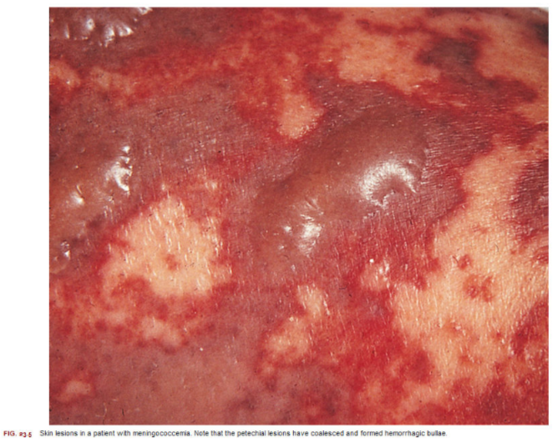
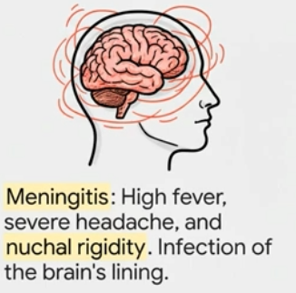
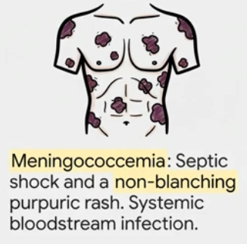
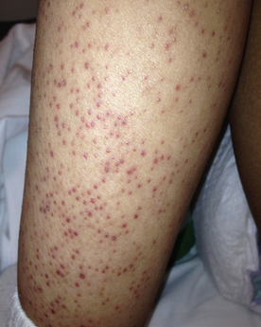
Clinical Disease
Meningooccemia
Neisseria meningitidis
• Septicemia (meningococcemia) with or without meningitis.
• Life-threatening
• Thrombosis (blood clots) of small blood vessels and multiorgan involvement
• Small, petechial skin lesions (tiny, flat, non-blanching red, purple, or brown spots) on trunk and lower extremities. May coalesce to form larger hemorrhagic lesions
• Overwhelming disseminated, intravesical clotting with shock, bilateral destruction of the adrenal glands (Waterhouse-Friderichsen syndrome)
Meningitis
• Begins abruptly with headache, fever, stiff neck
• Very young children challenging…may only see nonspecific signs such as fever and vomiting
• Mortality approaches 100% in untreated patients. Less than 10% if patients get promp antibiotic therapy.
• The incidence of neurologic sequelae is low, with hearing deficits, learning disabilities, and arthritis most common

Slide 19

Clinical Disease
Neisseria meningitidis
Meningitis occurs most often in patients who lack specific antibodies directed against the polysaccharide capsule
• Infants are initially protected by the passive transfer of maternal antibodies
• When the infant has reached age 6 months, however, this protective immunity has waned… incidence of disease is greatest in children between 6 month and 2 years
• Complement system is critical for Neiserria infections
Deficiencies in C5, C6, C7, or C8 increase risk 6000-fold

Slide 20




Laboratory Diagnosis
Test for meningitis
Neisseria meningitidis
• Similar to Neisseria gonorrhoeae.
• If you need to differentiate between
pathogenic and nonpathogenic species of Neisseria,
-Nonpathogenic strains grow on both blood agar and nutrient media,
-N. meningitidis grows on blood agar,
-N. gonorrhoeae cannot grow on either media.
- N. meningitidis eats Maltose, . N. gonorrhoeae does not

Slide 21


Treatment and Prevention
Treatment
Prevention
Two types of vaccines on the market
Recombinant vaccine made from Neisseria meningitidis Serogroup B purified recombinant proteins of Factor H-binding protein (fHbp), Neisserial adhesin A (NadA), Neisseria heparin-binding antigen (NHBAouter membrane vesicles (OMV)
Like N. gonorrhoeae but also given prophylactically to close contacts
Conjugate vaccine made from the purified capsular polysaccharides (sugars) of Neisseria meningitidis bacteria (serogroups A, C, W, and Y) conjugated to a carrier protein, such as diphtheria toxoid or CRM197 (a non-toxic mutant of diphtheria toxin).

Slide 22
Overview
Other Neisseria species
• Neisseria species such as N. sicca and N. mucosa
are commensal organisms in the oropharynx
• These organisms have been implicated in isolated cases of meningitis, osteomyelitis, endocarditis, bronchopulmonary infections, acute otitis media, and acute sinusitis, but not very common

Slide 23
Overview
Other Neisseria family
Eikenella Corrodens
• Associate this with an infection after getting a human bite
• Normal inhabitant of the human upper respiratory tract
Kingella Kingae
• Resides in the human oropharynx
• Septic arthritis in children and endocarditis in patients of all ages

