Slide 1
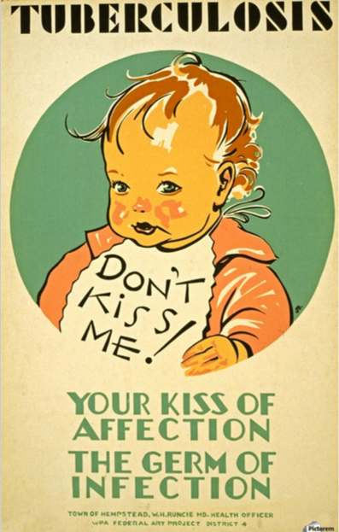
Chapter 22
MYCOBACTERIUM AND RELATED ACID-FAST BACTERIA
• Mycobacterium tuberculosis
• Other Slow-Growing Mycobacteria
• Mycobacterium leprae
• Mycobacterium avium complex (MAC)
M. avium
M. intracellulare
• Nocardia

Slide 2
Terms to Know
• Granuloma – a focal aggregate of immune cells that forms in response to a persistent inflammatory stimulus; focus of infection that causes a nodule or mass
• Caseous – cheese-like
• Fibrosis / fibrotic – thickening and scarring of tissue
• Calcification – when calcium builds up in tissues, making them hard (seen well on x-rays); can be normal or part of a disease process (like tissue damage)
• hilum of the lung - central portion of each lung, located on the medial (middle) aspect of each lung
• Lung consolidation - when the air that usually fills the small airways in your lungs is replaced with something else like fluid, infection, or blood, etc.
• Indolent – causes no pain, discomfort, or symptoms

Slide 3
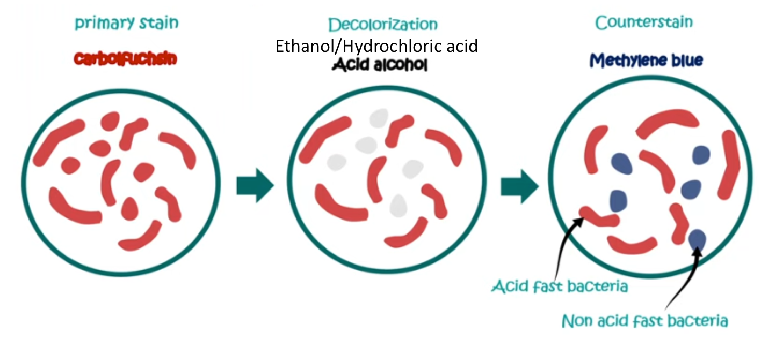
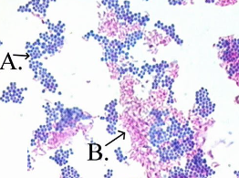
Overview
waxy cell walls rich in mycolic acids, making them impermeable to standard stains but allowing them to retain a strong stain even after exposure to acid-alcohol
Acid Fast-staining bacteria
All of these are nonmotile, non–spore-forming, aerobic gram-positive rods.
cell wall has mycolic acids containing 70 to 90 carbons
Have high guanine plus cytosine (G + C) DNA (61-71%)
High lipid content in cell walls make them acid-fast, hides then from the immune system, slow growing, and resistant to many antibiotics
All acid-fast organisms are grow slow, requiring incubation for 2-7 days (Nocardia, Rhodococcus, Gordonia, Tsukamurella) or months (Mycobacteria).
Classification is based on growth rate and colony morphology.
• Nowadays, 3 variants of acid-fast stains are used
- Ziehl-Neelsen: the oldest method, requires heating the specimen during the staining procedure –
Kinyoun : cold acid-fast stain (no heat required)
Auramine-rhodamine:- fluorescent stain. Nice because you can rapidly scan slides searching for fluorescing organisms against a black background

Slide 4
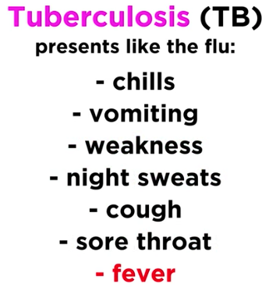


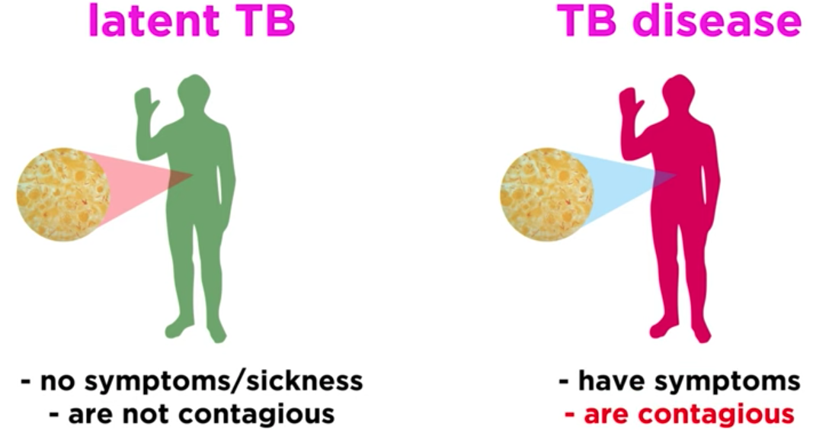

Overview
Mycobacterium tuberculosis
• an intracellular pathogen that can establish lifelong infection
• Spread by close person-to-person contact through the inhalation of infectious droplets (aerosol)
• Often, people have it but it never progresses to Tuberculosis (TB), (¼ of the world is infected)
• M. tuberculosis enters respiratory airways, then infectious particles penetrate to the alveoli, get
phagocytized by alveolar macrophages.
Wasn’t called this until 1834

Slide 5
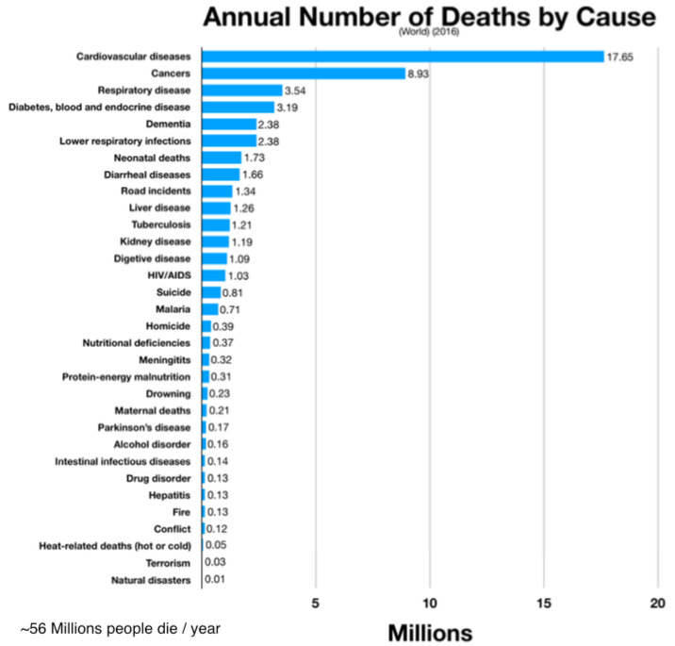
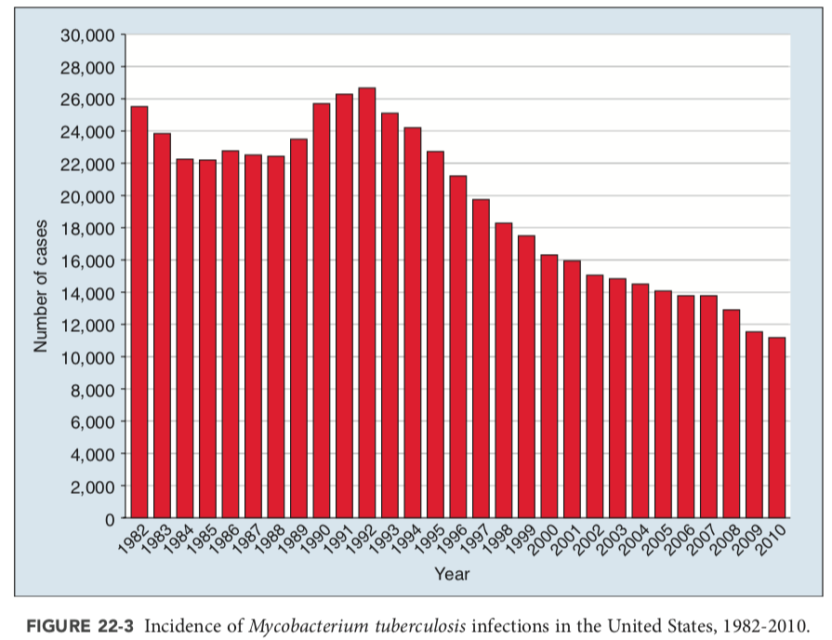
Epidemiology
Mycobacterium tuberculosis
• The World Health Organization (WHO) estimated that 1/4 of the world’s population is infected with M. tuberculosis and 460,000 developed disease with multidrug resistant strains
• In 2016: 10.4 million new cases of TB and 1.6 million deaths
• It is still one of the world’s leading cause of death
• Regions with the highest incidence of disease are India, Pakistan, sub-Saharan & South Africa, Eastern Europe, and China
• In the US: decreased steadily since 1992 - a total of 9272 cases were reported in 2016 – mostly in people from other countries

Slide 6
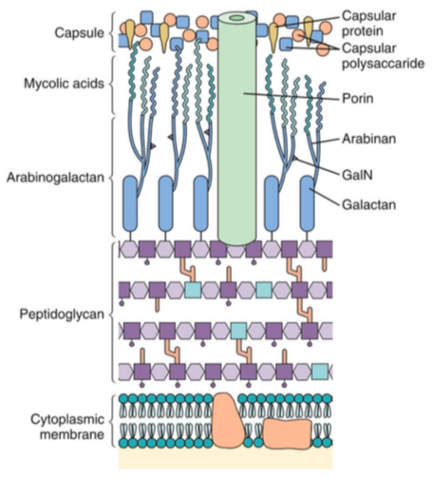
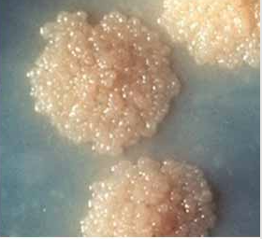
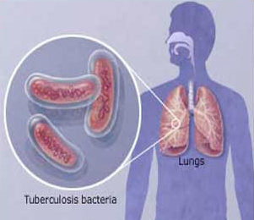
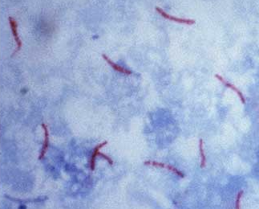
Physiology & Structure
Mycobacterium tuberculosis
Straight or curved, thin rod-shaped bacilli.
Non-sporing, non-motile, non-capsulated.
Acid-fast, not gram positive or negative.
They measure 0.5 µm x 3 µm.
Appear in single, in pairs, or small clumps.
high content of mycolic acid (50 to 60 %).
cell wall is rich in lipids and waxes.
They are wrapped together due to the presence of fatty acids.
Capable of intracellular growth.
They are resistant to disinfectants, detergents, common antibiotics, dyes, stains, osmotic lysis, lethal oxidation, etc.

Slide 7
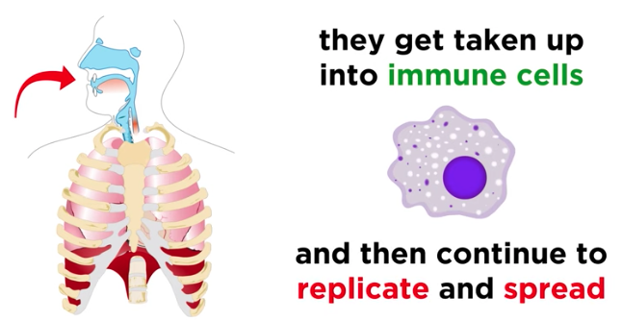
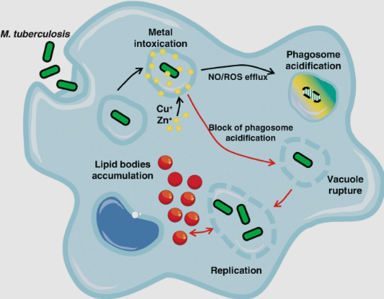
Pathogenesis & Immunity
Mycobacterium tuberculosis
A. Mycolic acid and Lipoarabinomannan (LAM)
Waxy layer that protects from host factors, antibiotics.
this protection promotes granuloma formation and caseous necrosis from the immune cells.
reduces INF-γ mediated activation of macrophages, cytokine production, and scavenges reactive oxygen intermediates, suppressing of T-cell proliferation.
B. ESX 1 secretion system
secretes enzymes that help the organism survive the phagosome.
delivers of bacterial enzymes to the macrophage cytoplasm.
Prevents fusion of lysosome to phagosome
C. Phagosome maturation factors
Ure, inhibits the acidification of early phagosome.
Superoxide dismutase (SOD), detoxifies reactive oxygen species
nlA gene product, somehow interferes with host cell apoptosis.

Slide 8
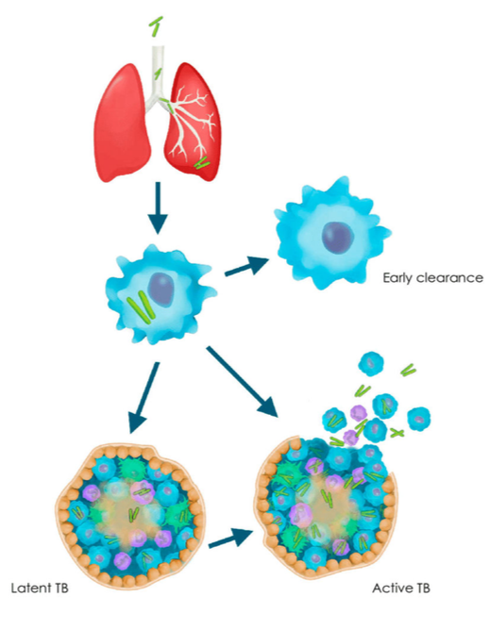
Pathogenesis & Immunity
Mycobacterium tuberculosis
Primary tuberculosis,
• Large particles are trapped on mucosal surfaces and removed by ciliary action of the respiratory tree
• However, small particles (containing only one to three tubercle bacilli) can reach the alveolar spaces and establish infection. Seen to occurs in mid/lower lung
There they get phagocytosed by alveolar macrophages.
• Once inside, M. tuberculosis prevents phagosome fusion with lysosomes (via early endosomal autoantigen 1 [EEA1] which blocks bridging molecule)
• In response to M. tuberculosis infection, macrophages secrete IL-12 and TNF-α which 1 increase inflammation, 2 recruit of T-cells, natural killer cells, 3 induce T-cell differentiation into T-helper cells) with IFN-γ secretion.
• IFN-γ, activates infected macrophages to help phagosome- lysosome fusion, intracellular killing by cytotoxic T- cells and NK cells, nitric oxide production… all of which together may help to clear the infection.

Slide 9
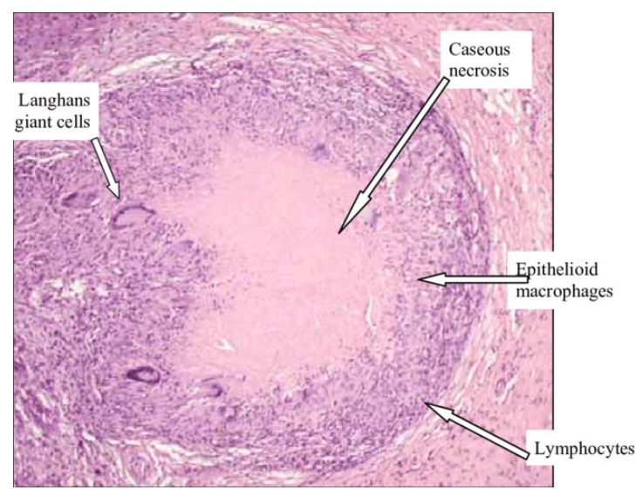
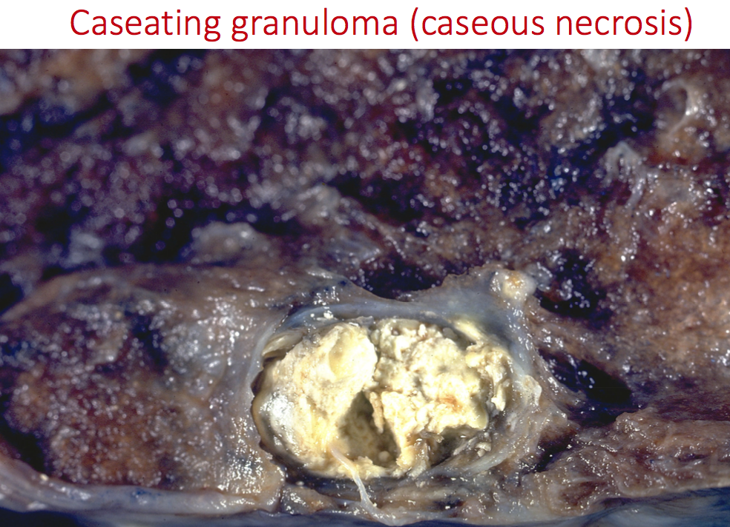
Pathogenesis & Immunity
Mycobacterium tuberculosis
Latent tuberculosis,
When the bacterial defenses allow it to survive the initial host defense mechanisms, survives and replicates in the macrophages, inducing a localized cell-mediated pro-inflammatory response leading to granuloma formation after ~3 wks.
fully developed granulomas consists of three zones
  a central area of large, multinucleated giant cells containing tubercle bacilli;
  a mid-zone of pale epithelioid cells often arranged radially; and
  a peripheral zone of fibroblasts, lymphocytes, and monocytes.
The center of the granuloma contains a mixture of necrotic tissue and dead macrophages, a caseous core.
the metabolically active macrophages in the granuloma consume oxygen, resulting anoxia and acidosis in the center kills most of the bacilli.
Granuloma can often limit the primary infection, and become quiescent. The surrounding fibroblasts produce dense scar tissue, which may become calcified called ghon focus.

Slide 10
Pathogenesis & Immunity
Mycobacterium tuberculosis
Active tuberculosis
For unknown reasons, dormant foci Reactivate and further develops in the upper lobes of the lungs
proteases from activated macrophages soften and liquefy the caseous material. excesses of TNF and cytokines cause fever and wasting appearance.
The expanding lesion of replicating bacilli erode through the bronchus wall, discharging its liquefied contents into the lung’s well-aerated cavity, which is ideal to support more replication of the bacilli.
Then, large numbers of bacilli gain access to the sputum, and the patient becomes an open, infectious case.
-Shows up nonspecific at first: malaise, weight loss, cough, and night sweats; sputum may be scant or bloody and purulent at first. -Then blood-streaked sputum (hemoptysis), indicating tissue destruction, cavitary.
Infection spreads through the bronchial tree. and secondary lesions develop in the lung and, sometimes, trachea, larynx, mouth.
Bacilli in swallowed sputum can lead to intestinal, renal, and bladder lesions..
.
Post-primary cutaneous tuberculosis (lupus vulgaris) usually affects the face and neck.

Slide 11

Clinical Disease
Mycobacterium tuberculosis
Clinical manifestation of the primary infection
Common presenting symptoms include:
low-grade fever
night sweats
fatigue
anorexia(loss of appetite)
weight loss.
A patient who presents with pulmonary tuberculosis usually has a productive cough, along with low-grade fever, chills, myalgias (aches), and sweating; however, these signs and symptoms are similar for influenza, acute bronchitis, and pneumonia.

Slide 12

Clinical Disease
Mycobacterium tuberculosis
Clinical manifestation of
Latent tuberculosis
In most infected individuals, the primary infection resolves.
but some residual tubercle bacilli can enter a poorly understood stage of latency or dormancy.
Can be asymptomatic but may see granulomas, ghon focus, on chest x-rays.
ghon focus

Slide 13
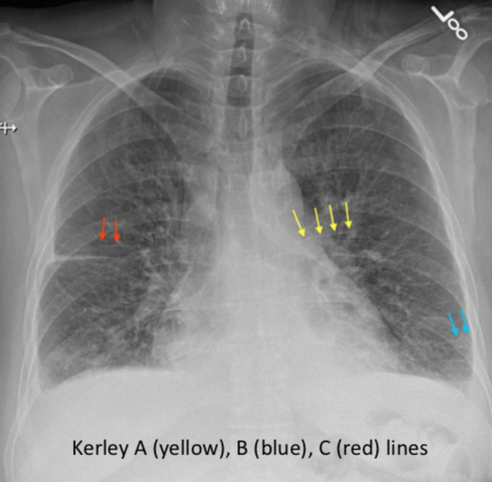
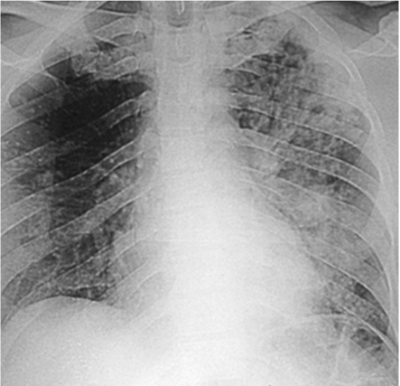
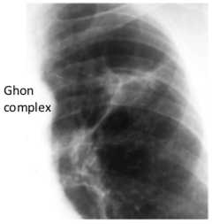
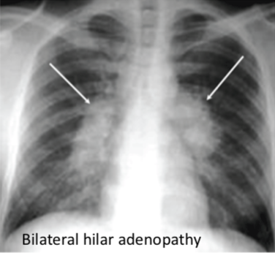
Clinical Disease
Mycobacterium tuberculosis
• Active pulmonary TB may manifest as pneumonic consolidation - homogenous dense opacity or patchy opacification mostly in middle and lower lobes with or without hilar lymphadenopathy called Ghon complex.
• Ghon complex is the same as a Ghon focus but now you can see all the lymph node activity around it, ‘hilar lymph node adenopathy’.
• Kerley lines – caused by edema (fluid build-up); A = medial (inner half), B = peripheral, C = central
• The chest x-ray finding of inactive TB can include fibrosis, persistent calcification (Ghon's focus), and a tuberculoma (persistent mass like opacities)
Ghon focus

Slide 14
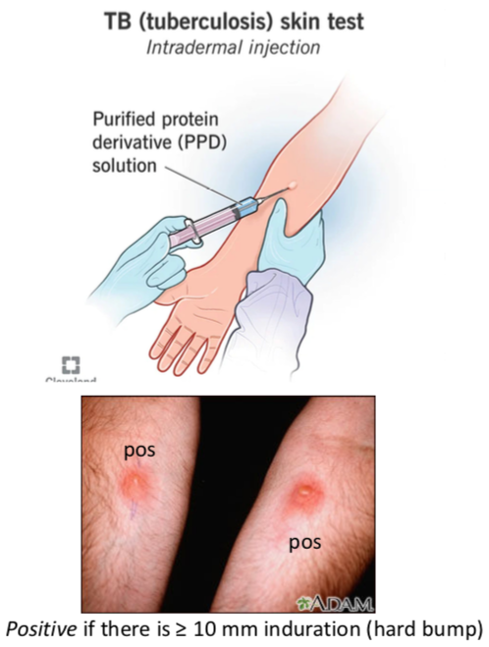
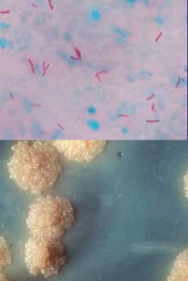
Laboratory Diagnosis
Mycobacterium tuberculosis
5 tuberculin antigens inoculated intra-dermally.
Skin test reactivity (defined by the diameter of the area of induration) is measured 48 hours later
Following symptoms, the clinical diagnosis is supported by:
(1) radiographic evidence of pulmonary disease
(2) positive skin test reactivity
(3) the laboratory detection of mycobacteria, either with microscopy or in cultures (PCR is most popular now)
1
2
3
• In some cases, extrapulmonary TB occurs as the result of the hematogenous spread during the initial infection- in these cases, there may be no evidence of pulmonary disease in patients with disseminated TB

Slide 15
Treatment and Prevention
Mycobacterium tuberculosis
Prolonged multi-antibiotic regimen
Vaccination with attenuated M. bovis (BCG)
• Treatment of M. tuberculosis infections, unlike those for most other bacterial infections, is complex
• Slow-growing mycobacteria are resistant to most antibiotics used to treat other bacterial infections, and in general, patients must take multiple antibiotics for an extended period (e.g., minimum of 6 - 9 months) or else antibiotic-resistant strains will develop
• 2 months of isoniazid, ethambutol, pyrazinamide, and rifampin, followed by 4 - 6 months of isoniazid and rifampin
• Many side effects, but rifampin causes temporary discoloration (yellow, reddish-orange, or brown color) of your skin, teeth, saliva, urine, stool, sweat, and tears)
• Commonly used in countries in which TB is endemic and is responsible for significant morbidity and mortality
• This practice can lead to a significant reduction in the incidence of tuberculosis if BCG is administered to people when they are young (it is less effective in adults)
• Unfortunately, BCG immunization cannot be used in immunocompromised patients (e.g., those with HIV infection); thus it is unlikely to be useful in countries with a high prevalence of HIV infections (e.g., Africa)
• An additional problem with BCG immunization is that positive skin test reactivity develops in all patients and may persist for a prolonged time

Slide 16
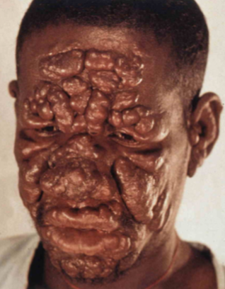
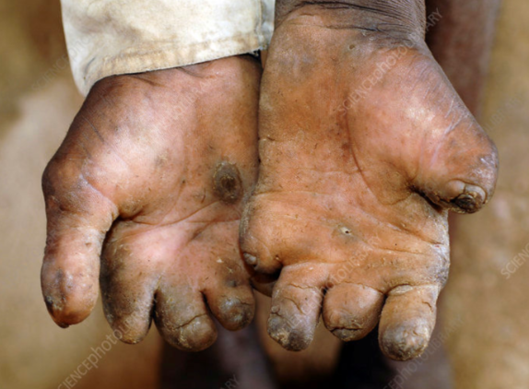
Overview
Mycobacterium leprae
Leprosy, Hansen's disease, is a bacterial infection that causes skin lesions, nerve damage, eye problems, and potentially crippling disabilities
Leprosy was first described in 600 BC and was recognized in
the ancient civilizations of China, Egypt, and India
• Spread either through the inhalation of infectious aerosols or through skin contact with respiratory secretions and wound exudates, however, it is not considered highly contagious
• Incubation is slow – varying from 6 months to 40 years or longer.
M. leprae is an acid-fast, gram-positive obligate intracellular bacillus that shows tropism for cells of the reticuloendothelial system and peripheral nervous system (notably Schwann cells).

Slide 17
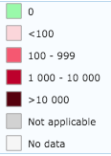
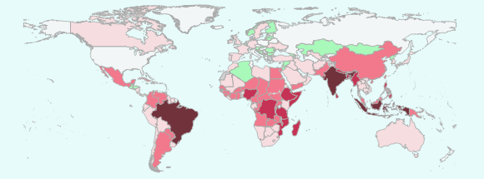
Overview
Mycobacterium leprae
• The global prevalence of leprosy has fallen dramatically with widespread use of effective therapy
More than 5 million cases were documented in 1985 but only 200,000 cases in 2016
Currently, the highest number of new diagnoses is in India, Brazil, and Indonesia
In the United States, leprosy is uncommon, with 178 new cases reported in 2015 primarily in immigrants from endemic countries

Slide 18
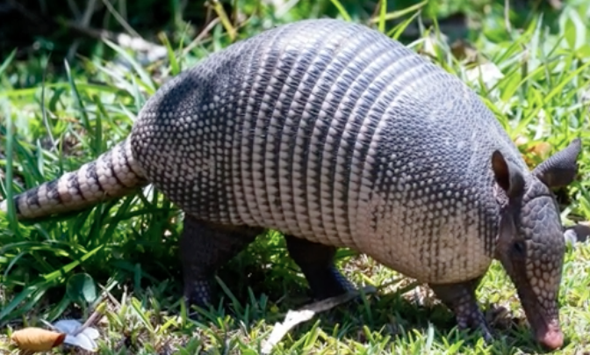
Epidemiology
Mycobacterium leprae
Global Burden (2023): 182,815 new cases reported.
Regional Concentration: South-East Asia reported 131,425 cases in 2023.
Americas (2023): 24,773 cases, with 22,773 (92%) in Brazil.
U.S. Cases: Approximately 225 people are diagnosed annually in the U.S..
Top U.S. Regions: Florida, California, Louisiana, Hawaii, New York, Arkansas, and Texas accounted for 62% of U.S. cases in 2023.
Impact: Approximately 2-3 million people are estimated to be living with permanent disabilities due to leprosy.
• The global prevalence of leprosy has fallen dramatically with widespread use of effective therapy.
.
• Interestingly, leprosy is endemic in armadillos found in Texas and Louisiana, producing a disease similar to the highly infectious lepromatous form of leprosy in humans. Thus, these armadillos represent a potential endemic focus in this country .
In Brazil up to 40% of armadillos carry M. leprae, and risk goes up woth those intexting with armadillos

Slide 19
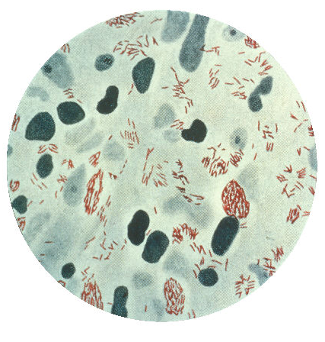
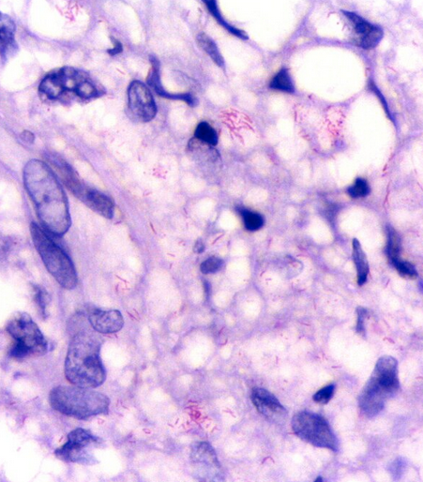
Physiology & Structure
Mycobacterium leprae
Similar to M. tuberculosis
M. leprae is an acid-fast, gram-positive obligate intracellular bacillus that shows tropism for cells of the reticuloendothelial system and peripheral nervous system (notably Schwann cells).
Cant be grown in culture
(you can grow it in armadillos!)
Attaches to and enters cells by binding Phenolic glycolipid-1 (PGL-I) aids in adhesion and internalization into Schwann cells.
TLRs, such as TLR-1 and TLR-2, found on Schwann cells macrophages, muscle cells, skin cells, and endothelial of blood vessels, are suggested to be responsible for activating apoptosis genes, leading to cell death and nerve damage seen in the mild disease.

Slide 20
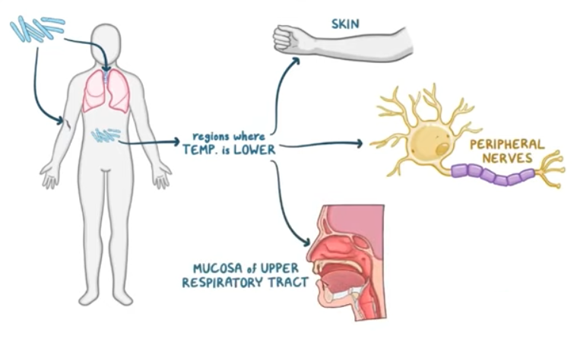
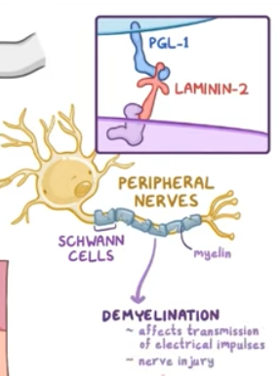
Pathology and Immunity
Mycobacterium leprae
bacilli invade macrophages which migrate towards skin, exterior neural tissue. (thrives best in cooler areas of the body (27-30C)).
Schwann cell invasion results in demyelination and loss of nerve function, viability.
Bacilli multiply slowly (~12-14 days to divide), get liberated from the destroyed cells, and enter other unaffected cells.
Till this stage person remains free from signs and symptoms of leprosy.

Slide 21
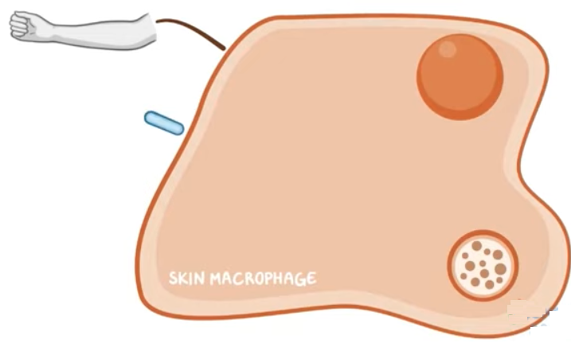
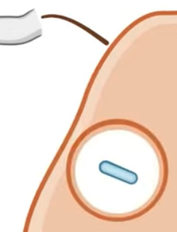
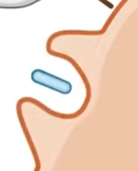
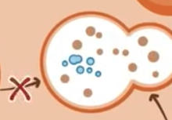
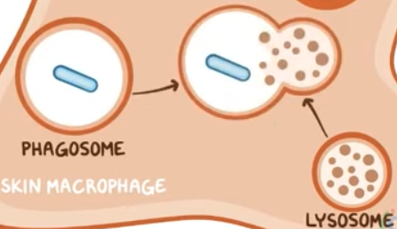
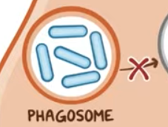
Pathology and Immunity
Mycobacterium leprae
Invading cells get phagocytosed
But prevent fusion with the lysosome.
This allows the bacilli to replicate.
They are liberated when the cell dies, and then reinfect new uninfected cells.
Bacilli multiply slowly (~12-14 days for one bacterium to divide into two), get liberated from the destroyed cells and enter other unaffected cells.
Till this stage person remains free from signs and symptoms of leprosy.
; the fate of the bacterium depends on the resistance of the infected individual towards the infecting organism.

Slide 22
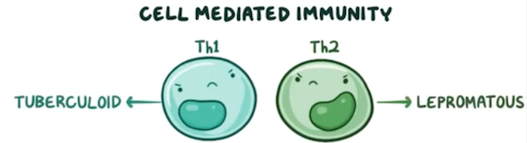
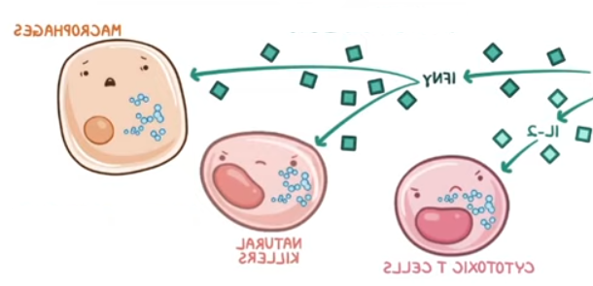

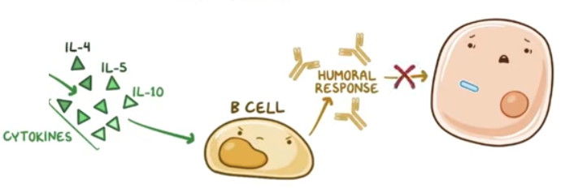
Clinical Disease
Mycobacterium leprae
the fate of the bacterium depends on the resistance of the infected individual towards the infecting organism.
Macrophages active T-helper cells…
But depending upon the person, the cytokines can preferentialy activate either Th1 or Th2
High cell-mediated immunity
Low cell-mediated immunity

Slide 23
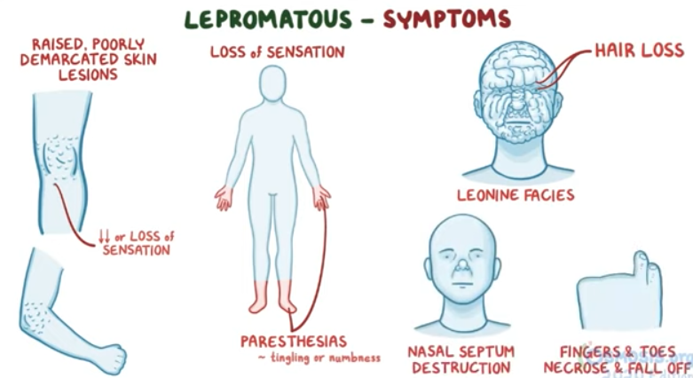
Clinical Disease
Mycobacterium leprae

Slide 24
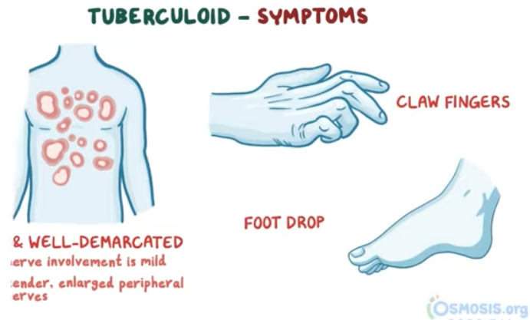
Clinical Disease
Mycobacterium leprae

Slide 25
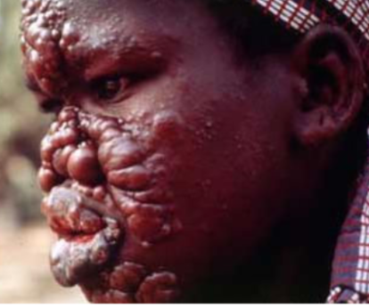
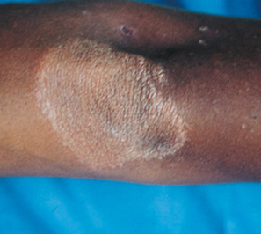
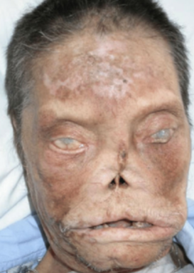
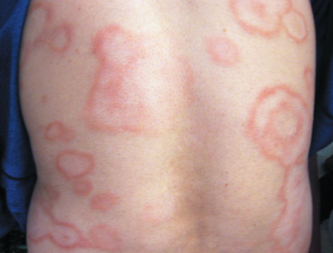
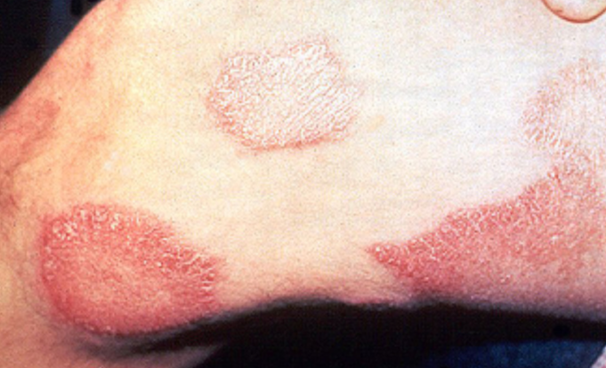
Clinical Disease
Mycobacterium leprae
Disease depends on the immune system of the patient
Strong cellular (T-cell) response
Weak cellular (T-cell) response to M. leprae antigens
• Patients get tuberculoid leprosy (also called paucibacillary Hansen disease) • bacillary clearance
• The tuberculoid form is characterized by hypopigmented skin macules.
• Patients with lepromatous leprosy (multibacillary Hansen disease)
• Thus, an abundance of bacteria are typically observed in dermal macrophages and the Schwann cells of the peripheral nerves
• As would be expected, this is the most infectious form of leprosy
• The lepromatous form is associated with disfiguring skin lesions, nodules, plaques, thickened dermis, and involvement of the nasal mucosa

Slide 26
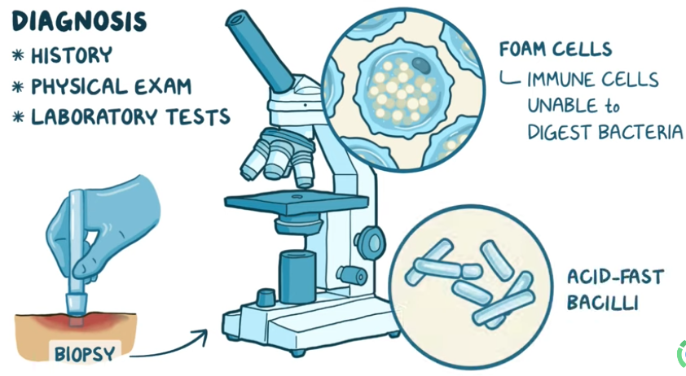
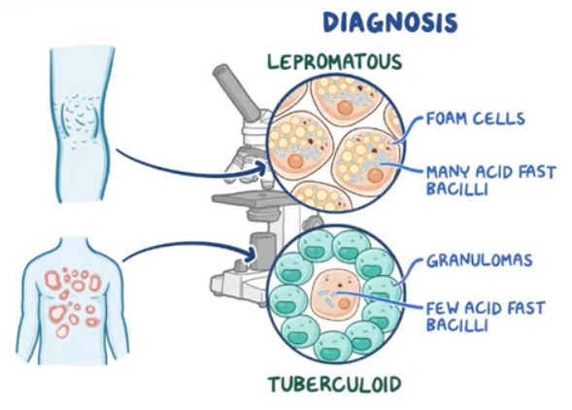
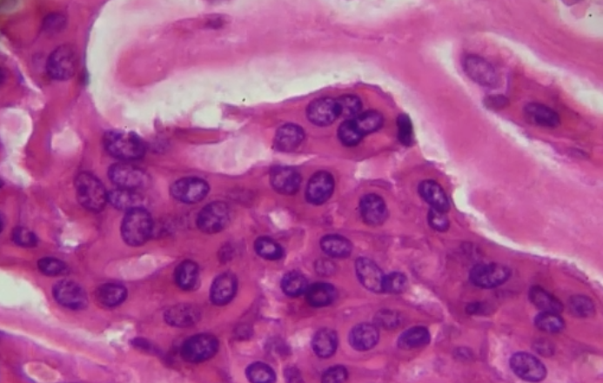
Lab Diagnosis
Mycobacterium leprae
• M. leprae cannot grow in cell-free cultures
PCR

Slide 27

Treatment Prevention
Mycobacterium leprae
Treatment
Prevention
Leave armadillos alone
Dapsone: inhibits dihydropteroate synthase, thus blocking bacterial folate synthesis

Slide 28
Overview
Other Slow-Growing Mycobacteria – the MAC
• Members of the Mycobacterium avium complex (MAC) are among the most common pathogenic acid-fast species
• Although some subspecies do not cause human disease, representatives of the two most common MAC species, M. avium and M. intracellulare, are human pathogens
• Both species can cause disease in immunocompetent, so anyone can get it.
• but frequently immunocompromised.

Slide 29
Clinical Disease
Other Slow-Growing Mycobacteria – the MAC
Pulmonary disease
in immunocompetent patients it presents in 1 of 3 forms:
(1). Most common, middle-age -old men with a history of smoking and pulmonary disease
• patients typically have a slowly evolving cavitary disease that resembles tuberculosis
(2). The second form of MAC infection is observed in elderly female nonsmokers
• Lingular or middle lobe infiltrates with a patchy, nodular appearance on x-ray and associated bronchiectasis (chronically dilated bronchi)
• Indolent but has high morbidity and mortality
• Speculated that this arides in “fastidious elderly women who chronically suppress their cough reflex”, leading to nonspecific inflammatory changes that predispose forMAC infection (named Lady Windermere syndrome from an Oscar Wilde play )
(3). The third form of MAC disease is the formation of a solitary pulmonary nodule
• MAC is the most common mycobacterial species that causes solitary pulmonary nodules

Slide 30
Treatment
Other Slow-Growing Mycobacteria – the MAC
• MAC and many other slow-growing mycobacteria are resistant to common antimycobacterial agents
• One regimen recommended currently for MAC infections is clarithromycin or azithromycin, combined with ethambutol and rifampin
• The duration of treatment and final selection of drugs for these species and other slow-growing mycobacteria are determined
by the response to therapy and
(2) by interactions among these drugs and other drugs the patient is receiving

Slide 31


Overview Physiology & Structure
Nocordia
• Nocardiae are strict aerobic rods that form branched filaments, resembling mold/fungal hyphae
• Stains poorly with the Gram stain and appear to be gram-negative, with intracellular gram-positive beads – categorized as weakly acid-fast
• Lack of staining is due to branched-chain fatty acids in their cell wall, like mycolic acid, etc.
• The length of the mycolic acids in nocardiae (50 to 62 carbon atoms) is shorter than in mycobacteria (70 to 90 carbon atoms)

Slide 32
Pathology and immunity
Nocordia
• Although toxins and hemolysins have been described for nocardiae, the role these factors play in disease has not been defined
• It appears that the primary factor associated with virulence is the ability of pathogenic strains to avoid phagocytic killing
• When phagocytes contact microbes, an oxidative burst occurs, with release of toxic oxygen metabolites (i.e., hydrogen peroxide, superoxide)
• Pathogenic strains of nocardiae are protected from these metabolites by their secretion of catalase and superoxide dismutase
• They can also replicate within macrophages and prevents fusion of the phagosome-lysosome

Slide 33
Clinical Disease
Nocordia
• Not normally found on humans, only in soil rich in organic matter
• Opportunistic – in people with low immune systems
• Bronchopulmonary disease develops after the initial colonization of the upper respiratory tract by inhalation and then aspiration of oral secretions into the lower airways
• Primary cutaneous nocardiosis develops after traumatic introduction of organisms into subcutaneous tissues, and secondary cutaneous involvement typically follows dissemination from a pulmonary site

Slide 34

Overview and Everything
Rhodococcus equi, Gordonia, and Tsukamurella
• other ‘weakly acid fast pathogens that can present as pulminary disease pathogens of immunocompromised patients

