Slide 1
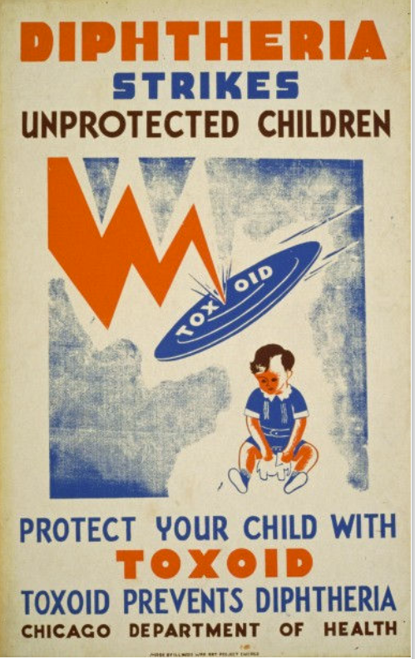
Chapter 21
LISTERIA AND RELATED GRAM-POSITIVE BACTERIA
• Listeria monocytogenes
• Corynebacterium diphtheriae
• Erysipelothrix rhusiopathiae
• These 3 are just lumped together because they are the 3 that are rods, Gram positive, and non-spore forming
• Erysipelothrix is not very important, so we will only briefly go over it
• They all present very differently from one another

Slide 2
Terms to Know
• Septicemia – same as sepsis
• Granuloma – an area of inflammation that forms a nodule (often seen in lungs on chest x-rays) but can form in any organ or tissue

Slide 3
Overview
Compilation of what we know so far….
• There are 7 medically important Gram positive bacteria
• 2 are cocci
Staphylococcus
Streptococcus
• 5 are bacilli / rods
• 2 spore forming rods
Bacillus
Clostridium
• 3 non-spore-forming rods
Listeria monocytogenes
Corynebacterium diphtheriae
Erysipelothrix rhusiopathiae (not as important as the others)
• Both of the spore forming Bacilli cause disease by releasing exotoxins
• Bacillus – aerobic
• Clostridium - anaerobic

Slide 4


Overview
Listeria monocytogenes
26 Listeria species, but monocytogenes is the most important one
Facultative intracellular pathogen
Facultative anaerobe, short rods in pairs or chains
On a Gram stain, it can almost look like Streptococcus pneumoniae
Both can cause meningitis
• Disease is uncommon and seen only in elderly, pregnant, impaired immunity
• But can be serious for late-term fetuses in pregnant women, and neonates.
Named by J.H. Harvey Pirie (in 19450) to honor Lord Joseph Lister for his contributions to antiseptic medicine (1863ish) and bacteriology.

Slide 5

Overview
Listeria monocytogenes
Contaminated food.. most common route of infection
-Raw/Processed/Undercooked Meat/Seafood/Vegetables
-*Unpasteurized diary products.
Typically has a high IC50. So you need a large dose of it to get sick.
But it grows well at 4°C (in your fridge).

Slide 6
Epidemiology
Listeria monocytogenes
Contaminated food. So its found worldwide

Slide 7
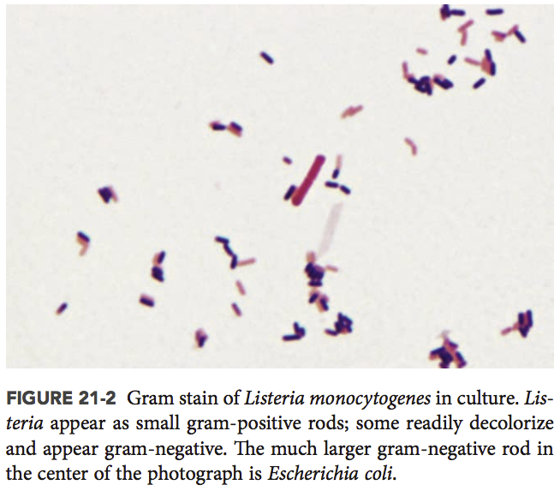
Physiology & Structure
Listeria monocytogenes
• Prelim identification:
• Gram positive rods
• Motile when examined in liquid broth culture
(end over end tumbling) under a microscope
• Βeta-hemolysis on a plate (weakly)
• Facultative intracellular pathogen (can live inside or outside cells.)

Slide 8
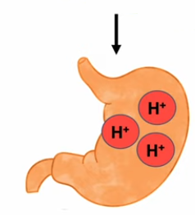
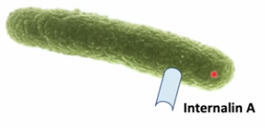
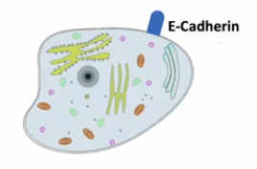
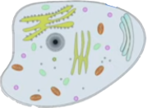
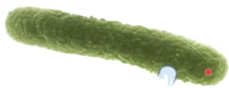

Pathogenesis & Immunity
Listeria monocytogenes
It has acid stress response genes that activate and allow it to survives stomach acid
It also has good adherence proteins (Internalins A and B)
• Once adhered, cells internalize it (by phagocytosis). the bacterium then becomes encased in a phagolysosome (cellular response to internalizing bacteria) which also has a low acidic pH.
• To escape, the lysosome’s acidic environment, it activates a pore forming cytolysin (listeriolysin O) and 2 phospholipase C enzymes (degrades the cytoplasmic membrane) which frees the bacterium into the cytosol of the human epithelial cells of the gastrointestinal tract.
• It can replicate in the cell.
• It also polymerizes actin (ActA) to move/push itself into other cells
phagolysosome

Slide 9
Pathogenesis & Immunity
Listeria monocytogenes
• They can infect other nearby cells, including macrophages, which get transported to the liver and spleen (now it’s systemic)
• Humoral immunity (Antibody) is unimportant in infection with L. monocytogenes because they replicate in macrophages and move within cells, avoiding antibodies.
• For this reason, patients with impaired cellular immunity (T cell), are susceptible to severe infections.
phagolysosome

Slide 10

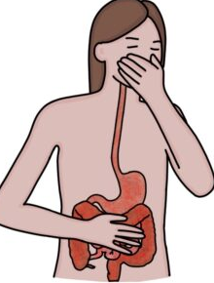
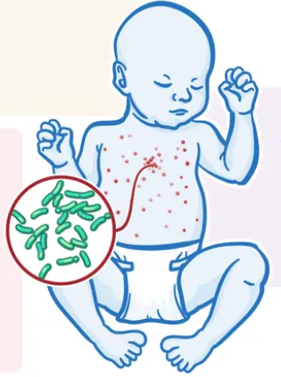
Clinical Disease
The exception to this is pregnant women in their third trimester (their T-cell response becomes suppressed):
2 forms of disease states:
Early onset:
Premature delivery
Chorioamnionitis (inflamed amnionic fluid membrane)
Spontaneous abortion
Stillbirth
*because the bacteria can cross the placental cells and infect the fetus
Listeria monocytogenes
In healthy (immunocompetent) individuals:
nausea
vomiting
diarrhea
myalgia
fever
malaise
gastroenteritis
Granulomatosis infantiseptica is a severe form of early-onset listeriosis.
Presents early with fever vomiting, and nodular skin rash.
Progresses quickly as abscesses and granulomas in multiple organs.
Death unless antibiotics applied quickly
Late onset:
acquired at birth
At 2 - 3 weeks meningitis, meningoencephalitis with septicemia develops
Clinical symptoms aren’t unique; so also need to consider other causes of neonatal central nervous system disease (ie. Streptococcal group B)

Slide 11


Clinical Disease
Listeria monocytogenes
In immunocompromised individuals:
Meningitis is the most common form of disseminated Listeria infection in adults
• Although the clinical symptoms of meningitis are not specific to Listeria, Listeria should always be suspected in patients with organ transplants or cancer and in pregnant women in whom meningitis develops.
• Disease is associated with high mortality (20% to 50%) and neurologic problems
Bacteremia
• Patients with bacteremia may have an unremarkable history of chills and fever (commonly observed in pregnant women) or a more acute presentation with high-grade fever and hypotension
• Only severely immunocompromised patients and the infants of pregnant women with sepsis appear to be at risk of death

Slide 12
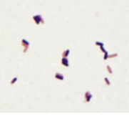
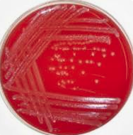

Laboratory Diagnosis,
Listeria monocytogenes
Lab diagnosis can be tough!
If presenting with meningitis, it is difficult to find on a Gram stain of Cerebrospinal fluid because they are present in low concentrations and live intracellularly. And if they are there, they can look similar to S. pneumoniae, Enterococcus, and Corynebacterium.
It grows easily on most types of media in culture, and you can enrich it by growing it in the cold… but this takes time.
Serotyping is most useful for food samples, because it can distinguish between other nonpathogenic Listeria that may be present.

Slide 13
Treatment and Prevention
Listeria monocytogenes
Prevention
Hand-washing, avoiding contaminated foods
Washing vegetables
Cooking food above 74C (165F)
Treatment
Gentamicin with either penicillin or ampicillin is typically prescribed in the case of serious infections

Slide 14
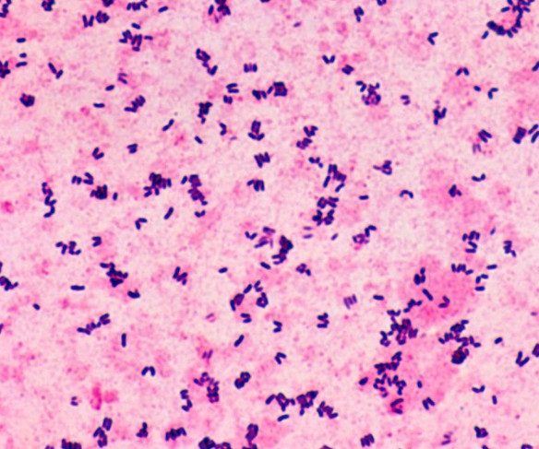
Overview
Corynebacteria diphtheriae
koryne (club) and diphthera (leather hide),
• 150 species
• Clumps of organisms and short chains
• They are irregularly shaped – “club-shaped” rods, or pleomorphic (various irregular forms, V ior L shaped)
• Organisms in the genus Corynebacteria are found everywhere, on your skin, in nose, in soil, etc.
• But only few cause disease
• The most common is diptheria
• This species is subdivided into 4 biotypes based on their colony morphology and biochemical properties
• belfanti, gravis, intermedius, and mitis
• most disease is caused by the biotype mitis

Slide 15
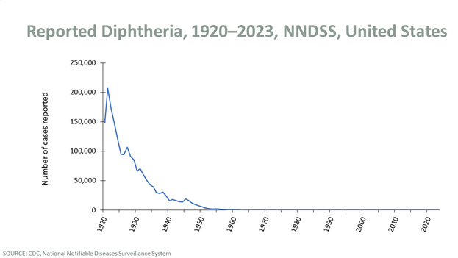
Epidemiology
Corynebacteria diphtheriae
• Found all over the world, but less common in areas with routine vaccination
• In the US, > 200,000 cases in 1921. 14 cases From 1996 – 2018 (<1case/yr).
• C. diphtheriae is maintained in the population by asymptomatic carriage in the oropharynx or on the skin of immune people
• Most people in the US and UK who get it contract it while in other countries where it occurs more often

Slide 16
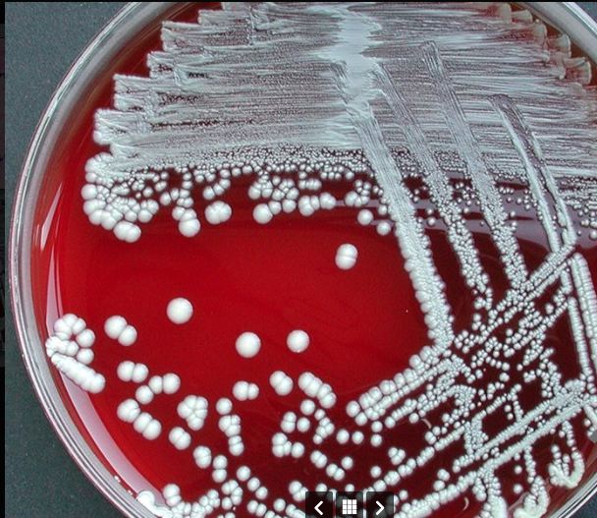
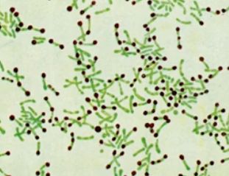
Physiology & Structure
Corynebacteria diphtheriae
koryne (club) and diphthera (leather hide),
• Clumps of organisms and short chains
• They are irregularly shaped – “club-shaped” rods, or pleomorphic (various irregular forms) . Have metachromatic granules which you can stain for….
Otherwise, it’s a standard gram-positive-looking membrane and cell.
Metachromatic granules

Slide 17
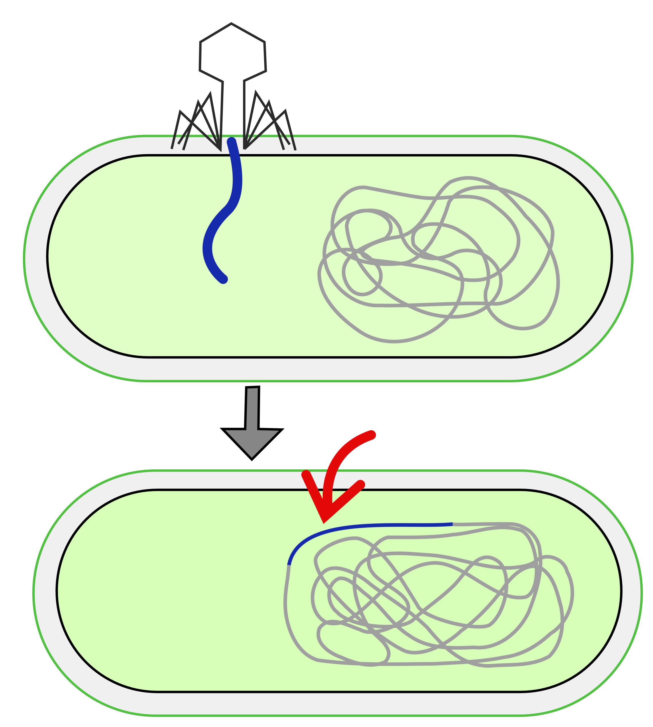
Pathogenesis & Immunity
Beta phage
Corynebacteria diphtheriae
It generally colonizes and replicates on the surface epithelial cells of the throat/pharynx. (Or skin for cutaneous infections.)
Some reports say it can also be internalized and partially survive inside cells (but its not thought to be its primary or an important mechanism.
Diphtheria exotoxin is the major virulence factor
The tox gene encoding the exotoxin is found on a bacteriophage that inserts into the chromosome, converting a nonpathogenic bacteria into a pathogenic one.
tox
tox

Slide 18



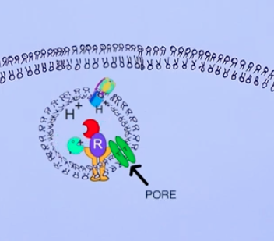
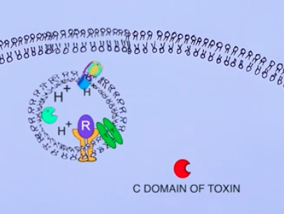

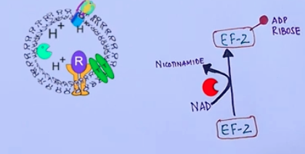
Pathogenesis & Immunity
Corynebacteria diphtheriae
•Two processing steps occur on Tox to produce a classic A-B toxin:
(1) proteolytic cleavage of the Tox leader peptide allows secretion from the bacterial cell
(2) Tox is then proteolytically cleaved into two polypeptides (A and B) that remain attached by a disulfide bond.
• The A-B toxin binds Heparin-Binding EFG receptor (found on many eukaryotic cells like heart and nerve).
• internalized, then the A catalytic subunit is injected into the cell.
• A is an enzymatic ADP-ribosylator that targets-inactivates EF-2, shutting down translation/protein synthesis.
• cause of the cardiac and neurologic symptoms in severe diphtheria cases.

Slide 19
Pathogenesis & Immunity
Corynebacteria diphtheriae
•Evasion of the immune system… kind of
It is an offensive strategy for defense.
The toxin (its best offense) is also (its best defense) for how it evades the immune system.
The potent exotoxin causes rapid, localized tissue destruction. Forming a pseudomembrane that walls off the bacteria from immune cells.

Slide 20
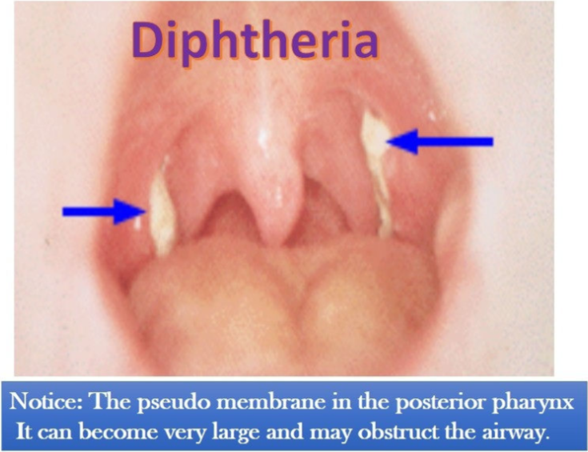
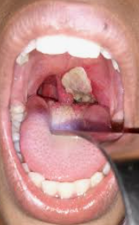
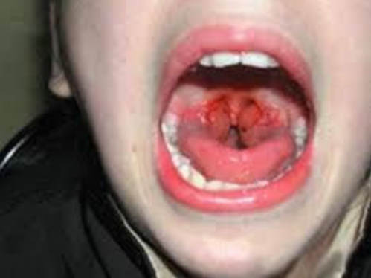
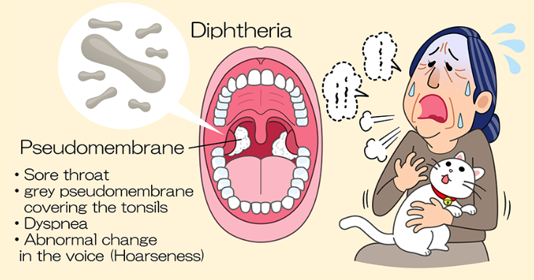
Clinical Disease
Corynebacteria diphtheriae
• Symptoms involving the respiratory tract develop after a 2-4-day incubation period
• Organisms multiply on epithelial cells in the pharynx and initially cause localized damage as a result of exotoxin activity
• The onset is sudden, with malaise, sore throat, exudative pharyngitis (coughing stuff up), shortness of breath, and a low-grade fever
• The exudate evolves into a thick grayish pseudomembrane composed of bacteria, lymphocytes, plasma cells, fibrin, and dead cells that can cover the tonsils, uvula, and palate and can extend into the nasopharynx or into the larynx (can cause suffocation)
• The pseudomembrane firmly adheres to the underlying tissue and is difficult to dislodge without making the tissue bleed (unique to diphtheria)
• If the patient recovers after approximately a 1-week course of the disease, the membrane dislodges and is expectorated (coughed up). Systemic complications in patients with severe disease primarily involves the myocarditis (heart muscle damage), and nervous system pain and inflammation. Thus the most common causes of fatality are airway obstruction, heart failure, and paralysis of the diaphragm.

Slide 21
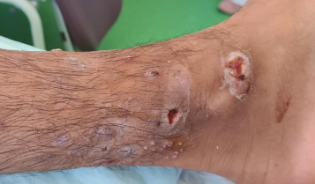
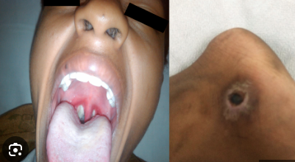
Clinical Disease
Corynebacteria diphtheriae
Cutaneous diptheria
• Cutaneous diphtheria is acquired through skin contact with other infected persons
• The organism colonizes the skin and gains entry into the subcutaneous tissue through breaks in the skin
• A papule develops first and then evolves into a chronic, nonhealing ulcer, sometimes covered with a grayish membrane
• S. aureus or S. pyogenes is also frequently present in the wound.

Slide 22
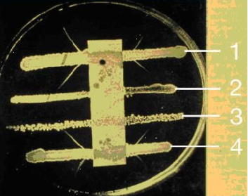
Laboratory diagnosis
Corynebacteria diphtheriae
Grows on several media.
But can do an ELEK test to see if it’s a toxin producing strain
PCR, of course for tox gene is common too

Slide 23
Treatment, Prevention
Corynebacteria diphtheriae
Treatment
Vaccine
• The most important aspect for treating diphtheria is early administration of diphtheria antitoxin to specifically neutralize the exotoxin before it is bound by the host cell.
• Once the cell internalizes the toxin, cell death is inevitable
• Unfortunately, because diphtheria may not be suspected initially, significant disease progression can occur before the antitoxin is administered.
• Antibody therapy with penicillin or erythromycin is also used to eliminate C. diphtheriae and terminate toxin production.
• Bed rest, isolation to prevent secondary spread, and maintenance of an open airway in patients with respiratory diphtheria are all important
• After the patient has recovered, immunization with toxoid is required because most patients fail to develop protective antibodies after a natural infection
• Symptomatic diphtheria can be prevented by actively immunizing people with diphtheria toxoid
• The nontoxic, immunogenic toxoid is prepared by formalin treatment of the toxin
• Initially, children are given five injections of this preparation with pertussis and tetanus antigens (DPT vaccine, aka DTaP) at ages 2, 4, 6, 15 - 18 months, and 4 - 6 years
• After that time, it is recommended that booster vaccinations with diphtheria toxoid combined with tetanus toxoid (DT shot) be given every 10 years

Slide 24
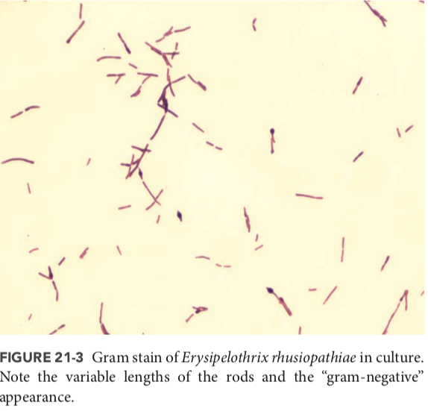
Overview
Erysipelothrix rhusiopathiae
Found in animals, soil, on plants, everywhere
Seen most in turkeys and pigs
Considered an animal disease, but can affect humans
• Spread from animals to humans and mostly in animal processing and vet industry (occupational)

Slide 25
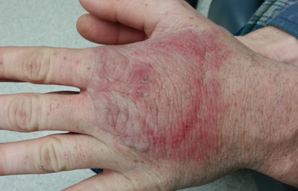
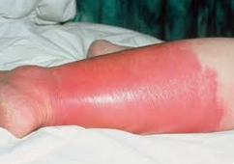
Clinical Disease
Erysipelothrix rhusiopathiae
3 primary forms of human infection with E. rhusiopathiae have been described:
(1) Infects broken skin, forms a localized skin infection, erysipeloid (not to be confused with streptococcal erysipelas)
-Inflammatory skin lesion that develops at the site of trauma after 2- 7 days of incubation (fish handler’s disease)
-Most commonly presents on finger/hands.
- appears violaceous (purple-ish) with a raised edge
-slowly spreads peripherally as the central discoloration area fades.
-lesion is pruritic (itches), and can burn- throb
(2) generalized cutaneous disease
- Similar to above, but can spread out
(3) septicemia
- uncommon
erysipeloid
streptococcal erysipelas

Slide 26
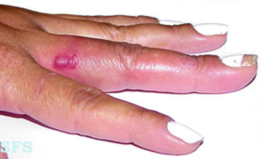
Treatment Prevention
Erysipelothrix rhusiopathiae
Penicillin works

