Slide 1
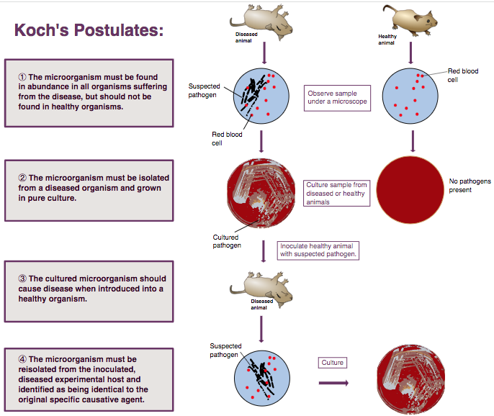
2
HUMAN MICROBIOME IN HEALTH AND DISEASE

Slide 2
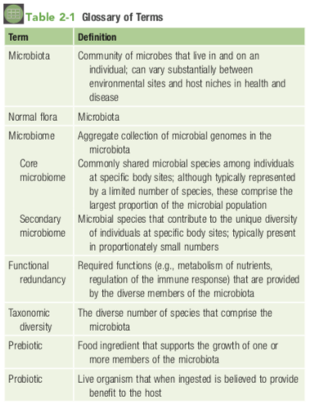

Slide 3
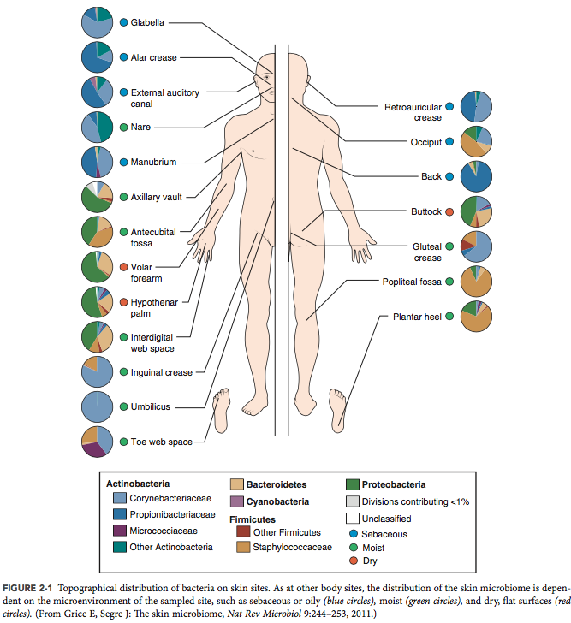
We carry as many bacterial cells as we do human cells

Slide 4
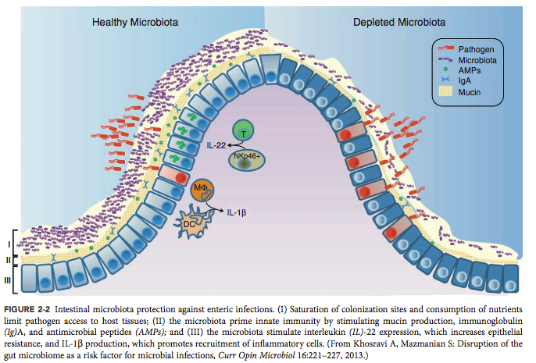
dysbiosis
obesity
type 2 diabetes
celiac disease

Slide 5
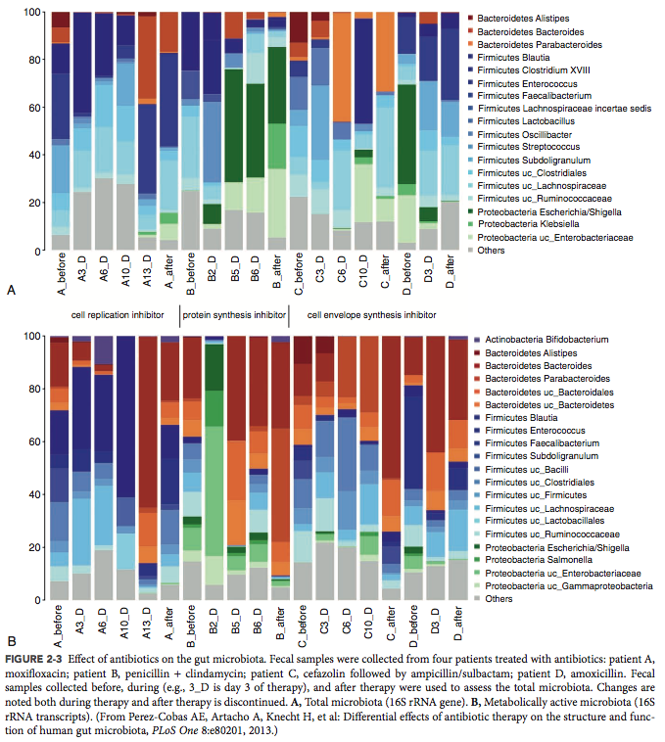
antibiotic-associated colitis
C. Difficile- entrotoxins resulting in colon inflammation
Mucin degrading bacteria leading to ulcerative colitis

Slide 6
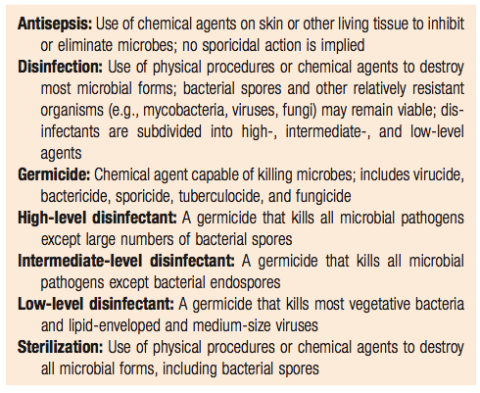
Clean vocabulary
3
STERILIZATION, DISINFECTION, AND ANTISEPSIS

Slide 7
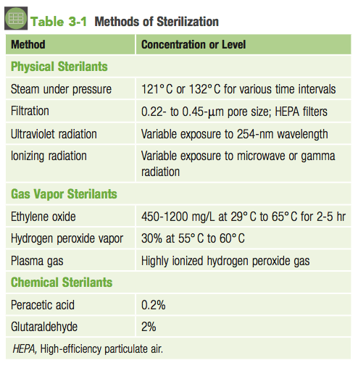

Slide 8
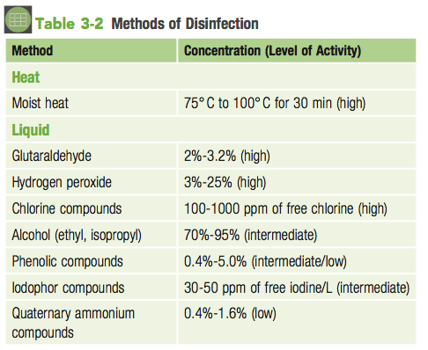

Slide 9
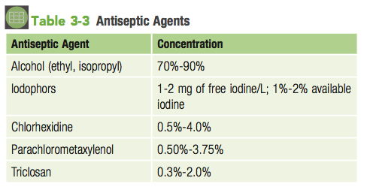

Slide 10
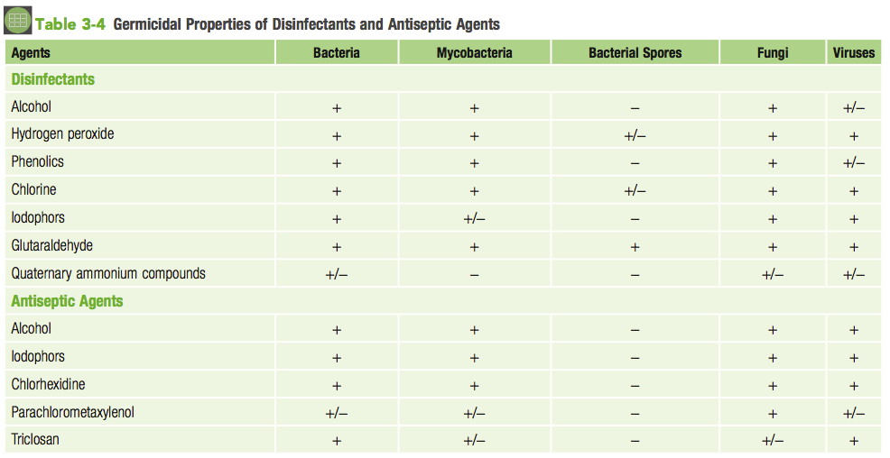

Slide 11
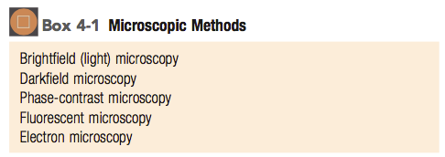
Techniques for seeing things…
4
MICROSCOPY AND IN VITRO CULTURE

Slide 12
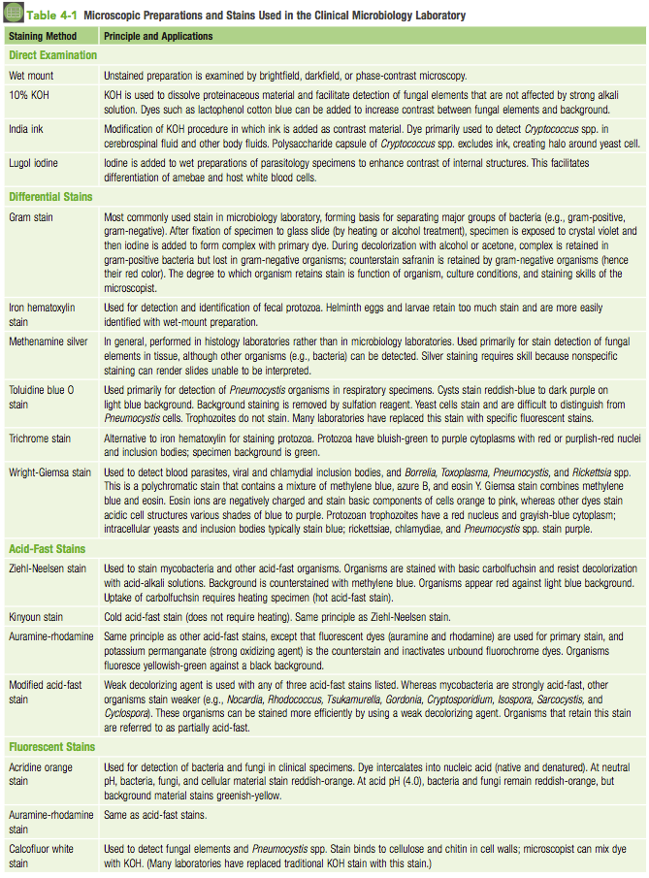
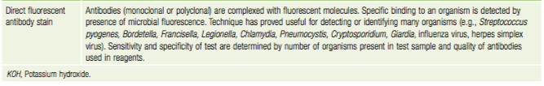
Stains to differentiate…

Slide 13
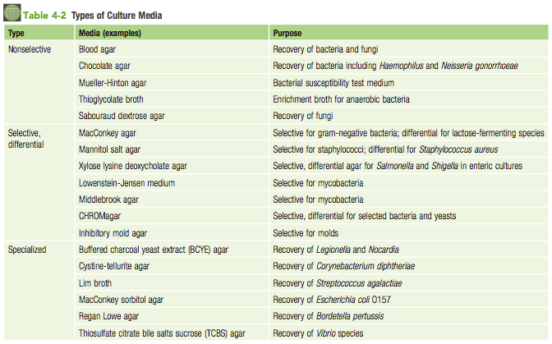
Media to isolate …

Slide 14
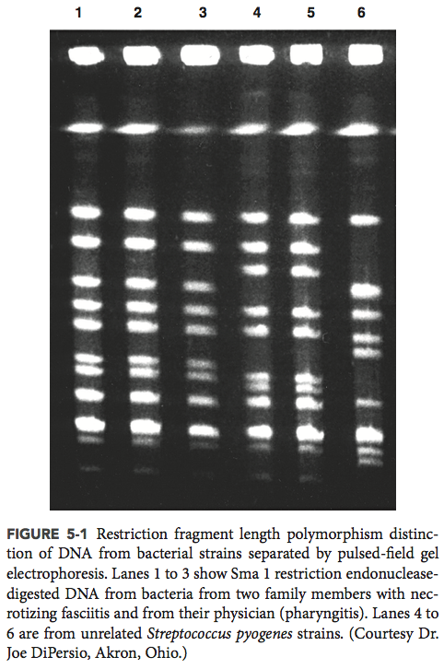
5
MOLECULAR DIAGNOSIS
RFLP can be used to differentiate between bacteria based on their unique DNA sequences

Slide 15
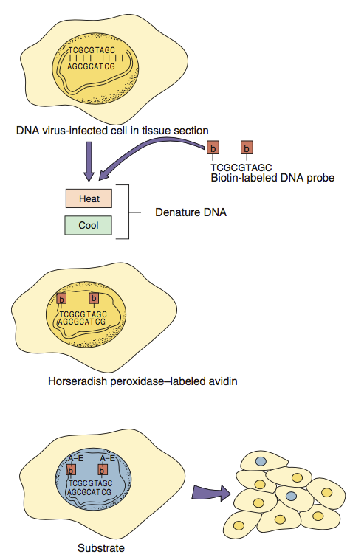
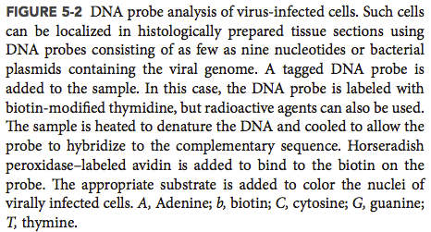
Labeled DNA probes can be used to identify whether biological samples contain DNA from ‘infectious organisms’

Slide 16
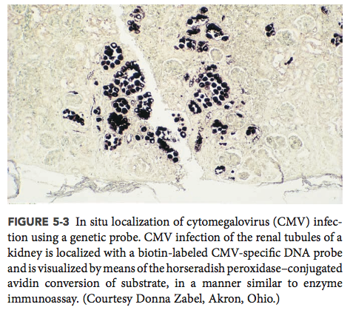

Slide 17
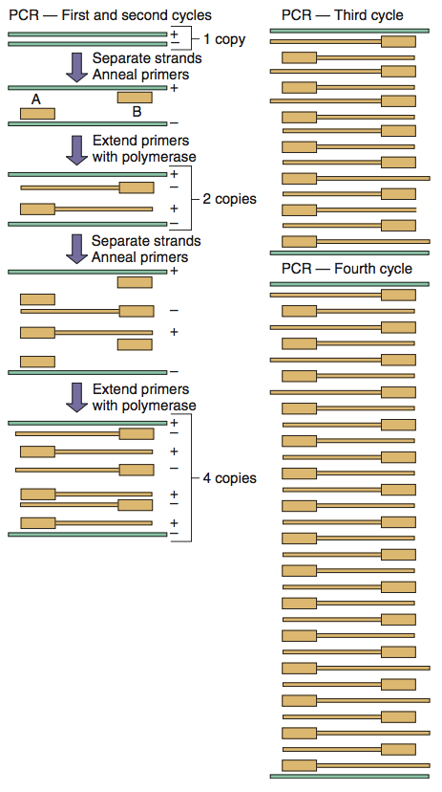
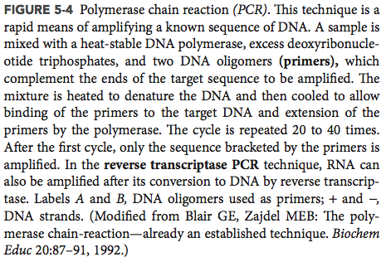
PCR can be used to identify whether biological samples contain DNA from ‘infectious organisms’

Slide 18
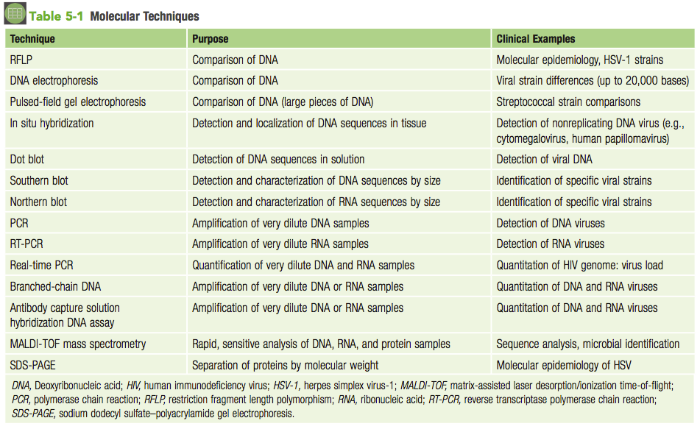

Slide 19
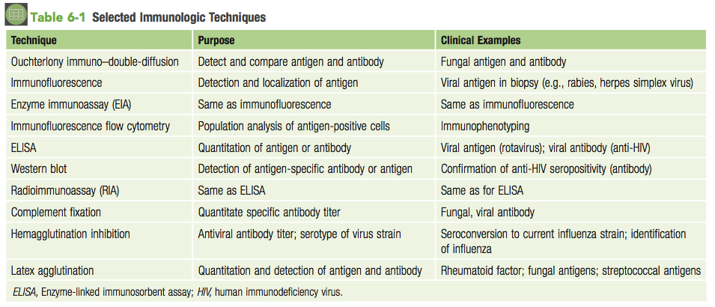
6
SEROLOGIC DIAGNOSIS

Slide 20
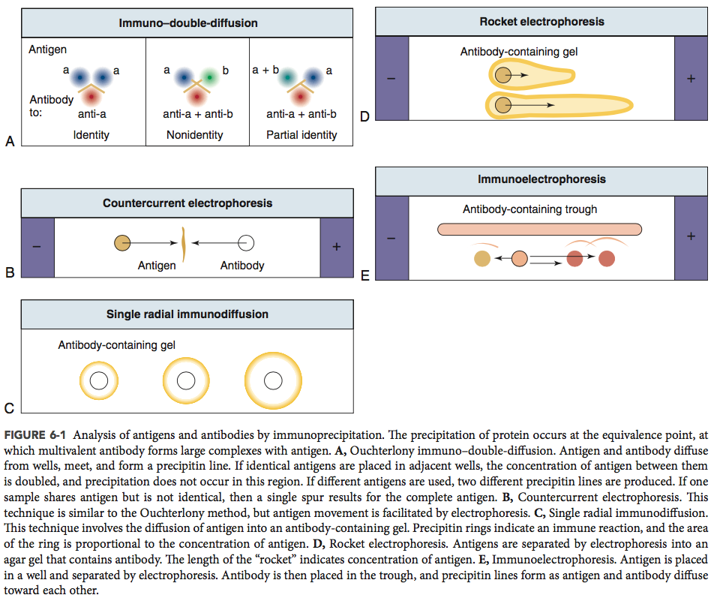

Slide 21
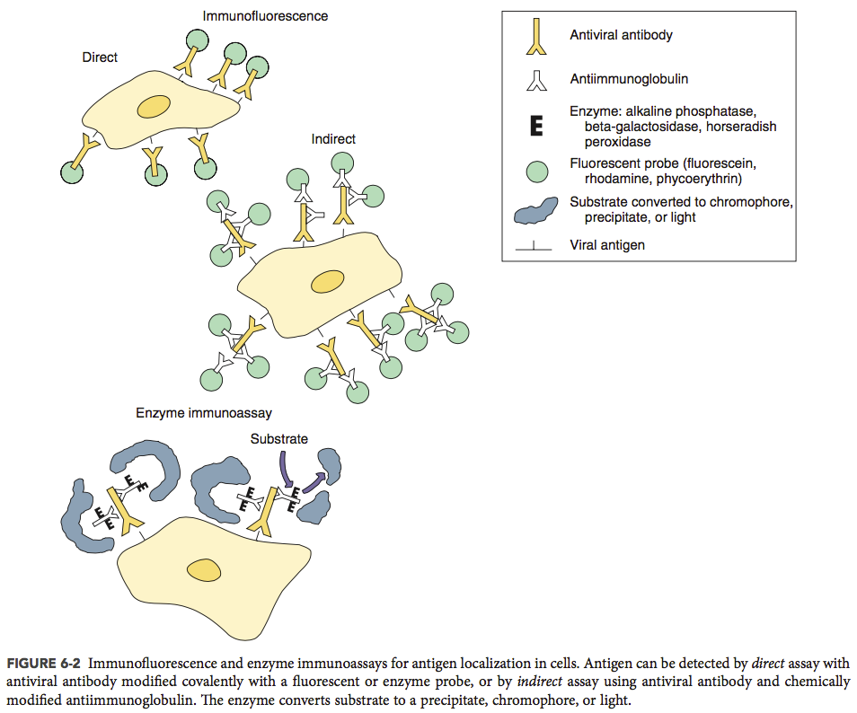
Antibodies can be used to identify the presence of an infectious organism

Slide 22
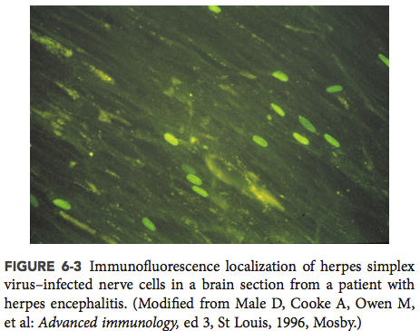
…in a slide preparation

Slide 23
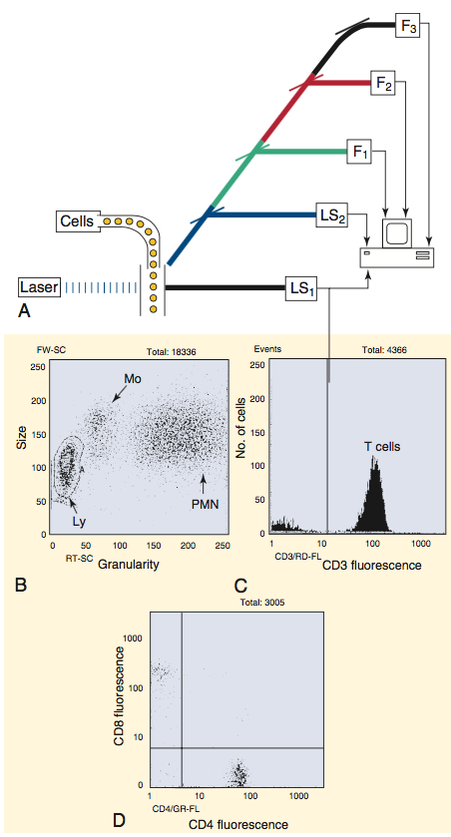
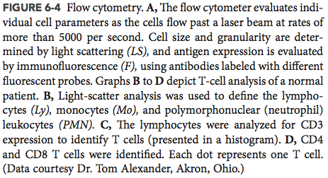
… using flow cytometry

Slide 24
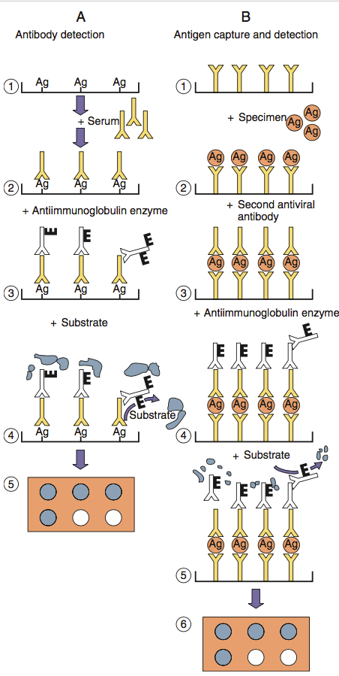
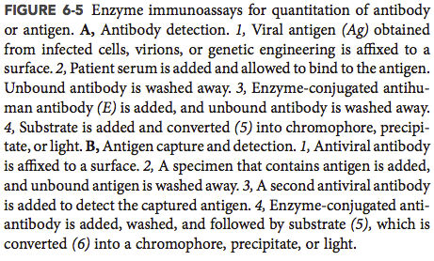
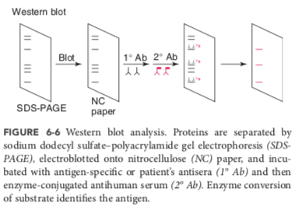
…or by dot blot, western analysis, or ELIZA assays

Slide 25
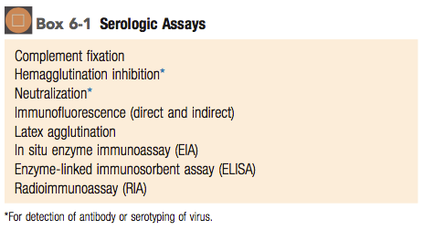

Slide 26
