Slide 1
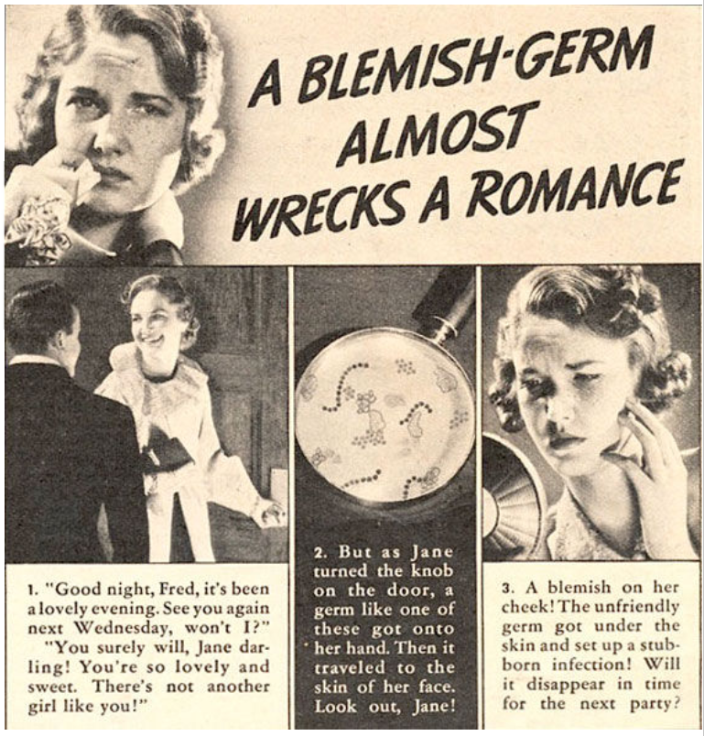
Staphylococcus
Overview,
Structure,
Pathogenesis,
Epidemiology,
Clinical Diseases,
Diagnosis,
Treatment, Prevention, and Control

Slide 2
Terms to know
Pyogenic – production of pus/exudate
Pyrogenic – fever causing
Cytotoxin – something toxic to cells
Virulent – something causing severe disease
Pathogenic – disease causing (can be severe or mild)
Purulent - containing or discharging pus
• Quorum sensing – communication mechanism in bacteria to sense and respond to colony density and changes by regulating certain genes (e.g. they need to behave differently if there are only a few vs. many – don’t waste energy on transcription/translation of useless proteins)
Erythema / erythematous – redness of the skin
Desquamate / desquamation – peeling of the skin

Slide 3
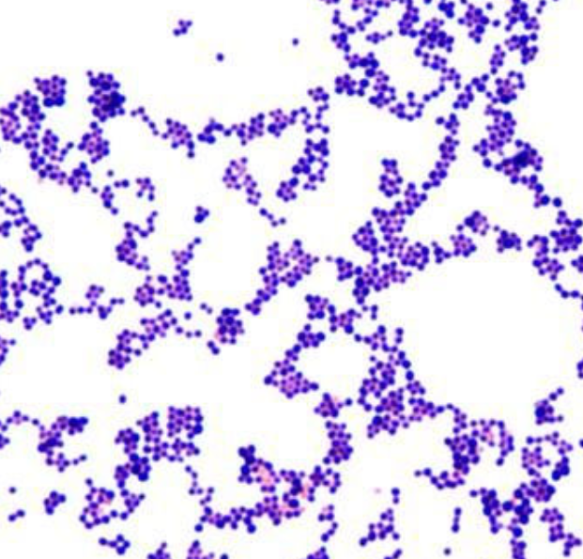
Overview
Genus of Gram-positive cocci bacteria
Arranged in grape-like clusters
Facultative anaerobes
Commonly found on skin and mucous membranes
Includes both harmless commensals and pathogenic species
Most important species: Staphylococcus aureus

Slide 4
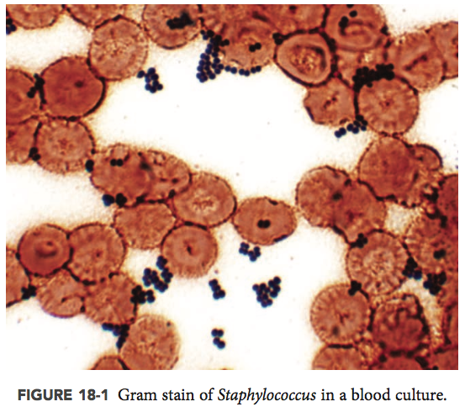
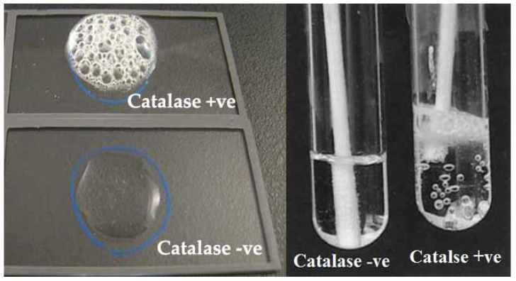
But there’s a lot of gram positive cocci,
so one easy way to differentiate
Staphalococcus from some common others (Streptococcus and Enterococcus) is by a catalase test
Staphalococcus is catylase positive
Streptococcus and Enterococcus is catalase negative

Slide 5
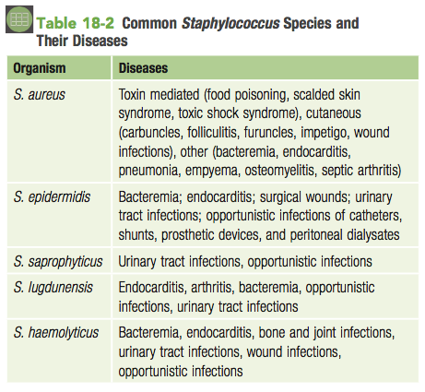
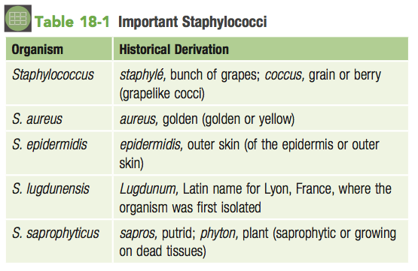
So… if you have a gram positive, catalase positive, cocci,
It still could be any one of over 80 species of Staphalococcus, several of which can cause disease.
(Includes the nasty MRSA)

Slide 6
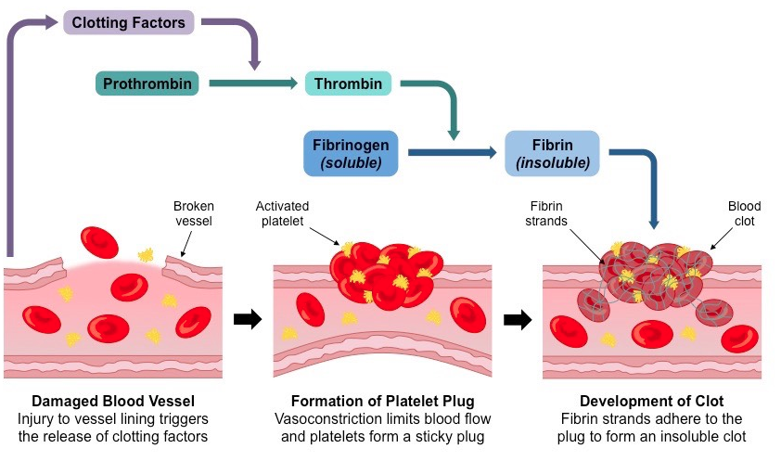
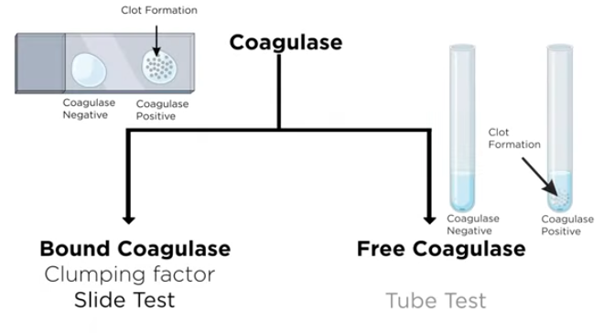
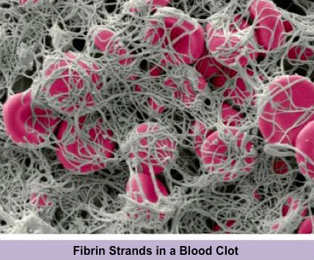
one way to tell if you have Staphalococcus aureus or one of the others is by a coagulase test
S. aureus produces two types of the enzyme coagulase, an enzyme that binds to a serum factor and this complex converts fibrinogen to fibrin, resulting in formation of a clot.
Staphalococcus aureus is coagulase positive.
All the others are coagulase negative

Slide 7
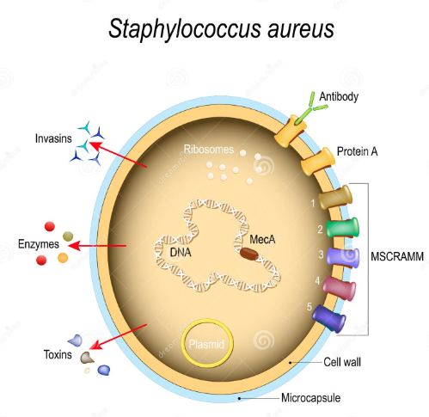
Physiology and Structure
Gram-positive cocci, ~0.5–1.5 µm in diameter
Non-motile, non-spore-forming
Facultative anaerobes

Slide 8
Physiology and Structure
• Most have an outer polysaccharide capsule
• Serotypes 1 and 2 produce thick mucoid colonies, but not usually human disease
• Serotypes 5, 7, and 8 are most often associated with human infections
• Provides protection from human immune system
• Highly organized and thick structure
• Slime layer – another layer of protection and ability to bind to its host, made from monosaccharides and proteins (loosely organized)
• Both of these are often referred to as the glycocalyx

Slide 9
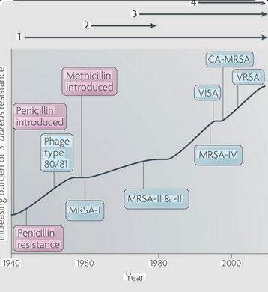
Physiology and Structure
• Remember, Gram positive bacteria have a lot of peptidoglycan (alternating subunits of N- acetylmuramic acid and N-acetylglucosamine)
• The cross linking is done by a group of enzymes called PBPs (penicillin binding proteins)
• In bacteria resistant to Penicilllins, they have a mutated PBP that still functions, but does not bind penicillin (or other β-lactams)
• In S. aureus, this mutated PBP is acquired by either the mecA or mecC gene (protein = PBP2a)

Slide 10
Physiology and Structure
• Staph (and other bacteria) use adhesion proteins to bind to their host tissues or other proteins
• In Staph, they are bound to the peptidoglycan layer and are called MSCRAMM proteins *(microbial surface components recognizing adhesive matrix molecules)
• The coagulase enzyme is within this group (it binds fibrinogen) (coagulase is also called clumping factor)
• There are many others, some unique to Staph, others are not

Slide 11
Pathology
Pathogenic = 1. adhere to host, 2. avoid immune system, 3. destroy tissue or produce toxins (or both)
Quorum sensing – low density = hold on tightly to host until grows/reproduces, then high density = ok, now it’s time to destroy some tissue and cause disease.
Under control by the agr operon

Slide 12
Pathology
Virulence factors include toxins, enzymes, and surface proteins
- Staphalococcus produces a lot of toxins!
Exfoliative toxins – affects the skin, causes
nasty peeling and sloughing
Enterotoxins – food poisoning type illness
TSST-1 – Toxic Shock Syndrome Toxin-1
Protein A binds IgG, inhibiting opsonization
Biofilm formation aids persistence on surfaces and devices
Immunity is incomplete; reinfection is common

Slide 13
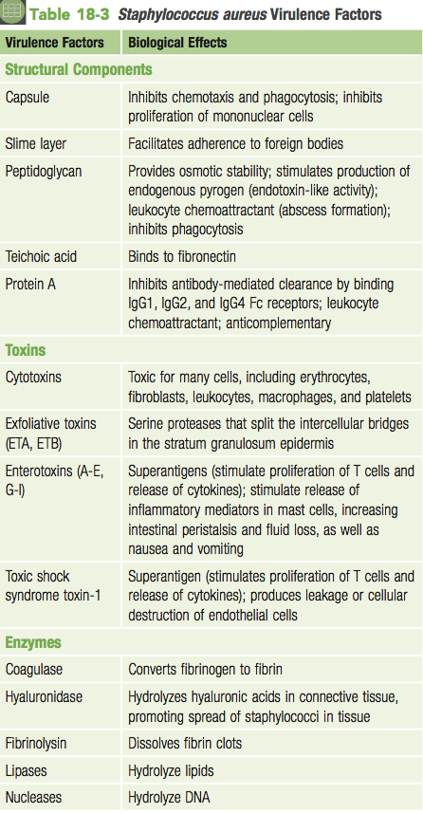
Pathology
defenses against innate immunity
Inhibits opsonization
alpha, beta, delta, gamma, and [P-V] leukocidin
Numerous distinct staphylococcal enterotoxins (A to X). A is most common and heat stable. Can also act as superantigens
Superantigens!

Slide 14
Epidemiology
Staph is everywhere, environment, on skin, mucous membranes, etc.
Coagulase negative staph is common on skin (mostly S. epidermidis) – can cause disease if your’e sick, in the hospital, have an IV, etc.
Anterior nasopharynx often contains S. aureus
People in hospitals (for other reasons) are more likely to manifest disease from Staph – we shed it all the time, but it usually doesn’t cause disease
Called a nosocomial infection (or Healthcare-Acquired Infection - HAI)
Transmission via direct contact or contaminated objects
Healthcare-associated, and now, community-acquired infections occur

Slide 15
Clinical diseases
• Some diseases are due to toxins, others due to
tissue destruction
• Think of Staphalococcus when you see tissue abscesses, cellulitis, boils, wound infections, etc. – soft tissue stuff – it is often S. aureus, but can also be from others.
• However, it also can show up as so many other things, like food poisoning, pneumonia, ear infections, and very specific skin diseases (not just localized infections)

Slide 16
Clinical Diseases
Skin and soft tissue infections (boils, abscesses, impetigo)
Wound and surgical site infections
Pneumonia, especially post-influenza
Bacteremia and endocarditis
Toxin-mediated diseases (toxic shock syndrome, food poisoning)

Slide 17
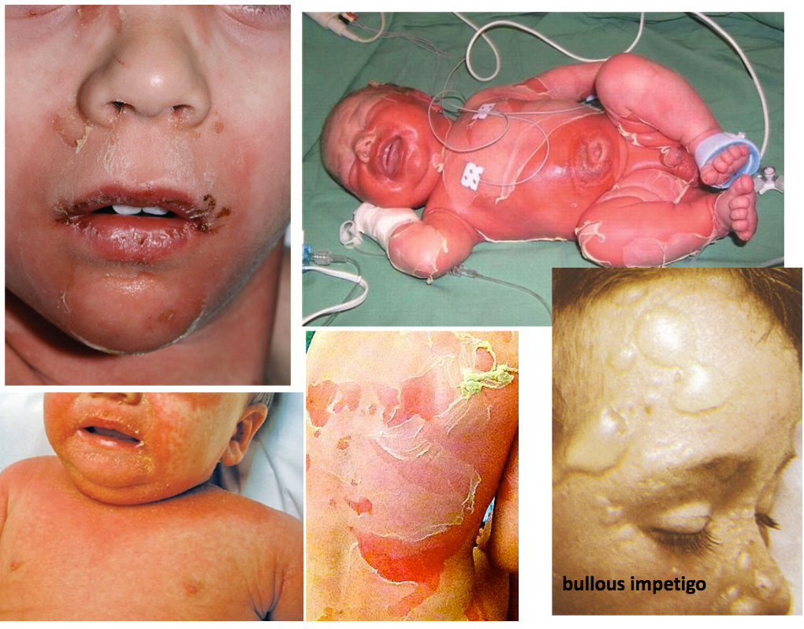
Clinical Diseases
Scalded skin syndrome
Aka Ritter disease
S. aureus creates a localized infection, then produces
exfoliative toxins A and B which causes body-wide problems
• Usually starts with erythema around the mouth and then
spreads
• Causes the middle layers of skin to breakdown and the outer
layer peels off leaving behind moist red patches
• Fluid filled blisters also form (bullae) – no organisms in it,
remember, this is all from the toxin (not the bacteria)
Most common in neonates / babies
Usually full recovery in 1-2 weeks, no scarring, low mortality
Bullous impetigo – localized SSS (blisters in one area)

Slide 18
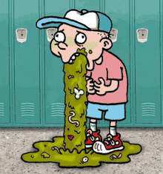
Clinical Diseases
Staphalococcus food poisoning
• Very common cause of food poisoning
• It’s the exotoxin, not the bacteria, in the– takes 3-4hrs to feel it
• The food often gets contaminated by another human
(remember, we shed bacteria and don’t know it)
• Think meats, mayo, and dairy – the food has to sit out for a while at room temp (e.g. eating that potato salad while on a picnic)
• The toxin is head stable, so re-heating doesn’t work and the food tastes fine (you can’t taste the toxin)
• Diarrhea, abdominal pain, puking, but no fever – feel good the next day

Slide 19
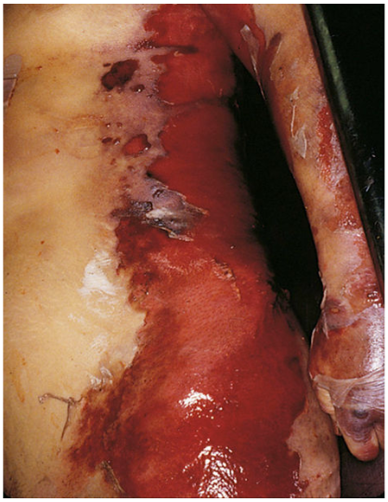
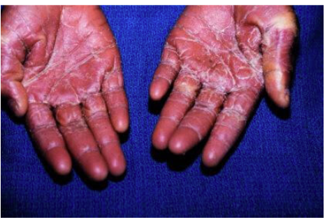
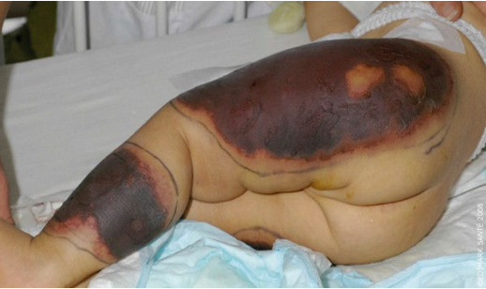
Clinical Diseases
Toxic shock syndrome (TSS)
• Commonly associated with women using “super-absorbent”
tampons
• S. aureus rapidly grows within the tampon and release TSST-1
when it is left in place for too long
• But can also occur within a lesion associated with sutures,
skin infections, vaginal lesions
• symptoms: fever, nausea, vomiting, diarrhea, then a few days later you see an erythematous rash and then the palms and soles of the feet desquamate (peel) and eventually shows signs of septic shock (low blood pressure, confusion, kidneys shut down, chills, breathing problems, etc.)
• purpura fulminans – a severe form of TSS, you see large purpuric (purple) lesions and the skin is basically dying, (This can also occurs in N. gonorrhea infections)
TSS
purpura fulminans

Slide 20
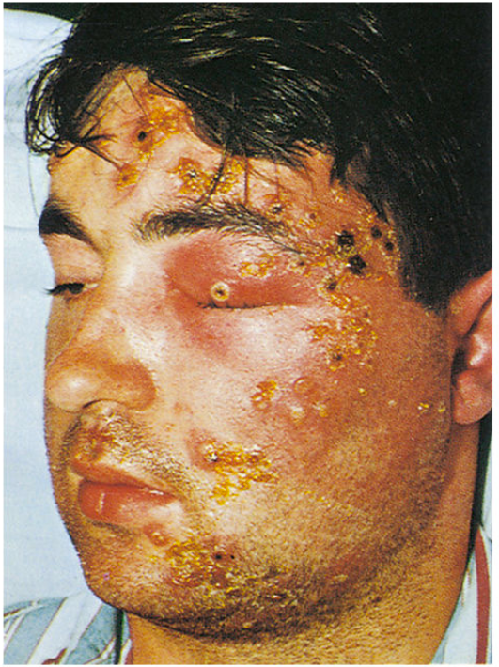
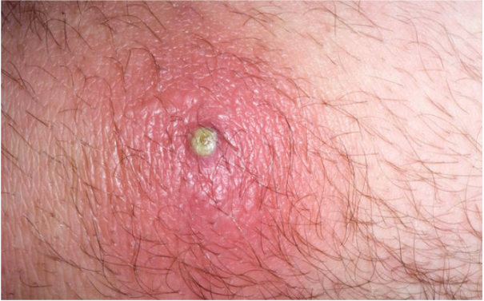
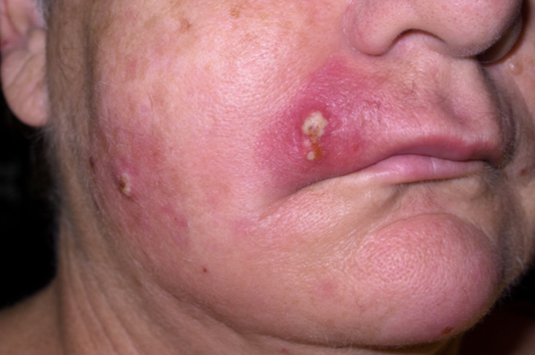
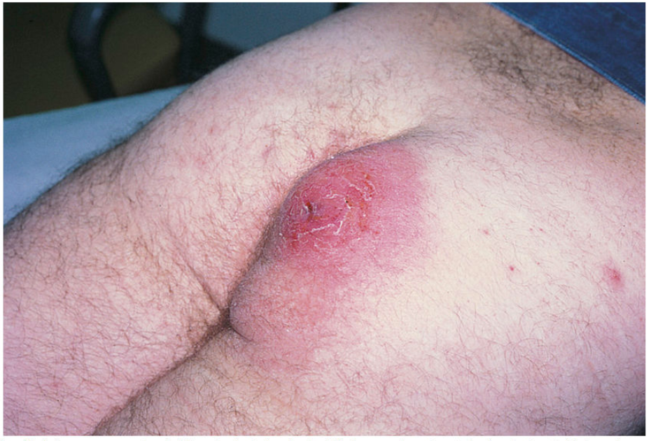
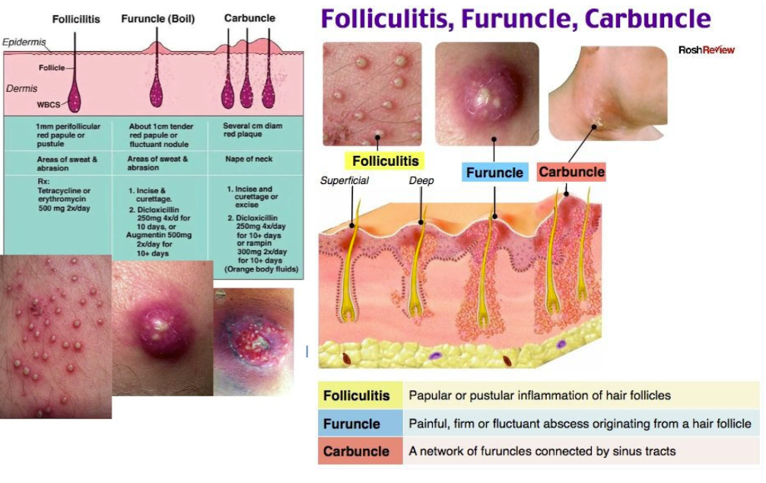
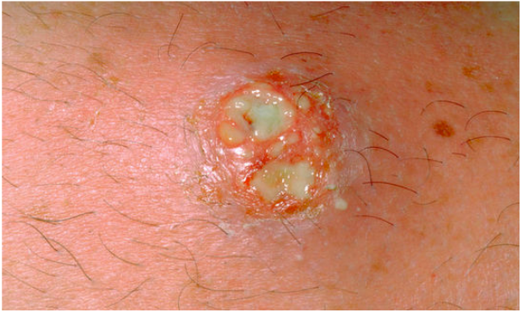
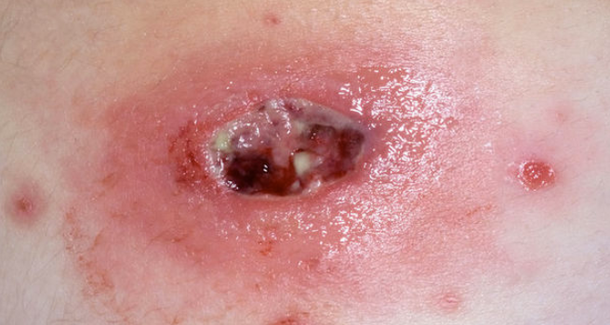
Clinical Diseases
Skin infections
• The most common diseases caused by S. aureus are
localized pyogenic cutaneous infections including
impetigo, folliculitis, furuncles, and carbuncles
• Impetigo - superficial infection that mostly affects
young children, primarily on the face and limbs
• Initially, a small macule (flattened red spot) is seen,
and then a pus-filled vesicle (pustule) on an
erythematous base develops
• Crusting occurs after the pustule ruptures
• Multiple vesicles at different stages of
development are common because of the
secondary spread of the infection to adjacent
skin sites
Pusular impetigo
S. aureus carbuncle

Slide 21
Clinical Diseases
MRSA Skin infections
• Methicillin-resistant Staphylococcus aureus
• Bacteria acquires a mecA (PCB-2a) gene
• Hard to treat due to resistance to many antibiotics
• Often seen as severe skin infections, but can be in the
blood or lungs too
• Vancomycin is the antibiotic of choice, however now
we are seeing vancomycin resistant strains (VRSA)
• They use an acquired gene called vanA, which
changes the PG cell wall from D-ala-D-ala to D-ala-
D-lactate and the Vancomycin can’t bind to it

Slide 22
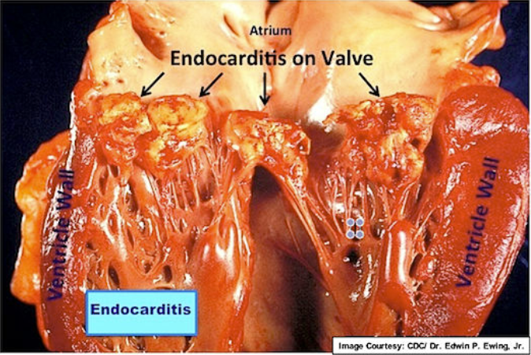
Clinical Diseases
Bacteremia and Endocarditis
• S. aureus commonly causes bacteremia and in 1/3 of cases, you cannot identify a source (like a wound)
• >50% are thought to be nosocomial
• When it spreads to the heart, you can end up with
endocarditis
-Usually, the left side of the heart
-In intravenous drug abusers, it infects the R side
-Infects the heart valves and destroys them
-They cause vegetations (growths) on the valves which
can break off and go to other parts of the body

Slide 23
Clinical Diseases
Bacteremia and Endocarditis
• S. aureus commonly causes bacteremia and in 1/3 of cases, you cannot identify a source (like a wound)
• >50% are thought to be nosocomial
• When it spreads to the heart, you can end up with
endocarditis
-Usually, the left side of the heart
-In intravenous drug abusers, it infects the R side
-Infects the heart valves and destroys them
-They cause vegetations (growths) on the valves which
can break off and go to other parts of the body

Slide 24
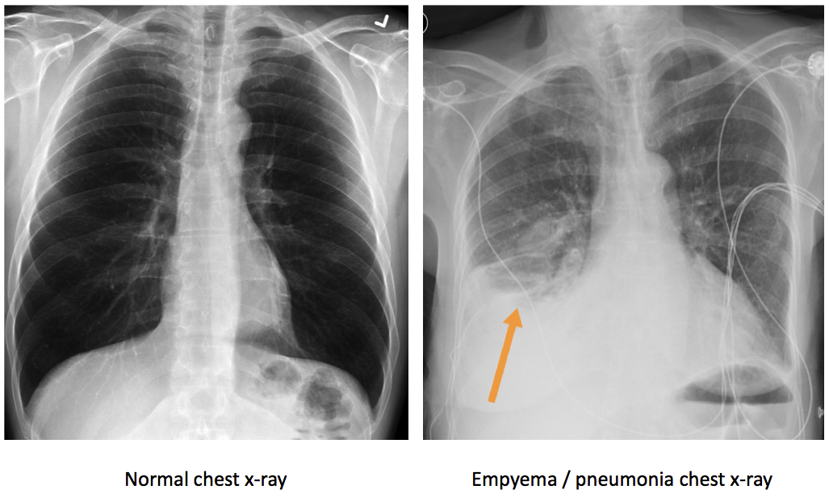
Clinical Diseases
Pneumonia and empyema
• Previous infections with S. aureus such as recurrent skin infections, nasal or skin colonization or underlying pulmonary disease are risk factors for pneumonia
• Aspiration pneumonia – seen when people drink too much, pass out, puke, and aspirate vomit into their lungs, but also in elderly and people with problems swallowing properly
• Can see lung abscesses - empyema

Slide 25
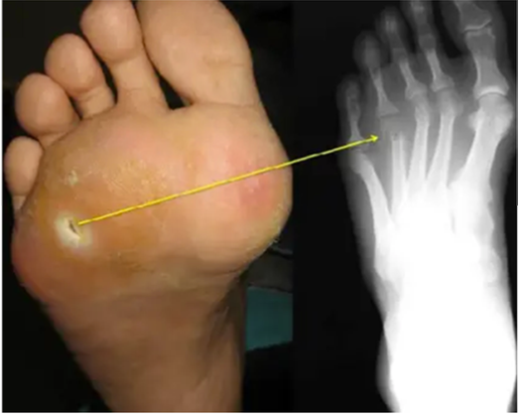
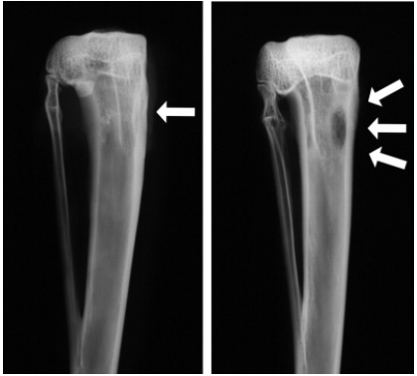
Clinical Diseases
Osteomyelitis and Septic Arthritis
• osteomyelitis results from hematogenous dissemination to
bone or it can be a secondary infection resulting from
trauma or the extension of disease from an adjacent area
• Most commonly in vertebrae (hematogenous spread)
– symptoms: back pain and fever
• Trauma causes osteomyelitis of other bones, like leg/arm and
you can see purulent drainage
• Septic arthritis – when the bacteria colonizes a joint,
commonly seen if getting injections into joints or if joints
are damaged, etc.

Slide 26
Clinical Diseases
The other Staph
• S. epidermidis, S. lugdunensis, and related coagulase- negative staphylococci can infect prosthetics and natural (native) heart valves
• S. lugdunensis – staph species most commonly associated with native valve endocarditis, although this disease is more commonly caused by streptococci and, less commonly, native heart valves
• S. epidermidis – on your skin right now and can become a problem if sick in the hospital with urine catheter or IV (moves along the tubing) (nosocomial) and forms biofilms for protection
• S. saprophyticus – 2nd most common cause of urinary tract infections UTIs in young women (E. coli is 1st)

Slide 28
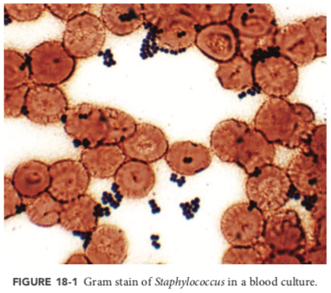
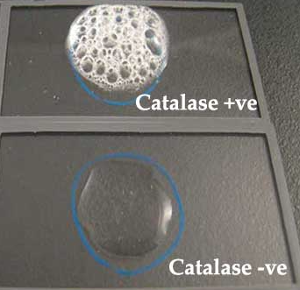
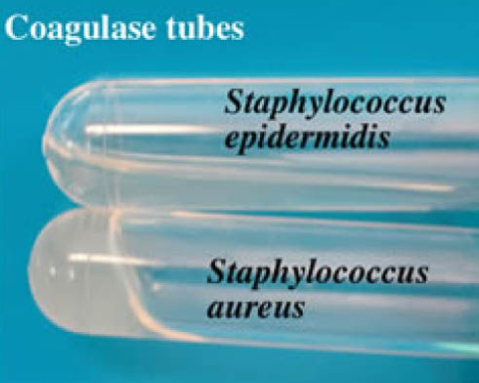
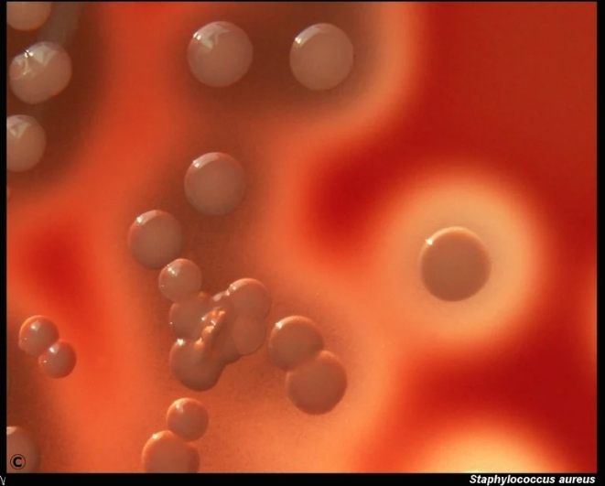
Laboratory Diagnosis
Gram stain shows Gram-positive cocci in clusters
Catalase-positive distinguishes from Streptococci
Coagulase test identifies Staphylococcus aureus
Culture on blood agar for characteristic colonies
Molecular tests used for rapid identification and resistance detection
Staphylococcus aureus is hemolytic

Slide 29
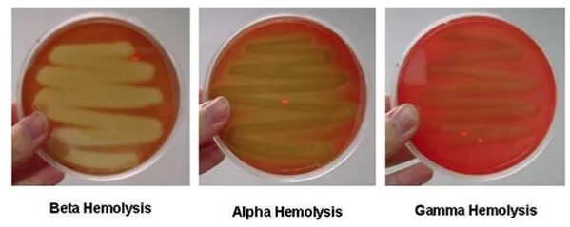
Hemolysis on blood agar plates
Beta-hemolysis (β-hemolysis) is associated with complete lysis of red cells surrounding the colony. Beta hemolysis is caused by two hemolysins O and S; the former is inactive in the presence of oxygen. Thus, stabbing of the plate increases the intensity of the hemolysis reaction. S is an oxygen-stable cytotoxin.
Alpha-hemolysis (α-hemolysis) is a partial or “green” hemolysis associated with reduction of red cell hemoglobin. Alpha hemolysis is caused by hydrogen peroxide produced by the bacterium, oxidizing hemoglobin to green methemoglobin.
It exhibit incomplete haemolysis with 1-2 mm wide. Persistence of some unhaemolysed RBC’s can be seen microscopically.
Gamma-hemolysis (γ-hemolysis) Colonies show neither typical alpha nor beta haemolysis. There may be, however, slight discoloration in the medium. The streptococci included in this group are usually not pathogenic.
Streptococcus agalactiae,
Clostridium perfringens,
Listeria monocytogenes
Streptococcus pneumoniae
Enterococcus faecalis

Slide 30
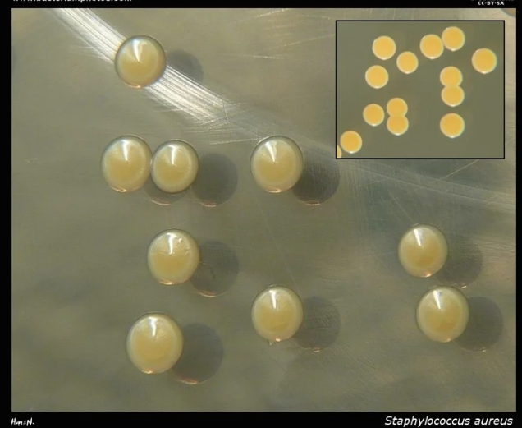
How to ID Staphalococcus aurius on plates
Plated on Trrypic soy agar.
*showing ‘Golden’ 2–3 mm in diameter, with a smooth, shiny surface , big fat colonies
Plated on Blood agar.
*Hemolytic
Plate on Mannitol Salt Agar.
*Test: a lot of other bacteria cant grow on high salt
Staphylococcus aureus can grow in 10% salt!
Deli meat!

Slide 31
Treatment, Prevention, and Control
• Most are Penicillin resistant these days, but other beta-lactams still work as well as some cephalosporins
• Antibiotics commonly prescribed to treat staph infections include cefazolin, nafcillin, oxacillin, daptomycin and linezolid
• Serious infections are treated with vancomycin
• MRSA (nosocomial) – vancomycin
• MRSA acquired outside of a health care facility - usually susceptible to other antibiotics, such as trimethoprim/ sulfamethoxazole (Bactrim), clindamycin, minocycline, or doxycycline
Proper wound care and hygiene reduce infection risk
Hand hygiene and infection control in healthcare settings
Screening and decolonization in high-risk areas/populations

