Slide 1
14
MECHANISMS OF BACTERIAL PATHOGENESIS
Assessing the Degree of Disease
Entry
Colonization, Adhesion, Invasion
Pathogenic Actions
Tissue destruction
Toxins
Exotoxins
Endotoxins, cell wall components
Immunopathogenesis
Escaping the host

Slide 2
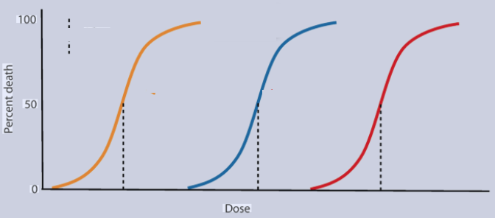
Factors Affecting the Degree of Disease
1) Importance of organ(s) affected
Heart worms vs intestinal worms
2) Strain and inoculum size
100
50
0
Shigella (ID₅₀ is in the 100s)
Salmonella (ID₅₀ is in the 1,000,000s)
Percent with Disease
3) Host Condition
Normal Host
Salmonella (ID₅₀ is in the 1,000,000s)
Host eating antacids
Salmonella (ID₅₀ is in the 100s)
10⁰ 10¹ 10² 10³ 10⁴ 10⁵ 10⁶ 10⁷
Number of organisms

Slide 3
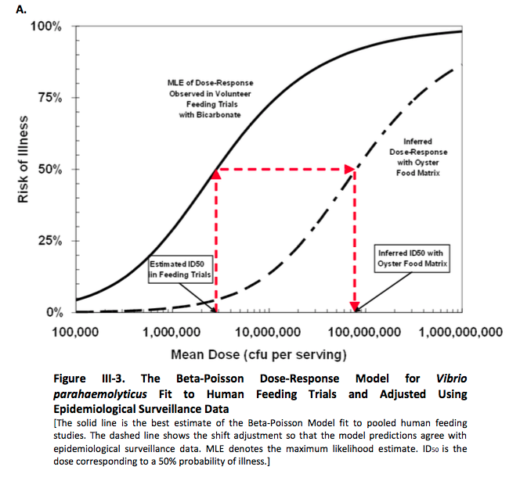
Factors Affecting the Degree of Disease
ID₅₀ :
infectious dose. Number of organisms required to cause disease in half the hosts.
LD₅₀ :
lethal dose. Number of organisms required to kill half the hosts.

Slide 4
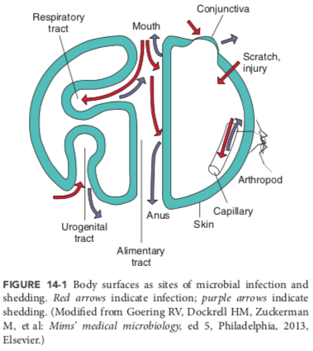
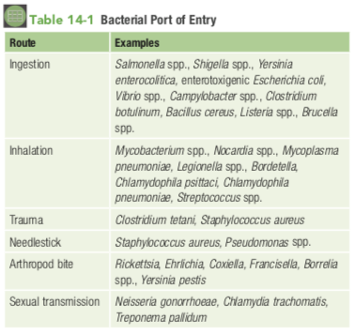
Entry

Slide 5
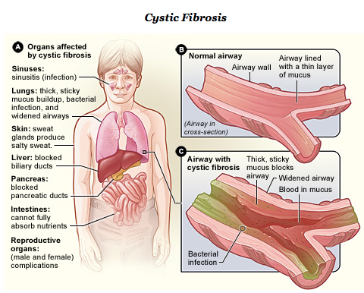
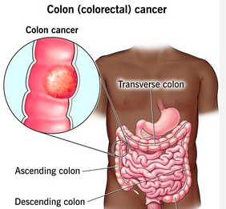
Colonization, Adhesion, Invasion
Colonization of a normally sterile site can sometimes be indicative of a ‘defect’ of the hosts barriers.
Cysticfibrosis>
reduced ciliary mucoepithelial function >
S. aureus and P. aeruginosa colonize lungs
Colon cancer is sometimes discovered because the patient presents as bacteremia (blood infection)

Slide 6
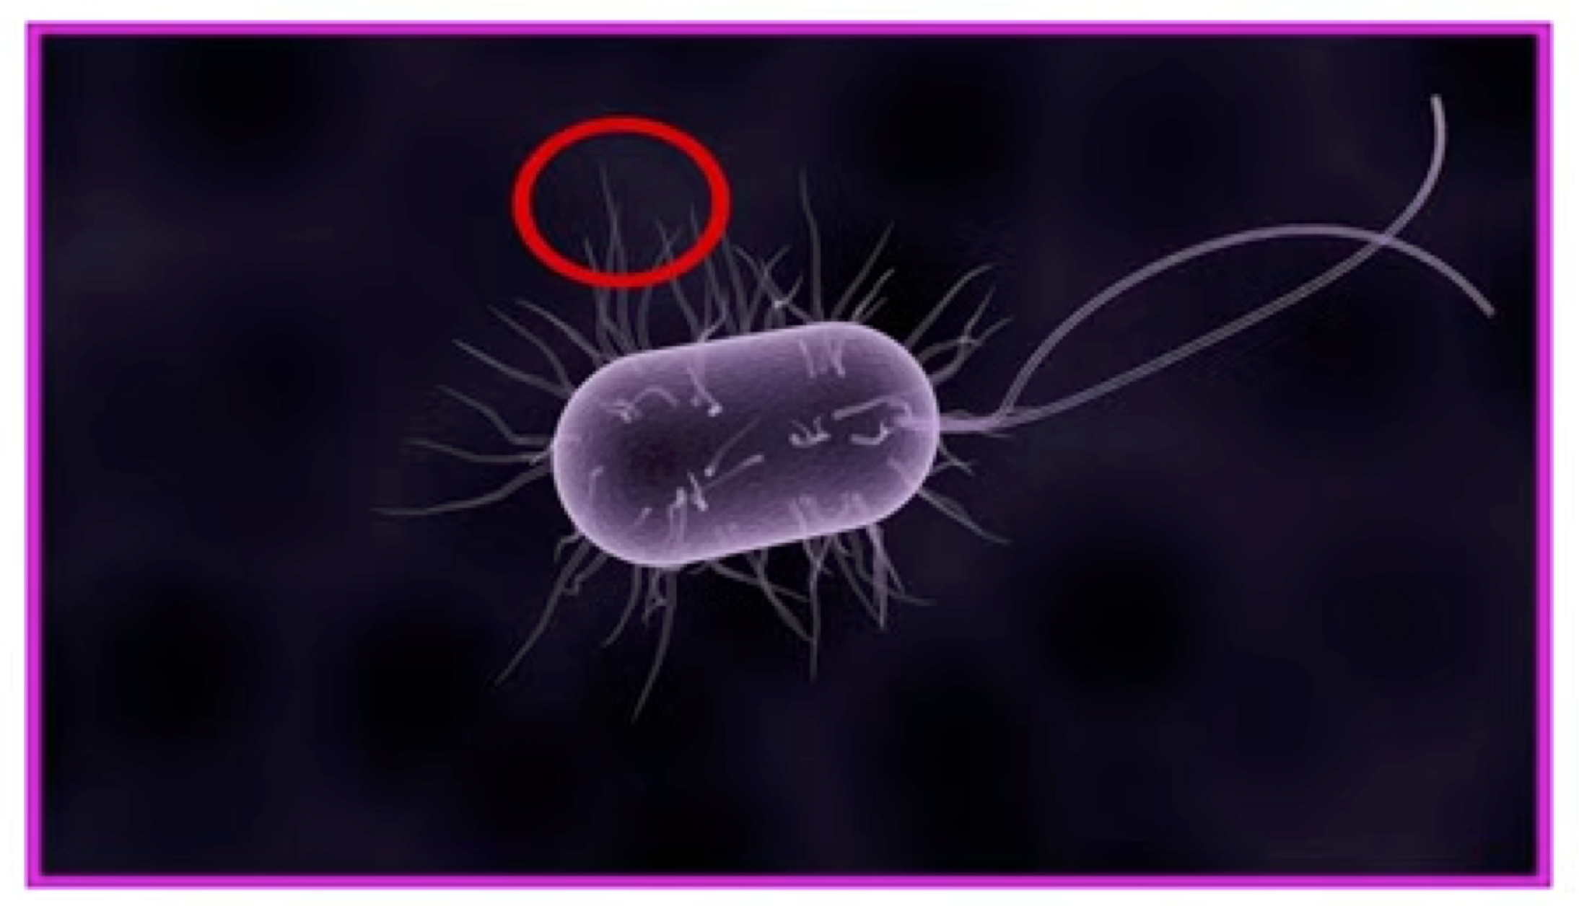
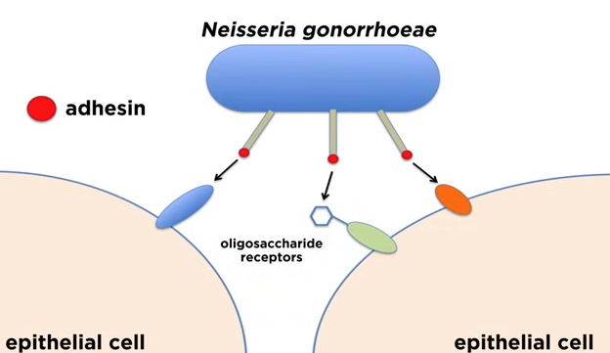
Colonization, Adhesion, Invasion
In other cases, bacteria promote their own colonization through attachment mechanisms to prevent flushing or washing away
Bacteria often have adhesins that bind to host epithelial cell membrane components which can be found on the tips of their pili or fibrae

Slide 7
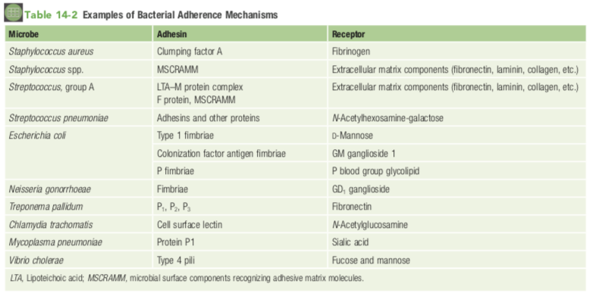
MSCRAMMs (microbial surface components recognizing adhesive matrix molecules).

Slide 8
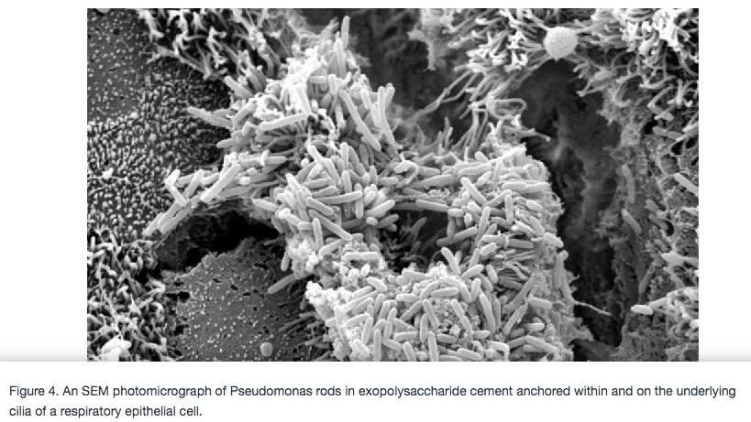
Colonization, Adhesion, Invasion
In still other cases, bacteria promote colonization by forming biofilms, which also attach and form structures resistant to flushing or washing away
Pseudomonas biofilms are triggered through quorum sensing and contain sticky polysaccharides that adhere to the epithelial cell walls.

Slide 9
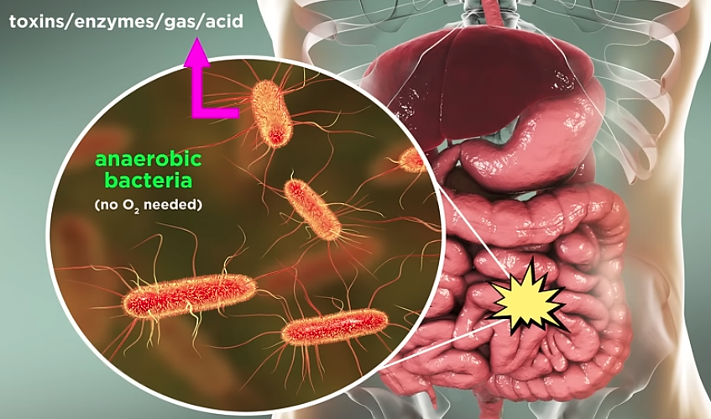
Pathogenic Actions
Tissue destruction
Toxins
Exotoxins
Endotoxins, cell wall components
Clostridium perfringens, normally present in GI, but can establish infection in oxygen-depleted tissues as an opportunistic pathogen to cause gas gangrene.
Produces enzymes (e.g., phospholipase C, collagenase, protease, hyaluronidase), several toxins, and acid-gas

Slide 10
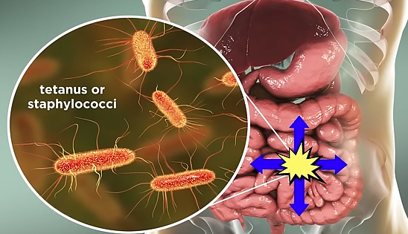
Pathogenic Actions
Tissue destruction
Toxins
Exotoxins
Endotoxins, cell wall components
Toxins can be
degradative enzymes that cause cell lysis either directly
or
specific receptor-binding proteins that initiate toxic reactions indirectly in a specific target tissue
Toxin can be the disease.
Toxins produced by the bacteria while growing on food
S. aureus food poisoning
Bacillus cereus food poisoning
Clostridium botulinum botulism
Typically symptom onset in these cases is faster because bacteria do not need to grow, you’re just ingesting toxin.
The toxin’s affect can be local
Or distant if it travels through the bloodstream

Slide 11
Pathogenic Actions
Tissue destruction
Toxins
Exotoxins
Endotoxins, cell wall components
Exotoxins
• Found in both Gram + and Gram - bacteria
• Most of the major Gram + organisms release exotoxins
• These cause things like anthrax, botulism, tetanus, cholera.
They can be neurotoxins – causes paralysis
They can be enterotoxins – causes diarrhea
• Infectious diarrhea – bacteria bind and continuously release their enterotoxin
• Food poisoning – bacteria grow in the food and release the enterotoxin in the food, then you eat the toxin
• Pyrogenic exotoxins – causes the release of cytokines and can cause rash, fever, and toxic shock syndrome (TSS)
• Tissue invasive exotoxins – destroys skin / tissues
• Other less common miscellaneous exotoxins can do various things and are organism specific

Slide 12
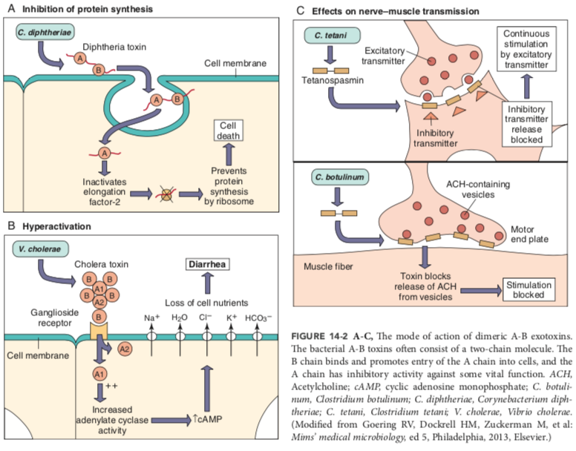
Pathogenic Actions
Tissue destruction
Toxins
Exotoxins
Endotoxins,
cell wall components
• Many exotoxins are dimeric with A and B subunits.
• B = binds, then A enters the cell and causes injury
• targets of A-B toxins include ribosomes, transport mechanisms, and intracellular signaling (cyclic adenosine monophosphate [cAMP] production, G-protein function), with effects ranging from diarrhea to loss of neuronal function to death

Slide 13
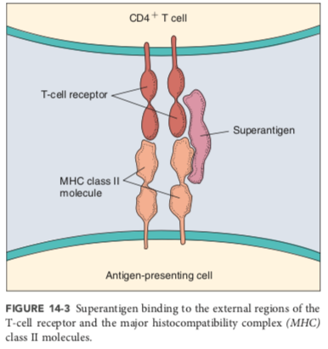
Pathogenic Actions
Tissue destruction
Toxins
Exotoxins
Endotoxins,
cell wall components
Superantigens
Activate T cells by binding simultaneously to a T-cell receptor and a major histocompatibility complex class II (MHC II) on an antigen-presenting cell without requiring antigen.
Thus, superantigens activate large numbers of T cells to release large amounts of interleukins (including IL-1, IL-2, IL-6), TNF-α, IFN-γ, and various chemokines. (A cytokine storm)
Can results in life-threatening fever, shock, rash, and autoimmune-like responses.
.

Slide 14
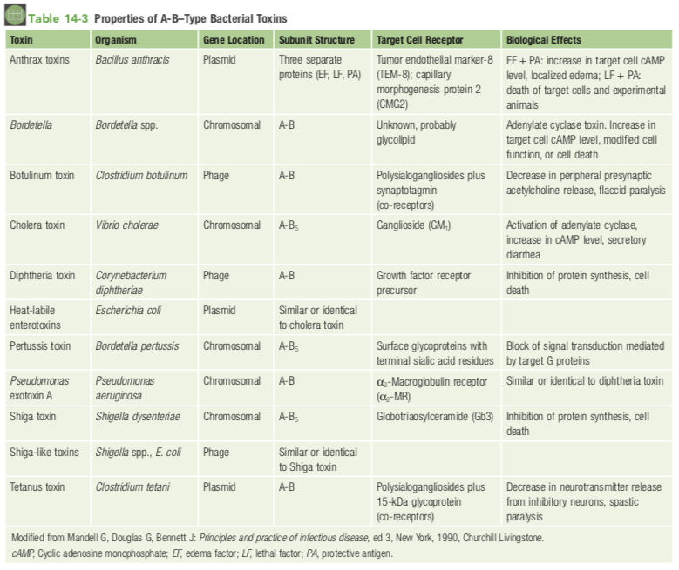

Slide 15
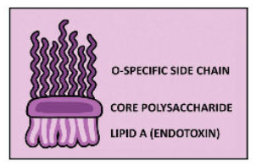
Endotoxins
• This is the lipid A portion of LPS (lipopolysaccharide) - we talked about it previously when we discussed the Gram neg outer membrane
• So, it’s only found in Gram negative bacteria
• Released during infection when inside the body
• One of the reasons why some infections (like meningitis from N. meningitidis) is so deadly
Lipopolysaccharide

Slide 16
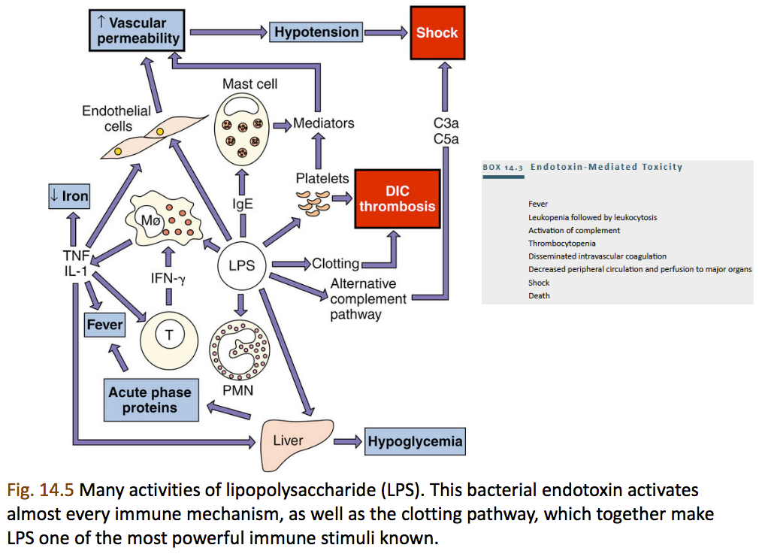

Slide 17
Immunopathogenesis
Septic Shock
• Septic shock – can be due to G + or G – bacteria • No. 1 cause of death in the ICU
• Bacteremia – bacteria in the blood (has spread from its localized infection site)
• Sepsis – when bacteremia is causing your immune response to react (you feel very sick)
• Septic shock – severe sepsis, causes low blood pressure and organ failure
• Your body responds by releasing endogenous mediators of sepsis (like tumor necrosis factor, TNF, and others).

Slide 18
Escaping the host
Some Bacterial Defenses
• Capsule – on some Gram+ and Gram– organisms • Carbohydrate rich layer that’s gelatinous (slime)
• Coats the outer membrane and protects the bacteria
• Macrophages cannot engulf them
• Biofilms – similar to a capsule, a slimy protective barrier
• Often found when bacteria infect devices in the body (heart valves, catheters, etc.)
• Protection from antibiotics
• Facultative intracellular organisms –
• macrophage engulfs them but they remain alive

Slide 19
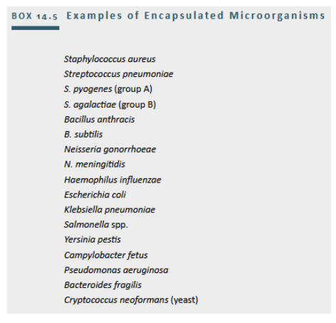
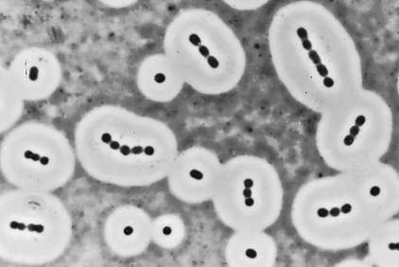
Capsules

Slide 20
Biofilms

Slide 21
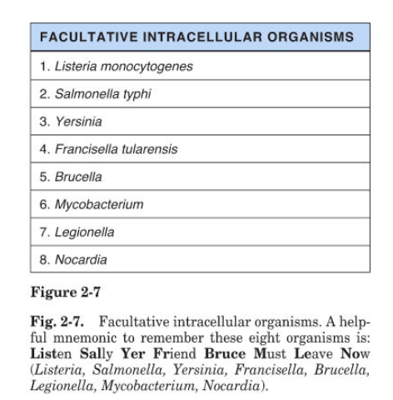
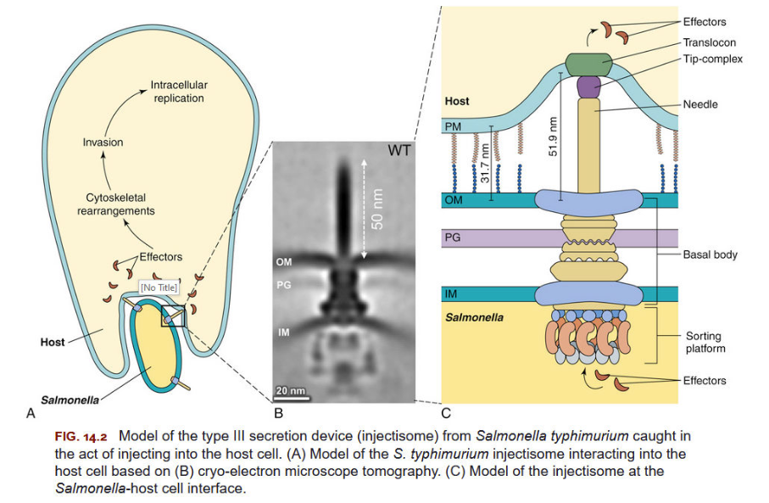
Facultative intracellular organisms

Slide 22
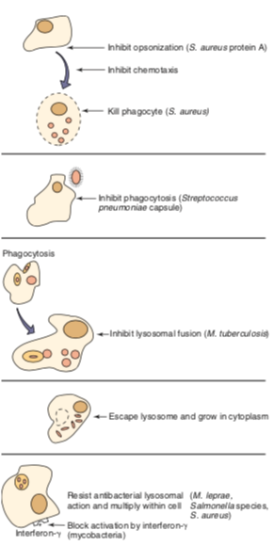


Slide 23
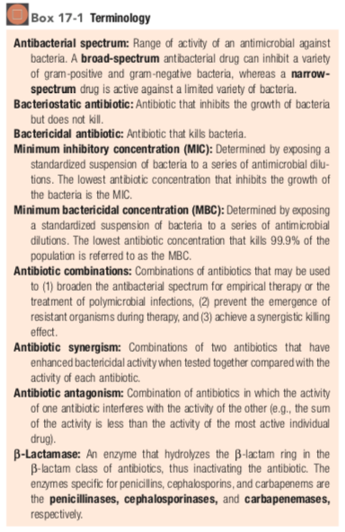
17
ANTIBACTERIAL AGENTS
Inhibition of cell wall synthesis
beta-lactams
penicillins
cephalosporins, cephamycins
carbapenams, monobactams
glycopeptides
lipopeptides
polypeptides
Inhibition of protein synthesis
Inhibition of DNA synthesis
Inhibition of RNA synthesis and other targets

Slide 24
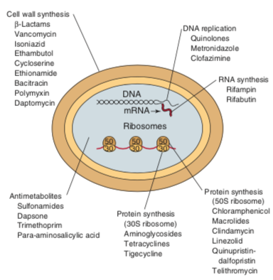

Slide 25
Inhibitors of cell wall synthesis
β-lactams
• Most common MOA (mechanism of action) for antibiotics and the most prescribed
• β-lactams – have a common 3-carbon and 1-nitrogen ring (beta lactam ring) that is highly reactive
• PCN (penicillins) – (most end with –cillin), has the lactam ring plus a thiazolidine ring
• Cephalosporins – lactam ring plus aminocephalosporanic acid ring; this group is divided into 5 generations
• Carbapenems – similar to PCN but the S is replaced with a C
• Monobactams – just the lactam ring
• Beta-lactamase inhibitors – they inhibit beta-lactamases (which bacteria can produce to break down the lactam ring)

Slide 26
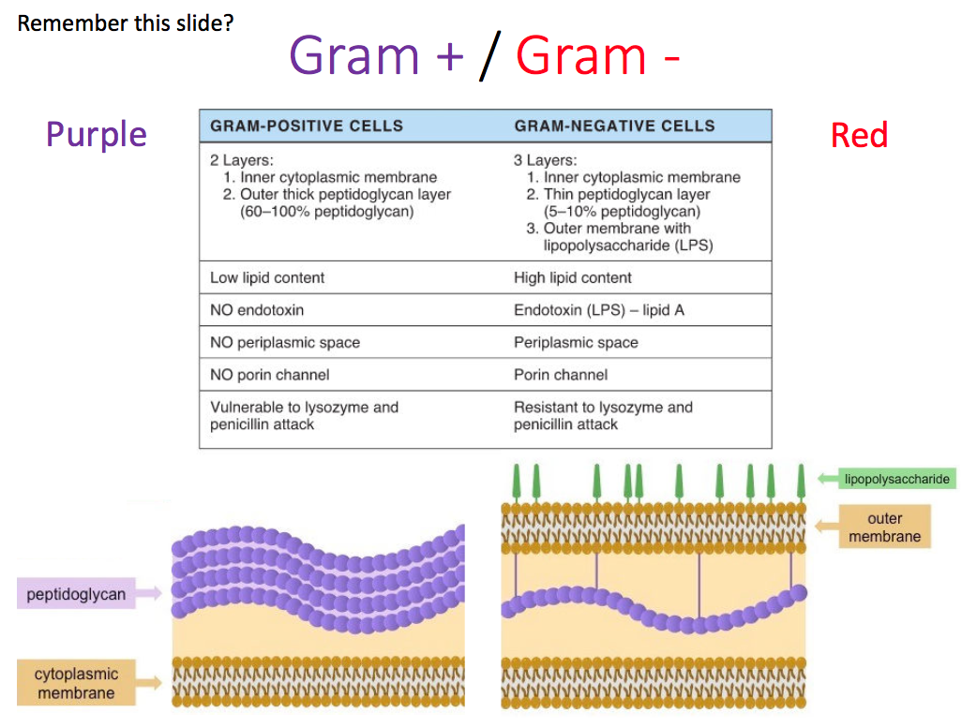
Inhibitors of cell wall synthesis
β-lactams
• The peptidoglycan (PG) component of the cell wall is important!
• It consists of alternating N-acetylglucosamine and N- acetylmuramic acid (these are monosaccharides)
Multiple enzymes build the peptidoglycan layer, including transpeptidases, transglycosylases, carboxypeptidases that belong to a large family of serine proteases and classified as PBPs (penicillin binding proteins).
• The various β-lactams can bind to specific penicillin binding proteins and inhibit peptidoglycan synthesis
• So, these are bactericidal (they kill) as opposed to bacteriostatic (suppress growth)
• Best against Gram + (like Staph and Strep) but still works on some Gram-
• The Gram – bacteria have outer cell membrane which helps prevent the penicillin from reaching the peptidoglycan layer.

Slide 27
Inhibitors of cell wall synthesis
β-lactams
Penicillins
Obtained from the mold Penicillium chrysogenum
Different types, like PCN G (IV or IM in the butt)
• A common combo antibiotic is Augmentin, which combines a β-lactam with a β-lactamase inhibitor (amoxicillin and clavulanate) – more powerful and overcomes some resistance

Slide 28
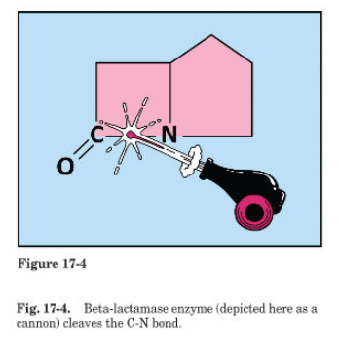
Inhibitors of cell wall synthesis
1) decreased concentration of the antibiotic at the cell wall target site.
*this happens only in gram negative bacteria. Mutations in the porins exclude the antibiotic. Or active efflux or pumping out of the antibiotic.
β-lactams
2) decreased binding of the antibiotic to the Penicillin Binding Protein.
Mutation in Penicillin Binding Protein or altered regulation of it. Or horizontal tranfer of a different Penicillin Binding Protein
Resistance !
3) hydrolysis of the antibiotic by bacterial enzymes - β- lactamases.
Bacteria can produce β-lactamases that inactivate the β- lactam antibiotics. More than 200 different β-lactamases have been described. Some are specific for penicillins (i.e., penicillinases), cephalosporins (i.e., cephalosporinases), or carbapenems (i.e., carbapenemases), whereas others have a broad range of activity, including some that are capable of inactivating most β-lactam antibiotics.

Slide 29
Inhibitors of cell wall synthesis
β-lactams
Cephalosporins and Cephamycins
• The cephalosporins are β-lactam antibiotics derived from the mold Cephalosporium.
• Same mechanism of action as penicillins but are effective against (more Gram - bacteria) and are more resistant to β-lactamases.
• General rule, the higher the generation, the more it shifts towards Gram- coverage and less of the Gram+ coverage (1-5 generations), some examples of names:
• 1- cefazolin, cephalexin – skin infections, ear infections, etc.
• 2 - cefuroxime – similar to 1st, plus some respiratory stuff • 3- ceftriaxone – penetrates the blood brain barrier for meningitis, Neisseria too
• 4- cefepime – covers more Gram negatives, but often not used first
• 5 - ceftaroline – used against MRSA
• They have “cef” in their names
• 1st gen have “ph”, other gens are “f”
• Third-generation cephalosporins (e.g., ceftriaxone and cefixime) have lower cross-reactivity with IgE- mediated penicillin-allergic patients (<1%) compared with first- and second-generation cephalosporins (range: 1%–8%) (ref. CDC)

Slide 30
Inhibitors of cell wall synthesis
β-lactams
Carbapenems and Monobactams
• The carbapenems are widely prescribed broad- spectrum antibiotics that are active against many groups of organisms
• the monobactams are narrow-spectrum antibiotics that are active only against aerobic, gram-negative bacteria (sometimes a good thing. Targeted. May be less disruptive to normal flora)

Slide 31
Inhibitors of cell wall synthesis
Glycopeptides
• Vancomycin is a glycopeptide obtained from Streptomyces orientalis
• Works against Gram + but never good for Gram – (too large to squeeze through outer membrane pores)
• disrupts Peptidoglycan synthesis by interacting with the d-alanine-d-alanine termini of the pentapeptide side chains, to prevent bridge formation.
• Good for infections with resistance to other β-lactams
• The genes for this resistance (vanA and vanB) can be carried on plasmids or transposons.
• Bacteria with other amino acid termini (not d-alanine-d-alanine) are naturally resistant (Enterococcus gallinarum, E. casseliflavus, E. faecium and E. faecalis).
• *super resistant strains of Staphylococcus arose/currently restricted to Michigan; worry is the spread.

Slide 32
Inhibitors of cell wall synthesis
Lipopeptides
• Daptomycin, a naturally occurring cyclic lipopeptide from Streptomyces roseosporus,
• binds irreversibly to the cytoplasmic membrane, resulting in membrane depolariza-tion and disruption of the ionic gradients, leading to cell death.
• potent against gram-positives, but gram-negatives are resistant because it cannot penetrate to the cytoplasmic membrane.
• good against multidrug-resistant staphylococci, streptococci, and enterococci (including vancomycin-resistant strains).

Slide 33
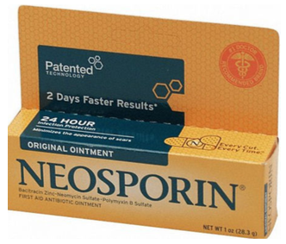
Inhibitors of cell wall synthesis
Polypeptides
• Bacitracin isolated from Bacillus licheniformis,
• a mixture of polypeptides used in topically applied products (e.g., creams, ointments, sprays) for the treatment of skin infections caused by Gram + (especially those caused by Staphalococci and Streptococci)
• Gram negatives are resistant

Slide 34
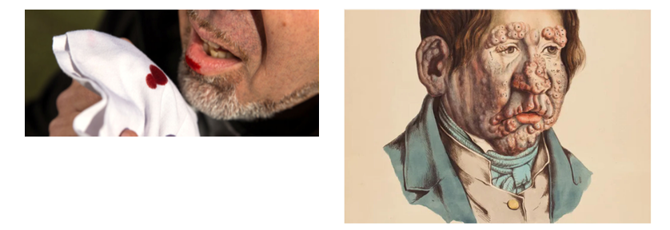
Inhibitors of cell wall synthesis
Others
• Isoniazid, ethionamide, ethambutol, and cycloserine are antibiotics used for the treatment of mycobacterial infections (like TB and leprosy)
• mechanism not completely understood for all of these, but it interferes or blocks the synthesis of mycolic acid or arabinogalactan

Slide 35
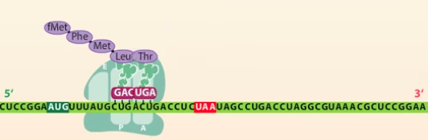
Inhibitors of protein synthesis
Aminoglycosides
• Streptomycin, neomycin, kanamycin, amikacin, and tobramycin were originally isolated from Streptomyces species.
• Gentamicin from Micromonospora species.
• They pass through the bacterial outer membrane (in Gram negative), cell wall, and cytoplasmic membrane to the cytoplasm, where they inhibit bacterial protein synthesis by irreversibly binding to the 30S ribosome
• Mostly for Gram negative but also works on some Gram positive
X

Slide 36
Inhibitors of protein synthesis
Aminoglycosides
Resistance!
Toxicity!
• Resistance to the antibacterial action of aminoglycosides can develop in one of four ways:
(1) mutation of the ribosomal binding site (2) decreased uptake of the antibiotic into the bacterial cell
(3) increased expulsion of the antibiotic from the cell (4) enzymatic modification of the antibiotic
• Toxicity Oto and renal (hearing loss, kidney damage)

Slide 37
Inhibitors of protein synthesis
Tetracyclines
• Broad spectrum, includes tetracycline, doxycycline, minocycline
• Inhibits protein synthesis in bacteria by binding reversibly to the 30S ribosomal subunits, blocking the binding of aminoacyl-transfer RNA (tRNA) to the 30S ribosome–mRNA complex
• Has become a first-line agent against chlamydia, also used for Lyme disease, acne, etc.
• Resistance to the tetracyclines can stem from decreased penetration of the antibiotic into the bacterial cell, active efflux of the antibiotic out of the cell, alteration of the ribosomal target site, or enzymatic modification of the antibiotic
Resistance!

Slide 38
Inhibitors of protein synthesis
Macrolides
• Erythromycin, azithromycin, clarithromycin, and roxithromycin
• Mostly for Gam positives
• Reversibly binds to the 23S ribosomal RNA (rRNA) of the 50S ribosomal subunit, which blocks polypeptide elongation
• Resistance to macrolides most commonly stems from methylation of the 23S rRNA, preventing binding by the antibiotic
Resistance!

Slide 39
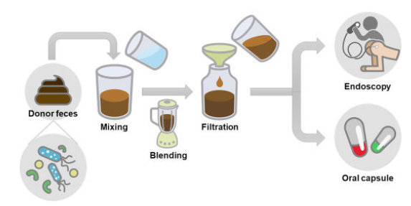
Inhibitors of protein synthesis
Clindamycin
• IsolatedfromS.lincolnensis • Blocks protein elongation by binding to the 50S ribosome
• Active against staphylococci and anaerobic gram- negative rods, but it is generally inactive against aerobic gram-negative bacteria
• It can cause pseudomembranous colitis so use with caution – destroys the natural gastrointestinal bacteria and C. difficile can overgrow (metronidazole can treat it, so can gastro bacterial replacement, aka fecal transplantation)
Caution!

Slide 40
Inhibitors of DNA synthesis
Quinolones
• ciprofloxacin, levofloxacin, and moxifloxacin
• Very commonly used
• Synthetic molecules that inhibit bacterial deoxyribonucleic acid (DNA) topoisomerase type II (gyrase) or topoisomerase type IV, which are required for DNA replication
• Resistance can arise through mutations in gyrase that prevent binding of the drugs
Resistance!

Slide 41
Inhibitors of RNA synthesis
Rifampin
• Semi-synthetic derivative of rifamycin B produced by S. mediterranei, binds to DNA-dependent RNA polymerase, and inhibits initiation of RNA synthesis
• Rifampin is effective against M. tuberculosis because it transcribes genes but doesn’t replicate frequently….
• Resistance can arise through mutations in that prevent binding of the drugs to the RNA polymerase
Resistance!

