Slide 1
12
BACTERIAL CLASSIFICATION, STRUCTURE, AND REPLICATION
OVERVIEW
Classification
• Macroscopic and microscopic
• Metabolic, antigenic, and genetic
Structure
• Cytoplasmic
• Cell wall – Gram staining • External structures
Structure & biosynthesis of major cell wall components
• Peptidoglycan
• Teichoic acid
• Lipopolysaccharide (LPS)
Cell Division • Spores

Slide 2
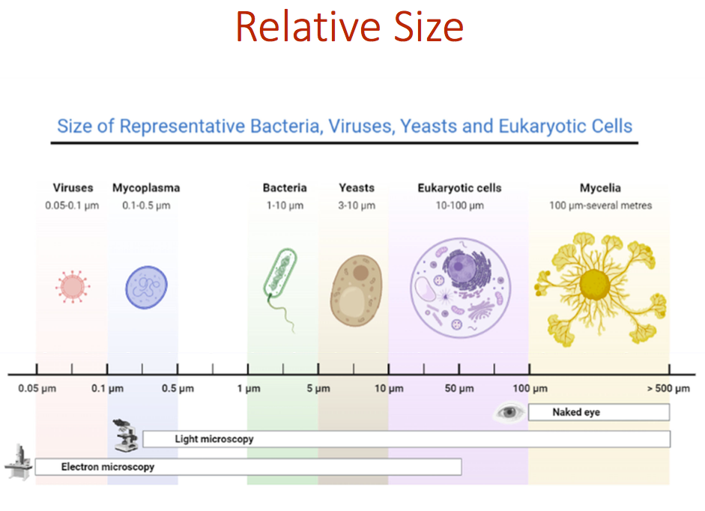

Slide 3
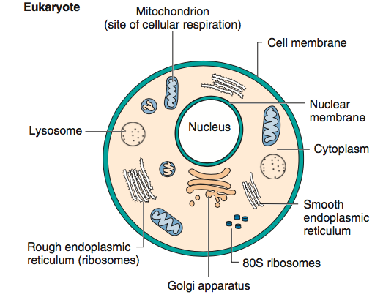
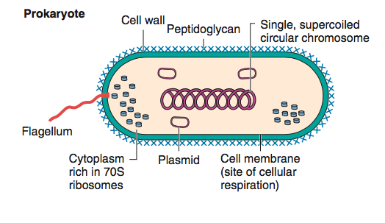
Prokaryotes vs. Eukaryotes
No nucleus membrane, mitochondria, Endoplasmic reticulum, or Golgi apparatus.
Has a cell wall, unique differently sized ribosomes (target for sequencing identification and many antibiotics)
Smaller

Slide 4
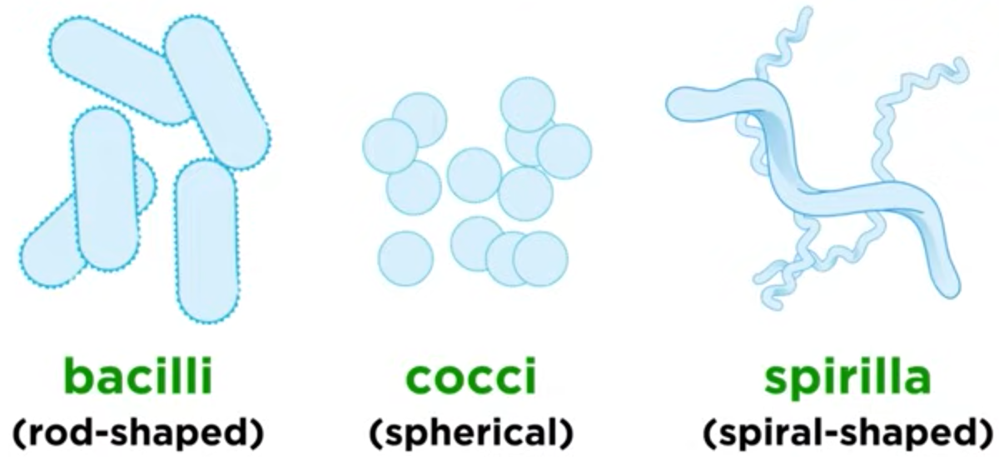
Factors for identification
Morphology

Slide 5
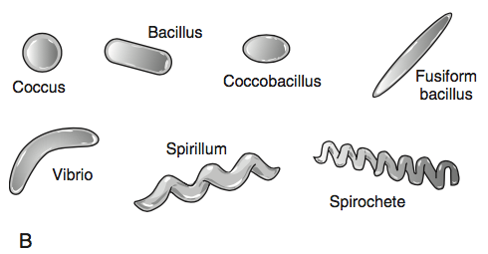
Factors for identification
Morphology can go a long way

Slide 6
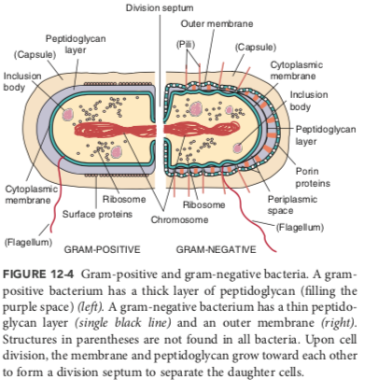
Wall and outer-membrane structure
is a big differentiator when classifying bacteria
Gram-Positive
Gram-Negative

Slide 7
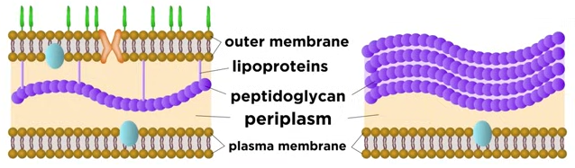
Gram-Negative
Gram-Positive
lipopolysaccharide (lps)
porins

Slide 8
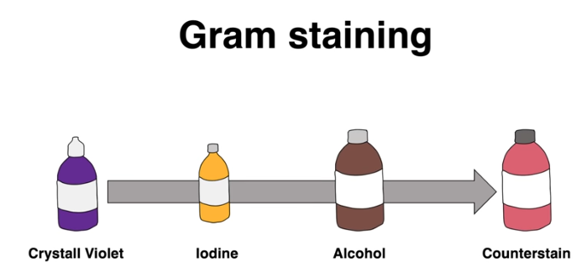
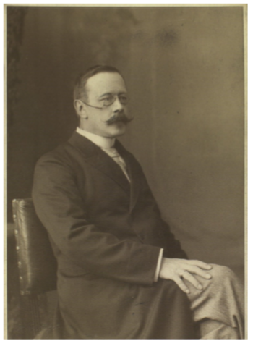
Quick way to group bacteria
• Antibiotics are often specific for each group – can get therapy started quickly
• Smear, heat, crystal violet, wash, iodine, wash, alcohol, safranin
• Whole thing takes just a few minutes
• Only a few exceptions
…Mycobacteria (tuberculosis and leprosy) do not stain well with the Gram stain, so confirmation is done with an acid-fast stain. Mycoplasma (type of pneumonia and STI) requires specialized staining, it does not have a cell wall
Safranin
Hans Christian Gram
Danish bacteriologist and physician
Developed the Gram stain in 1884

Slide 9
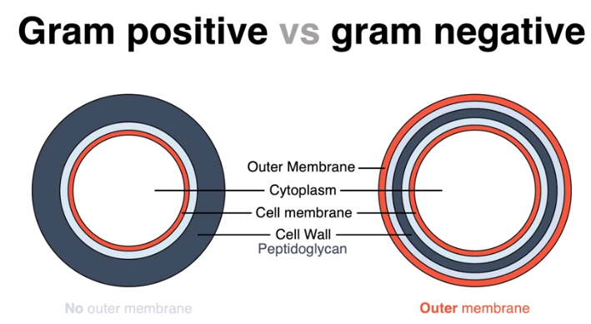

Slide 10
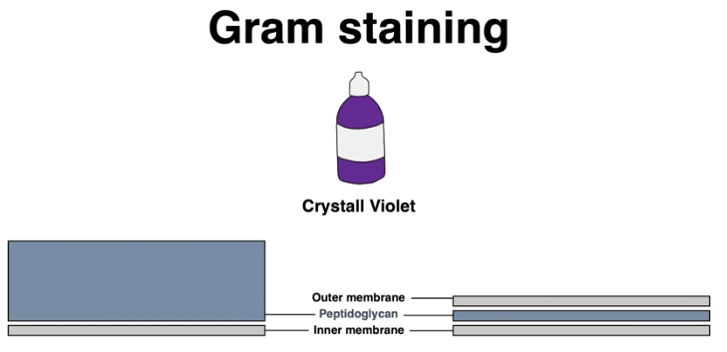
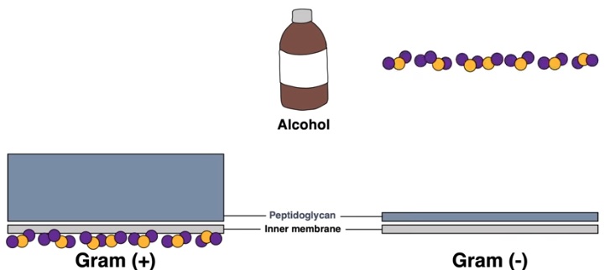
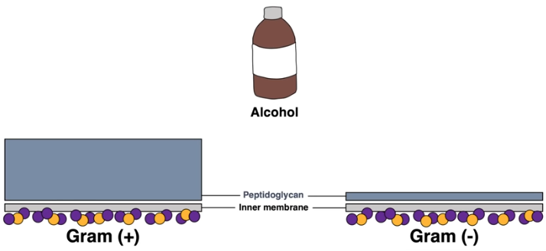
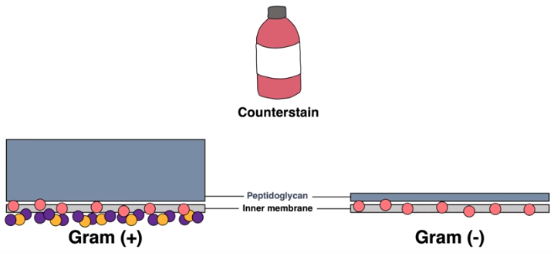
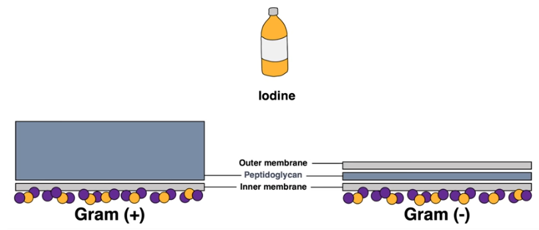
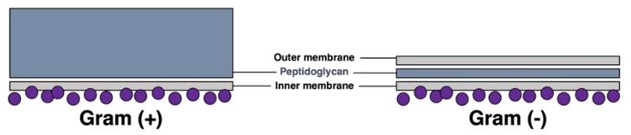
Safranin

Slide 11
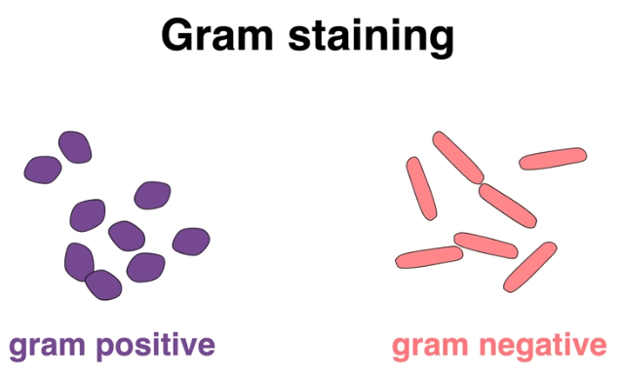
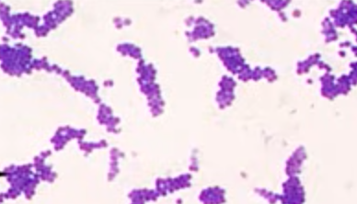
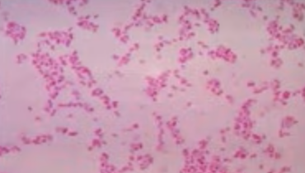

Slide 12
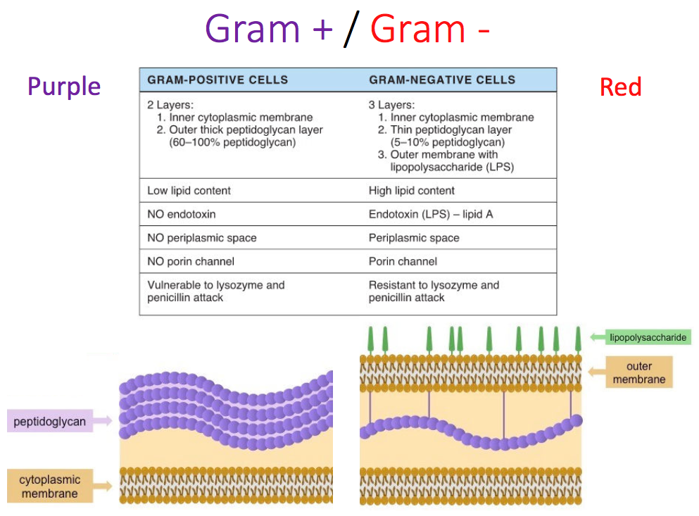

Slide 13
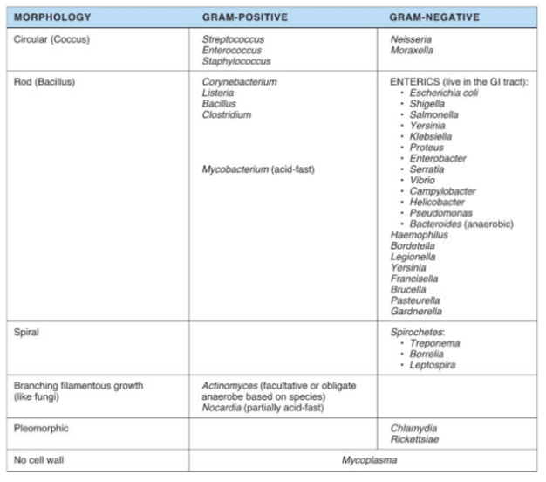
Just these two factors:
1) morphology and
2) gram stain
gets us pretty far for classifying the pathogens that we’ll be talking about the rest of the quarter.

Slide 14
A little more on the structural components…

Slide 15
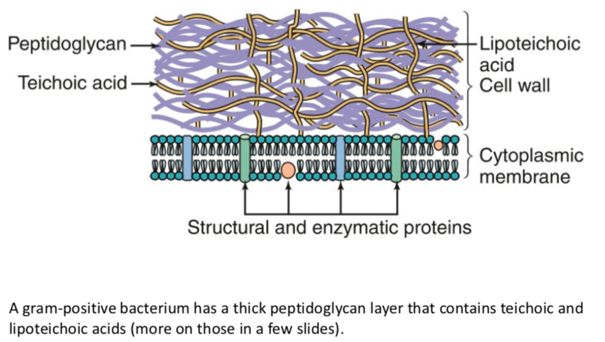
Gram Positive

Slide 16
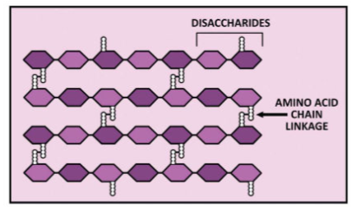
Peptidoglycan structure
The peptidoglycan layer is composed of repeating disaccharides with 4 amino acids in a side chain.
• The the amino acid side chains covalently link to each other, adding ridigity/stability.
• Transpeptidase (on the inner cytoplasmic membrane)
creates these links
• Penicillin (the β-lactam class of antibiotics) inhibits transpeptidase

Slide 17
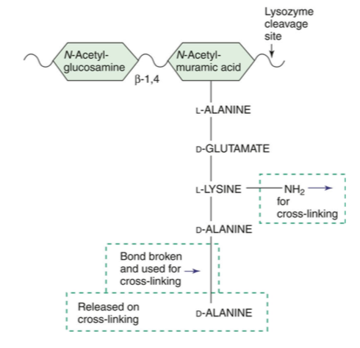
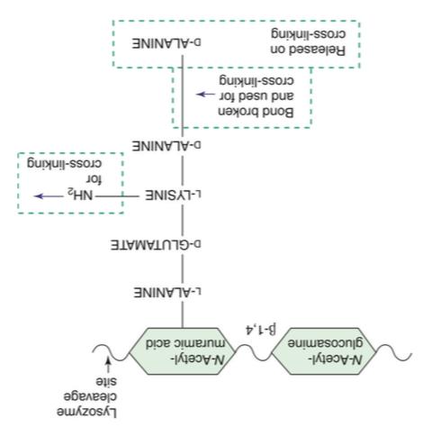
Precursor of peptidoglycan.
Prefabricated units containing a 5 amno acids attached to the N-acetylmuramic acid, ending with d- alanine-d-alanine unit.
Transpeptidase acts on the dipeptide to cross-link two layers
Penicillin and vancomycin antibiotics target transpeptidase, inhibiting crosslinking. .
GLYSINE
GLYSINE
GLYSINE
GLYSINE
GLYSINE
Transpeptidase

Slide 18
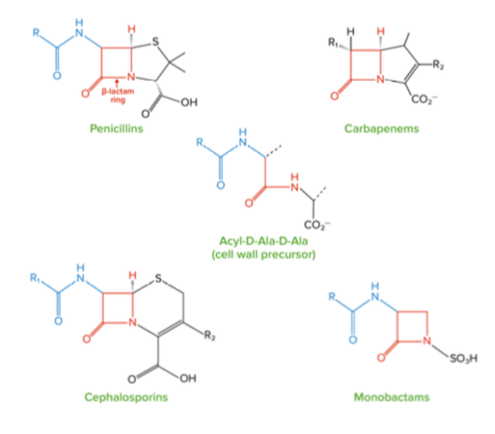
Transpeptidase can’t tell the difference between the 2 terminal alanines and Penicillin. So, it binds to Penicillin and gets inhibited

Slide 19
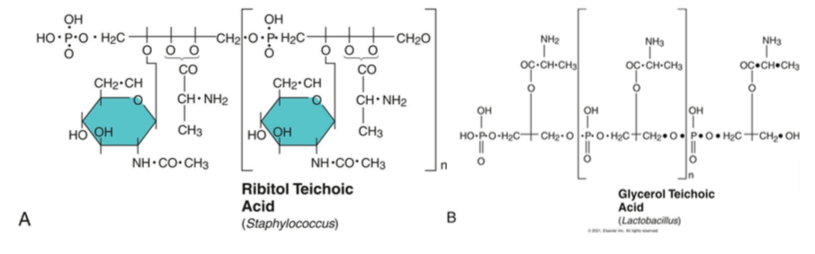
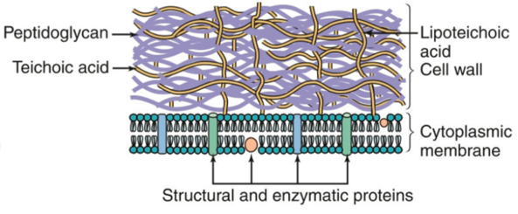
Teichoic acid is a polymer of chemically modified ribitol (a type of sugar) or glycerol phosphate. Teichoic acid is covalently attached to the peptidoglycan. Lipoteichoic acid is anchored in the cytoplasmic membrane by a covalently attached fatty acid.
Why are these important? They act as antigens and are used to identify the bacteria by using antibodies. They help to define the serotype (they are antigenic determinants).

Slide 20
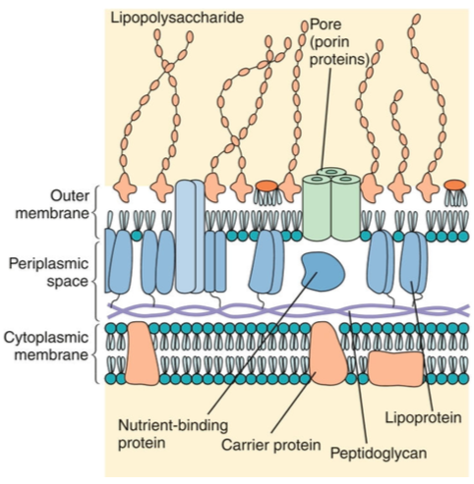
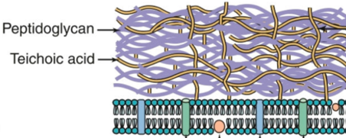
A gram-negative bacterium has a thin peptidoglycan layer and an outer membrane that contains lipopolysaccharide, phospholipids, and proteins. The periplasmic space between the cytoplasmic and outer membranes contains transport, degradative, and cell wall synthetic proteins. The outer membrane is joined to the cytoplasmic membrane at adhesion points and is attached to the peptidoglycan by lipoprotein links
Lipoteichoic acid
Gram Positive
Gram Negative

Slide 21
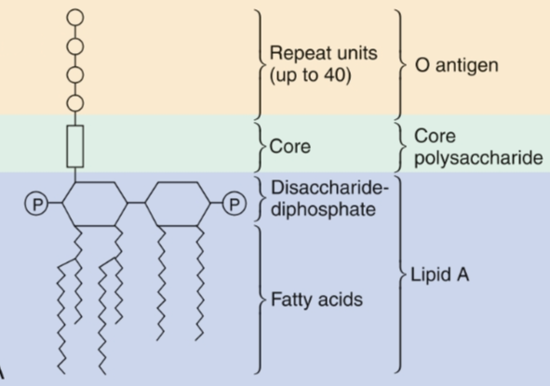
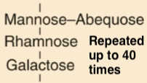
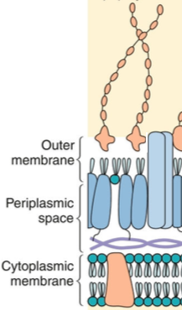
Lipopolysaccharide
Only found on Gram negative bacteria
Consists of lipid A, core polysaccharide, O antigen that are all covalently linked together
• Lipid A is most important and can cause toxicity during infections (endotoxin)
Endotoxins are released from the bacteria when they die
LPS features are common amongst similar groups – so it’s used to classify groups of bacteria that are “related”
• Lipid A = phosphorylated disaccharide with fatty acids attached
Core = polysaccharide with 9 – 12 sugars
O antigen = long polysaccharide

Slide 22
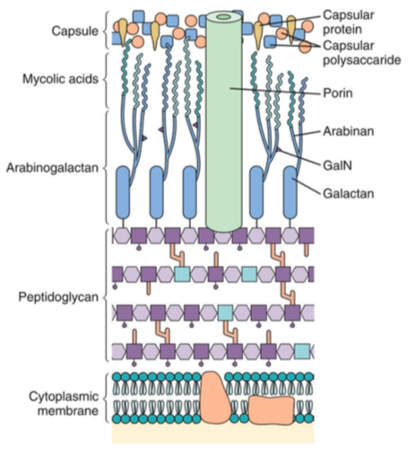
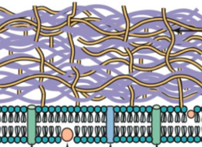
The exceptions:
Mycobacterial cell walls have a complex structure with a lipid rich waxy outer layer of mycolic acids with porins that permeate that layer
Gram Positive
Gram Negative
Mycobacteria

Slide 23
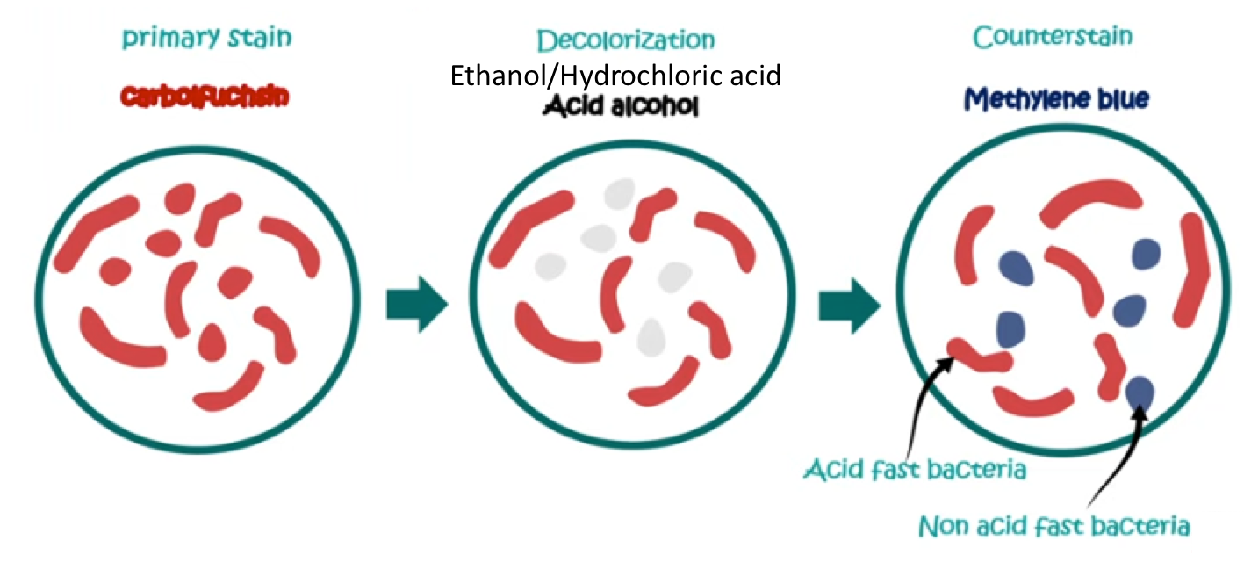
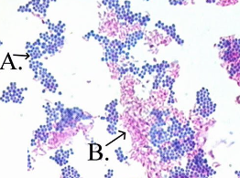
Acid Fast Stain
waxy cell walls rich in mycolic acids, making them impermeable to standard stains but allowing them to retain a strong stain even after exposure to acid-alcohol
vital for diagnosing tuberculosis (TB), leprosy, and other mycobacterial infections

Slide 24
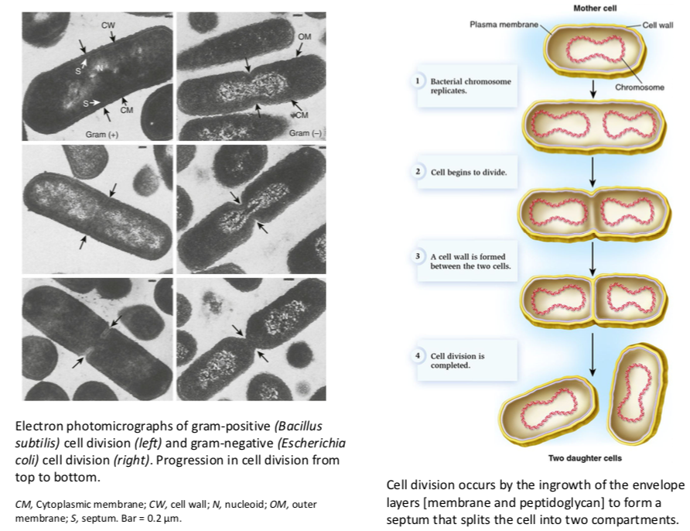
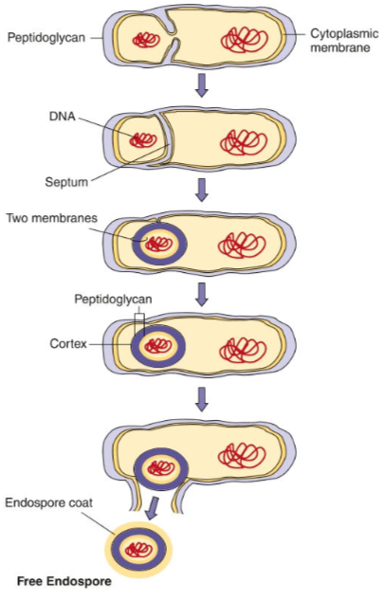
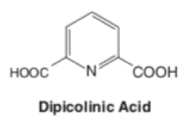
Spores
High concentrations of dipicolinic acid in the spore binds calcium, dehydrates and mineralizes to stabilize the contents
Some Gram positive bacteria, but never Gram negative, form spores.
For human pathogens,
Bacillus anthracis
Clostridium botulinum
Clostridium tetani

Slide 25
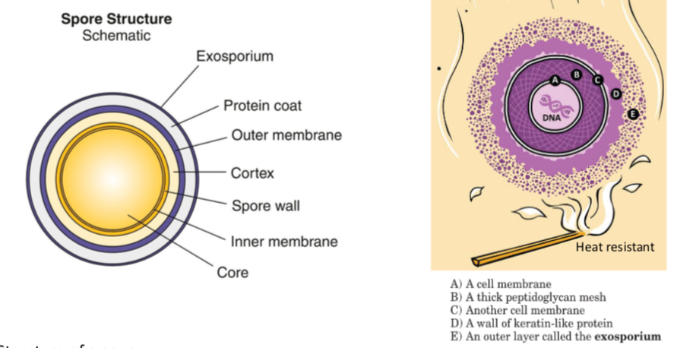

Slide 26
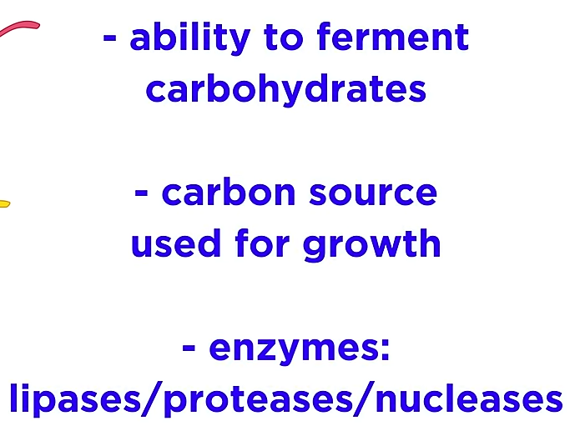
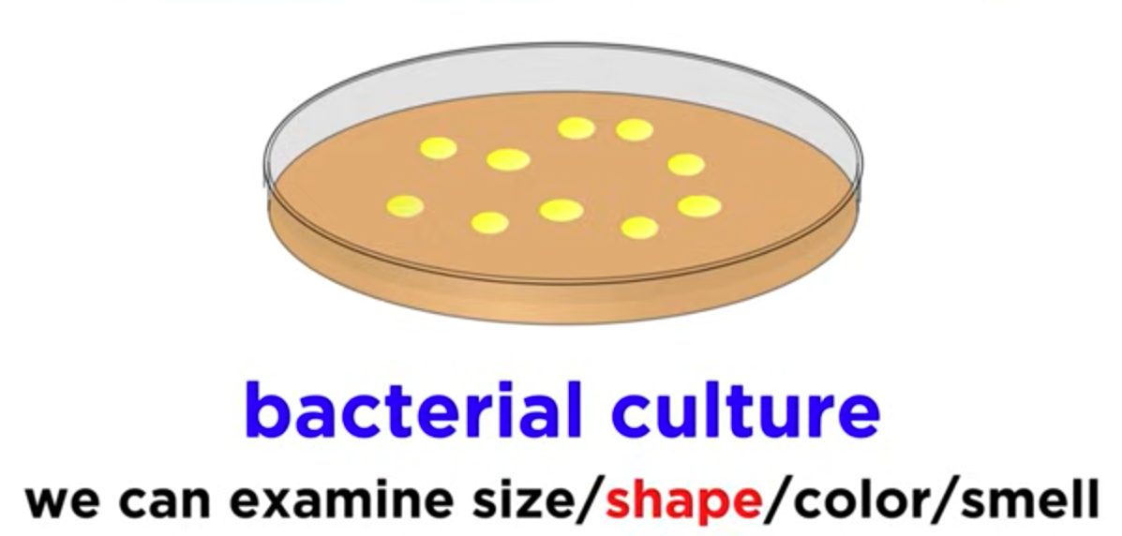
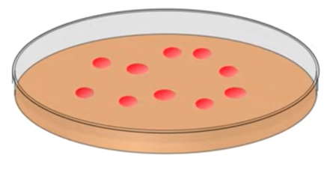
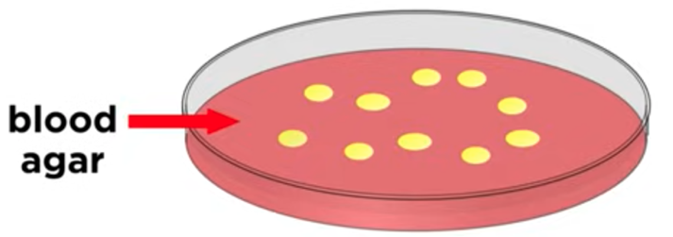
After morphology and gram strain, other factors can be useful too…
Escherichia coli
Serratia marcescens grows red at 22C

Slide 27
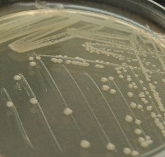
Even smell can be very useful
•Pseudomonas aeruginosa smells like grapes
Streptococcus milleri smells like butterscotch
Proteus bacteria smell like sweet corn tortilla (responsible for the corn chip smell of dog's feet)
Other Proteus spp. smell like burnt chocolate
Actinomycetes causes the wet-earth smell after rain
Bacillus subtilis smells like an open sewer
Escherichia coli smells a little like…
Saccharomyces cerevisiae smells like fresh bread

Slide 28
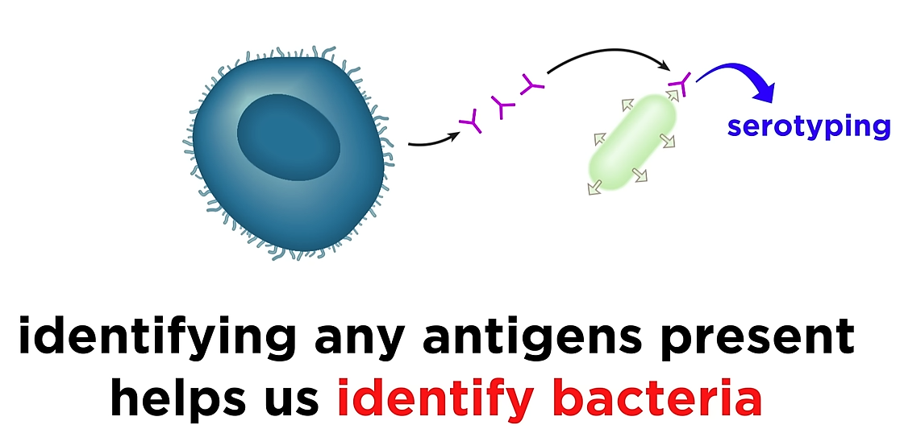
Serotyping

Slide 29
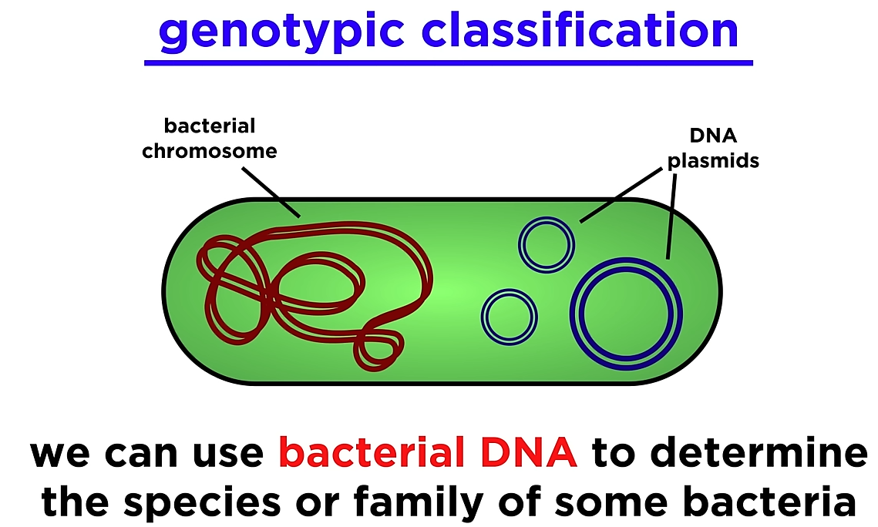
Genotyping

Slide 30
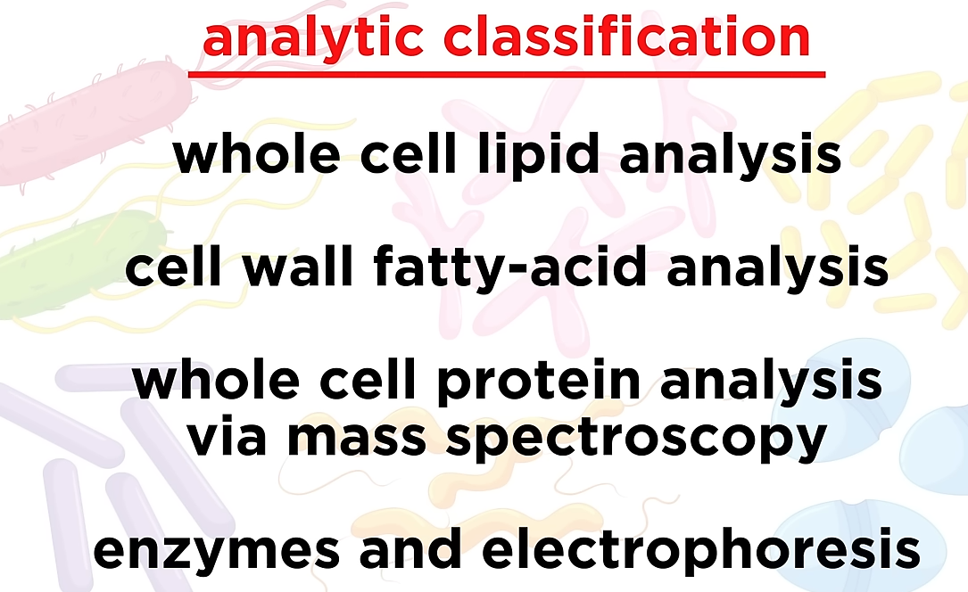

Slide 31
13
BACTERIAL METABOLISM AND GENETICS
Bacterial metabolism
• Metabolism / catabolism
• Glycolysis / fermentation (very brief overview) • Aerobic / anaerobic
Bacterial gene expression
• Transcription and translation
• Control of gene expression • Promoters and operators
Bacterial genetics

Slide 32

Metabolic Needs
Carbon, nitrogen, phosphate. Energy source, building blocks of lipids, proteins, and nucleic acids, and ions (used in metabolic pathways and enzyme cofactors).
• Obligate aerobes – Requires oxygen, uses glycolysis, Krebs cycle, electron trans chain
• Facultative anaerobes – Can still grow if there isn’t any (fermentation)
• Microaerophilic – prefers no oxygen, but can tolerate low amounts (it won’t kill them), they use fermentation
• Obligate anaerobes – oxygen will kill them
methanogenesis, hydrogen sulfide

Slide 33
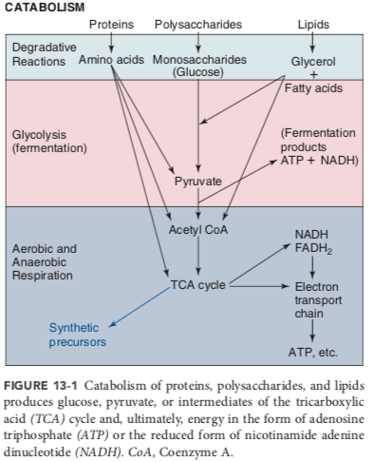

Slide 34

4 ATP

Slide 35


Slide 36



Slide 37


Slide 38


Slide 39


Slide 40




Slide 41


Slide 42


Slide 43


Slide 44


Slide 45


Slide 46


Slide 47


Slide 48



Slide 49


Slide 50


Slide 51


NO LACTOSE

Slide 52


Slide 53


Slide 54


Slide 55


Slide 56


Slide 57


Slide 58




Slide 59




Slide 60



Slide 61


Slide 62


Slide 63

Griffith's experiment 1928 demonstrating bacterial transformation

Slide 64


Late 1950s, Lederberg and Tatum discover bacterial conjugation

Slide 65

Bacterial Transduction

Slide 66


Insertion Elements, Transposons

Slide 67




Cancers in humans
Antibiotic resistance in bacteria
Interspecies sex in bacteria

Slide 68

Pathgenicity Islands
Pathogenicity islands are large genetic regions in the chromosome or on plasmids that contain sets of genes encoding numerous virulence factors that may require coordinated expression
Can be found in some Gram+ and Gram - bacteria
These genes may be turned on by a single stimulus (e.g., temperature of the gut, pH of a lysosome)
Mostly transferred on transposons

Slide 69

Enterohemorrhagic E. coli)
severe bloody diarrhea and kidney failure by producing Shiga toxins
Enteropathogenic E. coli
watery diarrhea, by damaging gut lining but lacks Shiga toxins
Uropathogenic E. coli
urinary tract infections (UTIs) through adhesion and invasion of urinary tract cells

Slide 70


Slide 71



