Slide 1
10 IMMUNE RESPONSES TO INFECTIOUS AGENTS

Slide 2
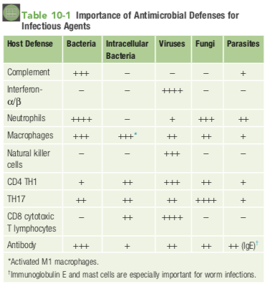

Slide 3
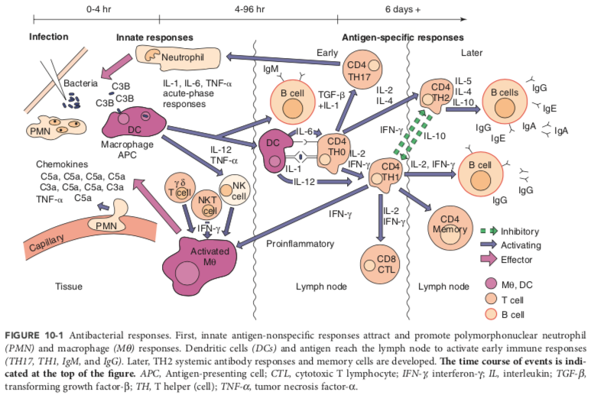

Slide 4
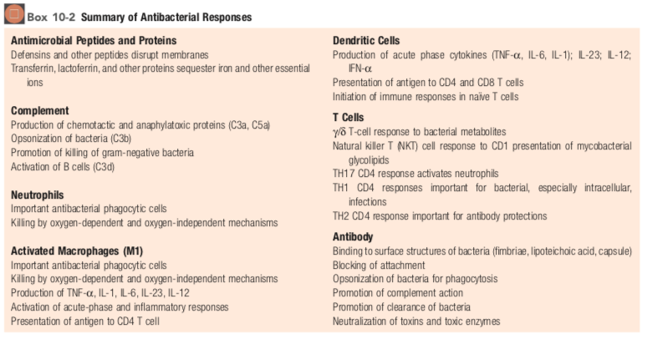

Slide 5
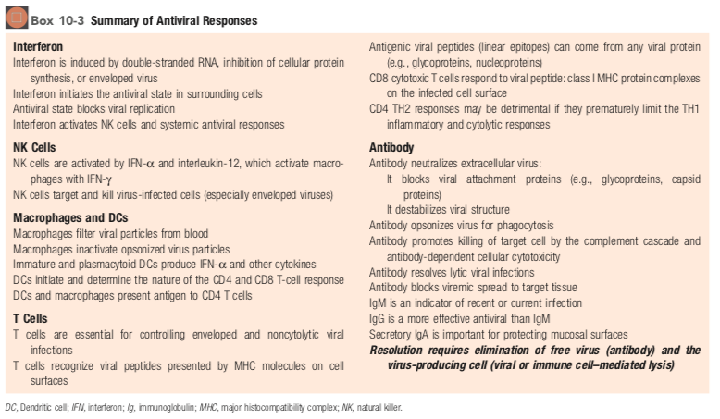

Slide 6
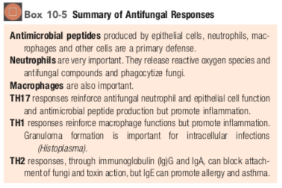

Slide 7
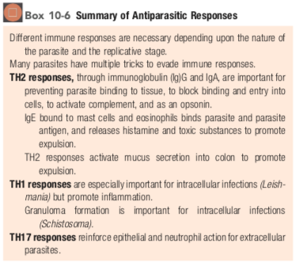

Slide 8
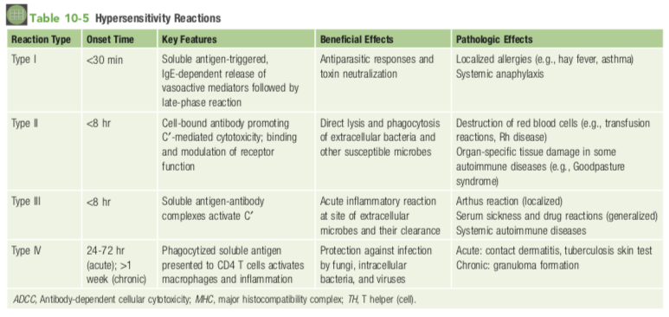

Slide 9
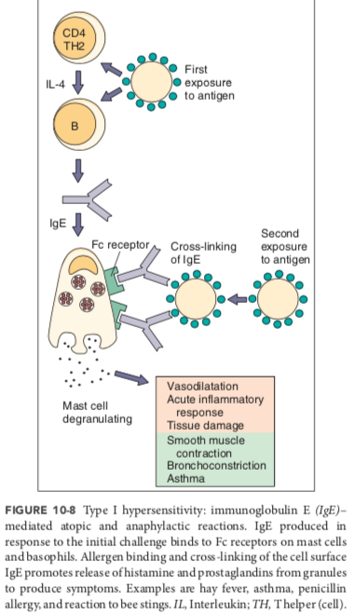
chemoattractants (chemokines, leukotrienes) attract eosinophils, neutrophils, and mononuclear cells; activators (histamine, platelet-activating factor, tryptase, kininogenase, cytokines) and promote vasodilation and edema.
spasmogens (histamine, prostaglandin D2, leukotrienes) to directly affect bronchial smooth muscle and promote mucus secretion.
Treatment: Desensitization (allergy shots) produces IgG to bind the allergen and prevent allergen binding to IgE

Slide 10
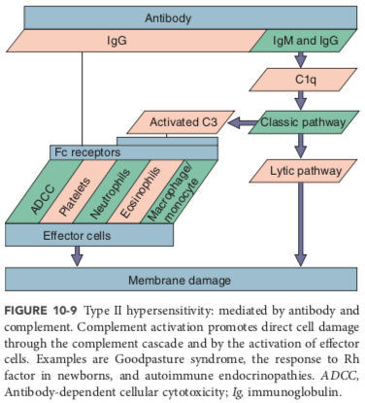
maternal IgG antibody, generated during the first pregnancy to an incompatible Rh factor on fetal erythrocytes, crosses the placenta and harms a second baby (Rh incompatibility).
Myasthenia gravis is due to antibodies to acetylcholine receptors on neurons, Graves disease results from antibody stimulation of the thyroid-stimulating hormone (TSH) receptor, and some forms of diabetes can result from antibodies blocking the insulin receptor

Slide 11
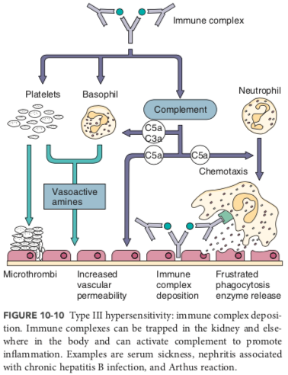
large antigen-antibody complexes form, become trapped in capillaries

Slide 12
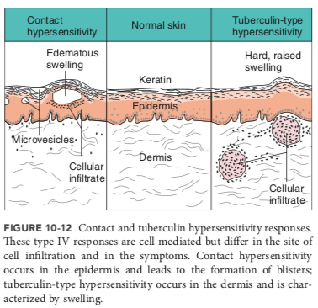
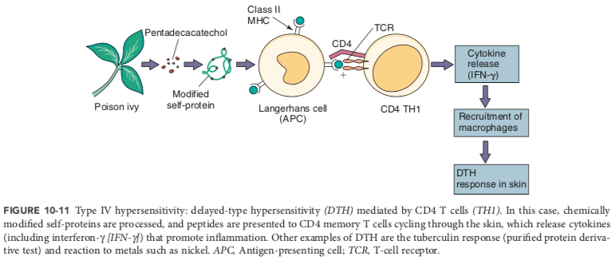

Slide 13
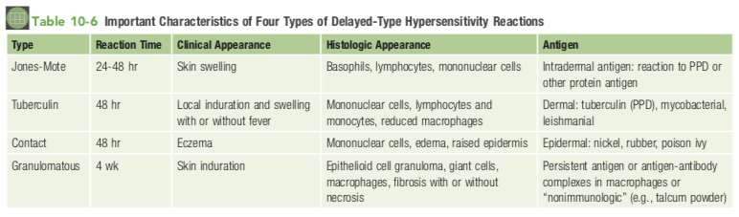

Slide 14
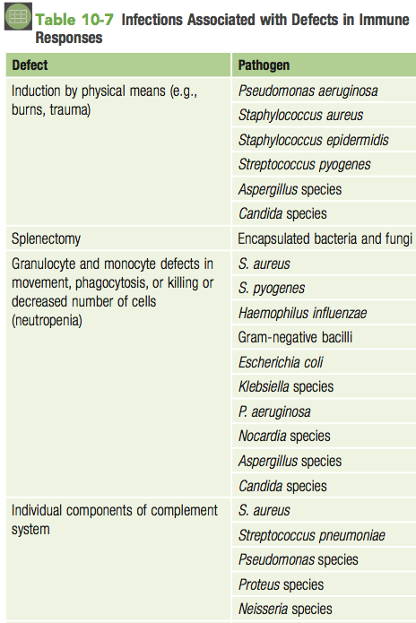
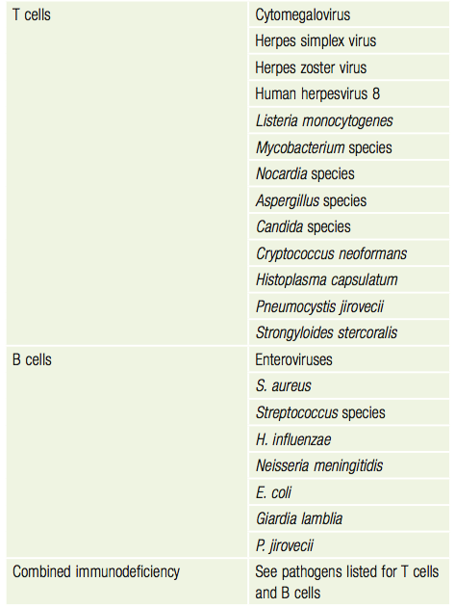

Slide 15
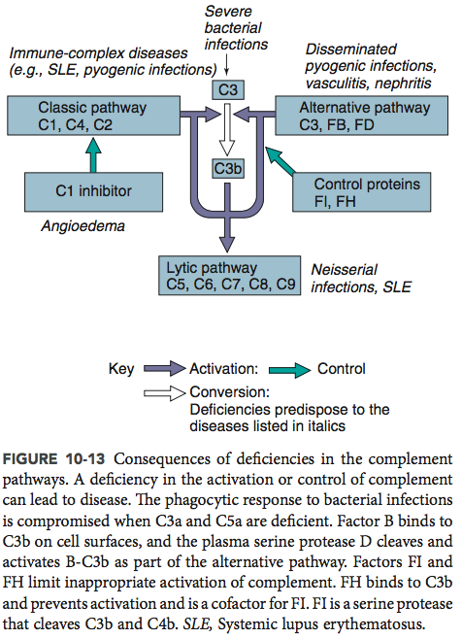

Slide 16
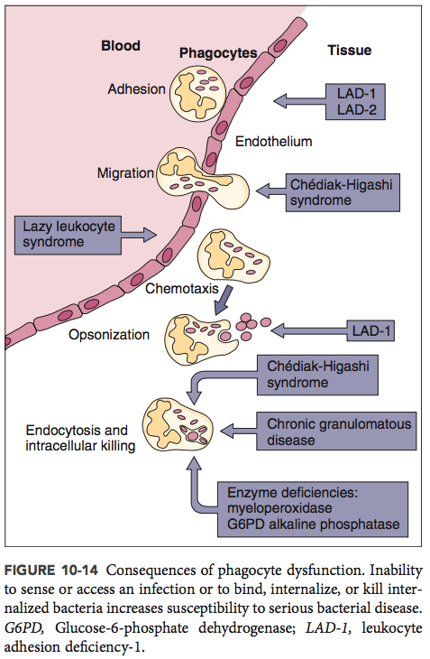

Slide 17
11 ANTIMICROBIAL VACCINES

Slide 18


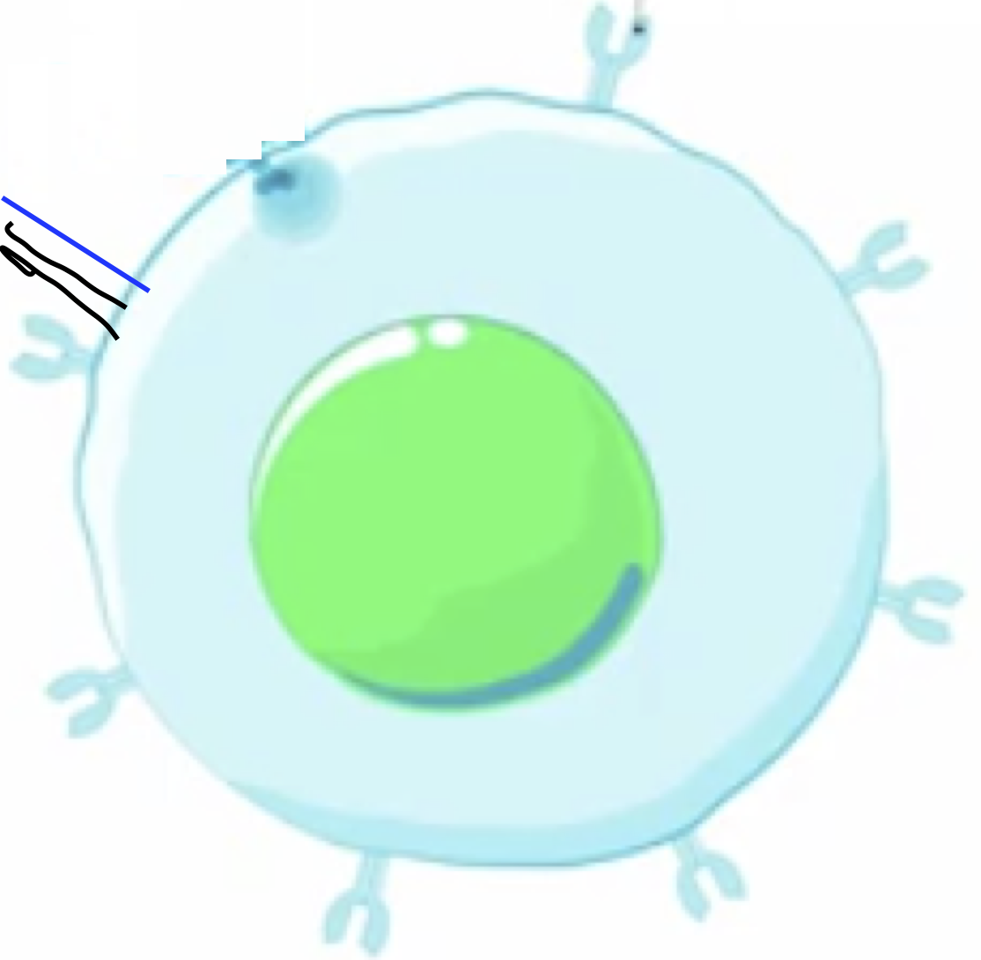


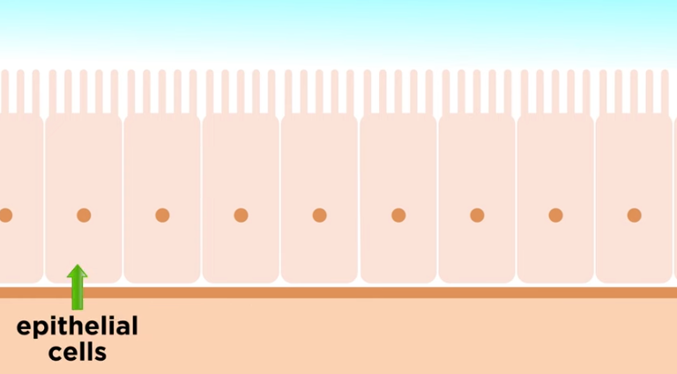


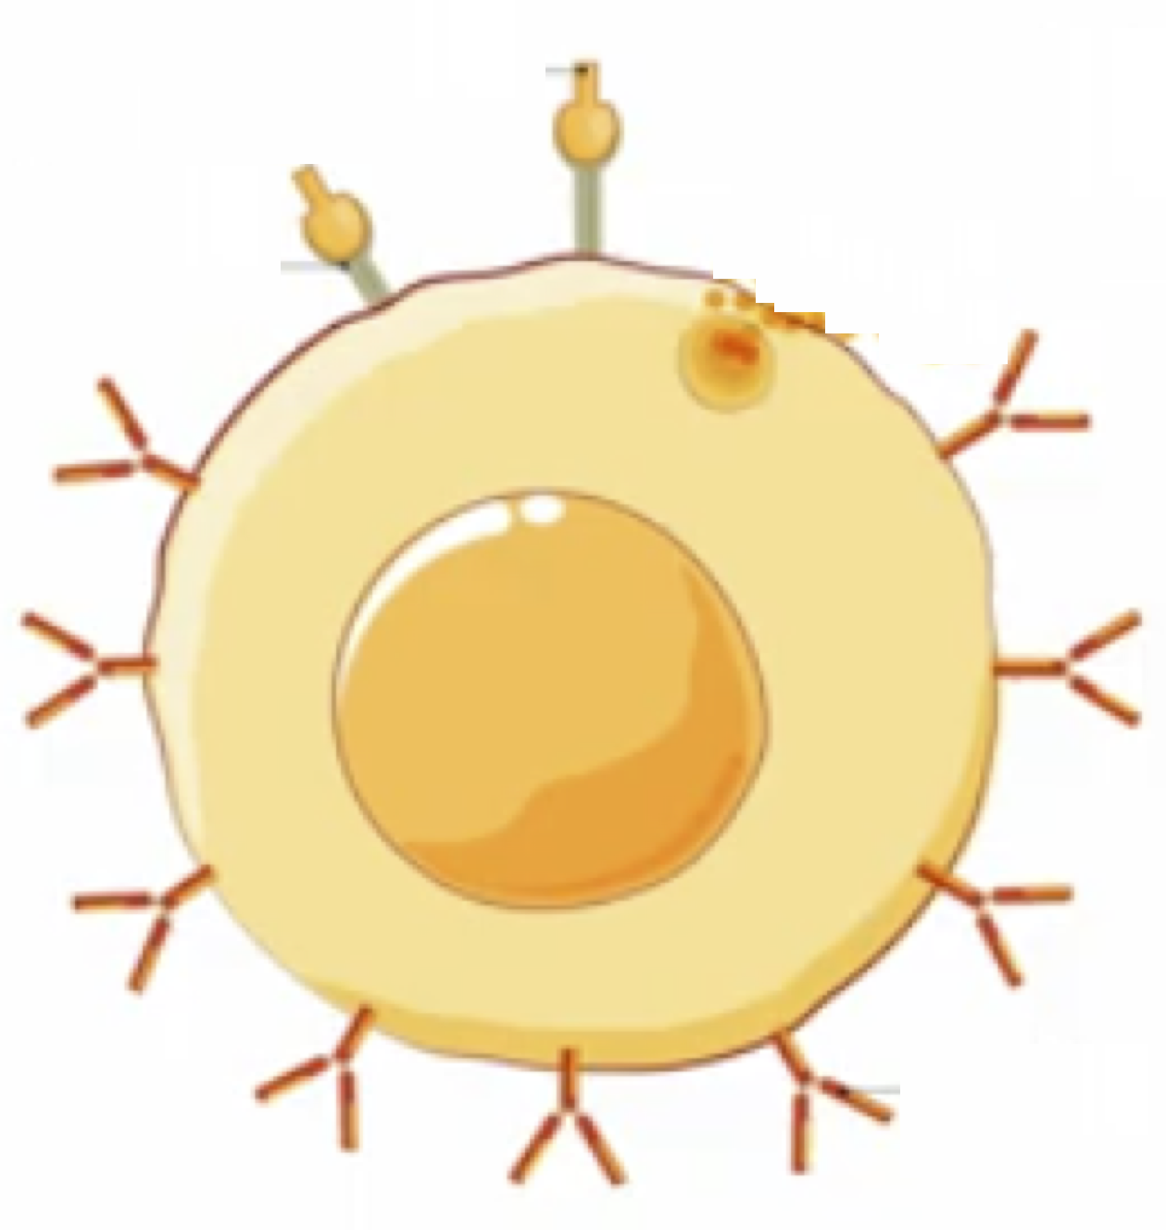
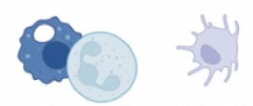



Natural Immunity
Epitheilial
cells
outside
inside
microbes
Cell-mediated immunity
Lymph node
Cytotoxic T cell
Cytotoxic T cells
Memory T cells
Helper T cell
macrophages
dendritic cells
Memory B cells
Antibodies
B cell
Antibody-mediated immunity
(humoral immunity)

Slide 19
Passive Immunization
Epitheilial
cells
outside
inside
microbes
Cell-mediated immunity
Lymph node
Cytotoxic T cell
Cytotoxic T cells
Memory T cells
Helper T cell
macrophages
dendritic cells
Memory B cells
Antibodies
B cell
Antibody-mediated immunity
(humoral immunity)

Slide 20
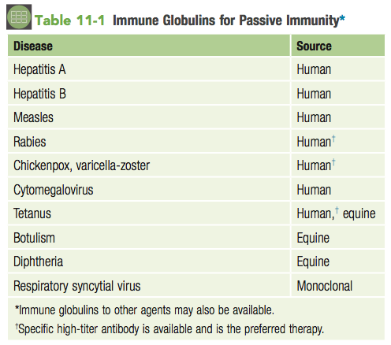
*snake bites and jellyfish stings
*serum preps from survivors if no vaccines are currently available

Slide 21
Active Immunization
Epitheilial
cells
*Or even just a protein or antigen
***Conjugate or use an Adjuvant: Alum
Bact Lipids
outside
inside
microbes
Cell-mediated immunity
Lymph node
X
Cytotoxic T cell
Dead microbes
Cytotoxic T cells
Memory T cells
Helper T cell
Attenuated live microbes
macrophages
dendritic cells
Memory B cells
Antibodies
B cell
Antibody-mediated immunity
(humoral immunity)

Slide 22
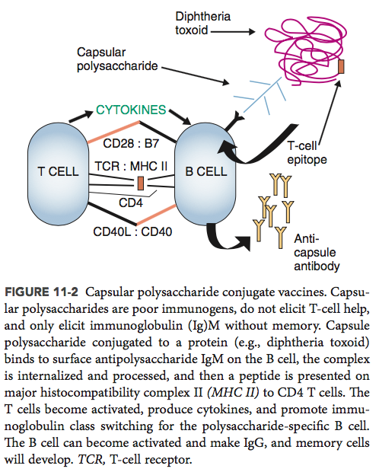

Slide 23
Active Immunization
Epitheilial
cells
*caution is possible reversion to its pathogenic form
Or sometimes cannot use with immunocompromised individuals
outside
inside
microbes
Cell-mediated immunity
Lymph node
Cytotoxic T cell
Dead microbes
Cytotoxic T cells
Memory T cells
Helper T cell
Attenuated live microbes
macrophages
dendritic cells
Memory B cells
Antibodies
B cell
Antibody-mediated immunity
(humoral immunity)

Slide 24



DNA and RNA Vaccines
Epitheilial
cells
outside
inside
microbes
MHC Class I
Cell-mediated immunity
With DNA vaccines
The worry can be that the pathogenic DNA will integrate into the genome
With RNA vaccines, the issue is RNA can be labile so it must be kept sterile, clean, and cold until its injected.
Lymph node
MHC Class I
Cytotoxic T cell
DNA
Cytotoxic T cells
Memory T cells
Helper T cell
RNA
macrophages
dendritic cells
Memory B cells
Antibodies
B cell
Antibody-mediated immunity
(humoral immunity)

Slide 25
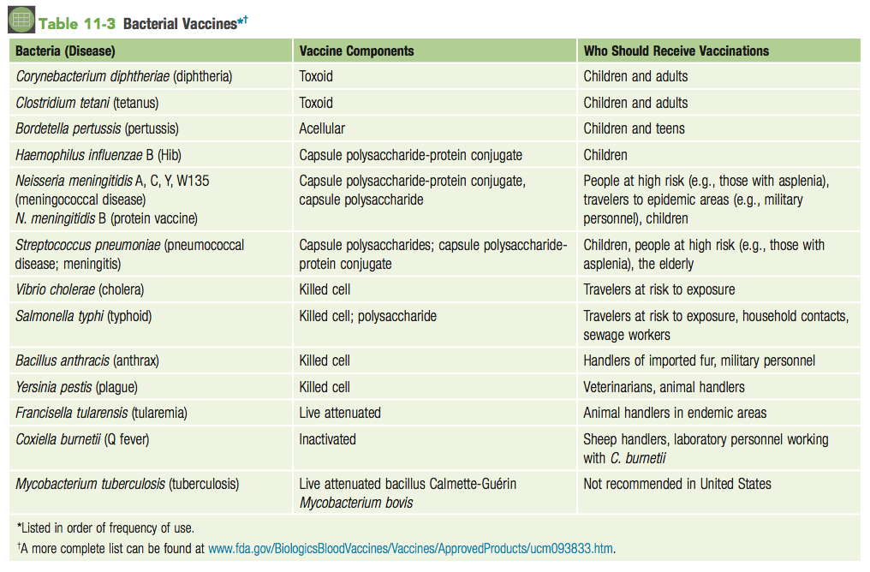

Slide 26
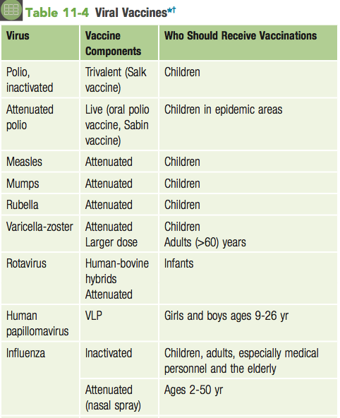
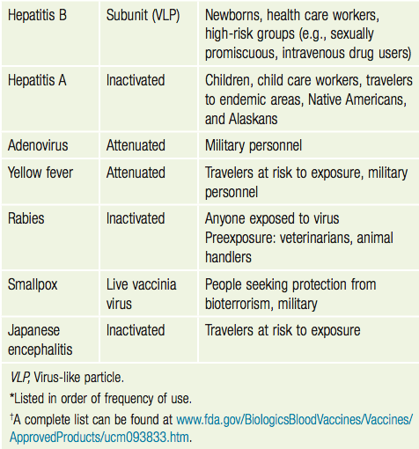

Slide 27
