Slide 1
Non-Spore forming Anaerobic Bacteria
Erin Brennan

Slide 2
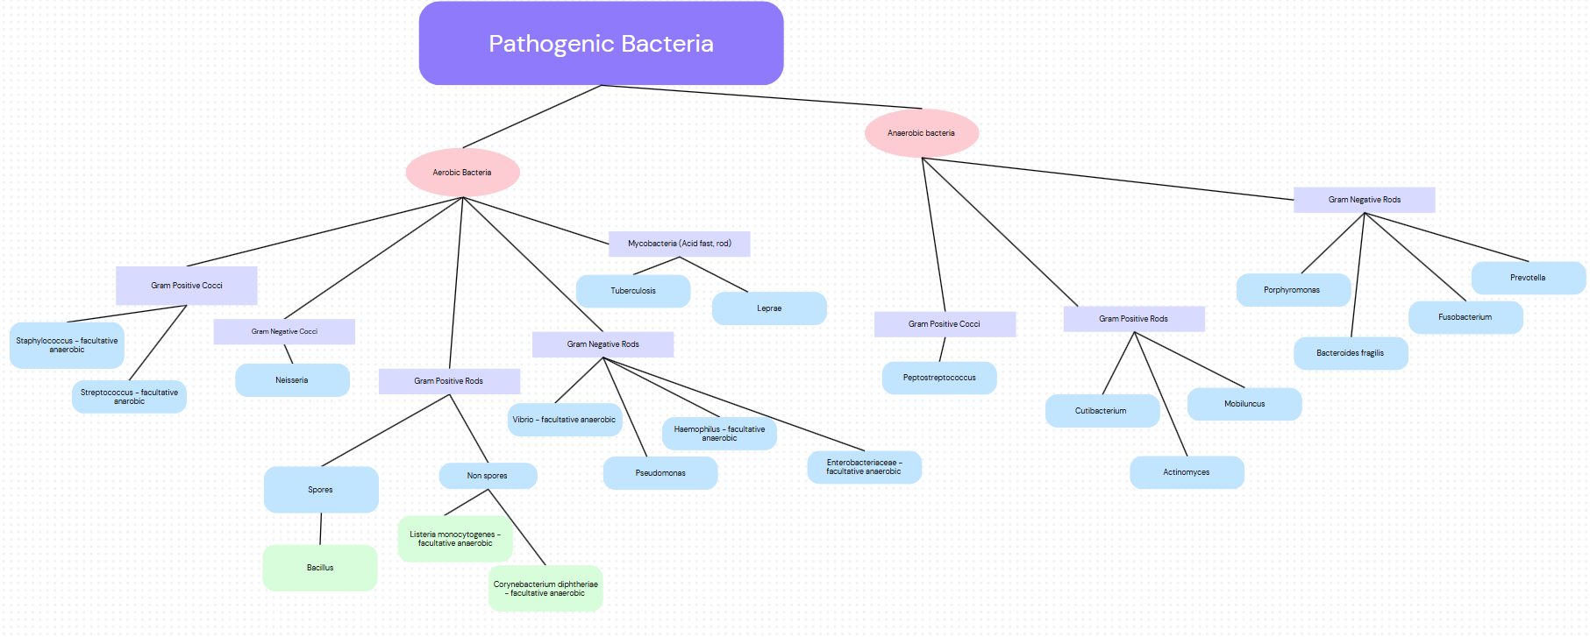
Notes:
General idea is to separate from Aerobic and Non Aerobic but a lot are facultative
No pathogenic Anaerobic gram negative cocci
Remember Mycobacteria are not gram negative or positive
Everything that has already been discussed is on the left, the right will be discussed in this presentation
Helicobaccter/Campylobacter and misc gram negative rods discussed on Monday not included

Slide 3
Terms To Know
Pleomorphic —> various shapes, “coccobacilli” —> somewhere between a rod and a cocci
Endogenous infection —> infection from within, usually in context of commensal bacteria
Pleuropulmonary infection —> infection of the pleura (mucoid lining of the lungs)
Suppuration —> pus
Polymicrobial infection —> multiple bacterial species/genus involved in the infection
Monomicrobial infection —> one bacterial species responsible for infection
Dysbiosis → disrupted/imbalanced microbiota
Eubiosis → healthy, balanced microbiota
Notes:
Pleomorphic — coccobacilli
Endogenous
Pleuropulmonary – lung mucosa
Suppuration – pus
Polymicrobial vs microbial
Dysbiosis vs eubiosis

Slide 4
Overview (All)
Mostly commensal on skin (except Actinomyces) and mucosal surfaces —> opportunistic pathogens, endogenous infections
Fastidious, slow growers (except B. fragilis)
Usually polymicrobial infection
Fermentation products are acidic which may affect pathogenesis (ex succinic acid inhibits phagocytosis)
Notes:
Exceptions to every rule but typically exist on skin and mucosal linings and only infect if barrier disrupted (endogenous) + fastidious slow growers + polymicrobial infections + not a lot of inherent virulence factors like toxins (except in B. fragilis) but they are anaerobic so fermente instead of respire which leads to acidic byproducts that are antiphagocytic

Slide 5
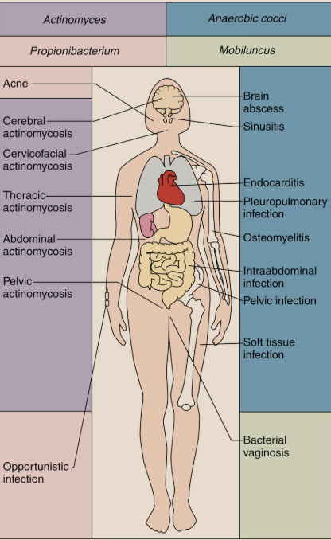
GRAM POSITIVE RODS
GRAM POSITIVE COCCI
Actinomyces
Propionibacterium
Mobiluncus
Lactobacillus
Notes:
Starting with gram positive (thick peptidoglycan layer) anaerobic bacteria
Diagram of all the infections and their locations - note what color coordinates to what, this will be referred to often - figure from textbook

Slide 6
GRAM POSITIVE COCCI
“Peptostreptococcus”
Colonization and Infection
Infections ranging from upper airways and intestines to genitourinary and skin (any place where barrier is damaged along mucosal linings or skin)
Notes:
Used to be all included in the genus Peptostreptococcus but gene sequencing shows different enough to classify in distinct genus of their own but morphologically and pathologically pretty much indistinguishable
In upper airways: sinusitis and pleuropulmonary infections
Intestines: intra abdominal infections
Genitourinary: endometritis, pelvic abscesses, and salpingitis (infection of fallopian tubes)
Skin: cellulitis and soft tissue infections
Can also get into the blood and spread to bones and organs

Slide 7
GRAM POSITIVE COCCI
“Peptostreptococcus”
Treatment
Cannot reasonably culture
Assume infection is polymicrobial with both aerobic and anaerobic —> broad spectrum antibiotics and/or combination of drug therapies
Give penicillins
NOT aminoglycosides
Notes:
Need sample which is pure (does not contain normal flora), contain and transport and grow in oxygen free environment, slowish growth (5-7 dyas)
Also some saph and strep (cocci gram positive) will grow initially in anaerobic environment (staph and strep facultative?)
Because culture and identification is difficult just assume that both anaerobic and aerobic are present (which they usually are) and give a broad spectrum abx
Tx
Penicillins and carbapenems susceptible
Some susceptibility to broad spectrum cephalosporins
Resistant to aminoglycosides (bc anaerobic and do not do electron transport with oxygen which aminoglycosides use to get in)
in other species that we will discuss penicillins are used in combination with aminoglycosides bc the penicillin opens up the wall for the aminoglycoside to get in

Slide 8
Actinomyces
Overview
Branched filamentous
Over 50 species, A. israelii is noteworthy
Commensal on mucosa but NOT SKIN
Chronic, slow growing infections
Low virulence (disease only when barrier disrupted, no toxins associated)
Infection range from central nervous system (CNS) and upper respiratory tract to gastrointestinal tract and female genetalia tract
Produce succinic acid (antiphagocytic)
GRAM POSITIVE RODS
Notes:
Over 50 species within this genera but the most implicated in human pathogens is A. israelii
Not on skin (present/commensal in upper resp, GI and female genitalia tracts as commensal species) – causes abscesses in all these areas when dysbiosis/barrial disruption occurs, endogenous infection (will not spread)
Chronic, slowly developing infections
Low virulence, only cause disease when barrier disrupted, no toxins associated but they do produce succinic acid which is antiphagocytic

Slide 9
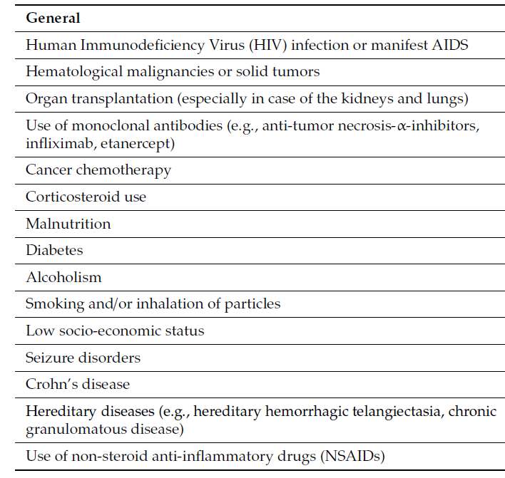
Actinomyces infection - associated factors
(Gajdács et al. 2019)
Notes:
Risk factors taken from Gajdács et al 2019
Immunocompromised
Anything that disrupts the microbiotia and cause dysbiosis
Anything that disrupts barriers
Poor hygiene and malnutrition (unfortunatley also indicated in low socioeconomic status)

Slide 10
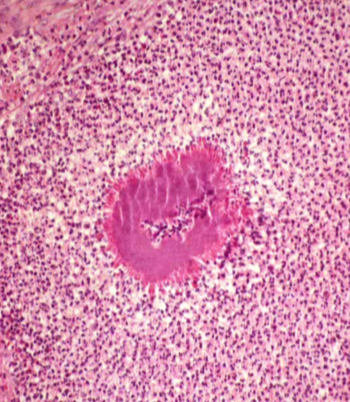

Actinomyces
Characterizing Actinomycosis
Actinomycosis → chronic granulomatous lesions which are suppurative and form abscesses
Colonies about the size of a grain of sand
  “Sulfur granules” because yellow/orange color
Mostly cervicofacial (oral abscesses which are connected by the sinus tract) but can also be thoracic, abdominal, or pelvic
Up to 19% mortality rate if untreated (Gajdács et al. 2019)
Can disseminate but healthy immune system and/or penicillins are usually able to clear it (Gajdács et al. 2019)
GRAM POSITIVE RODS
Notes:
Causes actinomycosis -- chronic granulomatous lesions that become suppurative (pus filled) and form abscesses (in cervicofacial these are often connected to sinus tracts)
Colonies within the abscess are visible to the naked eye (about the size of a grain of sand) and are yellow or orange. These are called sulfur granules
“Sulfur granules” after the color but do not actually contain sulfur)
Within the granules are masses of the filamentous bacteria in a biofilm held together by calcium salts and polysaccharide protein complex (bc gram positive, peptidoglycan layer)
Most well characterized are cervicofacial (oral abscess) but can also occur in pelvic, thoracic, and abdominal - will also colonize foreign substances (not IV catheter because slow growing, may colonize implants, example to come) -- could by pyogenic (fast growing) and painful or could be slowly evolving relatively painless
Polymicrobial – other bacteria contribute to tissue damage which gives the actinomyces an opening also the damaged host tissue releases nutrients which all bacteria benefit from. Additionally the other bacteria reduce the oxygen in the environment making it more ideal for actinomyces

Slide 11
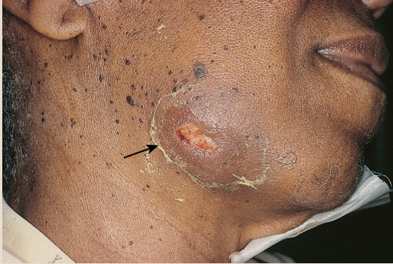
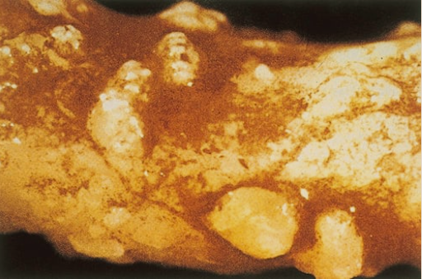
Actinomycosis
Pelvic abscess - IUD growth
Actinomycosis
“Lumpy Jaw” - cervicofacial abscess
Notes:
Left: Cervicofacial = lumpy jaw — abscess caused by actinomyces
Right: Pelvic infection - can range in severity (sometimes just vaginitis) but here presented as more severe case with multiple abscesses and tissue damage -- may colonize on foreign surface like IUD (intrauterine device) – this is image of uterus after IUD was in for 10 years (which for some brands is well within normal), surgical removal and debridement of large pelvic mass which extended into the fallopian tubes and also hepatic abscesses (liver), treated with penicillin for 1 yr and cured
Both from textbook

Slide 12
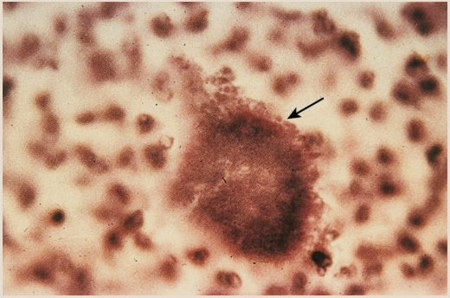
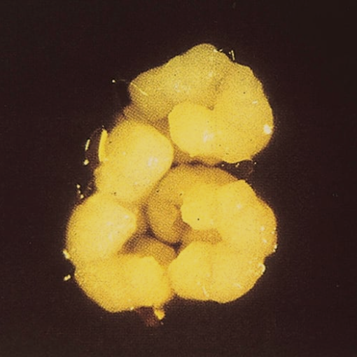
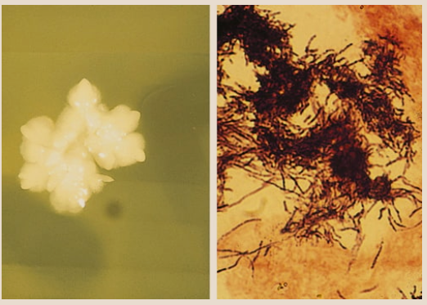
Actinomyces
In the lab
Culture difficult: need a large, pure sample + slow growth + fastidious (PRAS media required) (Gajdács et al. 2019)
If you are able to culture
  it resembles fungi (hyphae)
  delicate filamentous forms whose dome resembles the top of a molar)
Characteristic morphology of crushed sulfur granules: rods along periphery
**Usually just use mass spectrometry to diagnose (Gajdács et al. 2019)
GRAM POSITIVE RODS
Notes:
To culture need large (because bacteria concentrated in granules) sample which is as pure (not containing other pathogens or normal flora) as possible. Takes around two weeks to grow and requires pre reduced anaerobically sterilized (PRAS) media
Microscopic identification by crushing a granules and seeing thin gram positive branching rods along the periphery
if you do manage to isolate and grow it – white dome colonies (dome surface may be irregular and resemble the top of a molar - good to know bc it colonizes the mouth)
Often times mass spectrometry is used to diagnose rather than culture
Figures from textbook

Slide 13
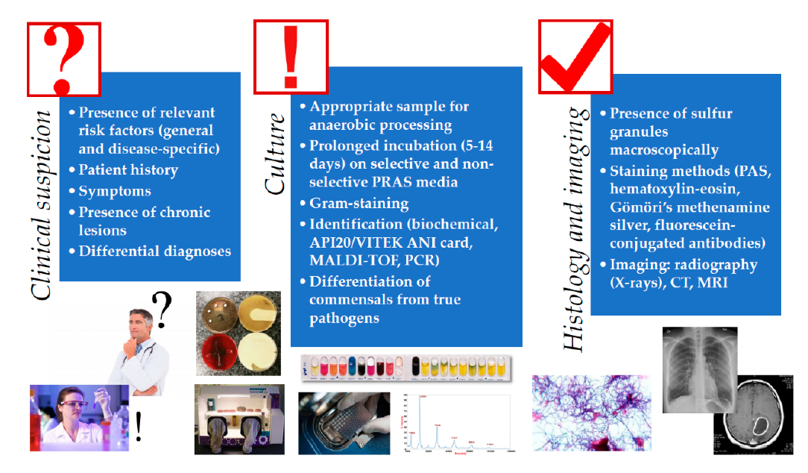
(Gajdács et al. 2019)
Notes:
Clinical diagnosis as dictated by (Gajdács et al. 2019)
Clinical discussion
Risk factors and symptoms (poor hygine, immunocompromosed, IUD or other long term foreign implant in mucosa – symptoms like pain and malese and sometimes fever – chronic reinfection)
Lab
Attempt to culture with large, pure sample on PRAS (pre reduced anaerobically sterilized) media
API20/VITEK ANI card is a bunch of wells (64) that turn color in response to certain samples, used for ID of any anaerobic bacteria, results within 6 hours
Matrix-assisted laser desorption/ionization time-of-flight mass spectrometry (MALDI-TOF MS)
Diagnostics
Sulfur granules
Staining
Rads for abscess evidence
NO PCR (may be doing PCR on commensal actinomyces not pathogenic strain and polymicrobial so other bateria may interfere)

Slide 14


Actinomyces
Treatment and Prevention
Prevention:
Oral hygiene
Prophylactic antibiotic course if there is anticipated barrier damage/disruption
Treatment:
Surgical debridement and drainage
Long antibiotic course
  Give Penicillin,, NOT Metronidazole or aminoglycans
GRAM POSITIVE RODS
Notes:
Tx: surgical debridment + drainage of abscess + long abx course (penicillin usually but could be carbapenems, macrolides, and clinadmycin too -- inherent resistance to Metronidozole)
Prevention: oral hygine, abx prophylaxis when mouth or GI tract penetrated
Inherent resistance to Metro

Slide 15
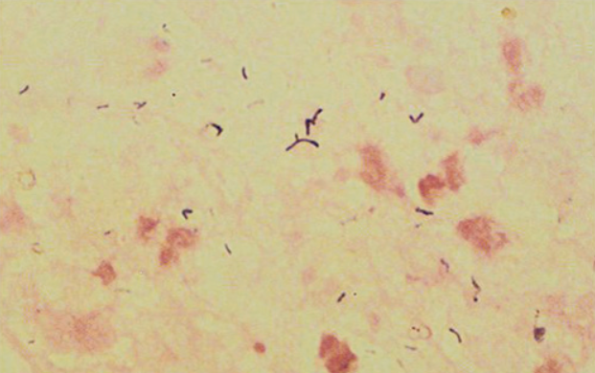
Propionibacterium
In 2016 name changed to Cutibacterium
Causes acne (sebaceous gland blocked + C. acnes colonizes) (Ayer & Burrows, 2006)
Small gram positive rods in short chains or clumps
Commensal anywhere you think you could get a pimple
GRAM POSITIVE RODS
Notes:
Commensal on: skin, conjunctiva, external ear, oropharynx, female genetalia tract
Acne results from blockage of a sebaceous gland and colonization of Cutibacterium acnes
Figure from book

Slide 16
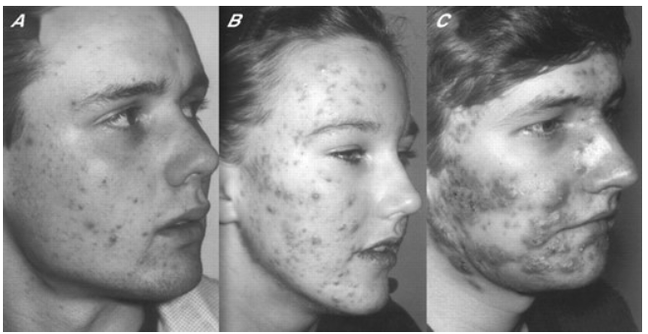
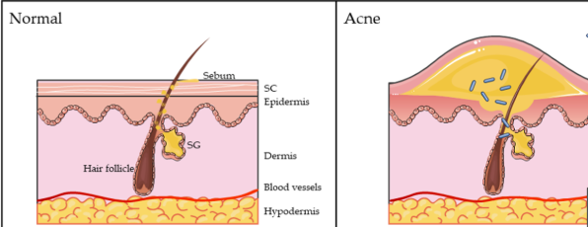
Propionibacterium
How it works (Ayer & Burrows, 2006)
C. acnes colonize the blocked sebaceous gland → increased triglycerides → immune response → eventually ruptures and sebum, bacteria, and lymphocytes released
Ranges from mild to severe
GRAM POSITIVE RODS
(Mosca et al., 2025)
Notes:
Bacteria are phagocytosed and hydrolytic enzymes are released to stimulate local inflammatory response
Colonize follicular duct (opening through which sebum from sebaceous gland is released) and proliferate which produces more triglycerides (because they are gram positive, thick peptidoglycan wall) leading to irritation and local inflammatory response
Anything that causes abnormal follicle/hair growth (puberty) may lead to acne
Commensal, endogenous
Ayer and burrows

Slide 17

Propionibacterium
Treatment
Direct:
Topical treatment with benzoyl peroxide + if needed use oral antibiotics - tetracycline then erythromycin and/or clindamycin (Ayer & Burrows, 2006)
Indirect:
Skin cleaning
Retinoids (Ayer & Burrows, 2006)
GRAM POSITIVE RODS
Notes:
Indirect
Disease is not related to skin cleansing, this will not affect sebaceous gland but can help to keep the duct from being blocked by excess oils and things and help to prevent dysbiosis of the skin
Retinoids to “correct abnormalities in follicular keratinocytes” - not antibiotics, not treating the infection but may help the cause of bacterial infection
Direct treatment of bacterial infection
Topic tx with benzoyl peroxide (oxidizing agent, creates an uninhabitable environment for bacteria, bacteria cannot inquire resistance)
If necessary oral abx in addition to topicals: tetracycline then erythromycin and clindamycin

Slide 18
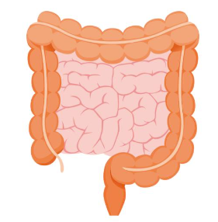
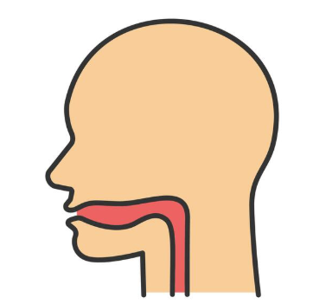

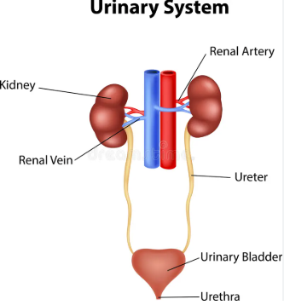
Lactobacillus
Commensal in mouth, stomach, intestine, and genitourinary tract
Most common bacteria in urethra but not the cause of UTIs
Opportunistic pathogen
  Dysbiosis or barrier disruption → bacteremia, septicemia, and/or endocarditis
GRAM POSITIVE RODS
Notes:
Commensal in mouth, stomach, intestine, and genitourinary tract
Don't cause UTI despite prevalence in urethra (cannot grow in urine) but they will invade the blood (opportunistic, only invade if barrier broken)
Bacteremia (bacteria presence in blood) (invade blood from genitourinary source like birth or gynecological procedure)
Endocarditis (ex: dental procedure without prophylactic abx lead to heart infection)
Septicemia (bacteria in blood and lead to infection) – immunocompromised

Slide 19
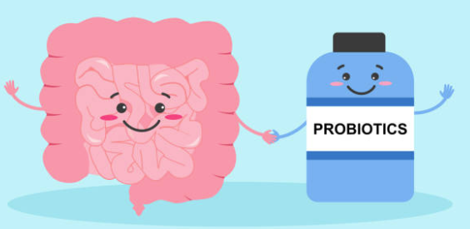
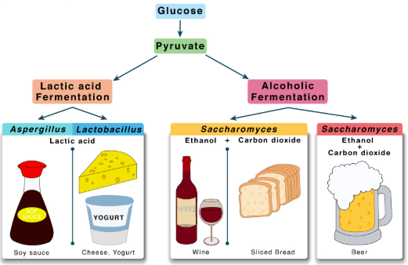
Lactobacillus
Probiotics
Peroxide producing so can contribute to eubiosis by controlling other bacteria and yeasts. This is why Lactobacillus is often in probiotics
Contribute to fermentation based bioprocesses (e.g. yogurt and cheese) due to lactic acid fermentation
Immunocompromised must be careful with probiotics as they can lead to dysbiosis and pathogenesis
GRAM POSITIVE RODS
Notes:
Often used in probiotics because they produce peroxide so can help with GI and urinary biota, of particular note it its presence in vagina where it helps to knockdown yeast and vagina (knockdown yeast)
Immunocompromised people much be careful with probiotics as they can lead to dysbiosis
Ferment lactic acid so also used for yogurt and cheese

Slide 20
Lactobacillus
Treatment
Treatment
Combo of penicillin and aminoglycosides (Elkins & Mullis, 2004)
NOT vancomycin (resistant to this)
Prevention
Prophylactic abx for predictable barrier disruption
GRAM POSITIVE RODS
Notes:
Treat with penicillin and aminoglycosides - if anyone remembers the Actinomyces were specifically not treated with aminoglycosides. This is likely because Aminoglycosides require respiration (oxygen based process) to get into the cell, once they are in they can inhibit protein synthesis. Why would they be necessary for Lactobacillus and not Actinomyces (both are facultative anaerobes). From research I suspect that penicillins degrade the cell wall and then the aminoglycosides are able to get in but in actinomyces the bacteria are in those granules so maybe even with penicillins the aminoglycosides cant gain access? Could also be the location of infection (lactobacillus is heat and blood while actinomyces is mucosa) Could also have to deal with the speed of infection (actinomyces is slow, unsure speed of lactobacillus) and what other bacteria are common in the infection.

Slide 21
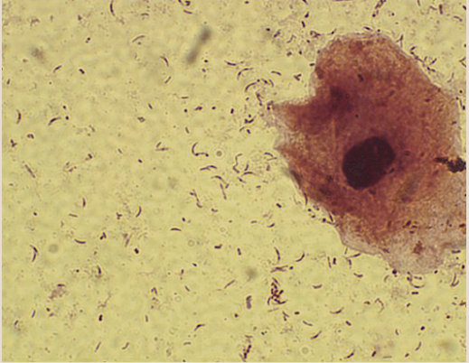
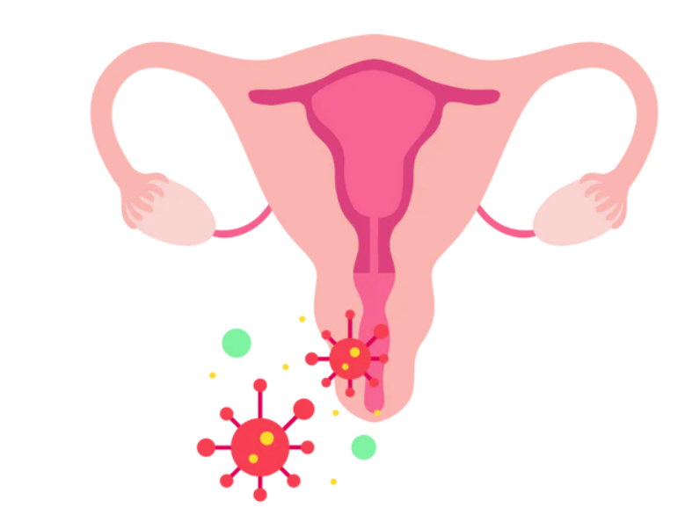
Mobiluncus
When lactobacillus eubiosis disrupted → M. curtisii colonize (non commensal - rare in healthy biota)
M. curtisii prevalent in bacterial vaginosis (aka vaginitis - inflammation of the vagina or vulva)
Gram variable or gram negative curved rods with tapered ends but considered gram positive
Susceptible to
  Vancomycin
  Clindamycin
  Erythromycin
  Ampicillin
GRAM POSITIVE RODS
Notes:
Considered gram positive because cell wall, no endotoxin, and antibiotic susceptibility to Vancomycin, Clindimycin, Erythromycin, and Ampicillin

Slide 22
Review
Anaerobic gram positive rod | Species and notes of importance | Treat with… | Colonize
Actinomyces | Actinomycosis = abscess with sulfur granules | Penicillins | Mucosa
Propionibacterium (aka Cutibacterium) | C. Acnes – cause of acne | Topical: benzoyl peroxide + if needed oral abx- tetracycline | Skin
Lactobacillus | Many species, very commensal (used in probiotics) | Penicillin and aminoglycosides | Mucosa of GI, genitourinary, and mouth but infection of blood or heart
Mobiluncus | M. curtisii – vaginitis | Vancomycin, Clindamycin, Erythromycin, or Ampicillin | Mucosa of vagina
GRAM POSITIVE RODS
Notes:
Mucosa meaning geniturinary tract, abdomen, lungs (pleura), mouth/sinuses, etc…

Slide 23
GRAM NEGATIVE COCCI = NON PATHOGENIC :)

Slide 24
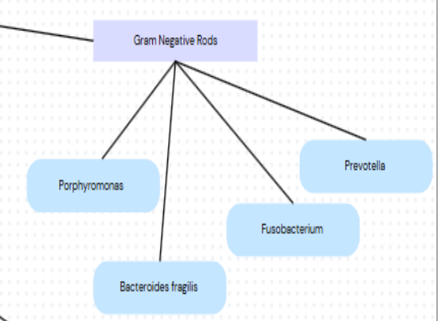
GRAM NEGATIVE RODS
Poor gram stain
Fastidious, slow growers (except B. fragilis)
  Usually mass spectrometry used to diagnose
Most produce short chain fatty acids (succinic acid) which inhibit phagocytosis
Commensal on mucosa but not skin
Endogenous, polymicrobial infections
Penicillin and Cephalosporin resistant
Metronidazole and Carbapenem susceptible
Notes:
Commensal in mucosal surfaces Predominate mucosal surfaces ( 10 to 1000 fold more than aerobes), infection is result of barrier disruption into usually sterile place
Polymicrobial infections of respiratory tract, brain, abdomen, mouth, and genetal tracts
Treat with metro and carbapenems NOT penecillins (they usually have beta lactamasases so they are resistant)
Inherently resistant to phagocytosis thanks to the succinate acid produced from fermentation (probably true for all anaerobes but book only mentioned it for gram negative rods)
Dont stain well and dont culture easily so usually mass spectrometry used for diagnosis

Slide 25
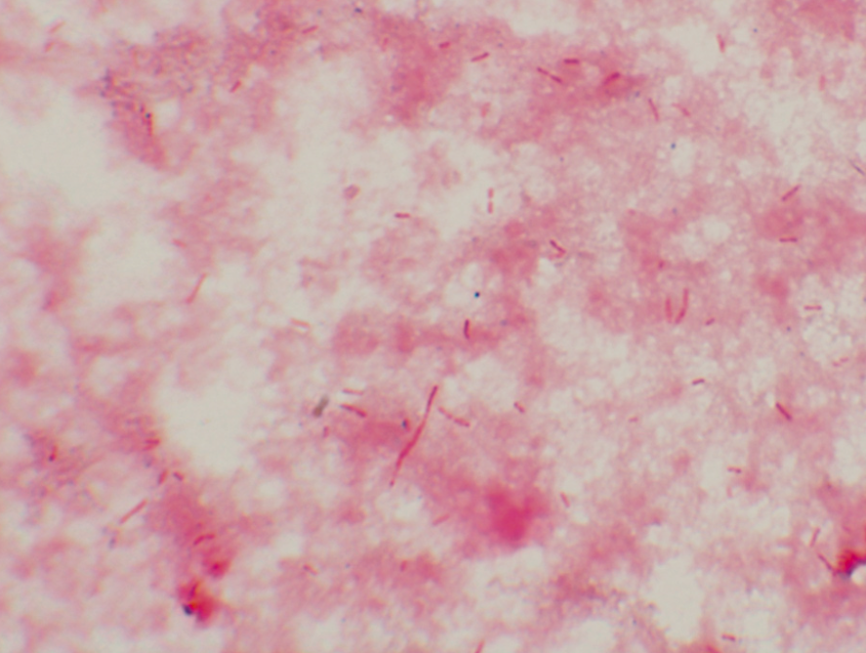
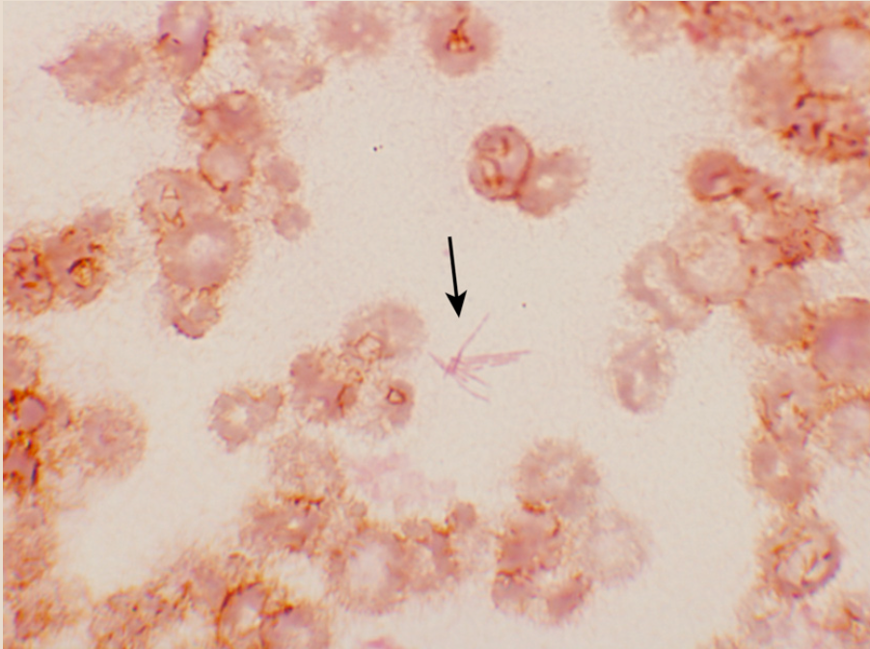
GRAM NEGATIVE RODS - the look
B. fragilis
Fusobacterium
(fusiform)
Notes:
Bacteroides - pleomorphic in size and shape
Fusobacterium - elongated structure in a little clump called a fusiform, not much else to say (head and neck infections, possible bacteremia)

Slide 26
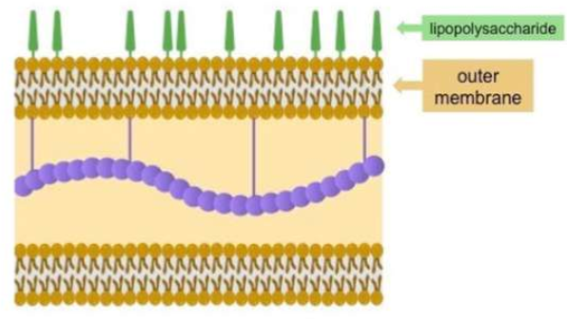
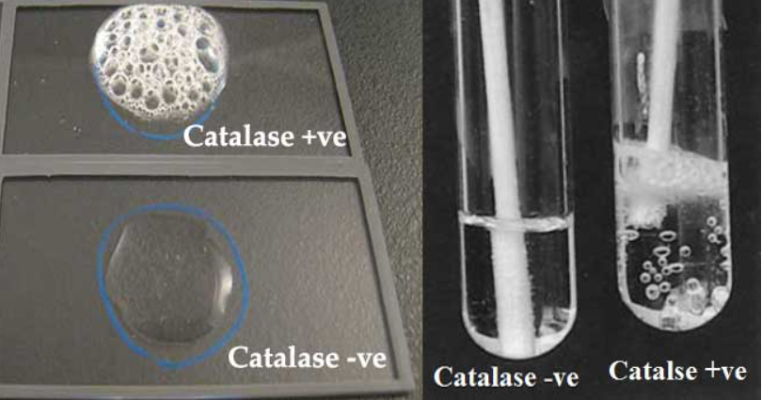

Bacteroides (all)
Growth stimulated by bile
Gram negative → cell wall, LPS but little to no endotoxin
Catalase and superoxide dismutase positive
GRAM NEGATIVE RODS
Notes:
Growth stimulated by bile (made in liver, stored in gall bladder, used in duadeum- first part of intestine) – the book focuses on this being for culturing purposes than pathogenesis although some research shows could infect the liver they are not normal colonizers of it
Gram negative cell wall surrounded by polysaccharide capsule (LPS but has little to no endotoxin activity bc 1. lipid A lacks a phosphate group and 2. number of fatty acids linked to amino sugars is reduced)
Catalase positive and superoxide dismutase (not the case for most anaerobes) -- these inactivate hydrogen peroxide and superoxide free radicals produced by immune system (resist oxidative bursts) thus can tolerate some oxygen exposure
Borrowed pics from prof

Slide 27
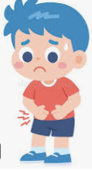
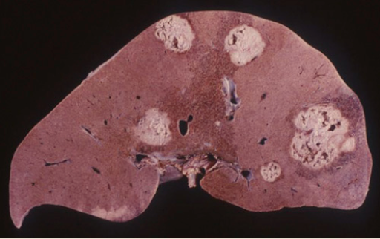
B. fragilis
Infections
Most common is abdominal → inflammatory, watery diarrhea, no blood
  >5 years old
Genital, Pleuropulmonary, and Liver —> usually abscess
GRAM NEGATIVE RODS
Notes:
Intra abdominal infections, genital infections, pleuropulmonary infection but in healthy individuals it is rare to see B fragilis in oropharynx or genital tract or colon (i.e infection is still endogenous but prevalence is due to dysbiosis and lack of biodiversity)
Most common is intra abdominal tract infection (children less than 5)
Usually contributes to abscess formation in gynecologic infections (but can be in other places as well like liver or lungs)
Most of these not involved in skin related disease but if there is a bite or other skin disruption and infection of gram negative rod its probably B fragillis
IF he asks, I think its a

Slide 28
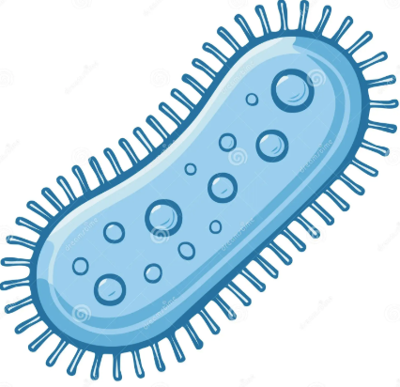
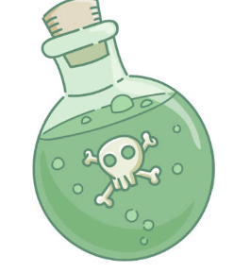
B. fragilis
Virulence
Virulence factors:
  Capsule
  Fimbriae (adherence)
  In intestinal infection: B. fragilis toxin -Bft (heat labile zinc metalloprotease) —> F actin rearrangement —> chloride and water loss —> watery diarrhea
    Toxin also causes IL8 —> inflammation
GRAM NEGATIVE RODS
Notes:
No blood in diarrhea
Not like heat labile in enterotoxogenic e coli because its not an AB protein and works extracellularly (AB proteins get into the cell)
Adhere to epithelia cells or peritoneal surfaces (membrane lining the abdominal cavity) cells through fimbriae and polysaccharide capsule
Capsule is also major virulence factor
B fragilis toxin aka heat labile zinc metalloprotease toxin --- causes F actin rearrangement in the intestinal epithelium leading to chloride secretion and fluid loss, also incudes IL 8 leading to inflammation -- watery D (not bloody) -- usually in kids less than 5 years old
Pathogenicity island unsure if phage or plasmid

Slide 29
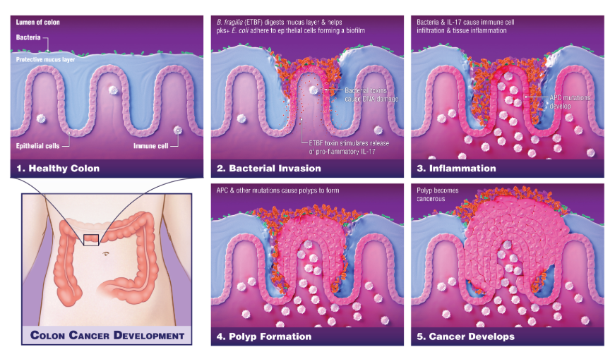
B. fragilis
Cancer Implications
Johns Hopkins Medicine (2018)
GRAM NEGATIVE RODS
Notes:
Implicated in colon cancer due to the inflammation caused by toxin
This paper mentions IL 7 but book mentions IL 8
Proliferation pathways involved are STAT and NFkB
This is proposed mechanism but research is still getting there plus there is a lot of other bacteria which may contribute (this paper only on E coli and B fragilis), for now research can conclude that B fragilis is more prominent in CRC (colorectal cancer) patients and may be used in screening (PCR)
Some strains of B. fragilis are non pathogenic and can actually increase the health of the biome leading to decreased inflammation

Slide 30
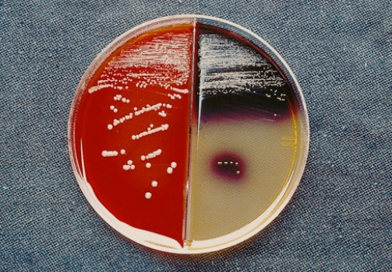
B. fragilis
In the lab
Grows fast (within 2 days)
Bile-esculin agar (BEA) with gentamicin —> black precipitate
GRAM NEGATIVE RODS
Notes:
Grow fast in culture within 2 days, supplement media with bile -- bile esculin agar (most other inhibited by bile and gentamicin but fragilis stimulated by bile and resistant to gentamicin and can hydrolyze esculin leading to black precipitate)
Reminder: tx with metronidozole or carbapenems

Slide 31
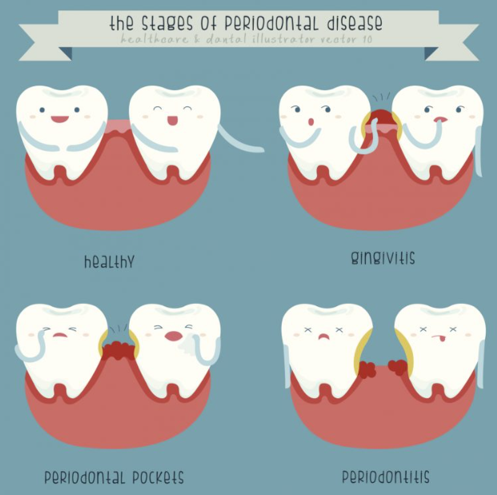
Porphyromonas
Capsule
Fimbriae
Proteases which degrade immunoglobulins
P. gingivalis
  As name implies, this is involved in gingivitis and gum disease
  Causes inflammation
GRAM NEGATIVE RODS
Notes:
Small
Same pathogenesis as B. fragilis except they also produce proteases which degrade immunoglobulins
P. gingivalis is notes to induce expression of proinflammatory cytokines like TNF alpha and IL 8
As name implies, this is involved in gingivitis and gum disease
Pic from dental office website

Slide 32
Infections are polymicrobial
Anaerobic gram negative rod | Virulence | Species of note
Bacteroides | Capsule, fimbriae, Bft | B. fragilis
Porphyromonas | Capsule, fimbriae, proteases | P. gingivalis
Prevotella | Capsule, fimbriae, proteases | P. melaninogenica
Fusobacterium | Capsule, proteases | F. nucleatum
Treat with metronidazole and/or carbapenems
GRAM NEGATIVE RODS
Notes:
Polymicrobial infections of respiratory tract, brain, abdomen, mouth, and genetal tracts
Treat with metro and carbapenems

Slide 33
References
Ayer, J., & Burrows, N. (2006). Acne: More than skin deep. Postgraduate Medical Journal, 82(970), 500–506. https://doi.org/10.1136/pgmj.2006.045377
Cheng, W. T., Kantilal, H. K., & Davamani, F. (2020). The mechanism of Bacteroides fragilis toxin contributes to colon cancer formation. Malaysian Journal of Medical Sciences, 27(4), 9-21. https://doi.org/10.21315/mjms2020.27.4.2
Elkins, C. A., & Mullis, L. B. (2004). Bile-mediated aminoglycoside sensitivity in Lactobacillus species likely results from increased membrane permeability attributable to cholic acid. Applied and Environmental Microbiology, 70(12), 7200–7209. https://doi.org/10.1128/AEM.70.12.7200-7209.2004
Gajdács, M., Urbán, E., & Terhes, G. (2019). Microbiological and clinical aspects of cervicofacial actinomyces infections: An overview. Dentistry Journal, 7(3), 85. https://doi.org/10.3390/dj7030085
Hajikhani, N. N., Amir, A. V., Firoozeh, F., Sameni, F., Yaslianifard, S., Goudarzi, M., & Dadashi, M. (2024). Association between colorectal cancer, the frequency of Bacteroides fragilis, and the level of mismatch repair gene expression in the biopsy samples of Iranian patients. BMC Gastroenterology, 24, 1-9. https://doi.org/10.1186/s12876-024-03169-z
Johns Hopkins Medicine. (2018, February 21). Bacteria play a critical role in driving colon cancers. Johns Hopkins Medicine. https://www.hopkinsmedicine.org/news/newsroom/news-releases/2018/02/bacteria-play-critical-role-in-driving-colon-cancers
Mosca, S., Ottaviani, M., Briganti, S., Di Nardo, A., & Flori, E. (2025). The sebaceous gland: A key player in the balance between homeostasis and inflammatory skin diseases. Cells, 14(10), 747. https://doi.org/10.3390/cells14100747
Patrick, M., Ken, R., & Michael, P. (n.d.). Medical microbiology (9th ed.). Elsevier Health Sciences. https://reader.yuzu.com/books/9780323673228
Shah, U. (2013). Infections of the liver. In Diseases of the liver in children (pp. 285–312). Springer. https://doi.org/10.1007/978-1-4614-9005-0_15

Slide 34
QUESTIONS?

