Slide 1

Atmospheric Rivers: What are they and why are they important to the Western US?
GEOG 312U, Portland State University
10/09/2017
Dr. Andrew Martin
Assistant Project Scientist, CW3E/SIO; Affiliate Faculty, PSU Dept. of Geography

Slide 2
Outline
What is an Atmospheric River and why are ARs important?
What disciplines does AR research combine?
What is the Low-Level Jet? Why is it a defining feature of ARs?
Web Resources to Learn More

Slide 3
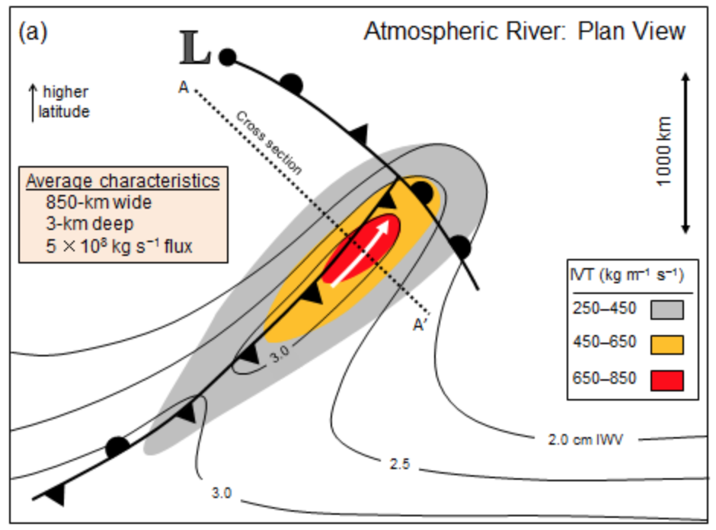
What is an Atmospheric River?
American Meteorology Society Glossary of Meteorology:
“A long narrow and transient corridor of anomalously strong horizontal water vapor transport that is typically located in the lowest 3 km of the troposphere and associated with a low-level jet stream ahead of the cold front of an extratropical cyclone…”
Other (Regional) Names:
“Pineapple Express”
“Mayan Express”
What is an AR?

Slide 4
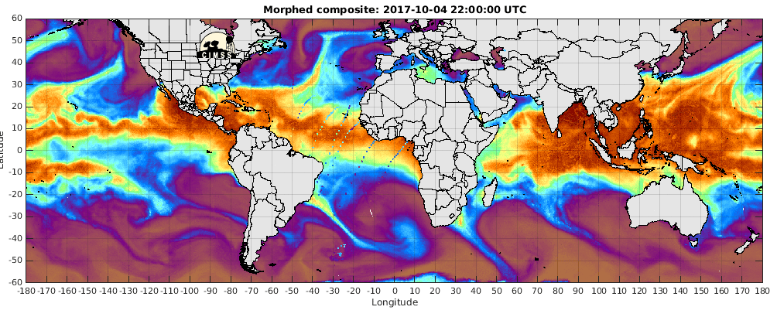
What is the role of ARs in the Atmosphere?
This animation shows integrated water vapor (IWV– mm).
Using IWV is an older and less quantitative way to detect an AR.
The most up-to-date criteria will be discussed next.
Zhu and Newell (1998) demonstrated that ARs occur in every ocean basin around the globe, and are the primary mover of water vapor from the tropics to the polar regions.
Even though ARs occupy only 10% of any given line of latitude in the extratropics, they are responsible for ~90% of the horizontal poleward transport of water vapor
What is an AR?

Slide 5
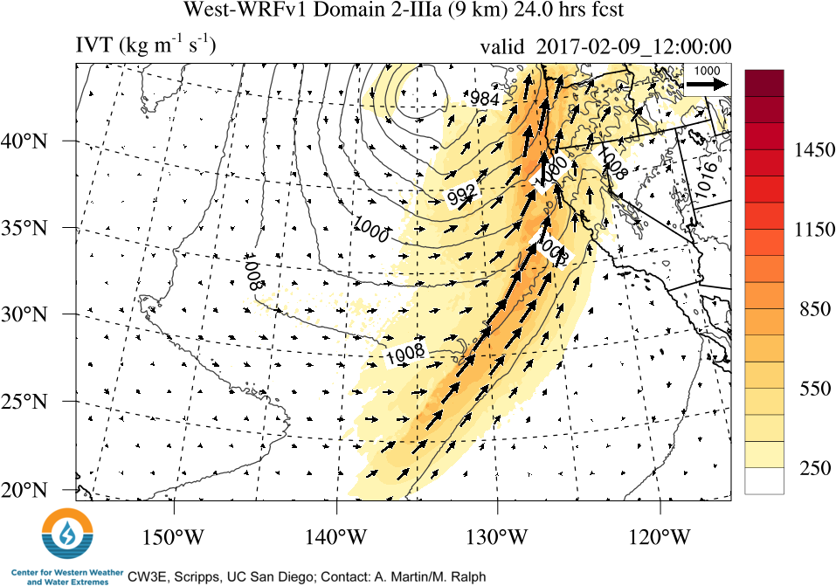
How Do I Know Its an Atmospheric River?
L
Must have:
Integrated Vapor Transport (IVT) > 250 kg m⁻¹ s⁻¹
A length (along IVT vectors) > 1000 km
A width (across IVT vectors) < 1/2 its length
IVT flows from equator to pole and/or west to east
Is supported by a nearby extratropical cyclone
The example here has maximum IVT value > 1000 kg m⁻¹ s⁻¹. A new proposed AR strength scale would define this as a “very strong” AR.
What is an AR?

Slide 6
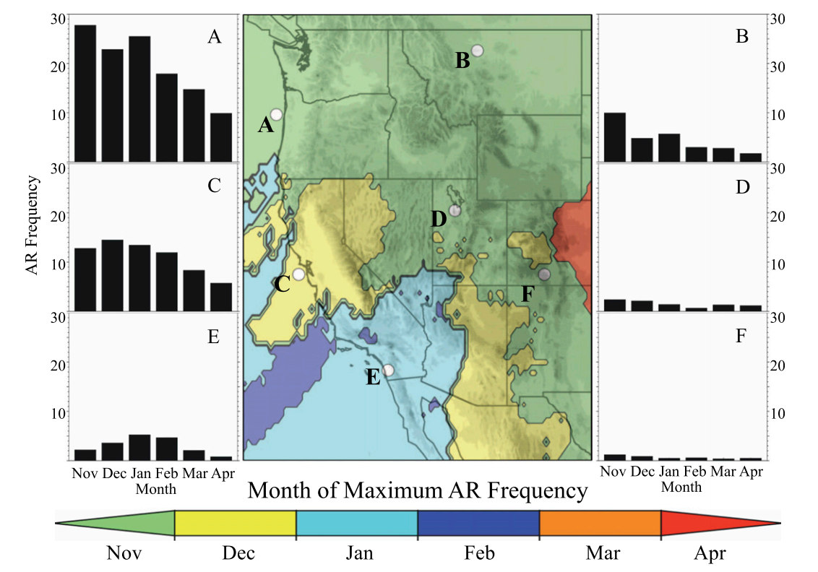
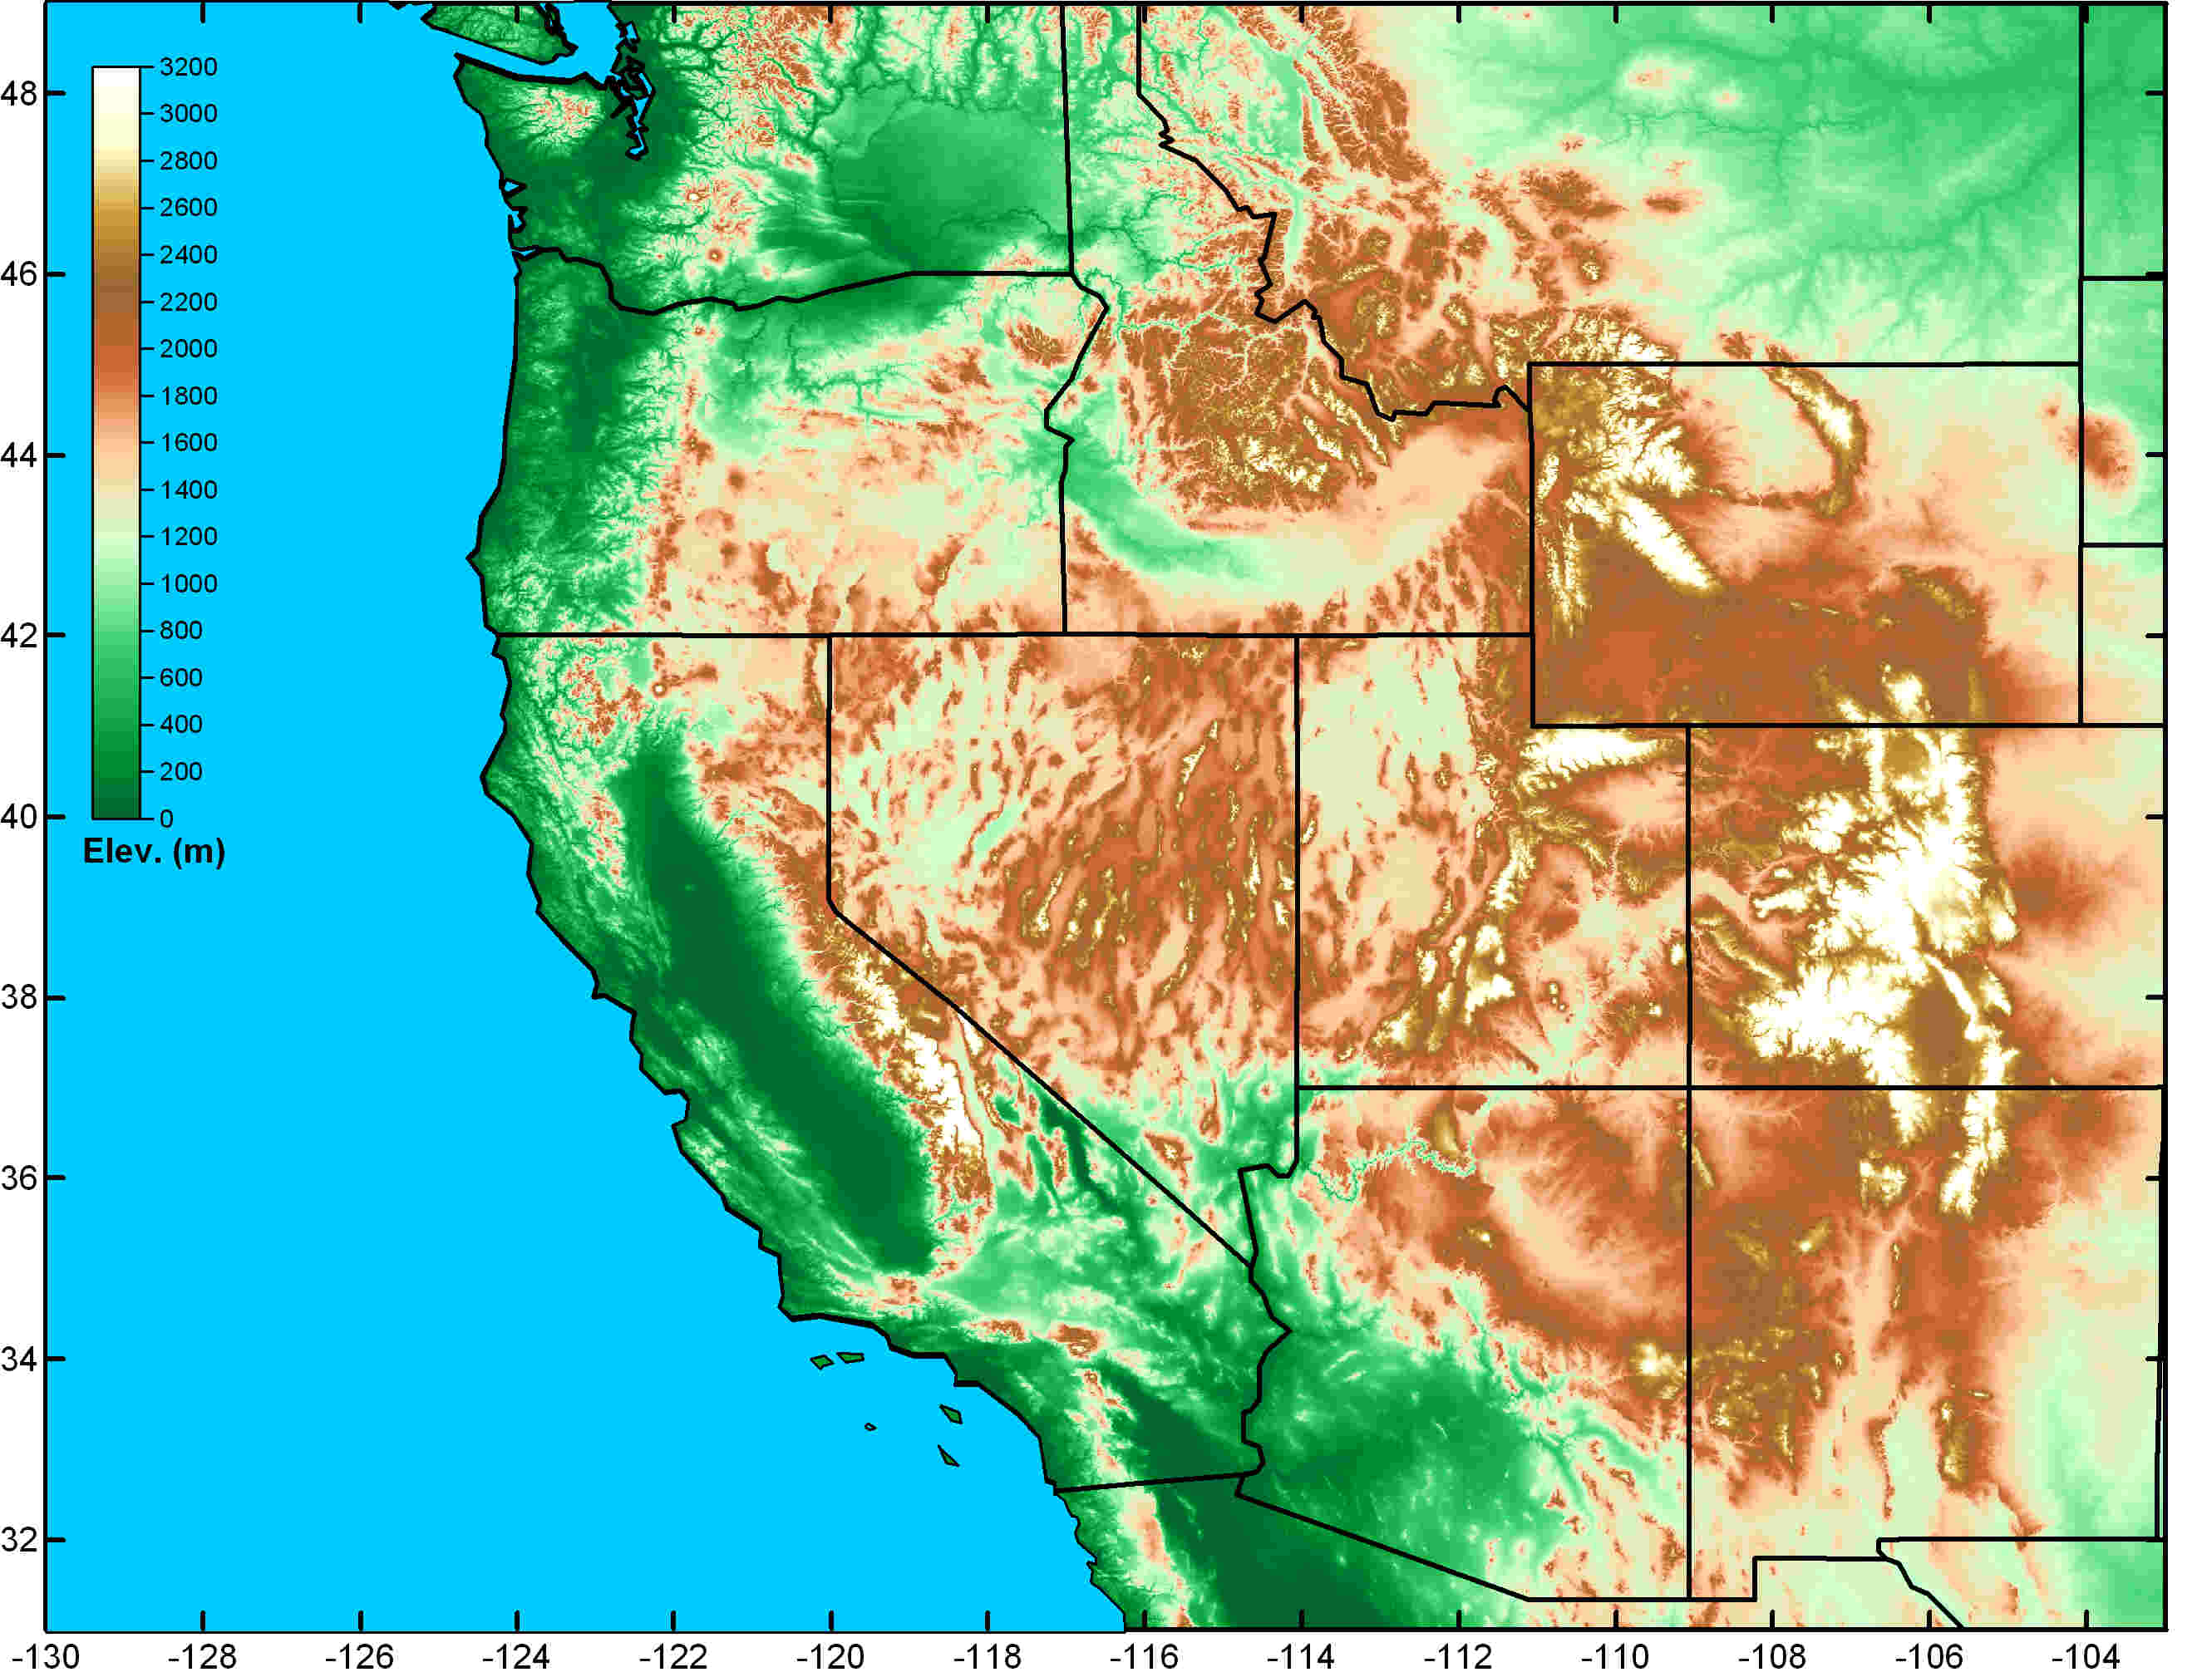
AR Region of Influence and Seasonality
Region of major atmospheric river influence
“Frequency” is % days in dataset that ”AR conditions” were met.
What is an AR?
Rutz et al. (2014) Mon. Wea. Rev.

Slide 7
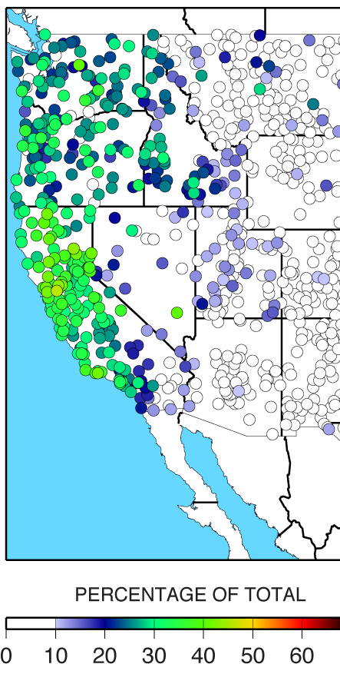
AR Contributions to Water Resources in the West
Why are ARs important?
Though AR are most frequent in PNW, they are most important to total water supply in CA
ARs Provide beneficial rain and snow for water supply
Region of major atmospheric river influence
25% - 45% of annual precipitation in the west coast states fell on the same day an atmospheric river was present.
Flooding on CA’s
Russian River
From Neiman et al. 2013
What is an AR?
Dettinger et al. (2011) Water

Slide 8
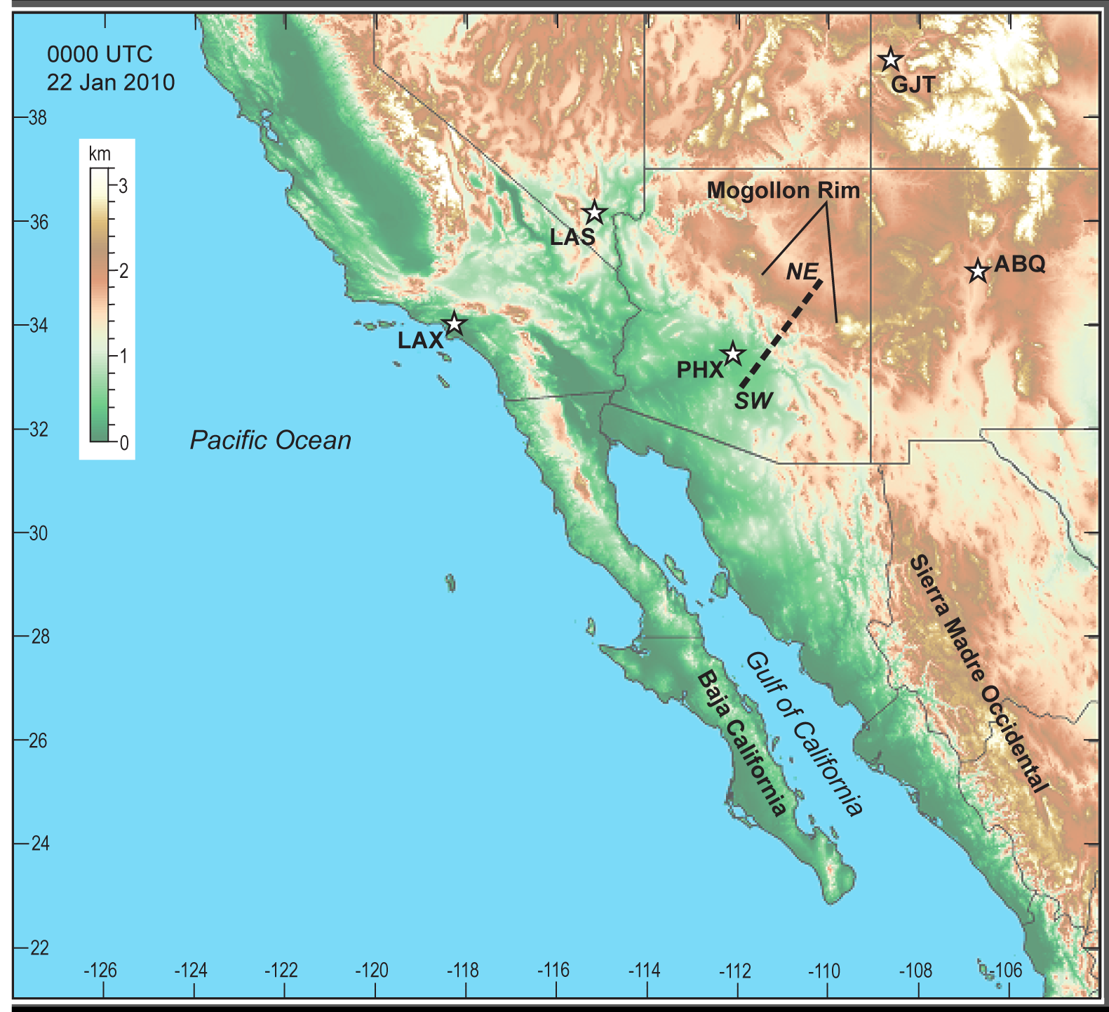
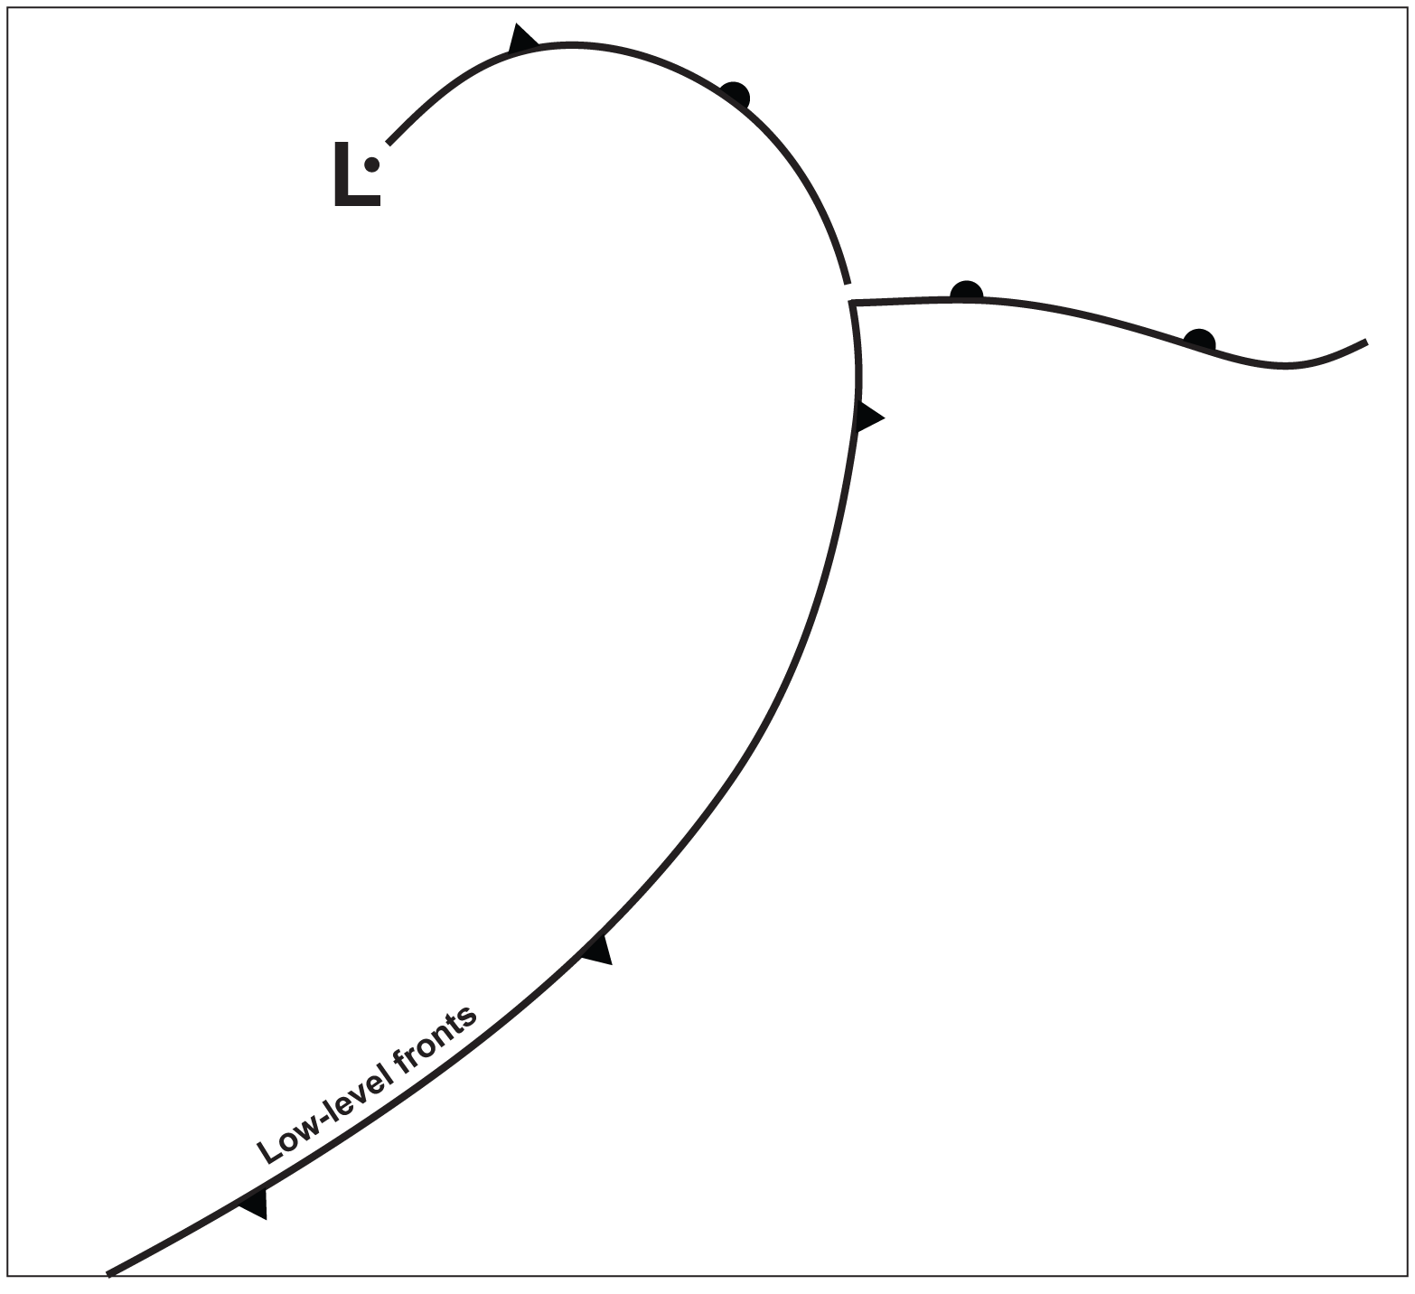
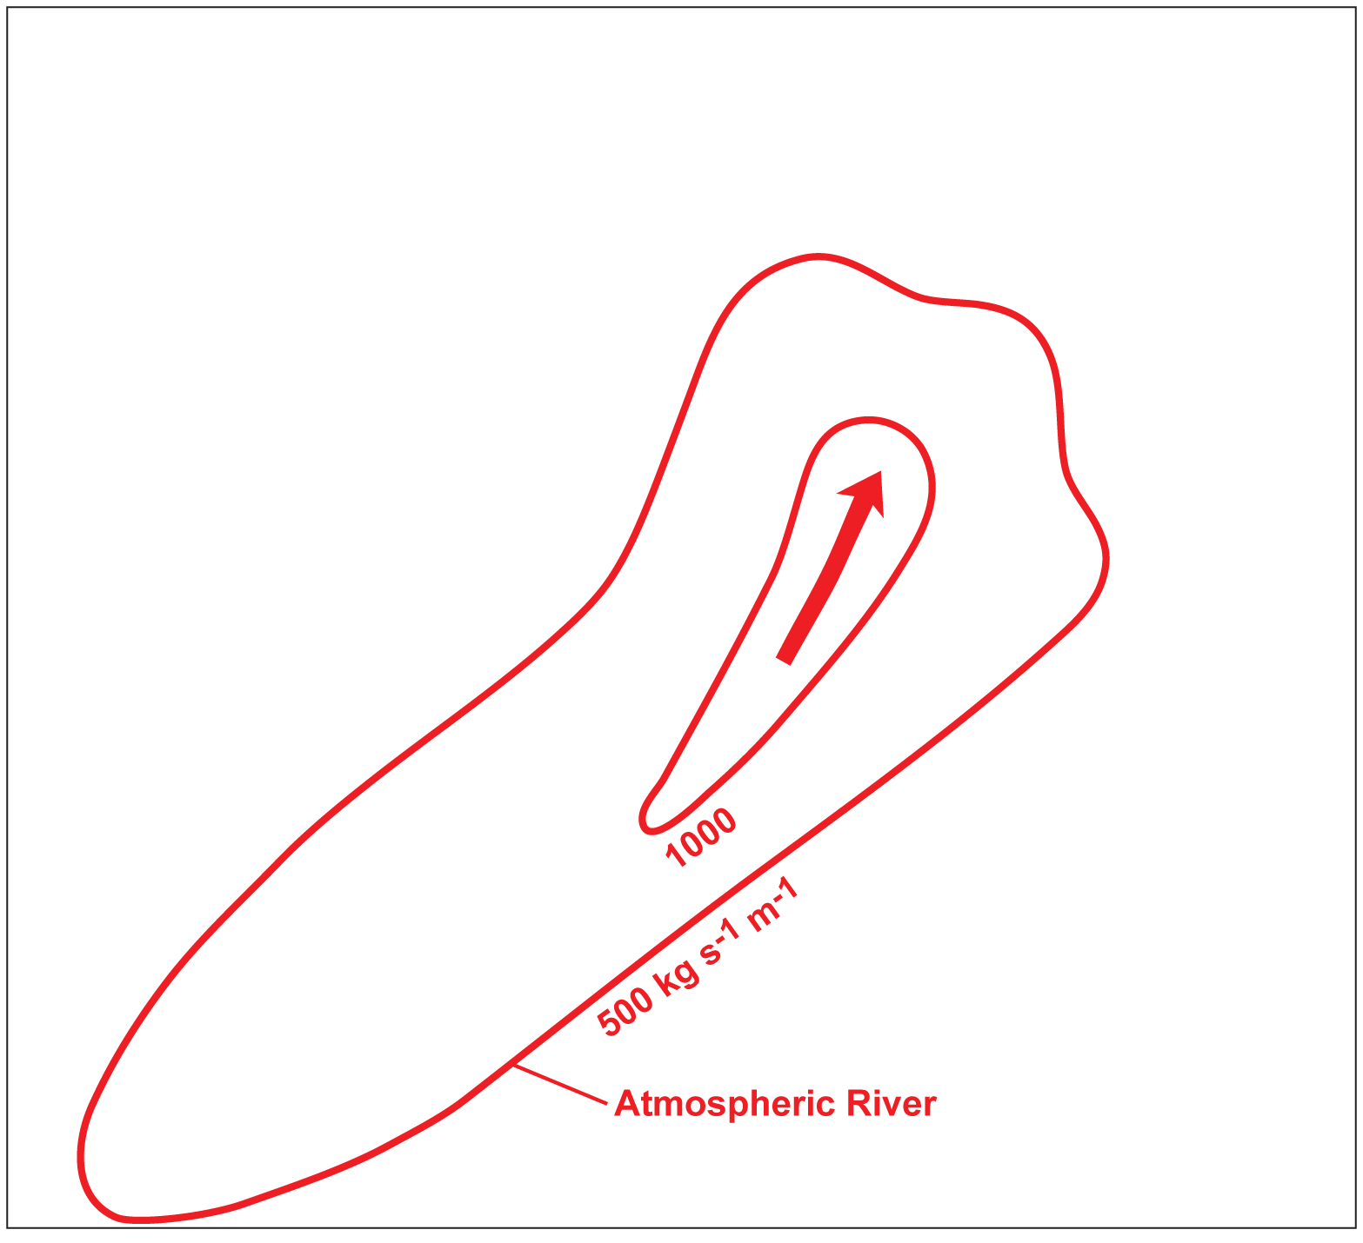
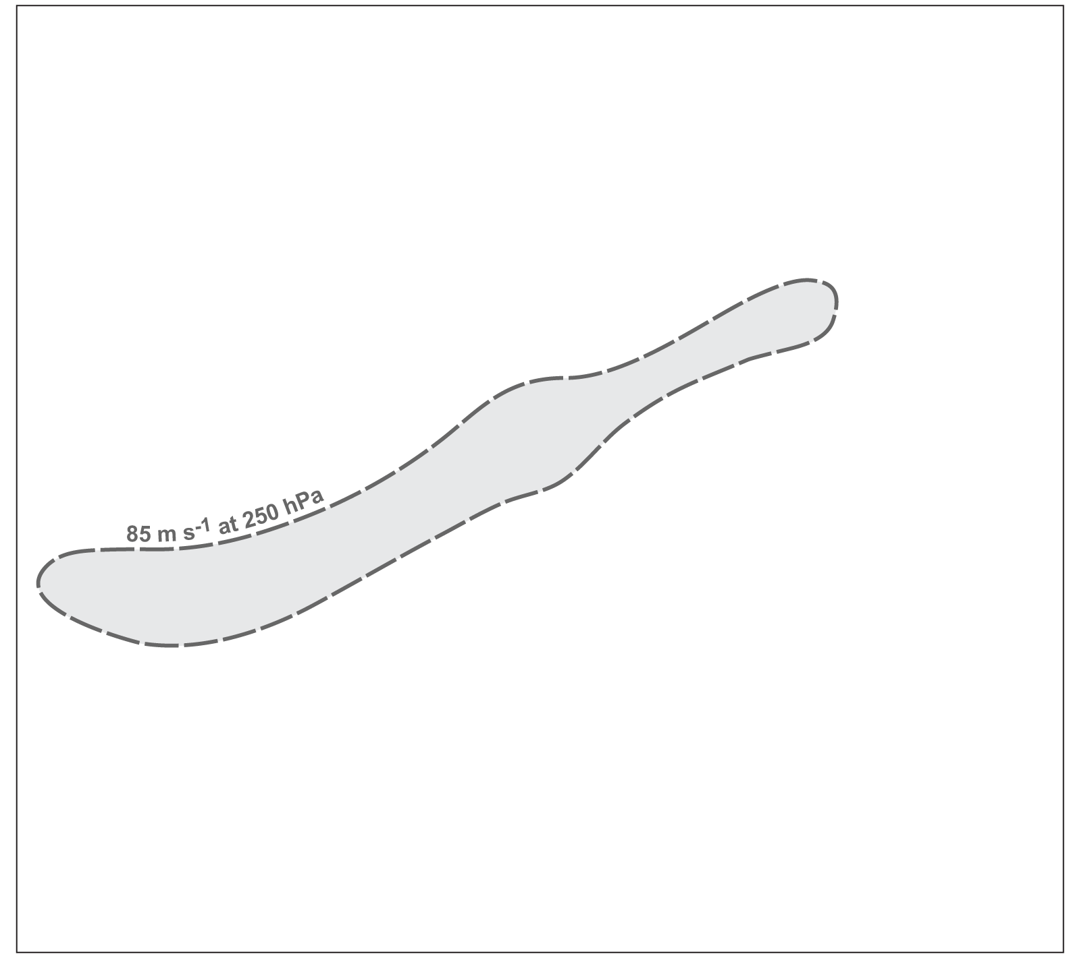
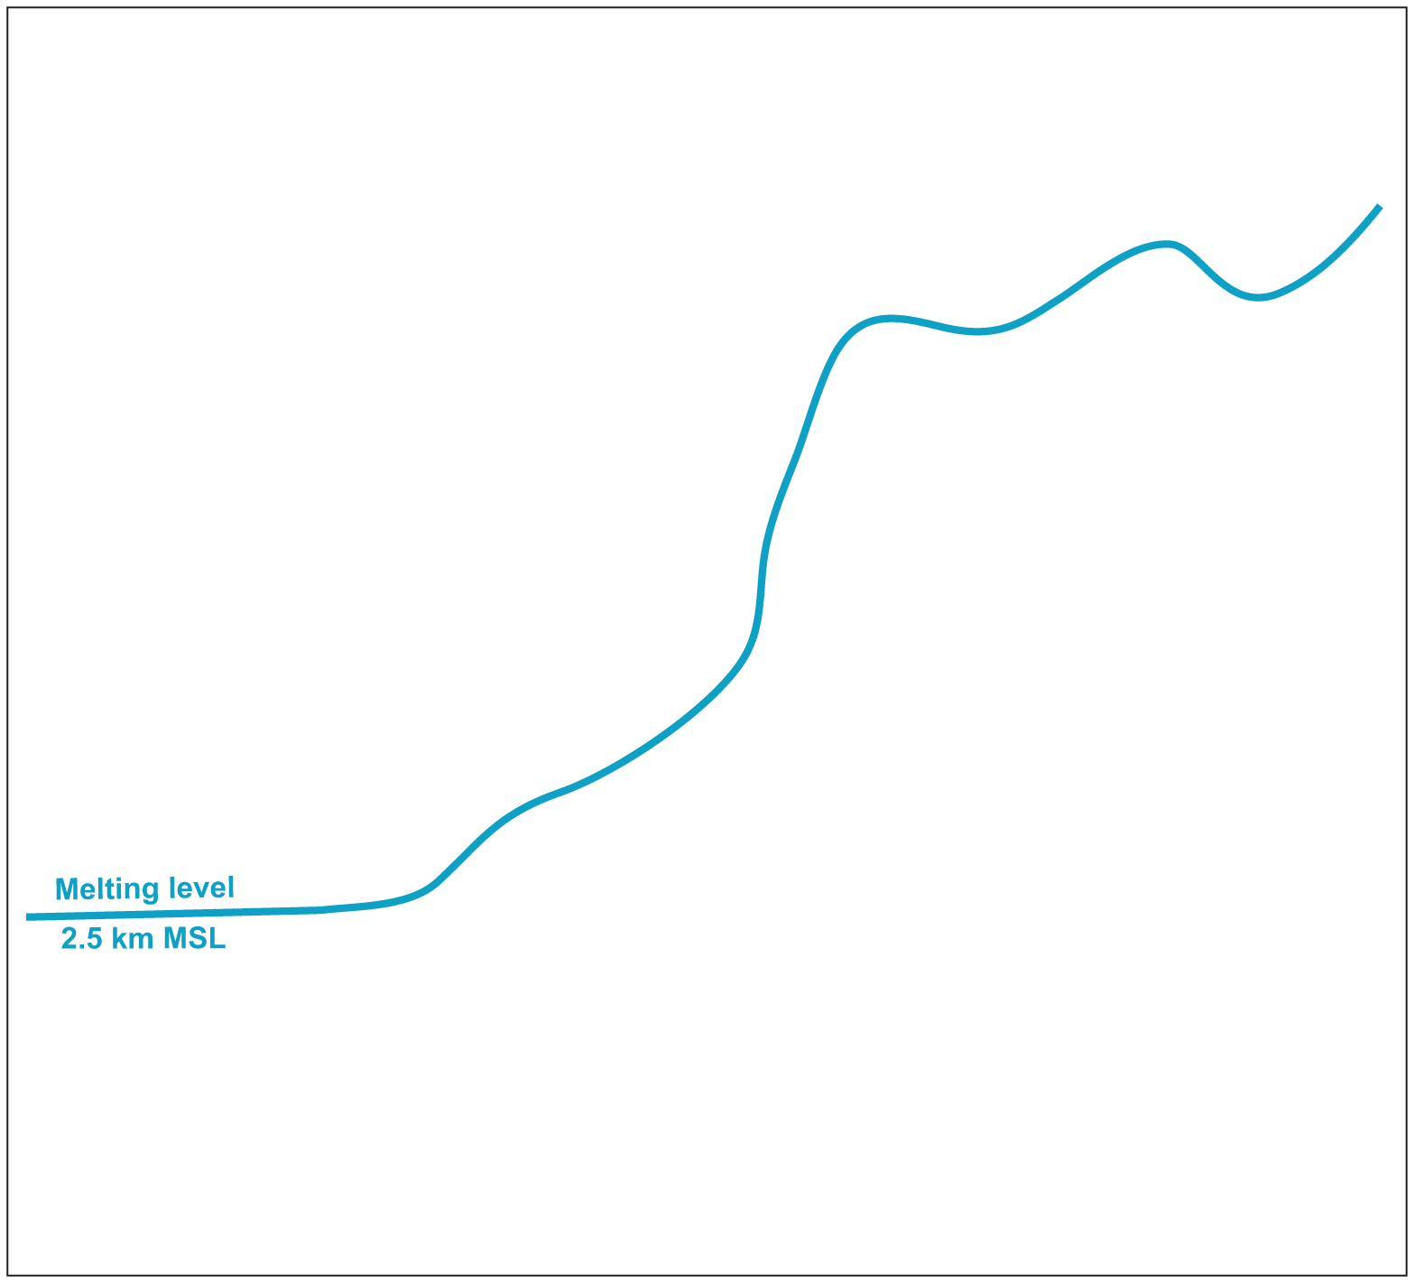
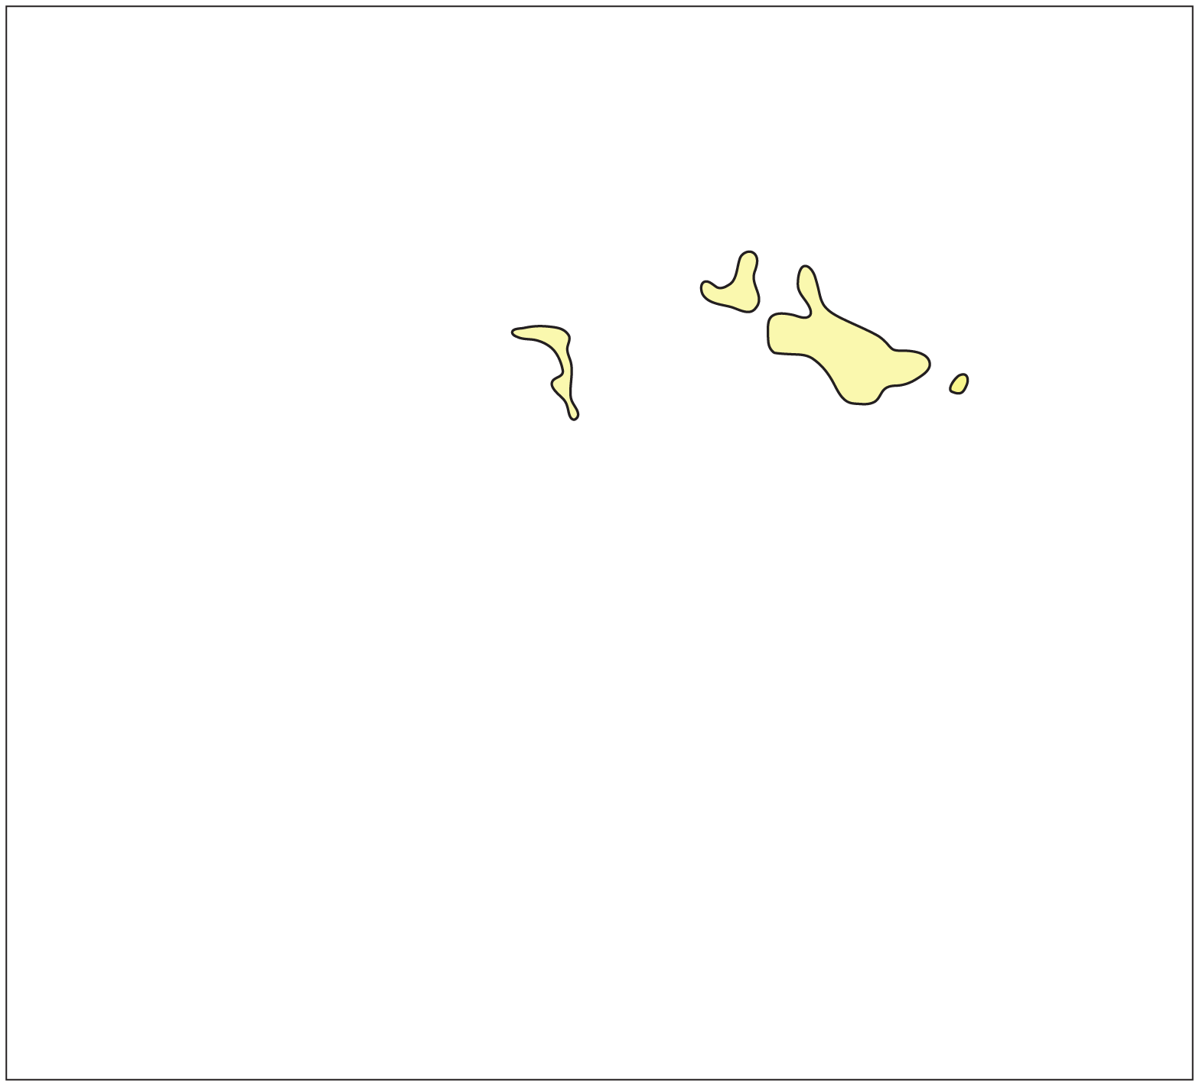
Meteorological Details of a Very Strong AR
A Schematic of Dynamic Meteorological Features Associated with an AR that Caused Flooding in Central AZ (2010).
Extratropical Cyclone (“L”), occluded, warm and cold fronts in black.
AR extent (by Integrated Vapor Transport –
kg m⁻¹ s⁻¹) and low-level jet (LLJ - arrow) in red.
AZ AR Case Study
Neiman et al. (2013) J. Hydrometeor.

Slide 9
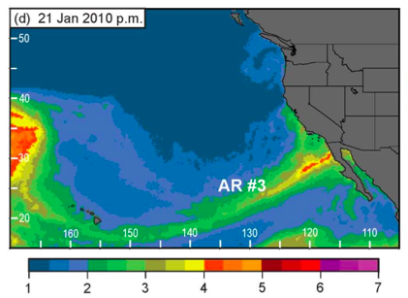
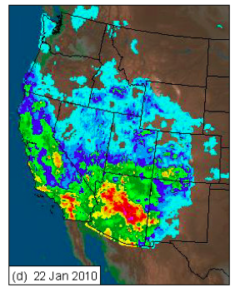

Impacts of the Central AZ Very Strong AR
Integrated Water Vapor (cm)
The AR was the last in a succession of 3 impacting S. CA / AZ.
From Neiman et al. 2013
Quantitative precipitation estimation (mm)
AZ AR Case Study
Neiman et al. (2013) J. Hydrometeor.

Slide 10
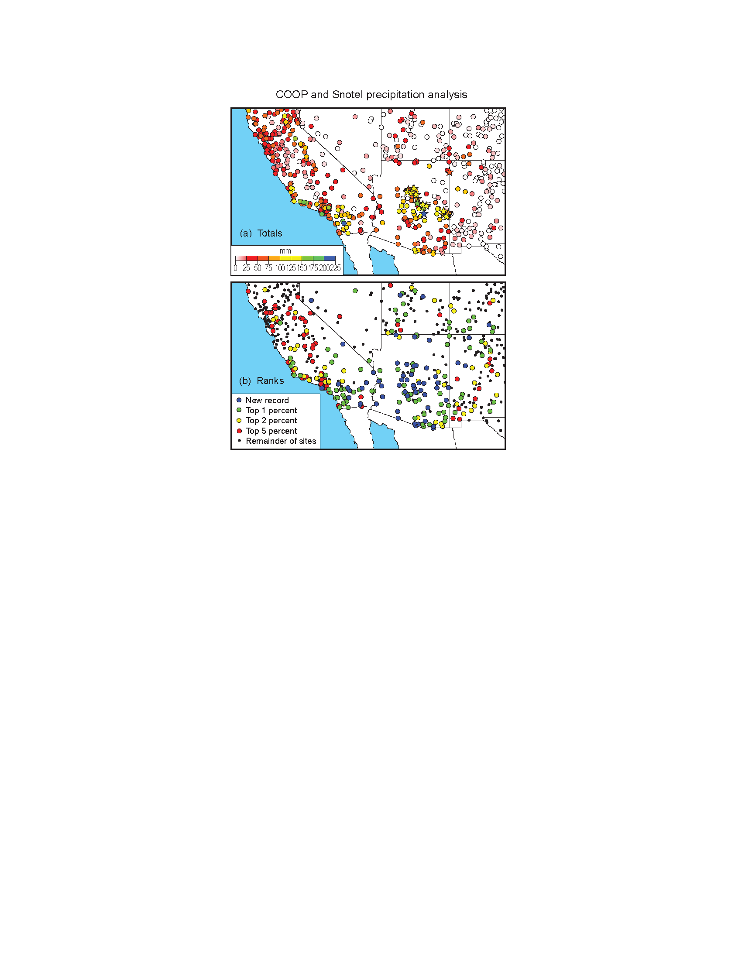
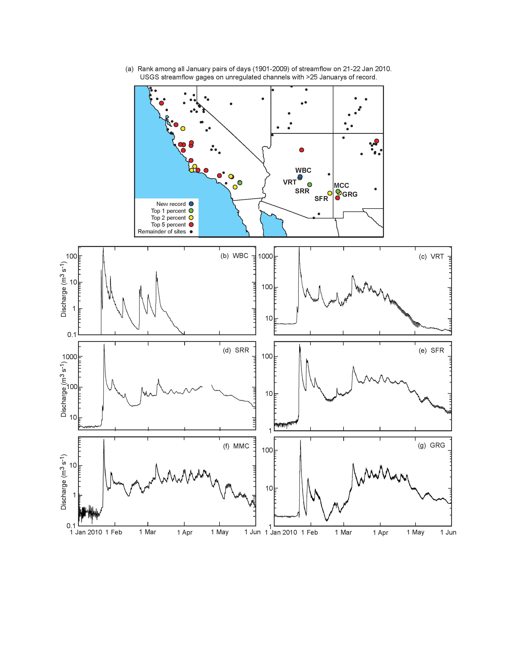
Climate Perspective of the Central AZ AR
“Rank” of COOP precip on 21-22 Jan. 2010.
“Rank” of USGS streamflow on 21-22 Jan. 2010 for unregulated channels.
AZ AR Case Study
Neiman et al. (2013) J. Hydrometeor.

Slide 11
Review of General AR Concepts
AR are defined by their prodigious horizontal water vapor transport.
They are rivers not in the sense that liquid water flows through stream channels, but in that water vapor flows in dynamic atmospheric “guides” (between the cold and warm front of an extratropical cyclone).
ARs influence nearly every region of the Western US, but are most frequent in the Pacific Northwest. Though they are more rare elsewhere (e.g. California), they play a larger role in yearly water supply (CA) or in driving flood events (Arid regions of the interior west).

Slide 12
Multi-Disciplinary AR Research
Meteorology
Atmospheric Chemistry
Hydrology
Climate Sciences
Water Resource Policy and Engineering

Slide 13
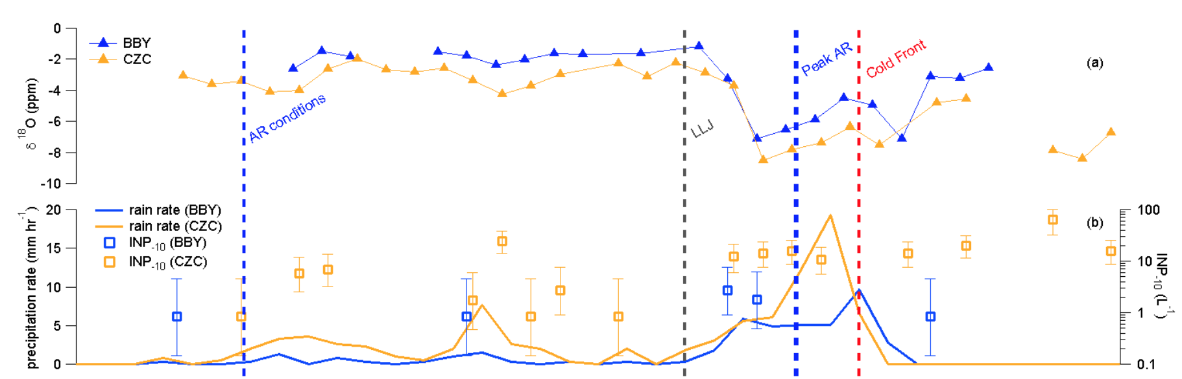
Atmospheric Chemistry
A Key Question: How Do the Trace Elements in Clouds Impact AR Precipitation?
How Does AR Dynamics Influence the Trace Elements in Clouds?
Blue measurements come from rainwater collected at a site in coastal N. CA during an AR with max. IVT > 900 kg m⁻¹ s⁻¹
Orange measurements come from rainwater collected at a site less than 40 km away on a nearby mountaintop.
These two sites have traditionally been studied together to learn about orographic processes during AR.
Top Panel:
“heavy” isotopic content of rain to infer water age
Bottom Panel:
Probability of freezing of rainwater to infer influence of chemistry on cloud ice.
AR and Atmospheric Chemistry
Martin et al. (In-Prep) Atmos. Chem. Phys.

Slide 14
Hydrology
A Key Question: How does the seasonal cycle of AR precipitation influence soil wetness and streamflow?
After deep (100 cm) soil moisture crossed and stayed above 0.5 m³ m⁻³, the proportional generation of streamflow by precipitation increased 7-fold.
AR and Hydrology
Lamjiri et al. (In-Prep.)

Slide 15
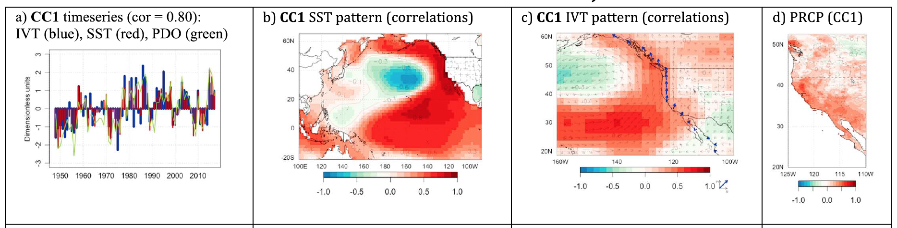
Climate Sciences
A Key Question: Do known patterns of intrinsic climate variability influence AR and their precipitation?
Canonical Correlation Analysis Reveals that a dominant mode of sea-surface temperature, IVT and precipitation co-variability may also strongly resemble the Pacific Decadal Oscillation.
AR and Climate Variability
Gershunov et al. (2017) Geophys. Res. Lett.

Slide 16
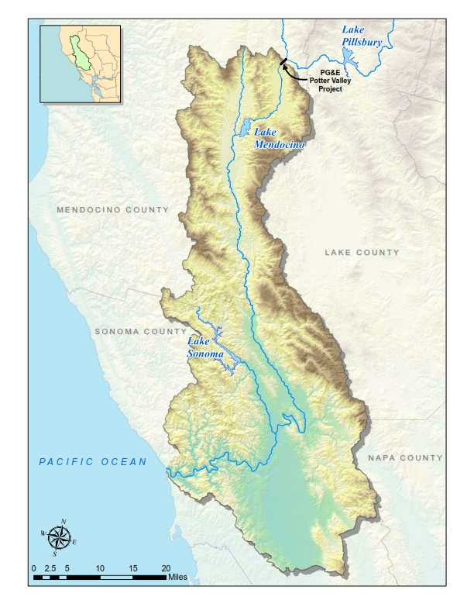
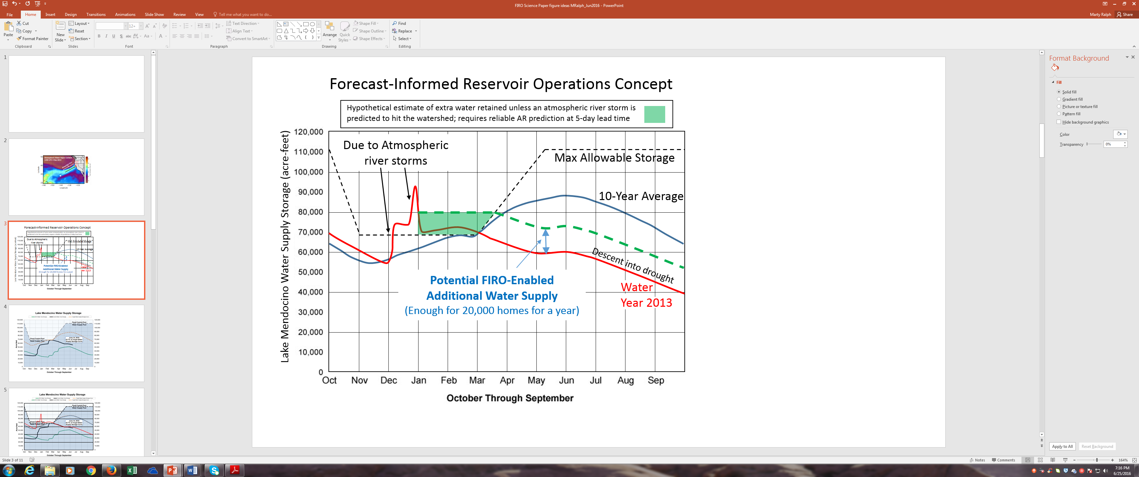
Water Resources Policy and Engineering
A Key Question: How much water can be left behind a dam during AR season to ensure maximum water supply but minimum flood risk?
Flow travel time from Lake Mendocino to Guerneville: 1-3 days
Lake Mendocino
Max. allowable storage 110,000 acre-feet (summer), 68,000 acre-feet (winter)
Russian River Watershed
0.95 million acres,
1.6 million acre-feet annual discharge
Guerneville
(a)
(b)
AR and Water Resources Policy and Engineering

Slide 17
Review of multidisciplinary AR research
Studying the trace chemical constituents of AR precipitation allows us to learn more about the sources of water vapor and the role of clouds in removing rare chemicals from the atmosphere
Studying hydrology in the context of ARs has yielded insight into the role that early-season soil wetting plays in determining river flow
Studying climate variability has yielded new understanding of how ARs and western US precipitation may be modulated on multi-decadal scales.
Studying the design of reservoirs in the context of their largest storms (AR) could yeield societal benefits in both water supply and flood risk mitigation.

Slide 18
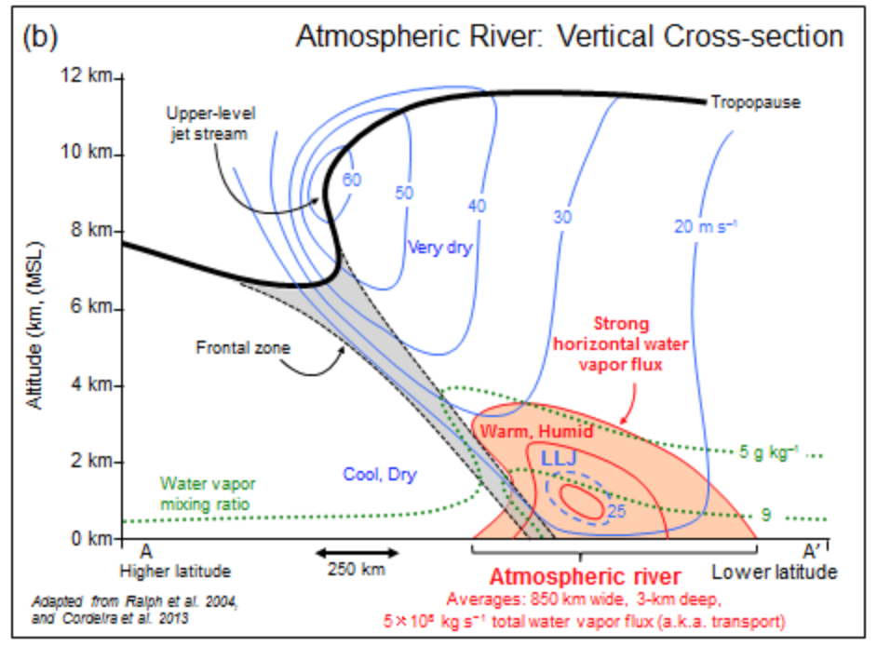
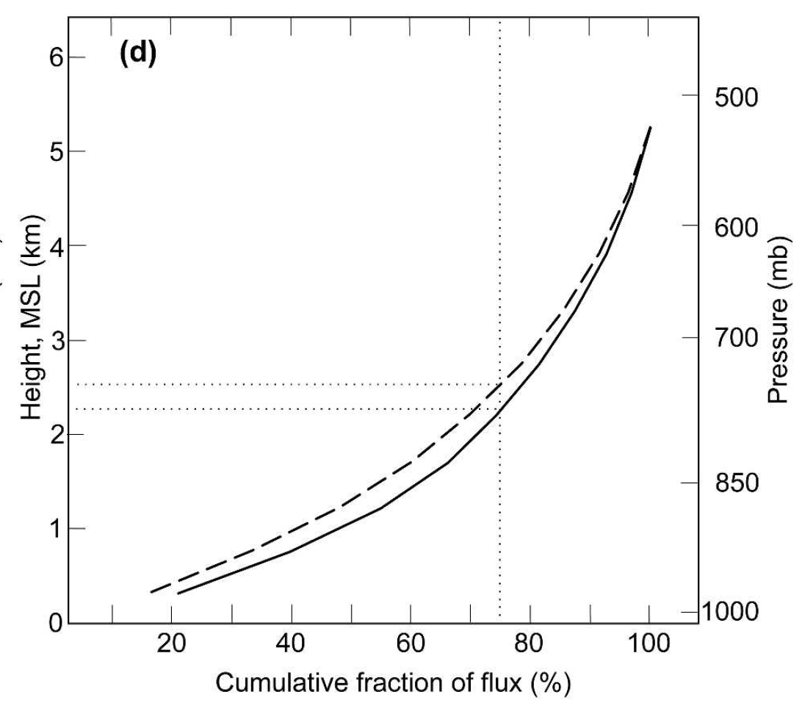
The Low-level Jet: Significance to AR Moisture Flux
Ralph et. al. (2005) examined 17 vertical profiles of moisture flux in AR over the Pacific Ocean and found that 75% of the total moisture flux occurred at heights below 2.5 km. The conceptual cross-section shown earlier is from this early work. In other words, even though both low-level and upper-level jets are often found in or near AR, it is the low-level jet that moves more moisture
Moisture flux composite
The LLJ: Significance
Ralph et al. (2005) Mon. Wea. Rev.

Slide 19
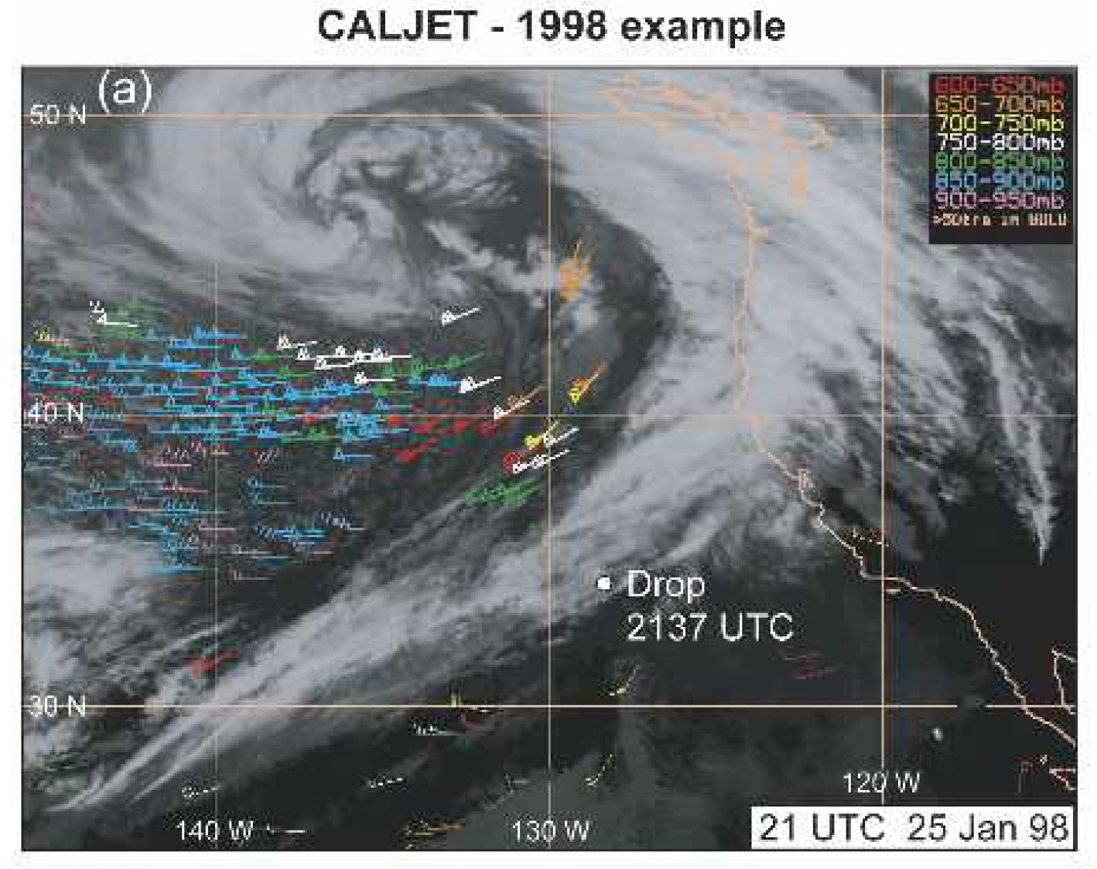
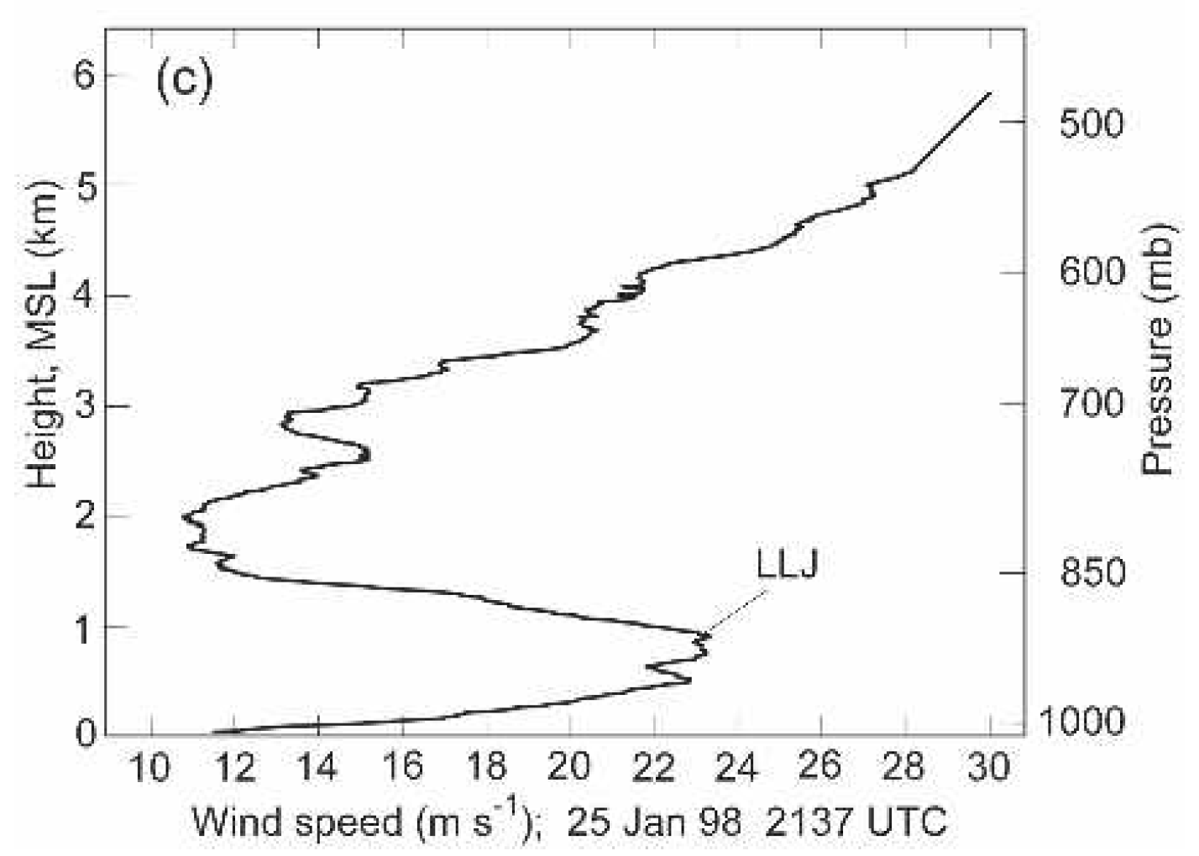
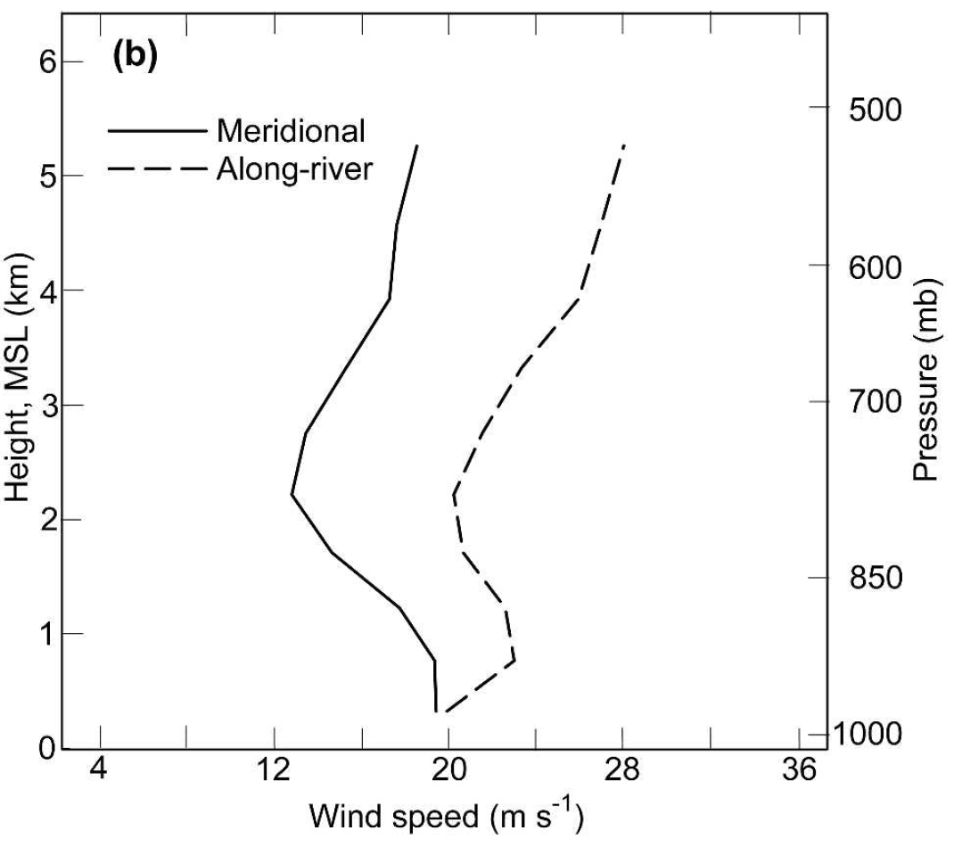
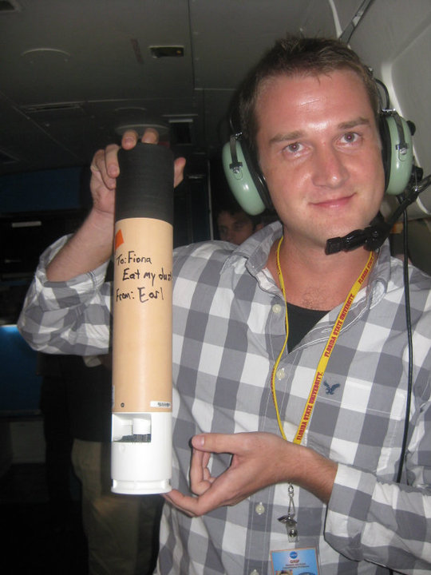
A Study to Measure Errors in the Modeled Low Level Jet
L
Ralph et. al. (2005) examined 17 dropsondes in AR from 2 airborne science campaigns and found that the low-level jet stands out in a composite of events. Since that time, new airborne science efforts have extended this analysis using hundreds of dropsondes..
Speed greater here..
AR
Satellite-derived winds shown by colored wind barb
Wind speed composite
Airborne dropsondes, such as the one on the left, can provide a vertical profile of meteorological variables in offshore AR.
But more moisture is in motion here
The LLJ: Measuring Errors in Forecasts
Martin et al. (In-Revision) J. Hydrometeorology
A. Martin 05/2017

Slide 20
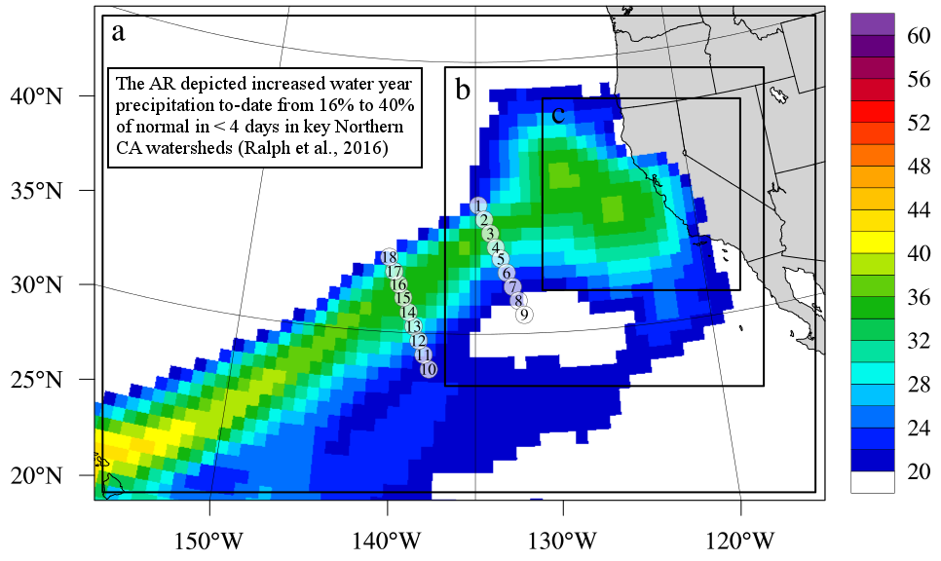
A Study to Measure Errors in the Modeled Low Level Jet
The CalWater experiment (2014-2015) provided 15 AR-normal transects by dropsonde instrumented aircraft.
Shown to the left are 2 examples crossing the same AR (depicted in IWV) Each dropsonde is numbered in temporal sequence.
Next, we will describe an effort to measure model errors using these transects.
IWV (mm)
The LLJ: Measuring Errors in Forecasts
Martin et al. (In-Revision) J. Hydrometeorology

Slide 21
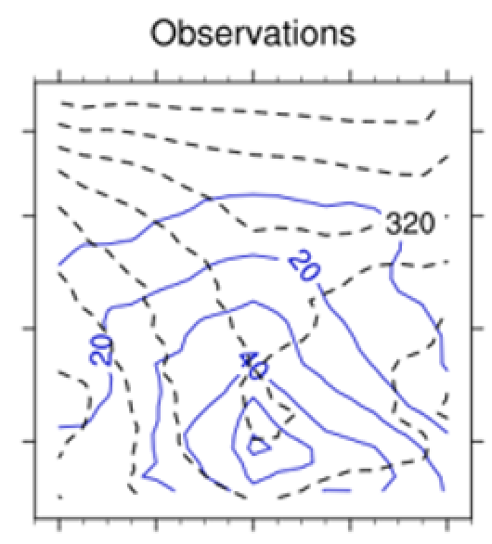


A Model Study to Measure Model Errors in the LLJ
15 Calwater AR-normal transects were simulated using a numerical weather prediction model:
West-WRF – 9 km horizontal resolution http://cw3e.ucsd.edu/west-wrf/
The mean observational transect is shown to the left.
Blue solid contours show vapor transport (kg m⁻¹ s⁻¹).
Black dashed contours show equiv. potential temperature (θ_{e} - K).
We have evaluates the model error (simulated flux minus observed) for short, middle and long lead times.
What does “lead time” mean?
Pressure (hPa)
Distance (km) from Center (maximum IVT)
The LLJ: Measuring Errors in Forecasts
Martin et al. (In-Revision) J. Hydrometeorology

Slide 22
Interlude to Explain Forecast Lead Time
Forecast started on day 1 of 3
Lead Time = 3 days
Forecast started on day 2 of 3
Lead Time = 2 days
Forecast started on day 3 of 3
Lead Time = 3 days
Event Occurs on Day 4
“Validation” Time (days)
The LLJ: Measuring Errors in Forecasts

Slide 23
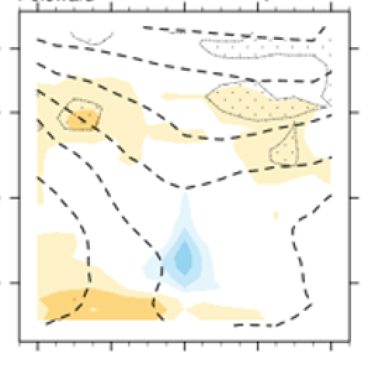
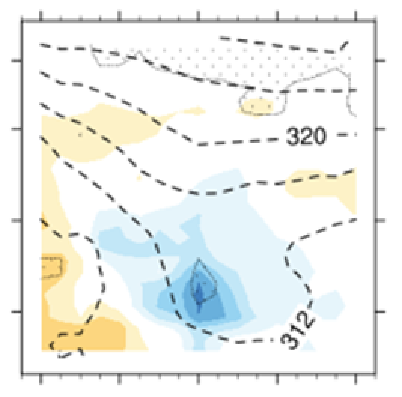
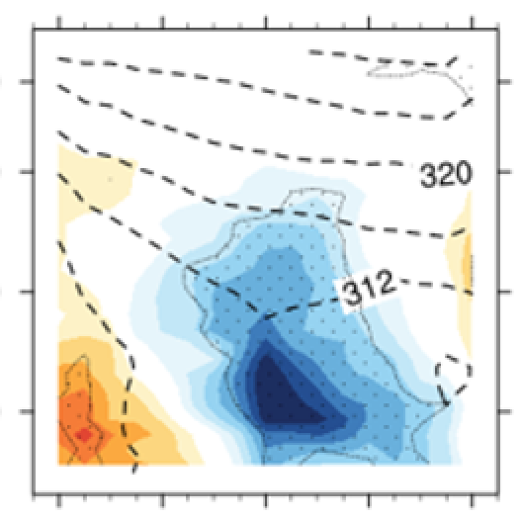
A Model Verification Study to Measure Errors in Forecast LLJ Vapor Transport
As before, the observational composite cross-section is on the left. Model error (simulated – observed) vapor transport is displayed in the colorfill. Forecast lead times increase from short (12-59 hr), medium (60 – 107 hr), and long (108 – 155 hr) as the colored panels progress left to right.
Observations
Short lead times
Medium lead times
Long lead times
Pressure (hPa)
Distance (km) from Center (maximum IVT)
Error (kg m⁻¹ s⁻¹)
The LLJ: Measuring Errors in Forecasts
Martin et al. (In-Revision) J. Hydrometeorology

Slide 24
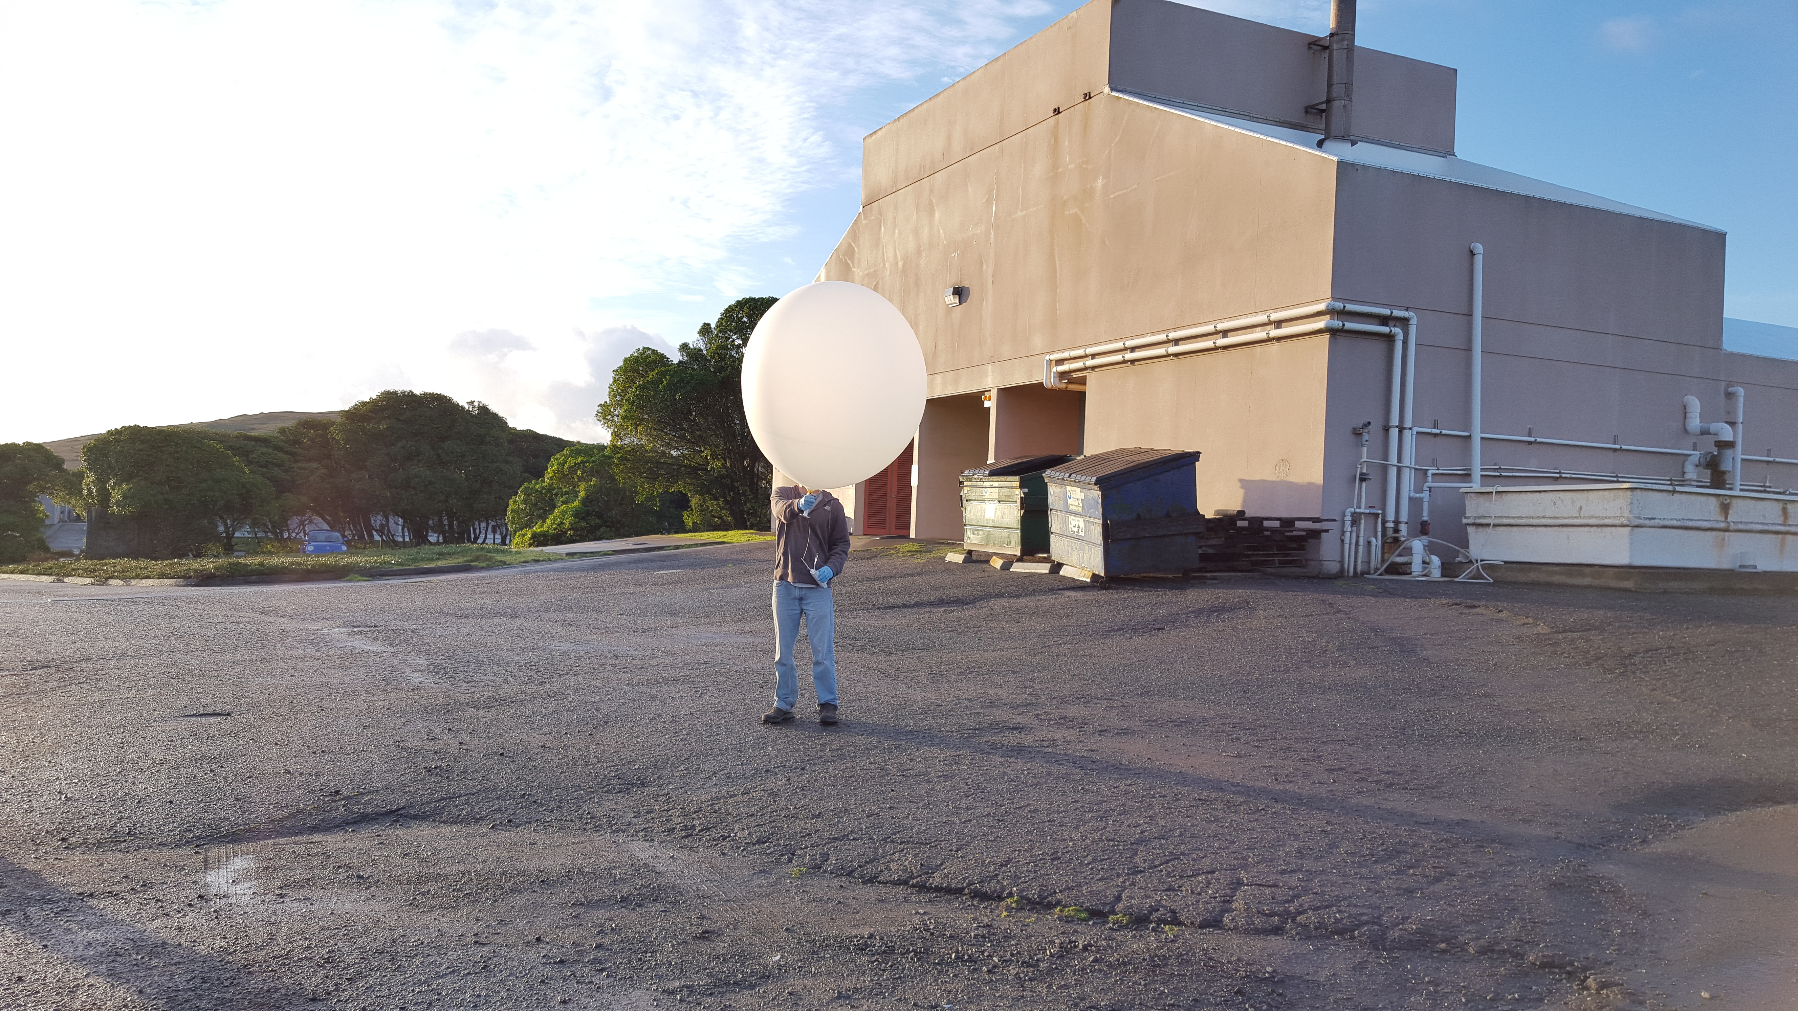
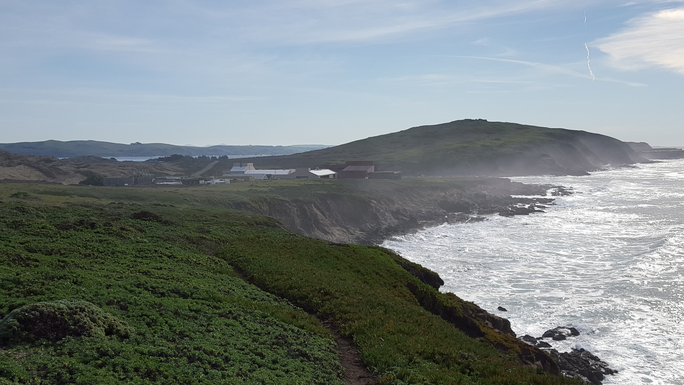
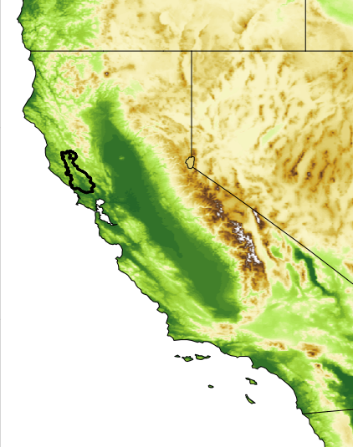
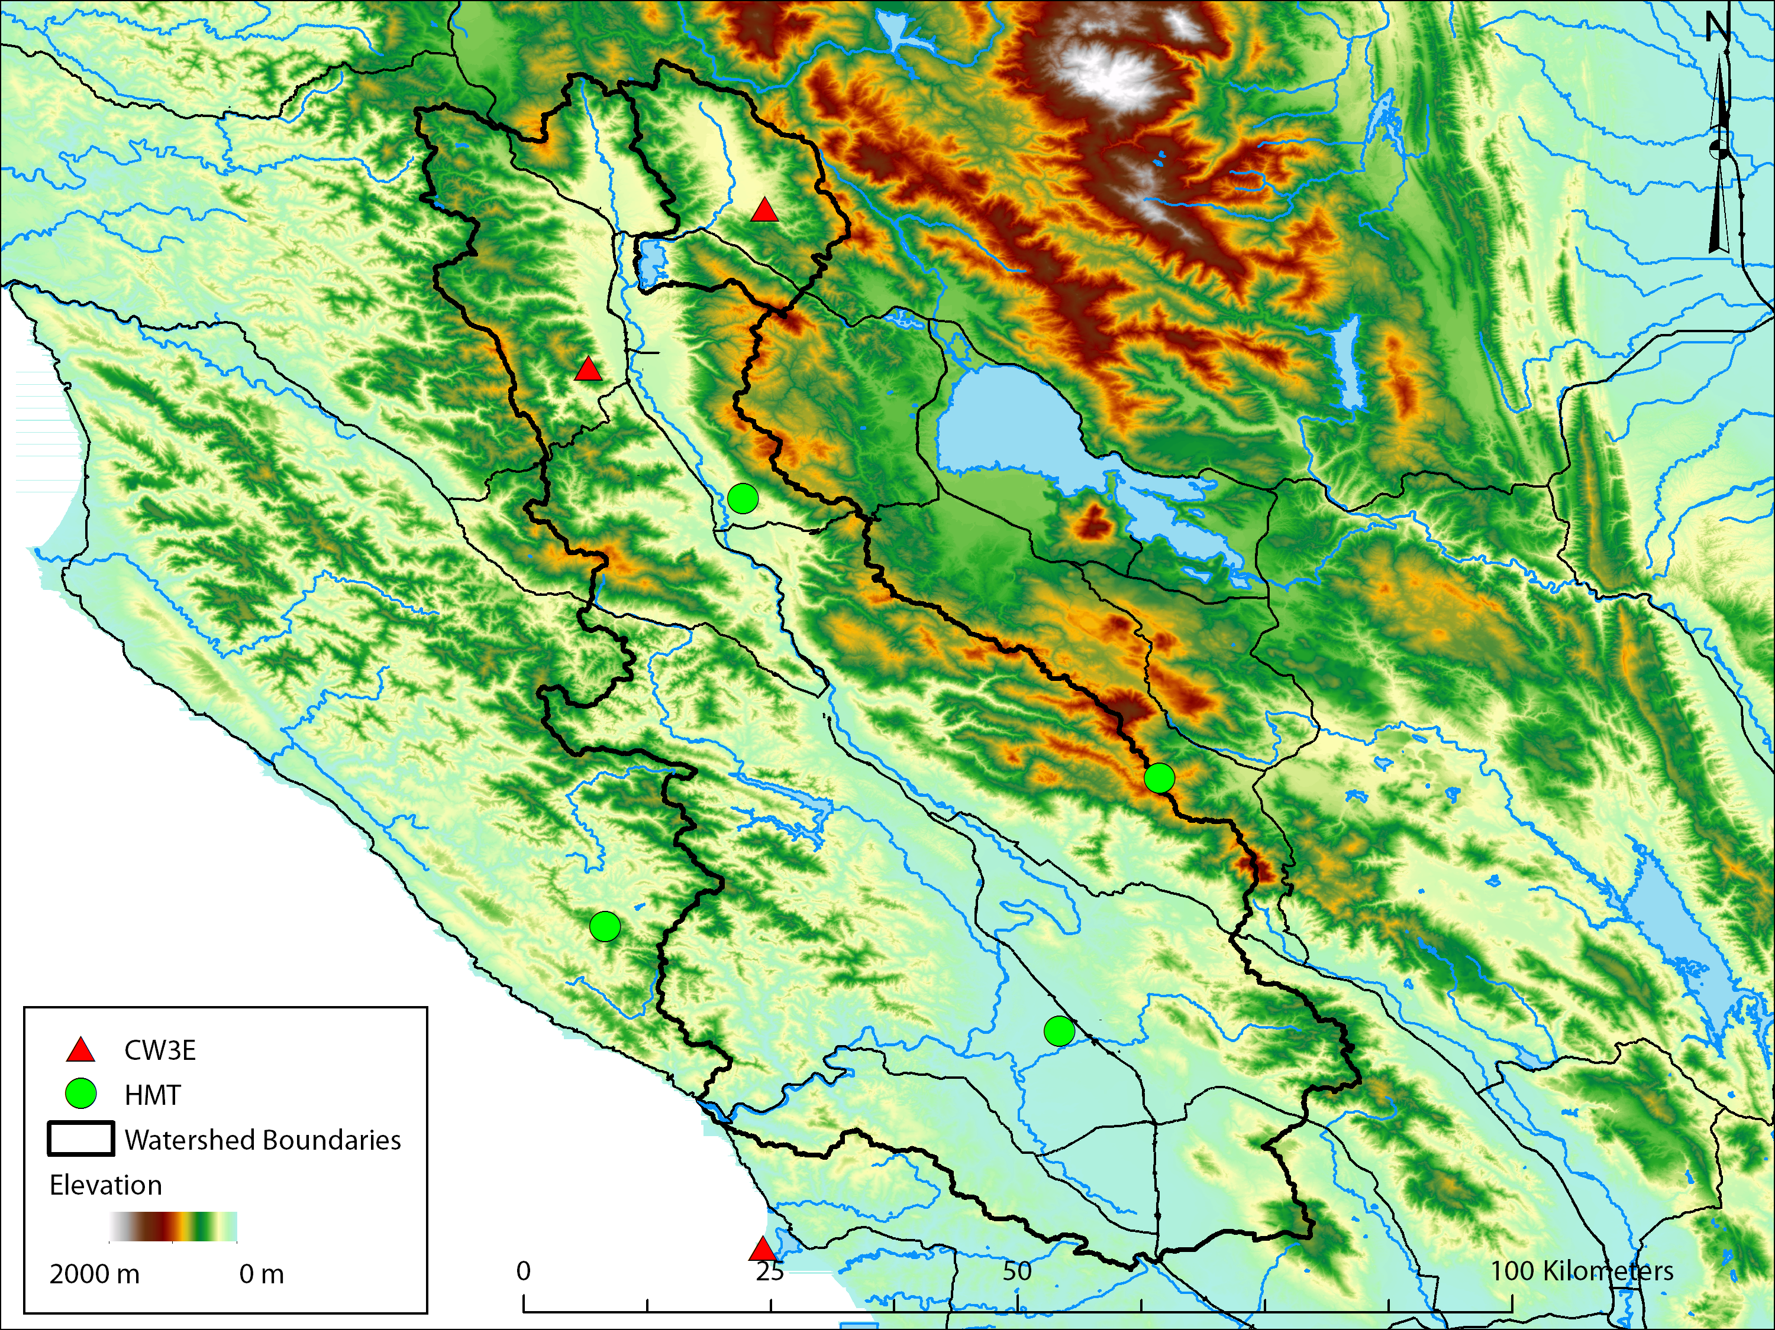
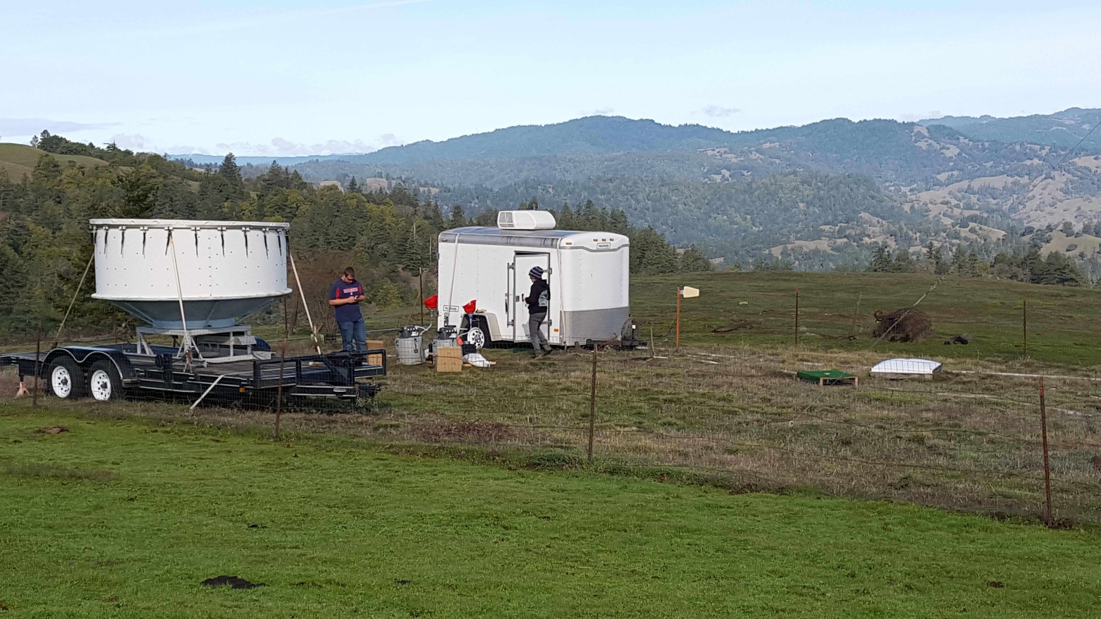
What is the Atmospheric River Observatory (ARO)?
Using Soundings to Verify Radar Observations of Flux
Coast Observing Site (BBY)
CZC
Mountaintop site for cloud and precip. Measurements (CZC)
BBY
The Bodega Bay Coastal ARO is a couplet of in-situ and remote sensing instrument sites designed to measure the horizontal flux of moisture as an AR strikes the coast and the resulting precipitation at mountaintop.
Maps provided by Brian Henn
Introducing the ARO

Slide 25
Atmospheric River Observatory
Plan view
Rain shadow
Atmos. Riv.
Heavy rain
Dividing streamline
Heavy rain
GPS satellite
Wind direction in AR
Concept: The coastal measurement “bulk upslope flux” (BUF) can be related to the precipitation and cloud measurements at mountaintop.
To first order, BUF can approximate IVT.
400 km wide
Mountains
ARO
3
Wind profiler beam with 100-m vertical resolution
S-PROF data up to 10 km MSL
Orographic cloud and precipitation
2
Snow level
Altitude MSL (km)
“Controlling layer” (upslope winds)
1
Rain shadow
Atmospheric River
Surface friction and barrier jet
Mountain
S-PROF precipitation profiler; surface met; disdrometer
0
Ocean
GPS-met receiver
10-m surface meteorology tower
CZC
BBY
Wind profiler
(915 or 449 MHz)
0-50 km between wind profiler/GPS-met site and S-PROF precipitation profiler
Introducing the ARO
slide courtesy of Dr. F. Martin Ralph
Notes:
Targeted observations – increase physical understanding – basic research steps that we are taking in order to work toward the ultimate goal of improve forecasts.

Slide 26
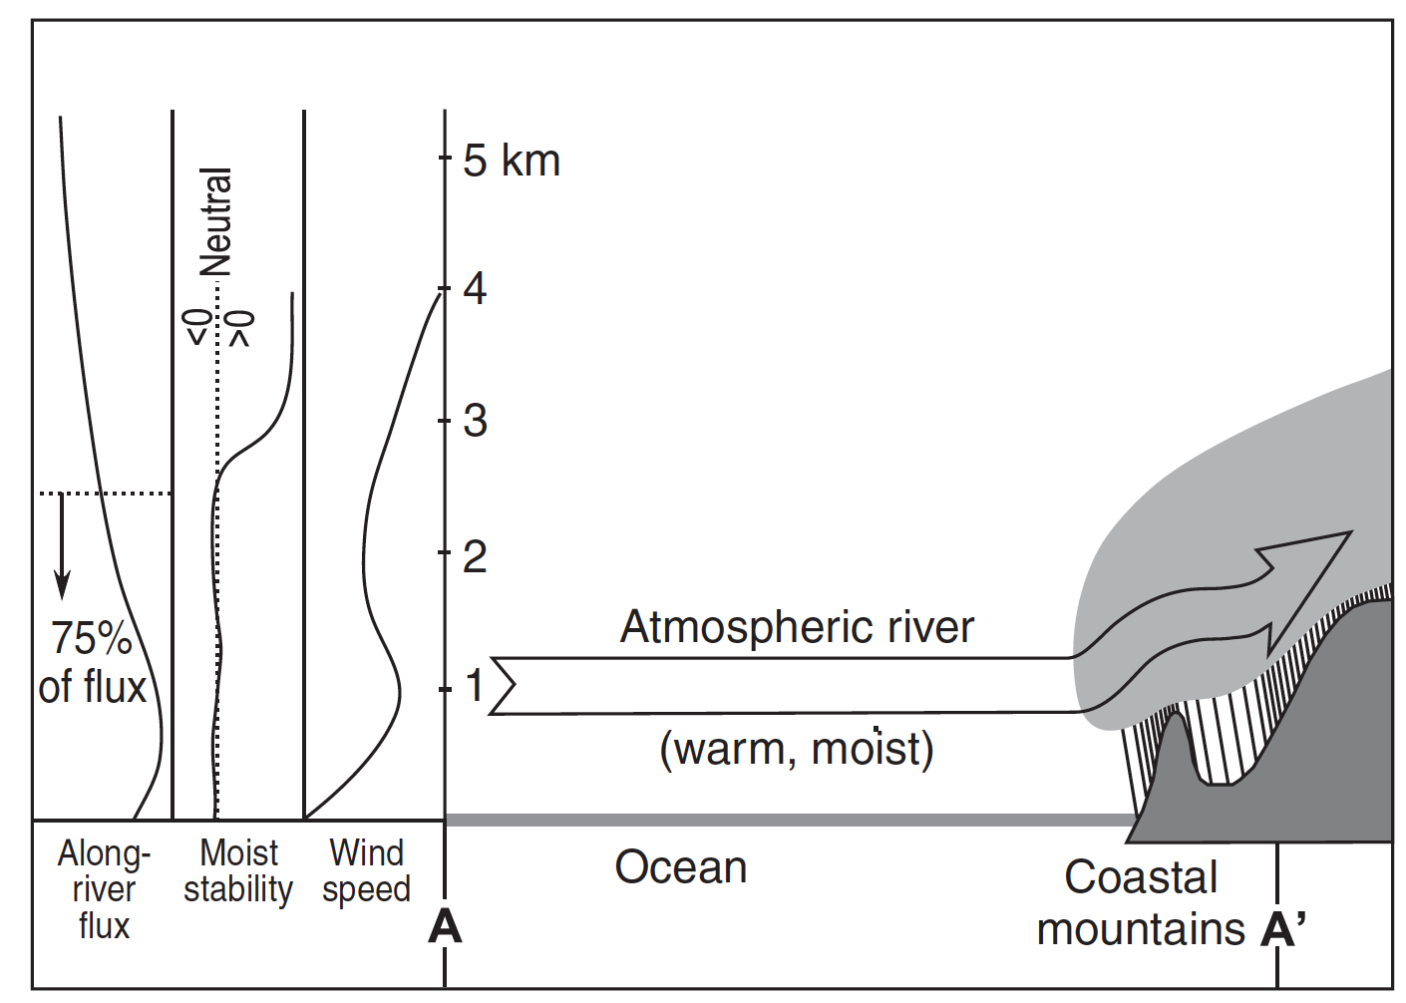
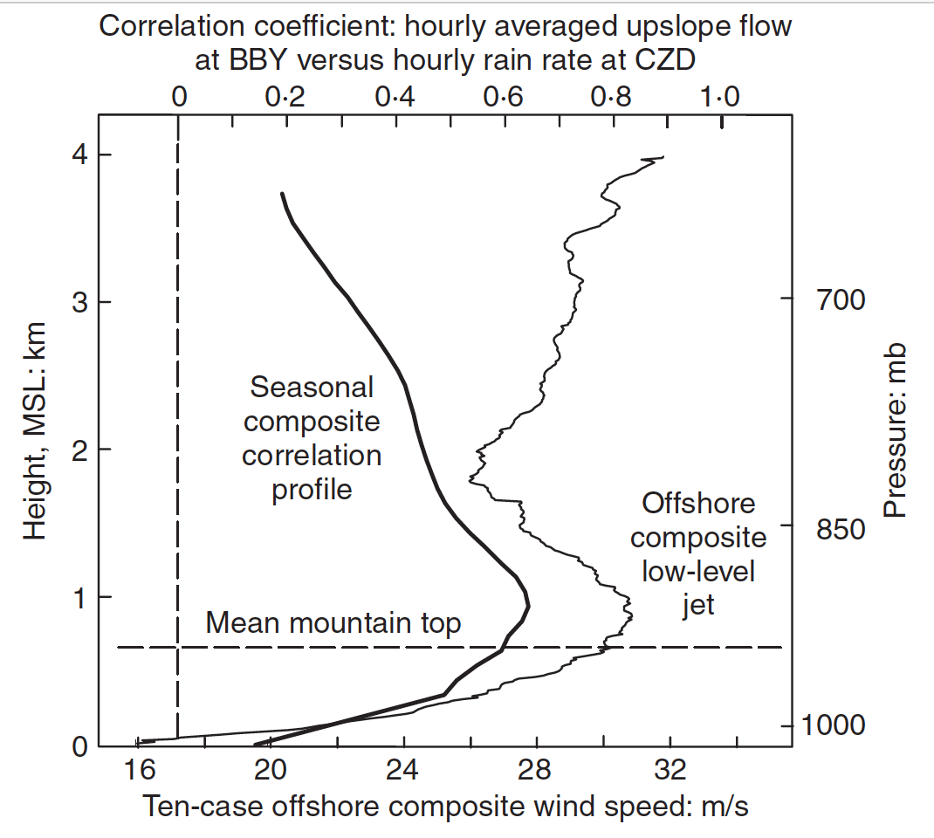
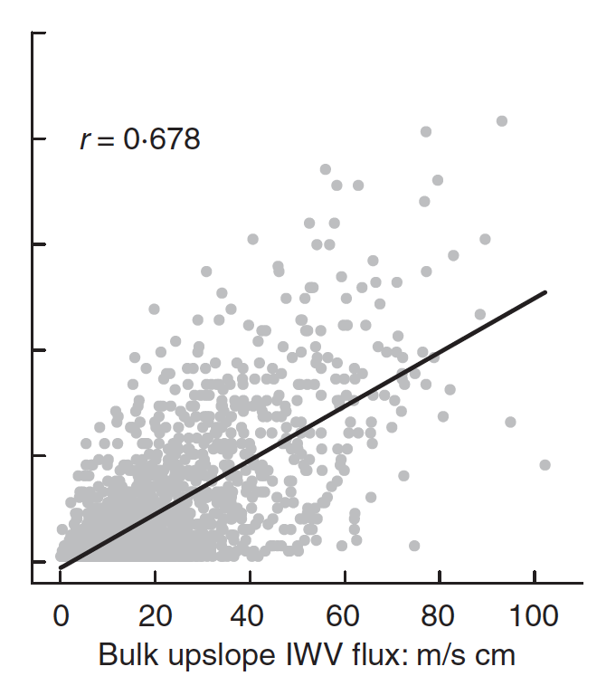
How does the LLJ relate to Orographic Precipitation?
Hypothetical Scenario:
Along-AR transport direction and cross-mountain barrier direction are same at AR landfall
BUF at the coast explains approximately 68% of the variability in precipitation at mountaintop.
Other factors (buoyancy, large-scale lift, cloud microphysics) are also important, and likely explain the remaining variability.
Orographic precipitation during AR at this location is quasi-linearly related to the strength and humidity of the LLJ.
Precipitation (mm)
BUF (m s⁻¹ cm)
The LLJ: Relation to Precip.
Neiman et al. (2009) Water Management

Slide 27
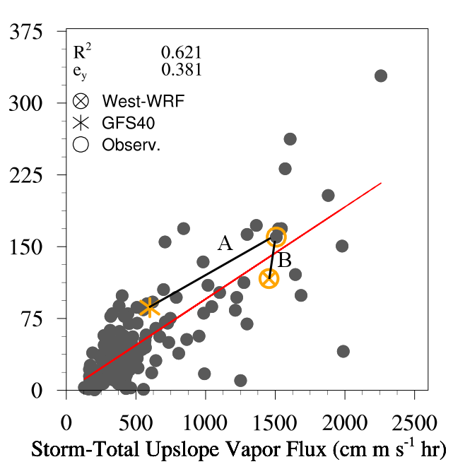
Evaluating Modeled Linear Orographic Relationships During AR
We can retrieve BUF and Precipitation from model simulations of a number of AR and ask how close to the observed relationship are the simulated values.
The figure shows an example of two forecasts and the observed BUF/precip. The mixed normalized error (e_{xy}) is shown as the distances A and B.
y: Storm-Total Precipitation (mm)
e_{xy} for West-WRF and GFS40 reforecasts of 10 ARs at the ARO
Lead Time (days) | West-WRF | GFS40
1 - 2 | 0.82 | 4.29
3 - 4 | 2.25 | 4.53
5 - 6 | 4.65 | 7.37
x:
Evaluating Forecast Orographic Precipitation
Martin et al. (In-Revision) J. Hydrometeorology

Slide 28
Web resources to learn more about AR:
Climate: Western US Precipitation in Historical Perspective
http://cirrus.ucsd.edu/~pierce/staweb/
Atmospheric Chemistry and AR: CalWater field study datasets
http://mead.ucsd.edu/bby_aerosols_2016.html
How is AR science being adopted by the US Army Corps of Engineers:
http://cw3e-web.ucsd.edu/firo/
CA Senate Bill 758:
https://leginfo.legislature.ca.gov/faces/billNavClient.xhtml?bill_id=201520160SB758
Forecasts: Probability of AR Landfall
http://cw3e.ucsd.edu/iwv-and-ivt-forecasts/#LFT
Forecasts: West-WRF high-resolution forecasts
http://cw3e.ucsd.edu/west-wrf
AR Web Resources

