Slide 1
Forecast Informed Reservoir Operations
How Water Management Objectives Support the Science of Atmospheric Rivers, Heavy Precipitation and Flooding
Dr. Andrew Martin, Department of Geography

Slide 2
Outline
Introduction to West Coast Water Management Problems
Drought Resiliency Solution: FIRO
  Enable more dry season supply, while meeting regulations, without increased risk of flood.
Research to Support the Solution
  Part 1: Climate
  Part 2: Forecasts
  Part 3: Basic Sciences
Future of FIRO

Slide 3
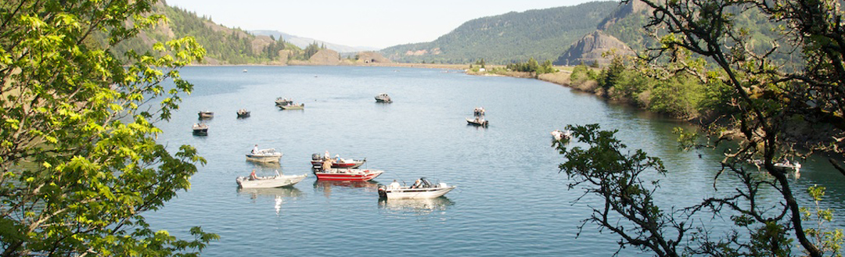
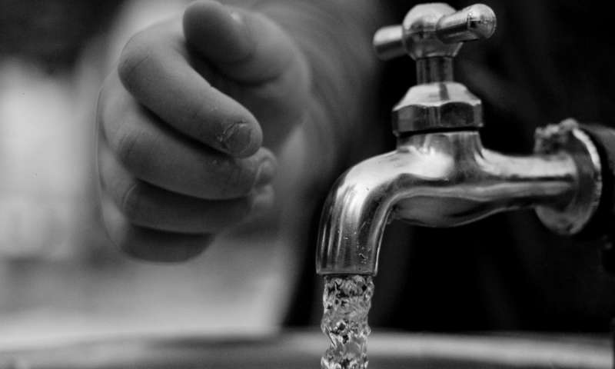
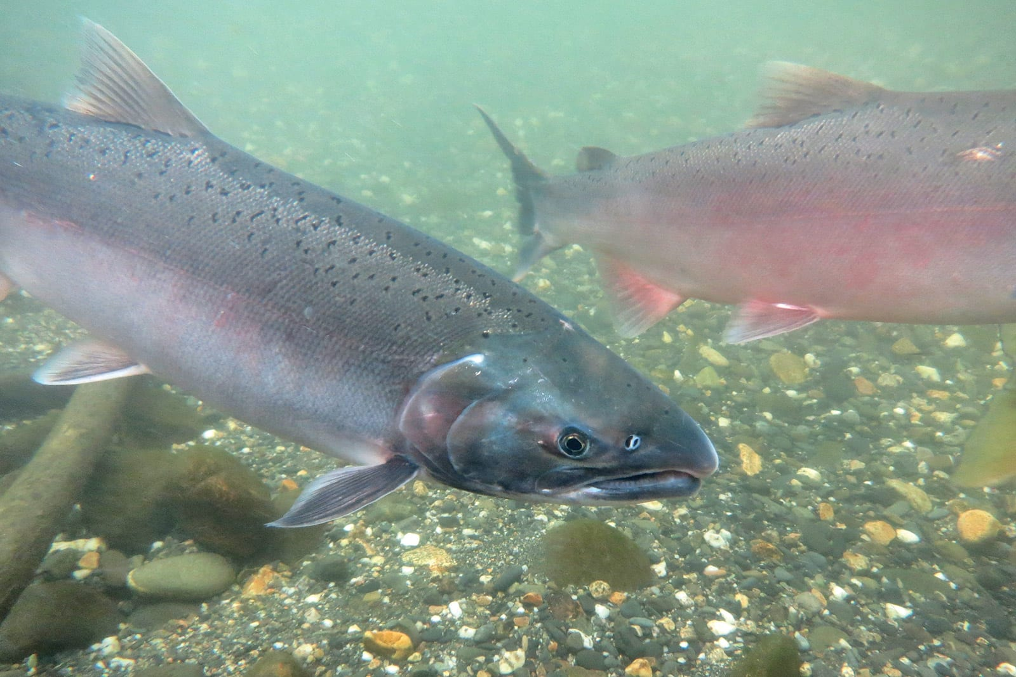
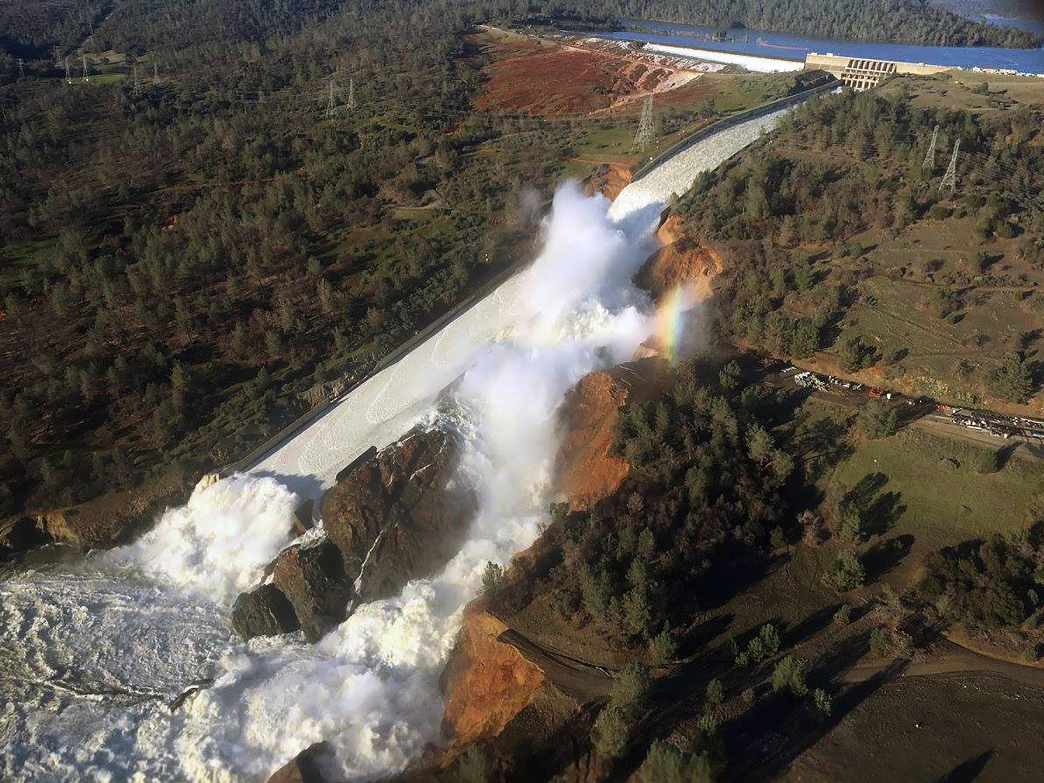
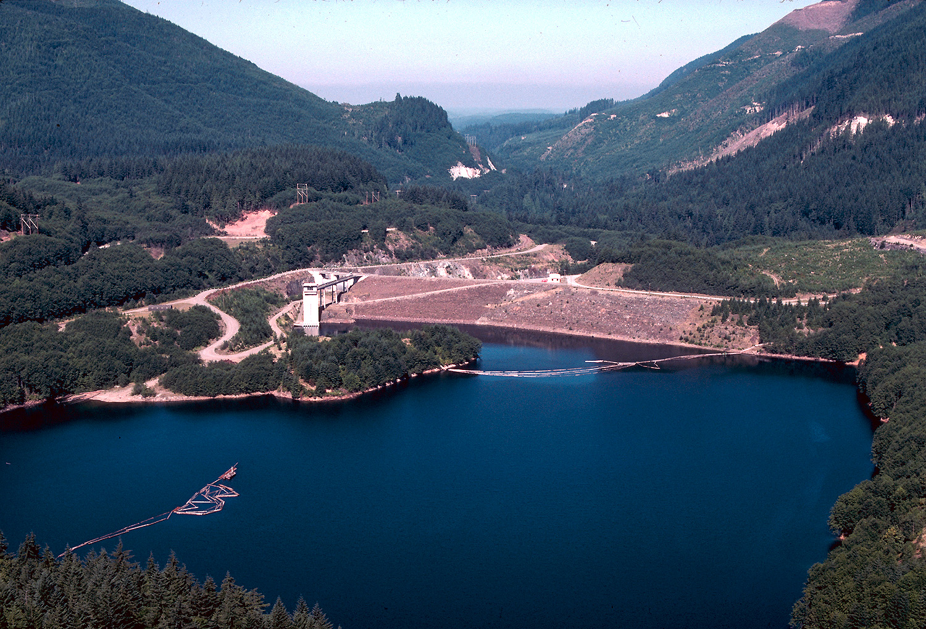
Water Management and Extreme Precipitation
Reservoir managers regularly face decisions about when to release impounded water
In the Western US, while precipitation is less frequent in many locations, precipitation extremes are as large as anywhere in CONUS.
These extremes bring problematic river flows that stress wet season release decisions.
Oroville Dam (CA) 2017
Howard Hanson Dam (WA) 2009

Slide 4
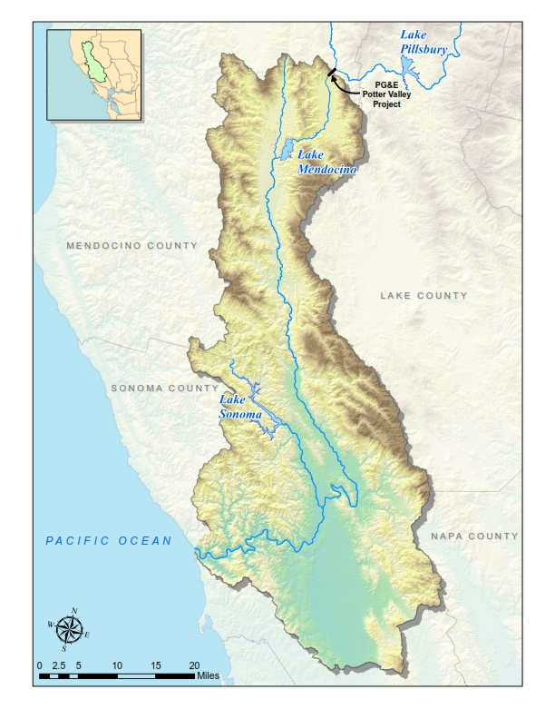
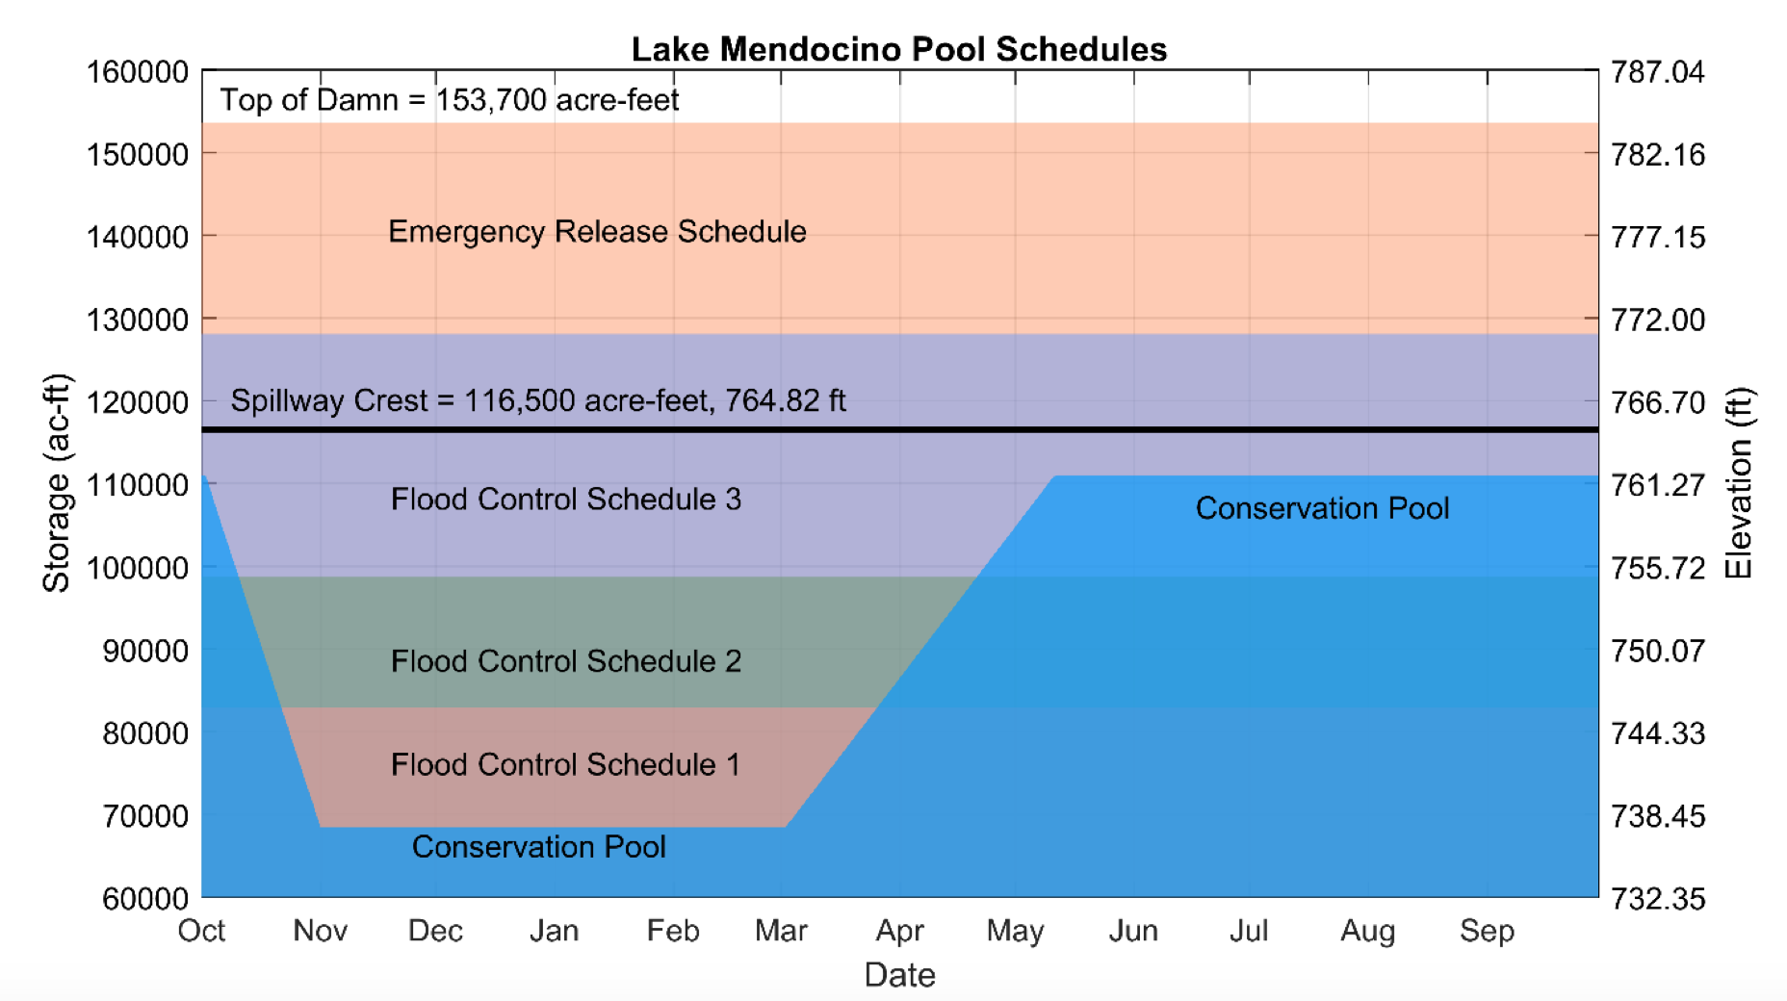
Lake Mendocino and the Russian River
Lake Mendocino
Max. allowable storage 110,000 acre-feet (summer), 68,000 acre-feet (winter)
Russian River Watershed
0.95 million acres,
1.6 million acre-feet annual discharge
(b)
Guerneville
a) Russian River Watershed with location of water supply reservoirs and the flood prone town of Guerneville, CA.
b) Lake Mendocino “Guide Curve” showing management schedules by US Army Corps of Engineers.
(a)

Slide 5
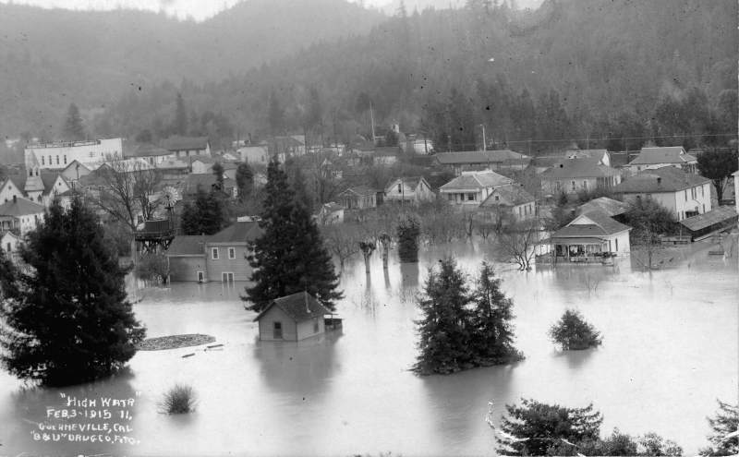
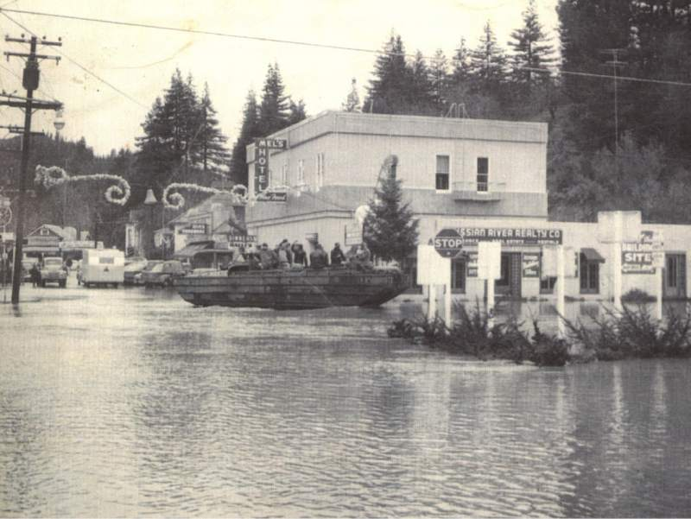
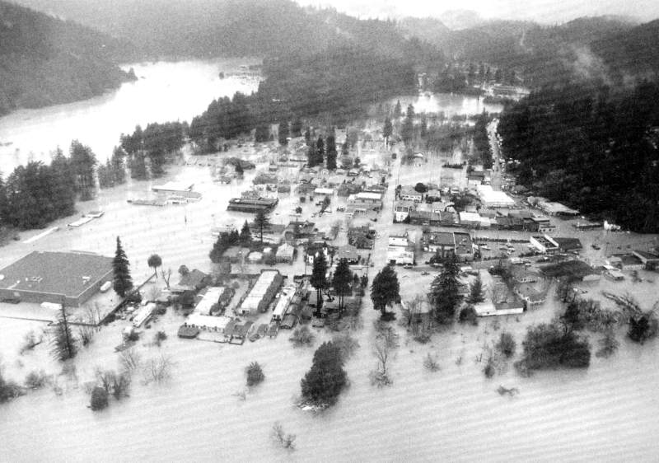
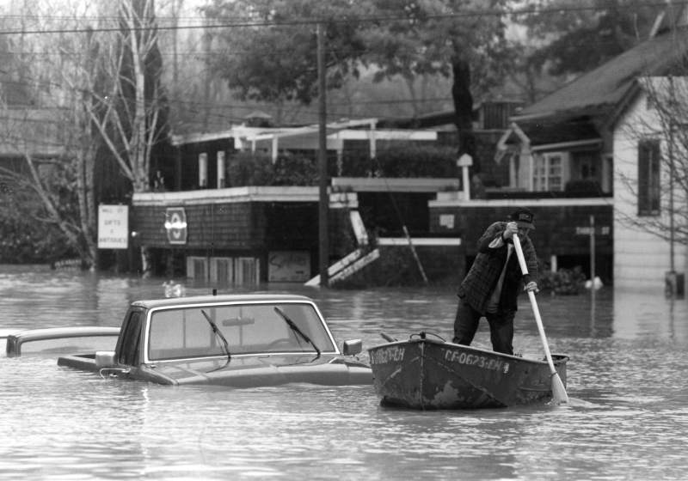
A History of Floods
Historically,
The river has reached flood stage at Hopland, CA in approx. 22% of years since 1959.
and at Guerneville, CA in approximately 50% of all years since 1940.
February, 1915. Guerneville.
December, 1955. Guerneville.
February, 1986. Guerneville.
December, 1995. Guerneville.

Slide 6
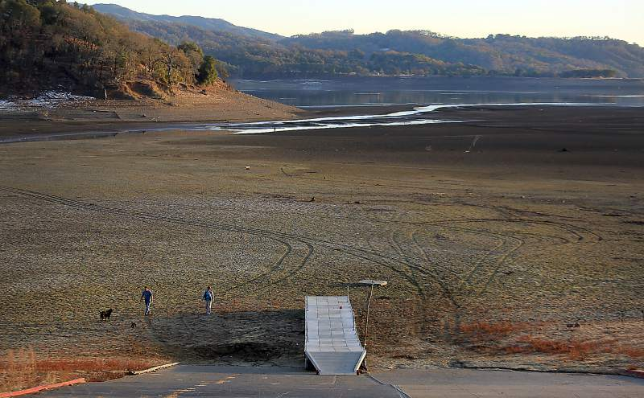
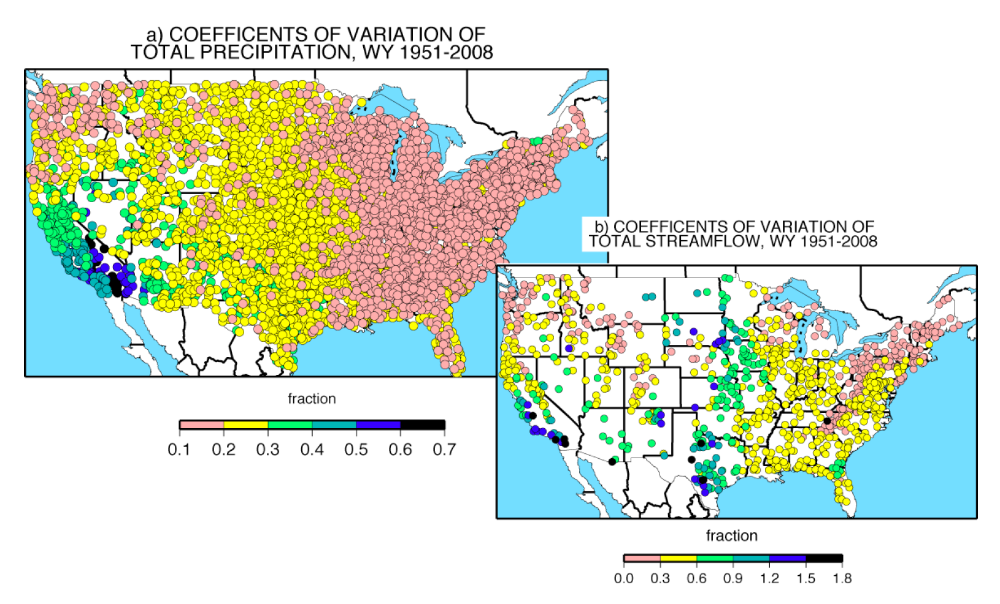
And of Drought
Left: Lake Mendocino during CA drought in Dec. 2013
Annual precipitation and streamflow are highly variable in N. CA, with standard deviation approaching annual mean in the latter.

Slide 7
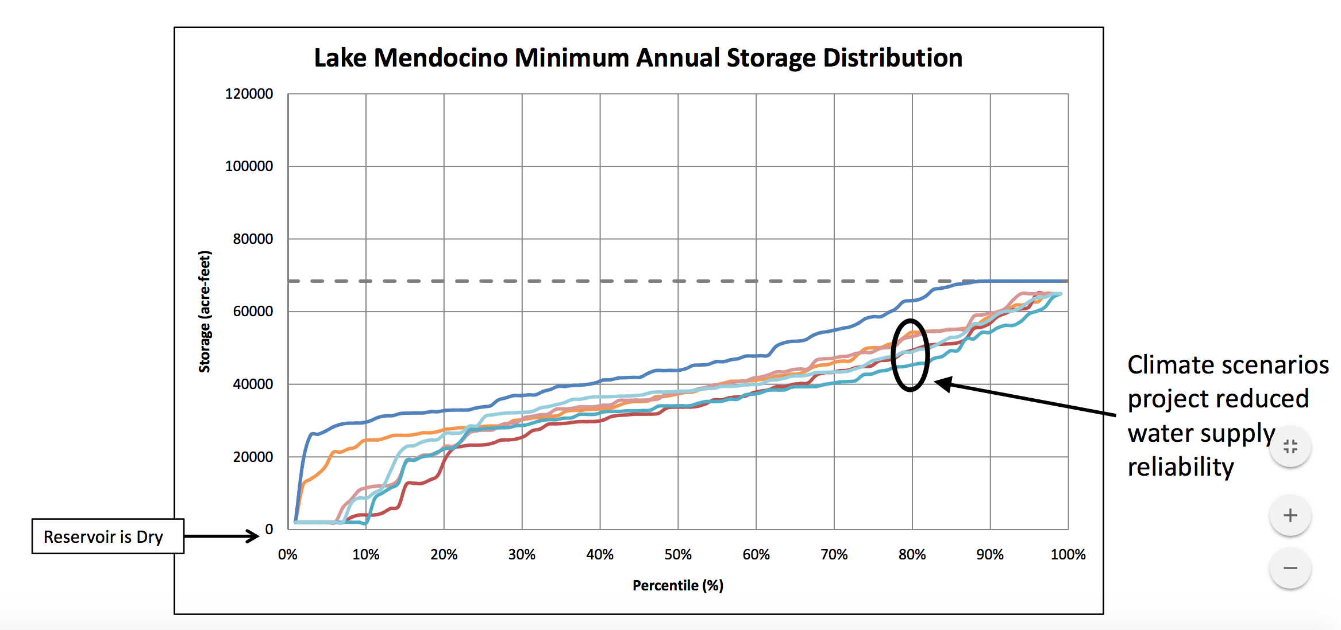

Future Climates
Current climate, current demand
Current climate, high demand
2099, low demand, dry climate
2099, high demand, dry climate
2099, low demand, wet climate
2099, high demand, dry climate
A range of climate projections and projections of regional growth all expect reduced water supply at end of dry season by end of 21st century.
This is water that is currently used for drinking water, hydropower and maintenance of aquatic habitat.

Slide 8
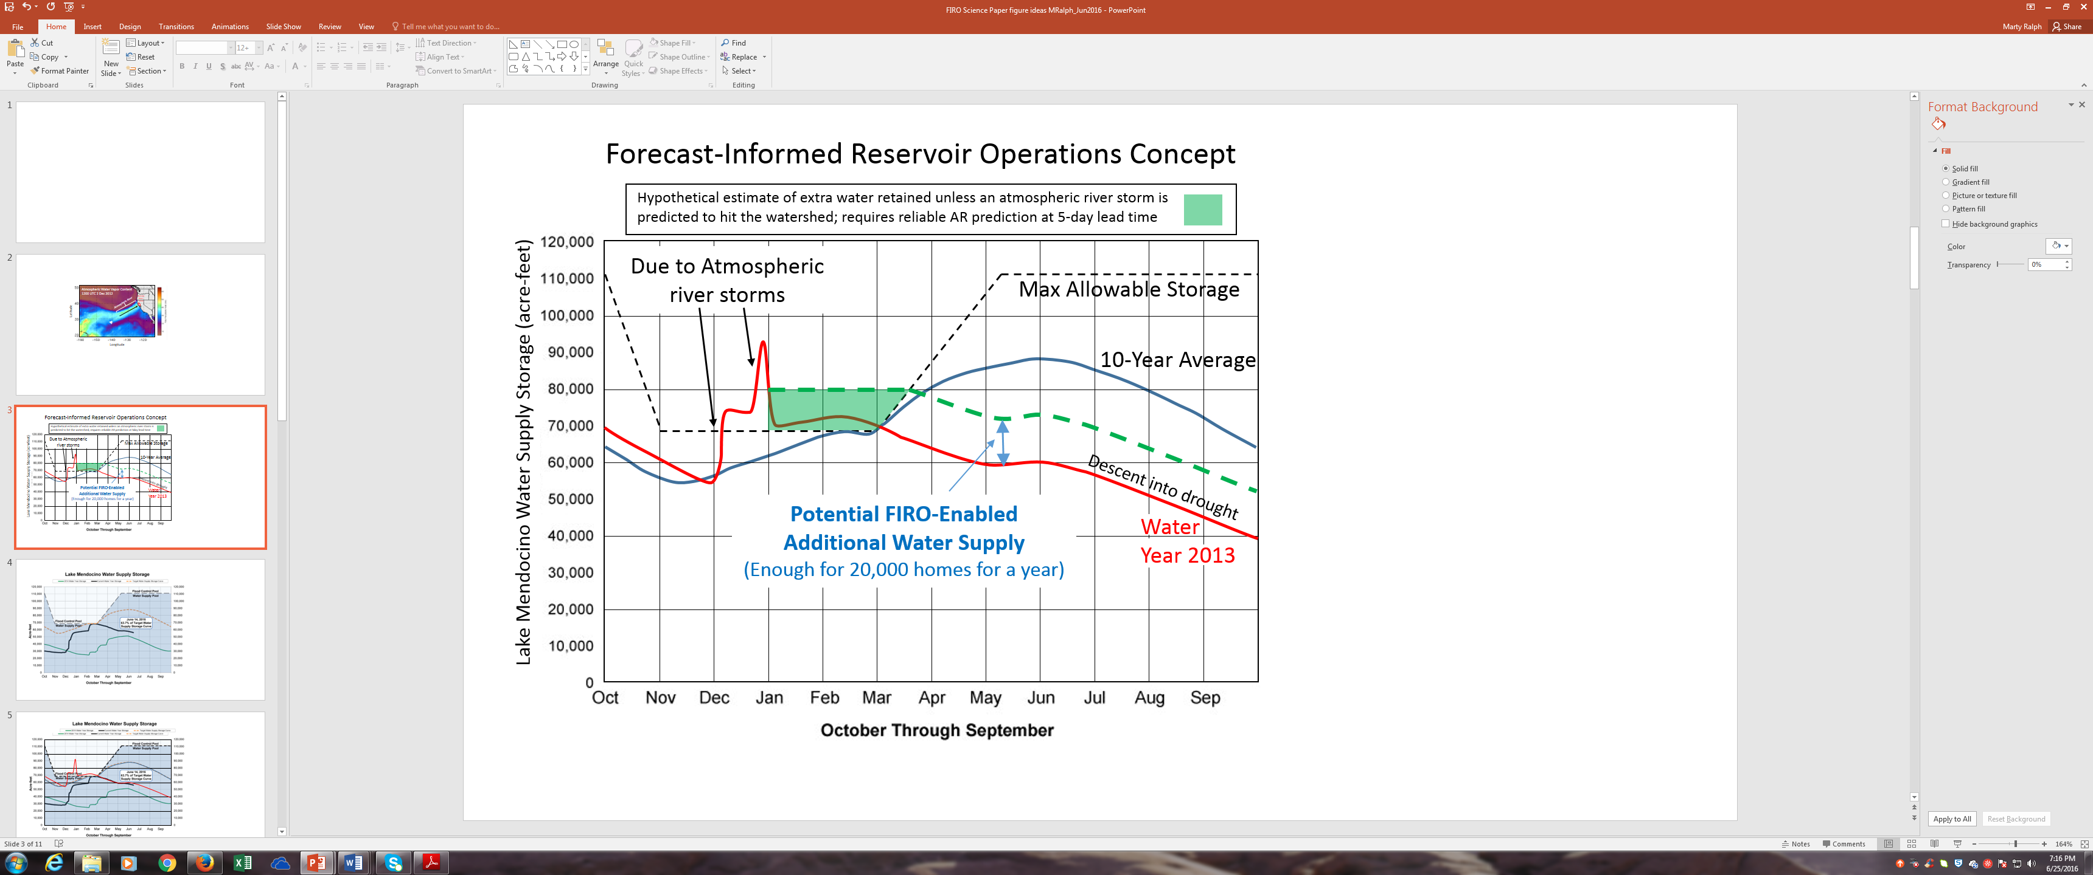
Modified Operations for Drought Resiliency
FIRO is investigating a deviation from rule curve to green line, but also must:
Release water to meet original rule curve if large (30,000 AF) inflow is forecast.
Cannot release if
  Downstream gauges exceed flood-critical thresholds.
Must not change rate of release too quickly.

Slide 9
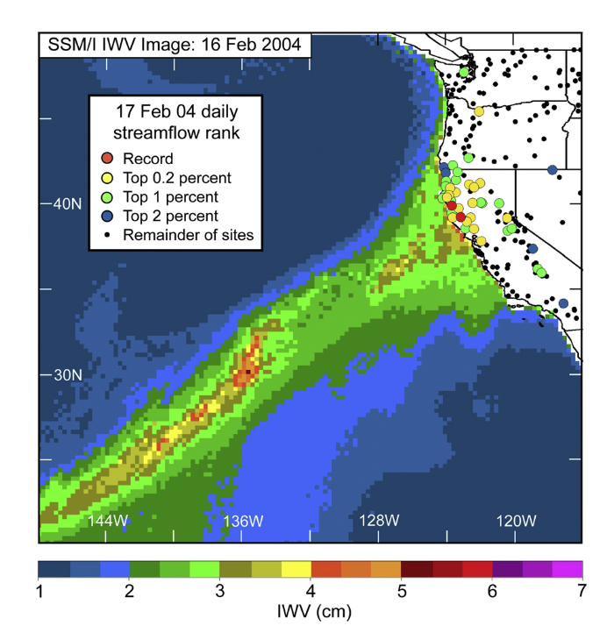
Regional Hydroclimate
Ralph et al., 2004: “Flooding on California’s Russian River: Role of Atmospheric Rivers” found that 6 of 7 largest floods at Guerneville were caused by AR.
Since FIRO project started, researchers have observed additional AR-caused floods in 2014 (x2), 2017 (x2) and 2019 (x2).
Flood Stage 32’

Slide 10
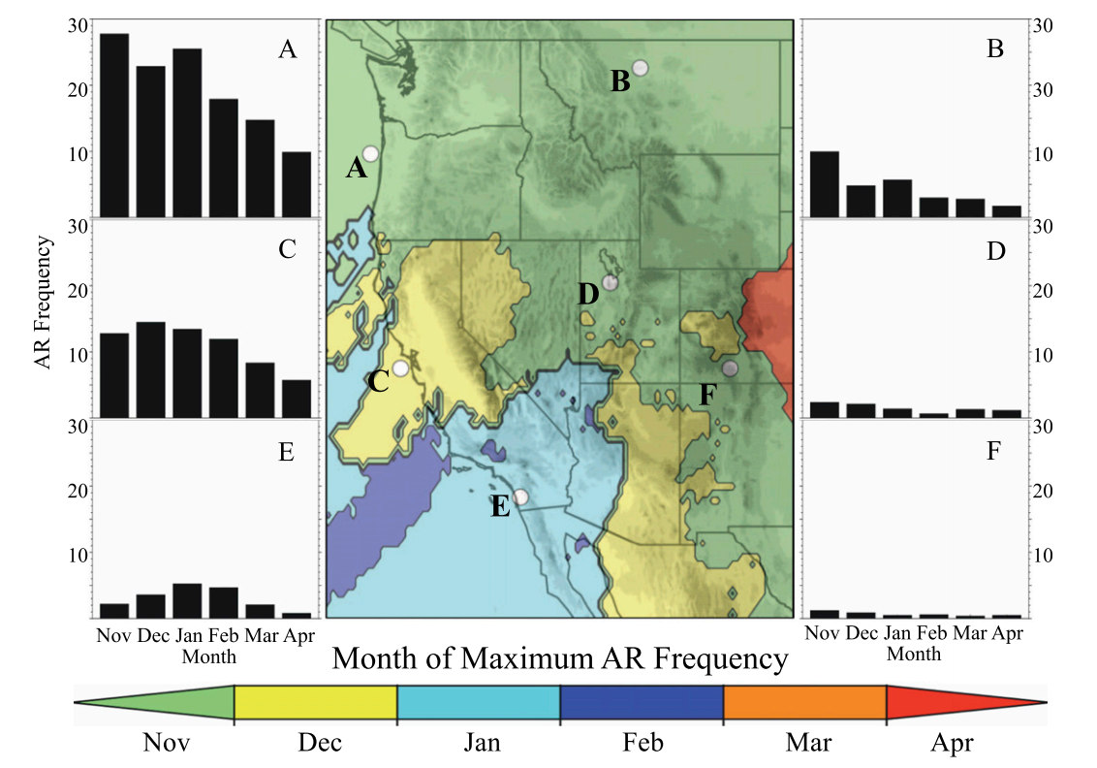
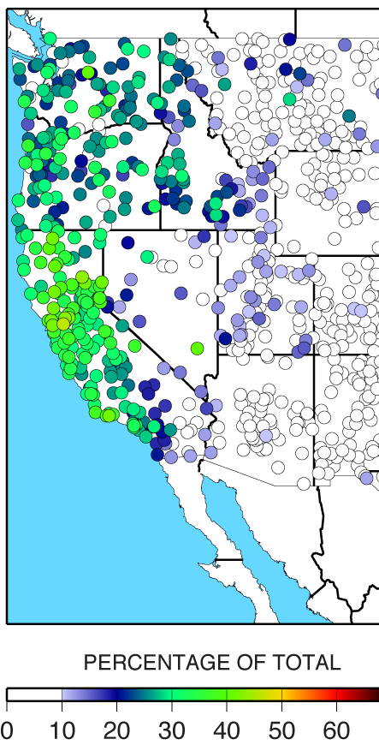
Regional Hydroclimate
When and how often do ARs hit the Russian River watershed and
How important are they for water resources?
~40% of annual precipitation in the west coast states fell on the same day an atmospheric river was present.
Rutz et al., 2014 (J. Hydromet.)
Dettinger et al., 2011 (Water)

Slide 11
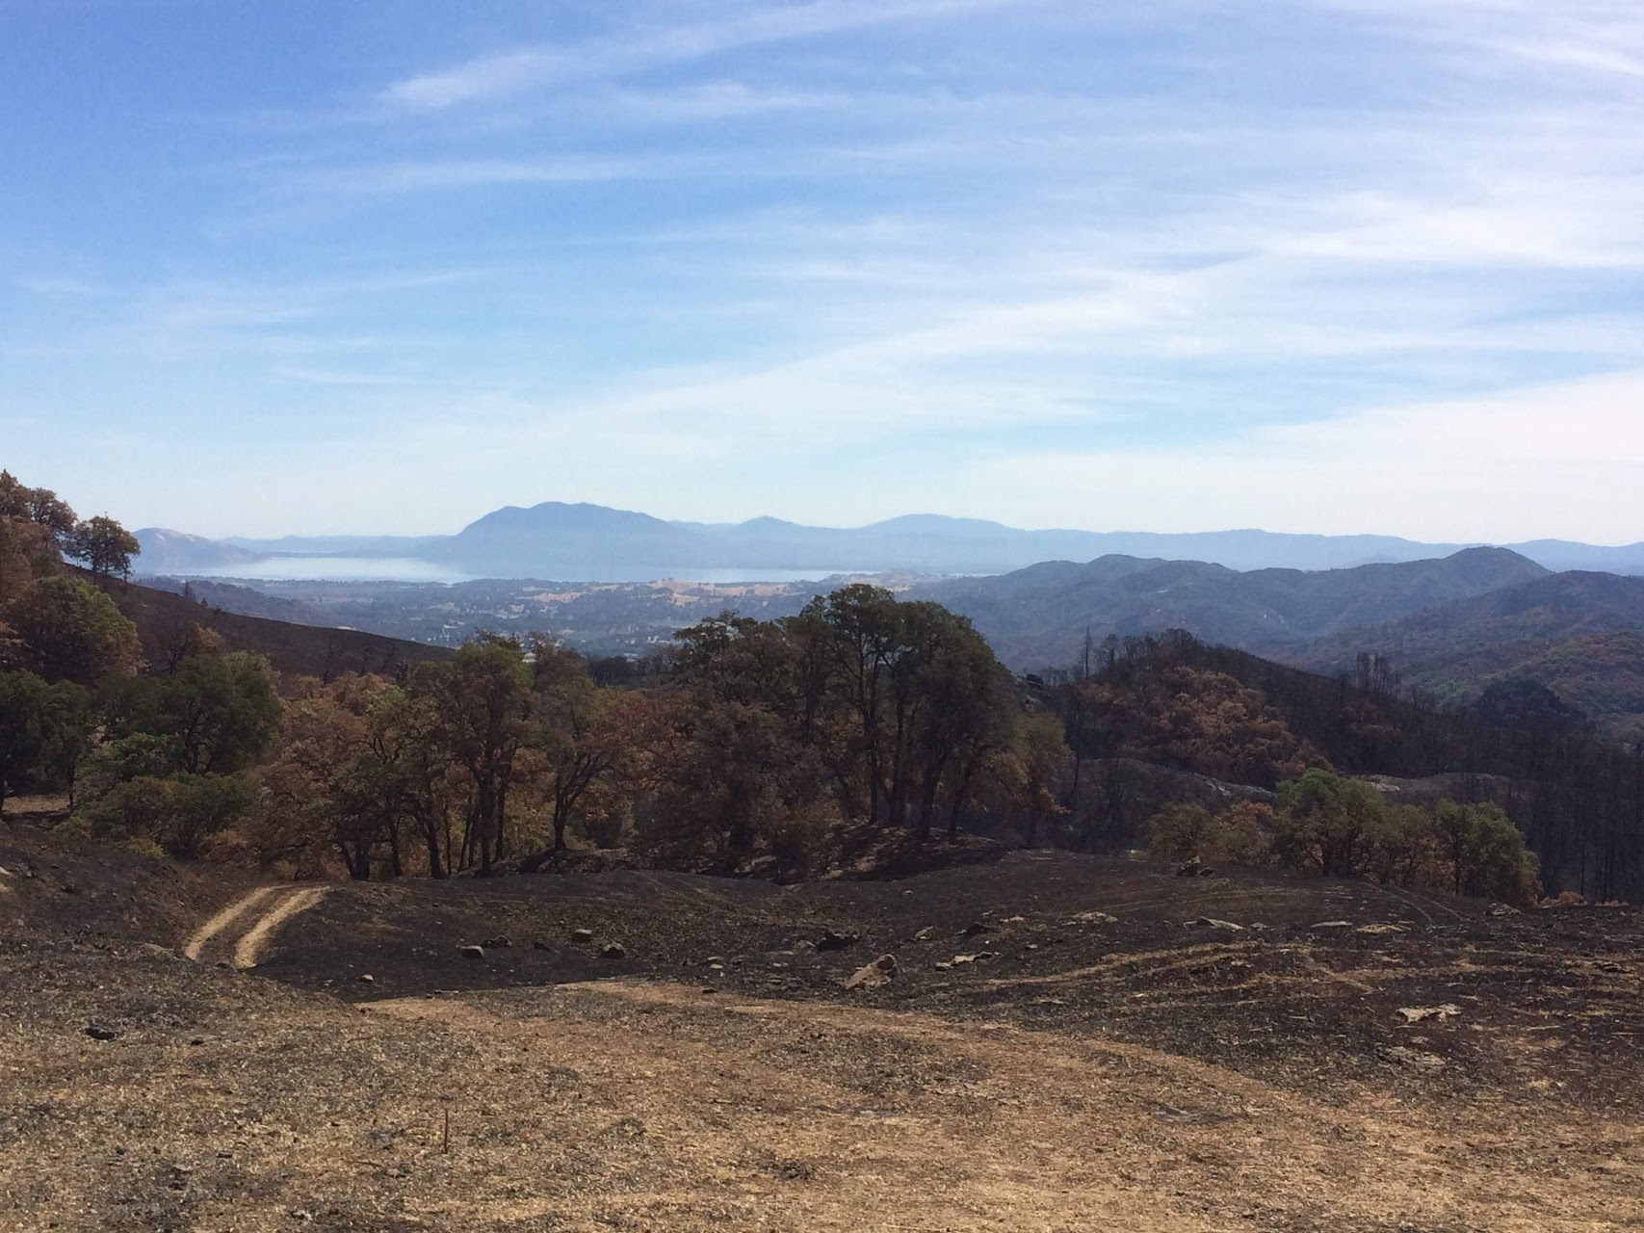
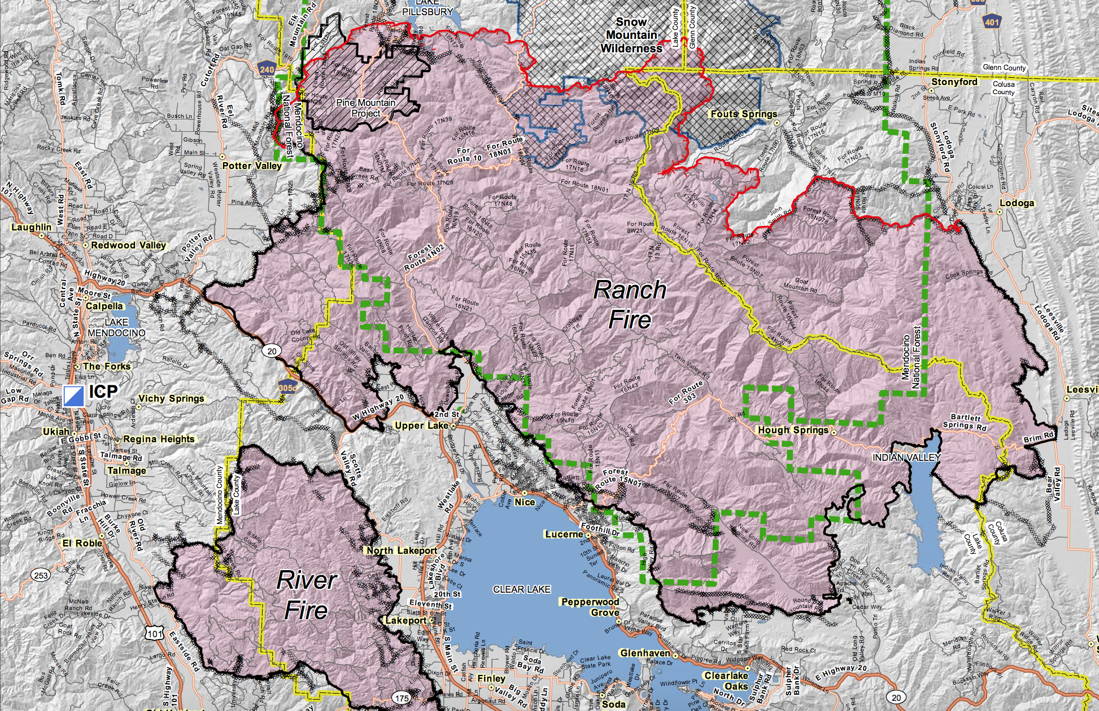
Regional Hydroclimate
FIRO researcher photo looking to L. Mendocino from Redwood Valley burn
Oct, 2018 perimeter of Ranch Fire with L. Mendocino.
In 2017, the Redwood Valley Fire burned 36,500 acres North and West of Lake Mendocino.
In 2018, the Ranch Fire burned 410,200 acres encroaching into the Eastern portion of the watershed.
High intensity fires change hillslope hydrology for several years after burning. Runoff can become more productive post-fire, leading to more water entering reservoir and less recharge of groundwater. c.f. Hallema et al. (2018 - Nature Comm.)

Slide 12
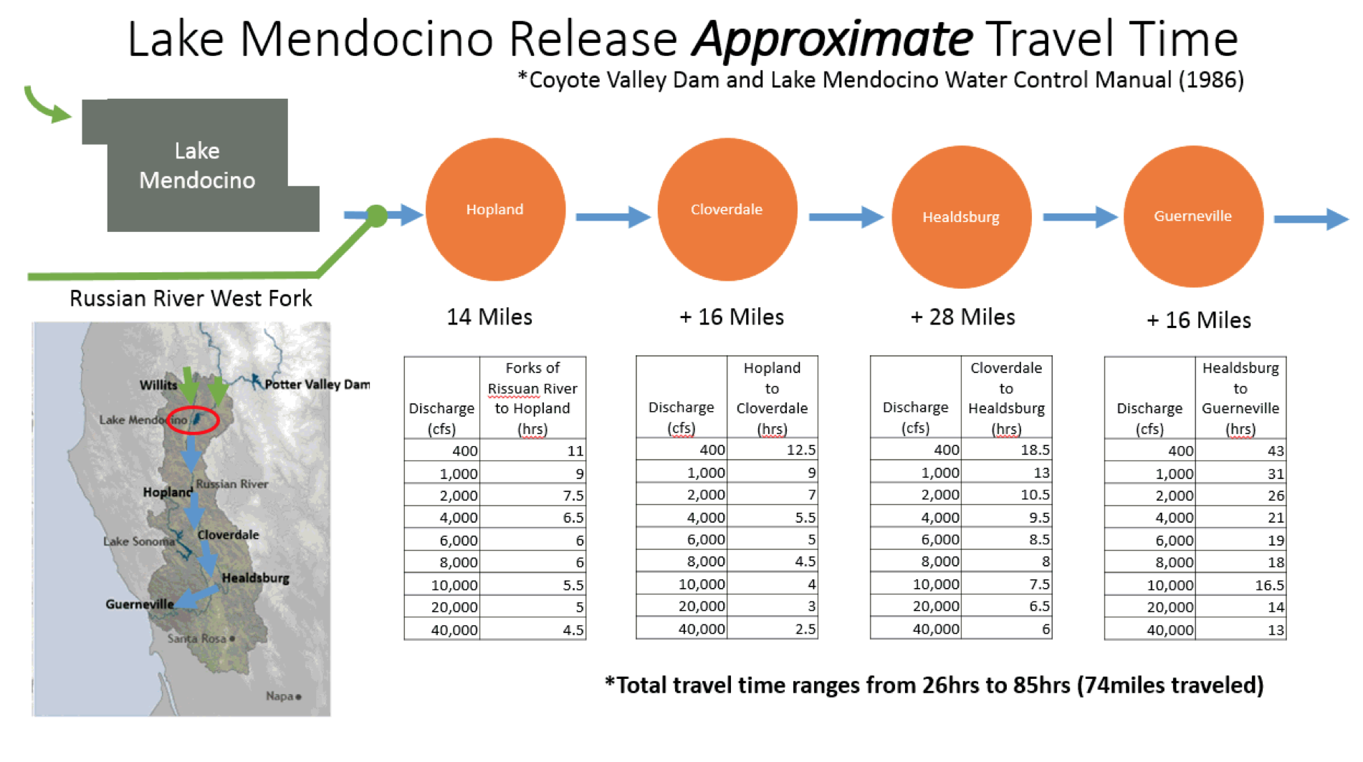
How Far Ahead Are Forecasts Needed?
To make new conservation level feasible, both inflows (for dam safety) and downstream flows (to avoid exacerbating flood with releases) must be accurately forecast.
Total travel time for released water to pass Guerneville ranges from 26 to 85 hours.
With extra buffer to observe ramping rate (Salmonids, BiOp), this means decisions need to account for forecasted conditions in the next 5 days.

Slide 13
How Accurate are Rainfall Forecasts?
An analysis of daily flows > 2500 cfs at Ukiah
(1986 – 2016)
Shows 94% of these are also Atmospheric River days. Mean 24 hour QPE = 2.7”
Correct more often
Incorrect more often
Current models do not show required level of skill at predicting rainfall amounts linked to critical downstream flows.
Human-aided forecasts are better, but need to improve days 3-5.

Slide 14
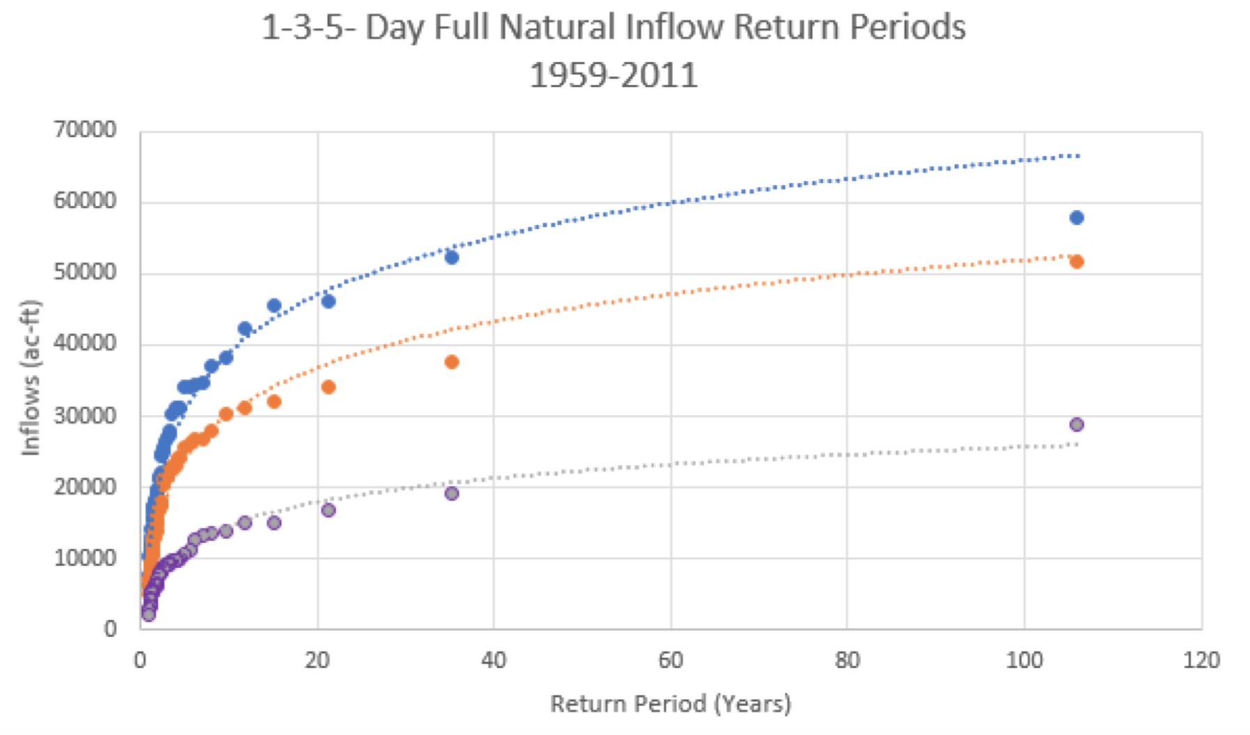
When Should We Expect Problematic Inflows?
5 day inflows exceeding 30,000 AF have ~ 33% chance in any given year.

Slide 15
Context for Forecast Challenge
Forecasts 5 days ahead are needed to ensure water has enough time to pass downstream communities.
Most high flows on the river are associated with 2” / 24 hr or greater events. Current Forecasts are only skillfull to 3-4 days.
Single event (5 day) flows into the reservoir that require pre-releases are common (1/3 years).

Slide 16
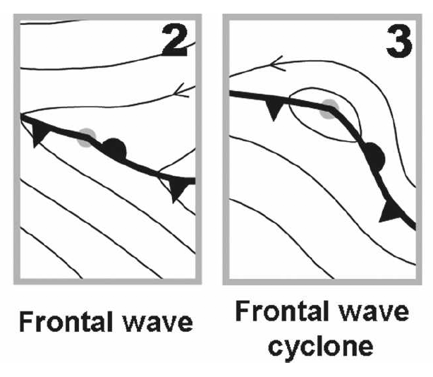
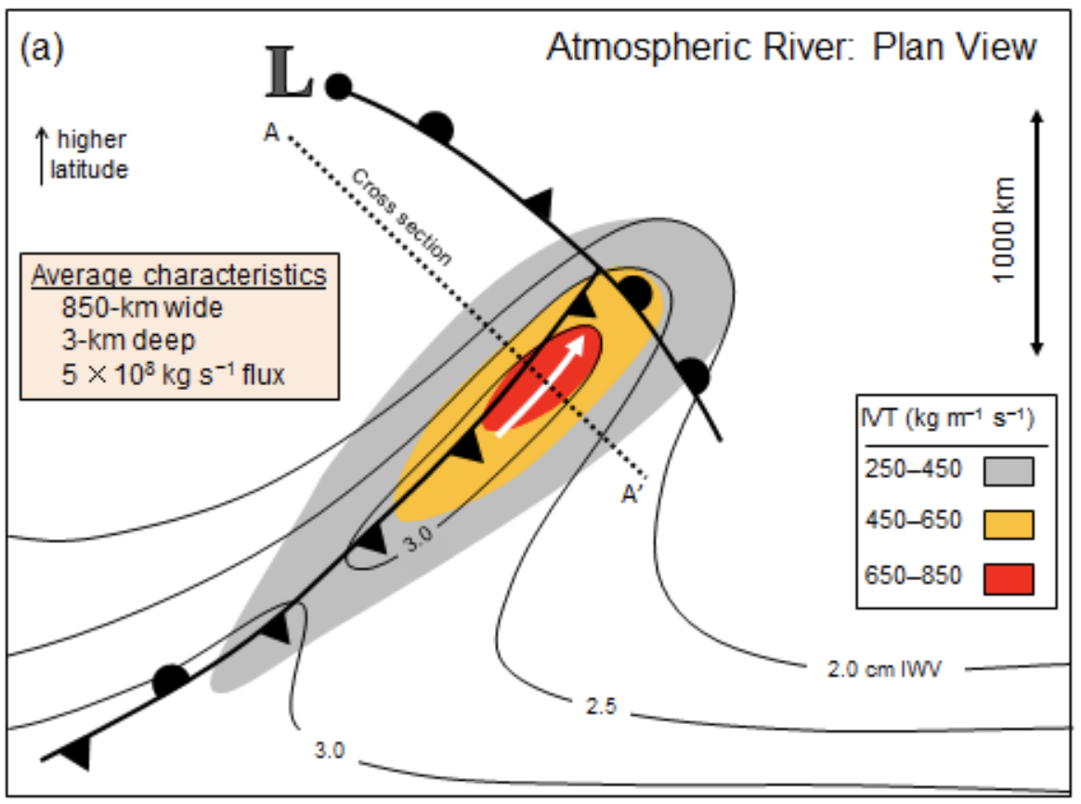
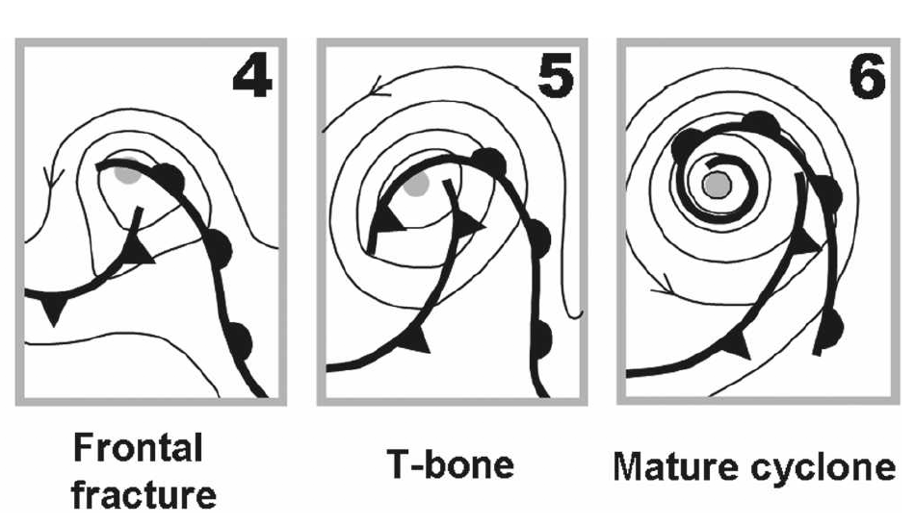
ARs and Secondary Cyclones
“Genesis”
Distinct Warm Sector
Repeat?

Slide 17
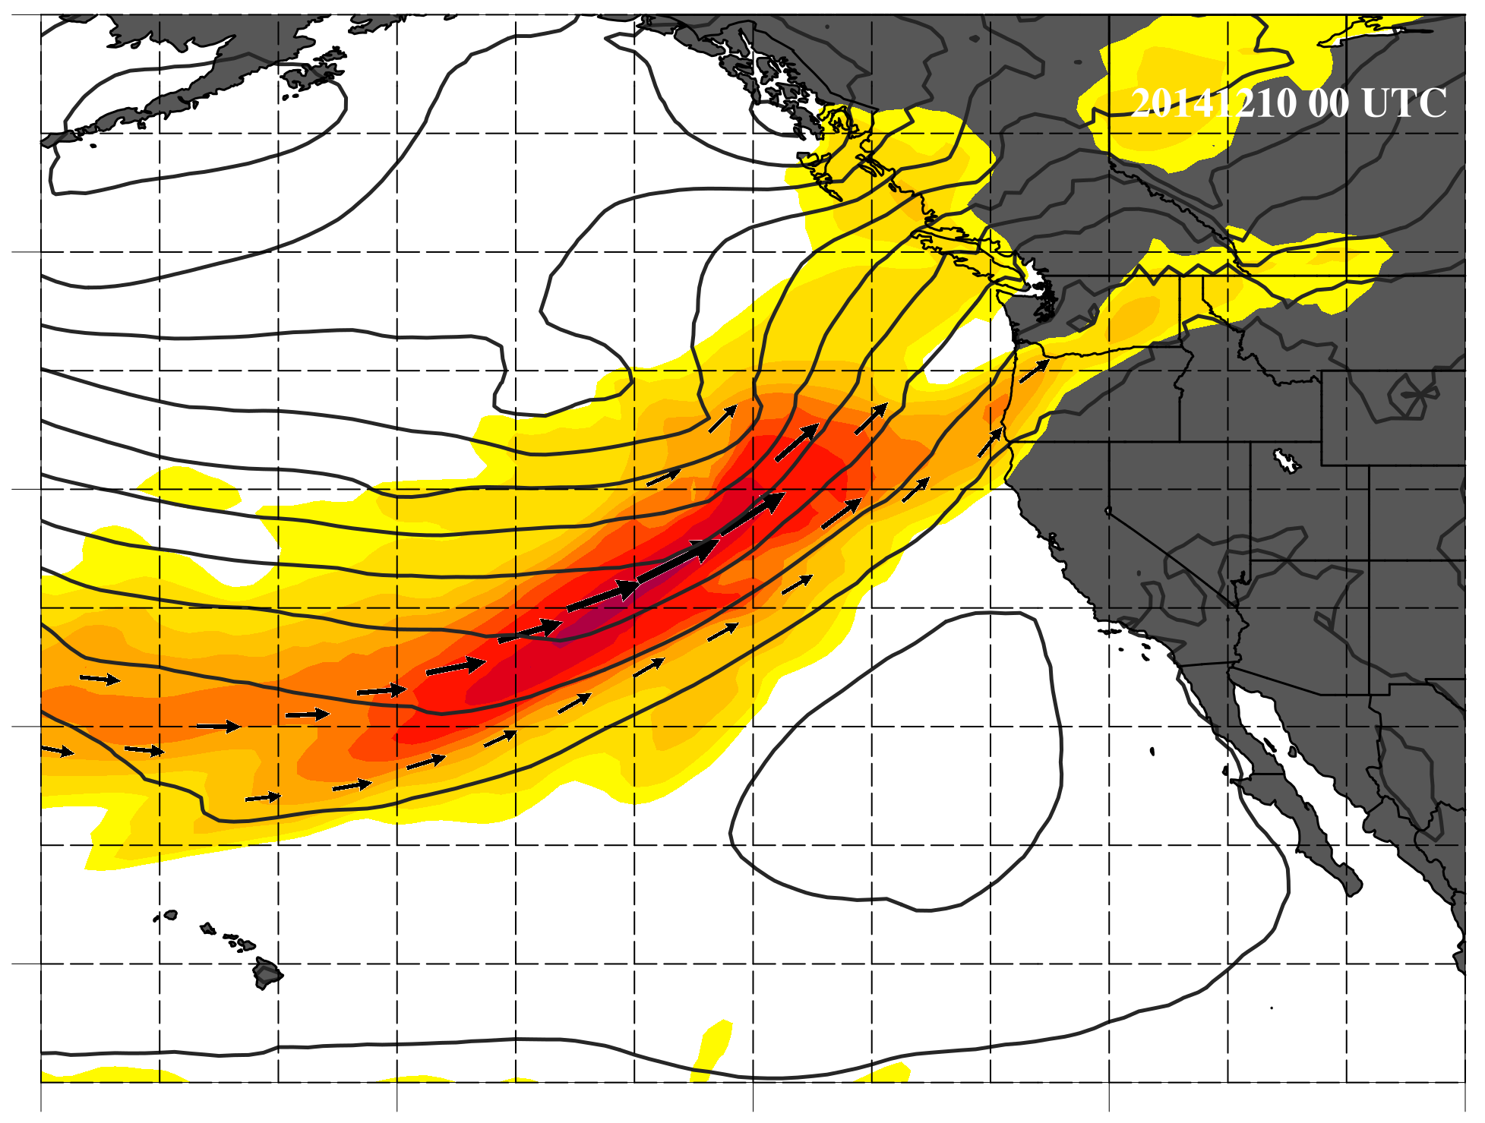
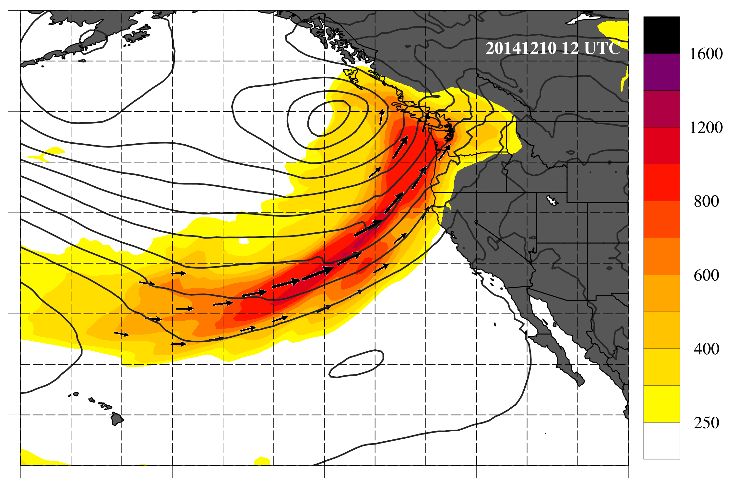
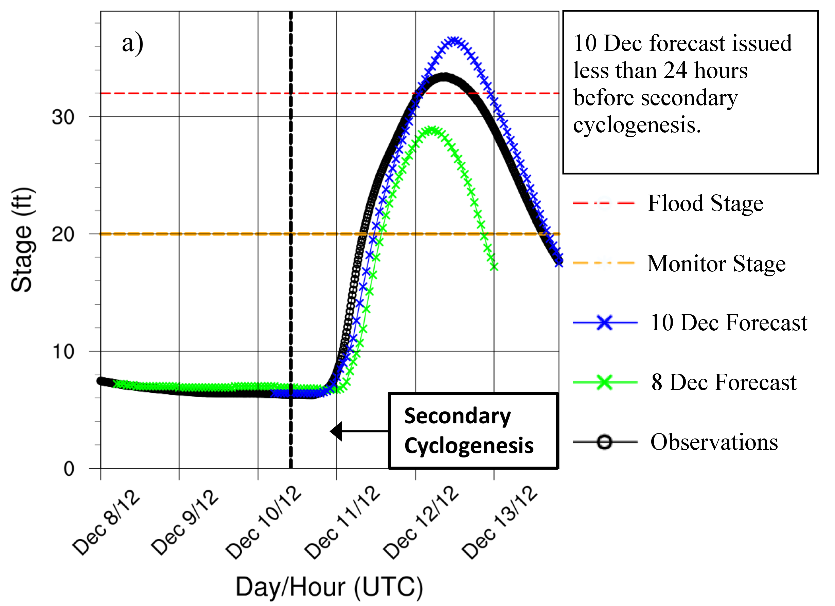
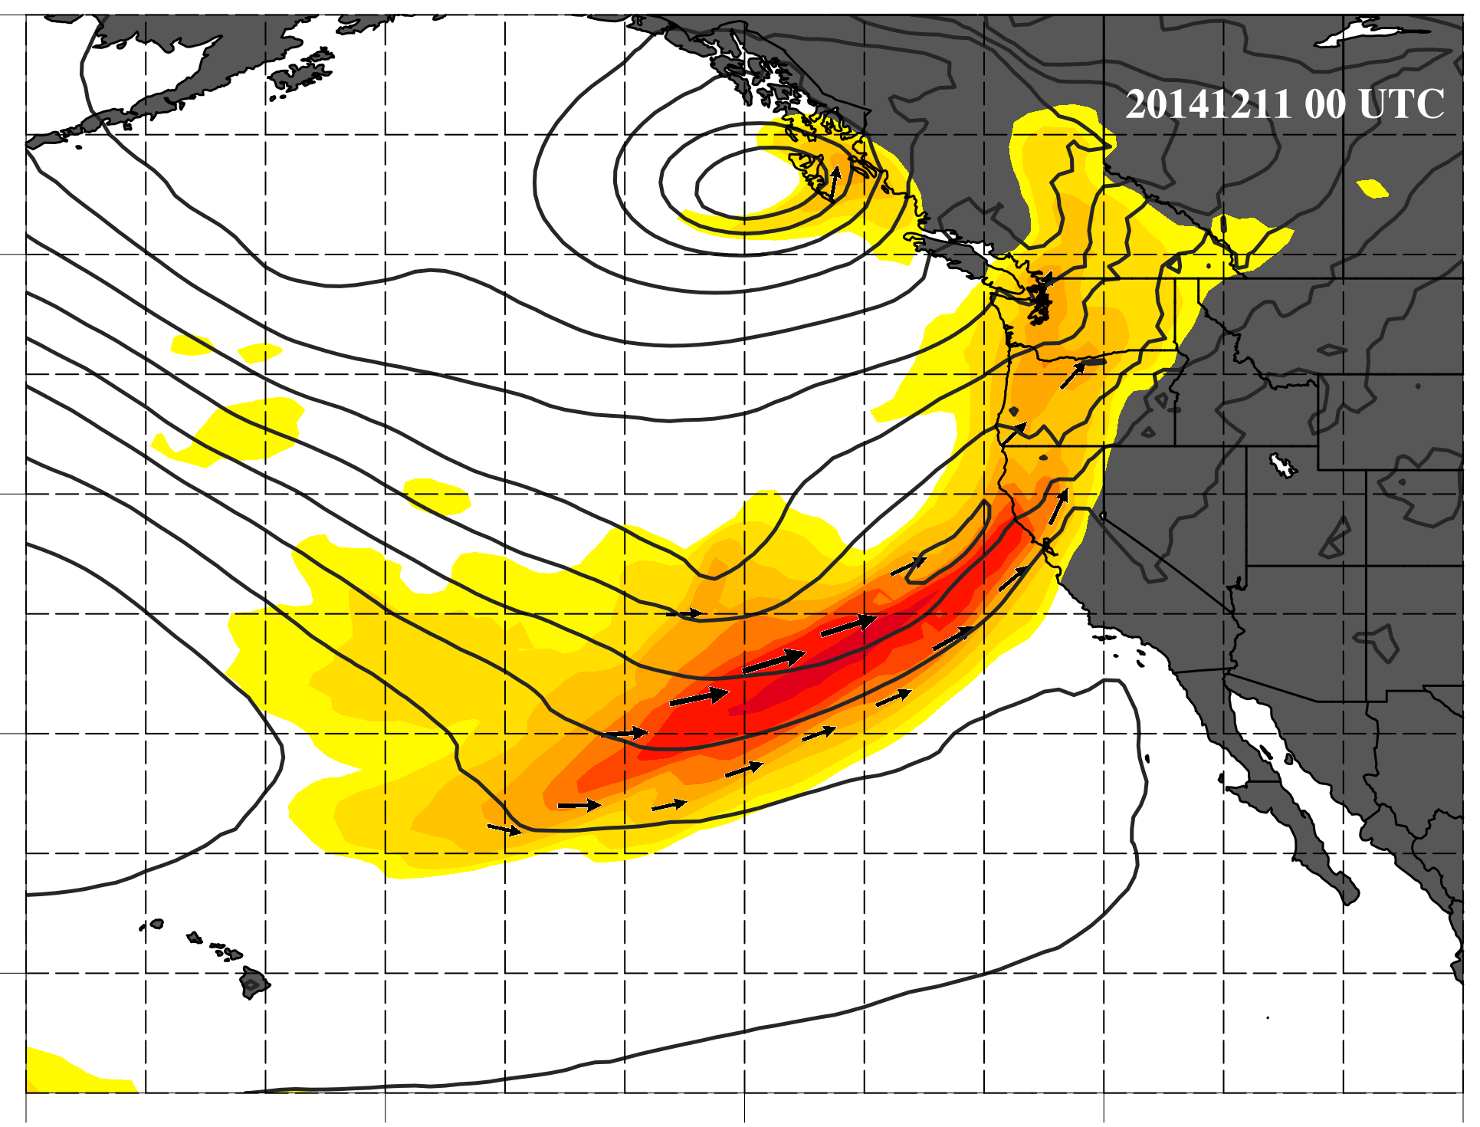
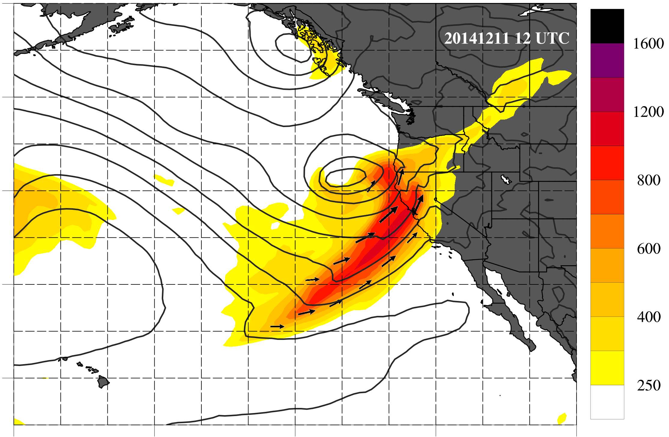
December 2014 Russian River Flood
1
2
Secondary Cyclone Developing on the AR trailing (cold) front:
modified the landfalling AR
led to a streamflow forecast challenge
L
L
3
4
L
L
L
X
Hydrographs @ Guerneville, CA
Martin et al. (2019 – J. Hydromet.) found two modes of reduced predictability.
Medium-range forecast failed to anticipate secondary cyclogenesis
Short-range ( < 36 hr) forecasts failed to diagnose modified precipitation processes

Slide 18
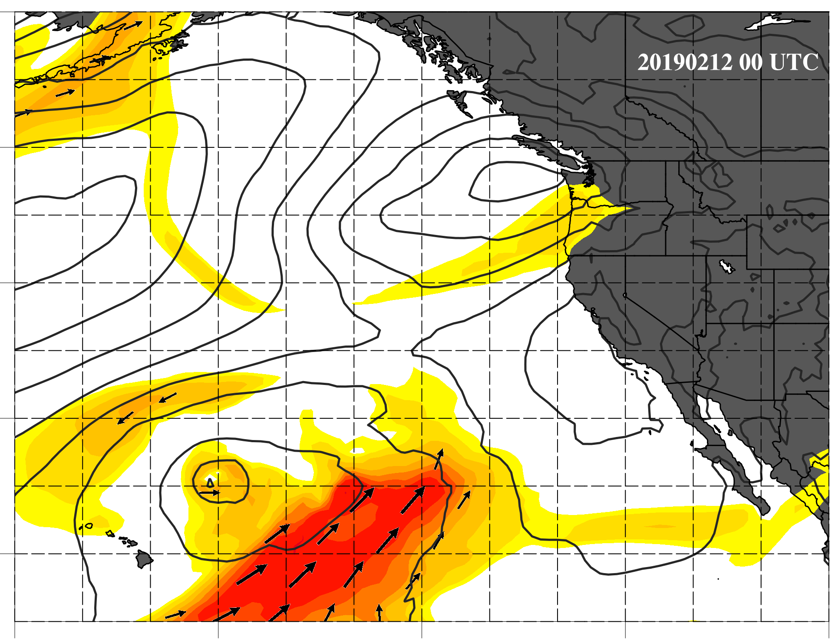
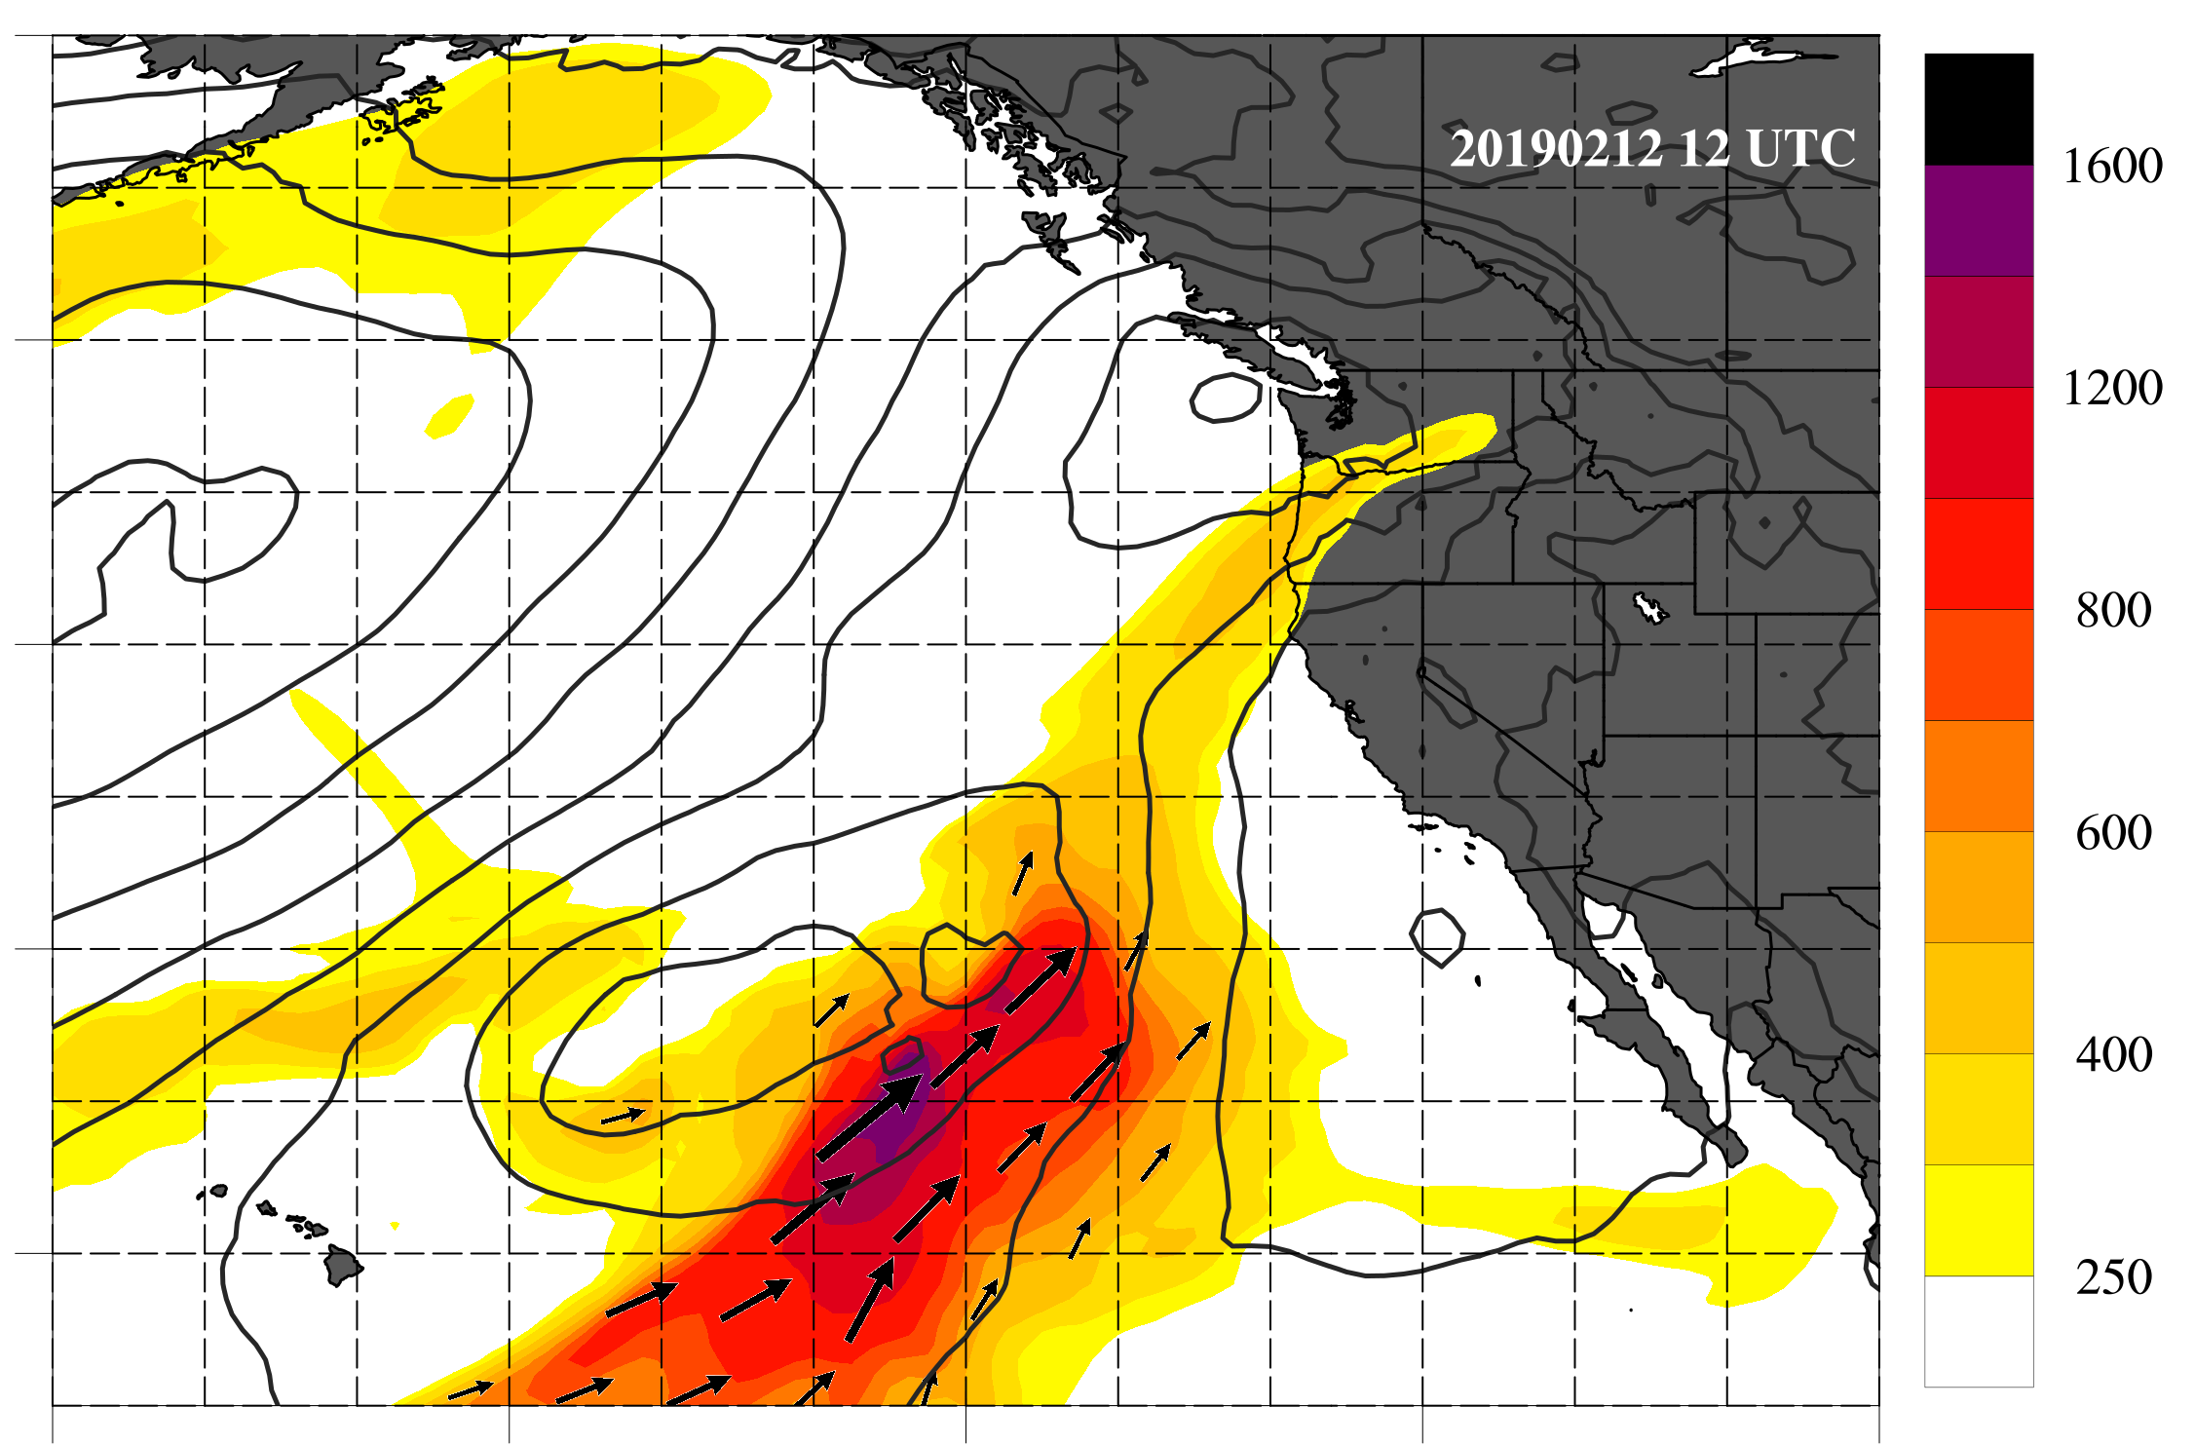
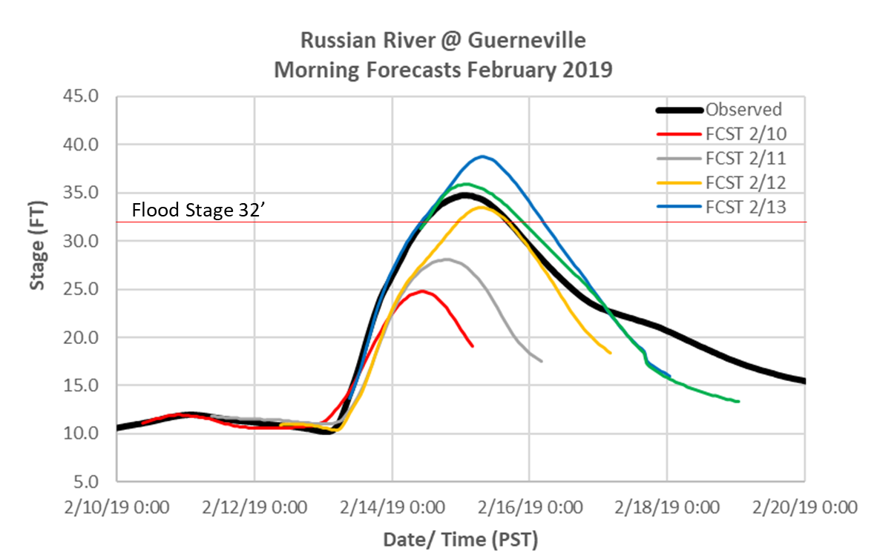
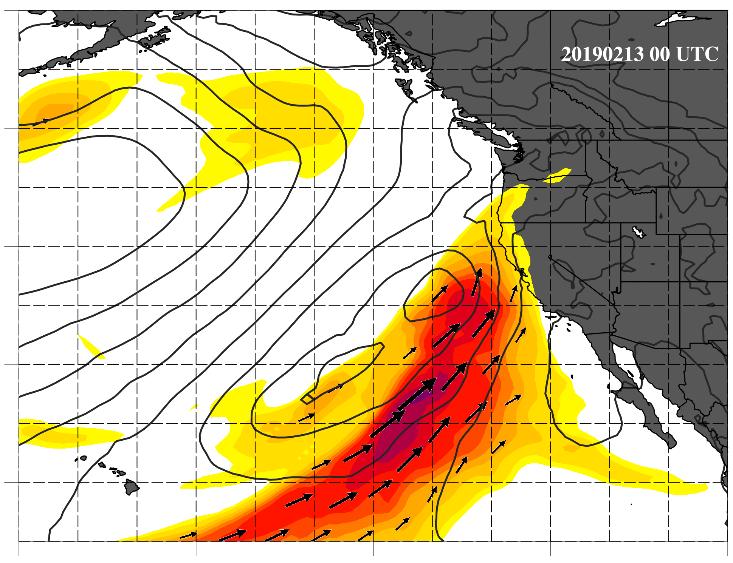
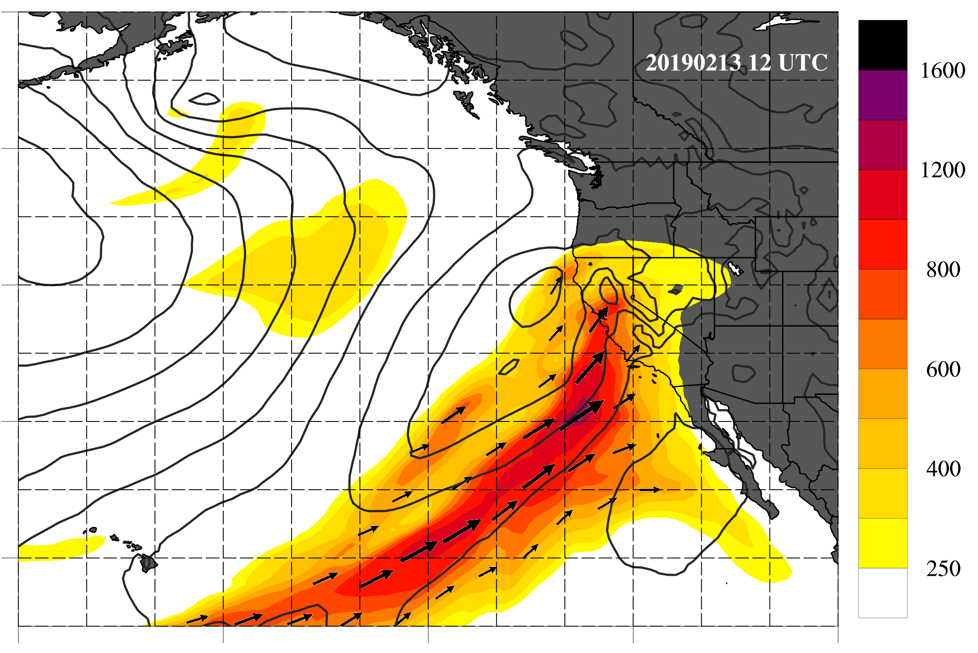
Valentines Day (2019) AR
1
2
Secondary Cyclone Developing on the AR leading (warm) front:
Strengthened and turned the AR northward
Again led to a short lead time streamflow forecast challenge
Because of event chronology, differing source of overforecast
L
L
L
3
4
L
L
L

Slide 19
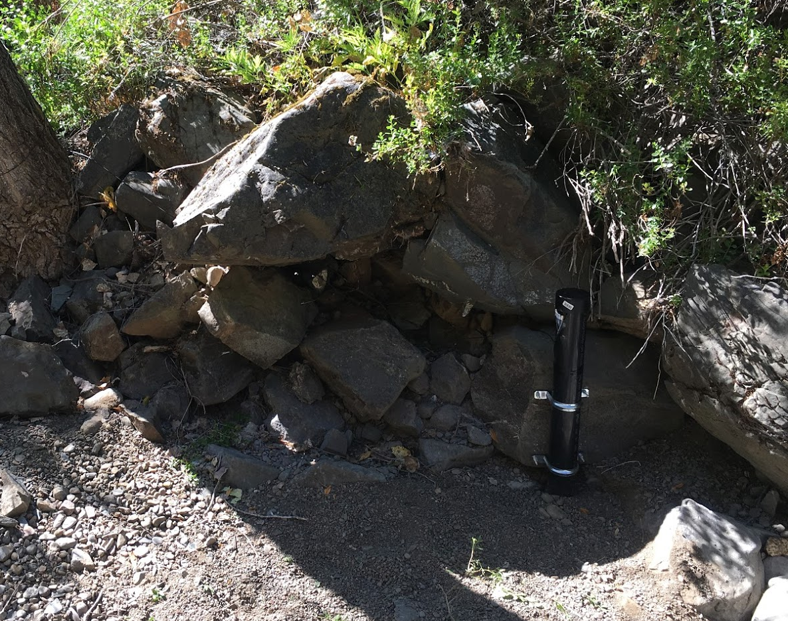
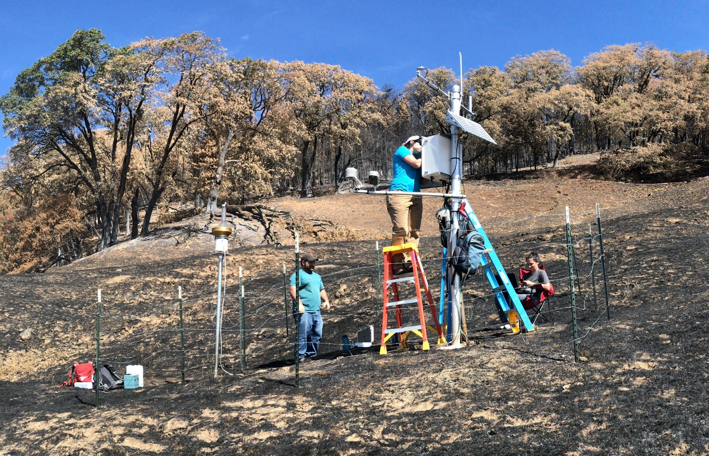
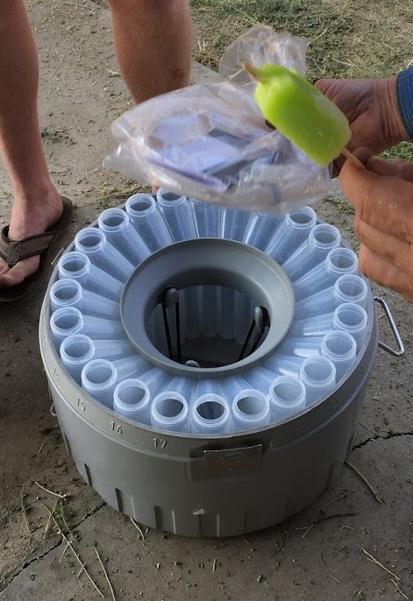
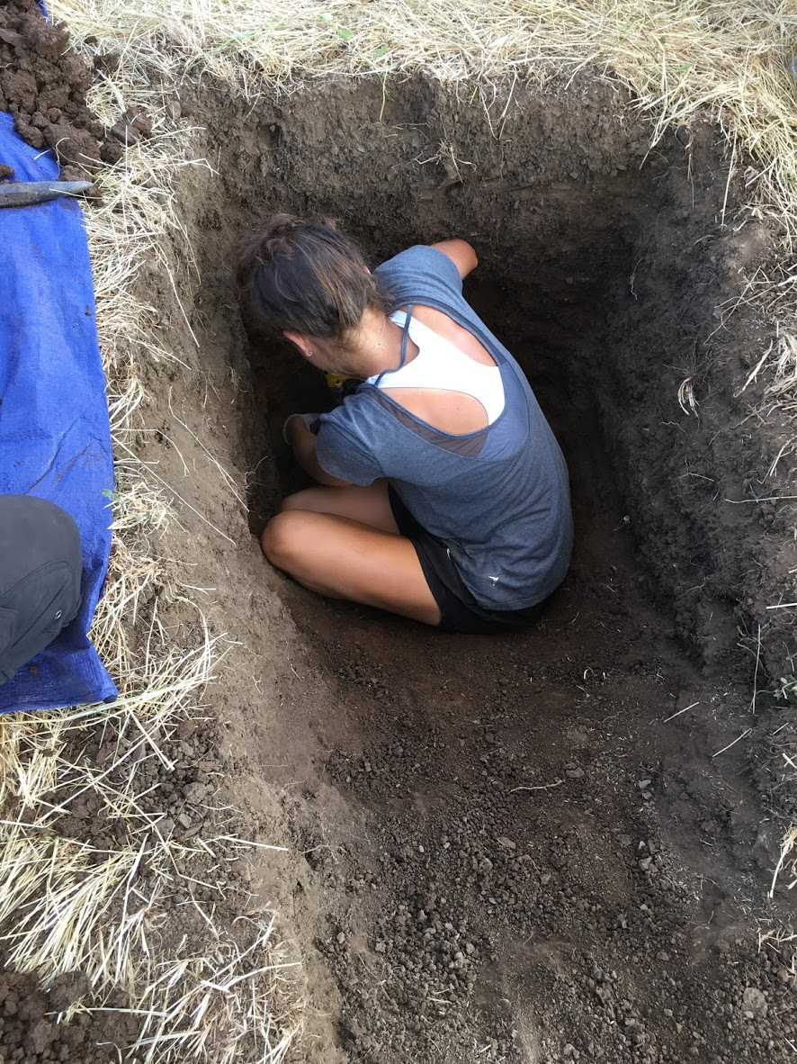
Basic Research: Land Surface
1)
2)
Clockwise from top-left:
Installing a stream gauge in a seasonal creek.
Setting up an automated weather and soil moisture monitoring site inside a recent burn.
Digging in preparation to install soil-moisture monitoring equipment.
Preparing an automated stream-water sampler.
4)
3)

Slide 20
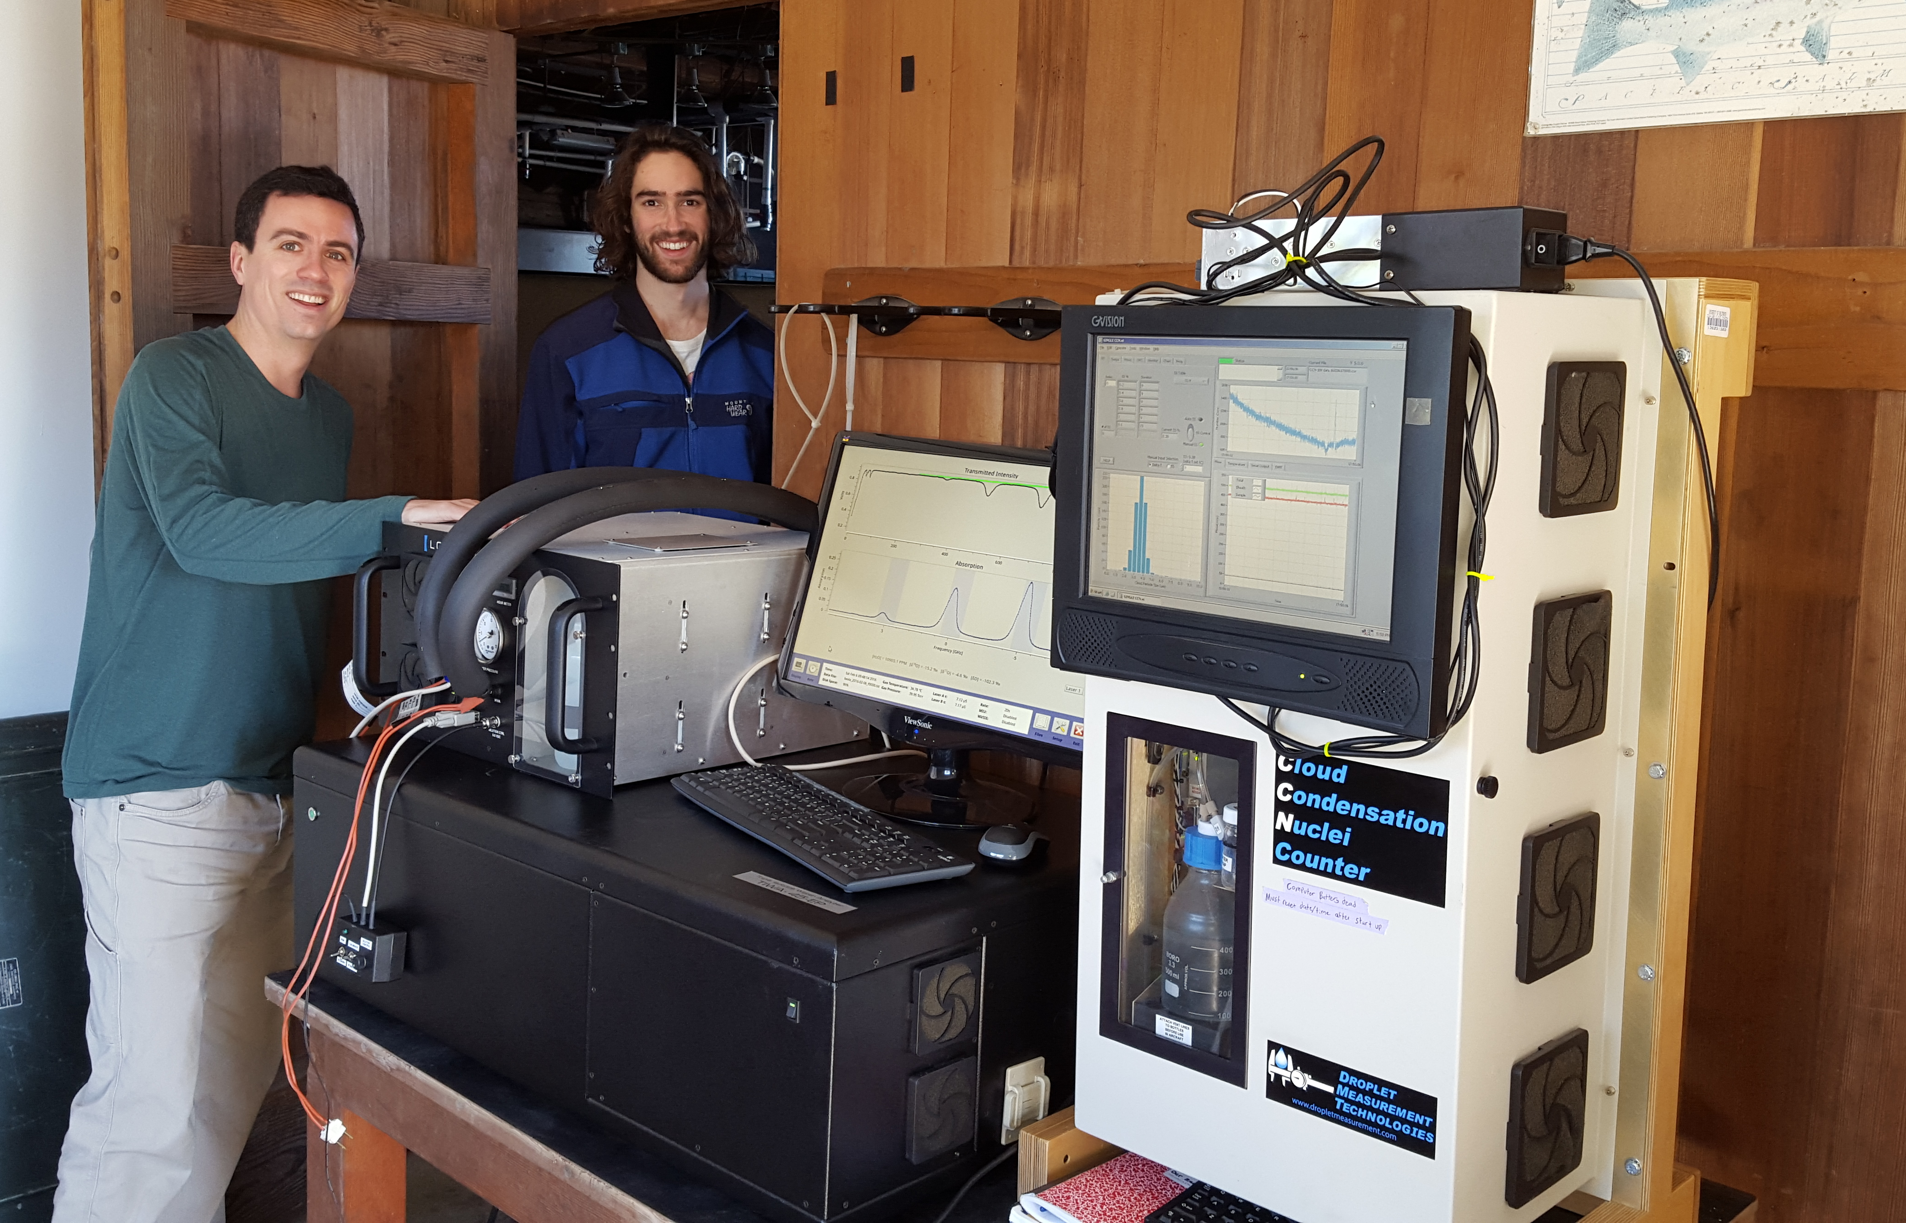
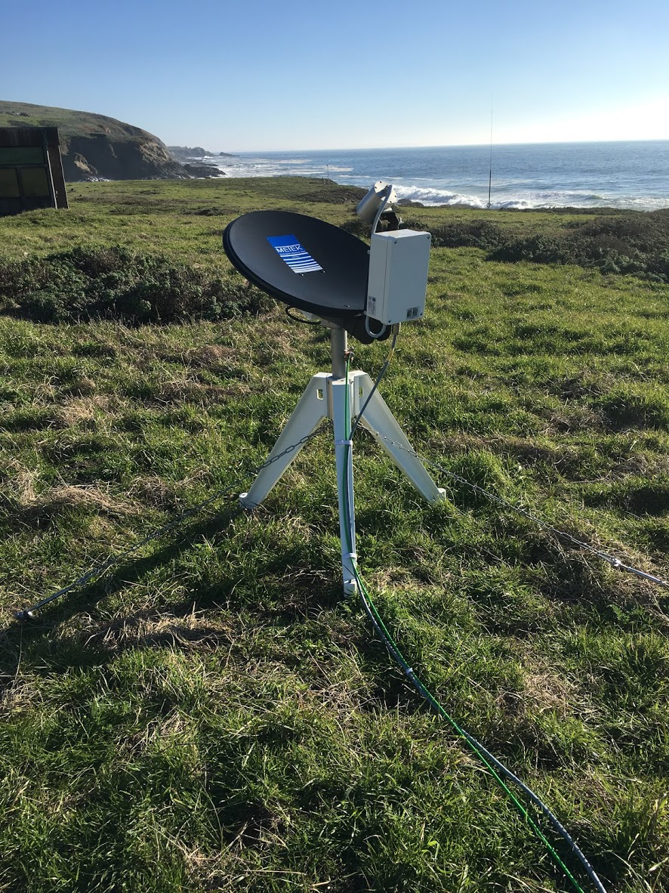
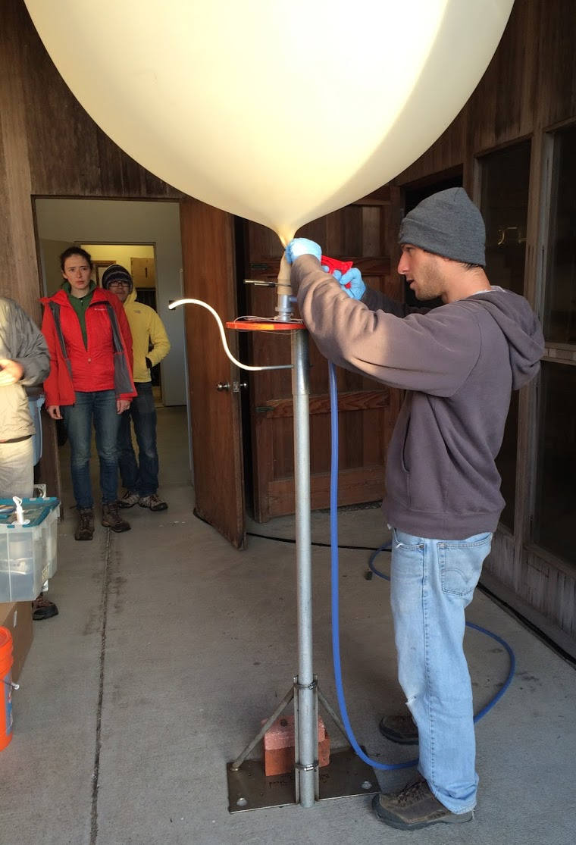
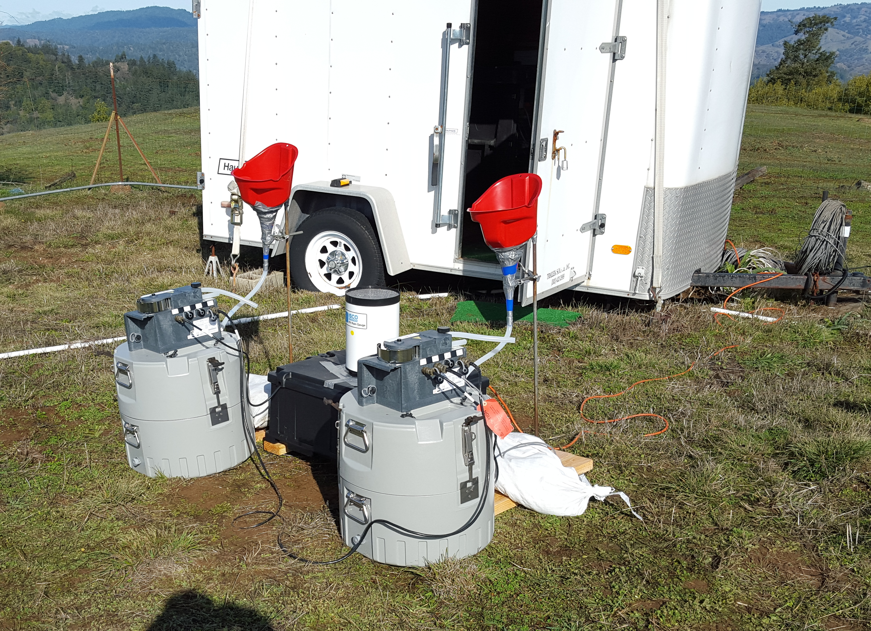
Basic Research: Atmosphere
Clockwise from top-right:
Researchers installing instruments to measure atmospheric chemistry
Automatic precipitation sampling equipment next to field trailer
Graduate students prepare to launch weather balloon
A “micro-rain” radar
1)
4)
2)
3)

Slide 21
Cloud Microphysics
To Left:
Conceptual model of the orographic seeder-feeder model in an AR with biological ice nucleating aerosols.
Adapted from Creamean et al. (2013 - Science)
Martin et al. (2019 – Atmos. Chem. Phys.) found that biological ice nucleating aerosols from terrestrial ecosystems can enhance cloud ice in AR seeder-feeder clouds, a pathway to invigorating precipitation.

Slide 22
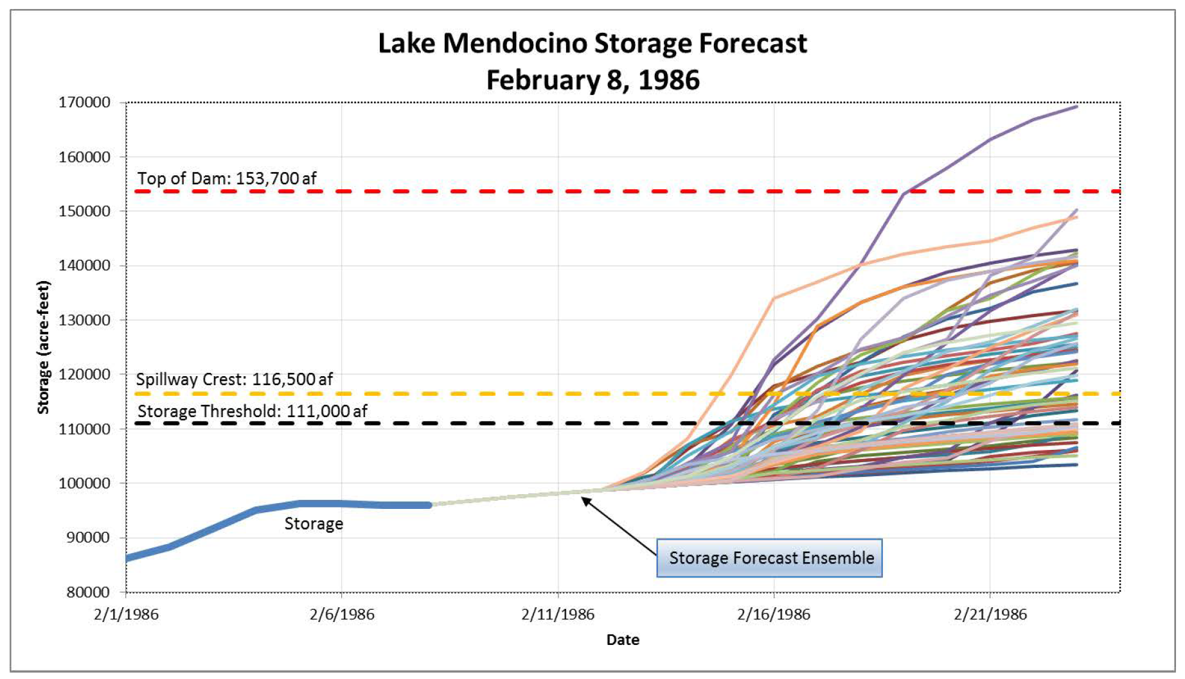
How Have Operations Changed?
Ensemble members are constructed by postprocessing NWP forecasts using 30-year model forecast climatology
SIO/SCWA experimental forecast ensemble estimates the probability of problematic reservoir inflow 5-10 days in advance

Slide 23
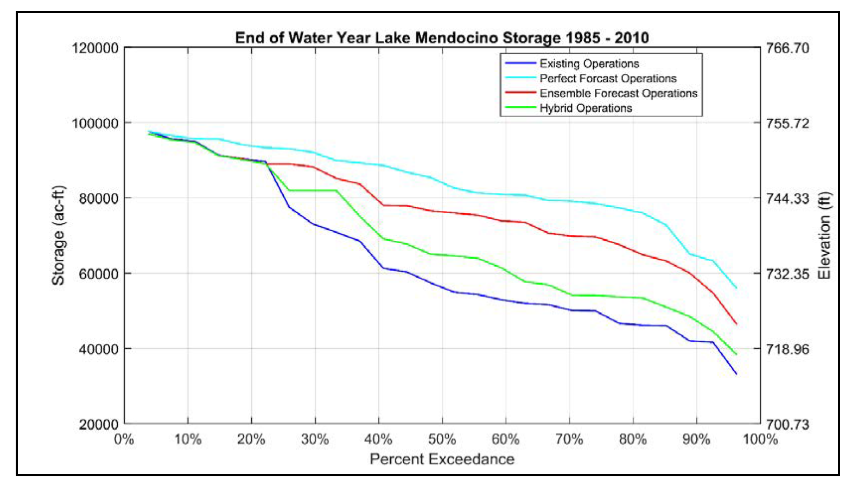
How Have Operations Changed?
Red curve: let the forecast ensemble prescribe releases regardless of current storage
Green curve: limit to WCM deviation if ensemble forecasts say risk is low.
Adopted 2018
The FIRO Preliminary Viability Assessment Report found that current technology (including forecasts) allowed for a partial implementation of FIRO at Lake Mendocino.
Simulated operations (above chart) under the Hybrid scenario estimates that median end of year storage would increase by 8,600 AF without impacting downstream flood risk.

Slide 24
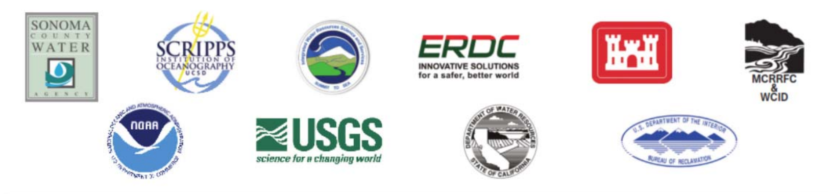
Future of FIRO
FIRO at Lake Mendocino Called for a Formal Assessment of “Transferability” to other water projects with other
  Climates: Snow, Seasonality, Event Magnitudes, Event Timescales
  Purposes: Hydropower, Habitat, Water Quality, Recreation

Slide 25
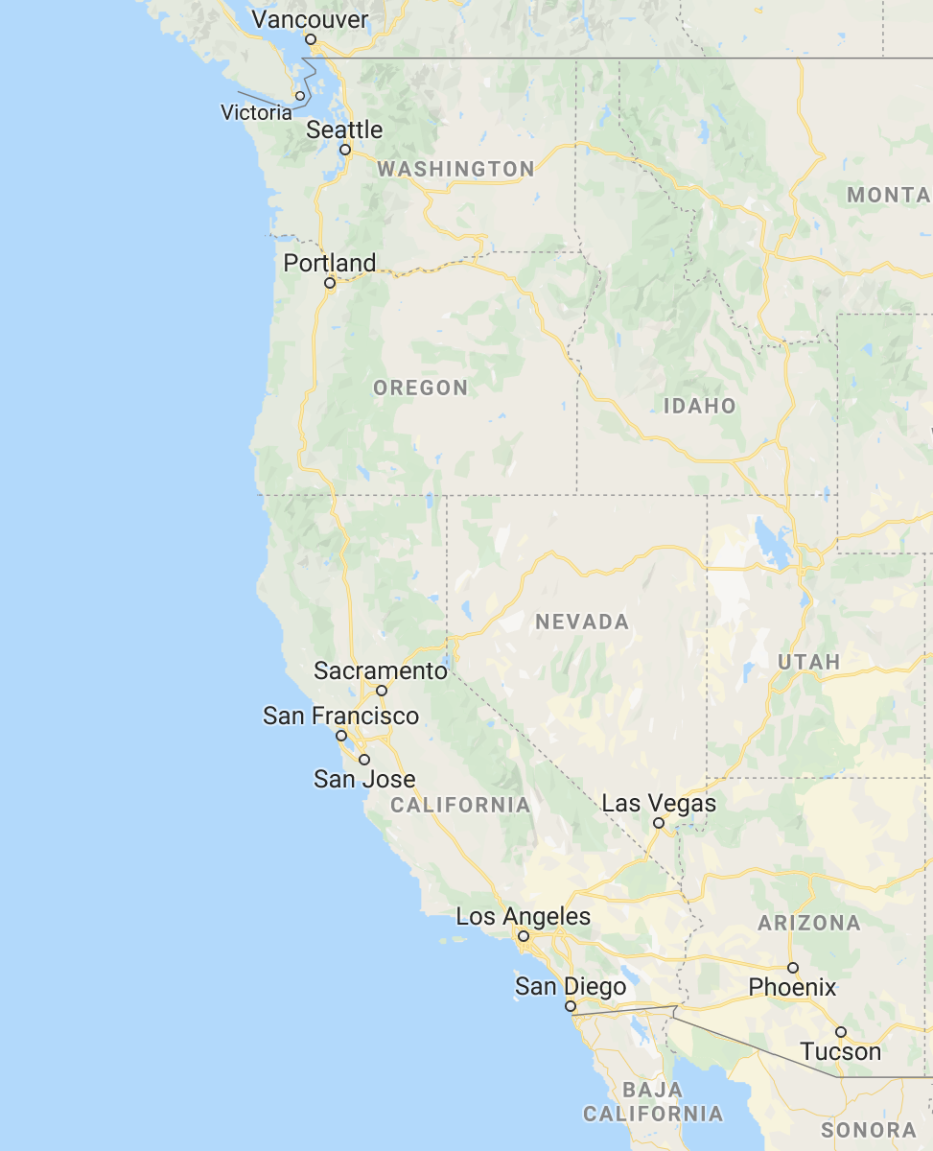

FIRO in 2020
From 2014 – Present, FIRO has expanded to additional water management projects, including:
Southern California to support aquifer recharge.
Northern Sierra Nevada to support hydropower operations and additional flood capacity.
Oregon Cascades are being investigated to enhance reliability of the summer salmon run.
?

Slide 26
Graduate Studies in FIRO
Interested in FIRO Research as a Graduate Student in the Atmospheric, Hydrological or Climate Sciences?
Portland State University, Portland, OR:
  Dr. Andrew Martin, anmarti2@pdx.edu
Scripps Institution of Oceanography, San Diego, CA:
  Dr. Anna Wilson, anna-m-Wilson@ucsd.edu
University of Colorado, Boulder, CO:
  Dr. Aneesh Subramanian, aneesh.subramanian@colorado.edu
Plymouth State University, Plymouth, NH:
  Dr. Jason Cordeira, j_cordeira@plymouth.edu

