Slide 1
Atmospheric Rivers: How do they make rain and how can we more accurately simulate that?
Dr. Andrew Martin, anmarti2@pdx.edu
Research Assistant Professor
Department of Geography, Portland State University
Geog 523, Winter 2019

Slide 2
Outline
What is an Atmospheric River?
How do Atmospheric Rivers Generate Precipitation?
What is an Atmospheric River Observatory (ARO)?
How Can an ARO be Used to Improve Weather and Climate Models?
Example from Literature: Martin et al. (2018)
Step I: Evaluating Model Simulations of ARs before they reach the ARO
Step 2: Does the Model Correctly Simulate ARO Relationships?
Step 3: If Not, What Part of the Model Would be Best to Improve?

Slide 3
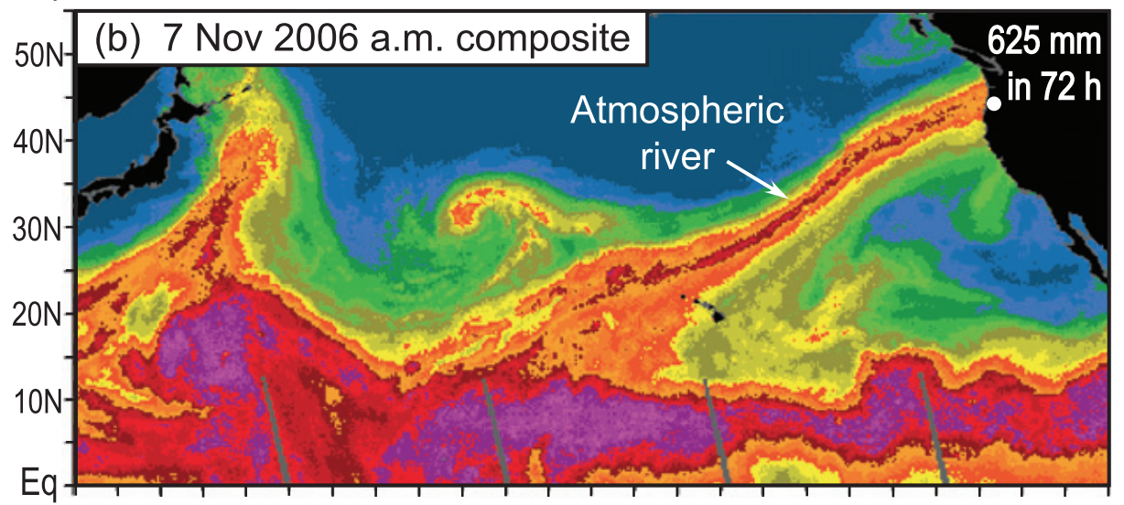
What is an Atmospheric River?
Simply, an AR is
A long, narrow corridor of moving water vapor
Directed horizontally from the tropics toward the poles
The figure shows the enhanced Integrated Water Vapor left behind by an atmospheric river as it moves. As seen by the SSM/I satellite microwave sensor.
Formally, from the Glossary of Meteorology:
“A long narrow and transient corridor of anomalously strong horizontal water vapor transport that is typically located in the lowest 3 km of the troposphere and associated with a low-level jet stream ahead of the cold front of an extratropical cyclone…”

Slide 4
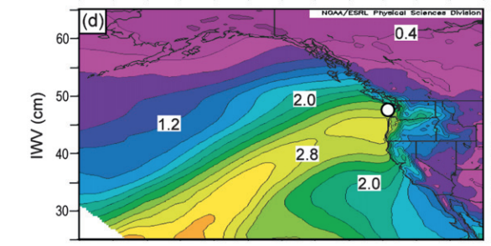
Why are ARs Important?
ARs Provide beneficial rain and snow for water supply
ARs can also cause damaging floods
25% - 45% of annual precipitation in the west coast states fell on the same day an atmospheric river was present.
Adapted from
Dettinger et al. (2011 – Water)
Above is shown the composite Integrated Water Vapor prior to the top-ten annual peak daily flows for Howard Hanson Dam (white dot)
Adapted from Neiman et al.
(2011 – J. hydrometeorology)
From Neiman et al. 2013

Slide 5
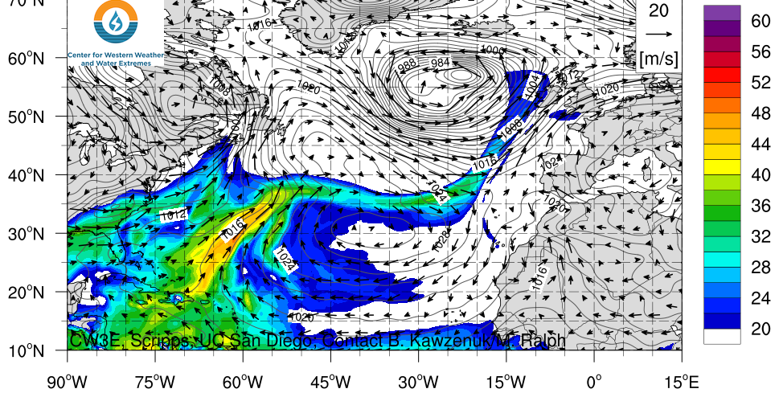
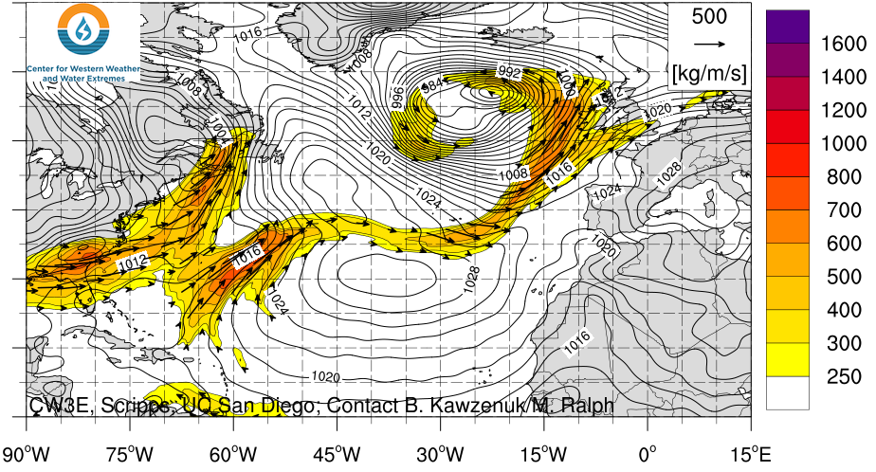
Atmospheric River Measurements
Where water vapor is concentrated
$$IWV=−\frac{1}{g}\int{q_{v}dp}$$
units = mm
Where water vapor is moving
$$IVT=−\frac{1}{g}\int{\overset{⃑}{u}q_{v}dp}$$
units = kg m⁻¹ s⁻¹
How microwave satellites see ARs, but not as useful for estimating impacts
Must be generated by model or atmospheric sounding. Better fit to AR definition and AR impacts

Slide 6
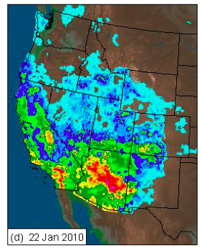
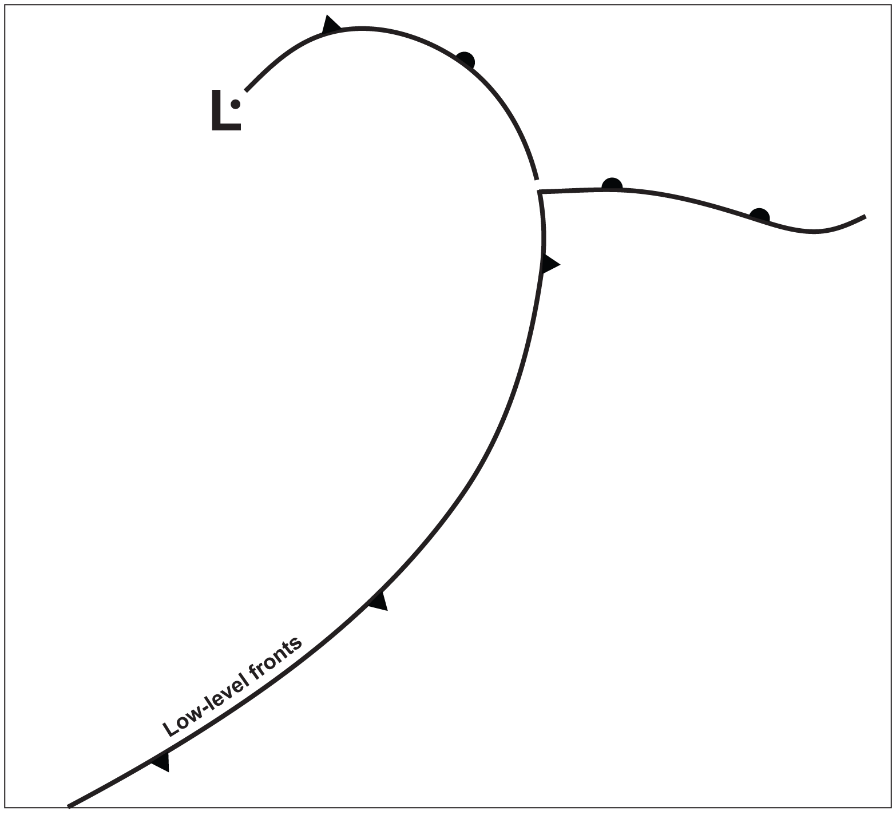
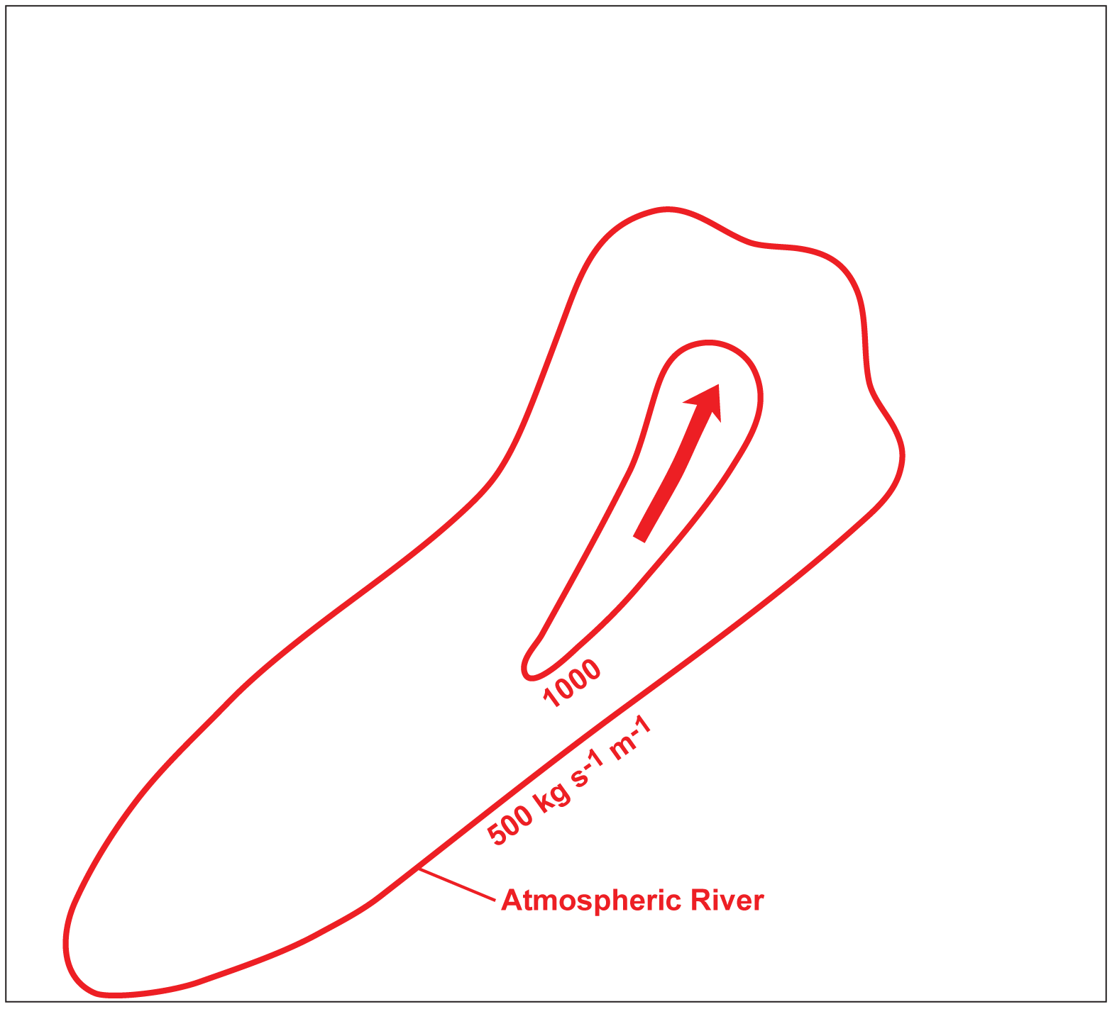
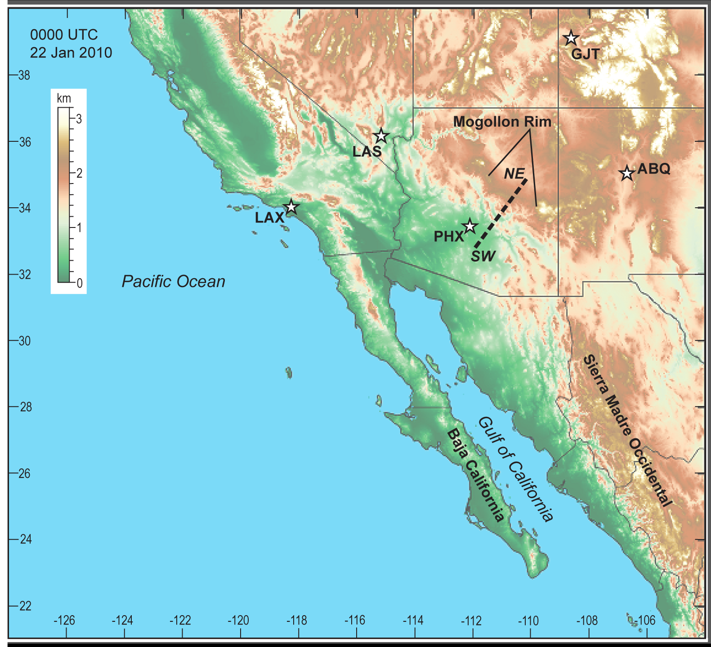
How do ARs Generate Precipitation?
24 hour accumulated precipitation
Schematic meteorology:
Fronts, AR (red contours) and low-level jet (red arrow)
On the US West Coast, ARs commonly cause precip. when the horizontal flux of water vapor is forced upward by mountains.

Slide 7
Three Ingredients for AR-caused Precipitation
Long corridor of strong water vapor flux, possibly with a low-level jet (LLJ).
Scale: 1000s km, synoptic scale
Vertical motion to cause horizontally moving vapor to condense.
Scale: Mountain range scale, 10s km, mesoscale
Processes that determine how much condensate falls, such as cloud microphysics and turbulence.
Scale: 1/1000 m – 10s m, microscale

Slide 8
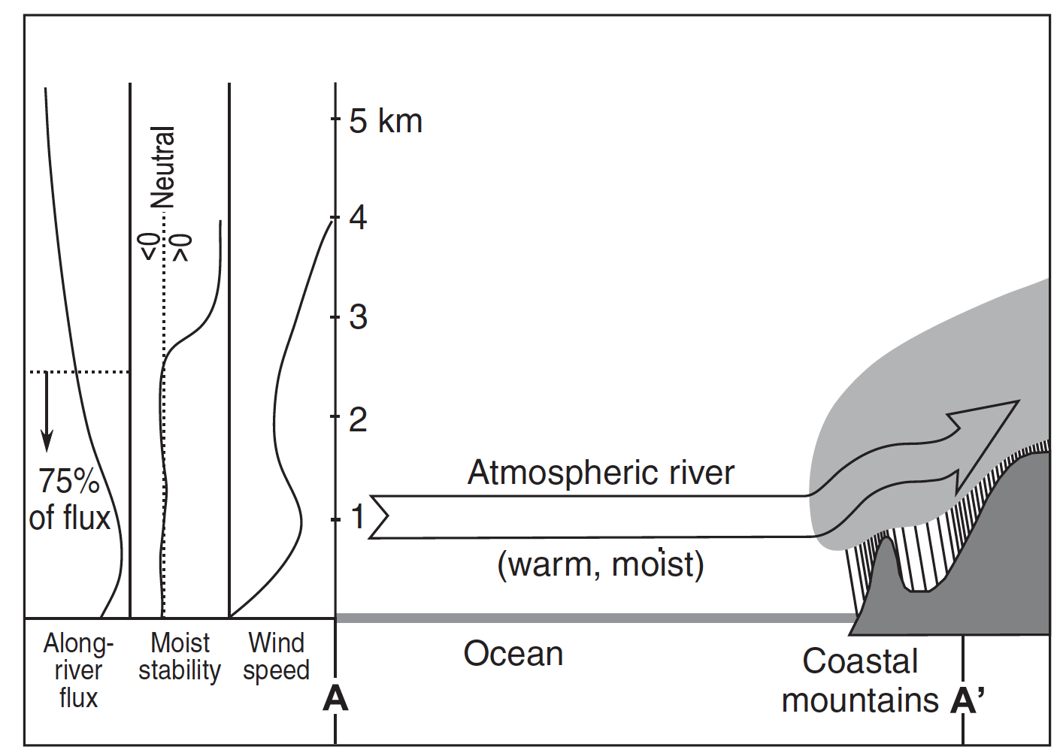
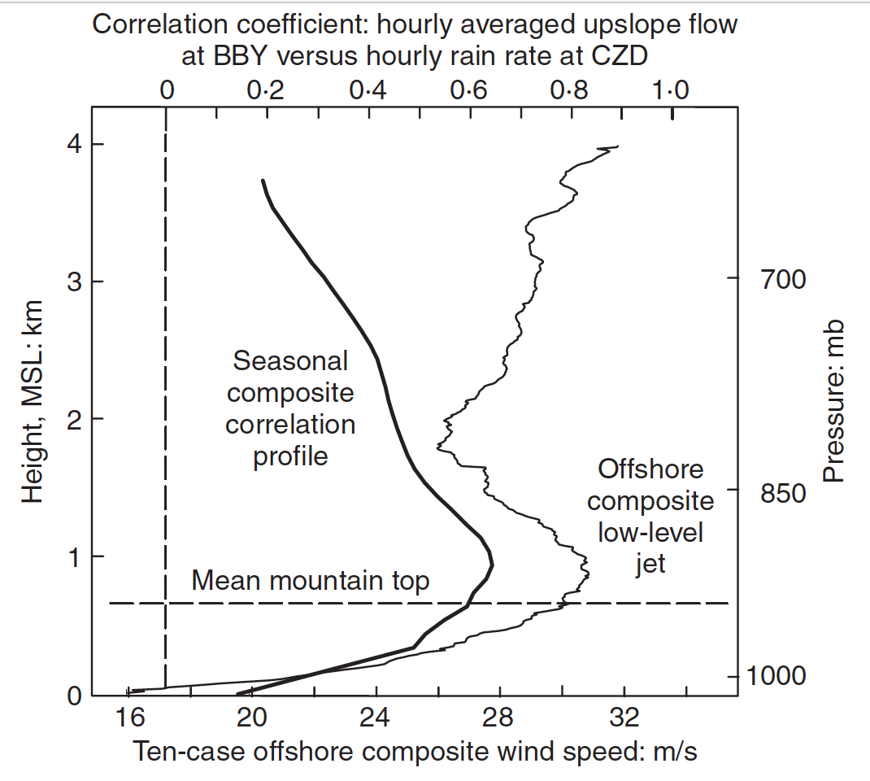
Conceptual Diagram
Hypothetical Scenario:
AR direction is same as cross-mountain direction.
Left: Vertical profiles of average AR.
Middle: Hypothetical AR with maximum precipitation productivity.
Key Finding: “upslope” component of wind during AR correlates most strongly with mountaintop precipitation rate at same height as low-level jet.

Slide 9
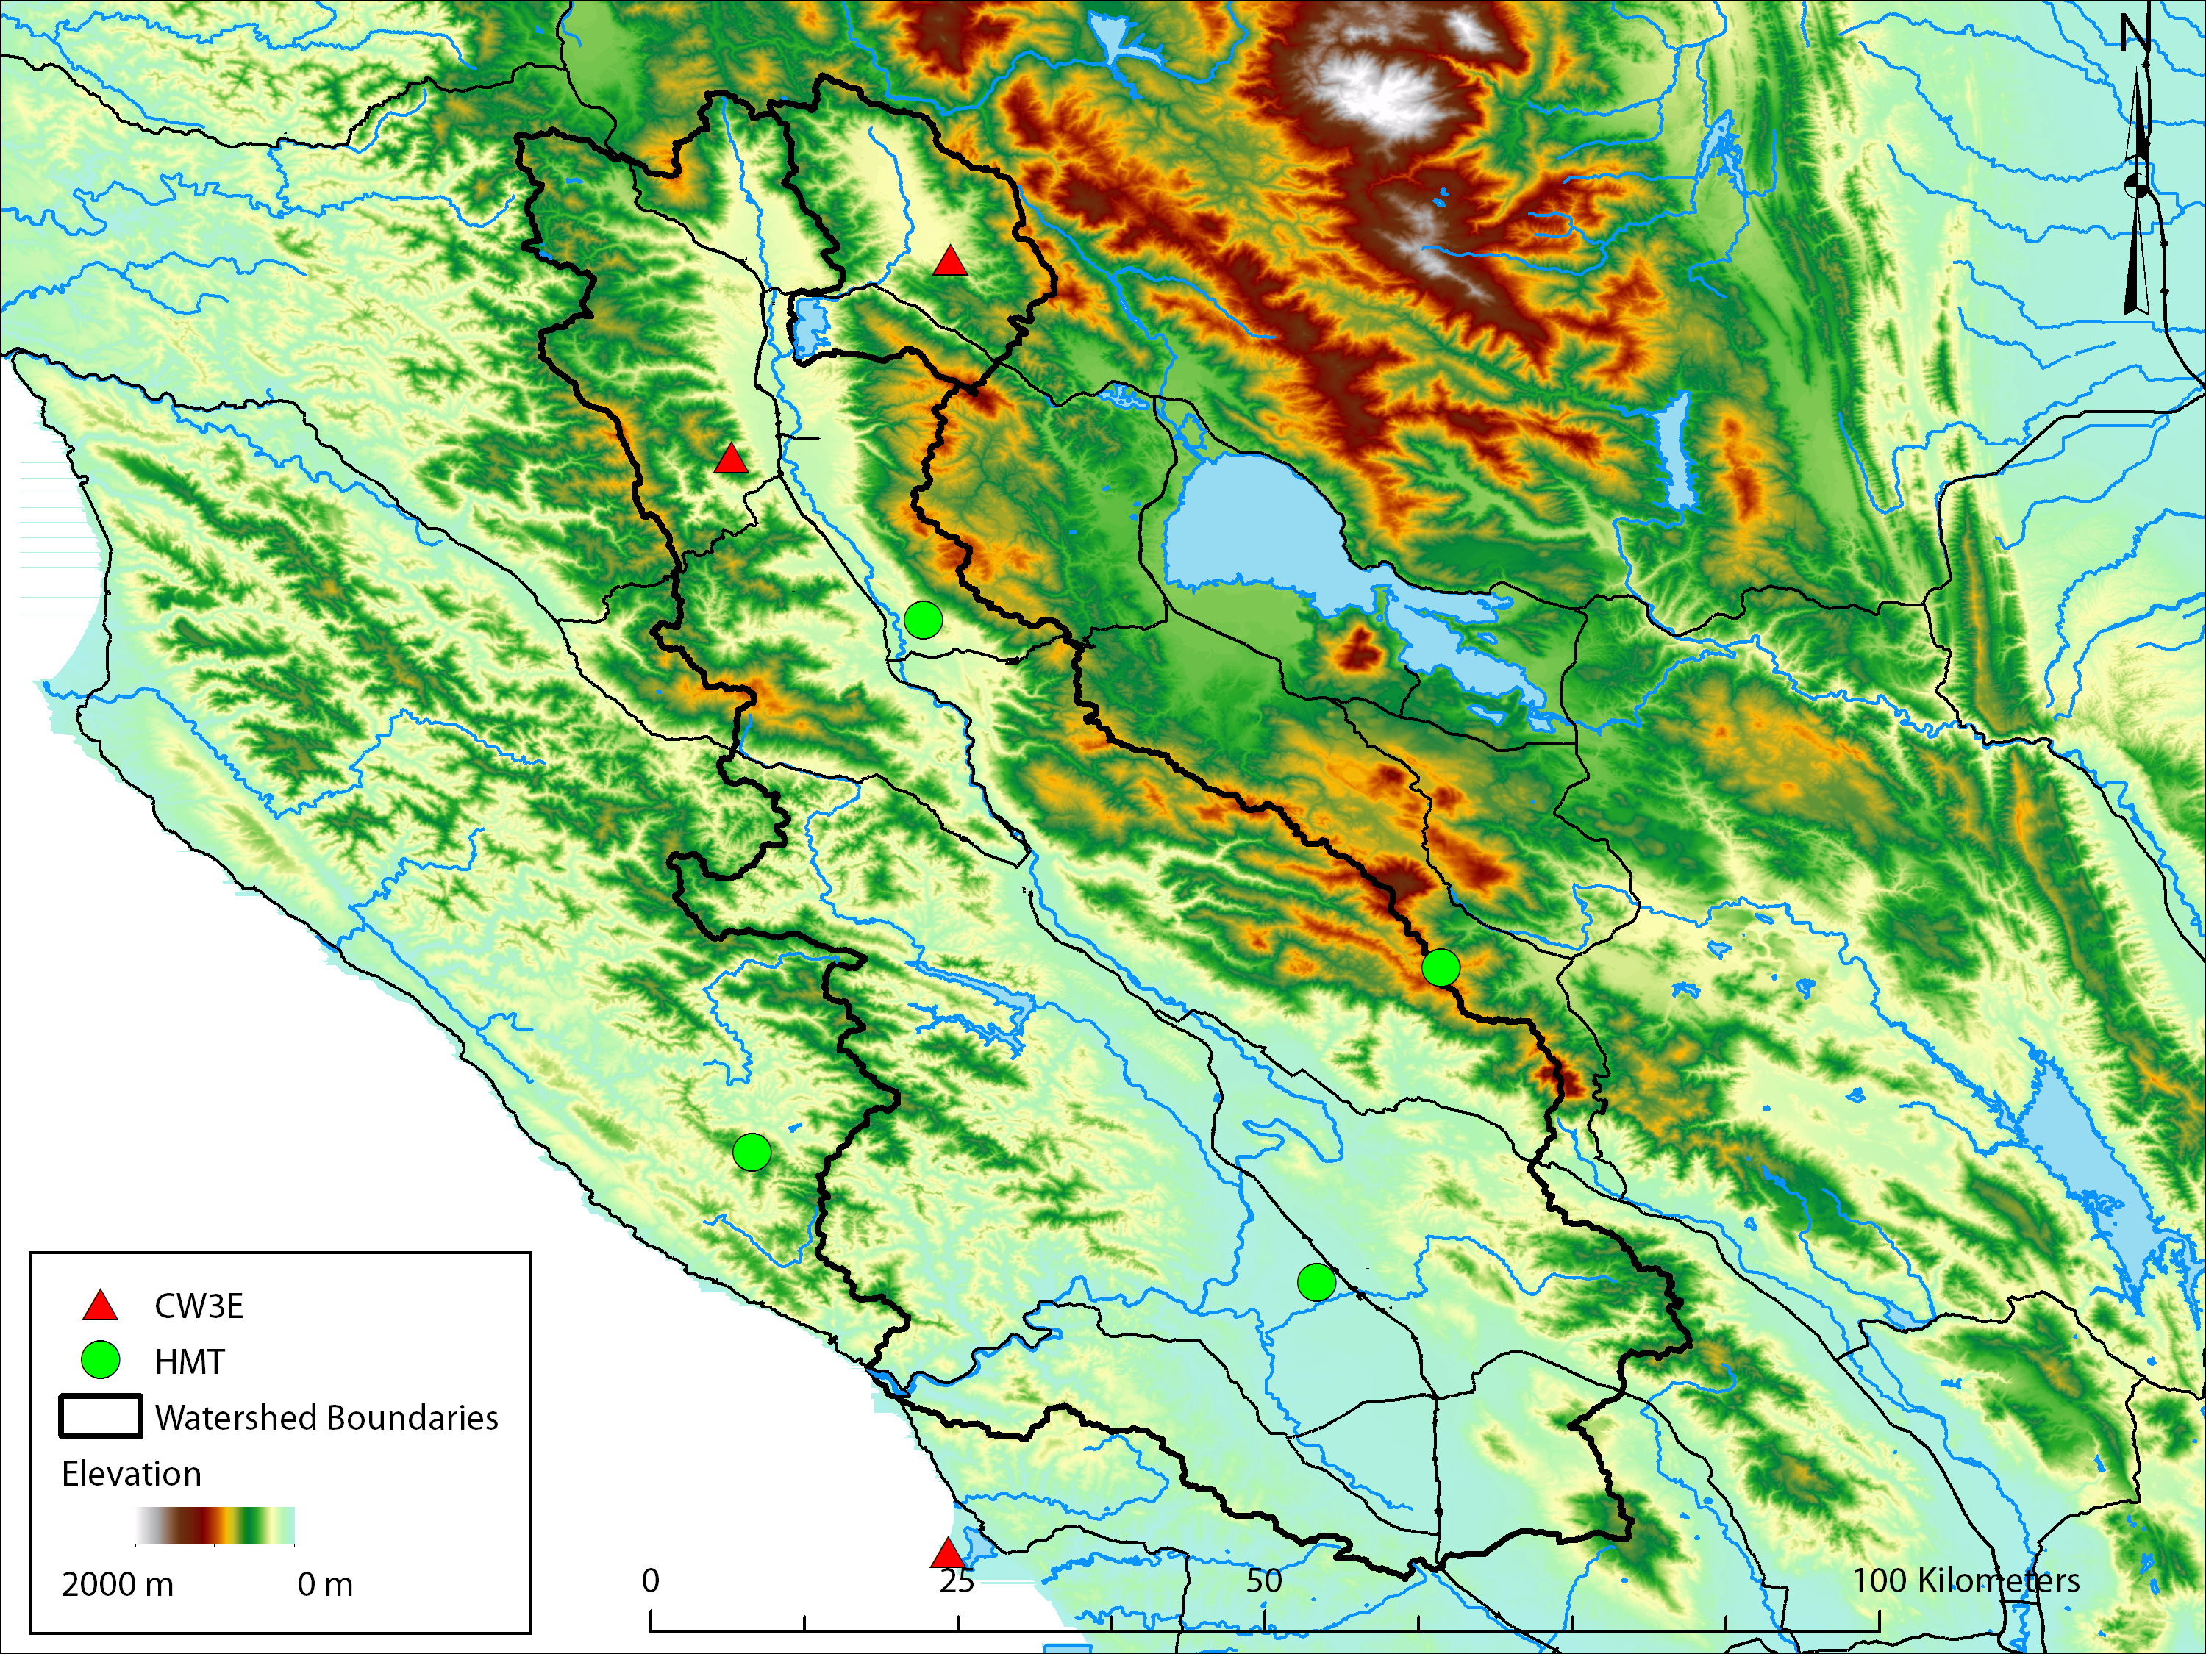
Atmospheric River Observatory
Russian River
Watershed
CZC
BBY
The Bodega Bay Coastal ARO is a couplet of in-situ and remote sensing instrument sites designed to measure the horizontal flux of moisture as an AR strikes the coast and the resulting precipitation at mountaintop.
Maps provided by Brian Henn

Slide 10
Atmospheric River Observatory
Plan view
Rain shadow
Atmos. Riv.
Heavy rain
Dividing streamline
Concept: The product of Integrated Water Vapor with Upslope Wind can be related to the precipitation and cloud measurements at mountaintop.
Its an approximation to IVT
Heavy rain
GPS satellite
Wind direction in AR
400 km wide
Mountains
ARO
3
Wind profiler beam with 100-m vertical resolution
S-PROF data up to 10 km MSL
Orographic cloud and precipitation
2
Snow level
Altitude MSL (km)
“Controlling layer” (upslope winds)
1
Rain shadow
Atmospheric River
Surface friction and barrier jet
Mountain
S-PROF precipitation profiler; surface met; disdrometer
0
Ocean
GPS-met receiver
10-m surface meteorology tower
CZC
BBY
Wind profiler
(915 or 449 MHz)
0-50 km between wind profiler/GPS-met site and S-PROF precipitation profiler

Slide 11
The Dominance of Synoptic and Mesoscales
Relationship between coast storm-total bulk upslope flux (BUF – x axis) and mountaintop storm-total precipitation (y axis).
Ralph et al. (2013)
J. Hydrometeorology
Found that total rainfall at the ARO responded most strongly to the total water vapor driven up the mountain by the controlling layer wind.
Storm-total Precip. (mm)
Bulk Upslope Flux = = $IWV∗u_{up, ctl}$ (cm m s⁻¹ hr)

Slide 12
How can the ARO be used to Improve Models?
Strategy (Martin et al., 2018 – J. Hydrometeorology):
To first order, weather and climate models should simulate the correct precipitation (“response”) given a value of BUF (“forcing”) during ARs. We’ll test a low-resolution and high-resolution model. Step 2
If we can isolate the simulated BUF (“forcing”), the remaining error in precipitation (“response”) can give information about how to improve the modeled microscales. Step 3
Because BUF is actually a combination of the synoptic and mesoscales after adjustment of the AR by mountains has occurred, we must also make sure the model simulated AR vapor transport is correct far upstream of the ARO. Step 1

Slide 13
Step 1: Evaluating Model Simulations of ARs before they reach the ARO
High-res model (WRF)
Low-res model (GFS)
Obs. vapor transport
(blue – kg m⁻¹ s⁻¹)
Short Simulations
( 1-2 days)
Pressure (hPa)
Distance from
AR Center
Longer Simulations
(5-6 days)
Error ( Model – Obs; kg m⁻¹ s⁻¹ )

Slide 14
Step 2: Does the Model Correctly Simulate ARO Relationships?
We’ll use the normalized 2-D distance between each model and the corresponding ARO observation as a measure of total error.
WRF (high-res)
GFS (low-res)
Observation
Line segments A and B represent this visually.
Storm-total Precip. (mm)
From Simulations of 10 AR at the ARO:
Sim. Length (days) | WRF Error | GFS Error
1 - 2 | 0.82 | 4.29
3 - 4 | 2.25 | 4.53
5 - 6 | 4.65 | 7.37
Storm-total BUF (cm m s⁻¹ hr)

Slide 15
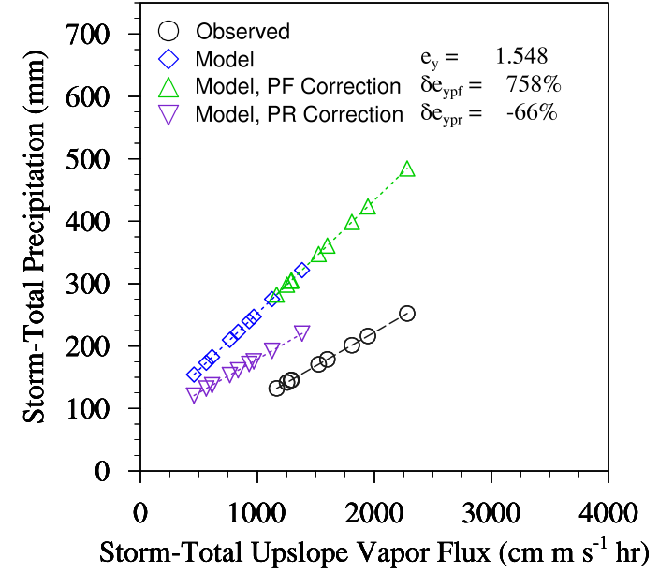
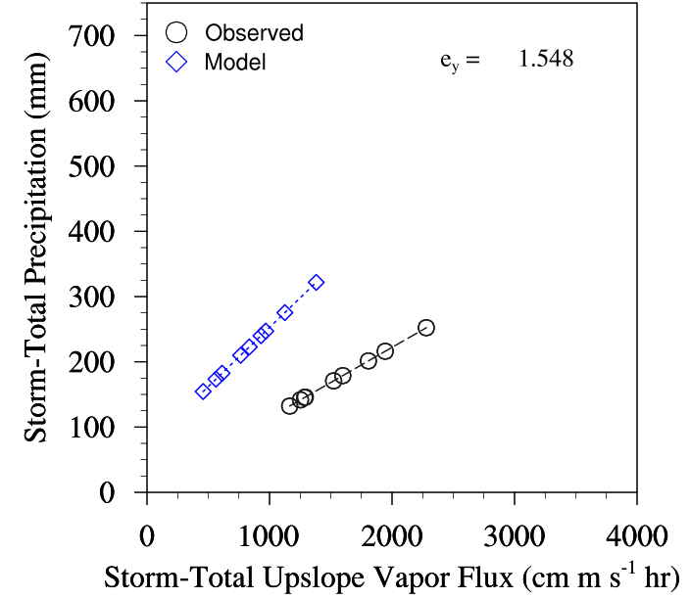
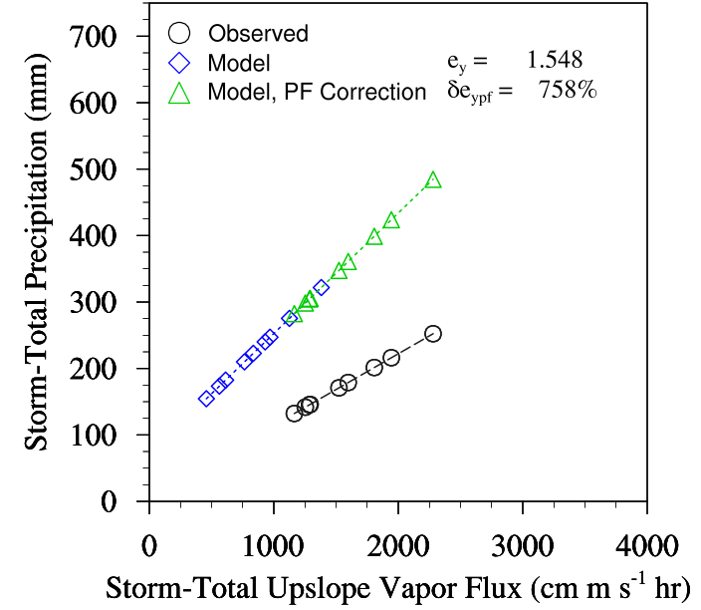
Step 3: If Not, What Part of the Model Would be Best to Improve?
We can use a set of ARO obs. (black) to calculate normalized error in precip. for a hypothetical model (blue).
We can also use the least-squared relationships of both to ask how much is the error improved or worsened
( $δe_{ypf}$ ) if the observed forcing (BUF) is substituted for the model values.
We can do the same by substituting the observed response relationship ($\frac{∆Precip.}{∆BUF})$ and measuring the fractional change in error ($δe_{ypr}$ ).
Storm-Total BUF

Slide 16
Step 3: If Not, What Part of the Model Would be Best to Improve?
When we applied this technique to our real-world weather and climate models,
We found that the high-res model error could be improved through better simulation of forcing or response mechanisms because it began closer to observations in both
However; the low-res model simulates the response very poorly and thus will only improve by correcting the response mechanisms (smallest scales)
Historical fit
WRF (high-res)
GFS (low-res)
Observations
Precipitation (mm)
Storm-Total BUF (cm m s⁻¹ hr)

Slide 17
Summary
ARs are an important feature of the hydroclimate in the Western US.
ARs generate precipitation via three major ingredients at distinct scales:
Horizontal vapor transport and a low-level jet (Synoptic)
Lift of moving vapor, causing condensation (Mesoscale in our examples)
Converstion of condensation into precipitation (Microscale).
The design and long record of the ARO enables its use as an effective model evaluation tool.
By iteratively separating the above ingredients in two currently used models, we can make prescriptions for improvement in simulation of AR precipitation.

Slide 18
Questions
Do you see possibilities of RNWP AR prediction reliably extending beyond 7 days, or will longer lead timeframes remain probabilistic for the foreseeable future?
Do you expect climate change to impact the frequency and severity of AR's on the US west coast?
Could this study be applied to atmospheric rivers that affect the east coast or are the mechanisms related to ARs in these two different geographic regions not related enough?
Of the models presented in the article, which would better represent unusual occurring effects such as splits in the polar vortex and its effects on the AR that interact with the west coast?
Have these models effectively predicted more recent AR events and been compared to the actual precipitation amounts and timing?
Being that this study is the first to investigate the predictability limit of AR state and core variables using GNWP and RNWP, what led you to choose this particular..?

