Slide 1
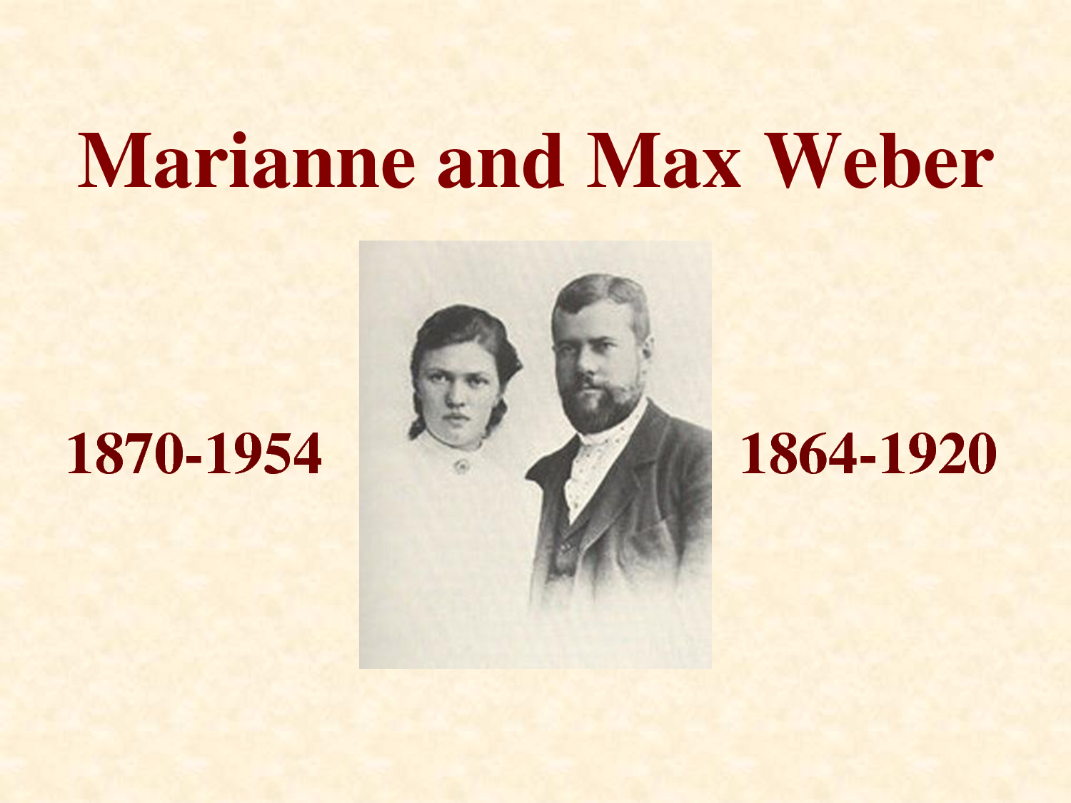
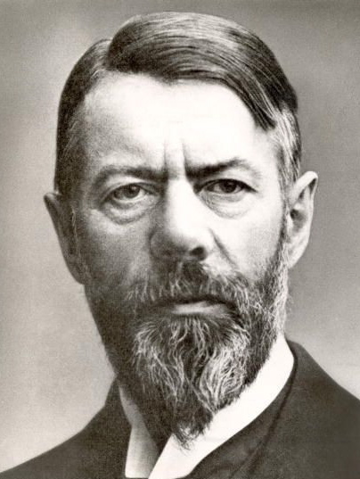
Maximilian Karl Emil "Max" Weber was a German sociologist, philosopher, and political economist whose ideas influenced social theory, social research, and the entire discipline of sociology. Perhaps most famous for his work on religion.

Slide 2
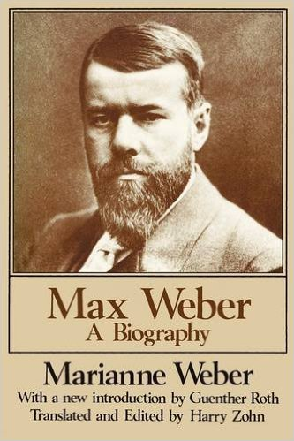
•1884 – Born in Erfurt, Germany, son of authoritarian, assertive
father and pious passive mother.
•1884-1889 – Studies law and economics at Universities of
Heidelberg, Berlin & Gottingen.
• 1886 – Passes bar exam.
• 1889 – Receives Ph.D.
• 1893 – Marries Marianne Schnitger, a distant cousin, moves out of his parent’s home.
•1894-1896 – Teaches economics, first at Freiburg, then at
Heidelberg.
• 1897 – Suffers mental emotional breakdown after confrontation with his father and his subsequent death.
• 1897-1903 – Deals with emotional distress, visiting spas and sanitariums.
• 1904 – Resumes intellectual life & productivity, publishing
essays on The Protestant Ethic and the Spirit of Capitalism.
• 1905 – Visits World’s Fair in St Louis, gives invited lecture, becomes familiar with America.
• 1906 – Begins work on what will become his monumental
studies of world religions.
• 1914 – In Great War (WW I) volunteers for medical service as hospital administrator.
•1918 – Resumes teaching, works on the Weimar Constitution as Germany transitions to representative government.
•1920 – Dies of the Spanish flu, survived by wife Marianne, who becomes literary/intellectual executor

Slide 3
Weber’s Works (& translations)
The Protestant Ethic and the Spirit of Capitalism (original - 1904 to 1905)
From Max Weber: Essays in Sociology (translation - 1947)
The Theory of Social and Economic Organization (original - 1915?)
Max Weber on the Methodology of the Social Sciences (translation 1949)
General Economic History - The Social Causes of the Decay of Ancient Civilisation
The Religion of China: Confucianism and Taoism (translation - 1951)
Ancient Judaism (original 1917-1920, translation - 1952)
Max Weber on Law in Economy and Society (translation - 1954)
The City (original - 1921, translation - 1958)
The Religion of India: The Sociology of Hinduism and Buddhism (translation - 1958)
Rational and Social Foundations of Music (translation - 1958)
The Three Types of Legitimate Rule (translation - 1958)
Basic Concepts in Sociology (translation - 1962)
The Agrarian Sociology of Ancient Civilizations (translation - 1976)

Slide 4
Weber’s Works (& translations)
Economy and Society: An Outline of Interpretive Sociology (translation - 1978)
On Charisma and Institution Building (translation - 1994)
Weber: Political Writings (translation - 1994)
The Russian Revolutions (original - 1905, translation -- 1995)
Essays in Economic Sociology (translation - 1999)
Sociology of Community
Sociology of Religion
Sociology of the World Religions: Introduction
The Rejection and the Meaning of the World
The Objectivity of the Sociological and Social-Political Knowledge, (original? - 1904)
Politics as a Vocation, (original? – 1918)
Science as a Vocation

Slide 5
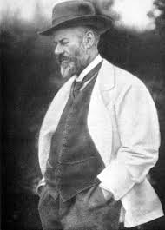
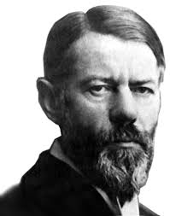

Slide 6



Slide 7
WEBER' S SEQUENTIAL THEORETICAL LEVELS
ENCASED WITHIN A COMMUNITY/NATION-STATE
displaying a Common f rame of
Reference or Weltanschauung - "World View"
CLASS
STATUS
PARTY
INTERMEDIATED·&
DIFFERENTIATED BY
law mores
convention custom

Slide 10
WHERE WEBER AND MARX DISAGREE
• SOCIETIES DID NOT “EVOLVE” ACCORDING TO SOME IMMANENT
OR NECESSARY LAW.
• THE DEVELOPMENT OF SOCIETIES CAN NOT BE ADEQUATELY
EXPLAINED BY ANY SINGLE OR PRIMARY CAUSAL MECHANISM.
• CULTURAL FORCES ARE EQUAL IN EFFECT TO MATERIAL
CONDITIONS
• WHILE ECONOMIC INTERESTS ARE POWERFUL FACTORS IN
INFLUENCING HUMAN BEHAVIORS IDEAS (especially as espoused
through charismatic figures) ARE EQUALLY POWERFUL.
• RATIONALIZATION AND BUREAUCRATIZATION RATHER THAN
CAPITALISM PER SE ARE THE PRIMARY FACTORS IN ALIENATING
INDIVIDUALS FROM A QUALITY OF MEANINGFUL LIFE.

Slide 11
The Classic Model of (Positivistic )Science:
•To KNOW, in order
•to PREDICT, in order
•to CONTROL
Weber’s Model of (Humanistic) Science:
•to UNDERSTAND, in order
•to FORESEE, in order
•to ANTICIPATE

Slide 12
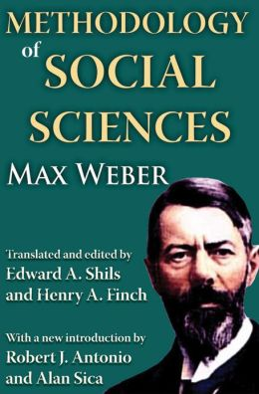
• Therefore we must
Develop Certain New
Methods
as Specifically Germaine
to
Studying Human
Social Behavior –

Slide 13
WEBER’S ARGUMENT REGARDING THE DEVELOPMENT OF THE TECHNIQUES OF SOCIOLOGY
• CAN THERE BE A SCIENCE OF HUMAN SOCIAL
BEHAVIOR – SOCIOLOGY
(GEISTESWISSENSCHAFT)?
YES
• CAN IT BE DONE USING THE METHODS OF THE
NATURAL SCIENCES
(NATURWISSENSCHAFT)?
NO

Slide 14
Social Methodology:
• Ideal Types
(historical/inductive; classificatory/deductive)
• Mental Experiments
(counterfactual, imaginary)
• Probability
(degrees of likelihood/elective affinities)
• Historical Comparison
• Verstehen
Subjective, interpretive understanding
(1st and 2nd order constructs)

Slide 15
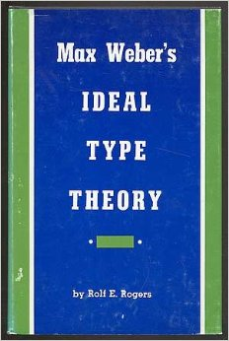

Slide 16
IDEAL TYPE ala Weber
An ideal type is an analytical construct that serves the investigator as a measuring rod to ascertain similarities as well as deviations in concrete cases. It provides the basic method for comparative study.
An ideal type is not meant to refer to moral ideals. There can be an ideal type of a brothel or of a chapel.
An ideal type never corresponds to concrete reality but always moves at least one step away from it. It is constructed out of certain elements of reality and forms a logically precise and coherent whole, which can never be found as such in that reality.

Slide 17
IDEAL TYPE
in contrast to
IDEAL
● A conception of something in its absolute perfection.
● Something that is regarded as a standard or model of perfection or
excellence.
● An ultimate object of endeavor; a goal.
● An honorable or worthy principle or aim.
IDEALISM
● The attitude of a person who believes that it is possible to live according
to very high standards of behavior and honesty.
● The act or practice of envisioning things in an ideal form.

Slide 18
Ideal Types of Social Action:
Three [four] major types:
Genus: Value-Rational (Wertrationalität)
Species:
Traditional
Affective
Instrumental or Means-Ends or
Rational-Legal (Zweckrationalität)

Slide 19
WEBER’S TYPES OF SOCIAL ACTION:
~ GENUS ~
value-rational (werkrational) –
action in support of, in defense of, in commitment to a particular value
(not necessarily pursued by rational means, by in some way that “makes sense”)
~ SPECIES ~
traditional –
action entrenched through habit, dictated by custom, past experience,
the weight of history
affective –
action stirred (even dictated) by an immediate emotion, often precipitated by
a charismatic figure
means-ends (goal) rational (zweckrational) –
action consonant with logic, rational calculation, instrumental assessment,
sometimes translated as “technocratic thinking”

Slide 21

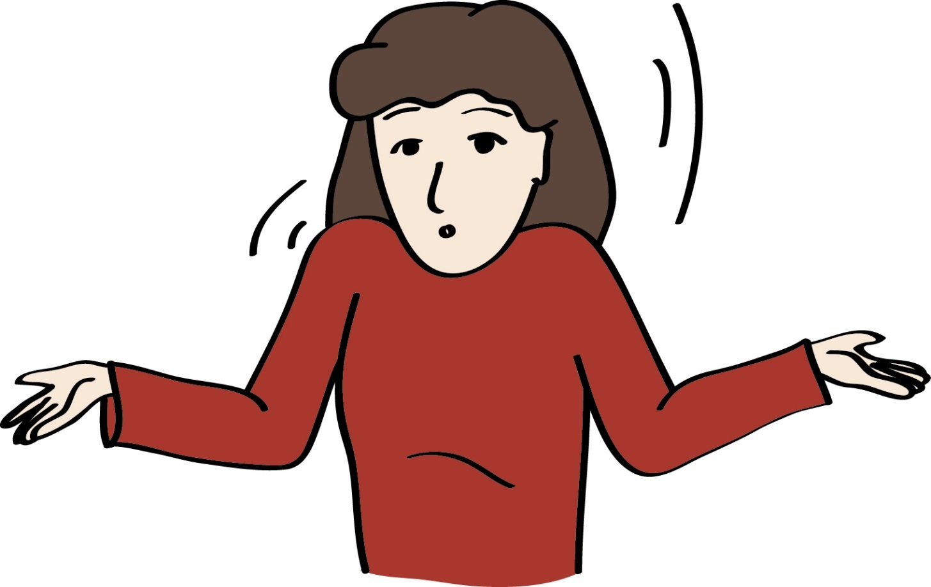

Slide 22
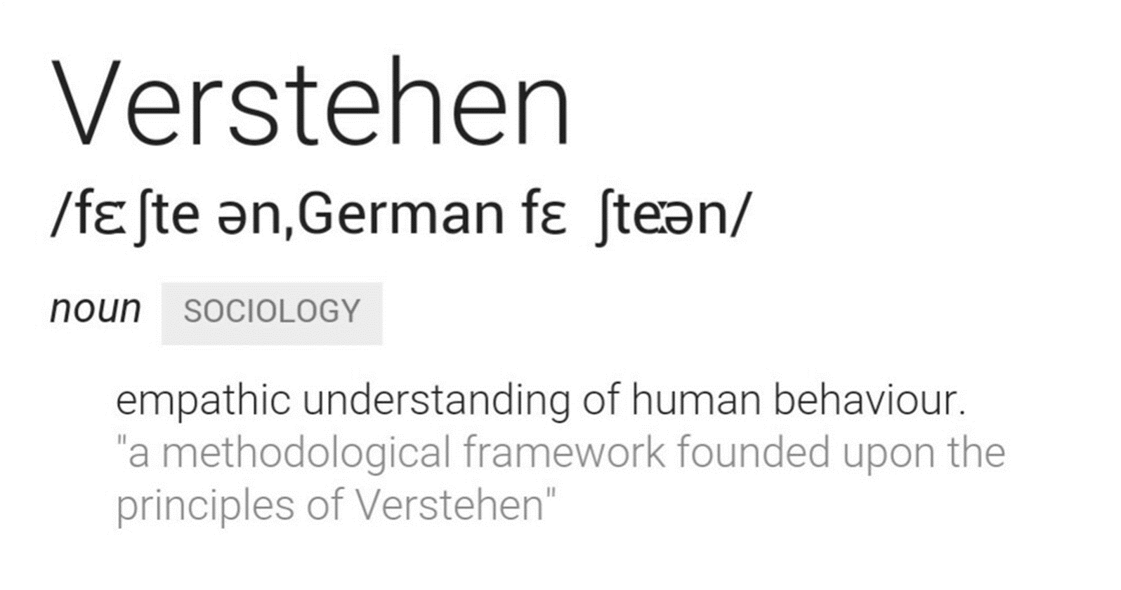
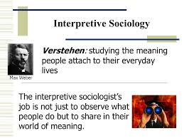

Slide 24
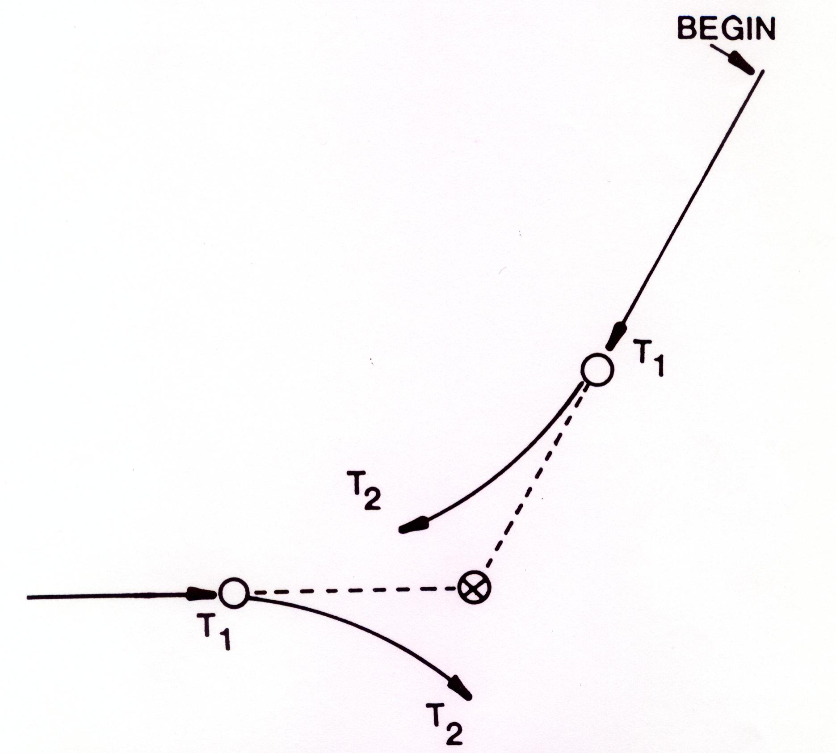
HOW DO WE EXPLAIN?
DIAGRAM V
TWO ATOMS on a POTENTIAL
COLLISION COURSE….
THAT DON’T COLLIDE….

Slide 25
HOW DO WE EXPLAIN?
TWO CYCLISTS on a POTENTIAL
COLLISION COURSE….
THAT DON’T COLLIDE….

Slide 26
EMERGENCE or “SIMULTANEOUS DISCOVERY”
(Late 19th – early 20th Centuries)
WEBER – verstehen
(subjective, interpretive understanding)
GIDDINGS – consciousness of kind
THOMAS – definition of the situation
COOLEY – sympathetic introspection & the looking glass self
MEAD – significant other, generalized other, role-taking, role-playing, self-referential symbol, mind and minding, internal conversation
DUBOIS – double-consciousness
SCHUTZ – “We” relationship, the natural attitude of the wide-awake
fully functioning adult

Slide 27
Additions from
MODERN NEURO-PSYCHOLOGY:
Mirror Neurons: Neurons that fire both when an animal acts and when the animal observes the same action performed by an Other. The neuron “mirrors” the behavior of the Other as though the observer were itself acting. Neuroscientists have argued that mirror neuron systems in the human brain help us understand the actions and intentions of other people.
Theory of Mind: The ability to attribute mental states – beliefs, intents, desires, pretending, knowledge, etc. – to oneself and others and to understand that others have beliefs, desires, and intentions that are different than one’s own. Having a theory of mind allows one to attribute these mental states to others, to predict or explain their actions, and to posit their intentions. This capacity seems to lacking in autistic persons.

Slide 29
Interpretative Sociology (verstehende Soziologie)
The study of society that concentrates on the meanings people associate to their social world. Interpretative society strives to show that reality is constructed by people themselves in their daily lives. It roughly translates to "Meaningful Understanding" or putting yourself in the shoes of others to see things from their perspective.
Interpretive sociology differs from scientific sociology (or positivist)in three ways. 1- Interpretive sociology deals with the meaning attached to behavior, unlike scientific sociology which focuses on action. 2- Interpretive sociology sees reality as being constructed by people, unlike scientific sociology which sees an objective reality "out there". 3- Interpretive sociology relies on qualitative data, unlike scientific sociology which tends to make use of quantitative data.

Slide 30
VERSTEHEN & SOCIAL ACTION
ACTION is SOCIAL INSOFAR as, by VIRTUE of the SUBJECTIVE MEANING ATTACHED to it by the ACTING INDIVIDUAL, it TAKES ACCOUNT of the BEHAVIOR of OTHERS and is THEREBY ORIENTED in its COURSE.
Social Relationship
Social interaction →
Social Action →

Slide 32
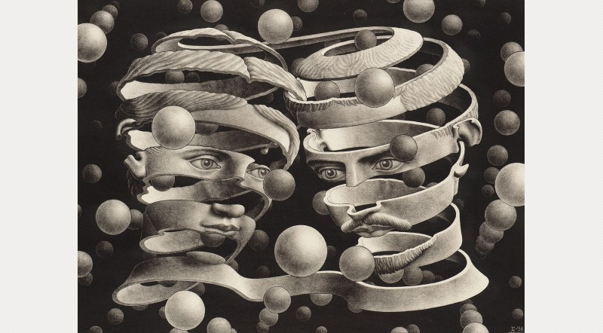
Escher’s “Bond of Union”

Slide 33
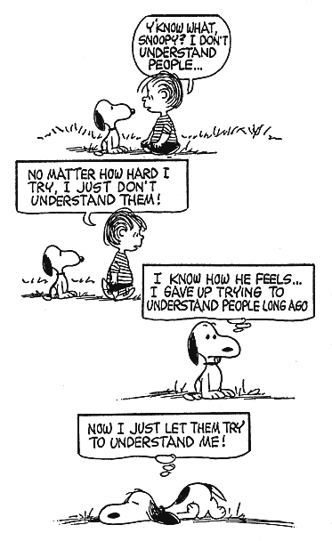

Slide 34
The PROBLEM(s) of VERSTEHEN = subjective, interpretive understanding
(1) As the EXPERIENTIAL FORM of COMMON-SENSE KNOWLEDGE of HUMAN AFFAIRS:
Here verstehen means simply that men and women in daily life interpret their world from the outset as a meaningful one.
(2) As an EPISTEMOLOGICAL PROBLEM:
Here verstehen is rooted in what Husserl calls the Lebenswelt, the Life-world that encompasses the rich totality of common-sense experience lived through by the individual in his or her concrete existence.
(3) As a METHOD PECULIAR TO THE SOCIAL SCIENCES:
Here is a qualitatively different situation; the social scientist’s objects are not only objects of his or her observation, they are beings who have their own pre-interpreted world, who are doing their own observing; they are fellow humans caught up in their own social reality. These “objects” are thus second-order constructs and the method of verstehen is employed in the social sciences in order to come to terms with – to come to grips with, or to grasp – the full subjective and intersubjective realities of the human beings they seek to comprehend

Slide 35
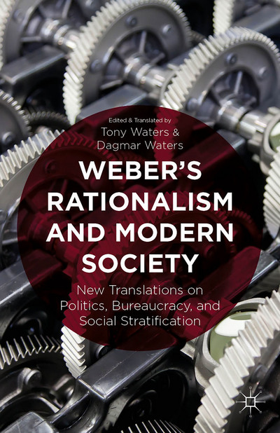

Slide 36
RATIONALIZE
1. attempt to explain or justify (one's own or another's behavior or attitude) with logical,
plausible reasons, even if these are not true or appropriate.
("she couldn't rationalize her urge to return to the cottage")
to think about or describe something (such as bad behavior) in a way that explains it
and makes it seem proper, more attractive, etc.
synonyms: justify, explain, explain away, account for, defend, vindicate, excuse
("he tried to rationalize his behavior")
2. make (a company, process, or industry) more efficient by reorganizing it in such a
way as to dispense with unnecessary personnel or equipment.
("his success was due primarily to his ability to rationalize production")
to find ways to make (something, such as an industry, a company, etc.) waste less
time, effort, and money.
synonyms: streamline, reorganize, modernize, update

Slide 37
for WEBER the meaning of rationalism/rationalization:
An increasingly theoretical mastery of reality by means of increasingly precise and abstract concepts.
and/or
The methodical attainment of a definitely given and practical end by means of an increasingly precise calculation of adequate (efficient, effective) means.

Slide 38
WEBER and the
RATIONALIZATION OF SOCIETY
• via RELIGION
Religious Evolution –
from Magic to Religion
from Polytheism to Ethical Monotheism

Slide 39
WEBER and the
RATIONALIZATION OF SOCIETY
• via CAPITALISM
Religious Culture:
The Protestant Ethic and the Spirit of Capitalism
Structural Influences:
Central, Bureaucratized State
Modes of Communication and Transportation
Class, Status, Party [Economics, Prestige, Power]

Slide 40
WEBER and the
RATIONALIZATION OF SOCIETY
• via FORMS OF LEGITIMATION
Traditional – the Past
Rational-Legal – Means-Ends Calculation, “Logical,
Reasonable” Procedures:
Predictable
Calculable
Efficient
Controlled
Technological (non-human)

Slide 41
WEBER’S Rationalization:
The far reaching process whereby traditional modes of thinking were being replaced by an ends/means analysis concerned with efficiency and formalized social control.
(1) Predictability
Predictability refers to the attempt to structure our environment so that
surprise and “differentness” do not encroach upon our sensibilities.
Rational people need to know what to expect.
(2) Calculability
An emphasis on things that can be calculated, counted, quantified.
Quantification refers to a tendency to emphasize quantity rather than
quality.

Slide 42
WEBER’S Rationalization:
(3) Efficiency
Efficiency means the choosing of means to reach a specific end rapidly,
with the least amount of cost or effort.
(4) Increased Control especially through the
(5) Substitution of Nonhuman for Human Technology
...these two elements are closely linked. Specifically, replacement of
human by nonhuman technology is often oriented towards greater
control. The great source of uncertainty and unpredictability in a
rationalizing system are people – either the people who work within
those systems or the people who are served by them.

Slide 43
RATIONALITY, RATIONALISM ala Weber
1) MEANS – ENDS CALCULATION:
The methodical attainment of a definitely given and practical end by means of an increasingly precise calculation of adequate means.
2) BUREAUCRATIC ORGANIZATION
• Predictability
• Calculability
• Efficiency
• Control of outcomes
• Non-human technology (from George Ritzer, The MacDonaldization of Society)
3) THE DISENCHANTMENT OF THE WORLD
Demystification
Desacralization
Depersonalization

Slide 45

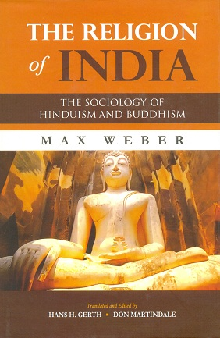



Slide 46
Weber’s Definition of Religion
(1) a belief in one or several of a wide-ranging variety of supernatural powers that are:
(2) evidenced in a variety of charismatic manifestations,
(3) articulated through symbolic expressions,
(4) responded to in a variety of forms,
(5) under the guidance of various types of leaders,
(6) in a variety of patterns of relationships significantly determined by the patterned behavior of the lay people of the community.
The leaders that comprise or come out of a particular strata or status group in a society greatly influence and even shape the larger community’s ultimate orientation toward life (their Weltanschuungen)

Slide 51
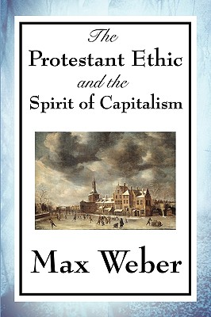


Slide 53
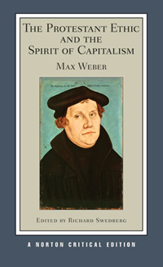

Slide 54
THE PURITAN’S DILEMMA:
MARTIN LUTHER: The Secular Calling
All work is service to the Lord and contributes toward one’s salvation.
However, one is saved by Grace alone.
JOHN CALVIN: Predestination
If God is omniscient, He knows the future, and therefore He knows whether or not one will be saved or damned.
PURITAN ETHIC: Hard work and asceticism
The individual’s task is to increase the glory of God, to do His will, and to fulfill His Commandments.
One must especially guard against being tempted into the sins of this life by the Devil.
Life is thus to be pure work, removed from distracting joy and pleasure, in the service of God.

Slide 55
Weber’s “Spirit of Capitalism”
•Embodied in an ethically-oriented maxim for the organization of life.
•Life is to be lived with a specific goal in mind.
•Each of us should have a vocational calling.
-We are obligated to pursue work, a duty to work.
- Within work we have a duty to be “competent and proficient.”
•Life and actions are legitimated “on the basis of strictly quantitative calculations”
It is good and moral to be honest, trustworthy, frugal, organized, and rational because it is useful for a specific end: making money, which has its own end, “the acquisition of money, and more and more money.”

Slide 56
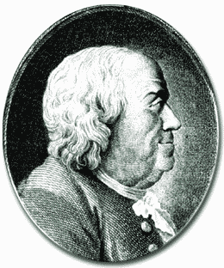
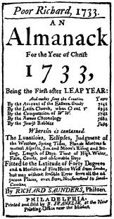
Aphorisms from Benjamin Franklin, in
Poor Richard’s Almanack
Idle hands are the devil’s workshop.
A bird in the hand is worth two in the bush.
What is serving God? Tis doing Good to Man
When the well's dry, we know the worth of water.
Early to bed, early to rise, makes a man healthy, wealthy and wise.
He that riseth late, must trot all day, and shall scarce overtake his business at night.
One good Husband is worth two good Wives; for the scarcer things are, the more they're valued.
He does not possess Wealth, it possesses him.
After three days men grow weary, of a wench, a guest, and weather rainy.

Slide 62
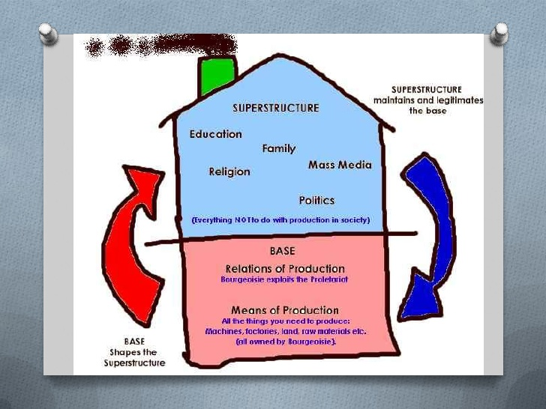

Slide 64
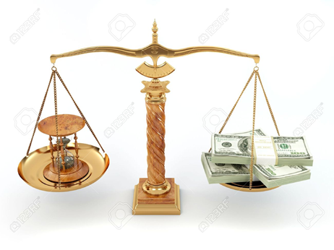

Benjamin Franklin,
Poor Richard’s Almanac:
•Time is Money
•Remember, that money is of the
prolific, generating nature.
Money can beget money, and
its offspring can beget more, and SO ON….
King James Bible:
For what shall it profit a man, if he shall gain the whole world, and lose his own soul?
Kahlil Gibran:
They deem me mad because I will not sell my days for gold,
And I deem them mad because they think my days have a price….

Slide 65
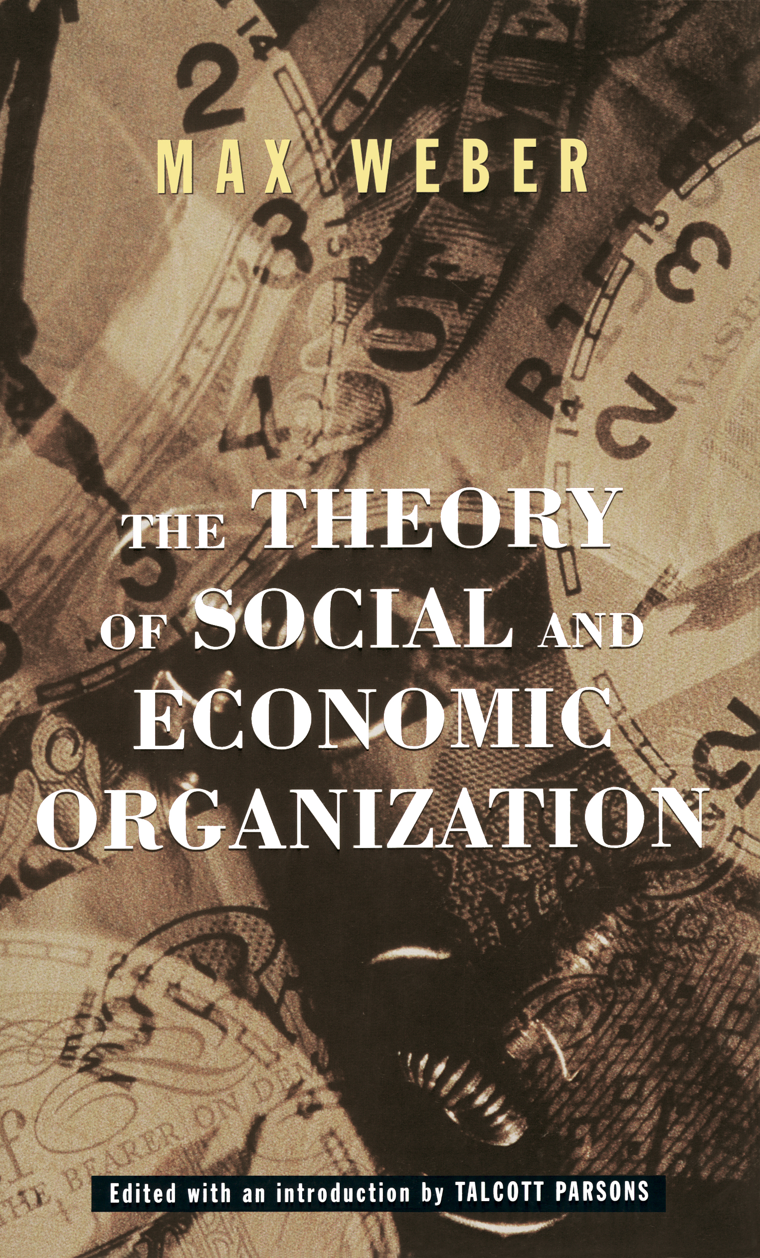



Slide 66
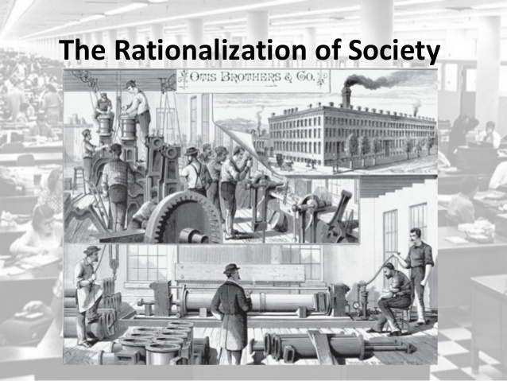

Slide 67


Slide 68

CONDITIONS for BUREAUCRATIZATION
• Size of the population
• Density of the population
• Diversity of the population
• Area of the geographical space
• Degree of specialization of work
• Complexity of the tasks being performed
• Sophistication of the technologies employed
• Intricacy of communication
• Range of transportation
• Degree to which political participation is permitted
• Volume and range of culture

Slide 69
WEBER’S Ideal Type of Bureaucracy
Explicit division of labor
Delineated lines of authority
An office (official) hierarchy
Defined spans of control
Written position descriptions
Written rules and communication
Accredited (credentialed) training
Technical competence
Management by rules
Emotionally neutral, “value free”
Organizational ownership of career ladder
Organizational ownership of position/office
Self-interested and self-perpetuating

Slide 70
Weber’s Ideal Type of Bureaucracy
• Legal norms established on expediency
and/or rational values.
• Rational pursuit of goals according to
legal precepts.
• Treatment of individuals based on
abstract principles, applied impersonally.
• Individuals occupy offices which are
subject to an impersonal abstract order.
• Persons obey authority only in their
capacity as members of the organization.
• Individuals obey the instructions of the
office, not the office holder.
• Offices are organized on the principle
of hierarchy.
• There is a complete separation of
property belonging to the office and
that belonging to the individual.
• The office as a physical place is
separated from the personal sphere.
• Administrative acts, decisions, and
rules are formulated according to
specific procedures.
• Records of all such acts, decisions, and
rules must be kept in writing.

Slide 71
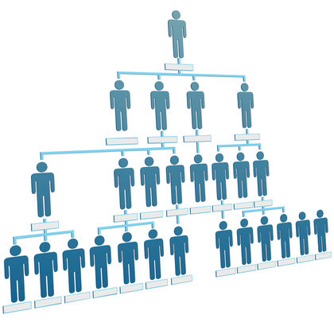
Bureaucratic Hierarchy
based on
Span of Control

Slide 72
Bureaucratic Outcome ala Allan: the Emergent Temperament of the Bureaucratic Personality
Overall, life is lived more rationally and less spontaneously; individuals are less emotionally connected to others.
Identification occurs with goals of the organization, supporting and believing in them, becoming bureaucratic “selves”
3) Dependence on expert systems
(experts who are credentialed by
bureaucratic organizations) for
knowledge and advice,
judgment and values.
4) Increased sequestration
(disjunction, separation and
compartmentalization) of
otherwise integral societal
functions and activities.

Slide 73
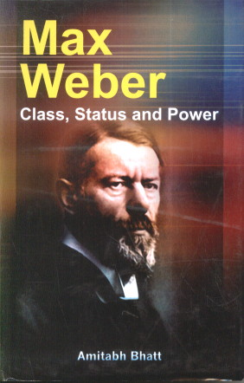
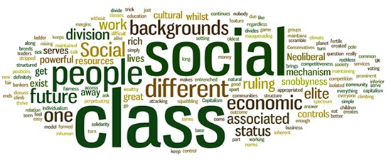

Slide 74
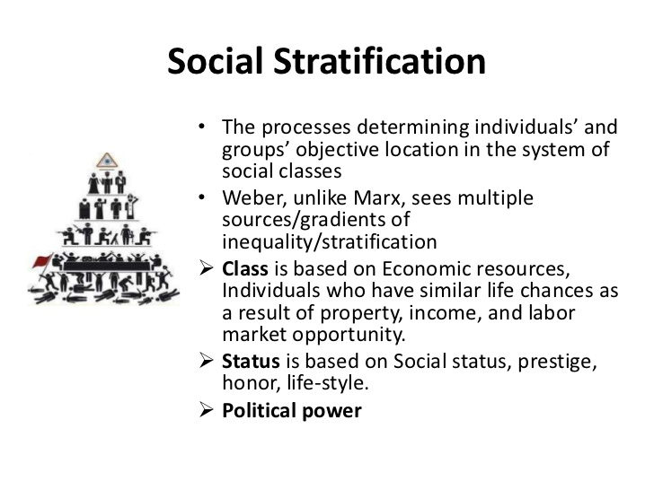

Slide 76
Max Weber’s View of Social Strata & Class
CLASS
Class Situation defined in terms of probabilities:
• of procuring goods
• of gaining a position
• of finding inner satisfaction
Expressed in:
• Property Class – ownership/non-ownership of Property
• Commercial Class – control/non-control of Market Position
Emergence of Class:
• Organized against other immediate economic groups
• Significant in size of membership
• Developed set of organizational skills/capacities

Slide 77
Max Weber’s View of Social Strata & Class
STATUS
Defined in terms of:
• Claims to Social Esteem (value)
• Claims to Honor and Privilege (deference)
• Boundary Maintenance (endogamy, rituals, traditions, acquisitions
Based on:
• Distinctive Lifestyle
• Formal Education
• Hereditary or Occupational Prestige
PARTY
Defined in terms of:
• Control of Organizations and/or Administrative Staffs
• Intended to achieve Specific Ends for its Members
• Oriented to Controlling and Exercising Power

Slide 78
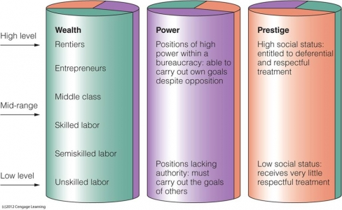

Slide 80
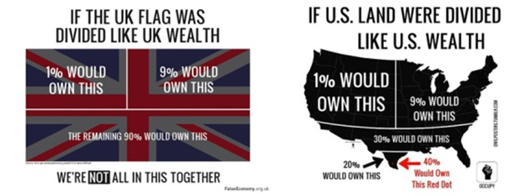

Slide 81
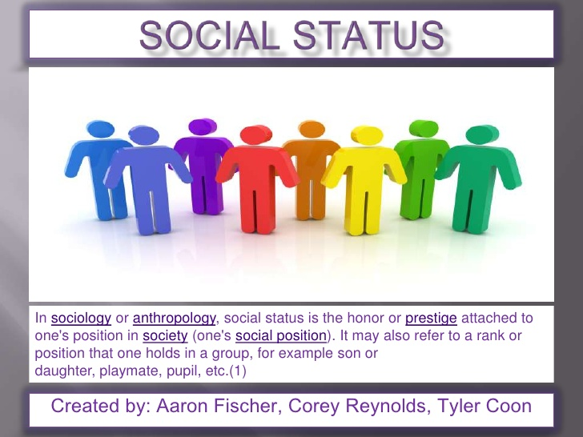

Slide 82
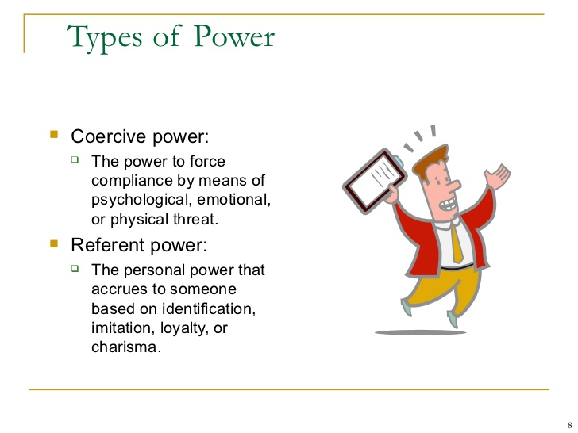

Slide 83
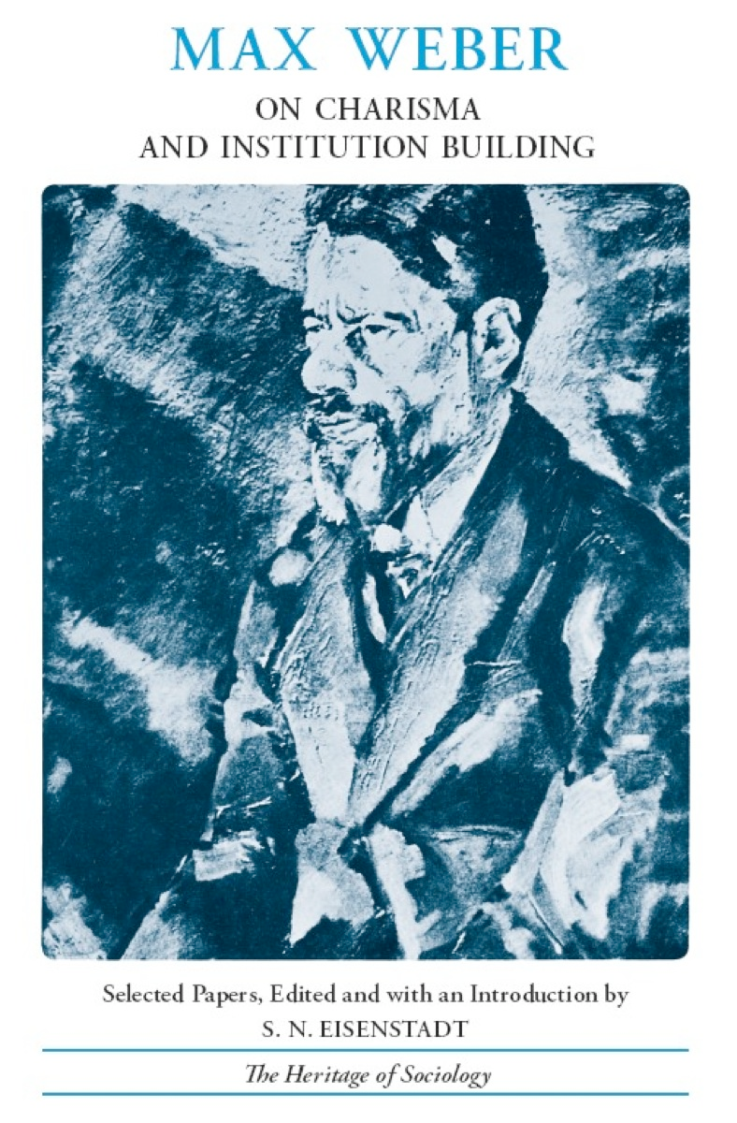

Slide 86
WEBER' S SEQUENTIAL THEORETICAL LEVELS
ENCASED WITHIN A COMMUNITY/NATION-STATE
displaying a Common f rame of
Reference or Weltanschauung - "World View"

Slide 87
WHY we in fact behave the way we do….

Slide 89
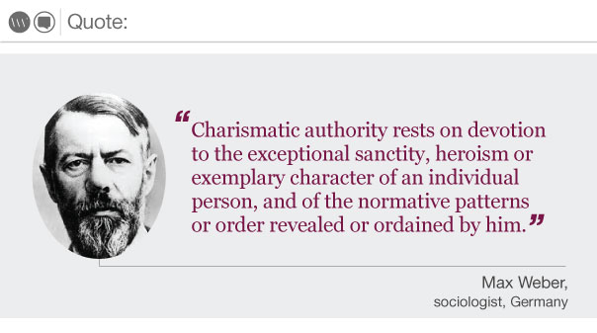

Slide 90
Dilemmas in the Routinization of Charisma
• The Problem of Succession
    For the continuation of the social system, especially from the perspective of those whose vested interests or statuses are most closely related to the charismatic leader, the concern is in terms of retaining the charisma but in some institutionalized, hence regular, predictable form.
• The Problem of the Second Generation
    For the introduction of the belief system associated with the charismatic figure, especially from the perspective of those most convinced of its validity by the direct influence of the charismatic leader himself, this concern is in term or re-presenting the full potency and self-evident quality of their experience to those who can not now know the charismatic leader directly.

Slide 91
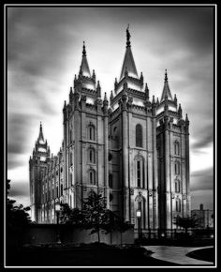
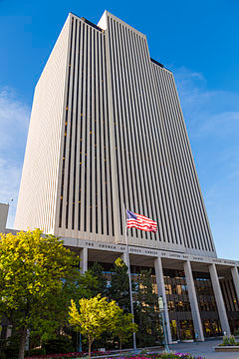
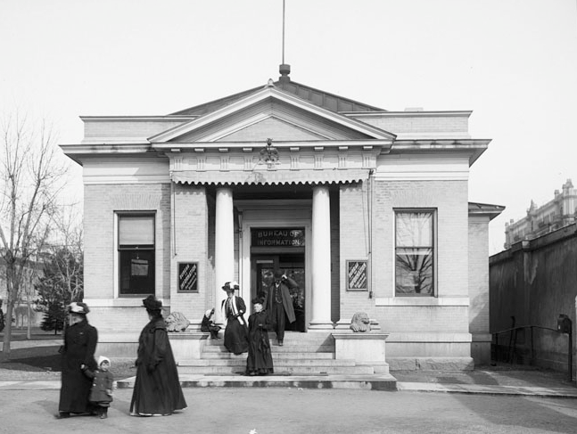
New LDS Church Office Building - 1972
Weber’s Historical Transition Expressed
in Mormon Architecture
BUREAUCRATIC
Salt Lake City
LDS Temple
1893
CHARISMATIC
Original LDS Church Office Building - 1904
TRADITIONAL
1

Slide 92
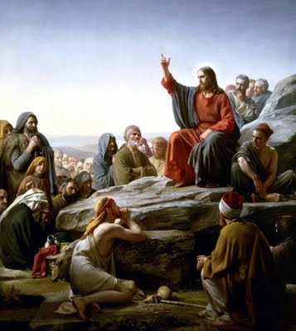
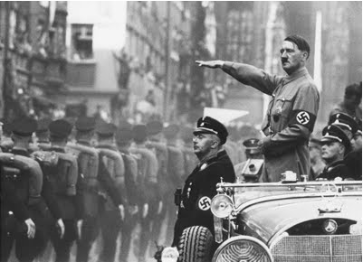
The Concept of Charismatic Leadership is Value Neutral
Jesus was considered by Weber to be perhaps the paradigmatic example of a charismatic religious leader.
Hitler is also considered to be an example of a charismatic leader, and one about whom we have a great deal of direct historical evidence.

Slide 93
A
FUNDAMENTAL PARADIGM
for
UNDERSTANDING HUMAN BEHAVIOR
A = Audience
The Individual: a leader exhibiting a commanding presence, a complex personality and background, great fluency in speaking, penetrating eyes, compelling the Audience to follow.
The Audience will be experiencing all the turmoil, open-endedness, ambiguity and anomie of the Situation and will be looking for some source of explanation and authority.
S = Situation
S = Symbols
The Situation: exhibiting dramatic change, unpredictability, chaos, unsettledness, and potential conflict which the Individual will heighten and exploit with speech and actions.
The Symbols: both new and dramatic yet at the same time resonating with those with which the Audience is already familiar; the Leader will draw on them and use them in new ways.

Slide 94
Durkheim’s description of “the particular attitude of a man speaking to a crowd” with which “he has succeeded in entering into communion:”
His language has a grandiloquence that would be ridiculous in ordinary circumstances; his gestures show a certain domination; his very thought is impatient of all rules, and easily falls into all sorts of excesses. It is because he feels within him an abnormal over-supply of force which overflows and tries to burst out from him; sometimes he has the feeling that he is dominated by a moral force which is greater than he and of which he is only the interpreter.
It is by this trait that we are able to recognize what has often been called the demon of oratorical inspiration. Now this exceptional increase of force is something very real; it comes to him from the very group which he addresses. The sentiments provoked by his words come back to him, but enlarged and amplified, and to this degree they strengthen his own sentiment. The passionate energies he arouses re-echo within him and quicken his vital tone. It is no longer a simple individual who speaks; it is a group incarnate and personified

Slide 95
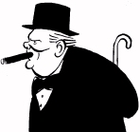
Of all the talents bestowed upon men, none is so precious as the gift of oratory. He who enjoys it wields a power more durable than that of a great king. [It is] the key to the hearts of men.

Slide 96
The direct, though not the admitted, object which the orator has in view is to allay the commonplace influences and critical faculties of his audience, by presenting to their imaginations a series of vivid impressions which are replaced before they can be too closely examined and vanish before the can be assailed.
Correctness of Diction
“There is no more important element in the technique of rhetoric than the continual employment of the best possible word.”
Rhythm
“The peculiar balance of the phrases produces a cadence which resembles blank verse rather than prose.” “The ear is tickled by the rhythm of the language.”
• Accumulation of Argument
“A series of facts is brought forward all pointing in a common direction. The end appears in view before it is reached. The crowd anticipate the conclusion and the last words fall amid a thunder of assent.”
Analogy
“…the unknown is only an extension of the known….” “An apt analogy connects or appears to connect these distant spheres.” “Argument by analogy leads to conviction rather than proof….”
A Tendency to a Wild Extravagance of Language
“The emotions of the speaker and the listeners are alike aroused and some expression must be found that will arouse all that they are feeling.” “The man who can inspire a crowd by words is…under their influence himself.”

Slide 98
Durkheim’s Model of religious evolution
Sense of
common
sentiments
that are
external
and
constraining
Crowd stimulation,
heightened
emotions, and
collective
contagion occur
Temporary
gatherings
occur
Interaction
escalates
Psychological need to represent “mana” with a material object
Structural need
for clan solidarity
Cultural need for resulting permanent groups
“Mana” is
symbolized
by the totem
and by sacred
objects of the
totem
Totems
promote a
sense of
unity and
solidarity
among
members
Powers are
attributed
to “mana”

Slide 100
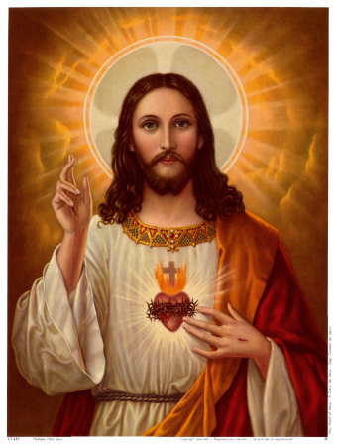
"Whoever is not with me is against me, and whoever does not gather with me scatters." (Matthew 12:30)
“I am the way and the truth and the life. No one comes to the Father except through me.” (John 14:6)
“I am the light of the world. Whoever follows me will never walk in darkness, but will have the light of life.” (John 8:12)
“Do not suppose that I have come to bring peace to the earth. I did not come to bring peace, but a sword. For I have come to turn a man against his father, a daughter against her mother, a daughter-in-law against her mother-in-law--a man's enemies will be the members of his own household.
Whoever loves father or mother more than me is not worthy of me, and whoever loves son or daughter more than me is not worthy of me.” (Matthew 10:34-37)
Jesus

Slide 101
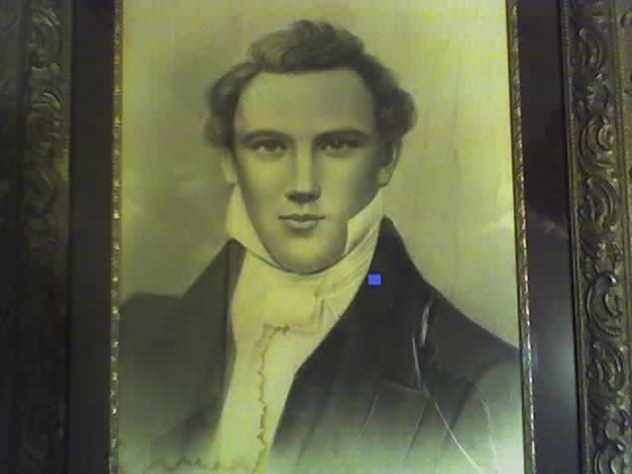
“I translated the record, by the gift and power of God. In this important and interesting book the history of ancient America is unfolded. . . . This book also tells us that our Savior made his appearance upon this continent after his resurrection, that he planted the gospel here in all its fullness, and richness, and power, and blessing; that they had apostles, prophets, pastors, teachers and evangelists; the same order, the same priesthood, the same ordinances, gifts, powers, and blessings, as was enjoyed on the eastern continent, that the people were cut off in consequence of their transgressions, that the last of their prophets who existed among them was commanded to write an abridgement of their prophesies, history &c., and to hide it up in the earth, and that it should come forth and be united with the bible for the accomplishment of the purposes of God in the last days.”
Joseph Smith

Slide 102
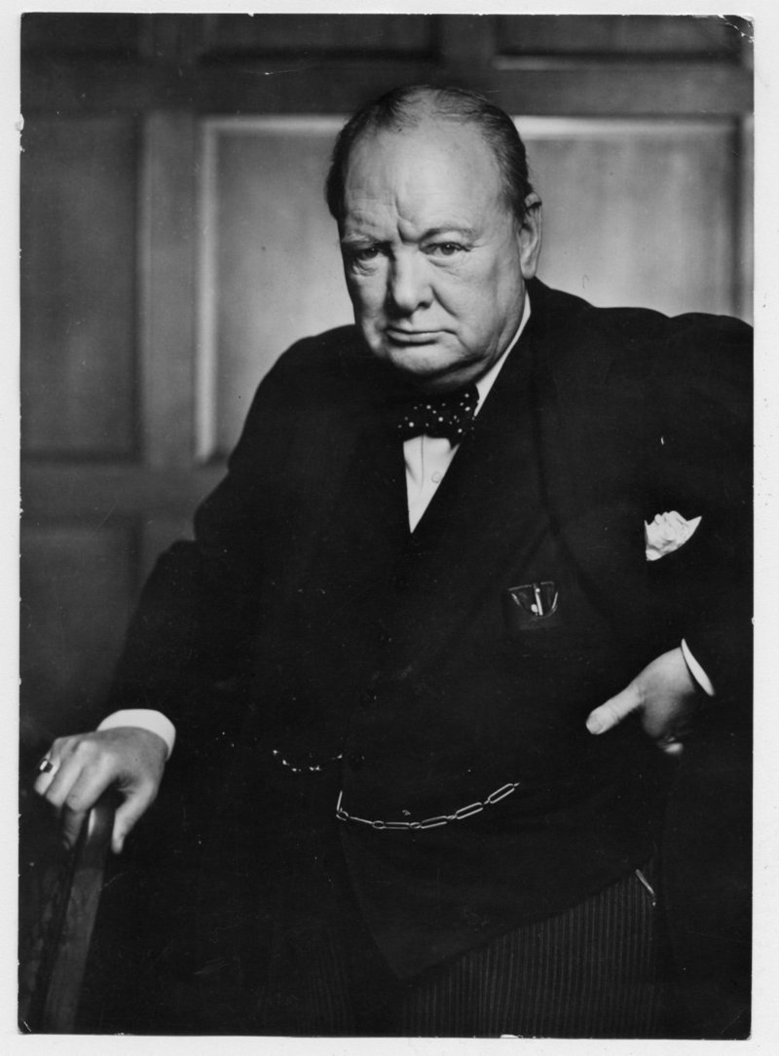
“I felt as if I were walking with destiny, and that all my past life had been but a preparation for this hour and for this trial... I thought I knew a good deal about it all, I was sure I should not fail.”
“We are all worms. But I do believe I am a glowworm.”
Winston Churchill

Slide 103
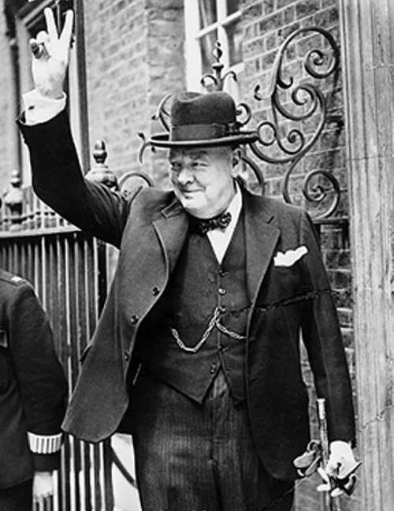
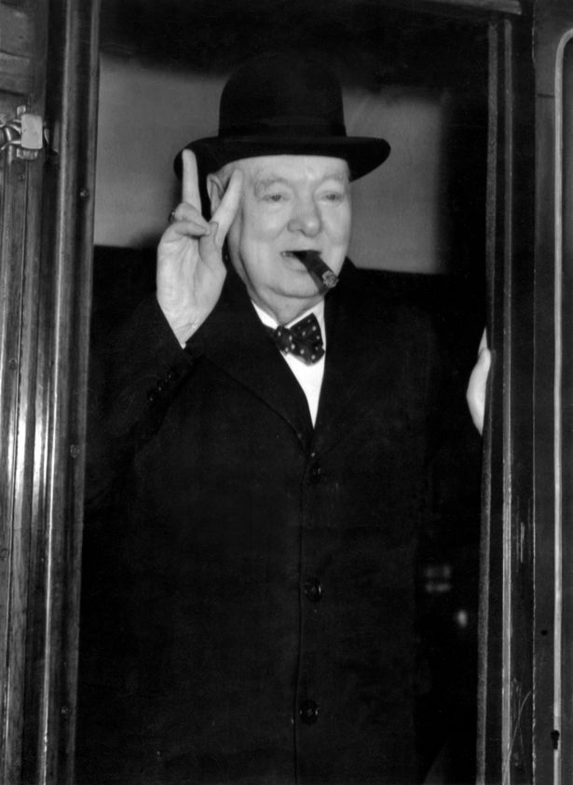
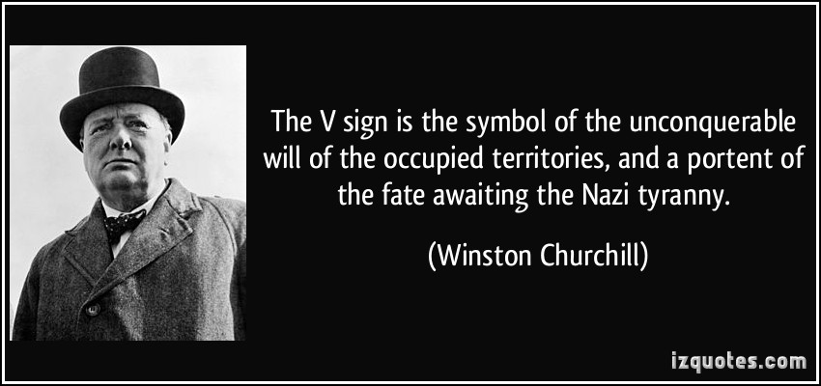
Churchill’s Famous Symbols
The V for Victory Sign
The Homberg Hat
The Unlit Cigar

Slide 104
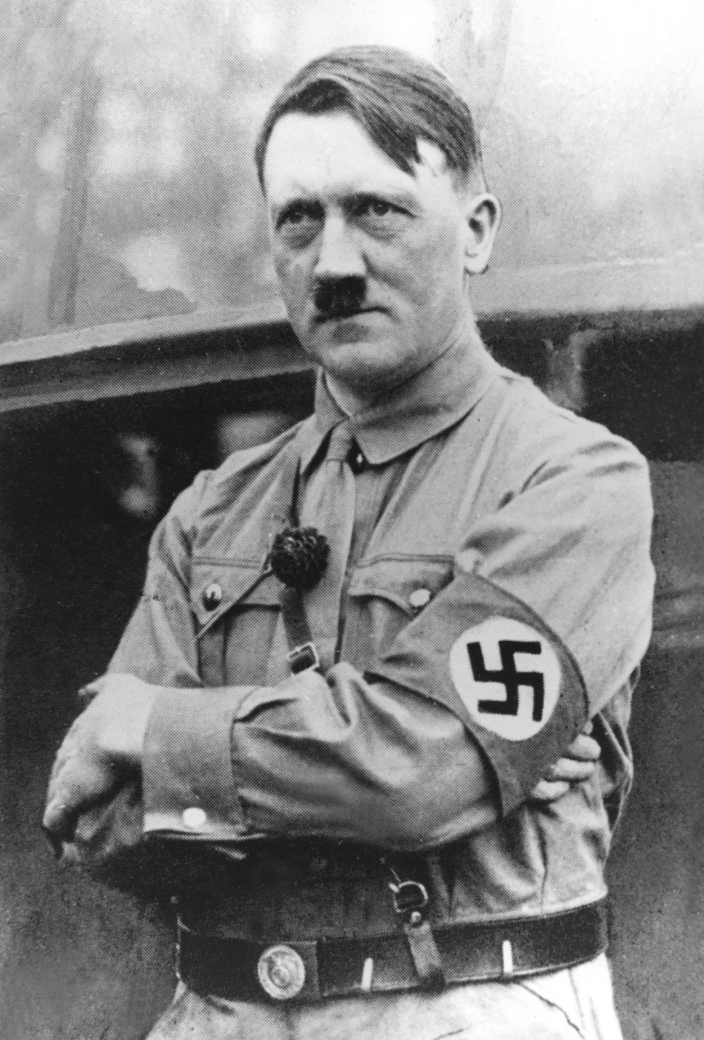
“I believe that today my conduct is in accordance with the will of the Almighty Creator.”
“I go the way that Providence dictates with the assurance of a sleepwalker.”
Adolf Hitler

Slide 105
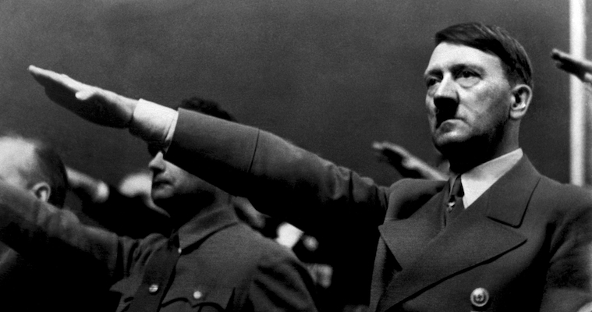
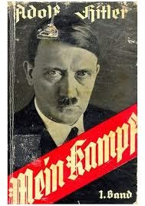


The Swastika
The Heil Salute
The Death’s Head
Hitler’s Famous Symbols

Slide 106
