Slide 1
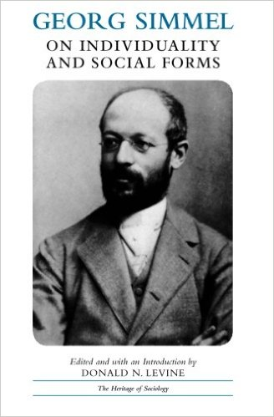



GEORG SIMMEL
(1858-1918)
Philosopher/Sociologist Georg Simmel was a German sociologist, philosopher, and critic. Simmel was one of the first generation of German sociologists: his neo-Kantian approach laid the foundations for sociological antipositivism.

Slide 3
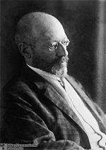
GEORG SIMMEL
1858-1918
Born in Berlin, Germany (an area similar to New York City’s Times Square)
His family was business-oriented, prosperous, and Jewish
His father converted to Christianity--died in Simmel’s youth
Earned his Ph.D. in Philosophy, 1881
Denied a regular academic position he taught as an adjunct, 1885-1914
During this period he was a popular public lecturer
Appointed Assistant Professor in 1914 at age 56
Career interrupted by WWI, during which he served as a hospital administrator
A modern urban man--without roots in traditional folk culture

Slide 4
Simmel Texts in English Translation

Slide 5
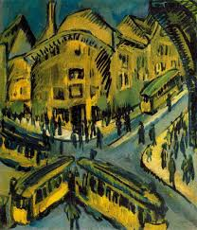
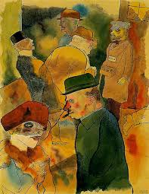
GEORG SIMMEL
    SOCIAL RELATIONS:
    • super-ordinate/sub-ordinate
    • conflict/cooperation
    • distance/intimacy
    • social/individual
    SOCIAL TYPES:
    • competitor
    • miser
    • adventurer
    • coquette
    • stranger

Slide 7
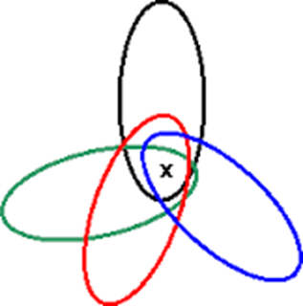
Dialectical & Paradoxical Dynamic Tension
between Individual and Group/Society
• Incorporated Within – Standing Against
• Product of Society – Self-Determined
• Dependent – Autonomous
• Acted Upon – Self-Activating
• Incorporated into Social Membership –
Reacting out of Unique Individuality

Slide 8
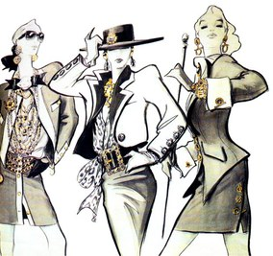
For Simmel
“... fashion represents nothing more than one of the many forms of life by the aid of which we seek to combine in uniform spheres of activity the tendency towards social equalization with the desire for individual differentiation and change.”
In each social relation there are two forces at work: one pushing us to bind ourselves to others through imitation, and another pushing us to unbind ourselves from others, to undo the social network, through distinction. But social life changes in so far as the balance between the socialising force and the de-socialising force is always unstable and provisional.
Fashion is an example of the way in which actual social life always includes in some way its own opposite, an asocial life.

Slide 9
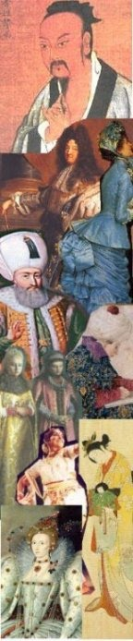
from Georg Simmel, in On Women, Sexuality, and Love:
Consider the charms of the simultaneous
For and Against, the Perhaps,
the protracted reservation of the decision
which permits a foretaste of the enjoyment
of both its aspects
which in their realization
are mutually exclusive.
(the original does not appear structured thus, but as a straightforward sentence)
And famously:
Flirtation also does no more than play with reality,
yet it is still reality with which it plays.

Slide 10
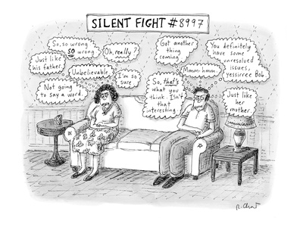
CONFLICT as a SOCIAL FORM

Slide 11

CONFLICT as a SOCIAL FORM
General characteristics of conflict
•Conflict instinctual for humans
•Unique feature of conflict for humans: it is goal oriented
•Opens up opportunities for negotiation and
different types and levels of conflict
Variability of violence
•Clearly expressed with rational goals → less violence
•Higher emotional involvement → increased violence
•Transcendent goals → greatly increased violence

Slide 12


Reciprocal Nature –
the Functions of Social Conflict
• Hostility as Helpful
• Group Binding
• Group Preserving
• Internal Cohesion
• Achieves Internal Unity
• Generates Energy, Effort, & Purpose
• Creates Satisfaction
• Binds Individuals to the Whole
• Establishes Group Identity

Slide 13
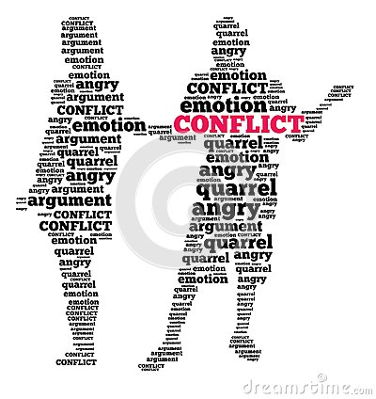
Reciprocal Nature –
the Functions of Social Conflict
• Hostility as Helpful
• Group Binding
• Group Preserving
• Defines Structure
• Achieves Stability
• Provides Baselines
• Establishes Knowledge of Power

Slide 14
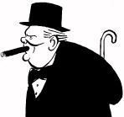
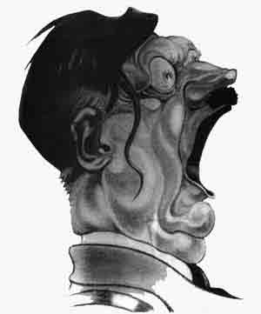
Reciprocal Nature –
the Functions of Social Conflict
• Hostility as Helpful
• Group Binding
• Group Preserving
• Creates Associations & Coalitions
• Combines Antagonists against an Other
“An enemy of my enemy is my friend.”
“If Hitler invaded hell I would make at least a favorable
reference to the devil in the House of Commons.”
• Produces Enemies
• Produces Unity in the Other

Slide 15




What’s at Issue
in the Conflict…?
• Differences in:
• Material Goods
• Social Services
• Cultural Values
• Social Esteem
• Political Power
• Degree: Small or Great
• Degree: Peripheral or Central
• Degree: Rational or Emotional
• Real or Perceived Difference
(Absolute or Relative)
• Procedure or Purpose
(Process or Goal)

Slide 20
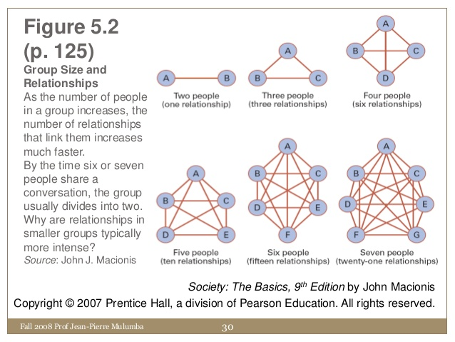
EFFECTS OF GROUP SIZE
ON THE NUMBER OF
RELATIONSHIPS

Slide 22
Significance of Numbers for Social Structure
• Dyad – fragile, no supra-personal level
• Triad – first suggestions of social structure, the supra-
personal possibility of coalitions, combinations
• Quadrad – first real emergence of social structure
• Small Group –
• total involvement of the individual
• personal valuation
• intense, frequent interaction
• highly personal
• emotional, subjective

Slide 23
Significance of Numbers for Social Structure
• Large Group –
• greater social distance
• reduced intimacy
• greater freedom
• increase in delegation, formality, formal offices
• increase in inequality
• segmental involvement
• greater resilience to internal conflict
• power alien and/or distant

Slide 25
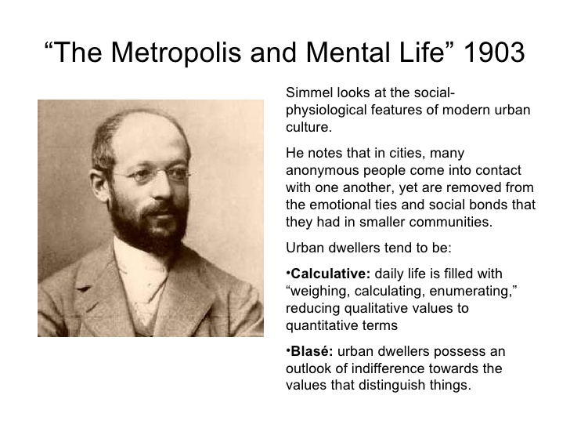

Slide 28

THE
PARADOX
of
MONEY

Slide 31
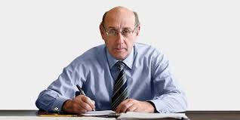
THE 9/11 VICTIM COMPENSATION CALCULUS
• First, the government will estimate how much a victim would have
earned over his or her lifetime had the planes never crashed. (That
means a broker’s wife will qualify for a vastly higher award than a
window washer’s wife.)
• To estimate this amount, each family was handed an easy-to-read
chart: find your loved one’s age and income and follow your finger
to the magic number.
• Each estimate of lifetime earnings was boosted by a flat $250,000 for
“pain and suffering” (non-economic loss).
• Add an extra $50,000 in pain and suffering for a spouse and each child.
•Then subtract all the money survivors received from other sources
except charities: deduct life insurance, pensions, Social Security death
benefits, and worker’s compensation.
The result – the total award the government offers for the loss of a life.
Administered by Special Master of the U.S. government's September 11th Victim Compensation Fund, Kenneth Feinberg (subsequently Special Master for TARP Executive Compensation) who had sole authority in applying the calculus.
To participate in this process and receive compensation, each survivor had to agree to waive any rights to pursue further compensation for their loss through legal procedures.

Slide 32
