Slide 1
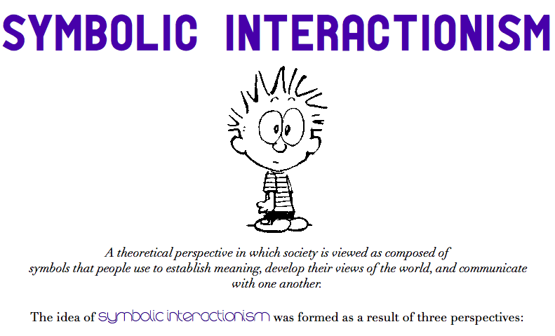

Slide 2
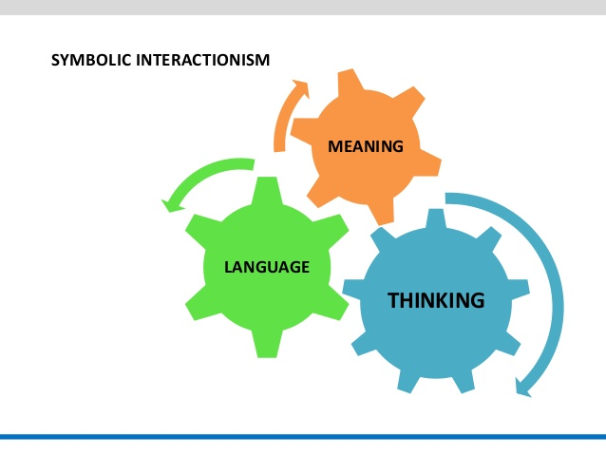
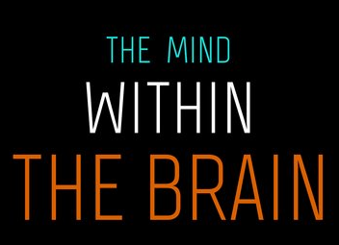


Slide 3
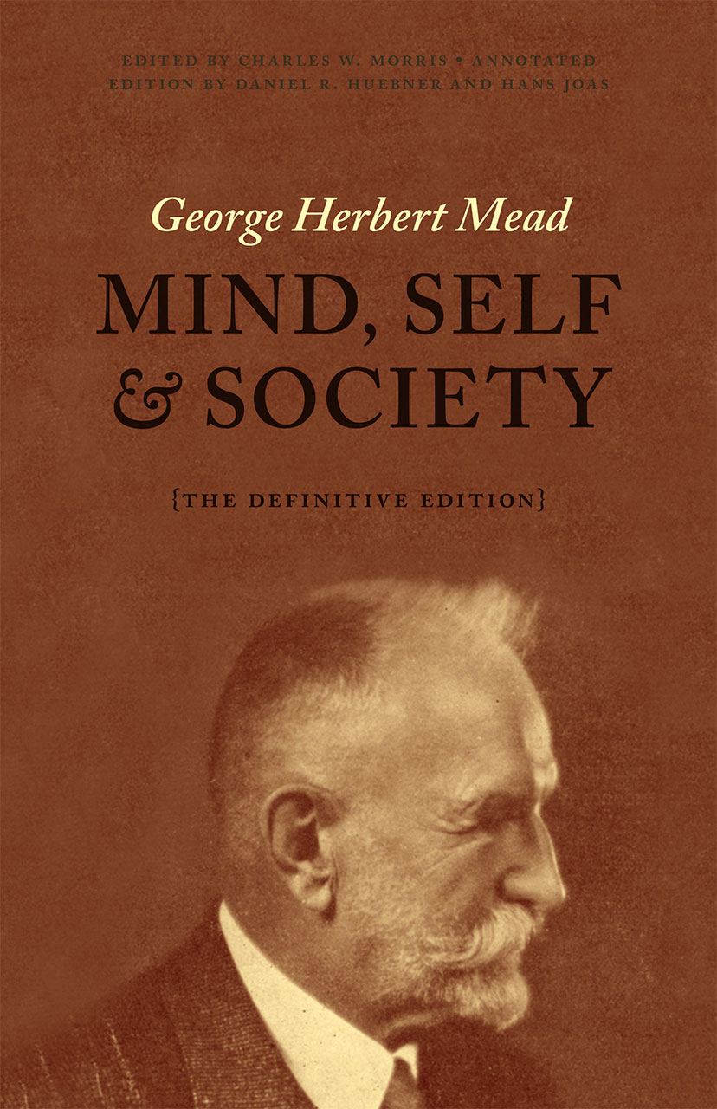
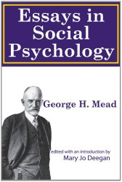
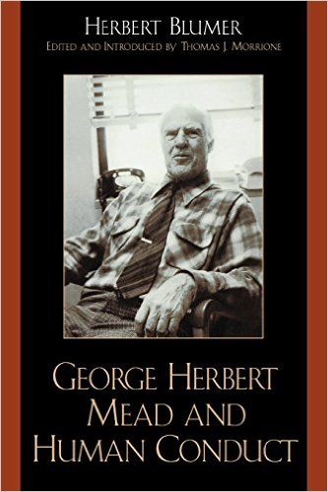
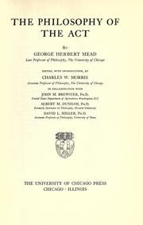
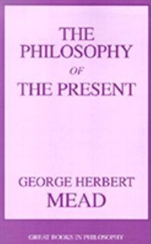
Mead’s Major Works

Slide 4
Mead’s works were assembled posthumously
from lecture notes and unpublished papers by several of his students;
these comprise his major works:
· 1932. The Philosophy of the Present.
· 1934. Mind, Self, and Society. (Ed. By C. W. Morris).
· 1936. Movements of Thought in the Nineteenth Century. (Ed. by C. W. Morris.)
· 1938. The Philosophy of the Act. (Ed. by C.W. Morris, et al.)
· 1964. Selected Writings. (Ed. by A. J. Reck).
[includes articles Mead himself prepared for publication.]
· 1982. The Individual and the Social Self: Unpublished Essays by G. H. Mead.
(Ed. by David L. Miller).

Slide 6
THE MIND
The MIND
is NOT a NOUN
The MIND
is actually a VERB!
The MIND
is a KIND of BEHAVIOR
The MIND
is the ACTIVITY of MINDING
(as in Who’s MINDING the Store?)
The MIND involves these abilities:
● Using Symbols to Denote Objects
● Using Symbols as its Own Stimulus
(carrying own an internal conversation with itself,
I said to myself, I thought to myself….)
● Using a Self-Referential Symbol for itself
(Me, Myself, and I)
● Reading and Interpreting An Other’s Gestures
● Using those Interpretations as further Stimuli for Response
● Suspending Reponses to Consider Possible Lines of Action
● Imaginatively Rehearsing One’s Behavior before actually
Behaving
MINDING TAKES PLACE VERY, VERY FAST….
THINK OF IT AS OCCURING IN A JIFFIY!

Slide 7
Jiffy =
Length of time it takes light traveling @
186,282 miles per second to travel one centimeter
or 0.39370079 inches
(3 x 10⁻²⁴) sec
or
.0000000000000000000000003 sec

Slide 8
U
N
I
T
A
C
T

Slide 9
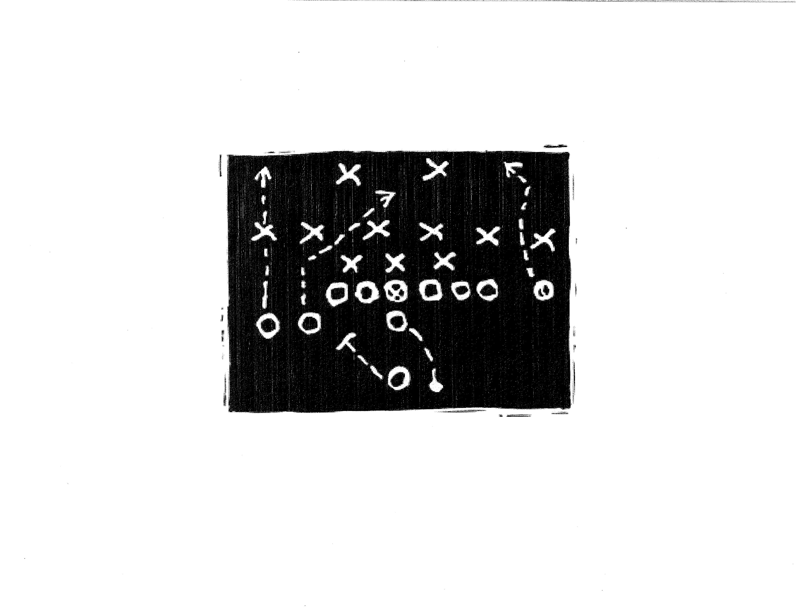
“Inside” a Quarterback’s Minding

Slide 10
Mead as a Social Behaviorist & Pragmatist
The meaning of things is rooted in everyday practical conduct, the uses that are made of these things as individuals go about constructing their behavior.
In the process, a “thing” becomes an object because of what we do with it, how we behave toward it and how it “behaves” back…
Thus the world is not something “out there” to be experienced by the subject, but is rather “a task to be accomplished.”
Furthermore the world is not something “out there” that can be experienced directly, but is only available through the filters of our biological physiology, our individual mental processes, our position (roles and statuses in the social structure) and the culture and sub-cultures in which we are embedded.

Slide 12
MIND
The first component in Mead's trilogy is termed mind. Mead's conception of mind is a "social phenomenon--arising and developing within the social process, within the empirical matrix of social interactions."
The mind emerges through such exchanges, thus its nature is that of an internal process of communication grounded in the utilization of significant symbols. Therefore, the mind is processually formed through self-conversation and interactions with others. Shared symbols, dominate the process. Our most vital and distinctive symbolic communication is language. In Mead's words, "out of language emerges the field of mind.“
For Mead and later symbolic interactionists, language is the distinguishing criterion for being human.
Mead believed that if one's actions evoke the same response in others, then the meaning of symbols is no longer private but a behavioral reality that can be studied.
M
I
N
D

Slide 13
SELF
The second component in Mead's trilogy is termed self. The self also "arises in social experience" and can be thought of as "an object to itself," possessing a "social structure". Individuals can conceive of their own being and convert that identity into a form of consciousness. So conceived, the self can be the recipient of both definition and emotion. Symbolic communication is crucial to the development of answers to the question Who am I? Mead argued that the self is best thought of as a process, and he traced its genesis developmentally.
The development of the self is dependent on learning to take the role of the other. Role taking requires that we imagine how our behavior will be defined from the standpoint of others (as in Cooley’s “looking-glass self”). For Mead, role taking occurs throughout the developmental process by which the self is constructed and refined. This process consists of three distinctive phases. From a period of imitation without meaning for infants, through the play-acting world of children, and finally to the phase of the generalized other, the self expands, changes, and comes into being.
S
E
L
F

Slide 14
SELF, continued
For the very young, role playing is simply a matter of doing what others do (Imitation). In time, however, the child begins to play "pretend" roles such as parent, sibling, even the imaginary friend. In the course of switching identities and imaginary conversations, the self through play becomes both separate and defined. The child is learning to see a unique self from the various perspectives of other role players (Role Playing).
When egocentric play gives way to the rules and "teamwork" of games, the individual learns that the behaviors of other players are somewhat fixed, impersonal, and predictable. In playing the multiple and interlocking roles of the game, and other organized endeavors, self-control emerges. Through such play, one develops and internalizes a group of perspectives on the self that Mead termed the “Generalized Other." As this collective frame of reference matures, the player becomes a social being who will demonstrate some consistency in future behavior. Thus, the "inner voice" of the generalized other continues to whisper the complex requirements of being "human."
S
E
L
F

Slide 16
SELF, continued
In the lifelong context of interdependent action, two dimensions of the self emerge, are formed and reformed. In one, the individual develops an identity in response to the attitudes of others. Such a response emanates from the solitary individual's definition of the situation. In the other, one assumes the "organized set of attitudes of others.” This component of the self provides the rules for the actual response. For these dimensions, Mead employed the concepts "I" and "Me," respectively. It is the latter that comes with the internalization of the generalized other.
Both “I” and “Me” necessarily relate to social experience. But the “I” is the response of the organism to the attitudes of the others; the “Me” is the organized set of attitudes of others which one assumes.
“We are,” Mead writes, “individuals born into a certain nationality, located at a certain spot geographically, with such and such family relations, and such and such political relations. All of these represent a certain situation which constitutes the ‘I’; but this necessarily involves a continued action of the organism toward the ‘Me.’”
S
E
L
F

Slide 17
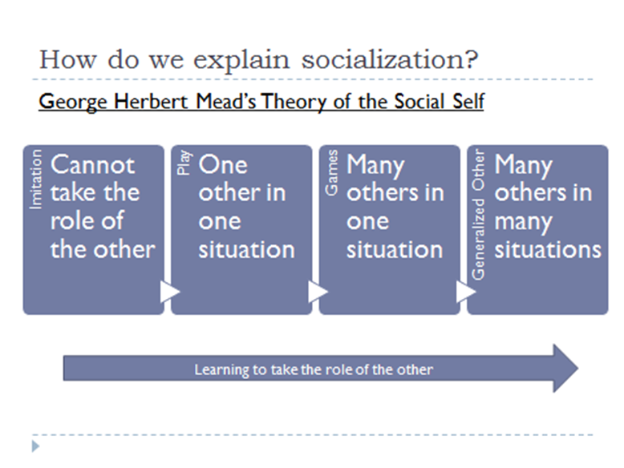

Slide 18
S
O
C
I
E
T
Y
SOCIETY
Society is the third component in Mead's system. It is little more than an extension of his "organized self." More precisely, through interaction the self takes on "generalized social attitudes" toward a wider environment. Such references are beyond the immediate spheres of personal relationships, intimate groups, or communities.
For Mead, the institution of society consist of "common responses" rooted in such attitudes by which "the modern civilized human individual is and feels himself to be a member not only of a certain local community or state or nation, but also of an entire given race or even civilization as a "whole."
Society is thus maintained by virtue of humans’ ability to role-take and to assume the perspective of generalized other.

Slide 19
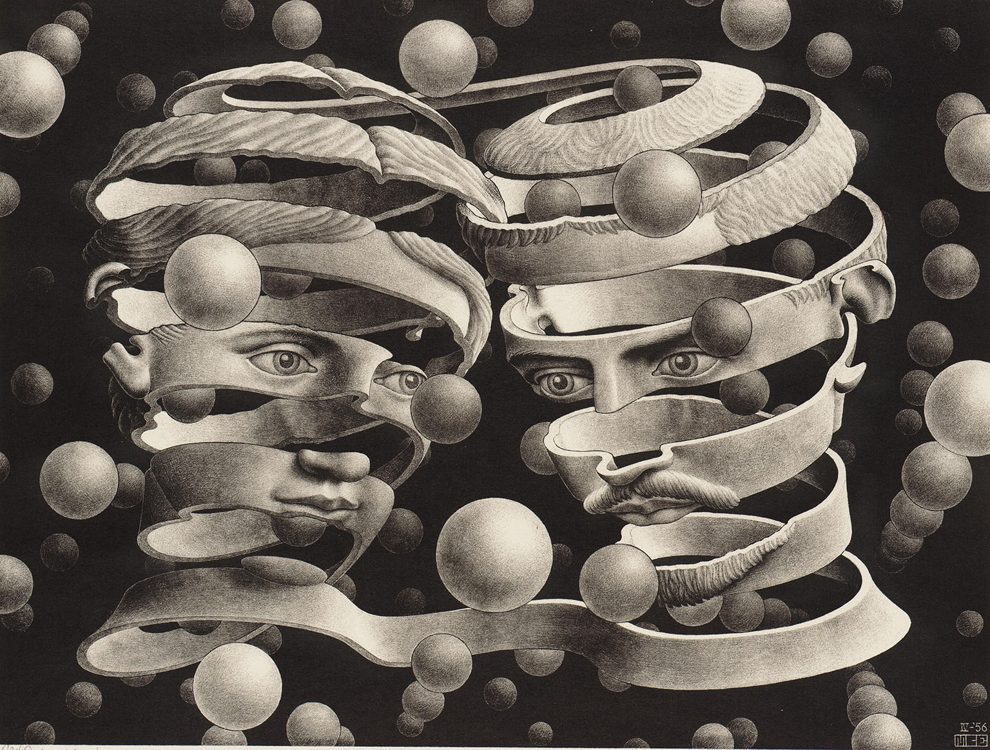
BOND
OF
UNION
MC Escher

Slide 20
S
U
M
M
A
R
Y
MEAD defined his focus as…
“…the activity or behavior of the individual as it lies with the social process. The behavior of the individual can be understood only in terms of the behavior of the whole social group of which he is a member, since his individual acts are involved in larger, social acts which go beyond himself and which implicate the other members of the group.”
While earlier social psychology had dealt with social experience from the individual psychological standpoint, Mead suggested that individual experience be dealt with “from the standpoint of society, at least from the standpoint of communication as essential to the social order.”
Mead argued that there can be no self apart from society, no consciousness of self and no communication.
In its turn, society must be understood as a structure that emerges through an ongoing process of communicative social acts, through transactions between persons who are mutually oriented toward each other.

Slide 22
The emergence of the Self (Me & I)
▪ Imitation (mimicry) =
role taking
▪ Play (taking turns) =
role-making
▪ Games (rules) =
role-playing
▪ Society/Generalized Other =
normative order, conscience collective
▪ Mind =
internalized conversation
AND The ROLES WE PLAY

Slide 23
HERBERT BLUMER’S
THREE BASIC RULES
of SYMBOLIC INTERACTIONISM
● Humans act on the basis of Meaning
● Meanings Emerge out of Social Interactions
● Meanings are Individually Interpreted
via a Collectively Established, Maintained, and
Constantly Changing Language…
Language, especially the spoken/written native language of any particular group becomes the dominant vehicle for articulating and communicating the meanings resident in the group’s culture.
Culture, in turn, is the collectively held beliefs and values – the groups “is’s and the ought’s” – that guide the pragmatic behavior of the group’s members.
.

Slide 24
Summarizing GEORGE HERBERT MEAD, per Herbert Blumer
His treatment of human society took the form of showing that human group life was the essential condition for the emergence of consciousness, the mind, a world of objects, human beings as organisms possessing selves, and human conduct in the form of constructed acts
He reversed the traditional assumptions underlying philosophical, psychological, and sociological thought to the effect that human beings possess minds and consciousness as original “givens, “ that they live in worlds of pre-existing and self-constituted objects, that their behavior consists of responses to such objects, and that group life consists of the association of such reacting human organisms.
Mead saw the self is a process and not as a structure:
The human being is an object to him or her self…and thus a self-referential symbol with which we each interact in the activity of minding, of carrying on an internal conversation….

Slide 25
The individual experiences oneself as such, not directly, but only indirectly, from the particular standpoints of other (significant) individual members of the same social group…
…or from the generalized standpoint of the social group as a whole to which one
belongs…
…and one becomes an object to oneself only by taking the attitudes of other
individuals reflexively back toward oneself.
Society consists of the generalized social attitudes that continually emerge through coordinated interaction between individuals and groups.
Social order is continually emerging through the ongoing activities of individuals who are reflexively taking the attitude of others and attempting to make sense of (i.e., define) and navigate the situations in which they collectively find themselves.

