Slide 1
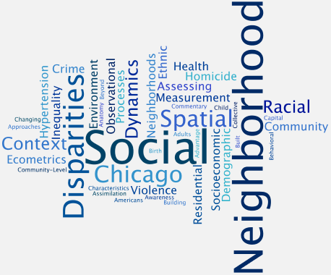
The
CHICAGO
SCHOOL
Of
SOCIOLOGY
Robert Park
W. I. Thomas
Charles H. Cooley
George Herbert Mead

Slide 2
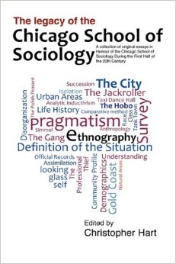
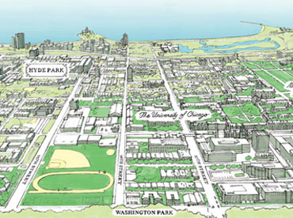
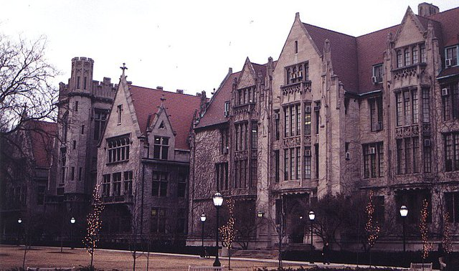
1892 - 1930

Slide 4
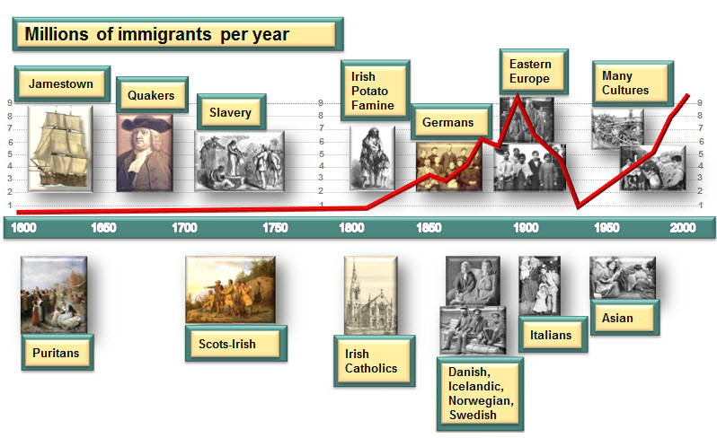

Slide 5
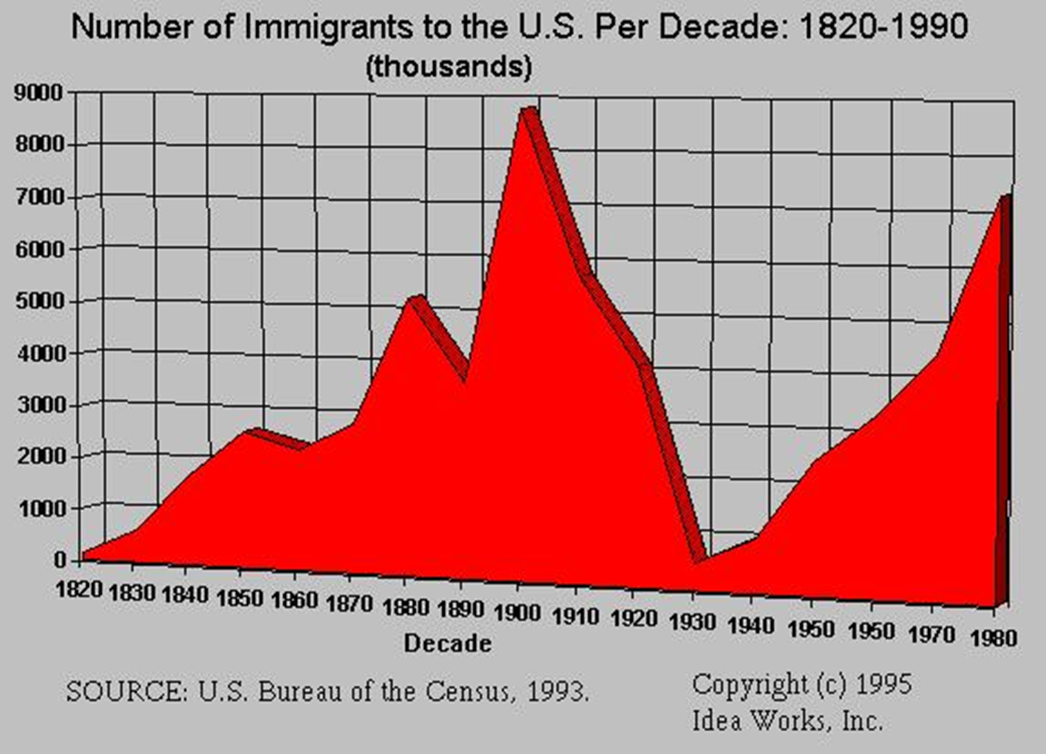
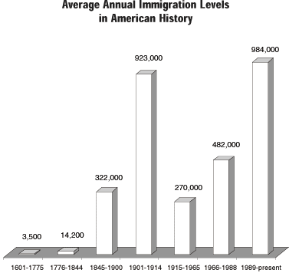
AMERICAN IMMIGRATION PATTERNS

Slide 6


Slide 7
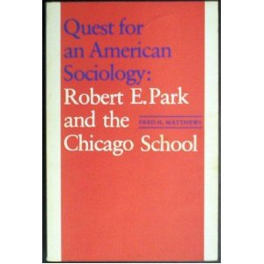
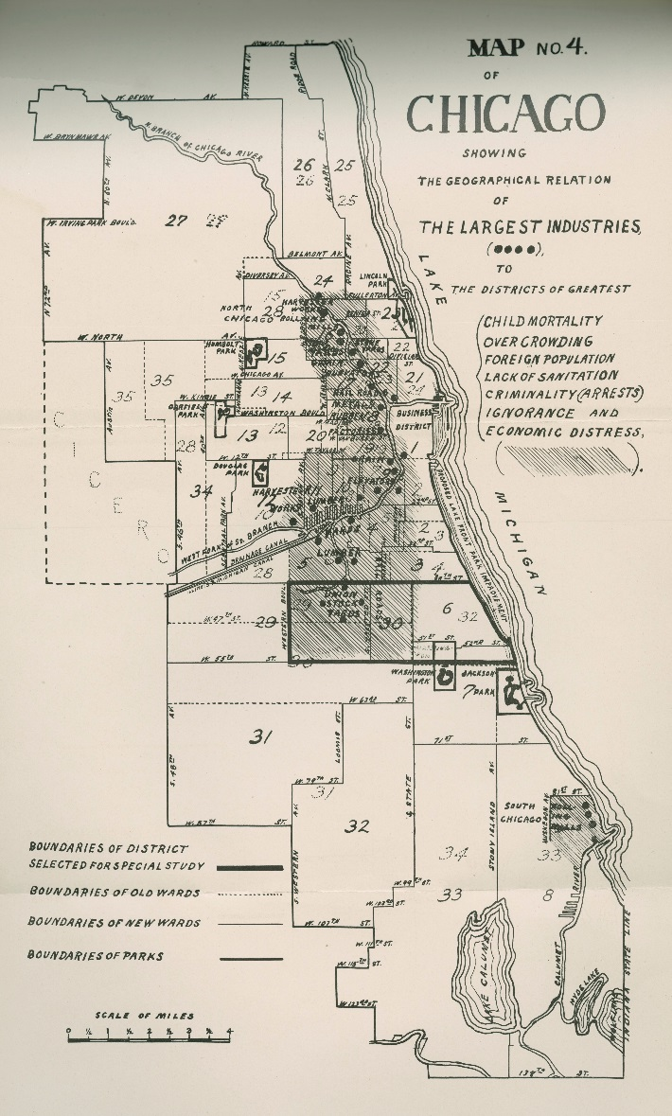
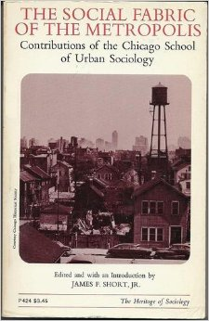
EARLY INFLUENCES COMING
OUT OF THE CHICAGO SCHOOL
THAT SHAPED AMERICAN SOCIOLOGY
●STUDIES OF SOCIAL STRUCTURE AND ORGANIZATION
● STUDIES OF HUMAN NATURE AND PERSONALITY
(Social Psychology)
● STUDIES OF SOCIAL CHANGE
● STUDIES OF RACE AND ETHNIC RELATIONS
(Minority Groups)
● URBAN STUDIES
● QUALITATIVE/ETHNOGRAPHIC STUDIES
● MICRO-SOCIOLOGY
● SYMBOLIC INTERACTIONISM

Slide 8
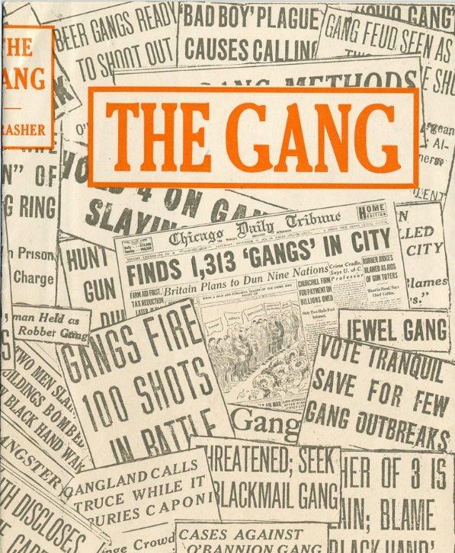
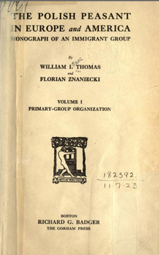
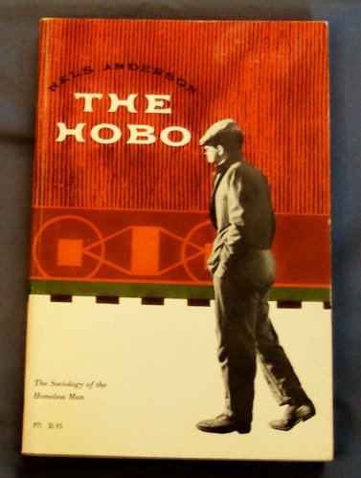


Slide 10
ROBERT PARK: SOME MAJOR CONCEPTS
● THEORY:
EMPIRICAL
DEMONSTRABLE
RELATIONSHIPS among
CLEARLY DEFINED CONCEPTS
● STRUCTURES AND PROCESSES
● URBAN/SOCIAL ECOLOGY
● SOCIAL PROCESS THEORY (OF ASSIMILATION)
CONFLICT (Economic)
COMPETITION (Legal)
ACCOMMODATION (Community)
ASSIMILATION (Personality)
● CONCENTRIC ZONE THEORY (with Burgess)
CENTRAL BUSINESS DISTRICT
TRANSITIONAL ZONE
WORKING CLASS ZONE
RESIDENTIAL ZONE
COMMUTER ZONE
● SOCIAL CHANGE
DISSATISFACTION
LOSS OF SOCIAL STRUCTURE
LOOSE COLLECTIVE BEHAVIOR
EMERGENCE OF LEADER (from Crowd to Audience)
● SOCIAL SPACE
SOCIAL DISTANCE
SOCIAL LOCATION
“MARGINAL MAN”
DOMINANCE AND SUCCESSION

Slide 11
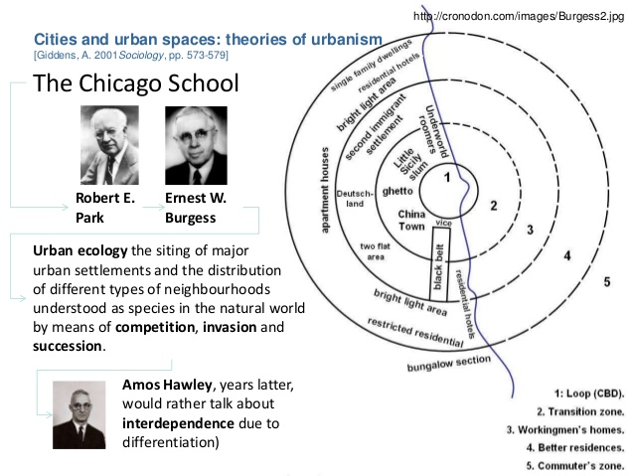

Slide 12
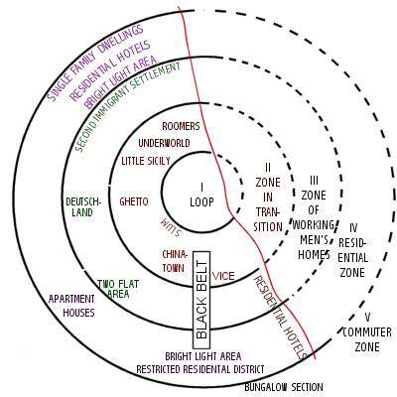
CHICAGO and the CONCENTRIC ZONE THEORY

Slide 18
W. I. Thomas
and
The Definition of
The Situation

Slide 19
W. I. Thomas
and
The Definition of
The Situation

Slide 21
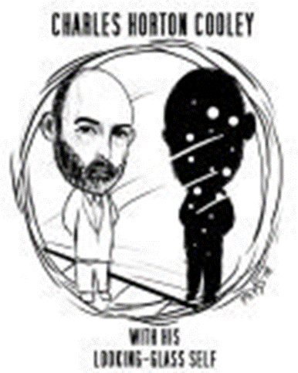

Slide 22
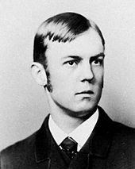
•COOLEY OBSERVED HIS OWN CHILDREN
TO STUDY HUMAN NATURE
•HIS ”METHODOLOGY” was
SYMPATHETIC INTROSPECTION
•THE PRIMARY GROUP – THE FAMILY - was the
SOURCE OF HUMAN NATURE
•THE PROCESS of SOCIALIZATION - the PRIMARY
FUNCTION of PRIMARY GROUPS - was the
CREATION of SOCIAL ACTORS
•Along with HEREDITY and ENVIRONMENT,
SOCIETY and the INDIVIDUAL are MUTUAL DETERMINANTS

Slide 23
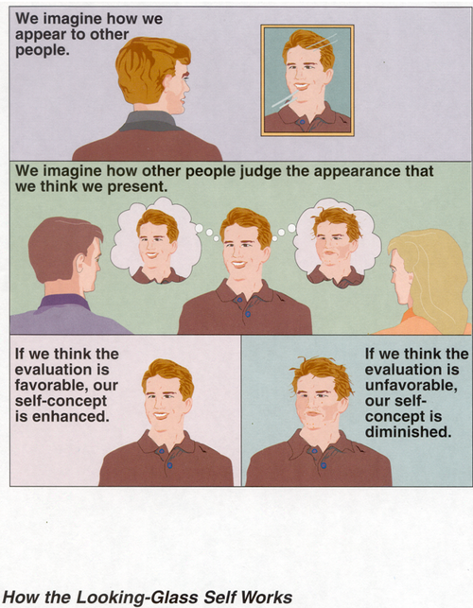

Slide 24
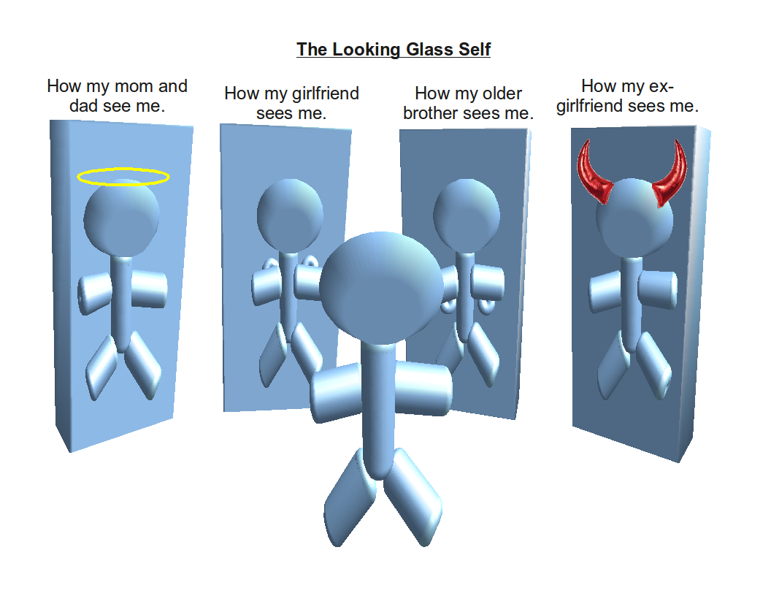

Slide 25
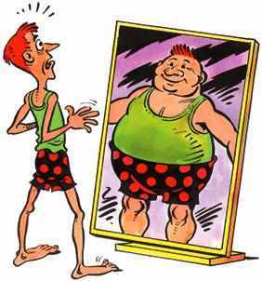
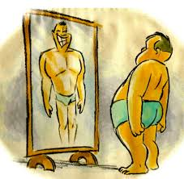



Slide 26


Slide 27
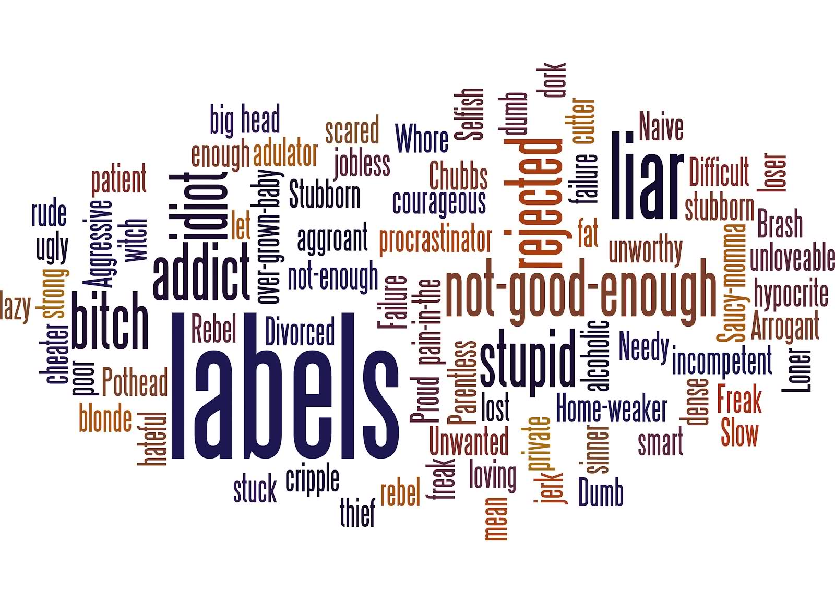

Slide 28
• SELF AND SOCIETY AS “TWIN-BORN”
An individual is an abstraction unknown to experience,
and so likewise is society when regarded as something apart from individuals....
“Society” and “individuals” do not denote separable phenomena,
but are simply collective and distributive aspects of the same thing....
•SOCIETY is seen as a MENTAL CONSTRUCT,
an IMAGINATIONAL LOCUS
•SOCIETY is a COMPLEX NETWORK OF COMMUNICATION
reflected in one’s MIND

