Slide 1

Performance of Forecasted ARs in the Pacific Northwest from 2007 - 2017
Andrew Martin¹
Laurel DeHaan²

Slide 2
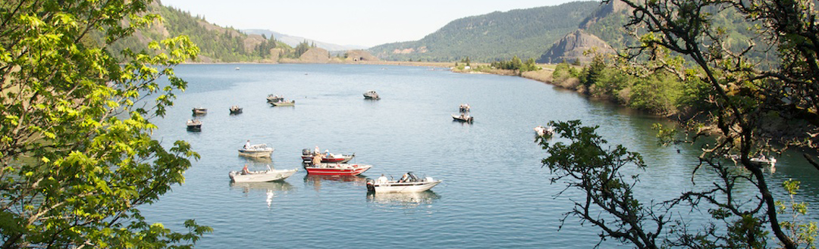

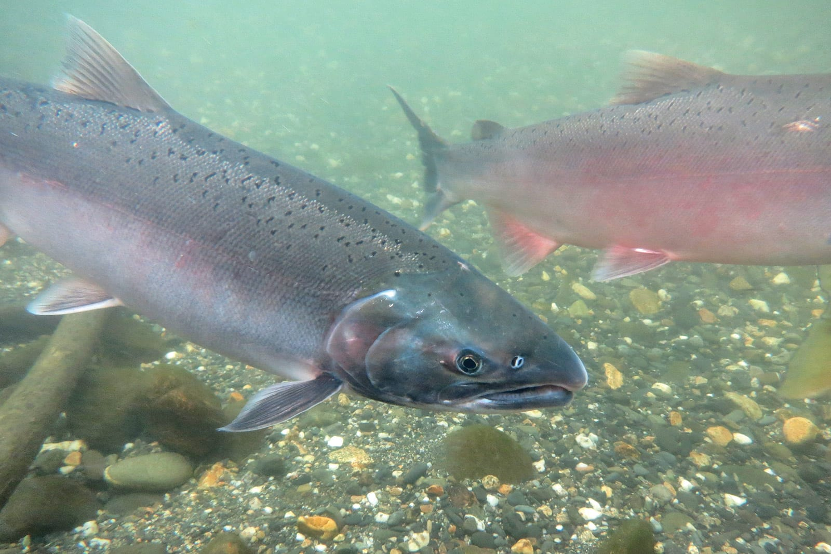
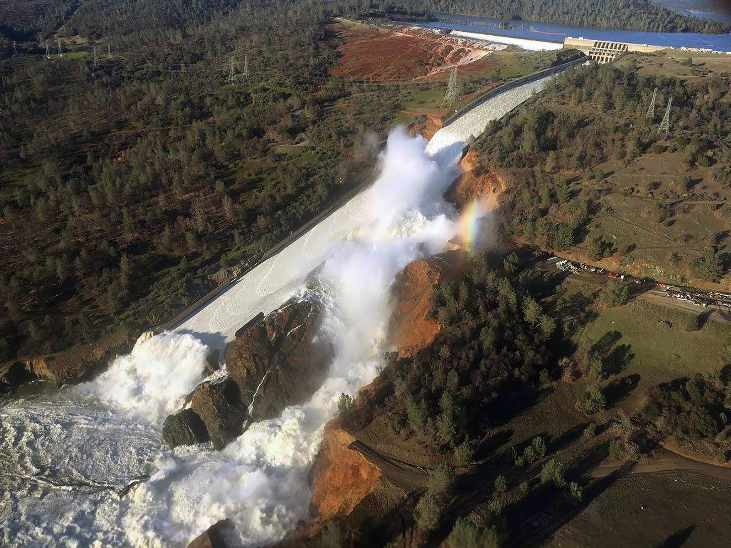
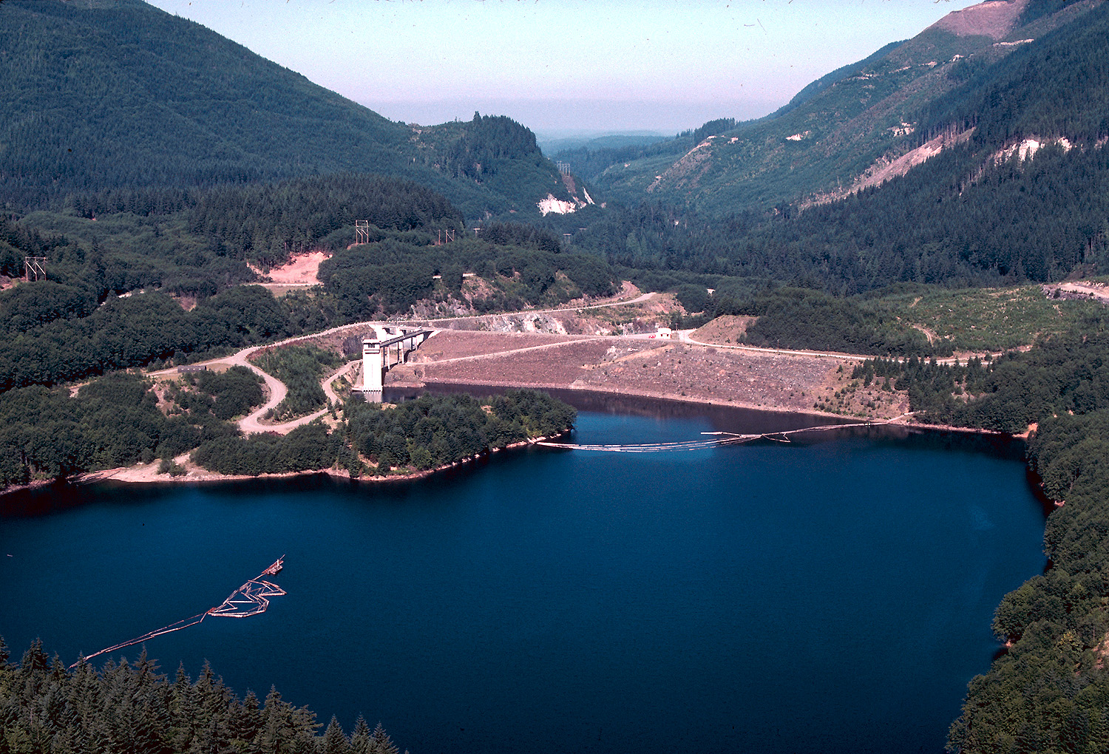
Water Management and ARs
Reservoir managers regularly face decisions about when to release impounded water
In the West, Atmospheric Rivers (ARs) drive the extreme precipitation and problematic flows that stress wet season release decisions
Oroville Dam (CA) 2017
Howard Hanson Dam (WA) 2009

Slide 3
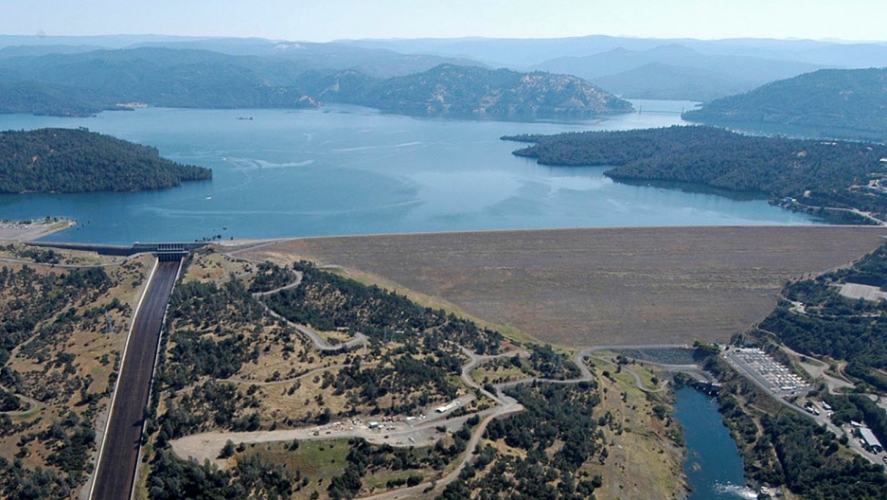
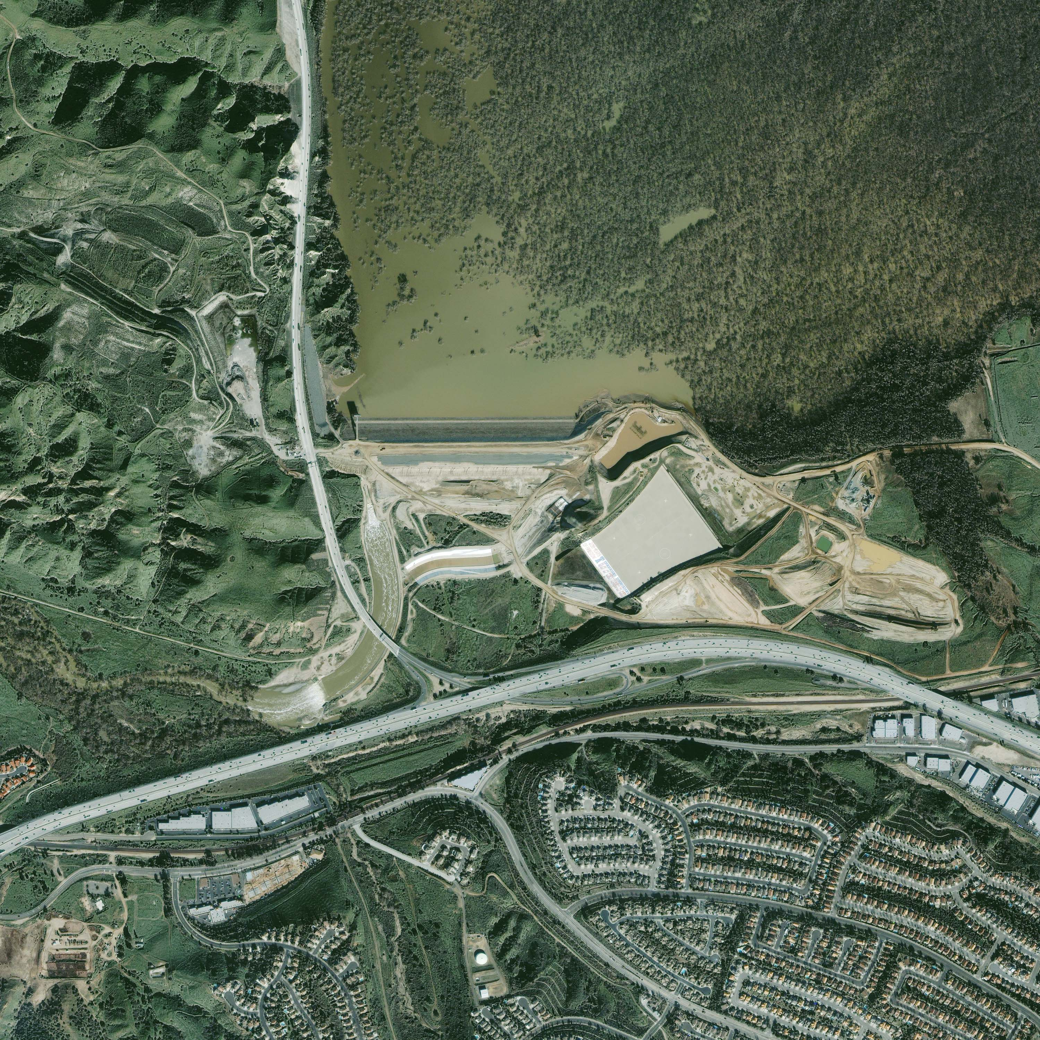
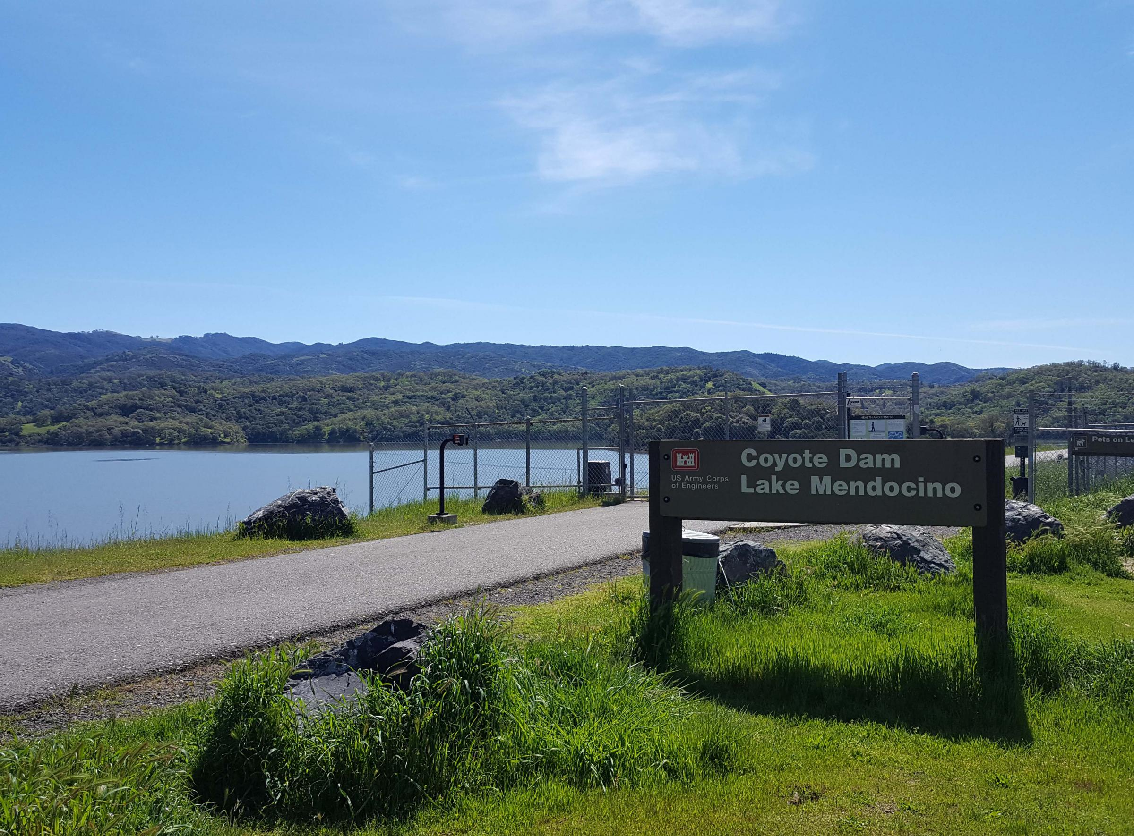
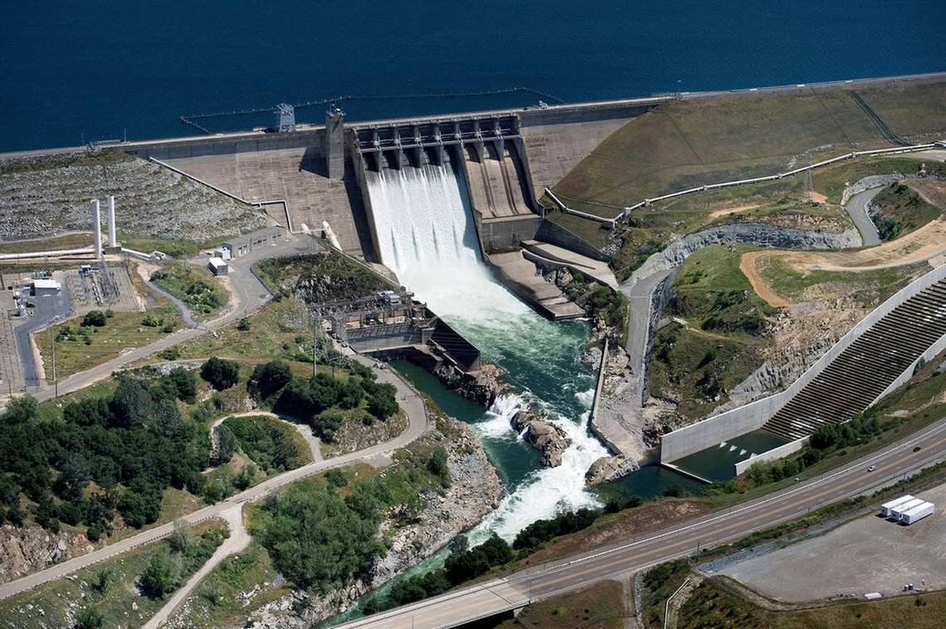
AR Forecasts and Decision-Making
Projects that are studying or have adopted operations informed by precipitation, streamflow and AR forecasts:
Oroville Dam
Prado Dam
Success depends on whether operators can be confident in forecasts far enough in advance of potential releases to make effective decisions
Lake Mendocino
Folsom Lake

Slide 4
Known Drivers of AR Forecast Error
AR Position
AR Size
AR Intensity (Integrated Vapor Transport)
Local Modification of IVT (Topography)
  IVT oriented across terrain causes precipitation and drying – thus diminishing IVT downstream

Slide 5
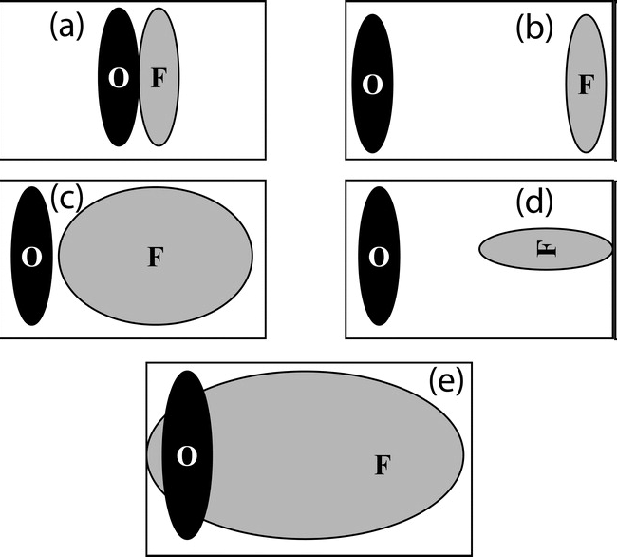
Object-Based Forecast Verification
Motivation for object-based verification
 | a-d | e
Correlation Coefficient | 0.0 | 0.2
Probability of Detection | 0.0 | 0.9
False Alarm Ratio | 1.0 | 0.9
Gilbert Skill Score | 0.0 | 0.1
Which Forecast is Qualitatively Best?

Slide 6
Method for Object-Based Diagnostic Evaluation (MODE)
72hour forecast
9 Jan 2017 0Z
NCAR’s MODE has been adapted to detect matching pairs of forecasted and observed ARs
In brief, the software constructs objects using
IVT magnitude exceeding a threshold
Shape Geometry
Geographic Region
Model Analysis for Observation
Model Forecast at Multiple Lead Times
Centroid Distance | 293 km
Intersection/Union Area | 0.32
Obs 90% intensity | 829 kg/m/s
Fcst 90% intensity | 618 kg/m/s
Advantage:
Errors in Position, Size and Intensity can be separated.
The effect of each relative to local topography can be evaluated using a large sample

Slide 7
Study
GFS Analyses and Deterministic Forecasts for water years 2007 – 2017 (0.5 deg., DJFM).
Stage-IV QPE (4 km)
AR objects that overlap the Pacific Northwest Water Resources Region (USGS WBD)
Extreme Event = Liquid Equivalent Precipitation Exceeding 3.0 inch 24 hr⁻¹. (0.1%)
Object-Describing Measures:
  Intersection of objects divided by their union (Position)
  Error in Object Centroid Location (Position)
  Error in 90th percentile IVT (Intensity)
  Probability of Detection

Slide 8
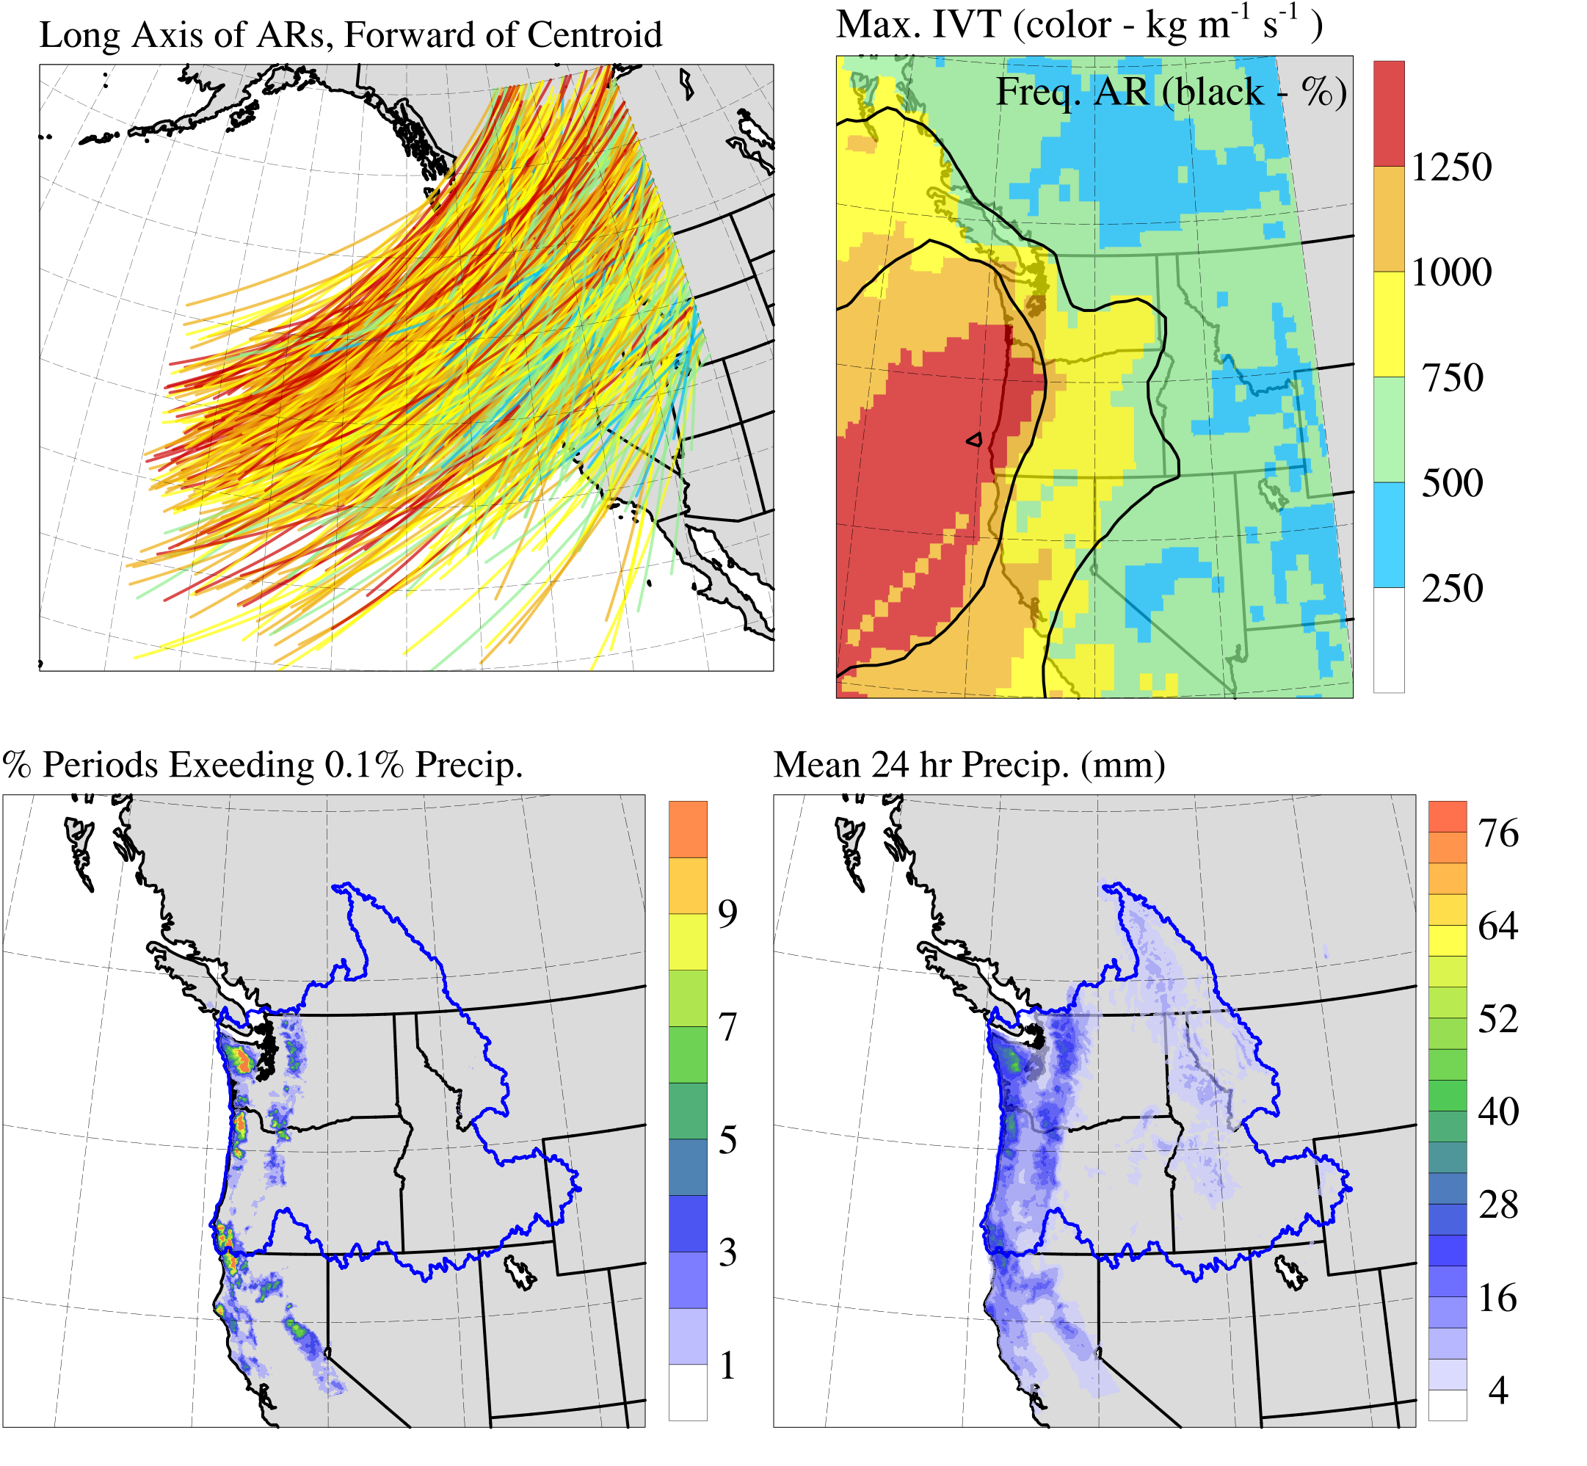

All Northwest ARs 2007 - 2017
5
10
15
N = 861
Mean Intensity = 637 kg m⁻¹ s⁻¹
Number ARs by “Category”:
58
226
273
205
99
Most Cascade and Coastal Range Locations > 1 inch 24 hr⁻¹ on AR day.
Olympics, NW and SW Oregon Coasts, Mt Hood Area: > 3 inch 24 hr⁻¹ for 5% of AR days (or more)

Slide 9
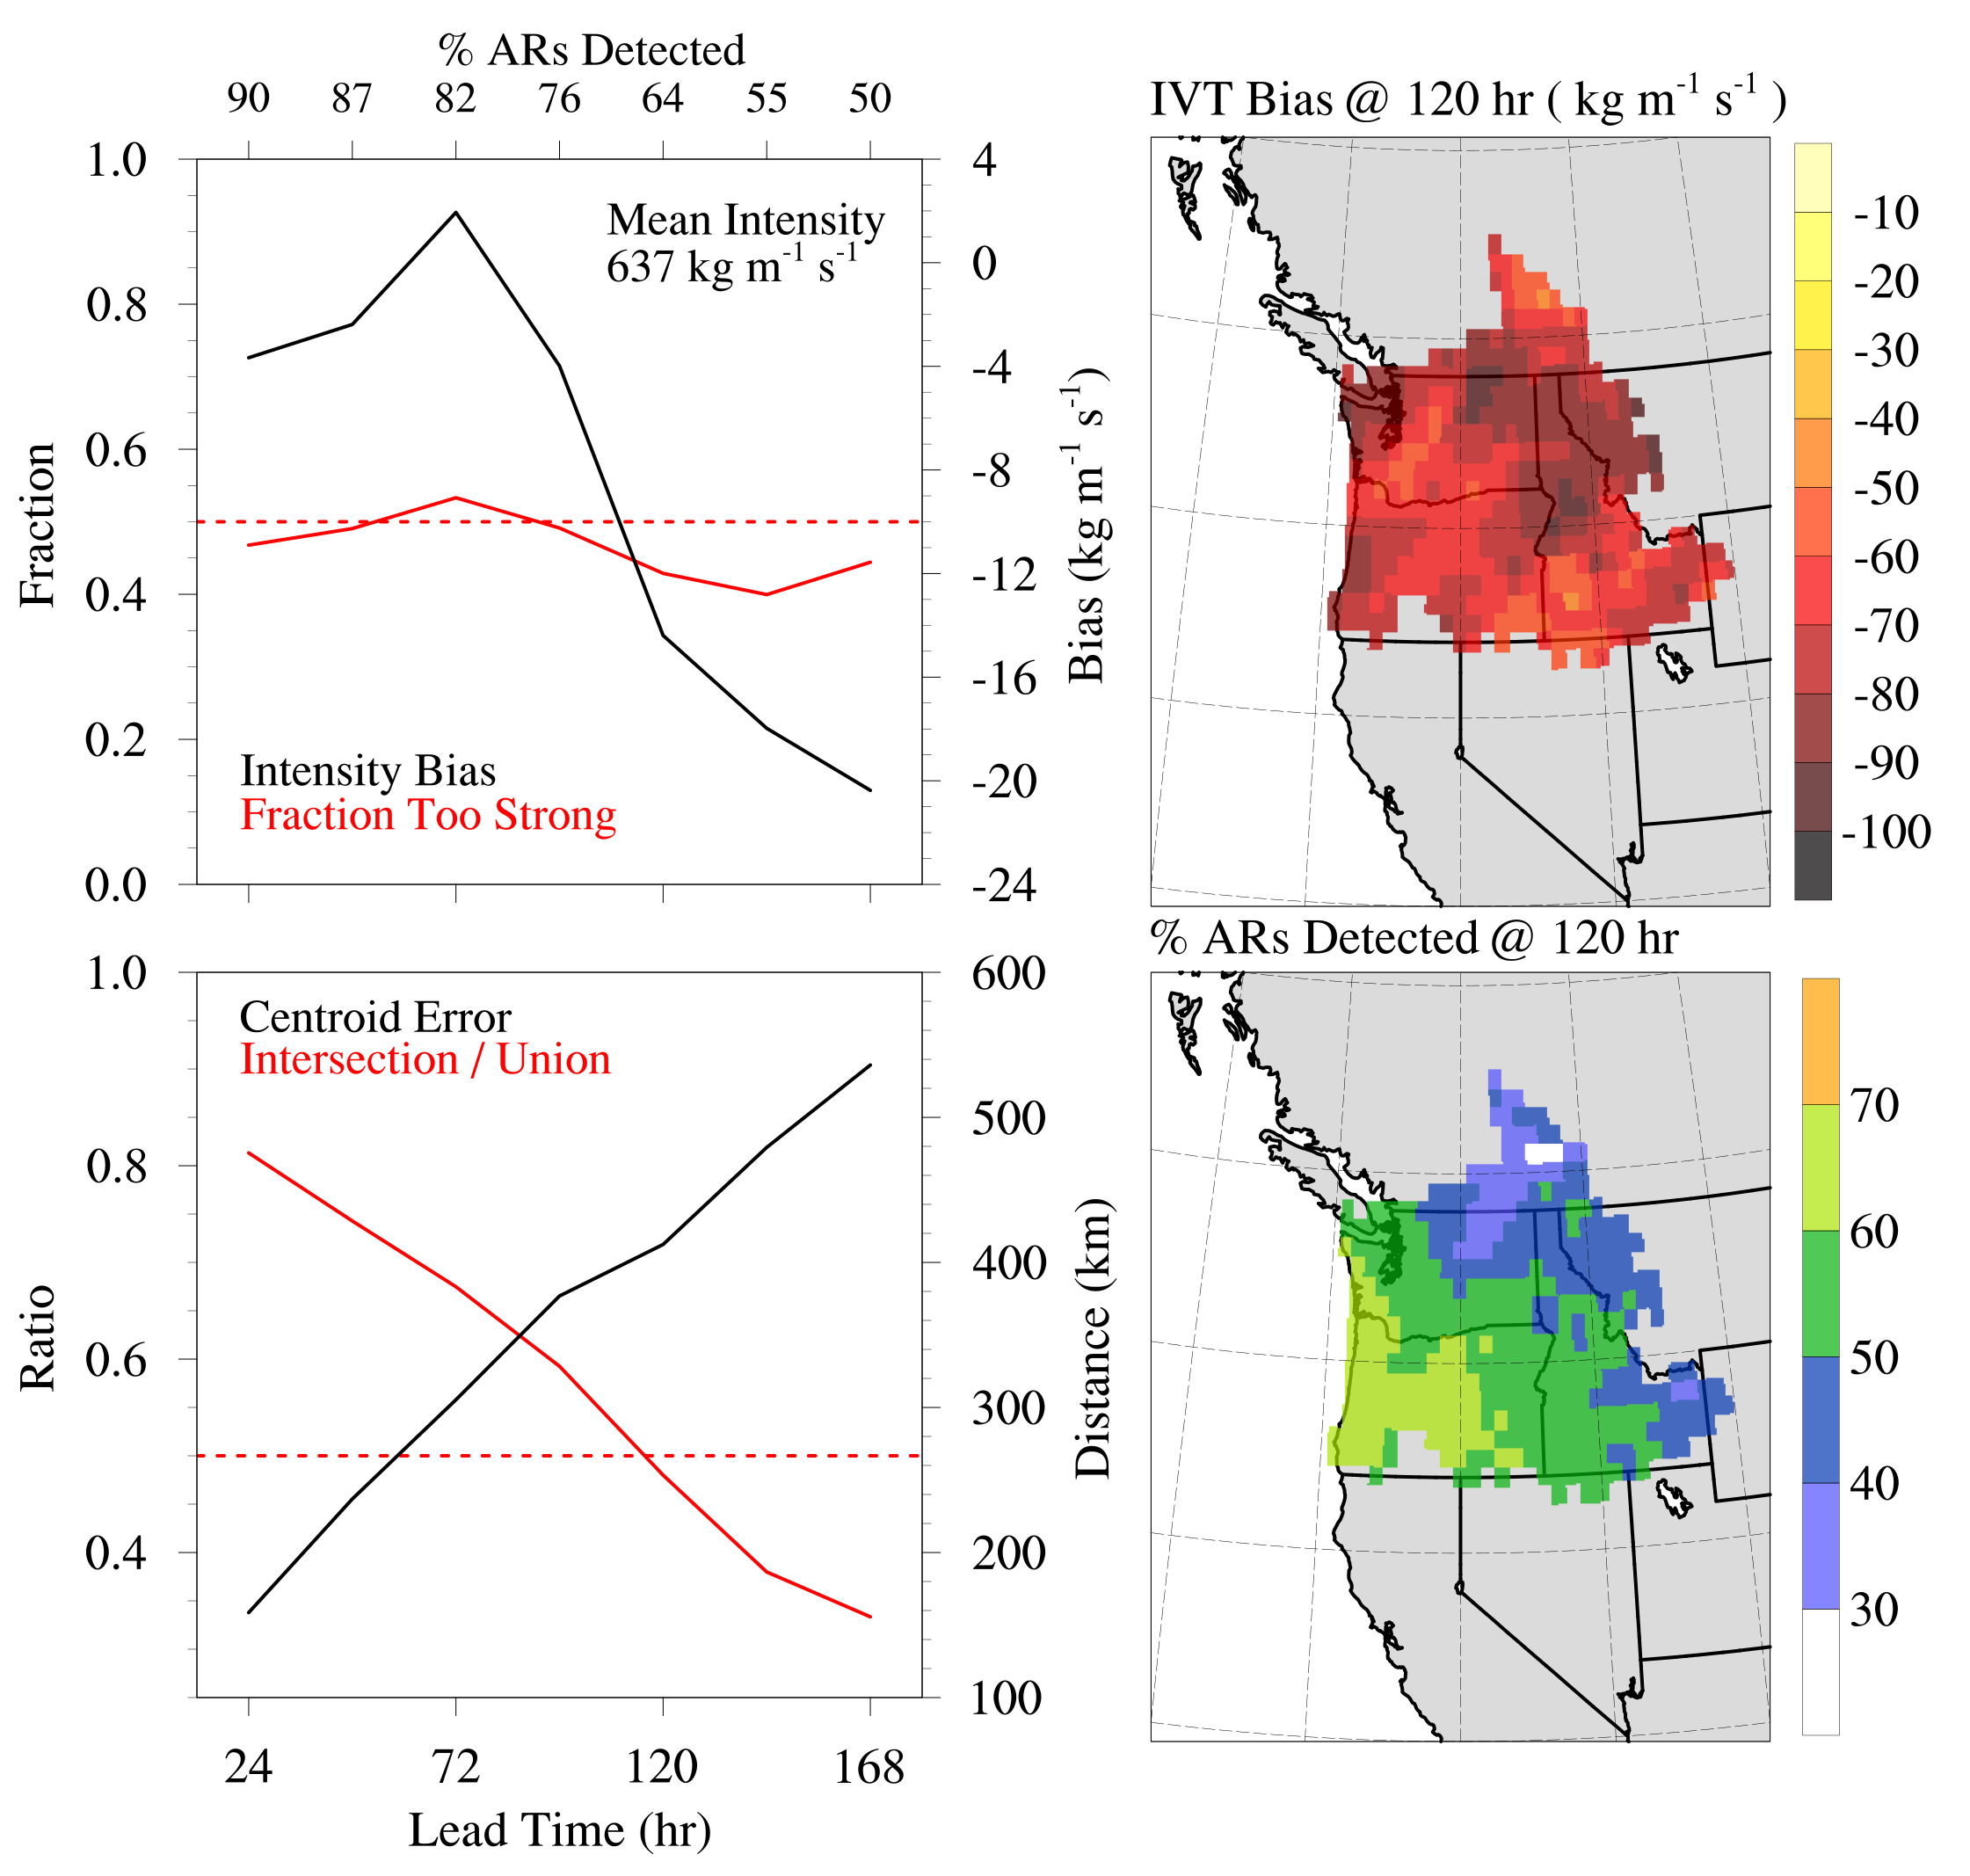
GFS Forecast Skill
Object-Describing Intensity Skill
Translation to Local Skill in IVT
AR Position Skill Becomes Poor for Lead Times > 5 days
AR Intensity Skill Remains High Through 7 days.
IVT Bias in the region largely follows local AR detection skill, which decreases inland.
Object-Describing Position Skill
Translation to Local Detection of AR Conditions

Slide 10
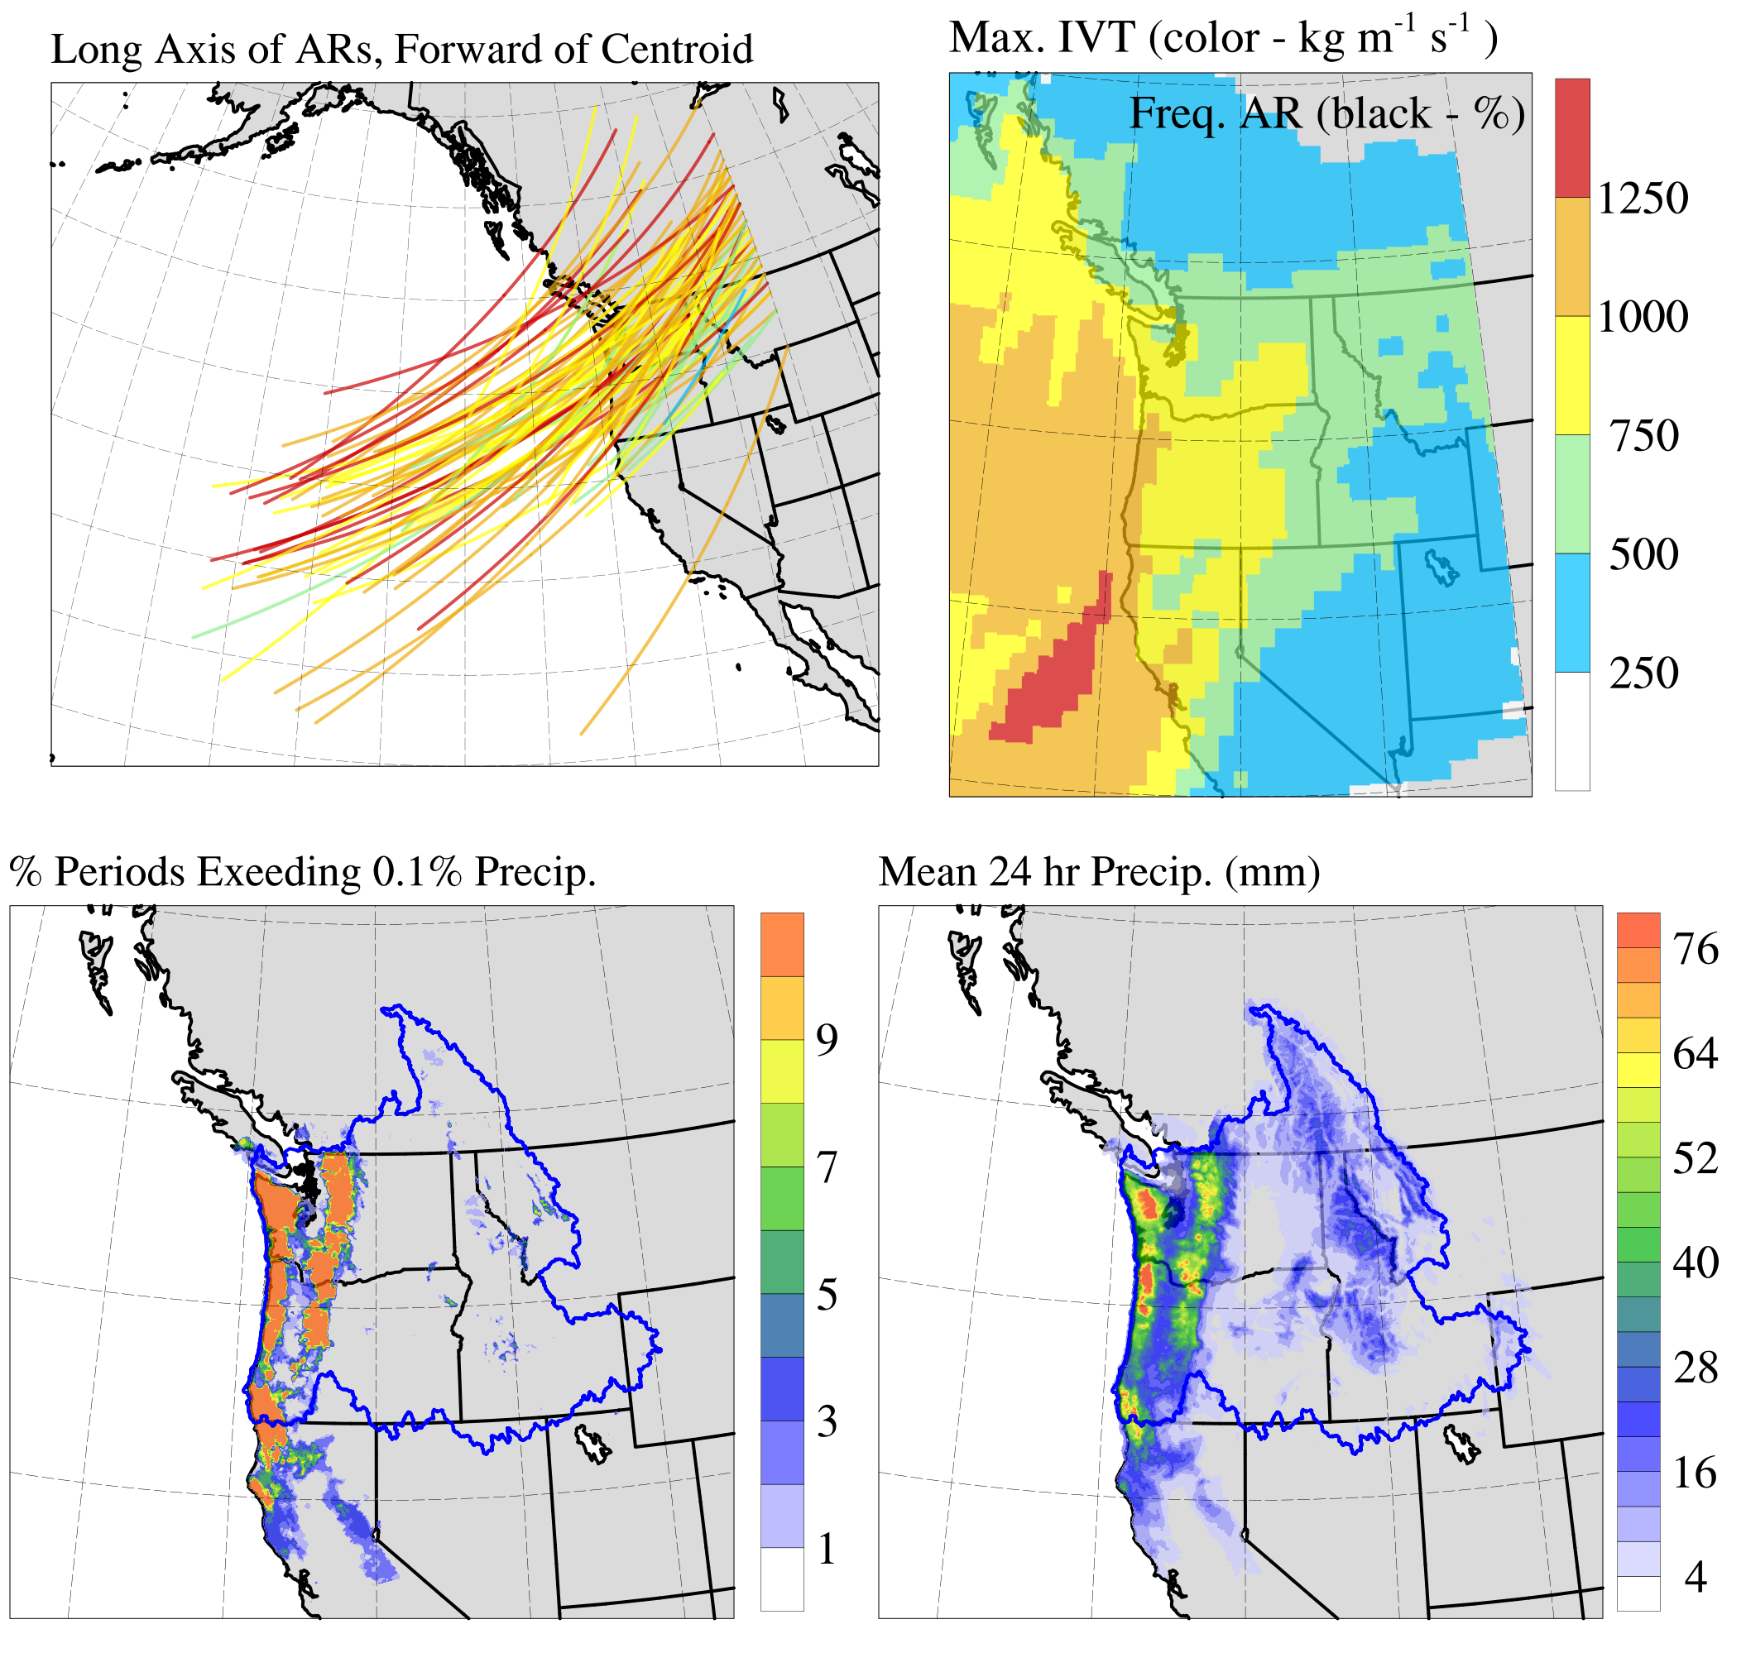
ARs That Produced Extreme Precip.
N = 90
Mean Intensity = 712 kg m⁻¹ s⁻¹
Number ARs by “Category”:
1
12
32
31
14
Significant Fraction of These Events Produced Extreme Precip. Inland.
All Areas Received More Precipitation, with Many Cascade and Coastal Range Locations Receiving > 3 in 24 hr⁻¹ on average.

Slide 11
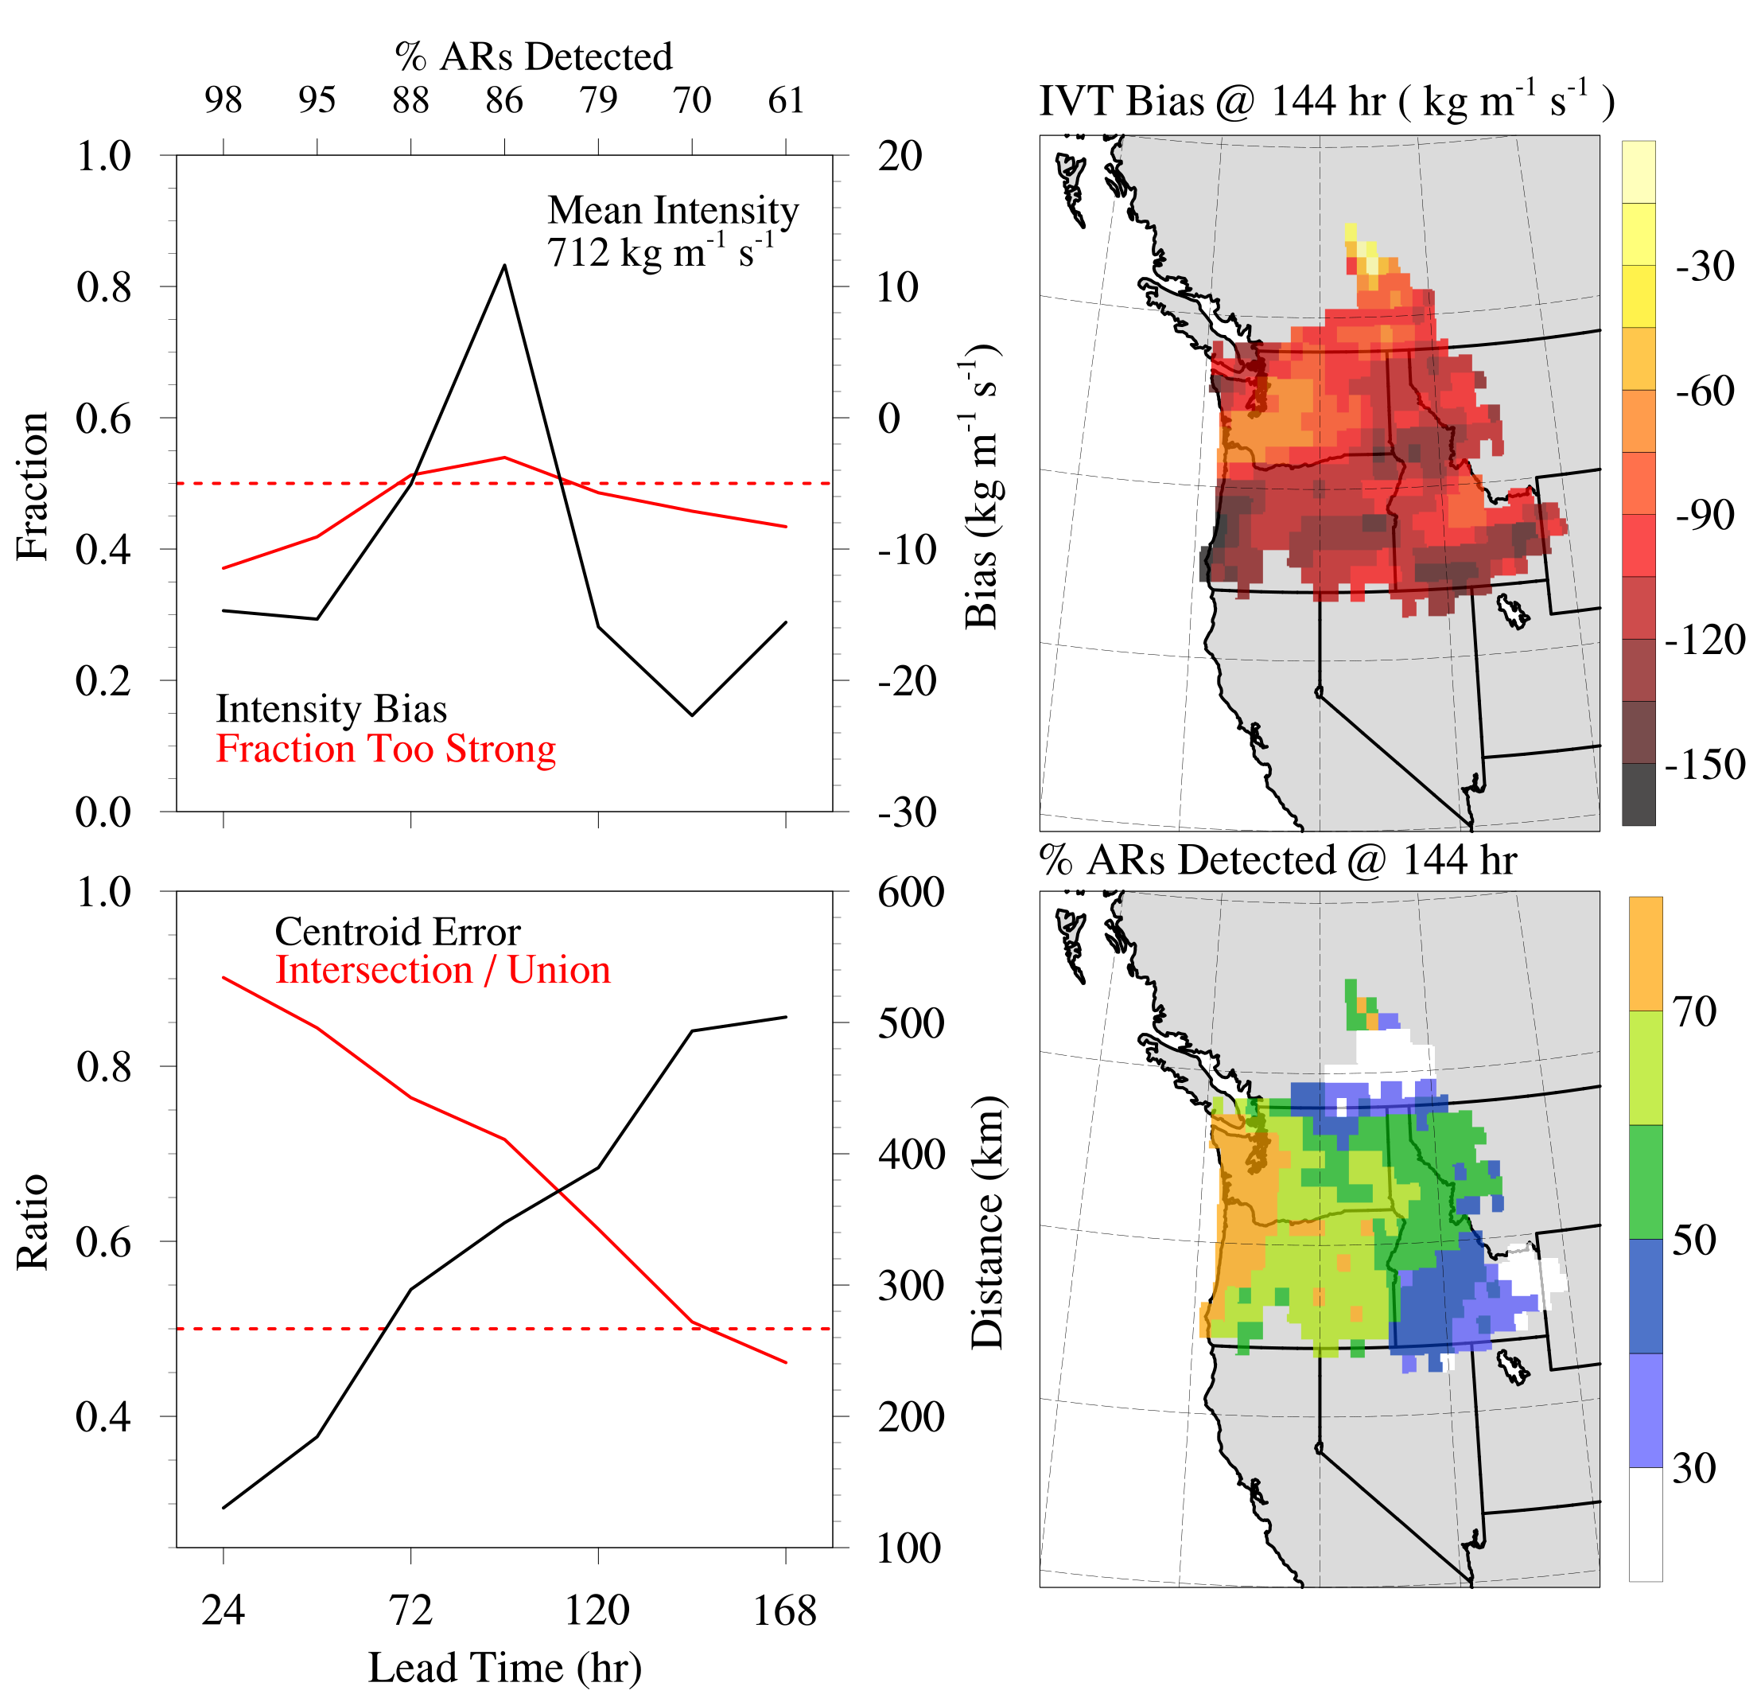
Skill in Extreme-Producing ARs
AR Position Skill Remains > 0.5 until 6 days lead time, an addition of 1 day.
AR Intensity is again not a factor in driving forecast skill during first 7 days.
In most places, the chance of detecting AR conditions improves.
For *most* places, these ARs are predicted with more skill.

Slide 12
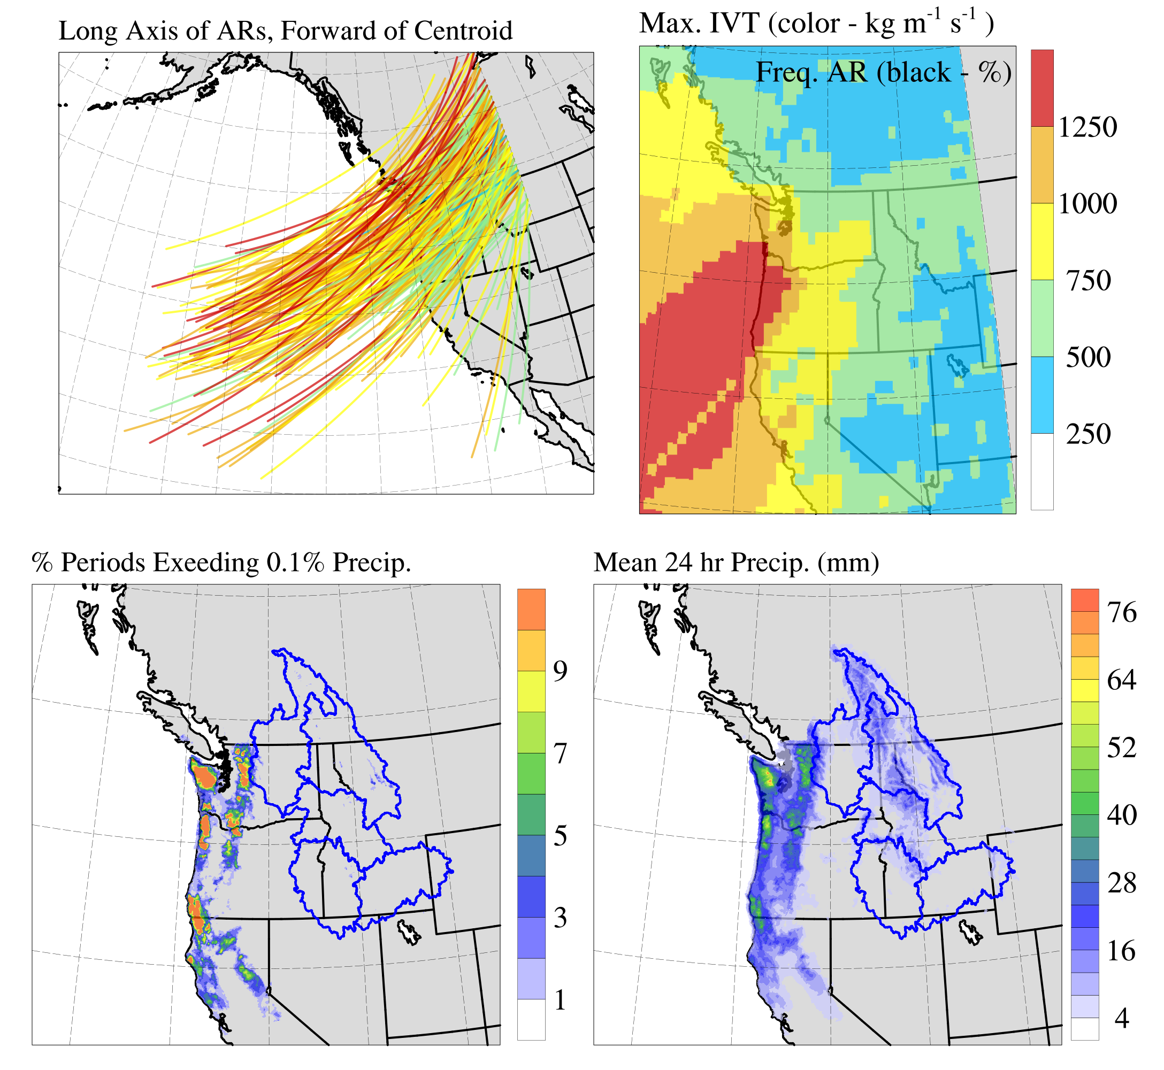
“Inland Penetrating” ARs
N = 247
Mean Intensity = 636 kg m⁻¹ s⁻¹
Number ARs by “Category”:
18
68
72
57
32
AR Objects are weighted toward more more intense and take more northern paths.
Most areas (even coastal) received slightly more precipitation than the typical AR.

Slide 13
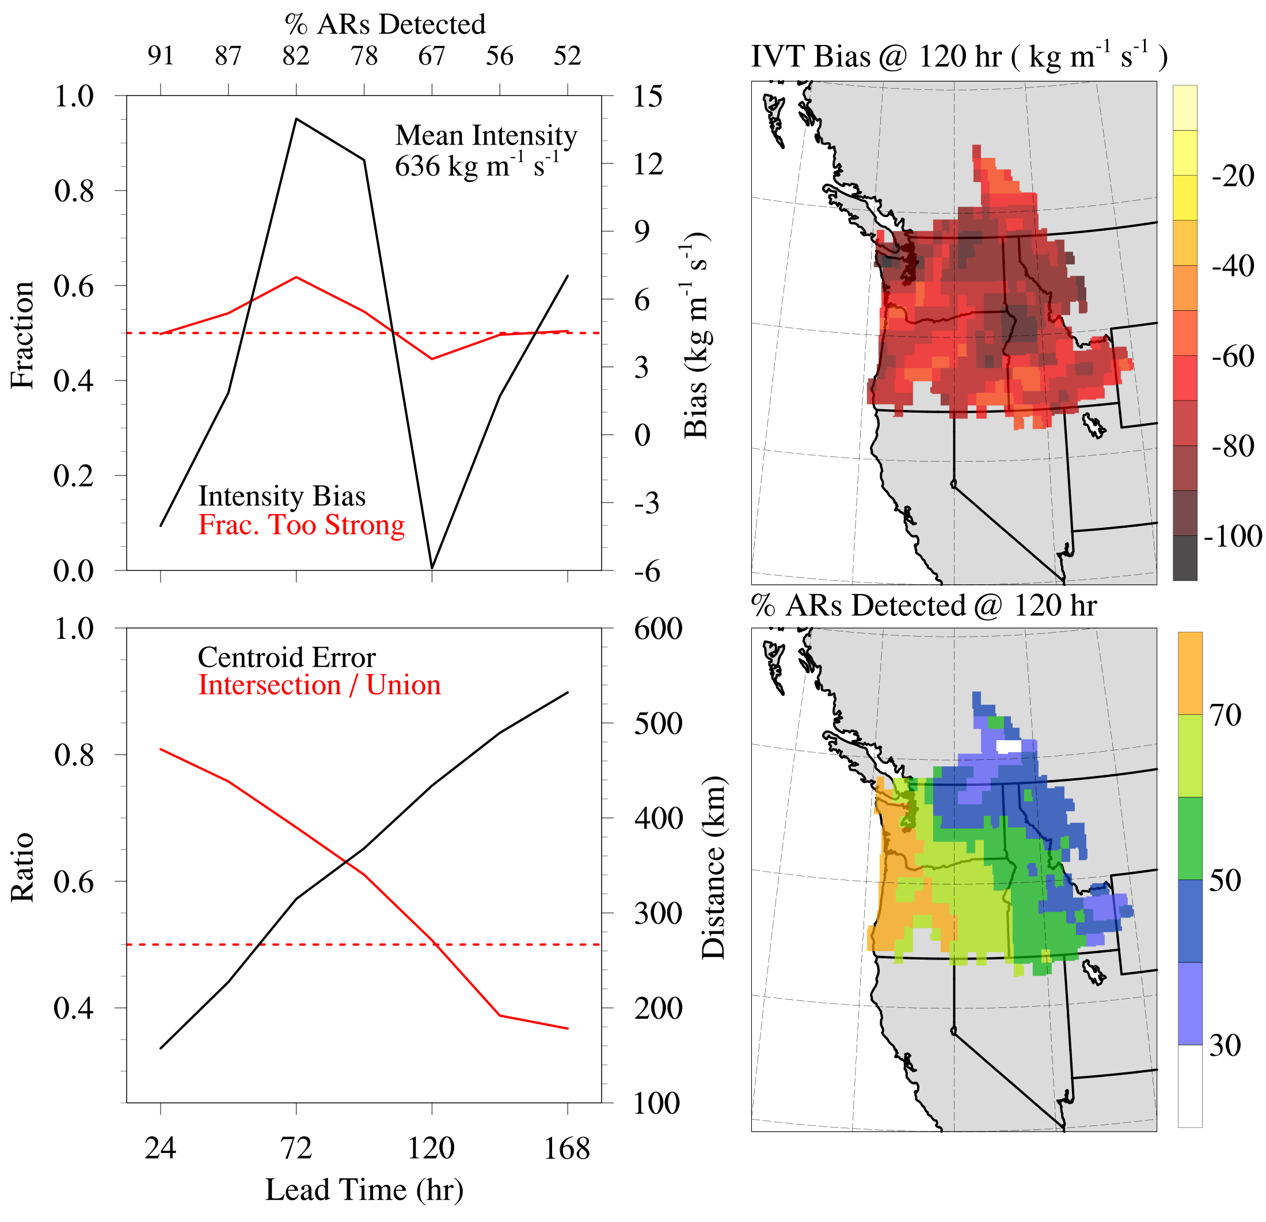
Skill in Inland ARs
Inland Penetrating ARs show similar predictability to all ARs:
Good skill to 5 days
AR position errors are more important than intensity
Similar local IVT bias map
Paradoxically, AR conditions at the coast are better predicted during inland penetrating ARs.

Slide 14
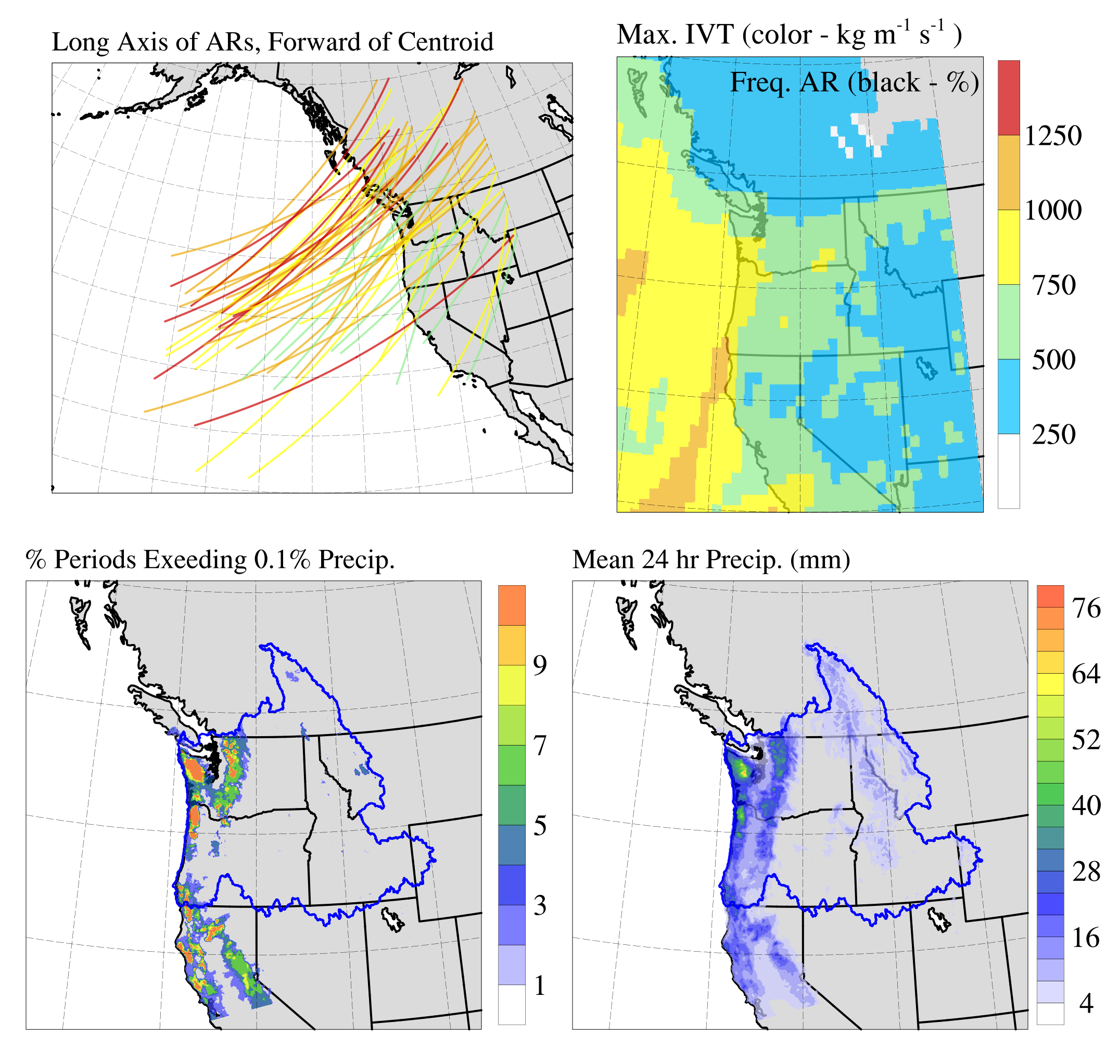
Best 50 Object Forecasts
N = 50
Mean Intensity = 683 kg m⁻¹ s⁻¹
These ARs are slightly stronger than average, slightly more zonally oriented, and take more northerly paths.

Slide 15
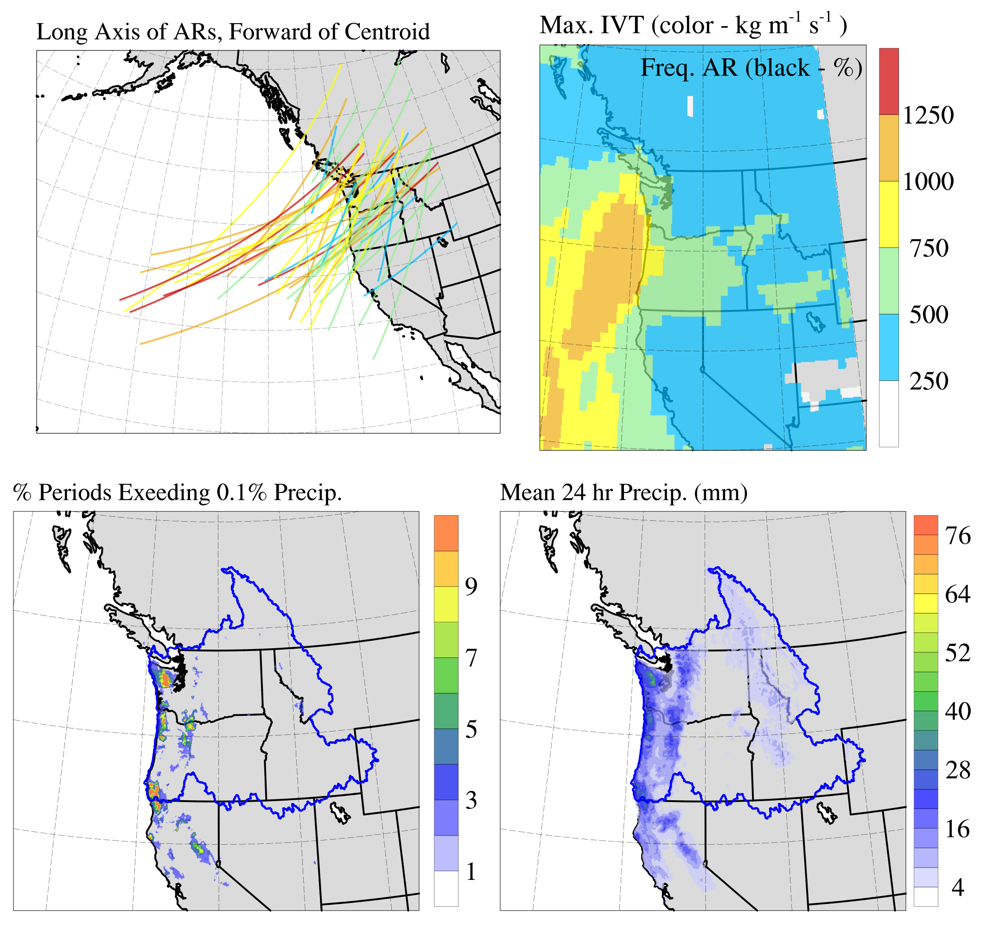
Worst 50 Object Forecasts
N = 50
Mean Intensity = 595 kg m⁻¹ s⁻¹
These ARs are weaker than the best forecast objects, and more often take southerly orientations.
These also produce less precipitation generally, but appear to produce more frequent extreme precipitation in the OR cascades than either all ARs sample or best ARs sample.

Slide 16
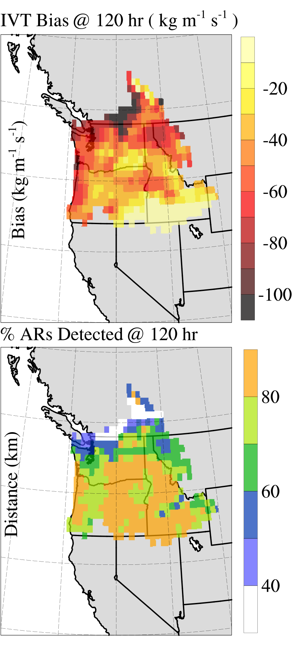
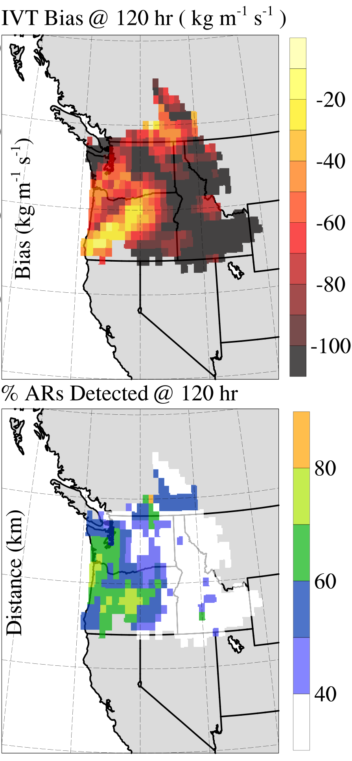
Local Impact of Best/Worst Skill
Best 50
Worst 50
Errors for best Forecast AR, given the best object location, are driven primarily by topography.
Errors for the inland regions are severely compounded by poor object location (and possibly intensity) forecasts.

Slide 17
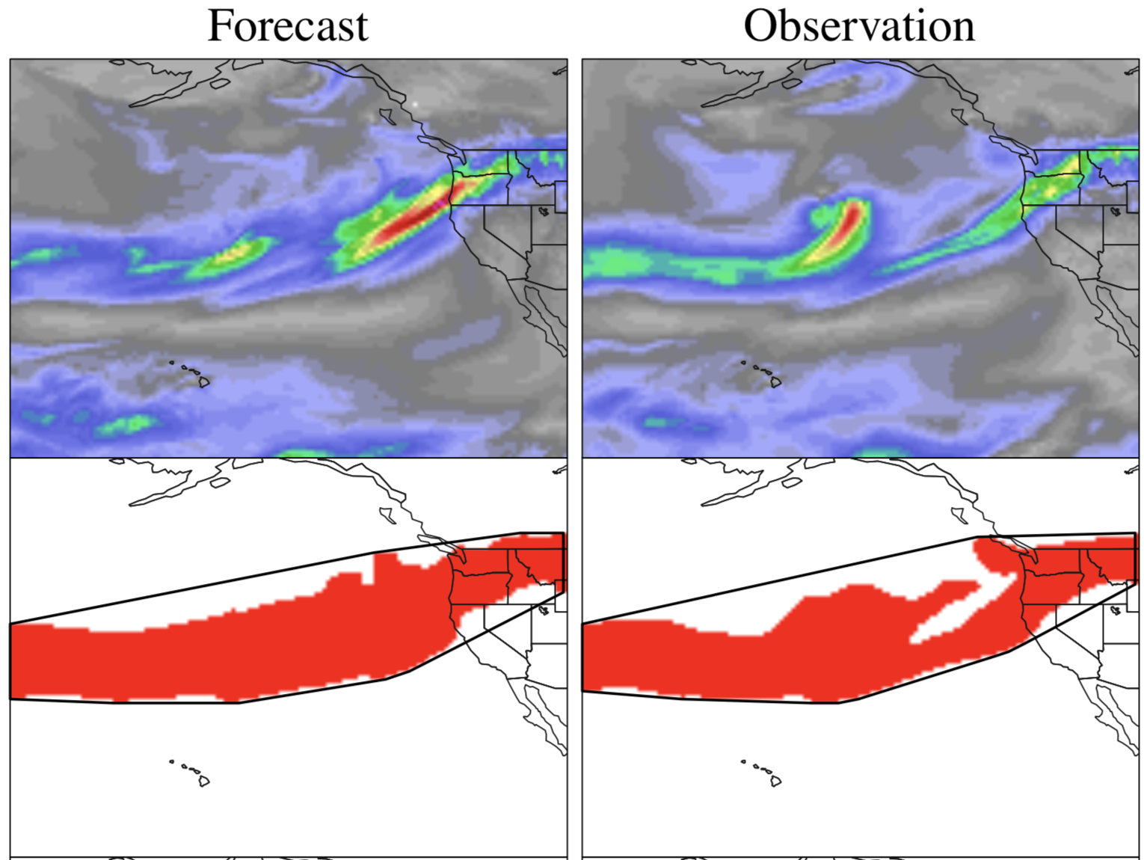
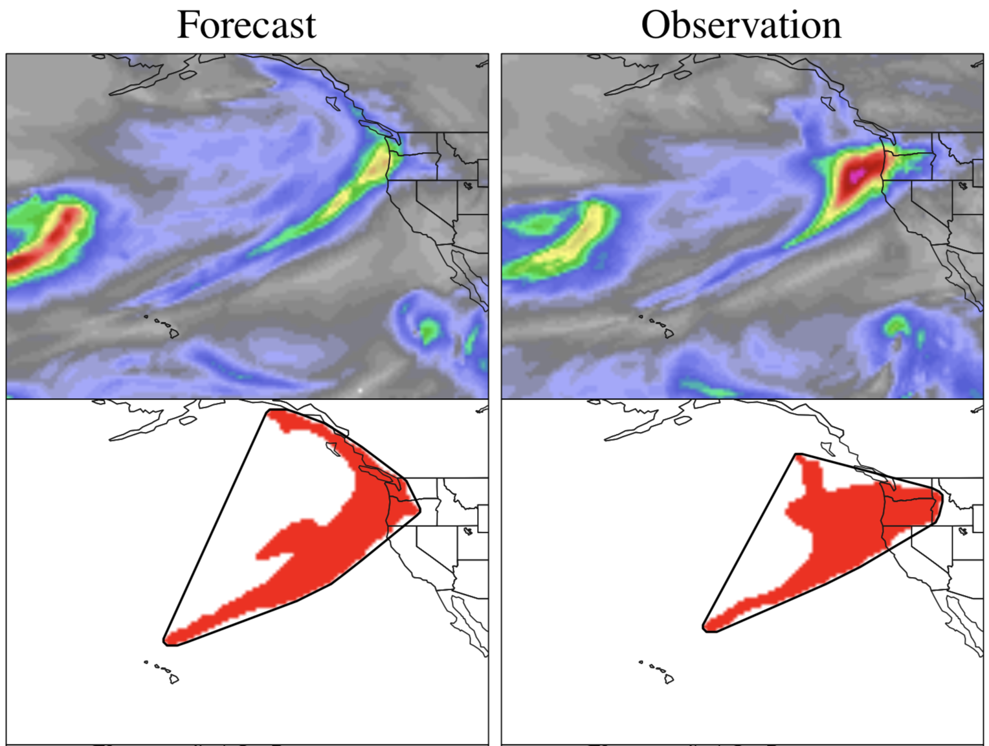
Notable Bests and Worsts
Best: 120 hr Forecast Valid
12 UTC on 09 Dec, 2015
Worst: 120 hr Forecast Valid
00 UTC on 18 Jan, 2015
IVT (kg m⁻¹ s⁻¹)
Max. IVT @ PDX: 875 (kg m⁻¹ s⁻¹)
Intersection/Union Ratio: 0.78
Intensity Bias: 35 kg m⁻¹ s⁻¹
IVT (kg m⁻¹ s⁻¹)
Max. IVT @ PDX: 850 (kg m⁻¹ s⁻¹)
Intersection/Union Ratio: 0.41
Intensity Bias: -239 kg m⁻¹ s⁻¹
1000
750
750
500
500
250
250

Slide 18
Lessons
AR forecasts in the PNW are skillful to 5 day lead time. Stronger ARs show additional skillful lead.
The largest contributor to poor AR forecasts is improper AR position (including size).
Modification by terrain is also important. This effect is compounded in poorly forecast ARs and more important for inland penetrating ARs.
Investments in model processes that determine the location of ARs and strength of orographic effects are likely to generate greatest improvements.

Slide 19

Future Work and Resources
30 year reforecast of NDJFMA for US West Coast using 9 km WRF
Development of 3D MODE to detect AR objects’ duration.
Real-Time AR Forecast Verification:
  https://cw3e.ucsd.edu/cw3e-atmospheric-river-landfall-met-mode-verification-tool/
Publication in-prep: DeHaan et al. (J. Hydromet.)
Thanks to:

Slide 20
Writing This Up
Goals
Split sources of AR forecast error into:
  Intensity
  Position
  Upstream conditions (e.g. rainout)
Comment on the differences in these error sources for coastal AR landfalls and inland penetrating ARs
Method Scope

