Slide 1
GEOG 314U: Severe Weather
Lectures 1-3: June 22, 2020
Dr. Andrew Martin

Slide 2
Lecture 1:
Introduction to Severe Weather

Slide 3
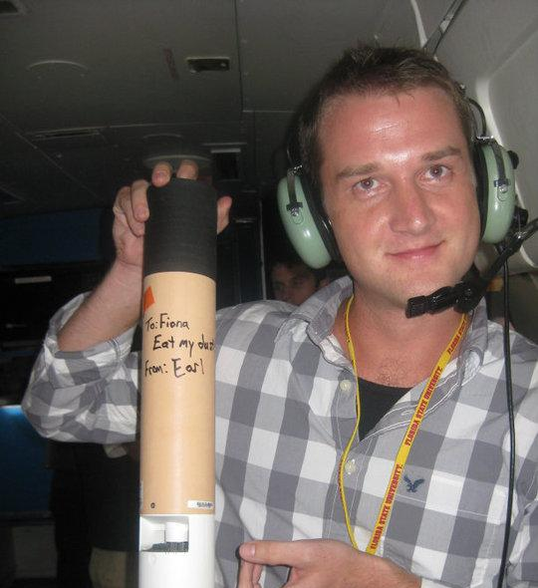
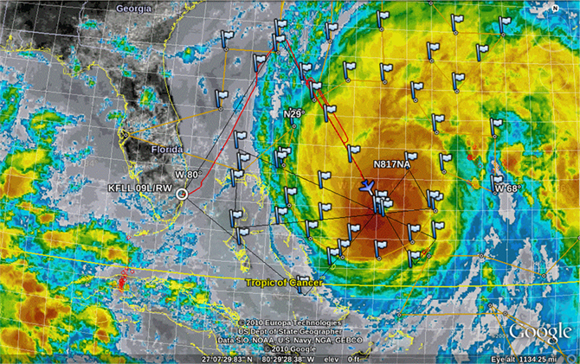
Meet Your Instructor
Dr. Andrew Martin
Research Assistant Professor, Department of Geography
PhD in Meteorology, Florida State University, 2012
Interests: Weather Forecasting; Clouds; Heavy Precipitation; Climate, Water and Energy; Atmospheric Rivers
Credit: NASA.gov

Slide 4
Class Survey
What is the highest level math class you have had?
How would you define “weather” in your own words?
What makes weather severe (in your own words)?
Describe a severe weather event that has impacted you, your family or your community.

Slide 5
What is “Severe Weather?”
A: Any weather event that is destructive.
Is this an objective definition? Destructive to what? to whom?
By contrast, what is “Extreme Weather?”
A: A weather event whose value is the highest or lowest in a given period of record.
If the period of record is defined, this is objective. What do these definitions mean for Severe Weather and Extreme Weather in the context of climate change?

Slide 6
What are some types of Severe Weather?
Severe Convective Weather (Unit 1: June 24 - July 10)
Thunderstorms
Tornadoes
Damaging wind and hail
Lightning
Extratropical Large-scale Severe Weather (Unit 2: July 15 - July 29)
Extreme cold
Atmospheric rivers with heavy rain
Extreme heat
Tropical Severe Weather (Unit 3: July 31 - Aug 7)
Tropical Cyclones
Severe Weather of Monsoons

Slide 7
What can you expect from this class?
Objectives and Skills from Syllabus

Slide 8
What can you expect from this class?
Wx Discussion (30 mins.) → Break (10 mins.) → Lecture 1 (40 mins.) → Break (10 mins.) → Lecture 2 and Announcements (40 mins.)

Slide 9
What will be expected of you?
Cover syllabus re:
Grading
Assignments, Skills
Conduct

Slide 10
Other Syllabus Items
DRC, Title IX reporting

Slide 11
Schedule for June 24
Introduction and Syllabus Review
10 Minute Break
How to think like a Meteorologist
10 Minute Break
Weather Observations and Data

Slide 12
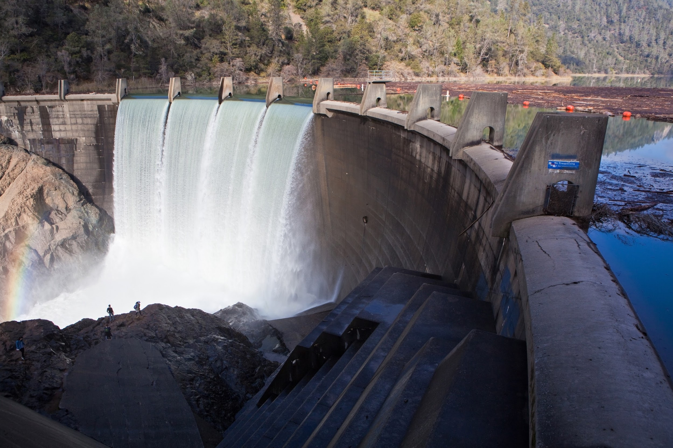
Meteorology is about communities
Meteorologists seek to understand and predict how the atmosphere will impact communities
Understand: Analysis. How did the atmosphere change to create the impact?
Predict: Forecast. How will the atmosphere change in the future, with specific impacts in mind?
If there is no impact, why study it?
Credit: NASA.gov

Slide 13
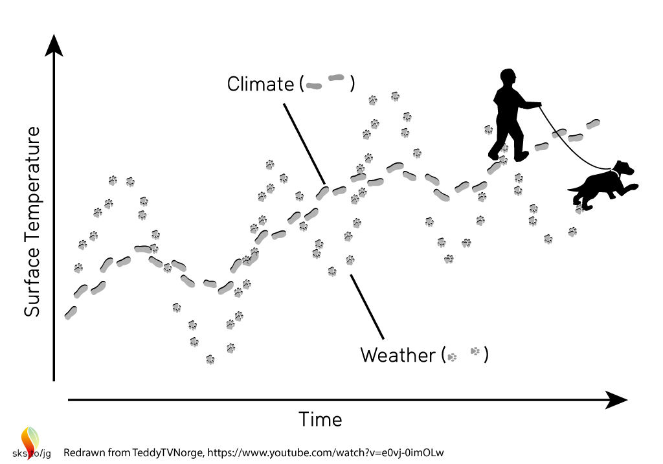
What is not Meteorology?
Climate: is the study of the states the earth’s systems can take (including the atmosphere).
Special cases of climate are
1) the average atmosphere
2) the recent past atmosphere.
Meteorology can be understood as how the atmosphere instantaneously changes from these.

Slide 14
What is not Meteorology?
The disciplines of earth science that do not primarily involve the atmosphere
Earthquakes?
Tsunamis?
Volcanic eruptions?
River floods?
Landslides?
Flash floods?
Air pollution?

Slide 15
Lecture 2:
How to think like a Meteorologist

Slide 16
The Process of Analysis
Identify the impact
What happened?
Identify the atmospheric processes that could have caused that impact
Why did it happen?
Identify the current impacts
What is happening?
Identify the atmospheric processes that are causing the impact
Why is it happening?

Slide 17
The Process of Forecasting
Identify the current impact
What is happening?
Identify the impactful atmospheric processes
Why is it happening?
Identify future impacts
What could happen?
Identify future impactful atmospheric processes
Why could it happen? and How likely is it to happen?

Slide 18
How to Describe and Measure and Forecast the Atmosphere
If you were to set up a weather station with only a few measurements, how many variables would you measure, and what would they be?
Temperature
Pressure
Humidity
Wind

Slide 19
Pressure
Units: Pa, mb, hPa (h for “hecta” = 100); Symbol: P
Pressure measures the weight of the atmosphere above a location. To avoid ambiguity, the weight is divided (“normalized”) by area.
Picture a scale one meter on a side. Does the air pressing on it have weight? How much?
In Portland, the answer is usually between 1000 hPa and 1020 hPa.

Slide 20
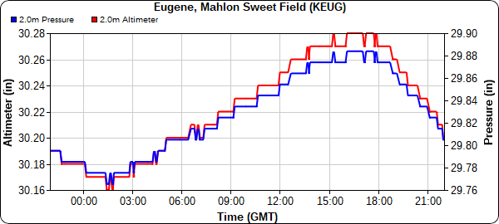
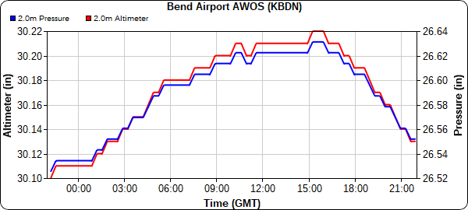
Can we see the effect of atmospheric weight on pressure?
Elevation ~ 300 feet A.M.S.L.
Elevation ~ 3300 feet A.M.S.L.

Slide 21
Temperature
Units: °F, °C, K; Symbol: T
Temperature measures the kinetic energy of molecules. In meteorology, the molecules in question are almost always air.
Heat is the transfer of internal energy from one parcel of air to another. Heat can therefore change the temperature of air.
What is a parcel? What are the ways air can be heated? Is cooling different than heating?

Slide 22
What kind of gas is the atmosphere?
A: An ideal gas, governed by the “Ideal Gas Law”:
PV = nRT P = ρR_{S}T
We talked about two of the variables in the Ideal Gas Law: pressure (P) and temperature (T). What about: density (ρ)?
When pressure is constant: warmer temperatures mean lower density, cooler temperatures mean higher density.
Meteorologists take this axiom for granted. Examples: “Cool, dense night air”; “Warm air rises, cool air sinks”

Slide 23
Adiabats
If the change that happened to a parcel involved no heating, it is called an adiabatic process.
In adiabatic processes, the parcels’ energy is conserved.
Adiabatic processes are very common in the atmosphere. Often it will seem like parcels go to great lengths to stay adiabatic. This includes expanding or contracting to avoid a change in internal energy.

Slide 24
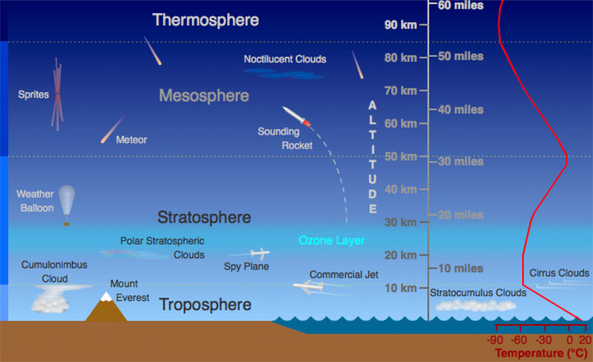
The vertical structure of the atmosphere
Credit: UCAR.edu

Slide 25
The vertical structure of the atmosphere
If density (at constant pressure) is determined by temperature, how thick is a parcel?
On the whiteboard: atmosphere as a cube
Hydrostatic Law:
dP / dz = - ρg

Slide 26
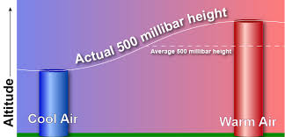
How thick is a stack of parcels?
Credit: NWS Jet Stream
The Ideal Gas Law and the Hydrostatic Law are so useful in describing the vertical structure of the atmosphere that meteorologists use height above earths’ surface and pressure interchangeably.

Slide 27
Humidity
Units: Pa, Kg/Kg; Symbol: q_{v}
What is air made of?
Nitrogen
Oxygen
Argon
Carbon Dioxide
What is its most variable component?
Humidity (the water vapor mixing ratio) measures of the water vapor content in a parcel.

Slide 28
What makes water vapor special?
Water is the only component that exists in all three phases (gas, liquid, solid) at the temperatures in earth’s atmosphere.
What decides the phase?
A1: the temperature
A2: amount of water
There is a limit to the amount of water vapor that can be contained in air. This limit is called saturation, and it depends on temperature.

Slide 29
Relative Humidity
Units: %; Symbol: RH
Relative humidity is expressed as the actual humidity divided by the saturation humidity.
The Clausius-Clapeyron Equation:
e_{s}(T) = a×exp( bT / T + c)
How do we experience humidity?
Example: Portland is “humid” in winter according to the relative humidity, so why do you feel so dry inside your home?

Slide 30
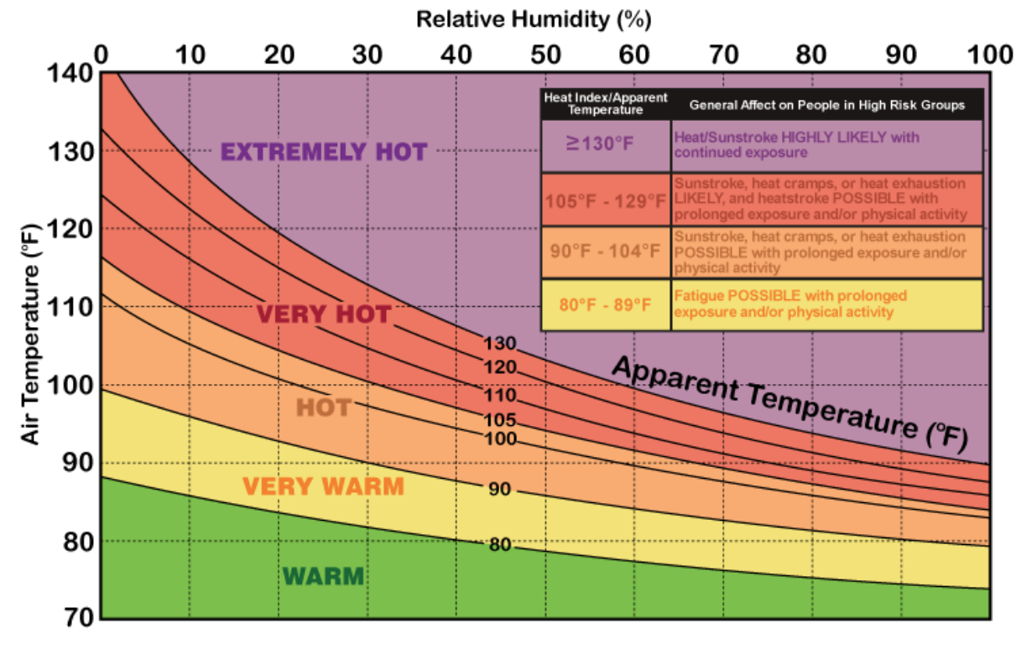
Dewpoint and Heat Index
Dewpoint temperature: The temperature that air must be cooled to at constant humidity for saturation to occur
Example: condensation on a glass of cold water
Heat Index: Your skin cools itself by evaporation of sweat. If the air is close to saturation, how well does this work?

Slide 31
Is humid air more or less dense than dry air?
A: less dense. Humid air has more water vapor and less nitrogen. Nitrogen molecules weigh more than water molecules.
How does this modify our model of the thickness of the atmosphere?
T_{v} = (1 + 0.061q_{v} ) Virtual Temperature
For many uses, we can substitute T_{v} for T if we want to account for the impact of humidity on density.

Slide 32
Wind

Slide 33
Wind Direction
A direction suggests coordinates. What coordinates do meteorologists use?
The atmosphere is three-dimensional, but it sits on the surface of the earth.
Two coordinates are required to describe motion relative to the earth’s surface. The third describes vertical motion.
We will discuss the horizontal (parallel to the earth’s surface) wind a lot. We will discuss the vertical component of wind less (though it is VERY important).

Slide 34
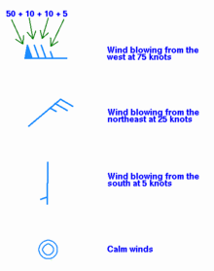
Earth coordinates and the wind-barb

Slide 35
Weather Journal Assignment
Keep track of the weather (Temperature and Precipitation) for a US city every day for the month of July
Write an analysis of the July weather in context of the expected climate for your city, identifying any severe weather events that occurred.
10% of grade
See D2L for List of Cities

Slide 36
Learning on Your Own
Jet Stream https://www.weather.gov/jetstream/matrix, Chapters:
‘The Atmosphere’ / Sections 1-4
‘Clouds’ / Sections 1-2
‘The Upper Air’ / Sections 1,2,4
Sign up for MetEd:
https://www.meted.ucar.edu/

