Slide 1
SUPRECIP and CalWater: Field Studies to Investigate the Roles Aerosols Play in Atmospheric River Clouds
AR Colloquium Summer School
La Jolla, CA

Slide 2
Outline
Background: How can aerosols influence clouds and precipitation?
Background: What are ice nucleating particles (INPs) and how can they influence clouds and precipitation?
Background: Findings that link aerosols to modulation of AR precipitation
Description of CalWater Field Study
What were some key questions about INPs and what did we find?
The potential for AR trace content of precipitation to improve understanding of the water cycle

Slide 3

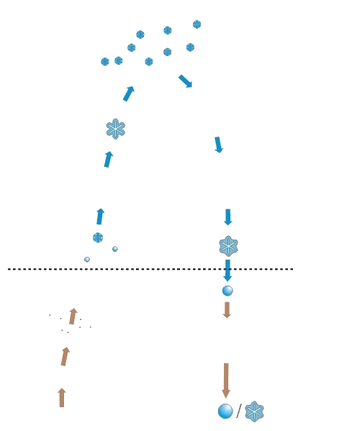
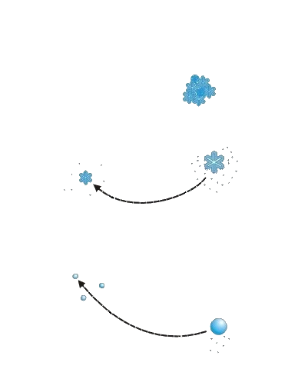
The Complexity of Clouds
Aerosols directly influence the smallest, or primary, cloud hydrometeors by liquid and ice nucleation.
Homogeneous
Ice Nucleation
Aggregation
The larger hydrometeors that become precipitation grow by the interactions among groups of hydrometeors, sometimes involving different phases
Vapor Deposition
Long-Range
Aerosol
Entrained
Bergeron
Process
Secondary
Ice
Riming
The amount and phase of precipitation depends indirectly on the primary nucleation (aerosols) and more directly on the secondary processes.
Heterogeneous
Ice Nucleation
Collision-
coalescence
Melting
Breakup
Condensation
Collection
CCN Activation
Local Aerosol
BL Transport
Updraft
Evaporation

Slide 4
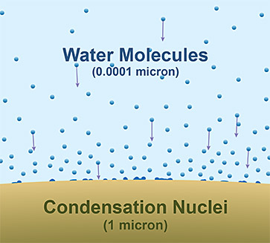
Cloud Condensation Nuclei: What are They?
CCN are water-soluble aerosols that support the formation of liquid cloud droplets at humidity just above saturation.
Without CCN, tropospheric humidity would have to reach extreme values for cloud droplets to form.
Pollutants are an important source of CCN but any aerosol of sufficient size can become one.
Important impact: Cloud droplet sizes scale inversely with the number of CCN.
Conceptual diagram of water vapor and the surface of a CCN aerosol. NWS Jet Stream

Slide 5
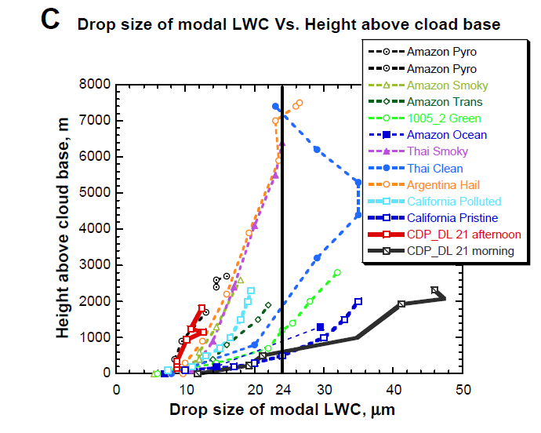
SUPRECIP (2004-2005)
The difference in droplet growth between pristine and polluted clouds in CA can be as large as anywhere in the world!
This has implications on the initiation of precipitation, as shown by the black line representing the drizzle threshold.
Rosenfeld et al., 2014, Atm. Res.

Slide 6
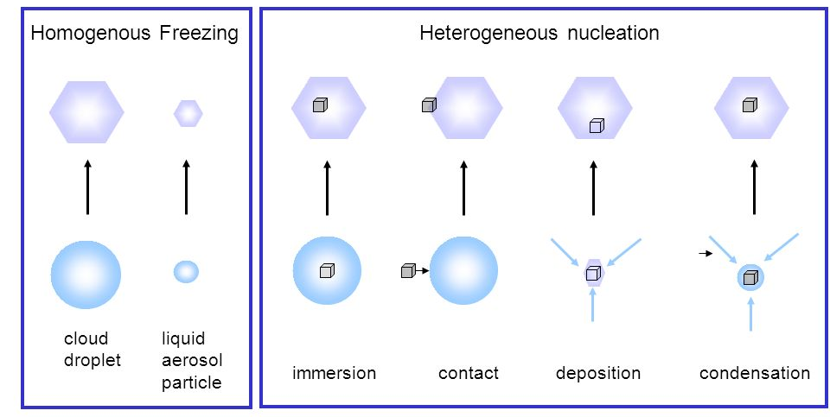

Ice Nucleating Particles: What are They?
Liquid water in droplets cannot freeze at
T > -35 °C unless it contains the right type of insoluble material: INPs
Credit: Thomas Leisner, DWD

Slide 7
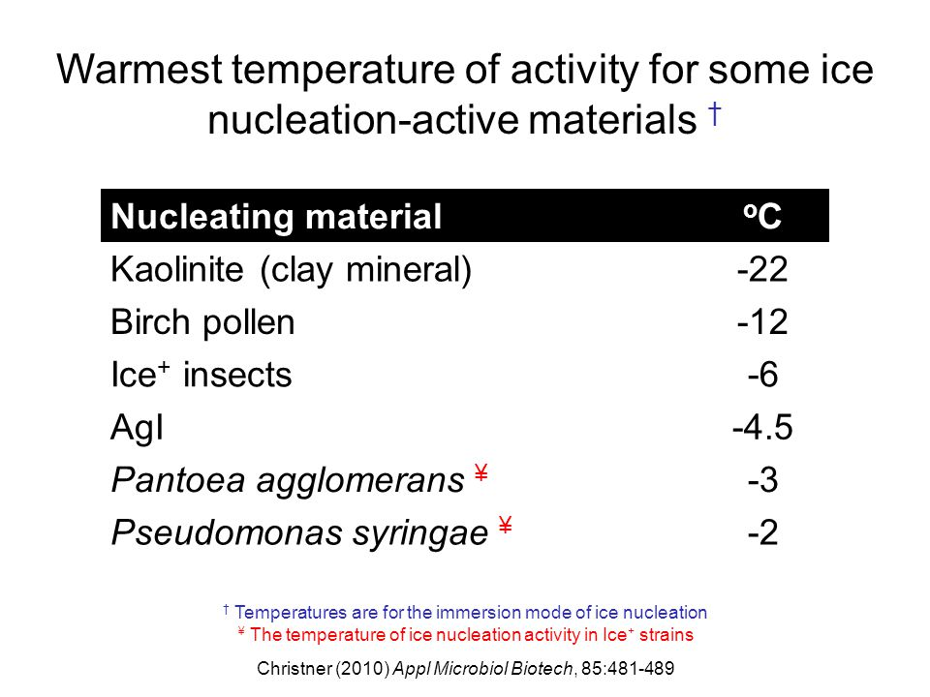
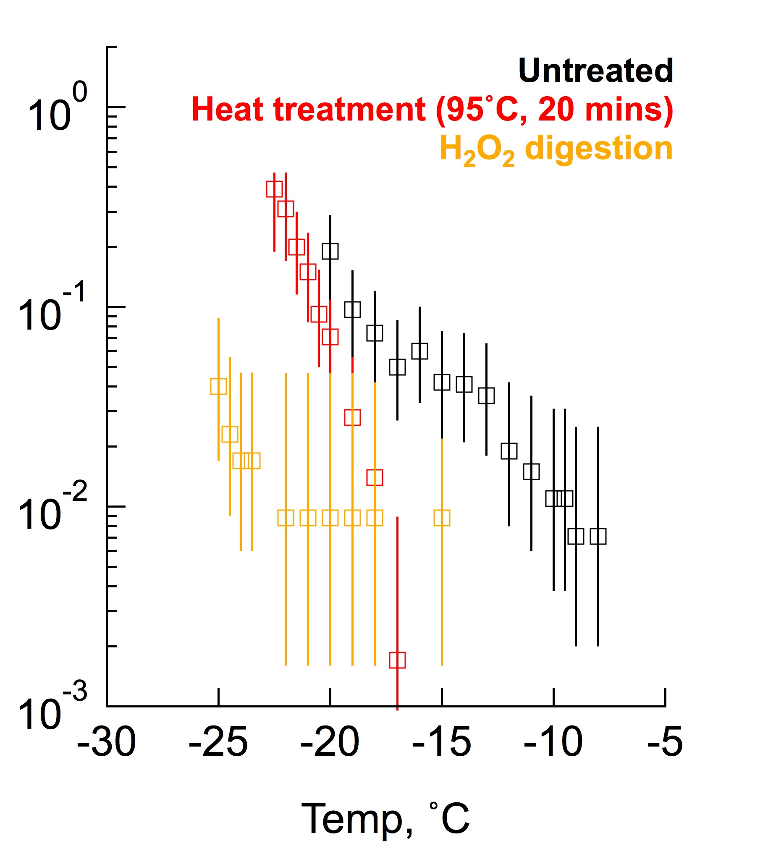
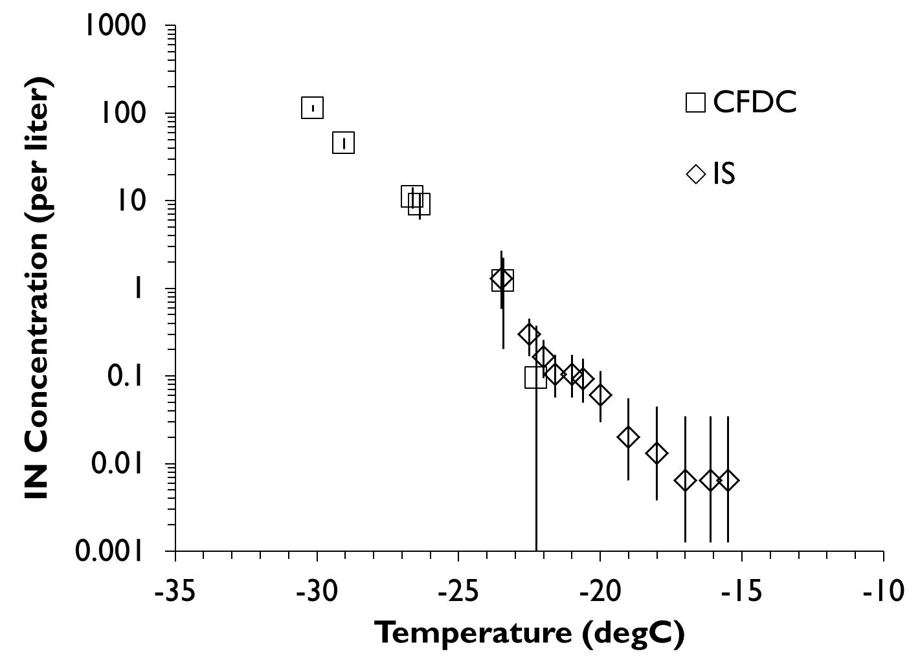
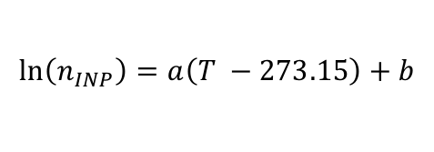
What are Warm INP?
Hill et al.,
(2016 – Atmos. Chem. Phys.)
Dusts:
Biological:
$$\ln\left(n_{INP}\right)=a\left(T −273.15\right)+b$$
Continuous Flow Diffusion Chamber
Ice Spectrometer
n_{INP} (L⁻¹)
n_{INP} (L⁻¹)

Slide 8
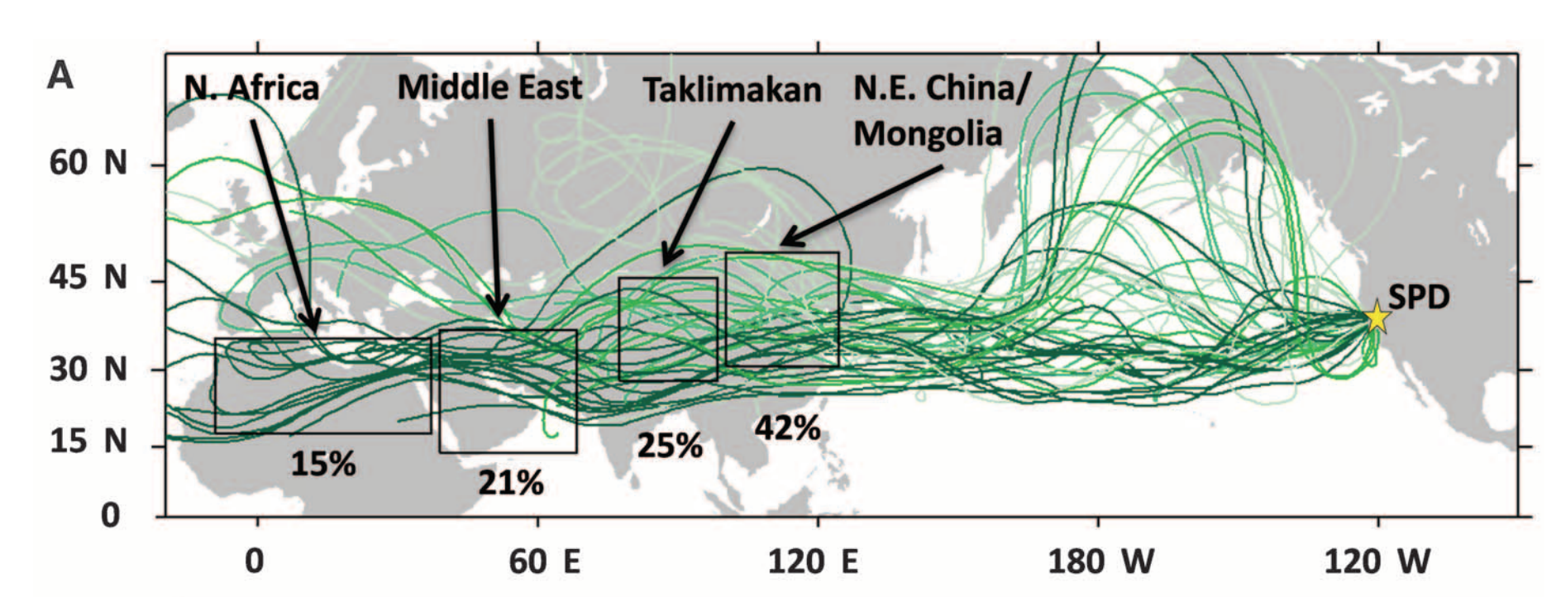
Long-range Transported Dust Found in Atmospheric River Precipitation
Creamean et al. (2013 - Science)
Creamean et al. (2013 – Science) found that dust originating in African and Asiatic deserts is commonly found in AR precipitation.
Ault et al. (2011 – J. Geophys. Res.) and Creamean et al. (2015 – Atmos. Chem. Phys. ) found that the amount of dust and biological residues in precipitation is related to precipitation amount (more) and phase (more snow than rain).

Slide 9
A Conceptual Model for Aerosol Modulation of AR Precipitation
This model leaves ample room for supercooled liquid.
If INP₋₁₀ become incorporated to the feeder cloud, more ice may result, thus invigorating precipitation.
Creamean et al. (2013 - Science)
ARs produce heavy precipitation by driving water vapor up mountain slopes (feeder cloud) underneath an upper-level dynamic disturbance (seeder cloud).
Temperatures in the seeder cloud are cold enough for either dust or biological INP to create ice. That ice then gains mass as it falls through the feeder cloud.

Slide 10
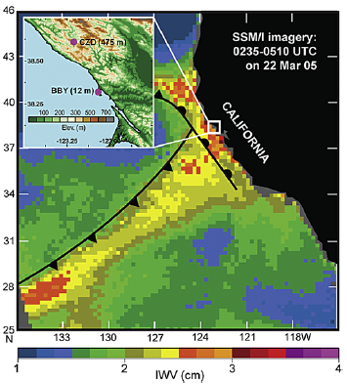
Measurement Locations
Bodega Bay, CA (BBY): Meters from breaking waves. Annual precipitation ~ 900 mm.
Cazadero, CA (CZC): At the top of ~ 500m mountain, 30 km inland. Annual precipitation ~ 1500 mm.
Permanent vertically profiling radars operated by NOAA at these sites comprise an “Atmospheric River Observatory” (ARO).
During ARs, CZC rainrates are typically 2-3 times that of BBY because of orographic lift.
Coplen et al. (2008 - GRL)

Slide 11
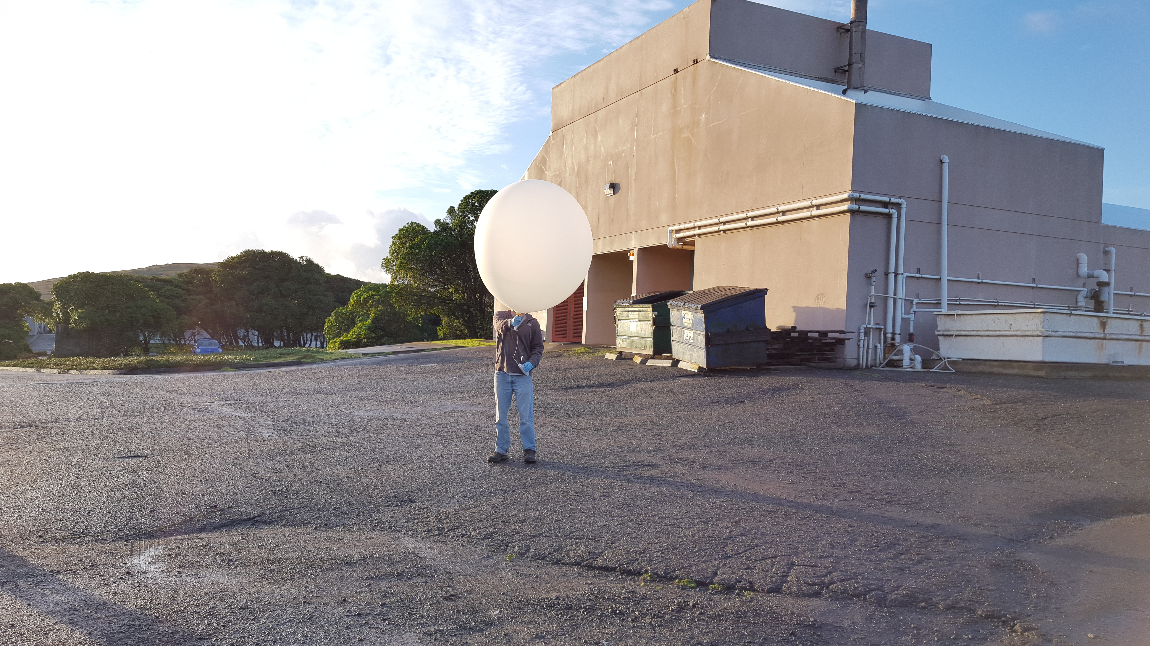
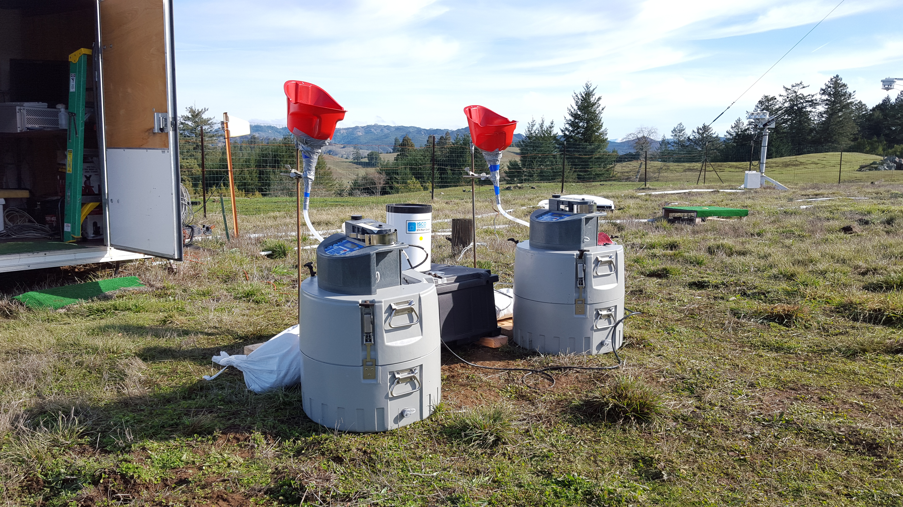
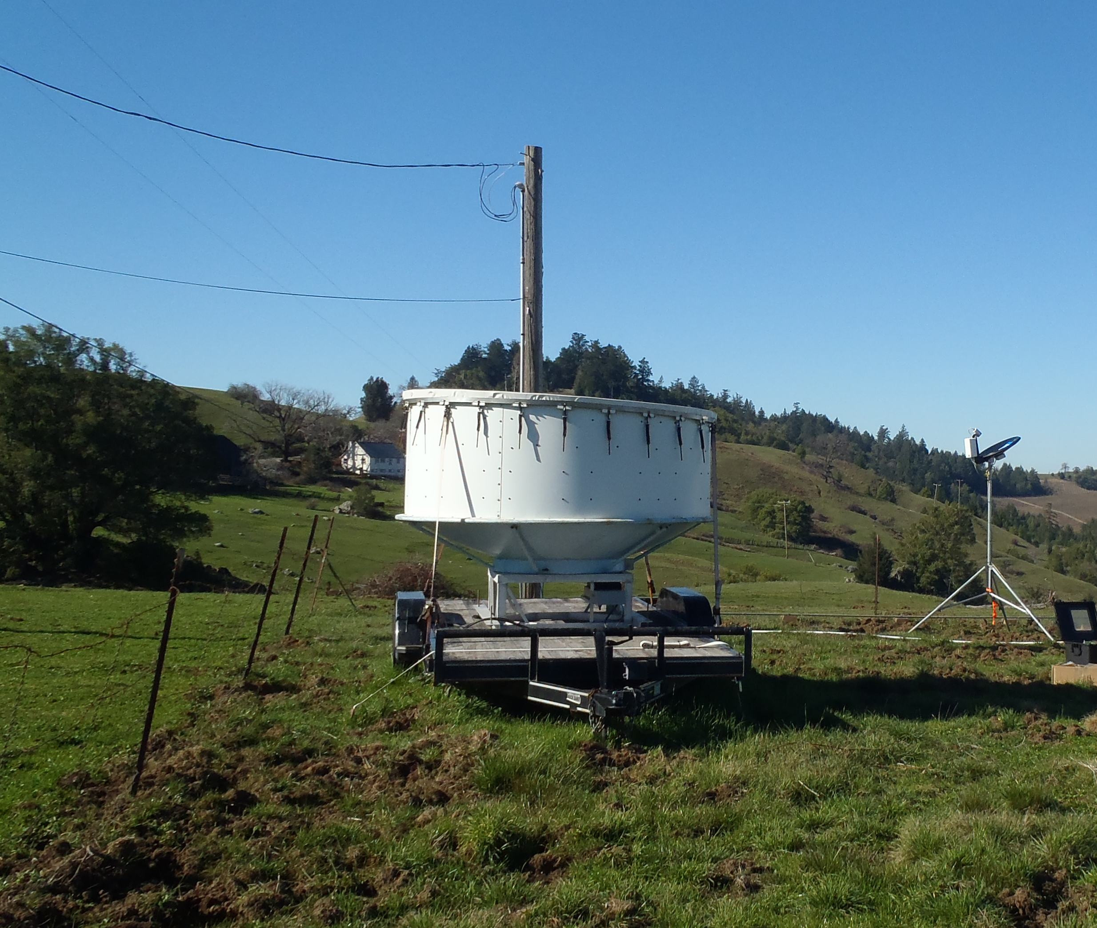
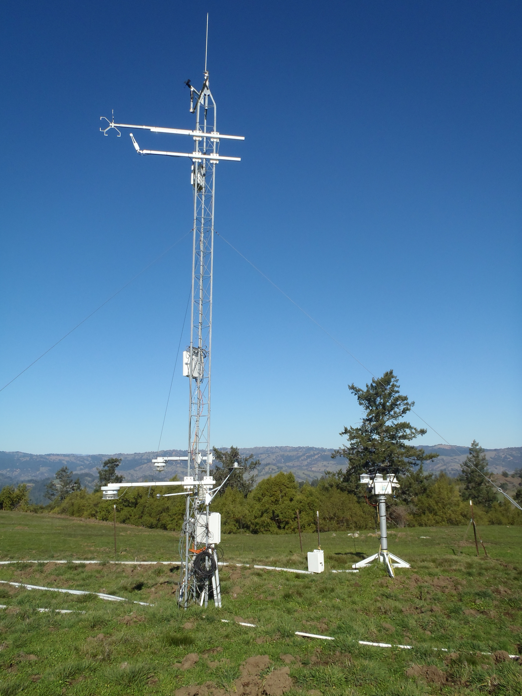
Measurements
Both Sites
Coast: BBY
Hourly profiles of wind and temperature
Surface Weather
Raindrop Sizes
Mountain: CZC
Hourly Rain Samples
Profiling Radar
These measurements were collected hourly during a Moderate AR that travelled across the ARO during March 5/6, 2016.

Slide 12
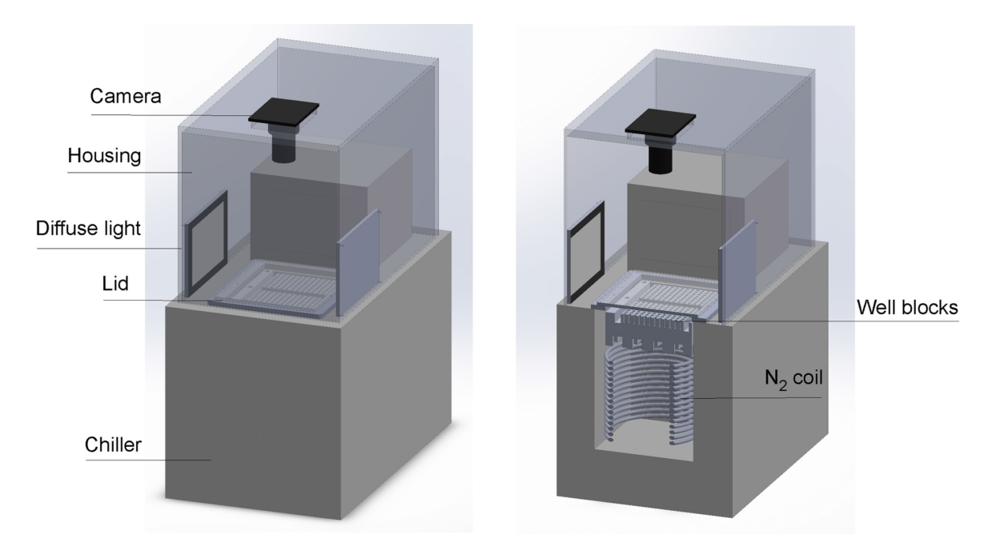
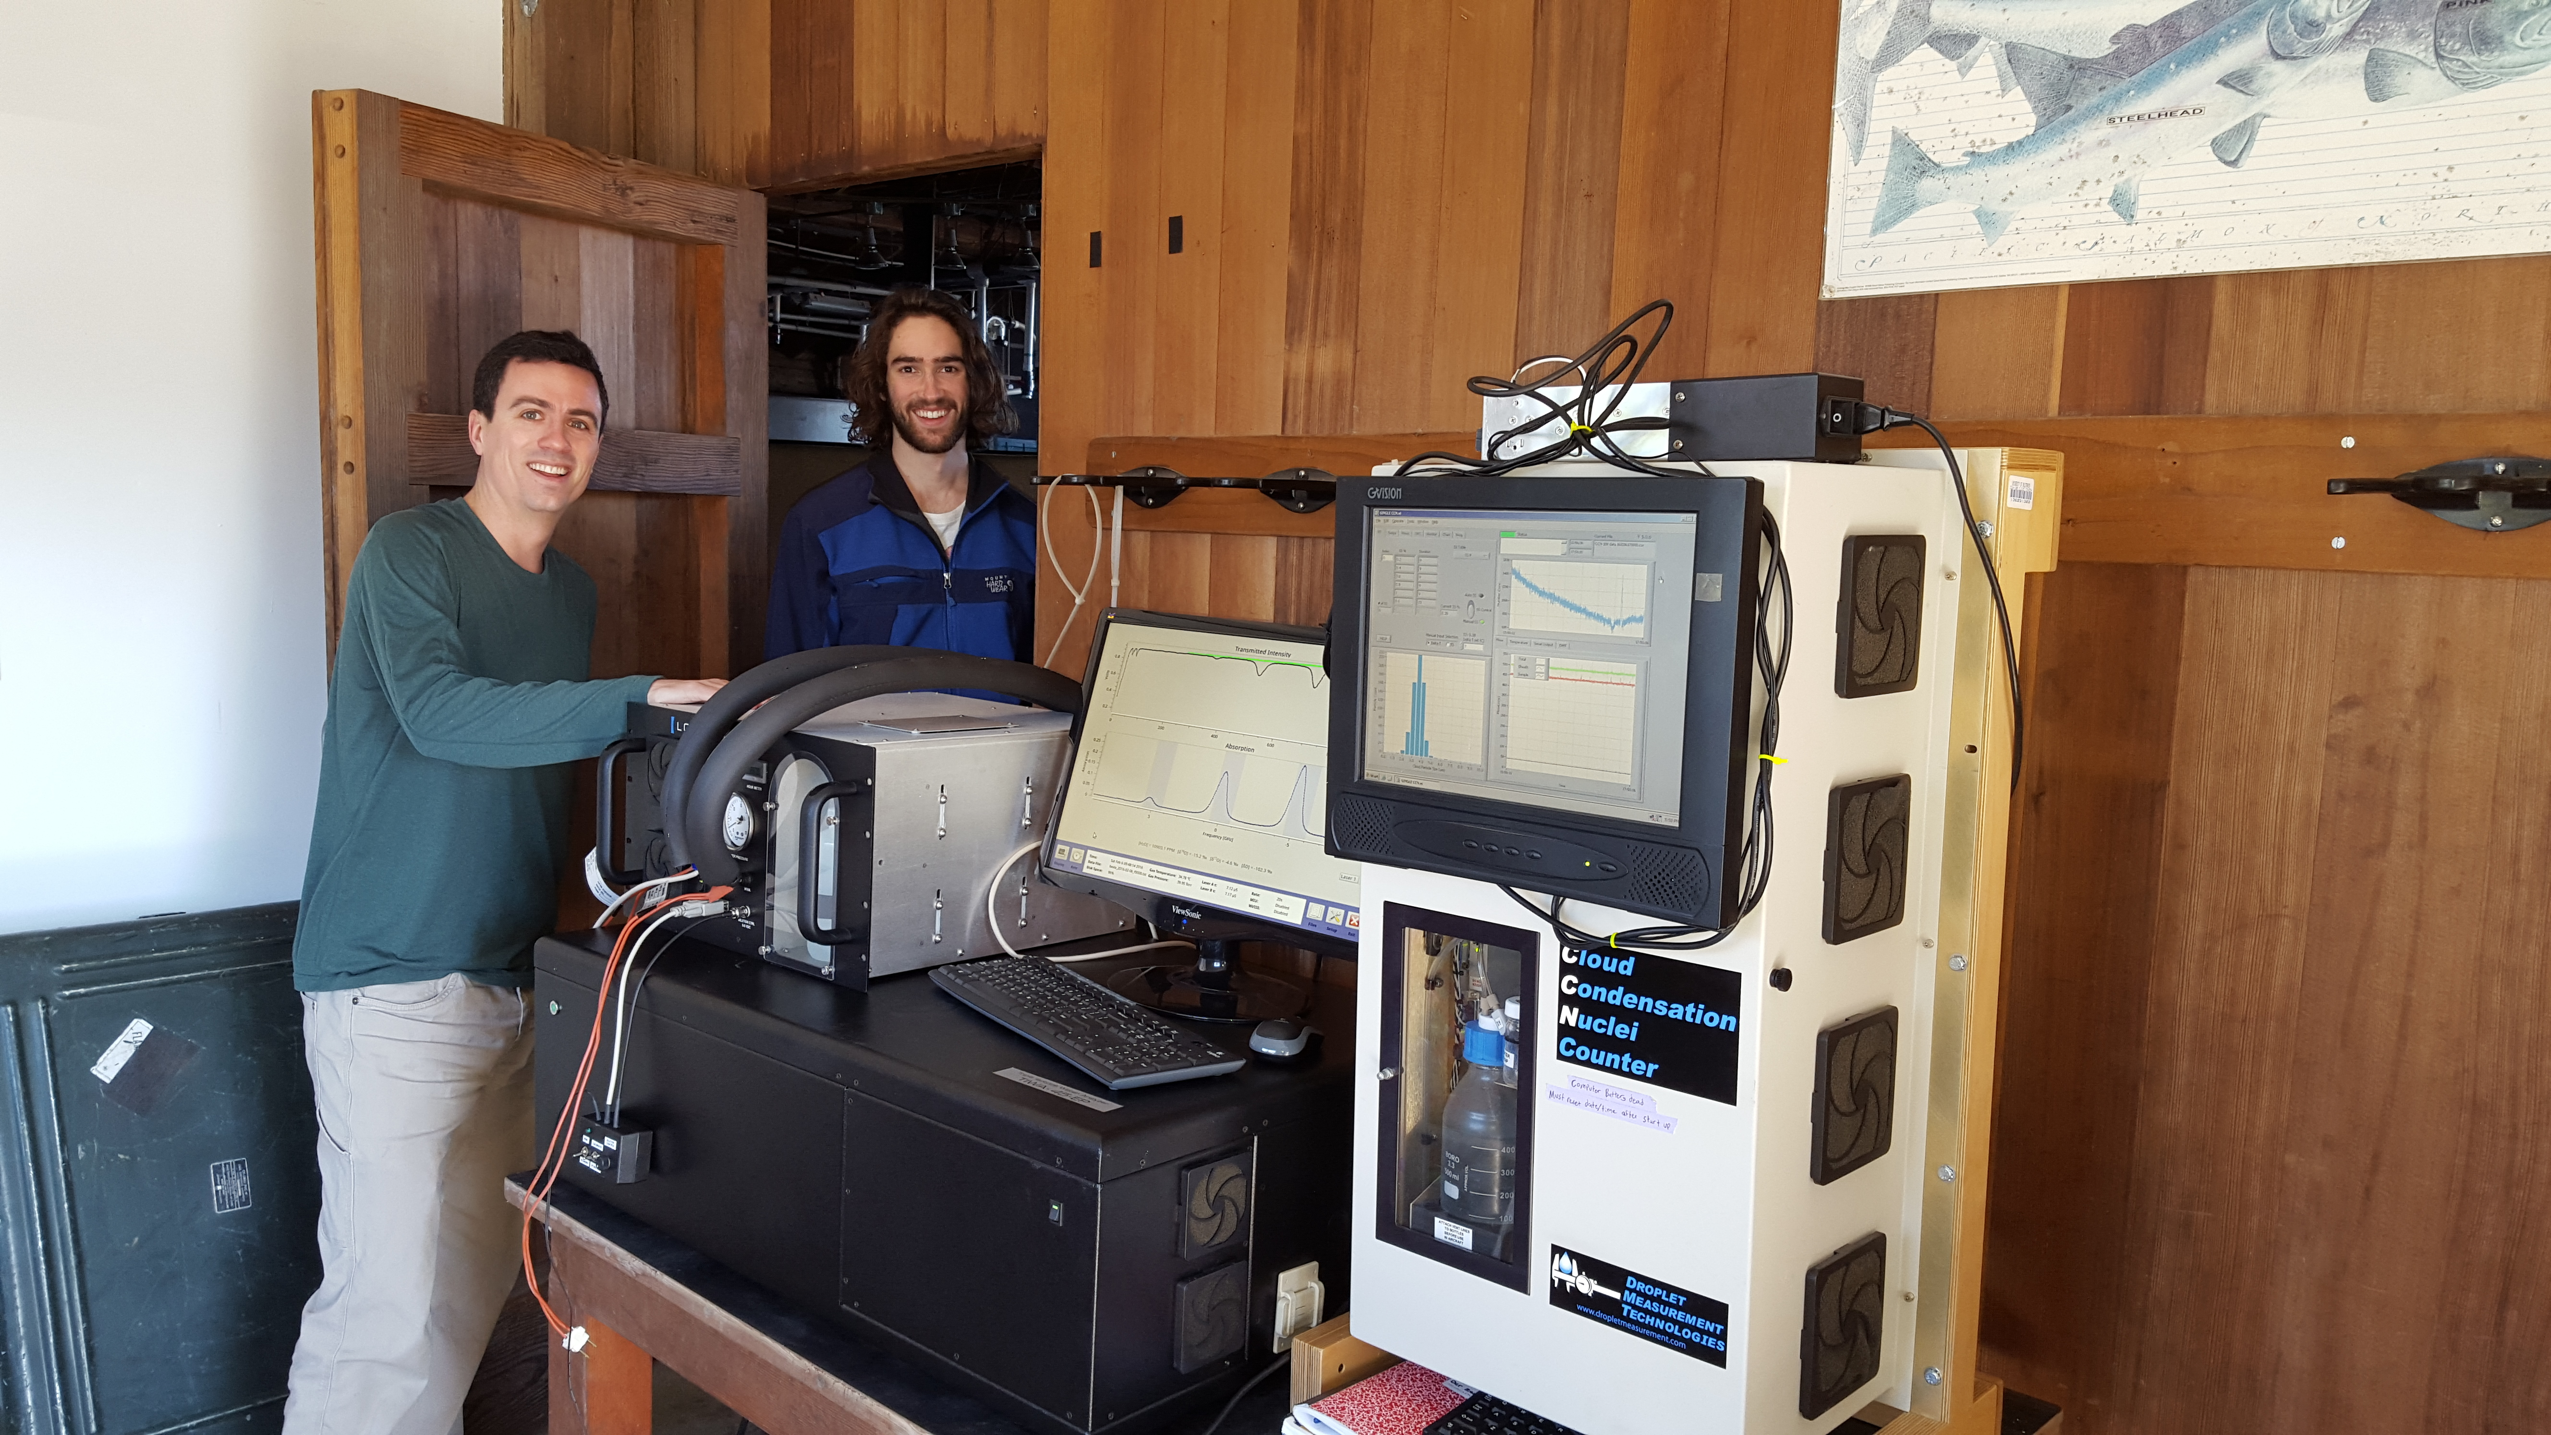
More Measurements
Automated Ice Spectrometer:
Counts the number of heterogeneous freezing events that occur as a liquid sample is slowly cooled.
Laboratory
Los Gatos Research Triple Water Isotope Analyzer:
In-situ measurement of δ¹⁸O_{v} and δ²H_{v}.
Off-site measurement of δ¹⁸O_{p} and δ²H_{p}.
Laboratory and In-Situ

Slide 13
Questions Driving INP₋₁₀ Analysis
What are the dominant sources of INP₋₁₀ in the AR? Can the differential between the two sites lend any insight?
Do INP₋₁₀ impact cloud properties in manner that may lead to precipitation impacts?

Slide 14
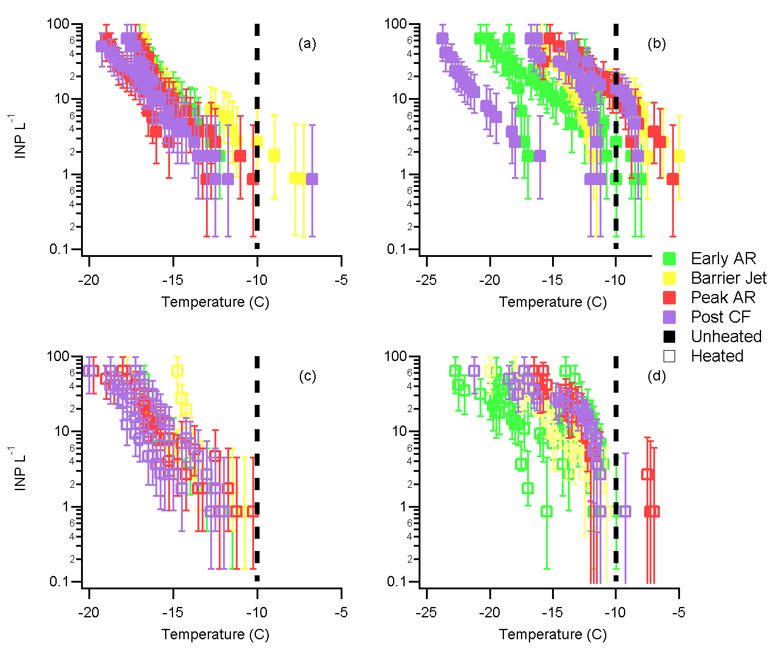
Freezing Temperature Spectra Show a Different Source of INP₋₁₀ at each Site
Much fewer INP₋₁₀ were found in BBY precipitation.
Freezing spectra and heat treatment indicate differing sources of INP at each site.
Lagrangian airmass modeling suggests that the dominant INP₋₁₀ source for CZC is local, whereas occasional INP₋₁₀ at BBY are transported from far away.
BBY / Unheated
CZC / Unheated
BBY / Heated
CZC / Heated
Martin et al.,
(2019 – Atmos. Chem. Phys.)

Slide 15
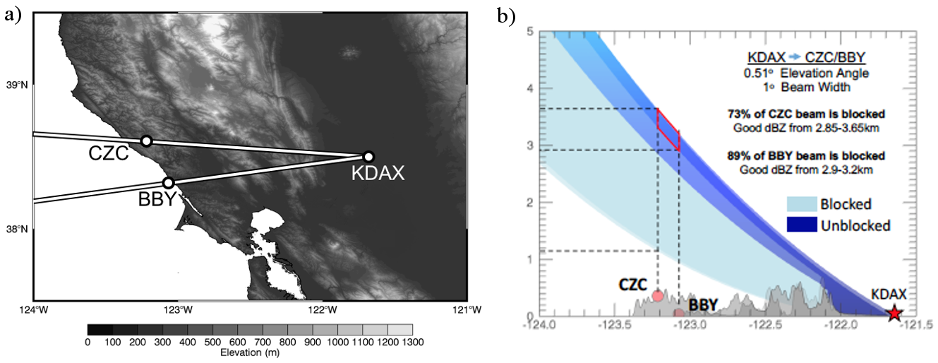
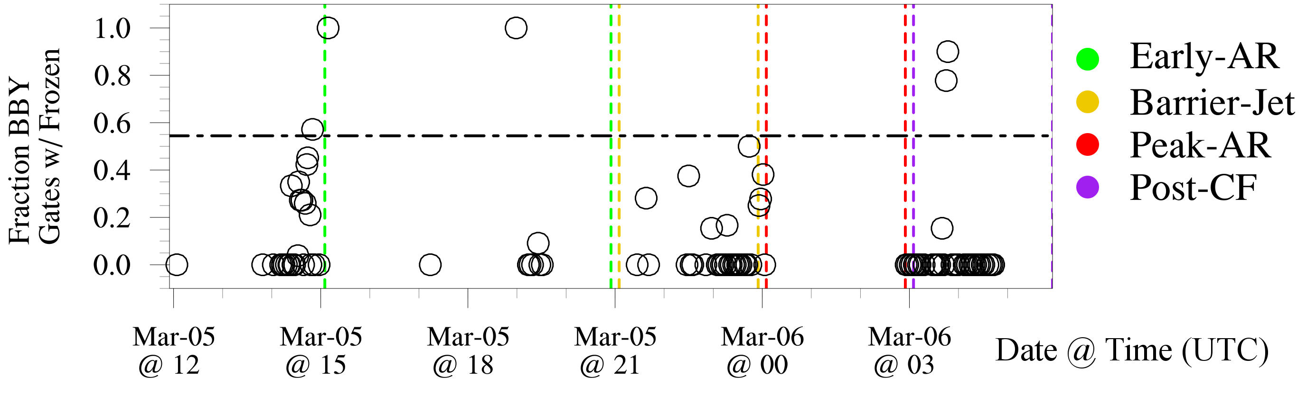
More Numerous INP₋₁₀ at CZC Differentially Impact Clouds There
Radar beam blockage by coastal mountains was used to constrain temperature of sensed hydrometeors to
  -10 °C < T < 0 °C
At these temperatures, frozen hydrometeors are more likely over CZC with 99% confidence.
Martin et al.,
(2019 – Atmos. Chem. Phys.)

Slide 16
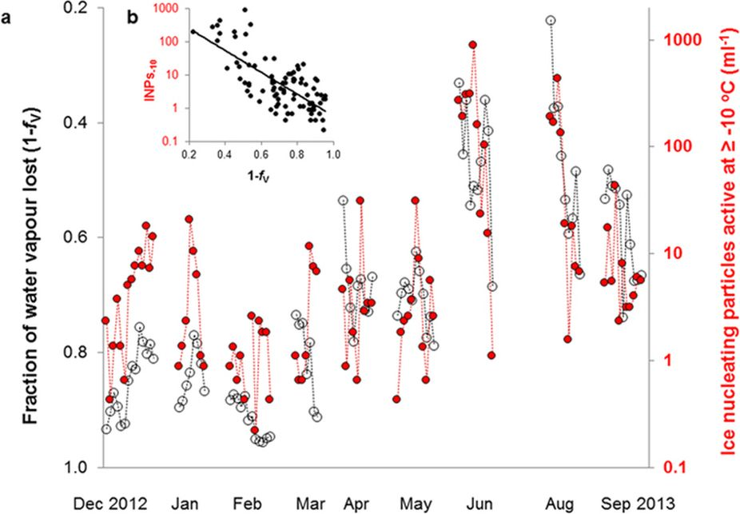
How Might Stable Isotopes Fit?
Snow measurements showed that the amount of ¹⁸O depleted from snowfall was inversely proportional to the INP₋₁₀ concentration.
If repeatable, this suggests coordination between the atmospheric transport patterns of both INP and water vapor and precipitating clouds.
Stopelli et al., 2015 Nature SREP “Ice Nucleation Activating Clouds are Efficiently Removed by Precipitation”

Slide 17
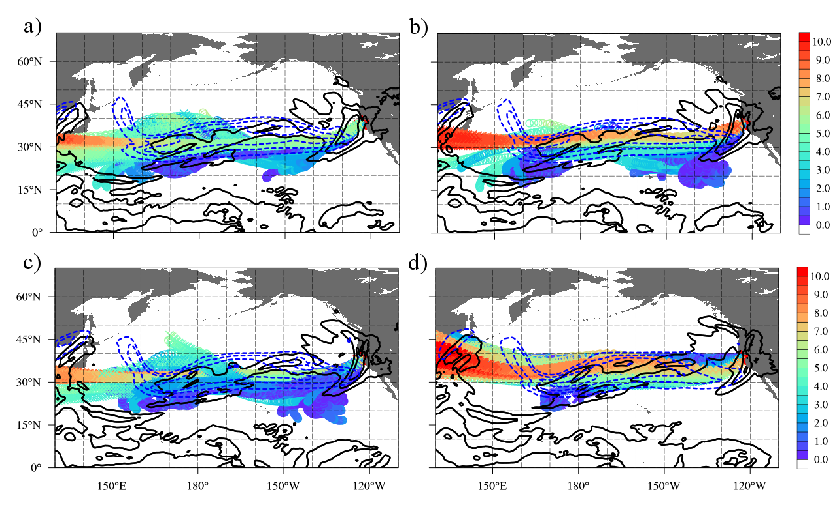
ARs are a Candidate for Such Coordination

Slide 18
Review
Hourly INP₋₁₀, δ¹⁸O and δ²H in AR rainfall and water vapor were used, along with meteorological data, to investigate cloud physical processes.
A strong source of biogenic INP₋₁₀ was identified at the mountain site. Lagrangian modelling and the timeseries of INP₋₁₀ at the coastal site revealed that these INP₋₁₀ come from nearby terrestrial ecosystems.
Polarimetric radar hydrometeor retrievals, constrained to the temperatures relevant for INP₋₁₀ activity, revealed that significantly more cloud ice is present where INP₋₁₀ are also numerous.

Slide 19
Review
More on the CalWater 2016 INP Study
  Martin et al., 2019: Contrasting Local and Long-Range Transported Warm Ice-Nucleating Particles During an Atmospheric River in Coastal California, USA, Atmos. Chem. Phys.
More on the CalWater 2016 Isotope Study
  Mix et al., 2019: Evaluating the Roles of Rainout and Post-Condensation Processes in a Landfalling Atmospheric River with Stable Isotopes in Precipitation and Water Vapor, Atmosphere.

